Slide 1
Birth/Death Registration Integration with Services
PIP2001 Capstone Project
Review-1
Batch Number:CSE-G200
Under the Supervision of,
Mr.Amarnath JL
Assistant Professor
School of Computer Science and Engineering
Presidency University
Roll Number | Student Name
20211CSE0628 | Prakruthi S
20211CSE0677 | Nidhisha N
20211CSE0618 | Deepthi R
Name of the Program: CSE
Name of the HoD: Dr.Asif Mohammed H.B
Name of the Program Project Coordinator: Mr. Amarnath J.L
Name of the School Project Coordinators: Dr. Abdul Khadar A

Slide 2
Introduction
Birth and death registration is crucial for public health and governance, providing essential data for understanding population dynamics and informing policy decisions. Traditional manual registration methods are often inadequate, especially in rapidly growing populations. Integrating vital records with services like healthcare, education, and social welfare can enhance efficiency, improve data quality, reduce administrative burdens, and increase accessibility for citizens. The aim is to create a more efficient, effective, and equitable governance system.

Slide 3
Literature Review
Birth and death registration is crucial for effective population management, public health, and legal identity. Integrating these services with government databases enhances efficiency, accuracy, and accessibility.
Current trends highlight a shift toward digitalization, with many countries adopting electronic systems for better data management (McKinsey & Company, 2020). Interoperability is vital, enabling systems to interact with health and social security services (Smith et al., 2021). User-centric design focuses on creating accessible interfaces for registrars and citizens (Johnson & Lee, 2022).
However, challenges persist. Data privacy concerns complicate the protection of personal information during integration (Davis & Thompson, 2020). Inconsistent technology adoption across regions poses technological barriers (World Bank, 2021), and unclear legislative frameworks can hinder system development (Garcia & Patel, 2019).
Case studies from Kenya and India illustrate both successes and challenges. Kenya's national civil registration system has improved data accuracy (UNICEF, 2021), while India's integration with health services enhances demographic data collection (Ministry of Health, 2022).

Slide 4
Literature Review
Best practices for successful integration include engaging community members and building capacity. Involving stakeholders fosters acceptance (Nguyen et al., 2023), and training registrars on new technologies is crucial for effective service delivery (WHO, 2021).
Looking ahead, advancements in AI and machine learning can enhance data analysis and predictive modeling (Zhang & Kim, 2022). Global partnerships can improve registration systems and facilitate the sharing of best practices (International Organization for Migration, 2023).
In conclusion, integrated registration services offer significant benefits for public administration and health outcomes, but more research is needed to understand their long-term impacts. Studies provide valuable insights into trends and challenges in this field.

Slide 5
Existing method Drawback
Drawbacks of Existing Methods for Birth and Death Registration Integration ServicesThe integration of birth and death registration services, while crucial for public health and demographic analysis, faces several challenges. Here are some of the common drawbacks of existing methods:
Data Quality and Consistency: Inaccurate or Incomplete Data:Data Discrepancies.
Interoperability Issues: Standardization ChallengesLegacy Systems.
Privacy and Security Concerns: Data BreachesRegulatory Compliance.
Technological Limitations: Infrastructure ConstraintsDigital Divide.
Resource Constraints: Funding ShortagesHuman Resource Limitations.
Cultural and Social Factors: Cultural BarriersSocial Inequality.

Slide 6
Proposed Method
Proposed Methods for Birth and Death Registration Integration Services Overcoming the challenges associated with birth and death registration integration requires a combination of technological, organizational, and policy-based approaches. Here are some proposed methods:
Technological Solutions: Standardized Data FormatsCloud-Based PlatformsMobile ApplicationsBlockchain Technology.
Organizational Approaches: Interagency CollaborationCapacity BuildingCommunity Engagement.
Policy-Based Initiatives: Legal FrameworksIncentives and DisincentivesData Quality Assurance.
Specific Case Studies: India's National Health MissionGhana's Civil Registration and Vital Statistics (CRVS) System.
It's important to note that the most effective approach will depend on the specific context and challenges faced by a particular country or region. A combination of these methods, tailored to local needs, is likely to yield the best results.

Slide 7
Objectives
Integrating birth and death registration services aims to improve data quality and accuracy by reducing errors and duplications while ensuring timely and complete registrations. The initiative enhances efficiency and accessibility, making the registration process easier for individuals and families. It also creates a comprehensive database that serves as a single source of truth for various stakeholders, supporting evidence-based decision-making across sectors. Furthermore, it prioritizes the protection of individuals' rights by ensuring data confidentiality and accessibility to personal records. Ultimately, this integration contributes to national development by bolstering statistical systems and providing reliable demographic data, thereby promoting sustainable development and improving public health outcomes.

Slide 8
Methodology/Modules
The integration of birth and death registration services requires a systematic approach that involves various components or modules. Here's a breakdown of the key methodology and modules:
Data Collection and Standardization: Data CollectionData Standardization.
Data Entry and Validation: Data EntryData Validation.
Data Integration: InteroperabilityData Mapping.
Data Storage and Management: Database DesignData SecurityData Backup and Recovery.
Data Analysis and Reporting: Data Analysis ToolsReporting.
Quality Assurance and Monitoring: Data Quality AuditsPerformance Monitoring.
Capacity Building and Training: TrainingCapacity Building.
Community Engagement and Outreach: Awareness RaisingCommunity Participation.
Awareness RaisingCommunity ParticipationBy following this methodology and implementing these modules, countries can establish effective birth and death registration integration services that contribute to improved public health, evidence-based decision-making, and national development.

Slide 9
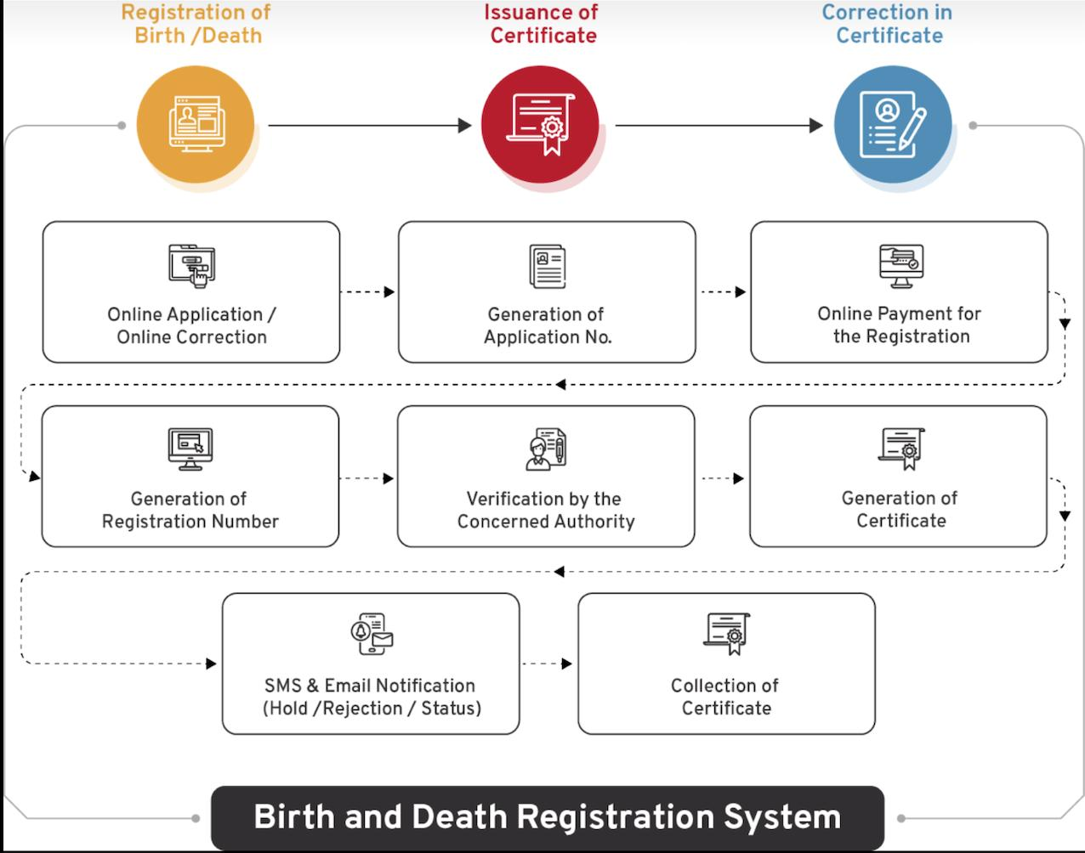
Architecture

Slide 10
Software Components
To effectively integrate birth and death registration, a robust software infrastructure is essential. Key components include:
Data Collection Modules: Traditional paper forms, mobile apps for remote data entry, and integration with electronic health records (EHRs).
Data Entry and Validation Systems: User-friendly interfaces, built-in validation rules, and error handling mechanisms to ensure data accuracy.
Data Integration Platforms: APIs for data exchange, data mapping tools, and centralized data warehousing.
Database Management Systems (DBMS): Relational databases (e.g., MySQL) for structured data and NoSQL databases (e.g., MongoDB) for unstructured data.
Analytics and Reporting Tools: Business intelligence software for trend analysis, data visualization tools, and standardized reporting templates.
Security and Access Control: User authentication, data encryption, and role-based access controls to protect sensitive information.
Mobile and Cloud Technologies: Mobile apps for on-the-go registration and cloud computing for scalable storage and processing.
Interoperability Frameworks: Standards like HL7 FHIR for health information exchange and ICD-10 for disease classification.
Integration Middleware: Enterprise Service Bus (ESB) for application integration and ETL tools for data movement.

Slide 11
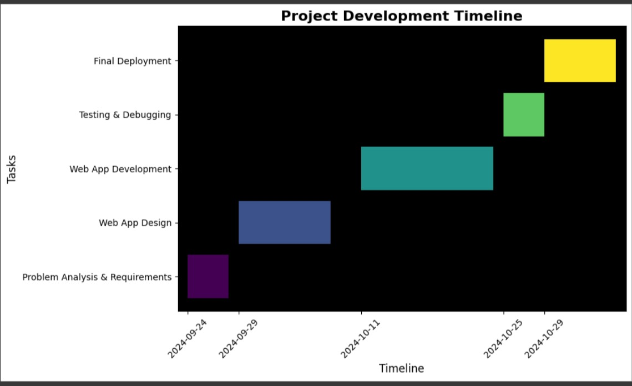
Timeline of Project

Slide 12
Expected Outcomes
Effective birth and death registration integration can yield several significant outcomes:
Improved Data Quality and Accuracy: Reduced errors and inconsistenciesEnhanced data completenessIncreased data accuracy.
Enhanced Efficiency and Accessibility: Streamlined registration processesImproved access to servicesReduced administrative burdens.
Improved Public Health Outcomes: Accurate mortality and morbidity dataBetter-informed policymakingImproved disease surveillance.
Enhanced Demographic Analysis: Accurate population estimatesInformed planningImproved economic forecasting.
Strengthened Governance and Accountability: Improved transparencyEnhanced decision-makingImproved service delivery.
Improved Citizen Services: Faster and more efficient servicesEnhanced access to vital recordsImproved data privacy and security.

Slide 13
Conclusion
Birth and death registration integration services are crucial for effective public health, demographic analysis, and governance. By improving data quality, enhancing efficiency, and supporting informed decision-making, these services contribute to a more equitable and sustainable future. The integration of birth and death registration data can provide valuable insights into population dynamics, inform policy decisions, and improve the delivery of essential services.

Slide 14
Github Link
The Github link provided should have public access permission.
Github Link
https://github.com/Prakruthi27441/Project/blob/main/Capstone_project-CSE200_review-0.pptx

Slide 15
References
R. Kumar, "Birth and Death Registration in India: Current Status and Future Directions," Indian Journal of Public Health, vol. 64, no. 1, pp. 23-29, 2020.
Government of India, "National Health Mission: Guidelines for Birth and Death Registration," Ministry of Health and Family Welfare, New Delhi, India, 2019.
M. Sharma and P. Gupta, "Challenges in Birth and Death Registration: A Study of Urban and Rural Disparities," Journal of Community Health, vol. 45, no. 2, pp. 234-240, 2021.
S. Verma and A. Chatterjee, "Digital Initiatives for Birth and Death Registration in India: A Review," in Proceedings of the International Conference on E-Governance, Bangalore, India, 2022, pp. 112-117.
C. R. Sahu and T. K. Mohanty, "Integrating Vital Registration with Health Services in India: A Systematic Approach," International Journal of Health Systems and Services, vol. 11, no. 3, pp. 155-162, 2023.
Davis, G. 2009. Stillbirth registration and perceptions of infant death, 1900–60: The Scottish case in national context. Economic History Review 62.3: 629–654.
Jewkes, R., and K. Wood. 1998. Competing discourses of vital registration and personhood: Perspectives from rural South Africa. Social Science & Medicine 46.8: 1043–1056.
Li, S., Y. Zhang, and M. W. Feldman. 2010. Birth registration in China: Practices, problems and policies. Population Research and Policy Review 29.3: 297–317.
Zhang, Y., & Kim, S. (2022). The Role of AI in Public Registration Services: Journal of Information Technology, 37(2), 145-160.
Davis, J., & Thompson, R. (2020). Data Privacy in Integrated Registration Systems: Journal of Public Administration, 45(3), 123-134.

Slide 16

Project work mapping with SDG

Slide 17
Thank You

