Slide 1
Birth/Death Registration Integration with Services
PIP2001 Capstone Project
Review-0
Batch Number: CSE-G200
Under the Supervision of,
Mr.Amarnath JL
Assistant Professor
School of Computer Science and Engineering
Presidency University
Roll Number | Student Name
20211CSE0628 | Prakruthi S
20211CSE0677 | Nidhisha N
20211CSE0618 | Deepthi R
Name of the Program: CSE
Name of the HoD: Dr.Asif Mohammed H.B
Name of the Program Project Coordinator: Mr. Amarnath J.L
Name of the School Project Coordinators: Dr. Abdul Khadar A

Slide 2
Content
Problem Statement
Github Link
Analysis of Problem Statement
Timeline of the Project
References

Slide 3
Problem Statement Number: PSCS135
Organization:
Category (Hardware / Software / Both) : Software
Problem Description: There are different services which are linked to Birth and Death of an individual. If these services are integrated together it will help individuals. Maternity Nursing home register's chid birth to Municipal Office Then Parent/guardian can one time enter the name of their child and get a print of Birth Certificate after few days. No need to visit MO. In case of Death registration at MO then build a systen which will notify all tear down services to update death status of the individual
Difficulty Level: Easy

Slide 4
Analysis of Problem Statement
Technology Stack Components:
Front-end technology
Back-end technology
Database
API’s and Web Services
Authentication
Cloud Services
Version Control

Slide 5
Analysis of Problem Statement (contd...)
Software and Hardware Requirements: Integrating birth and death registration services with other systems requires careful consideration of various software requirements.
System Requirements
Functional Requirements
Integration, Compliance and Security Requirements
User Experience and Performance Requirements
Maintenance and Support

Slide 6
Analysis of Problem Statement (contd...)
Proposed Solution for the problem statement:
This project aims to integrate services to streamline registration. Maternity Nursing Homes can directly register births with the MO, allowing parents to enter the child's name once and receive the Birth Certificate online. In case of death, the system will automatically notify relevant services to update the individual's status.
Impact:
This system reduces the need for in-person visits, saves time, and ensures quick updates across services, making the process efficient for individuals and government departments.

Slide 7
Github Link
The Github link provided should have public access permission.
Github Link

Slide 8
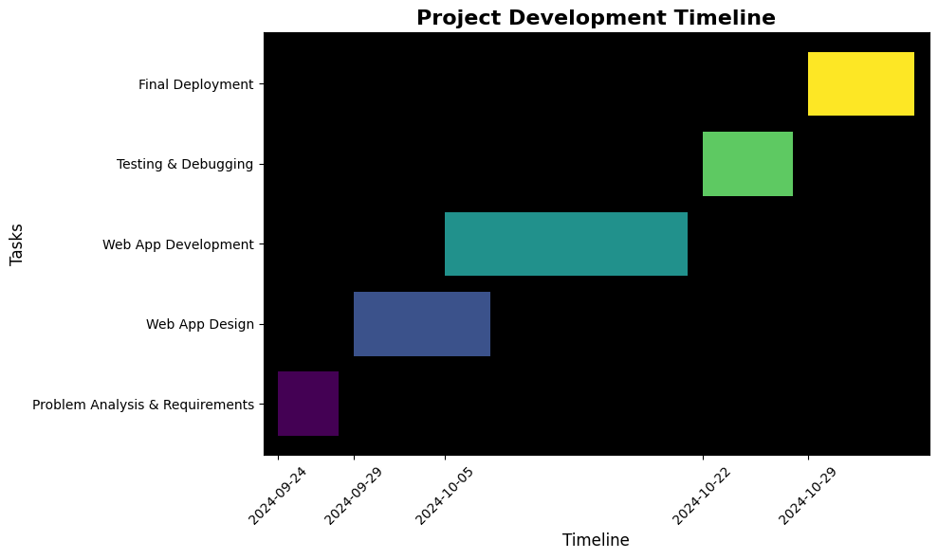
Timeline of the Project (Gantt Chart)

Slide 9
References (IEEE Paper format)
R. Kumar, "Birth and Death Registration in India: Current Status and Future Directions," Indian Journal of Public Health, vol. 64, no. 1, pp. 23-29, 2020.
Government of India, "National Health Mission: Guidelines for Birth and Death Registration," Ministry of Health and Family Welfare, New Delhi, India, 2019. [Online]. Available: https://nhm.gov.in/images/pdf/guidelines/birth_death_registration.pdf. [Accessed: Sep. 18, 2024].
M. Sharma and P. Gupta, "Challenges in Birth and Death Registration: A Study of Urban and Rural Disparities," Journal of Community Health, vol. 45, no. 2, pp. 234-240, 2021.
S. Verma and A. Chatterjee, "Digital Initiatives for Birth and Death Registration in India: A Review," in Proceedings of the International Conference on E-Governance, Bangalore, India, 2022, pp. 112-117.
C. R. Sahu and T. K. Mohanty, "Integrating Vital Registration with Health Services in India: A Systematic Approach," International Journal of Health Systems and Services, vol. 11, no. 3, pp. 155-162, 2023.

Slide 10


