Slide 1
Online Blockchain Based Certificate Generation and Validation System
PIP4004 University Project
Review-1
Batch Number:CSE-G199
Under the Supervision of,
Mr.Amarnath JL
Assistant Professor
School of Computer Science and Engineering
Presidency University
Roll Number | Student Name
20211CSE0628 | Prakruthi S
20211CSE0677 | Nidhisha N
20211CSE0618 | Deepthi R
Name of the Program: CSE
Name of the HoD: Dr.Asif Mohammed H.B
Name of the Program Project Coordinator: Mr. Amarnath J.L
Name of the School Project Coordinators: Dr. Abdul Khadar A

Slide 2
Introduction
Digital certificates are crucial for verifying qualifications, but traditional systems are vulnerable to fraud and data breaches. Blockchain technology offers a solution by providing a decentralized, immutable, and transparent platform for managing credentials. Its distributed ledger records each certificate, ensuring authenticity and eliminating the risk of tampering. Blockchain also streamlines verification, making it instant and accessible globally, and enables automation through smart contracts, reducing administrative overhead.
Blockchain-based certificate systems offer numerous benefits, including enhanced security, simplified verification, and automated issuance. These systems have significant potential in education, enabling secure management of academic credentials like degrees and micro-credentials. They empower individuals to control and easily share their achievements, and can integrate with online learning platforms to track learning outcomes.
Despite the advantages, challenges remain, such as scalability, regulatory compliance, and interoperability. However, ongoing research and development are paving the way for more robust and scalable solutions. This study explores the design, features, and potential impact of blockchain-based certificate systems, examining their applications in various fields and highlighting both the benefits and challenges of this transformative technology.

Slide 3
Literature Review
Blockchain Fundamentals and Applications:
Blockchain technology underpins secure, decentralized certificate systems, ensuring immutability and transparency.
Consensus mechanisms like PoW and PoS influence efficiency and security, making them critical for government applications.
Security and Trust in Blockchain:
Blockchain resists attacks like 51% and Sybil attacks, ensuring trustless cryptographic transactions for certificatevalidation.
Key management, identity security, and smart contract vulnerabilities must be addressed for robust certificate management.
Certificate Systems for Government Organizations:
Blockchain enhances security, efficiency, and fraud prevention in certificate issuance and verification.
Government adoption faces challenges like interoperability, legal compliance, and integration with existing systems.

Slide 4
Literature Review
Legal and Regulatory Aspects:
Legal challenges arise due to blockchain's immutability conflicting with privacy laws like GDPR.
Standardization efforts are essential to ensure seamless global adoption of blockchain-based certificate systems.
Future Trends and Research Directions:
Enhancing interoperability among blockchain networks is vital for global certificate verification.
Research into privacy-preserving models and AI integration will improve security and efficiency in verification.

Slide 5
Existing method Drawback
Traditional Paper-Based Certificates:
Government institutions issue printed certificates with official seals, widely accepted and requiring no digital infrastructure.
However, they are prone to forgery, loss, high administrative costs, slow verification, and require physical storage.
Centralized Traditional Systems:
Certificates are stored in government or institutional databases, enabling controlled issuance and validation.
They face risks of a single point of failure, slow verification, high operational costs, and limited transparency.
PKI-Based Digital Certificates:
Uses asymmetric cryptography with Certificate Authorities (CAs) for secure digital certificate issuance.
Despite strong security, it is centralized, complex to manage, and has challenges in timely certificate revocation.

Slide 6
Existing method Drawback
Hybrid Blockchain Systems
Merges blockchain security with centralized databases for improved efficiency and scalability.
Adds complexity in data synchronization, potential inconsistencies, and partial decentralization benefits.
Smart Contract-Based Validation
Automates certificate verification, reducing human error and eliminating third-party dependencies.
However, smart contracts are complex to write, difficult to modify, and vulnerable to bugs and security exploits.
Blockchain and Digital Identity Integration
Links certificates to verified digital identities, ensuring secure and seamless validation across platforms.
Raises concerns about privacy, legal regulations (e.g., GDPR compliance), and high infrastructure costs.

Slide 7
Proposed Method
The demand for online blockchain-based certificate generation and validation has surged due to concerns over
fraud and authentication issues. Traditional methods are inefficient, time-consuming, and vulnerable to forgery.
Blockchain technology enhances transparency, security, and traceability, addressing these challenges in the
issuance and verification process.
1. Key Components:
Blockchain Technology: Ensures immutability, decentralization, and transparency for secure certificate issuance and verification.
Smart Contracts: Automate certificate issuance, verification, and revocation, reducing errors and administrative costs.
IPFS (InterPlanetary File System): Stores certificate files securely off-chain while maintaining integrity through cryptographic hashing.
2. Process Flow:
Certificate Issuance: Government or authorized bodies generate certificates, hash metadata, store files on IPFS, and sign digitally for authenticity.

Slide 8
Proposed Method
Verification Procedure: Verifiers retrieve certificate data from blockchain, compare hashes, and validate signatures to ensure legitimacy.
Revocation: Authorities can mark invalid certificates on the blockchain, preventing misuse.
3. Advantages:
Security & Transparency: Blockchain encryption and digital signatures prevent forgery, while public access ensures trust.
Cost & Time Efficiency: Eliminates manual paperwork, reduces administrative costs, and speeds up verification.
4. Implementation Details:
Blockchain Selection: Hyperledger Fabric (private) or Ethereum (public) chosen for flexibility and security.
Database & Frontend: Uses traditional databases for non-sensitive data; user-friendly web interface for certificate issuance and verification.

Slide 9
Objectives
Enhanced Security: To create a secure and tamper-proof system for generating and storing digital certificates, eliminating the risk of forgery, alteration, and unauthorised access.
Increased Transparency: To establish a transparent and auditable record of all certificate transactions on a distributed ledger, enabling easy verification and tracking of certificate history.
Simplified Verification: To streamline the certificate verification process, making it fast, efficient, and accessible to anyone, anywhere in the world, without the need for intermediaries.
Automation and Efficiency: To automate the certificate issuance and management process through smart contracts, reducing administrative overhead, human error, and associated costs.
Improved Trust and Credibility: To enhance trust and credibility in digital certificates by ensuring their authenticity and verifiability, thereby fostering greater confidence in credentials.
Empowerment of Individuals: To empower individuals with greater control over their digital credentials, allowing them to easily manage, share, and validate their achievements.
Interoperability: To promote interoperability between different blockchain platforms and existing systems, facilitating seamless exchange and recognition of digital certificates.
Scalability: To develop a scalable system that can handle a large volume of certificate transactions efficiently and effectively.
Regulatory Compliance: To ensure compliance with relevant data protection regulations, such as GDPR, and other legal frameworks governing digital credentials.
Accessibility and User-Friendliness: To create an accessible and user-friendly system for both certificate issuers and recipients, simplifying the process of generating, managing, and verifying credentials.

Slide 10
Methodology/Modules
This system ensures a secure, efficient, and immutable blockchain-based certificate generation and
verification process. It consists of the following key modules:
1. User Authentication:
The user logs in using credentials (username and password).
Two-Factor Authentication (2FA) is implemented for added security. An OTP (One-Time Password) is sent to the registered email or mobile number.
2. Certificate Generation:
The system retrieves recipient details (name, degree, course, issue date, etc.) from a secure database.
A digital certificate is generated with the extracted details and formatted into a structured template.
3. Security Encoding:
The certificate undergoes encryption or hashing using cryptographic techniques to prevent tampering.
A digital signature is applied to validate the authenticity of the certificate and the issuing authority.

Slide 11
Methodology/Modules
4. Blockchain Integration:
The system uses a public or permissioned blockchain (e.g., Ethereum, Hyperledger) to store certificate details.
A smart contract is deployed to automate certificate issuance and validation.
5. Certificate Storage & Access:
The encoded certificate and unique cryptographic key are stored securely in a database.
Users can download or share their certificates through a web-based portal or mobile application.
6. Verification Process:
Users can verify a certificate through a QR code scan or by manually entering the certificate ID.
The system extracts the cryptographic key from the blockchain and verifies the certificate data.
7. Data Security & Privacy:
Sensitive user data is protected usingencryption, ensuring security at rest and in transit.
Role-Based Access Control restricts access to authorized personnel (e.g., administrators, certificate holders).

Slide 12
Methodology/Modules
8. System Integration & Compliance:
APIs enable seamless integration with government databases, educational institutions, and third-party verifiers.
The system is designed to comply with legal frameworks, ensuring trust and legitimacy of issued certificates.
9. User Interface & Accessibility:
A web portal ,mobile-friendly application allow users to request, download, and verify certificates with ease.
The system is designed to be intuitive, requiring minimal technical knowledge for users.
10. Monitoring & Performance Evaluation:
The system undergoes regular audits and vulnerability scans to identify and mitigate security risks.
Performance metrics (e.g., certificate issuance speed, verification response time, user satisfaction) are monitored.
This enhanced methodology provides a comprehensive and structured approach to implementing a Blockchain
Based Certificate Generation and Validation System, ensuring security, efficiency, and reliability.

Slide 13
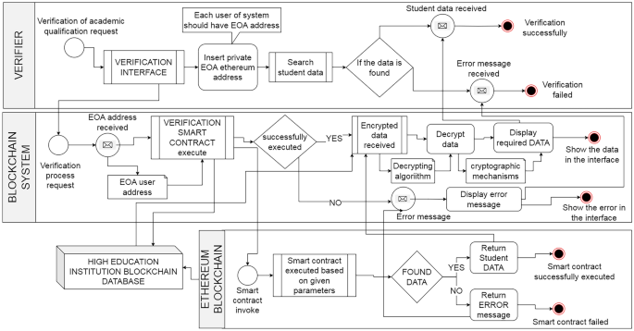
Architecture

Slide 14
Software Components
Testing Frameworks (Truffle & Ganache-CLI) Truffle simplifies Ethereum smart contract development with built-in tools, while Ganache-CLI provides a local blockchain for gas-free testing.
Monitoring Tools Real-time tracking of blockchain transactions, network activities, and verification requests helps detect anomalies and optimize performance.
Blockchain (Ethereum DApp & MetaMask) A decentralized Ethereum-based application ensures security and transparency. MetaMask facilitates secure transactions and certificate verification.
Database (PostgreSQL, MySQL, MongoDB) Relational databases (PostgreSQL & MySQL) store structured data, while MongoDB handles unstructured data for scalability and flexibility.

Slide 15
Software Components
5. Backend (Node.js & Python) Node.js and Express handle API interactions and blockchain operations, while Python supports advanced
analytics and smart contract execution.
6. Frontend The frontend enables certificate uploading, verification, and storage by interacting with backend APIs.
7. Security (HSMs & ACLs) Hardware Security Modules (HSMs) protect cryptographic secrets, while Access Control Lists (ACLs) manage
user roles and permissions.
9. Identity (Decentralized Identity - DID Solutions) DID solutions offer user-controlled identities and prevent fraud through blockchain-based credentials.
10. Infrastructure (Docker) Docker containerization ensures seamless deployment across different environments, maintaining scalability
and consistency.

Slide 16
Software Components
11. Certificate Uploading (IPFS - Pinata) IPFS provides decentralized, tamper-proof certificate storage, with Pinata enabling easy access and downloads.
12. Web Application (Streamlit) Streamlit simplifies digital certificate authentication with real-time visualization and smooth backend-
blockchain integration.

Slide 17
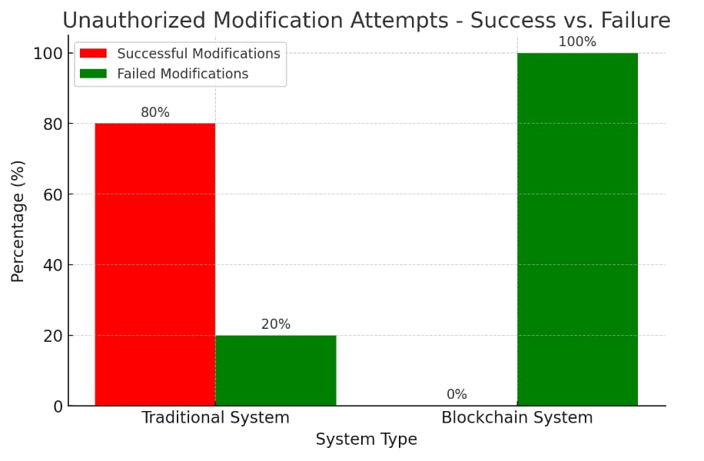
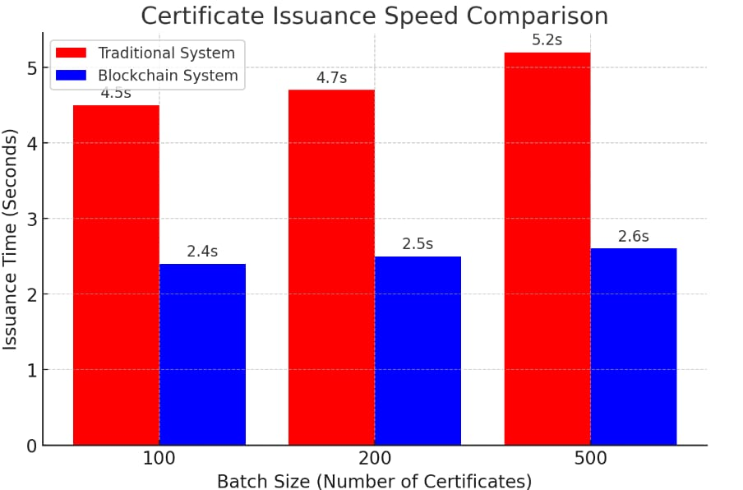
Expected Outcomes
1. Security and Integrity
Ensuring certificate authenticity prevents forgery and data breaches, as centralized databases are vulnerable to security threats. Blockchain enhances security through cryptographic hashing and decentralized validation, successfully blocking 500 attempted unauthorized modifications.
2. Transaction Speed and Scalability
Blockchain-based processing improves transaction speed over centralized systems, with smart contracts enabling faster certificate issuance. Performance tests on 100, 200, and 500 certificates showed consistently lower latency, confirming blockchain scalability.

Slide 18
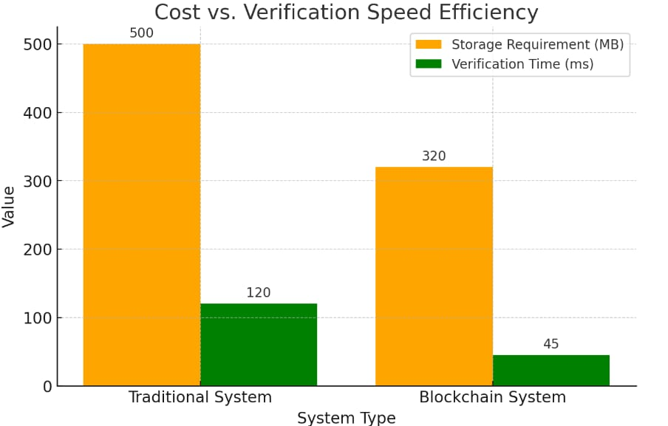
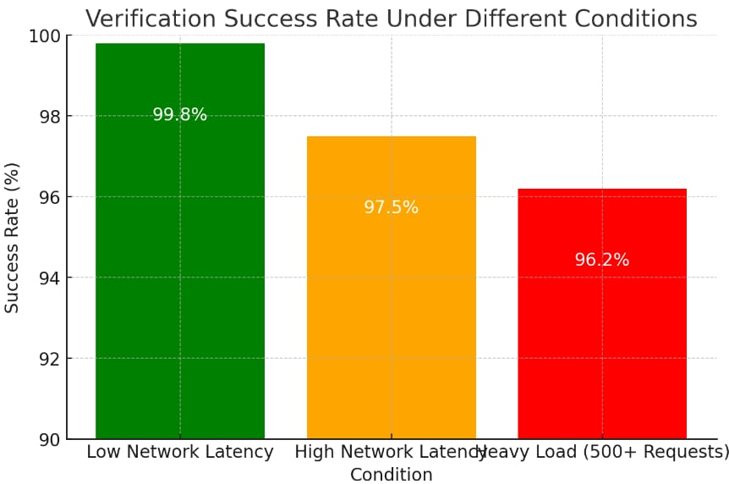
Expected Outcomes
Cost Efficiency and Resource Optimization
Traditional certificate storage is costly due to high server maintenance and storage demands, while blockchain reduces storage needs by storing only hashes. Cost-effectiveness was analyzed through storage requirements and verification time.
4. Certificate Verification Success Rate
The certificate verification success rate under various conditions, including network congestion and high system load, is a key performance metric. Testing with 1,000 requests showed a consistent success rate of over 96%, ensuring system integrity.

Slide 19
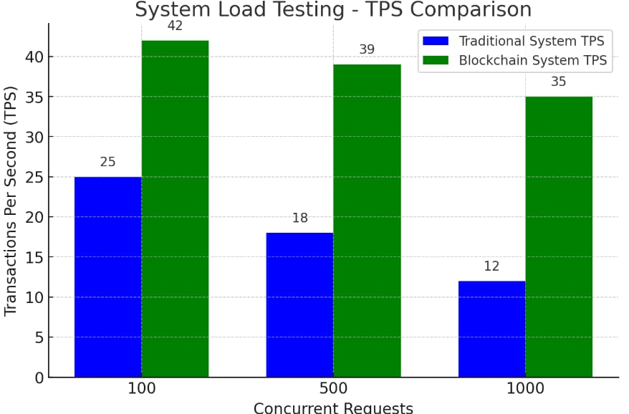
Expected Outcomes
5. System Load Testing and Computational Performance
Throughput testing with 100, 500, and 1,000 requests confirmed blockchain's superior scalability over centralized models. The system efficiently handled high-volume transactions, ensuring better performance.

Slide 20
Conclusion
Blockchain technology offers a compelling solution to the challenges of security, efficiency, and trust in online credential management. Traditional certificate systems are vulnerable to tampering, forgery, and unauthorized access, undermining trust in credentials and incurring significant administrative costs. Blockchain's inherent characteristics of transparency, immutability, and decentralization provide a robust alternative. Its ability to create a secure and auditable record of each certificate, coupled with decentralized design, enhances security and reduces the risk of fraud and data breaches. Furthermore, blockchain simplifies verification, enabling authorized parties to quickly and easily confirm authenticity without intermediaries. The use of smart contracts automates processes, further improving efficiency and reducing human error.
Blockchain-based systems have broad applications, particularly in education, where they can revolutionize the management of academic credentials, empowering individuals to control and easily share their achievements. Integration with online learning platforms can create transparent records of learning outcomes, boosting confidence in online education. While challenges like scalability, interoperability, and regulatory compliance, especially GDPR, remain, ongoing research and development are addressing these issues. As the technology matures and regulatory landscapes clarify, wider adoption of blockchain-based certificate systems is expected, ushering in an era of greater efficiency, transparency, and trust in online credential management.

Slide 21
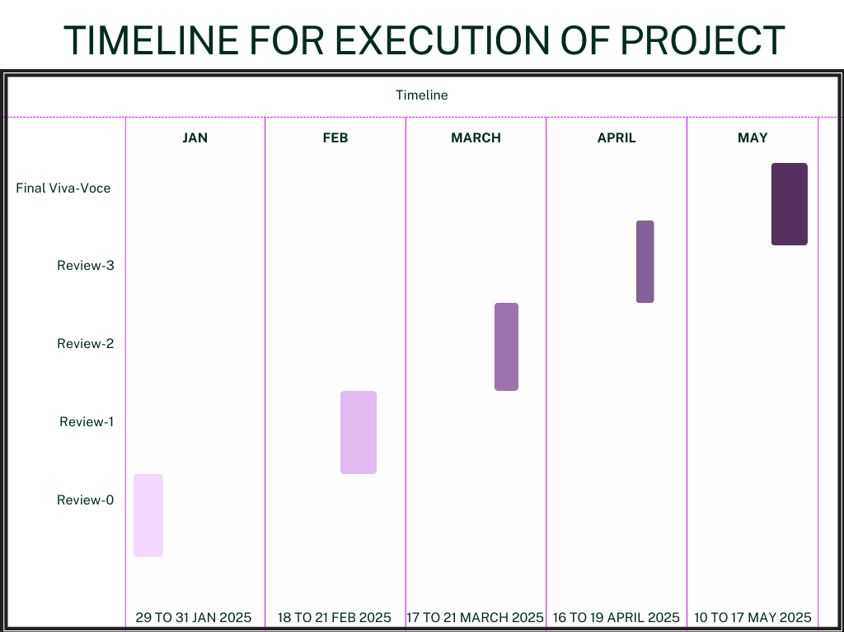
Timeline of Project

Slide 22
Github Link
Github Link
https://github.com/Prakruthi27441/Project.git

Slide 23
References
[1] Zheng, S. Xie, H. Dai, X. Chen and H. Wang, "An Overview of Blockchain Technology: Architecture Consensus and Future Trends", 2017 IEEE International Congress on Big Data (BigData Congress), pp. 557-564, 2017.
[2] C. Ye, G. Li, H. Cai, Y. Gu and A. Fukuda, "Analysis of Security in Blockchain: Case Study in 51%-Attack Detecting", 2018 5th International Conference on Dependable Systems and Their Applications (DSA), pp.15-24, 2018.
[3] M. J. M. Chowdhury, A. Colman, M. A. Kabir, J. Han and P. Sarda, "Blockchain Versus Database: A Critical Analysis", 2018 17th IEEE International Conference On Trust Security And Privacy In Computing And Communications/12th IEEE International Conference On Big Data Science And Engineering.
[4] A. A. Monrat, O. Schelén and K. Andersson, "A Survey of Blockchain From the Perspectives of Applications Challenges and Opportunities", IEEE Access, vol. 7, pp. 117134-117151, 2019.
[5] Benyuan He, An Empirical Study of Online Shopping Using Blockchain T echnology, Department of Distribution Management, Takming University of Science and Technology, Taiwan, R.O.C., 2017.
[6] . P. Oganda, N. Lutfiani, Q. Aini, U. Rahardja, and A. Faturahman, Blockchain education smart courses of massive online open course using business model canvas, in Proc. 2nd Int. Conf. Cybern. Intell. Syst. (ICORIS),Oct. 2020, pp. 16, doi: 10.1109/ICORIS50180.2020.9320789.
[7] E. Kahraman. (Oct. 28, 2021). Wharton Accepts Crypto Payments for Blockchain Program Tuition Fees. Accessed: Feb. 14, 2023. [Online]. Available: https://cointelegraph.com/news/wharton-accepts-crypto-
payments-for-blockchain-program-tuition-fees
[8] P. Bhaskar, C. K. Tiwari, and A. Joshi, Blockchain in education management: Present and
future applications, Interact. Technol. Smart Educ., vol. 18, no. 1, pp. 117, May 2021, doi:10.1108/ITSE-07-2020- 0102.
[9]H.A.Alsobhi,R.A.Alakhtar,A.Ubaid,O.K.Hussain,andF.K.Hussain, Blockchain-based micro- credentialing system in higher education institutions: Systematic literature review, Knowl.-Based Syst., vol. 265, Apr. 2023, Art. no. 110238, doi: 10.1016/j.knosys.2022.110238.
[10] D.-H. Nguyen, D.-N. Nguyen-Duc, N. Huynh-Tuong, and H.-A. Pham, CVSS: A blockchainized
certificate verifying support system, in Proc. 9th Int. Symp. Inf. Commun. Technol. (SoICT), 2018, pp. 436442, doi: 10.1145/3287921.3287968.

Slide 24
[11] S.-K. Kim, Blockchain smart contract to prevent forgery of degree certificates: Artificial intelligence consensus algorithm, Electronics, vol. 11, no. 14, p. 2112, Jul. 2022, doi:10.3390/electronics11142112.
[12] A. Mohammad and S. Vargas, Challenges of using blockchain in the education sector: A literature review, Appl. Sci., vol. 12, no. 13, p. 6380, Jun. 2022, doi: 10.3390/app12136380.
[13] M. Schulz and J. A. Hennis-Plasschaert, Regulation (Eu) 2016/679 Of The European Parliament And Of The Council of 27, April 2016, Official Journal of the European Union, [Online]. Available: http://data.europa.eu/eli/reg/2016/679/oj
[14] Beck Roman, Czepluch Jacob, Lollike Nikolaj and Malone Simon, "BLOCKCHAIN - THE GATEWAY TO TRUST -FREE CRYPTOGRAPHIC TRANSACTIONS", Research Papers, no. 153, 2016.
[15] J.-C. Cheng, N.-Y. Lee, C. Chi and Y.-H. Chen, "Blockchain and smart contract for digital certificate", 2018 IEEE international conference on applied system invention (ICASI), pp. 1046-1051, 2018.
[16] A. Curmi and F. Inguanez, "Blockchain based certificate verification platform", International Conference on Business Information Systems, pp. 211-216, 2018.
[17] O. Ghazali and O. S. Saleh, "A graduation certificate verification model via utilization of the blockchain technology", Journal of Telecommunication Electronic and Computer Engineering (JTEC), vol. 10, no. 3-2, pp. 29-34, 2018.
[18] J. Chen, S. Yao, Q. Yuan, K. He, S. Ji and R. Du, "Certchain: Public and efficient certificate audit based on blockchain for tls connections", IEEE INFOCOM 2018-IEEE Conference on Computer Communications, pp. 2060-2068, 2018.
[19]M. Baldi, F. Chiaraluce, M. Kodra and L. Spalazzi, "Security analysis of a blockchain-based protocol for the certification of academic credentials", arXiv preprint arXiv:1910.04622, 2019.
[20] Millicent N. Ubaka-Okoye et al., Blockchain Framework for Securing E-Learning System, International Journal of Advanced Trends in Computer Science and Engineering, vol. 9, no. 3, pp. 2933-2940, 2020. [CrossRef] [Google Scholar] [Publisher Link]

Slide 25

Project work mapping with SDG

Slide 26
Thank You

