Slide 1
PIP4004 University Project
Review-2
Online Blockchain Based Certificate Generation andValidation System
Batch Number:CSE-G199
NAMES | ROLL.NO
PRAKRUTHI S | 20211CSE0628
DEEPTHI R | 20211CSE0618
NIDHISHA N | 20211CSE0677
Under the Supervision of,
Dr. Anand Prakash
Associate Professor
School of Computer Science and Engineering
Presidency University
Name of the Program: CSE
Name of the HoD: Dr.Asif Mohammed H.B
Name of the Program Project Coordinator: Dr. Anand Prakash
Name of the School Project Coordinators: Dr. Abdul Khadar A

Slide 2
Introduction
Problem
Traditional digital certificate systems are vulnerable to fraud and data breaches.
Solution
Blockchain technology provides a decentralized, immutable, and transparent platform for managing credentials.
Benefits
Enhanced security and authenticity.
Simplified verification.
Automated issuance and management through smart contracts.
Empowerment to control and share their credentials.
Streamlined integration with online learning platforms.
Applications
Significant potential in education for managing academic credentials (eg.Courses).
Challenges
Scalability, regulatory compliance, and interoperability.
Outlook
Ongoing research and development are addressing these challenges.
.

Slide 3
Literature Review
Blockchain Fundamentals and Applications:
Blockchain technology underpins secure, decentralized certificate systems, ensuring immutability and transparency.
Consensus mechanisms like PoW and PoS influence efficiency and security, making them critical for government applications.
Security and Trust in Blockchain:
Blockchain resists attacks like 51% and Sybil attacks, ensuring trust-less cryptographic transactions for certificate-validation.
Key management, identity security, and smart contract vulnerabilities must be addressed for robust certificate management.
Certificate Systems for Government Organisations:
Blockchain enhances security, efficiency, and fraud prevention in certificate issuance and verification.
Government adoption faces challenges like interoperability, legal compliance, and integration with existing systems.

Slide 4
Literature Review
Legal and Regulatory Aspects:
Legal challenges arise due to blockchain's immutability conflicting with privacy laws like GDPR.
Standardisation efforts are essential to ensure seamless global adoption of blockchain-based certificate systems.
Future Trends and Research Directions:
Enhancing interoperability among blockchain networks is vital for global certificate verification.
Research into privacy-preserving models and AI integration will improve security and efficiency in verification.

Slide 5
Existing method Drawback
Traditional Paper-Based Certificates:
Government institutions issue printed certificates with official seals, widely accepted and requiring no digital infrastructure.
However, they are prone to forgery, loss, high administrative costs, slow verification, and require physical storage.
Centralised Traditional Systems:
Certificates are stored in government or institutional databases, enabling controlled issuance and validation.
They face risks of a single point of failure, slow verification, high operational costs, and limited transparency.

Slide 6
Existing method Drawback
Hybrid Blockchain Systems
Merges blockchain security with centralised databases for improved efficiency and scalability.
Adds complexity in data synchronisation, potential inconsistencies, and partial decentralization benefits.
Smart Contract-Based Validation
Automates certificate verification, reducing human error and eliminating third-party dependencies.
However, smart contracts are complex to write, difficult to modify, and vulnerable to bugs and security exploits.
Blockchain and Digital Identity Integration
Links certificates to verified digital identities, ensuring secure and seamless validation across platforms.
Raises concerns about privacy, legal regulations (e.g., GDPR compliance), and high infrastructure costs.

Slide 7
Proposed Method
User Authentication Module (Flask & MySQL)
User login & registration using Flask-Login.
Stores user credentials in MySQL (passwords hashed with Flask-Bcrypt).
Session management for authentication.
Blockchain Implementation Module (Python Blockchain)
Implements a custom blockchain to store certificate hashes.
Supports block creation & mining to ensure data integrity.
Provides functions to add and validate certificate hashes.
Smart Contract Module (Ethereum & Solidity)
Defines certificate issuance & verification logic.
Uses Ethereum blockchain to store certificate hashes.
Emits events (CertificateIssued, CertificateVerified).
Accessed using Web3.py in Python.

Slide 8
Proposed Method
Certificate Management Module
Users upload certificates.
Converts the certificate into a SHA-256 hash.
Sends the hash to the blockchain for permanent storage.
Web Interface (Flask App)
Templates (HTML templates for UI)
Static (CSS & JavaScript files)
Provides a dashboard for users.
Users can upload & verify certificates.
Database Module (MySQL)
Stores user details
Manages metadata of certificates issued.

Slide 9
Objectives
Enhanced Security
Secure and tamper-proof system for generating and storing digital certificates
Eliminating the risk of forgery, alteration, and unauthorised access.
Increased Transparency
Transparent record of all certificate transactions
Enabling easy verification.
Simplified Verification
Streamline the certificate verification a fast process
Efficient
Accessible to public without the need for intermediaries.
Automation and Efficiency
Automate the certificate issuance and management process through smart contracts
Reducing administrative overhead, human error and associated costs.
Improved Trust and Credibility
Trust and credibility in digital certificates
Authenticity and Verifiability,

Slide 10
Objectives
Empowerment of Individuals
Greater control over digital credentials
Can easily manage, share, and validate achievements.
Interoperability
Interoperability between different blockchain platforms and existing systems
Facilitating seamless exchange.
Scalability
Handles large volume of certificate transactions efficiently and effectively.
Regulatory Compliance
Data protection regulations.
Accessibility and User-Friendliness
User-friendly system for both certificate issuers and recipients
Simplifies the process of generating, managing, and verifying credentials.

Slide 11
Methodology/Modules
This system ensures a secure, efficient, and immutable blockchain-based certificate generation and
verification process. It consists of the following key modules:
1. User Authentication:
The user logs in using credentials (username and password).
2. Certificate Generation:
The system retrieves recipient details (name, degree, course, issue date, etc.) from a secure database.
A digital certificate is generated with the extracted details and formatted into a structured template.
3. Security Encoding:
The certificate undergoes encryption or hashing using cryptographic techniques to prevent tampering.
A digital signature is applied to validate the authenticity of the certificate and the issuing authority.

Slide 12
Methodology/Modules
4. Blockchain Integration:
The system uses a public or permission blockchain (e.g., Ganache) to store certificate details.
A smart contract is deployed to automate certificate issuance and validation.
5. Certificate Storage & Access:
The encoded certificate and unique cryptographic key are stored securely in a database.
Users can download or share their certificates through a web-based portal or mobile application.
6. Verification Process:
Users can verify a certificate through the generated hash tag.
The system extracts the cryptographic key from the blockchain and verifies the certificate data.
7. Data Security & Privacy:
Sensitive user data is protected using encryption, ensuring security at rest and in transit.
Role-Based Access Control restricts access to authorized personnel (e.g., administrators, certificate holders).

Slide 13
Methodology/Modules
8. System Integration & Compliance:
APIs enable seamless integration with government databases, educational institutions, and third-party verifiers.
The system is designed to comply with legal frameworks, ensuring trust and legitimacy of issued certificates.
9. User Interface & Accessibility:
A web portal ,mobile-friendly application allow users to request, download, and verify certificates with ease.
The system is designed to be intuitive, requiring minimal technical knowledge for users.
10. Monitoring & Performance Evaluation:
The system undergoes regular audits and vulnerability scans to identify and mitigate security risks.
Performance metrics (e.g., certificate issuance speed, verification response time, user satisfaction) are monitored.
This enhanced methodology provides a comprehensive and structured approach to implementing a Blockchain
Based Certificate Generation and Validation System, ensuring security, efficiency, and reliability.

Slide 14
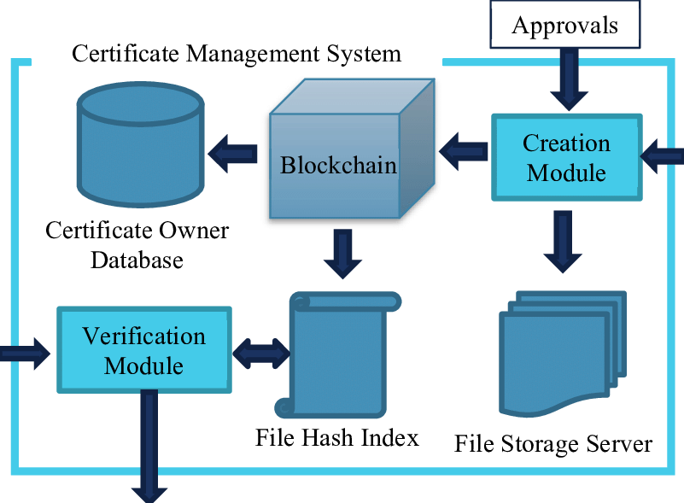
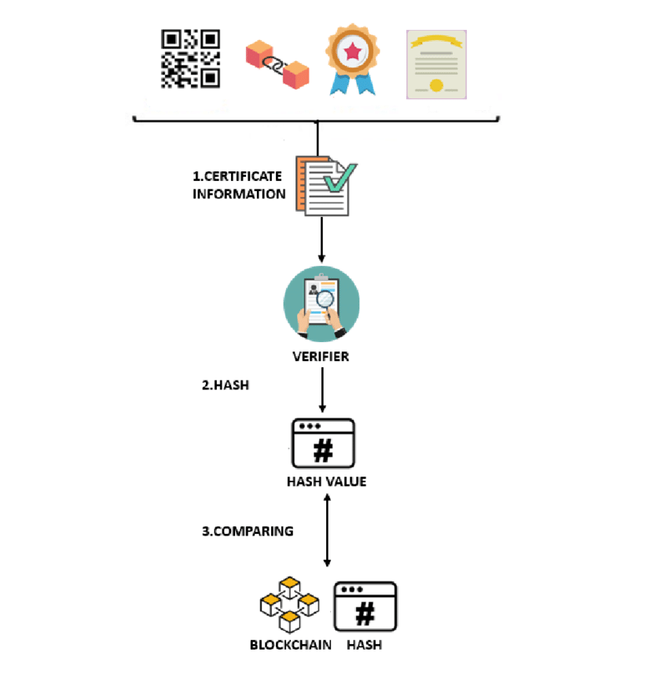
Architecture

Slide 15
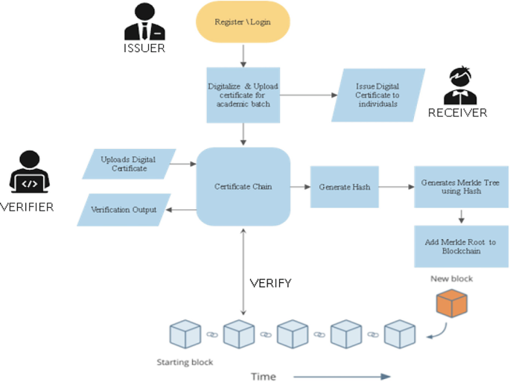
Architecture

Slide 16
Software Components
Flask (Python Framework)
Manages the web interface for certificate generation and verification.
Blockchain (Ethereum - Smart Contracts)
Ensures certificate authenticity by storing unique certificate hashes on Ethereum.
Solidity (Smart Contracts)
Defines rules for issuing and verifying certificates.
Web3.py (Ethereum Interaction)
Connects the backend with the Ethereum blockchain to interact with smart contracts.
SHA-256 Hashing (Digital Signature)
Generates a cryptographic hash for each certificate to prevent forgery.
FPDF (PDF Generation)
Creates and formats the final certificate PDF, including authorized signatures and official seals.

Slide 17
Software Components
HTML + CSS (Frontend)
Designs the user interface for easy certificate generation and validation.
Ganache (Local Blockchain Simulator)
Provides a test blockchain environment for deploying and testing smart contracts without using real ETH.

Slide 18
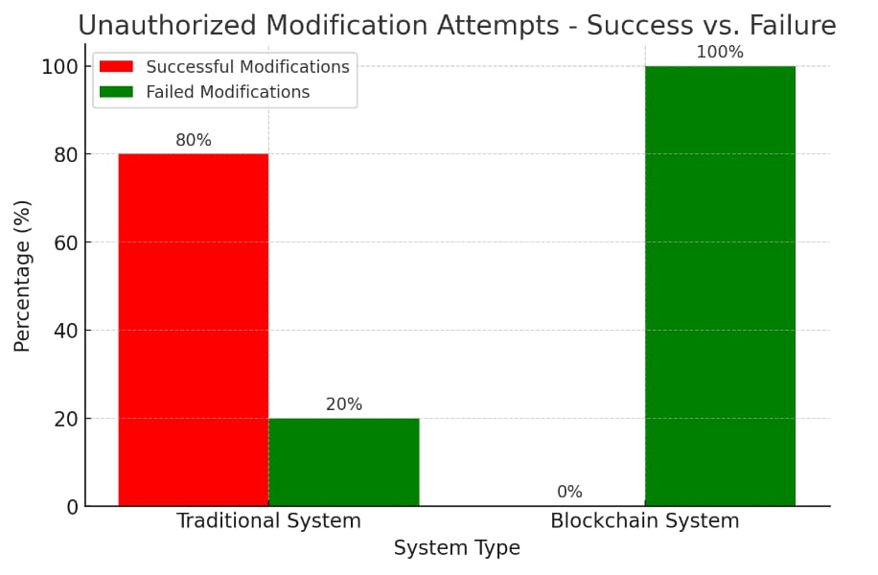
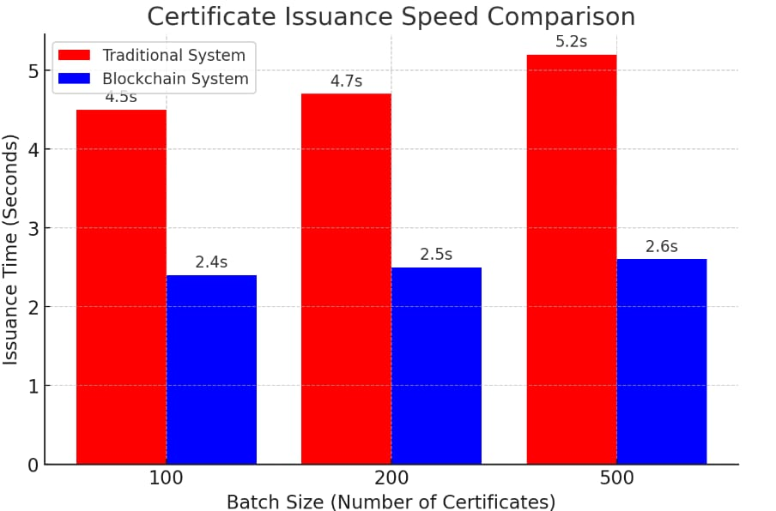
Expected Outcomes
Security and Integrity
Ensuring certificate authenticity prevents forgery and data breaches, as centralised databases are vulnerable to security threats. Blockchain enhances security through cryptographic hashing and decentralized validation, successfully blocking 500 attempted unauthorized modifications.
Transaction Speed and Scalability
Blockchain-based processing improves transaction speed over centralised systems, with smart contracts enabling faster certificate issuance. Performance tests on 100, 200, and 500 certificates showed consistently lower latency, confirming blockchain scalability.

Slide 19
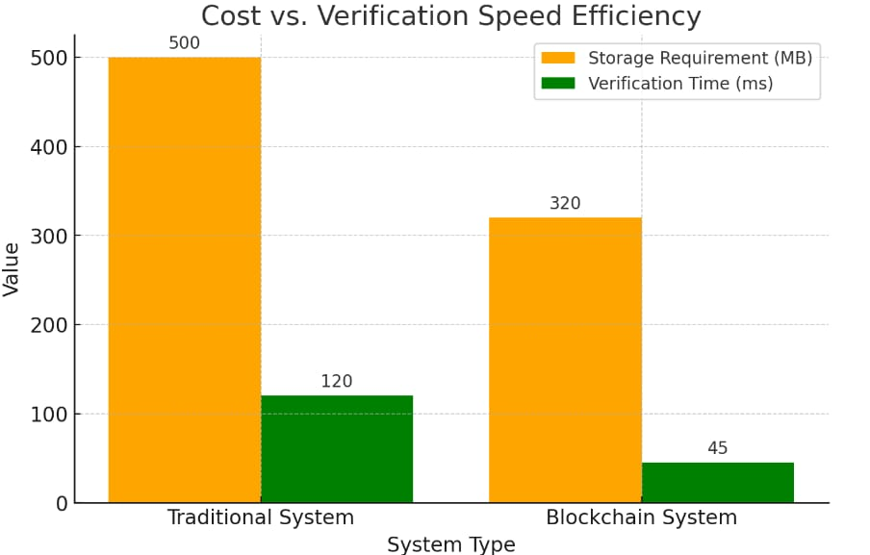
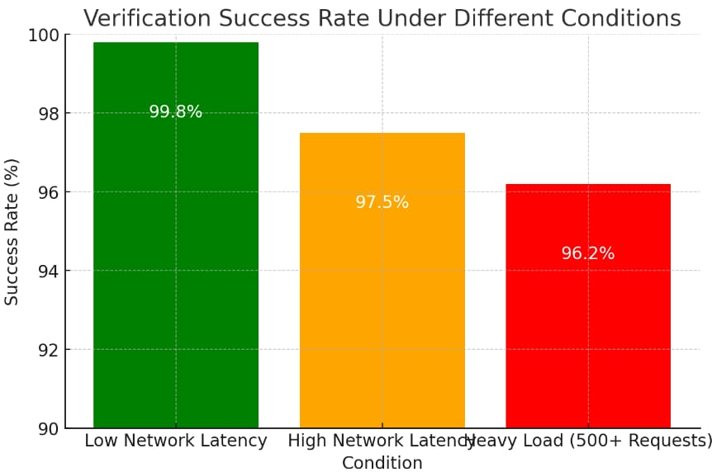
Expected Outcomes
Cost Efficiency and Resource Optimisation
Traditional certificate storage is costly due to high server maintenance and storage demands, while blockchain reduces storage needs by storing only hashes. Cost-effectiveness was analysed through storage requirements and verification time.
Certificate Verification Success Rate
The certificate verification success rate under various conditions, including network congestion and high system load, is a key performance metric. Testing with 1,000 requests showed a consistent success rate of over 96%, ensuring system integrity.

Slide 20
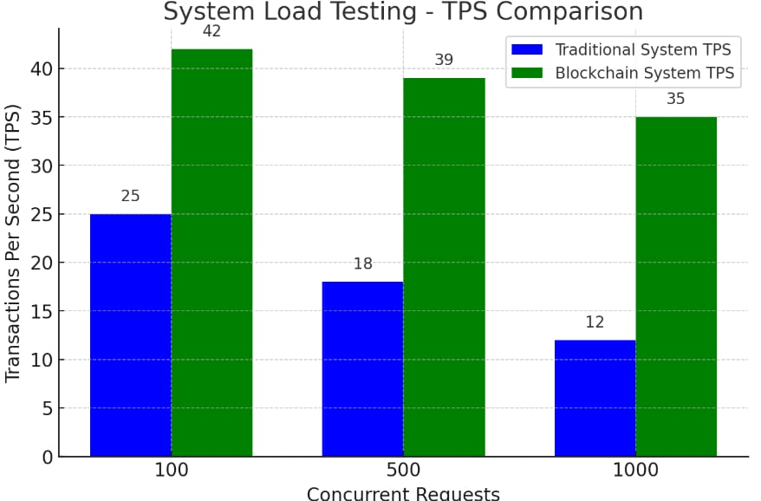
Expected Outcomes
System Load Testing and Computational Performance
Throughput testing with 100, 500, and 1,000 requests confirmed blockchain's superior scalability over centralised models. The system efficiently handled high-volume transactions, ensuring better performance.

Slide 21
Conclusion
Problem
Traditional systems suffer from vulnerabilities like tampering, forgery, and security breaches
Trust issues and high administrative costs.
Solution
Blockchain technology offers a secure, transparent, and decentralized alternative.
Key Features
Immutability and transparency to prevent fraud.
Decentralization for enhanced security.
Simplified and efficient verification.
Automation through smart contracts.

Slide 22
Conclusion
​​Applications
Particularly beneficial in education for managing academic credentials.
Challenges
Scalability, interoperability
Outlook
Ongoing research and development are addressing challenges.

Slide 23
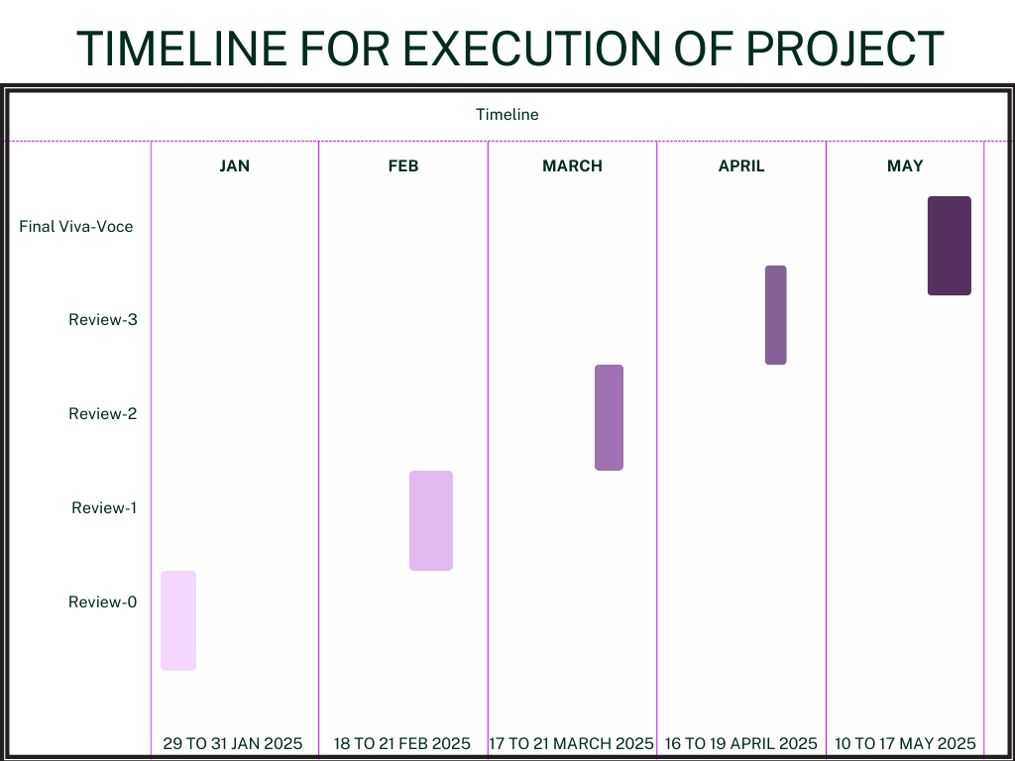
Timeline of Project

Slide 24
Github Link
https://github.com/Prakruthi27441/Project_S8.git

Slide 25
References
[1] Zheng, S. Xie, H. Dai, X. Chen and H. Wang, "An Overview of Blockchain Technology: Architecture Consensus and Future Trends", 2017 IEEE International Congress on Big Data (BigData Congress), pp. 557-564, 2017.
[2] C. Ye, G. Li, H. Cai, Y. Gu and A. Fukuda, "Analysis of Security in Blockchain: Case Study in 51%-Attack Detecting", 2018 5th International Conference on Dependable Systems and Their Applications (DSA), pp.15-24, 2018.
[3] M. J. M. Chowdhury, A. Colman, M. A. Kabir, J. Han and P. Sarda, "Blockchain Versus Database: A Critical Analysis", 2018 17th IEEE International Conference On Trust Security And Privacy In Computing And Communications/12th IEEE International Conference On Big Data Science And Engineering.
[4] A. A. Monrat, O. Schelén and K. Andersson, "A Survey of Blockchain From the Perspectives of Applications Challenges and Opportunities", IEEE Access, vol. 7, pp. 117134-117151, 2019.
[5] Benyuan He, An Empirical Study of Online Shopping Using Blockchain T echnology, Department of Distribution Management, Takming University of Science and Technology, Taiwan, R.O.C., 2017.
[6] . P. Oganda, N. Lutfiani, Q. Aini, U. Rahardja, and A. Faturahman, Blockchain education smart courses of massive online open course using business model canvas, in Proc. 2nd Int. Conf. Cybern. Intell. Syst. (ICORIS),Oct. 2020, pp. 16, doi: 10.1109/ICORIS50180.2020.9320789.
[7] E. Kahraman. (Oct. 28, 2021). Wharton Accepts Crypto Payments for Blockchain Program Tuition Fees. Accessed: Feb. 14, 2023. [Online]. Available: https://cointelegraph.com/news/wharton-accepts-crypto-
payments-for-blockchain-program-tuition-fees
[8] P. Bhaskar, C. K. Tiwari, and A. Joshi, Blockchain in education management: Present and
future applications, Interact. Technol. Smart Educ., vol. 18, no. 1, pp. 117, May 2021, doi:10.1108/ITSE-07-2020- 0102.
[9]H.A.Alsobhi,R.A.Alakhtar,A.Ubaid,O.K.Hussain,andF.K.Hussain, Blockchain-based micro- credentialing system in higher education institutions: Systematic literature review, Knowl.-Based Syst., vol. 265, Apr. 2023, Art. no. 110238, doi: 10.1016/j.knosys.2022.110238.
[10] D.-H. Nguyen, D.-N. Nguyen-Duc, N. Huynh-Tuong, and H.-A. Pham, CVSS: A blockchainized
certificate verifying support system, in Proc. 9th Int. Symp. Inf. Commun. Technol. (SoICT), 2018, pp. 436442, doi: 10.1145/3287921.3287968.

Slide 26
[11] S.-K. Kim, Blockchain smart contract to prevent forgery of degree certificates: Artificial intelligence consensus algorithm, Electronics, vol. 11, no. 14, p. 2112, Jul. 2022, doi:10.3390/electronics11142112.
[12] A. Mohammad and S. Vargas, Challenges of using blockchain in the education sector: A literature review, Appl. Sci., vol. 12, no. 13, p. 6380, Jun. 2022, doi: 10.3390/app12136380.
[13] M. Schulz and J. A. Hennis-Plasschaert, Regulation (Eu) 2016/679 Of The European Parliament And Of The Council of 27, April 2016, Official Journal of the European Union, [Online]. Available: http://data.europa.eu/eli/reg/2016/679/oj
[14] Beck Roman, Czepluch Jacob, Lollike Nikolaj and Malone Simon, "BLOCKCHAIN - THE GATEWAY TO TRUST -FREE CRYPTOGRAPHIC TRANSACTIONS", Research Papers, no. 153, 2016.
[15] J.-C. Cheng, N.-Y. Lee, C. Chi and Y.-H. Chen, "Blockchain and smart contract for digital certificate", 2018 IEEE international conference on applied system invention (ICASI), pp. 1046-1051, 2018.
[16] A. Curmi and F. Inguanez, "Blockchain based certificate verification platform", International Conference on Business Information Systems, pp. 211-216, 2018.
[17] O. Ghazali and O. S. Saleh, "A graduation certificate verification model via utilization of the blockchain technology", Journal of Telecommunication Electronic and Computer Engineering (JTEC), vol. 10, no. 3-2, pp. 29-34, 2018.
[18] J. Chen, S. Yao, Q. Yuan, K. He, S. Ji and R. Du, "Certchain: Public and efficient certificate audit based on blockchain for tls connections", IEEE INFOCOM 2018-IEEE Conference on Computer Communications, pp. 2060-2068, 2018.
[19]M. Baldi, F. Chiaraluce, M. Kodra and L. Spalazzi, "Security analysis of a blockchain-based protocol for the certification of academic credentials", arXiv preprint arXiv:1910.04622, 2019.
[20] Millicent N. Ubaka-Okoye et al., Blockchain Framework for Securing E-Learning System, International Journal of Advanced Trends in Computer Science and Engineering, vol. 9, no. 3, pp. 2933-2940, 2020. [CrossRef] [Google Scholar] [Publisher Link]

Slide 27

Project work mapping with SDG

Slide 28
Thank You

