Slide 1
Securities
Presentation By : Prakruthi E Gowda

Slide 2

What is Security ?
A security is a tradable financial asset. Securities are broadly categorized into: debt securities (e.g., banknotes, bonds, and debentures) equity securities (e.g., common stocks) , derivatives (e.g., forwards, futures, options, swaps) and hybrid securities(e.g., convertible bonds, preference shares).

Slide 3

Financial Markets
A financial market is a market in which people trade financial securities and derivatives at low transaction costs. Some of the securities include stocks and bonds, raw materials and precious metals, which are known in the financial markets as commodities.

Slide 4
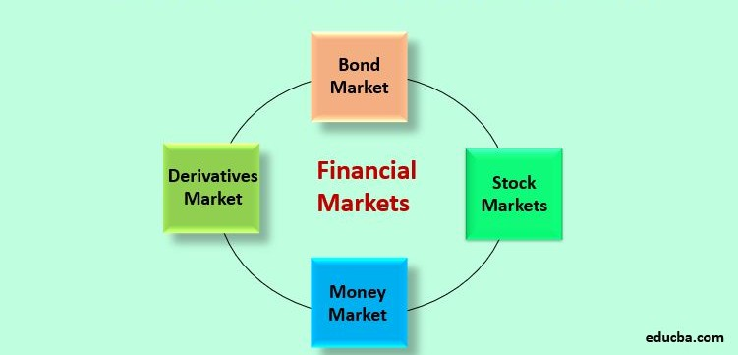
Types Of Financial Markets

Slide 5

How Securities Trade ?
Publicly traded securities are listed on stock exchanges.
An initial public offering (IPO) represents a company's first major sale of equity securities to the public.
Shareholders can sell their securities to other investors for cash and/or capital gain.

Slide 6
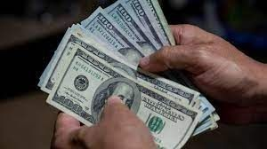
Investing in Securities
Securities represent an investment and a means by which companies, and other commercial enterprises can raise new capital.
Purchasing securities with borrowed money, an act known as buying on margin is a popular investment technique.
Depending on an institution's market demand or pricing structure, raising capital through securities are preferred.

Slide 7
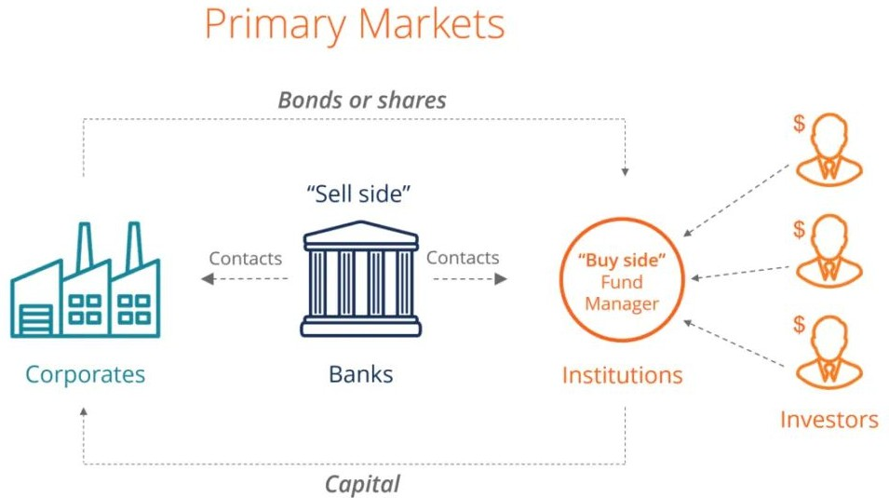
Primary Market
A primary market is a source of new securities.
Primary markets are facilitated by underwriting groups consisting of investment banks that set a beginning price range for a given security and oversee its sale to investors.
Once the initial sale is complete, further trading is conducted on the secondary market, where the bulk of exchange trading occurs each day.
Investors are able to purchase securities directly from the issuer.
Types of primary market issues include an initial public offering (IPO), a private placement, a rights issue, and a preferred allotment.

Slide 8
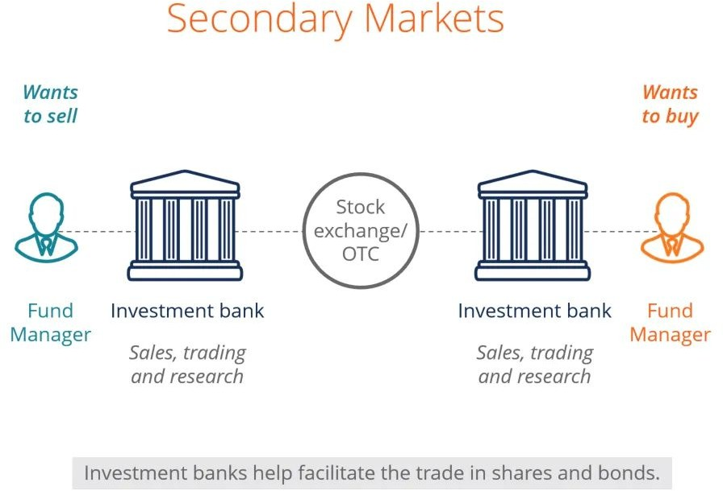
Secondary Market
The secondary market is where investors buy and sell securities they already own.
The national exchanges, such as the New York Stock Exchange (NYSE) and the NASDAǪ, are secondary markets.
In secondary markets, investors exchange with each other rather than with the issuing entity.
Through massive series of independent yet interconnected trades, the secondary market drives the price of securities toward their actual value.

Slide 9

Issuing Securities
Company can tap public markets by conducting an IPO or it can raise money by offering its shares to investors in a private placement.
The former method enables the company to generate more capital, but it comes saddled with hefty fees and disclosure requirements.
In the latter method, shares are traded on secondary markets and not subject to public scrutiny.
Government interested in raising money to revive its economy. It uses bonds or debt security to raise that amount, promising regular payments to holders of the coupon.

Slide 10
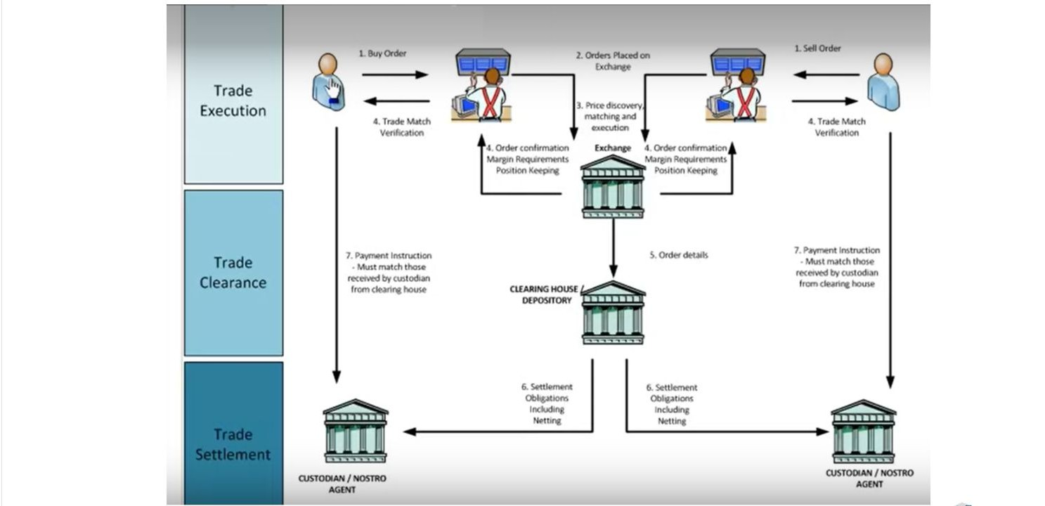
Security Process

Slide 11



Workﬂow
Back oﬃce
The back office provides administrative, support, and payment services.It
takes care of settlements of
trade.
03
Front Oﬃce
The front office includes sales personnel and corporate finance.Client orders are placed with
front office. .
02
Middle Oﬃce
The middle office manages risk and IT resources.It draws the resources of both the front and the back offices.
01

Slide 12
Dirty price
Bid price
Clean price
Important terms
Coupon rate
Settlement

Slide 13

Stock Trade Orders
An order consists of instructions to a broker or brokerage firm to purchase or sell a security on an investor's behalf. An order is the fundamental trading unit of a securities market.

Slide 14
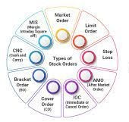
Types of Orders
Market Order
Limit Order
Stop Order
Stop-Limit Order
Trailing Stop Order

Slide 15



Thank You

