Slide 1
ONLINE SHOPPING

Slide 2
DEFINITION :
Online Shopping is the process whereby consumers directly buy goods or services from a seller in real time, without an intermediary service, over the internet.

Slide 3
Payment Method :
Credit.
Debit.
Cash on Delivery.

Slide 4
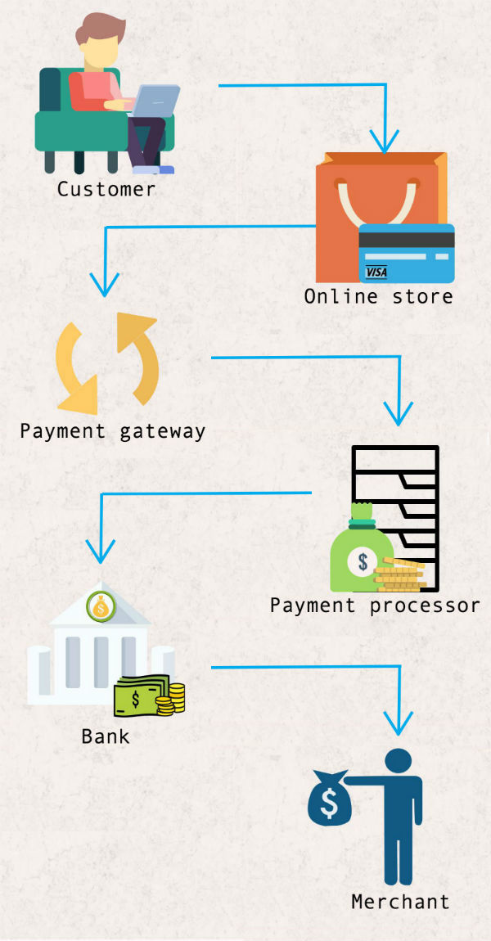
How does it works :

Slide 5
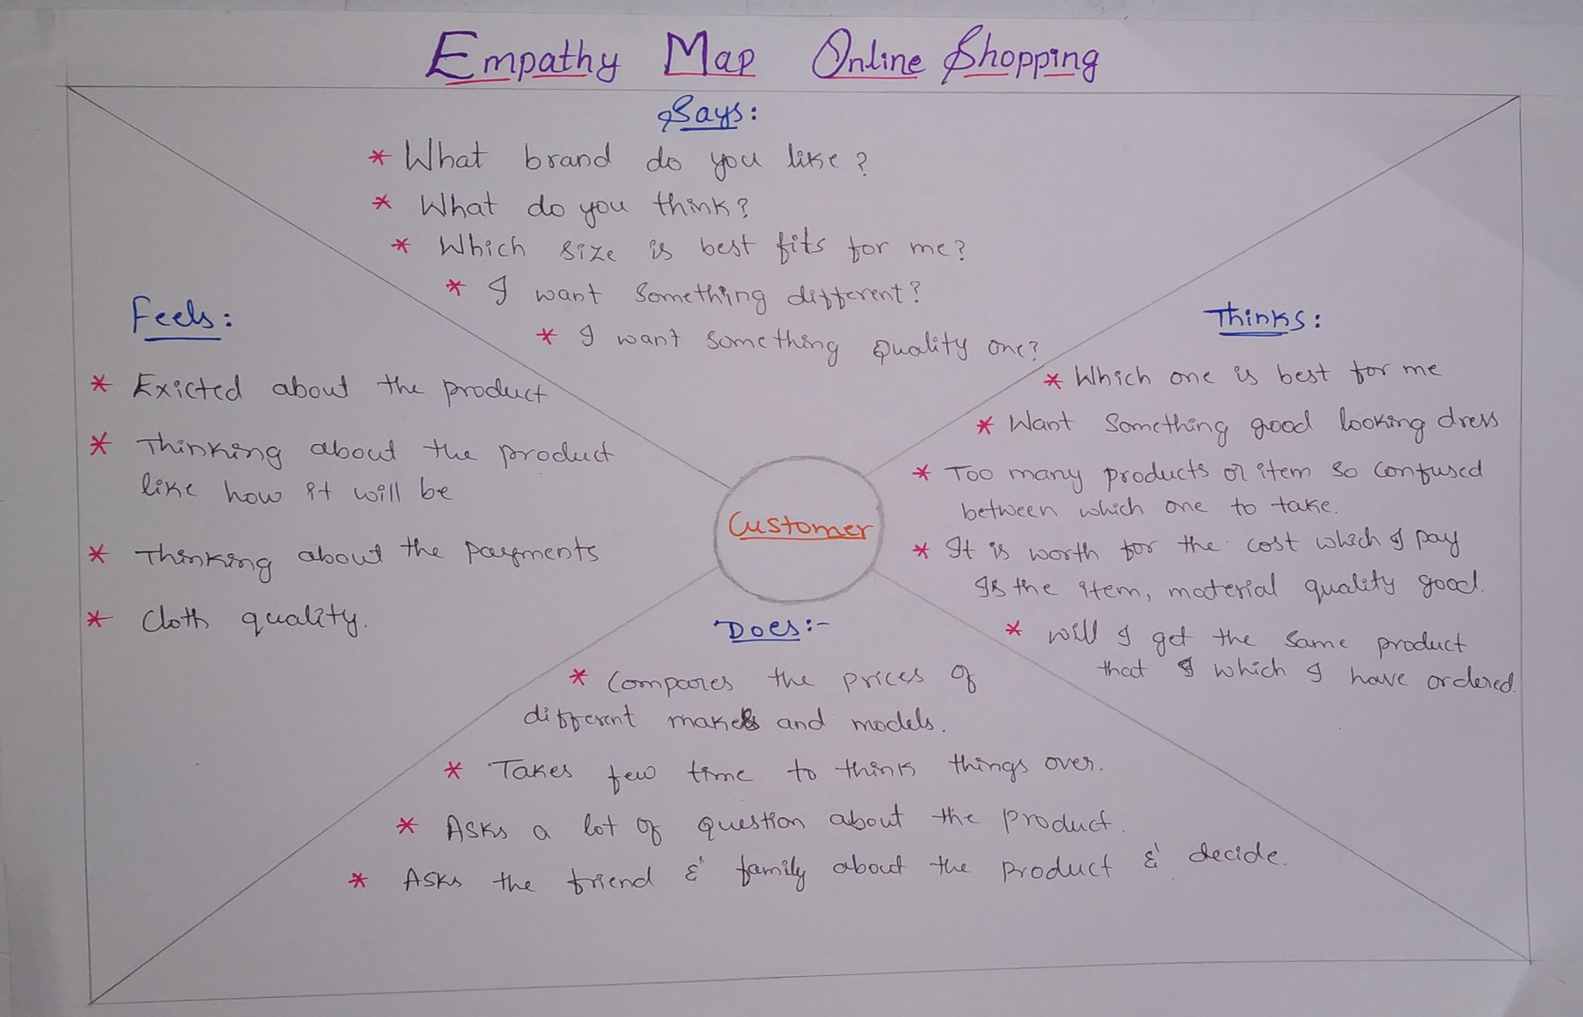
Empathy map :

