Slide 1
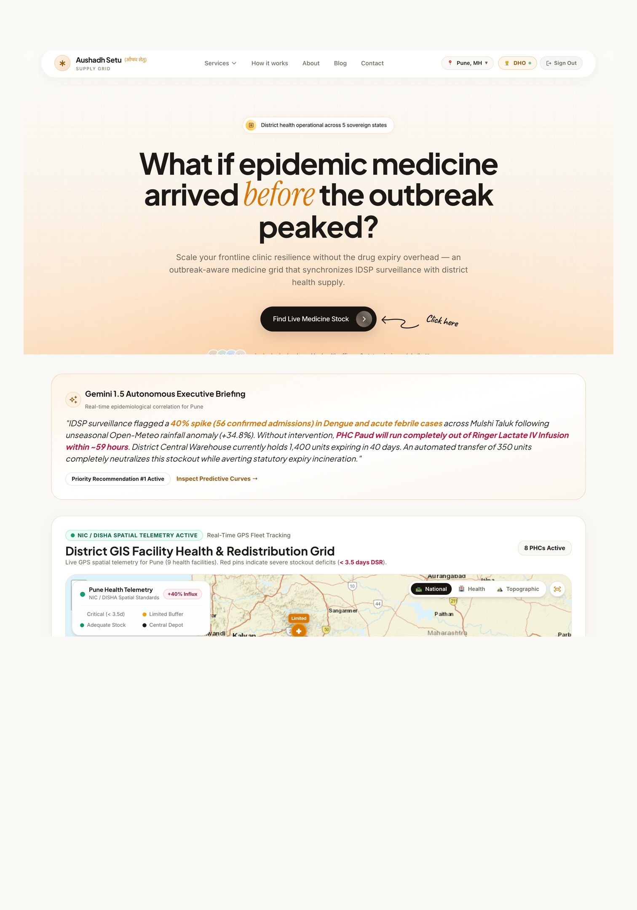
Aushadh Setu
औषध सेतु — Outbreak-Aware Medicine Intelligence Grid
An intelligent, outbreak-aware public health supply chain platform — an automated logistical nervous system for India's public healthcare grid, connecting disease surveillance, satellite climate early warnings, AI-driven consumption forecasting, and peer-to-peer inter-facility drug redistribution.
GOOGLE CLOUD BUILD WITH AI: CODE FOR COMMUNITIES — SECOND EDITION
DEVELOPED BY PRAKSHAL JAIN · HEALTHCARE AI · SUPPLY CHAIN

Slide 2
The Public Health Supply Chain Paradox
India operates one of the largest public healthcare facility networks on the planet — spanning Sub-Centres, Primary Health Centres (PHCs), Community Health Centres (CHCs), Sub-District Hospitals (SDHs), and District Hospitals (DHs). Despite heavy government expenditure under the National Health Mission (NHM), the public drug delivery mechanism suffers from a severe structural paradox: while millions of citizens arrive at clinics expecting treatment, the system is simultaneously haemorrhaging resources through expiry, disconnection, and logistical blindness.
🔴 Acute Stock-Outs
💸 Out-of-Pocket Burden
Rural PHCs regularly face zero-inventory situations for vital antibiotics, IV fluids, and anti-diabetics — forcing patients into catastrophic out-of-pocket expenditure.
OOPE on medicines accounts for 60–70% of total personal healthcare spending in India, pushing millions of vulnerable families below the poverty line every year.
🗑️ Massive Drug Wastage
📡 Surveillance–Supply Disconnect
CAG audits document ₹6.57 crore of expired medicines in a single state's warehouses — while peripheral clinics go without the same drugs.
IDSP disease data never talks to the drug inventory system. Procurement runs on rigid quarterly averages — completely blind to real-time clinical surges.

Slide 3

Five Critical System Failures — In Detail
Each failure point is not an isolated incident — they are interconnected symptoms of a supply chain that operates without real-time intelligence, predictive capability, or inter-facility coordination. Together, they create a system where patients suffer, money is wasted, and lives are lost unnecessarily.
Problem 1: Acute Peripheral Stock-Outs
Problem 2: Massive Drug Wastage in Central Warehouses
Problem 3: The Surveillance–Supply Disconnect
Rural and semi-urban PHCs regularly face zero-inventory situations for vital antibiotics (Amoxicillin), IV fluids (Ringer Lactate, Normal Saline), anti-diabetics (Metformin), and anti-hypertensives. When a PHC runs out, poor and rural patients are forced to visit private retail chemists. In many cases, patients simply skip chronic medications — leading to avoidable complications and hospitalisations.
At the exact moment peripheral clinics face shortages, CAG audits document crores of rupees worth of medicines expiring unused in district medical stores. Medicines expire because facilities receive bulk supplies without considering local consumption rates, older batches are pushed to the back of shelves instead of following FEFO protocols, and there is no automated trigger to alert administrators before expiry.
India's IDSP and IHIP platforms compile weekly syndromic disease reports every Monday. However, this disease data never communicates with the drug inventory system. If an unseasonal monsoon triggers a sudden Dengue wave in Taluk North, local PHCs run out of IV fluids and ORS within 48–72 hours — the supply system has no mechanism to react to real-time clinical surges.
Problem 4: Logistical Blind Spots & No Inter-Facility Sharing
Problem 5: Manual Data Entry Burden on Rural Pharmacists
PHC A has 2 days of Paracetamol left during a viral fever outbreak. PHC B, just 14 km away, holds 1,200 bottles of IV fluids expiring in 45 days — 800 of which will expire and be destroyed. Currently, there is no automated, regulatory-compliant digital system to connect them. Health officers have zero visibility into peer inventories, and pharmacists have no legal or digital mechanism to authorise a peer-to-peer transfer.
Rural pharmacists manage patient dispensing, physical stock registries, and paper registers simultaneously. Expecting them to manually type 15-digit alphanumeric batch numbers, manufacturing dates, and expiry dates for hundreds of cartons into a slow web portal leads to non-compliance, backdated logs, and missing inventory records — undermining the entire data pipeline.

Slide 4
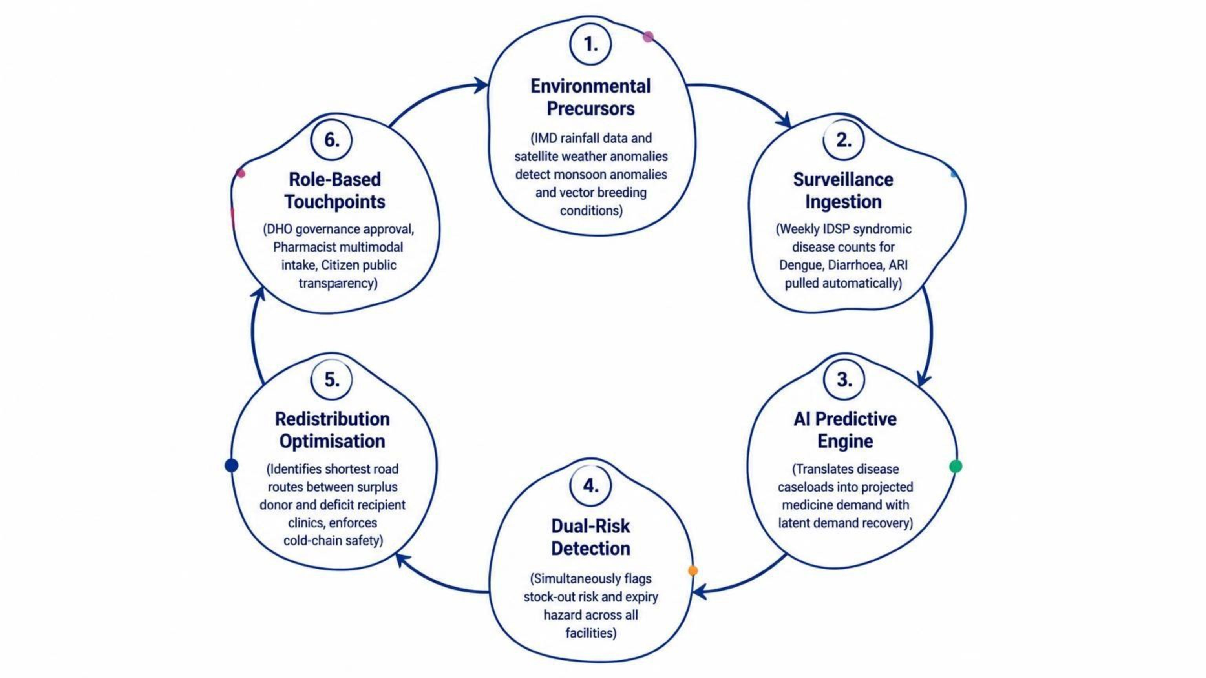
Aushadh Setu: The Closed-Loop Intelligence Grid
Aushadh Setu bridges every one of these gaps through an end-to-end, closed-loop system that treats medicine distribution as a living, dynamic, predictive network — not a static, bureaucratic, once-a-quarter order form. It anticipates drug shortages 2 to 3 weeks before they happen, identifies which nearby facilities have expiring surpluses of the exact medicines needed, and coordinates authorised transfers before stocks run out or expire.
This closed-loop architecture ensures that no signal — whether an environmental precursor, a disease surveillance spike, or an expiring batch — is ever disconnected from the supply response mechanism. Every stage feeds the next, creating a self-reinforcing system of continuous intelligence and action.

Slide 5



Frictionless AI Stock Logging & Inventory Ingestion
Designed specifically to eliminate the manual typing burden that causes non-compliance and missing inventory records at rural facilities. Aushadh Setu uses Google's Gemini 1.5 Flash multimodal vision capabilities to transform a simple smartphone photograph into a fully structured, verified inventory entry — in seconds, not minutes.
Gemini 1.5 Flash Vision Scanner
Offline-Resilient Architecture
Vernacular Voice Logging Simulator
Pharmacists photograph an incoming medicine carton, box, or blister strip. The multimodal vision pipeline instantly parses the physical packaging and extracts 9 key attributes: Generic Name, Brand Name, Batch Number, Manufacturing Date, Expiry Date, Quantity & Pack Type, Manufacturer Name, and Cold-Chain Requirement flag. Features an instant visual confirmation card for one-click ledger entry.
Uses memory-based storage processing so image analysis runs without writing temporary files to server disks — preventing failures in serverless cloud environments. Built with high-fidelity realistic fallbacks so the scanner functions reliably even in poor connectivity conditions typical of rural India.
Pharmacists can simulate hands-free voice logging in local languages — for example, "Dispensed 60 packets of ORS and 30 strips of Paracetamol today" — drastically cutting administrative overhead and enabling truly zero-touch inventory management in the field.

Slide 6
Epidemic Surveillance, Climate Warning & Predictive Intelligence
Epidemiological Ingestion & Climate Warning Grid
Dynamic Consumption Forecasting & Dual-Risk Engine
Days of Stock Remaining (DSR): Calculates real-time stock runway for every medicine across every facility: DSR = Usable Physical Stock ÷ Projected Daily Consumption. Categorises inventory into Green (7+ days), Amber (3–7 days), and Red (under 3 days — immediate replenishment required).
FEFO Expiry Hazard Scoring: Evaluates every batch against remaining shelf life and local consumption rate. Expiring Surplus = Batch Stock − (Days to Expiry × Daily Consumption). If positive, the system flags it as an "Imminent Expiry Surplus" and queues it for outward transfer.
Latent Demand Correction: When a clinic is out of stock, patients stop asking — causing historical records to show zero consumption. The model uncouples projected demand from zero-dispensing records, estimating true demand based on catchment population, disease prevalence, and seasonal indices.
SEIR Outbreak Dynamic Modelling: Implements mathematical Susceptible-Exposed-Infected-Recovered curves to simulate transmission dynamics and generate forward-looking 14-day medicine consumption projections.
Weekly IDSP Epidemiological Ingestion: Ingests weekly district disease surveillance data across key public health indicators — Acute Diarrhoeal Disease, Dengue & Chikungunya, and Acute Respiratory Infections — tracking week-over-week trends and identifying anomalous surges above baseline thresholds.
Climate Vector Tracking (IMD Integration): Monitors weekly rainfall anomaly percentages, temperature fluctuations, and humidity indexes. Provides a 14-day pre-surveillance early warning — flagging high-risk mosquito breeding conditions weeks before patients arrive at outpatient departments.
Syndromic-to-Drug Matrix (SDM): An algorithmic bridge mapping clinical syndromes directly to essential medicines — Dengue outbreak triggers demand multipliers for Paracetamol, IV Fluids, and ORS; Diarrhoeal surge triggers ORS, Zinc, and Ciprofloxacin; Respiratory wave triggers Amoxicillin and Azithromycin.

Slide 7

Intelligent Geospatial Redistribution & Logistics Engine
The operational core that matches surplus with deficit and coordinates medicine movement — transforming a fragmented, invisible network of isolated facilities into a coordinated, intelligent redistribution grid. This core engine directly solves the paradox of simultaneous shortage and expiry.
Peer-to-Peer Facility Matching Algorithm
Interactive Transit Map (Leaflet GIS)
Automatically pairs a Donor Facility (holding an expiring surplus) with a Recipient Facility (facing a projected stockout of the exact same medicine). Enforces Safety Reserve Buffers: a donor clinic is never allowed to donate medicines if doing so would drop its own inventory below a 15-day emergency safety buffer.
Eligible recipients are ranked using a composite score based on: Severity of Impending Stockout + Inverse Driving Distance + Cold-Chain Transport Compatibility.
Visualises public healthcare facilities across the district with colour-coded geographic markers. Renders live transfer routes connecting donor and recipient facilities. Features animated logistics transit pulses showing medical supply transport vehicles in transit. Displays cold-chain warnings (blue ice badge) for temperature-sensitive drugs like Anti-Snake Venom, Rabies Vaccines, and Insulin — ensuring they are only moved via cold-box equipped vehicles.
Regulatory Compliance by Design: Every transfer is fully auditable, with digital approval trails, dispatch challans, and recipient verification — meeting all NHM and state pharmaceutical governance requirements without adding bureaucratic friction.
Human-in-the-Loop Governance & Digital State Machine
To comply with pharmaceutical regulations, medicines are never moved autonomously without human authorisation. Governed by a strict state-transition workflow: RECOMMENDED (AI detects imbalance and proposes transfer) → APPROVED_BY_DHO (District Health Officer reviews clinical rationale and signs off) → IN_TRANSIT (Driver departs with dispatch challan) → RECEIVED_AND_VERIFIED (Recipient pharmacist scans and enters stock into destination inventory).

Slide 8
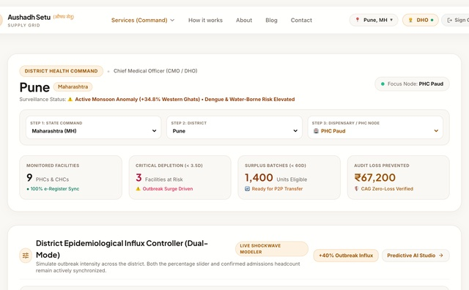
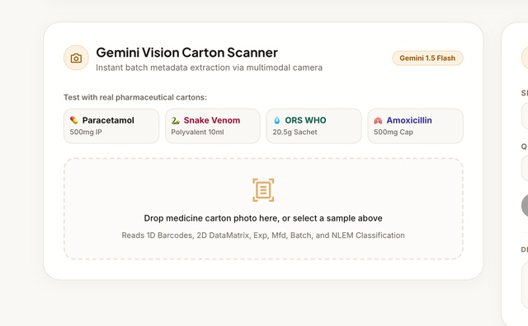
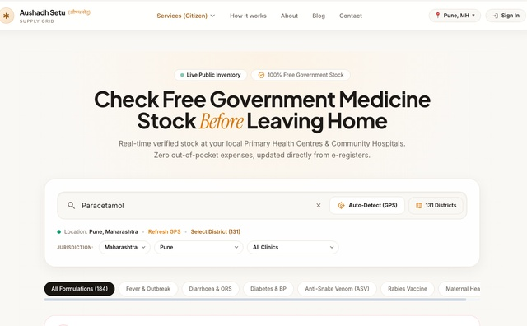
Unified Three-Tier Stakeholder Ecosystem
Aushadh Setu provides purpose-built interfaces for every participant in the public health ecosystem — from the District Health Officer making strategic decisions, to the rural pharmacist managing daily dispensing, to the citizen checking medicine availability before travelling to a clinic.
DHO Command Console
Pharmacist Facility Portal
Citizen Public Medicine Finder
Executive AI Copilot generates concise, natural-language briefing cards explaining which taluks are under threat and which transfers need urgent sign-off. District Map View shows facility status, active alerts, and logistics movement. Transfer Approval Desk provides complete clinical context, driving distance, and one-click digital approval. Monday Morning Surveillance Sync allows the DHO to ingest new IDSP weekly reports and trigger re-forecasting on demand.
Live Facility Inventory displays current stock, batch numbers, days of stock remaining, and expiry countdowns. AI Camera Scanner enables immediate photo intake with auto-extraction of batch details. Stock Outward & Inward Transfer Verification allows pharmacists to track driver progress and confirm receipt. Quick dispensing forms and consignment receipt tools minimise administrative burden on overworked rural staff.
Simple, ultra-fast, mobile-friendly interface designed for rural and urban citizens. Browser Geolocation automatically detects GPS coordinates and calculates exact driving distance to nearby government health centres. Search by medicine name or illness keyword. Clear stock availability badges (🟢 In Stock, 🟡 Limited, 🔴 Out of Stock). Shows complete address, operating hours, Medical Officer name, and a direct "Navigate via Google Maps" button — eliminating futile trips and lost daily wages.

Slide 9

Outbreak Simulation Sandbox & Cloud Architecture
Interactive Outbreak Stress-Testing Sandbox
Role-Based Access Control & Serverless Architecture
An interactive simulation testbench that allows administrators, evaluators, and health ministers to stress-test the district healthcare grid under emergency conditions — before a real crisis occurs.
Configurable Parameters: Select outbreak type (Dengue Surge, Acute Diarrhoeal Disease, or ARI), set intensity multiplier (20% baseline up to 150% epidemic spike), and target specific vulnerable sub-districts.
Live Cascade Demonstration: Clicking "Trigger Outbreak Simulation" executes the entire reactive intelligence chain in real time — injecting an epidemiological spike, recalculating 14-day consumption curves, showing DSR plummeting into the red zone, scanning for unutilised batches nearing expiry, calculating optimal delivery routes, and surfacing new transfer recommendations on the DHO approval desk. Live impact counters demonstrate total patient stockout days averted and value of expired medicines rescued.
Role-Based Access Control (RBAC): Dedicated credentials and permission levels for District Health Officers, Facility Pharmacists, and unauthenticated public citizens. Clean authentication modal with demo quick-login credentials for zero-friction evaluations.
Unified Single-Domain Architecture: Frontend built with React, Vite, and Tailwind CSS. Backend built with Node.js and Express, pre-configured as serverless edge/lambda functions using vercel.json and api/index.js.
Resilient Data Layer: Server-side db.js automatically switches between local filesystem storage and writable /tmp cache in cloud environments — preventing read-only filesystem errors in serverless deployments on Google Cloud.
Google Cloud Ready: Architected for immediate deployment on Google Cloud Run or Cloud Functions with zero infrastructure management overhead.

Slide 10
Measurable Real-World Impact
Implementing Aushadh Setu across a standard Indian administrative district — serving 2.5 to 3.5 million residents across 40 to 60 health facilities — delivers immediate, quantifiable outcomes that directly address every failure point identified in the problem analysis.
₹3,500
₹80L
Saved Per Illness Episode
Medicines Rescued Annually
By maintaining continuous availability of essential drugs at primary health clinics, low-income families are spared private retail chemist markups — saving between ₹800 and ₹3,500 per acute illness episode.
Inter-facility FEFO rebalancing redirects near-expiry batches from low-volume dispensaries to high-volume taluk and district hospitals, recovering up to ₹40–80 lakhs of government-purchased medicines per district per year.
48hrs
0
Outbreak Response Time
Wasted Patient Journeys
Reduces response latency during seasonal epidemics from 2–3 weeks down to 48 hours — enabling health departments to flood outbreak epicentres with IV fluids, antibiotics, and testing kits before casualty rates climb.
The Citizen Public Medicine Finder allows villagers and urban citizens to verify medicine availability and opening hours before leaving their homes — eliminating futile trips and lost daily wages entirely.
"No citizen in India should spend their hard-earned money, time, and hope travelling to a public health clinic, only to be turned away because life-saving medicines are out of stock or sitting expired on a distant warehouse shelf." — Aushadh Setu Mission Statement

