Slide 1
Stock Management System
Presented by
Prakshal Jain & Shirisha Yemul
Roll No : 36 & 53
(praks1117@gmail.com)
(shiriyemul001@gmail.com)
Dept of Information Technology
Project Supervisor
T.S INDI
Dept. of Information Technology,
Walchand Institute Of Technology , Solapur

Slide 2
Synopsis:
The main aim of our system is to reduce the paper work for the user.
Stock management is a very complex process which also need a very efficient management.
It enhances correctness and reduces man power.
It also gives a detail and variety for producing different types of report.

Slide 3
Existing System
People tend to make errors like data entry and others.
Manual entry is also huge time consuming.
Reports are not attractive.

Slide 4
Proposed System
Simplicity in controlling system.
Leaving all manual control totally.
Security and quality management.
Reducing human errors.
Attractive report generator.

Slide 5
Requirements:
Hardware Requirement – Laptop or Personal Computer.
Software Requirement - JDK 1.8 or greater version
Back-End Database : Microsoft SQL Server
Operating System : Windows 7 or higher.

Slide 6
Classes to be Implemented:
1) Shop Keeper.
2) Login.
3) Product.
4) Bills.
5) Stock .
6) Stock Analysis.
7) Customer.
8) Sells and Purchase.

Slide 7
Data to be stored into Classes :
Shopkeeper: shop_id,shopkeeper_name,shopkeeper_mobile,shopkeeper_email.
Login: Login_id ,Login_shopkeeper_name,password
Product: Pro_num,Pro_id,Pro_cus_id,Pro_desc,Pro_items,Pro_type
Bills: Bill_desc,Bill_date,Bill_id,Bill_cus_id,Bill_num
Stock: Stck_id,Stck_type,Stck_desc
Stock Analysis: Stck_id,Stck_Report,Stck_details,Sells_date,Purchase_date
Customer: Cus_add,cus_pass,cus_name,cus_id,cus_mobile
Sell and Purchase: Sells_date,cus_id,Purchase_date,pro_num

Slide 8
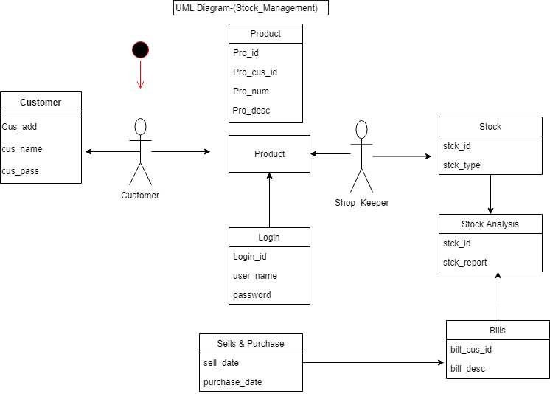
UML Diagram –(Stock Management)

Slide 9
Thankyou

