Slide 1
Logic Flow Code Visualiser
Mini Project using Java
Sr. No.
Student Name
PRN
1
Prakul Singh
1032233410
2
Vedika Rana
1032233559

Slide 2

Problem – Broken Grading Code at Scale
Every semester, educators face a growing crisis in code evaluation — inconsistency, blind spots, and sheer volume. The tools available today were not built with academic grading in mind.
The Three Core Pain Points
How Existing Tools Fall Short
1
Subjectivity
Tool
Structural Analysis
Plagiarism
Auto Grading
Two professors reviewing the same student submission may award grades that differ by 20+ points, undermining fairness and academic integrity.
MOSS
✗
Text only
✗
SonarQube
Partial
✗
✗
2
Plagiarism Blindspot
Checkstyle
Style only
✗
✗
Text-matching tools such as MOSS detect copied text — but miss structural copying where only variable names and string literals are changed.
Manual Review
✓
Unreliable
✗
3
Scale
There had to be a better way.
A professor with 40 students and 4 assignments faces 160 individual code reviews per semester — each requiring deep comprehension, not a skim.

Slide 3



Logic-Flow Code Visualizer (LFCV)
A white-box static analysis suite that tells you HOW code is structured, not just whether it works.
What It Analyses
What It Produces
Who Uses It
Java source files are parsed via a full Abstract Syntax Tree (AST), giving LFCV complete structural visibility into every decision point, loop, dependency, and method call within submitted code.
Complexity metrics, interactive CFG diagrams, structural plagiarism flags, per-student detailed reports, and auto-generated gradebook exports — all from a single folder of .java files.
University professors and teaching assistants evaluating programming assignments — eliminating subjective bias and dramatically compressing review time at any class size.
<2min
160+
100%
Full Evaluation
Reviews Automated
Objective Scoring
A 30-submission batch — parsed, analysed, scored, and exported — in under 2 minutes.
Per semester for a typical 40-student, 4-assignment course load.
Every grade is backed by mathematical metrics — fully reproducible and auditable.

Slide 4
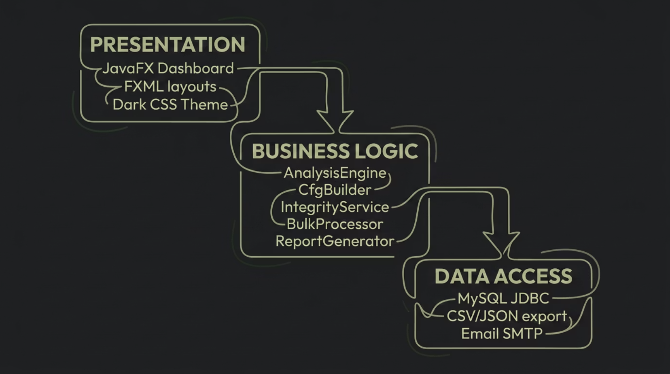

Three-Tier Architecture
LFCV is structured as a clean, layered system — separating presentation, business logic, and data access — ensuring modularity, testability, and future extensibility.
Design Patterns Applied
Visitor
Builder
Five independent metric visitors traverse the AST without modifying it.
CFG nodes and edges assembled incrementally with a dedicated builder.
Facade
Observer / MVC / Strategy
AnalysisEngine exposes a single entry point hiding all internal complexity.
Real-time UI updates, clean view–model separation, and swappable scoring strategies.

Slide 5


Inside the Analysis Pipeline
Every submitted .java file passes through a deterministic, multi-stage pipeline. Five AST visitors run in parallel before results converge into a single scored CodeMetrics object.
.java File
JavaParser
AST Tree
Five Visitors
Metric
What It Measures
Threshold
All five visitors traverse the AST in a single parse pass — minimising overhead while maximising analytical depth. Results are aggregated into a unified CodeMetrics object ready for scoring and reporting.
Cyclomatic Complexity
Decision points per method
>10 flagged
Nesting Depth
Block nesting levels
>4 flagged
CBO
External class dependencies
>10 flagged

Slide 6


Control Flow Graph
The CFG Visualiser renders a hierarchical, top-to-bottom flow diagram for every analysed method. Each node type is colour-coded to instantly communicate structural meaning — no code reading required.
CC verified using both AST visitor count and graph formula: CC = Edges − Nodes + 2
Colour
Node Type
■ Green
ENTRY point
■ Red
EXIT point
■ Amber
if / decision branch
■ Yellow
Loops with back-edges
■ Blue
return statements
■ Purple
try / catch blocks
■ Teal
Method call nodes
Dashed amber curves represent loop back-edges. Cross-method call edges trace execution flow between methods declared in the same source file.

Slide 7





Structural Plagiarism Detection
LFCV's Logic Fingerprint system detects structural copying that text-based tools like MOSS cannot identify — even when students rename every variable and rewrite every comment.
The Four-Step Normalisation Process
Caught in the Act
Strip Comments
Student A
Student B
All comments removed from the AST — only code structure remains.
int counter = 0;String message = "hello";for (int i = 0; i < n; i++)
int x = 0;String txt = "world";for (int k = 0; k < n; k++)
Rename Variables
All identifiers replaced: VAR_0, VAR_1…
✓ Same Logic Hash: a3f9c2d1…IDENTICAL — structurally caught.
Replace Literals
All string literals replaced with the token STR.
This catches plagiarism that MOSS and all text-matching tools miss entirely — the logic is the same regardless of surface-level renaming.
SHA-256 Hash
The normalised AST is hashed into a unique Logic Hash fingerprint.

Slide 8



Sample Analysis Outputs
The following two submissions were drawn from the same assignment batch. LFCV evaluated, scored, and flagged both in under a second each — surfacing quality and integrity issues that manual review might have missed.
GRADE: A — EXCELLENT
GRADE: F — FAILING
S001_Alice — Stack.java
S006_Frank — DataManager.java
Metric
Value
Metric
Value
Total CC
11
Total CC
47
Avg CC / Method
1.57
Avg CC / Method
2.61
Max Nesting
2
Max Nesting
4
Code Smells
None detected
Code Smells
God Class, Spaghetti Code, Magic Numbers
Score
88 / 100
Score
12 / 100
Clean, well-structured implementation with low complexity and no maintainability concerns.
Critically complex and unmaintainable. Multiple high-severity smells detected across methods.
⚠ Integrity Alert — S001_Alice ↔ S002_Bob: IDENTICAL logic hash match — structural plagiarism flagged for instructor review.

Slide 9

From Folder to Gradebook in Minutes
LFCV's bulk processing engine parallelises analysis across all submitted files simultaneously, delivering a complete class gradebook from a single folder selection.
The Four-Step Workflow
Export Formats
Select Folder
CSV Gradebook
Professor selects the submission directory via the JavaFX file picker — no configuration required.
Importable into any spreadsheet or student information system.
JSON for LMS
Parallel Analysis
Structured output for direct ingestion by Moodle, Canvas, or custom APIs.
A managed thread pool dispatches one analysis task per file — all executing concurrently.
Summary TXT + Detailed Reports
Human-readable per-student reports and a class-wide summary file.
Real-Time Progress
Email via SMTP
A live progress bar fills as each file completes — results populate the table incrementally.
Automated delivery of individual reports directly to students' inboxes.
⚡ 6 student submissions analysed in under 8 seconds — including parsing, scoring, CFG construction, and export.
Results Ready
Full class results appear in the sortable dashboard table, ready for review and export.

Slide 10



Built on a Solid Foundation
LFCV was engineered for correctness and long-term maintainability — selecting mature, well-documented open-source libraries and verifying every analytical component with a dedicated test suite.
Technology Stack
Testing Coverage — 60 Unit Tests across 6 Classes
1
2
CC Accuracy
CFG Construction
3
Cyclomatic complexity correctness
Edge, node, and back-edge validity
4
5
1
Apache Maven
Hash Equality
Smell Detection
2
Commons CSV · Gson · JavaMail
Logic fingerprint determinism
God Class, Spaghetti, Magic Numbers
3
MySQL 8
4
JGraphT 1.5 · JavaParser 3.25
Report Generation
Plagiarism Detection
5
JavaFX 21 · Java 17
CSV, JSON, and TXT output fidelity
Identical and near-identical pair flagging

Slide 11
Where LFCV Goes from Here
Three Core Takeaways
Development Roadmap
Objective Grading
Near Term
1
Every score is derived from verifiable mathematics — not opinion. Cyclomatic complexity, nesting depth, and CBO are reproducible by any evaluator.
Native platform installers via jpackage; multi-file package-level analysis across class hierarchies.
2
Medium Term
Structural Plagiarism Detection
Python language support via an alternative parser; direct LMS integration with Moodle and Canvas grade passback APIs.
The Logic Fingerprint catches identity-obfuscated copying that no text-matching tool — including MOSS — can detect.
3
Long Term
Machine learning anomaly detection trained on historical submissions; real-time hot-drop folder monitoring for live assessment environments.
Scalable and Extensible
Adding a new code metric requires writing a single Visitor class. The architecture scales to any class size without reconfiguration.
"LFCV doesn't replace the professor's judgment — it informs it, with evidence."

Slide 12
Thank You

