Slide 1
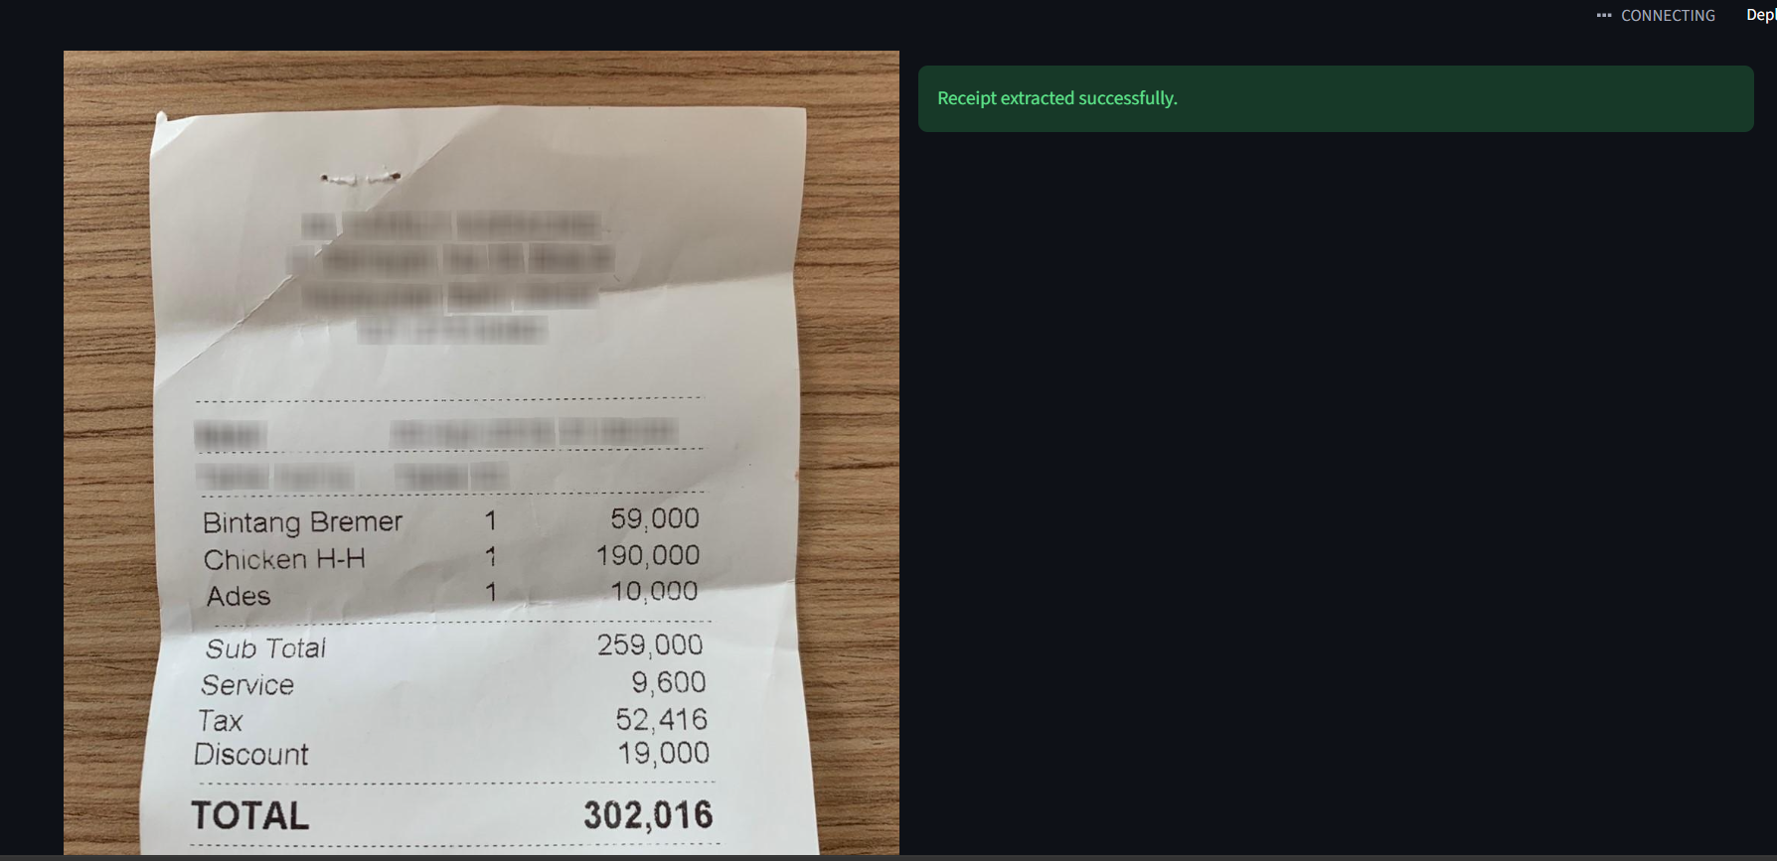
SplitSnap
Receipt extraction + correction + fair bill splitting
A working Streamlit app: upload a receipt, run the fine-tuned Donut model, correct the draft, assign items, and split charges proportionally.
Fine-tuned Donut
Manual correction
Fair split engine
93.62%
91.49%
85.11%
valid JSON on test
exact grand total
charge F1
Start with the working extraction flow — not the failure case.
SplitSnap
01

Slide 2
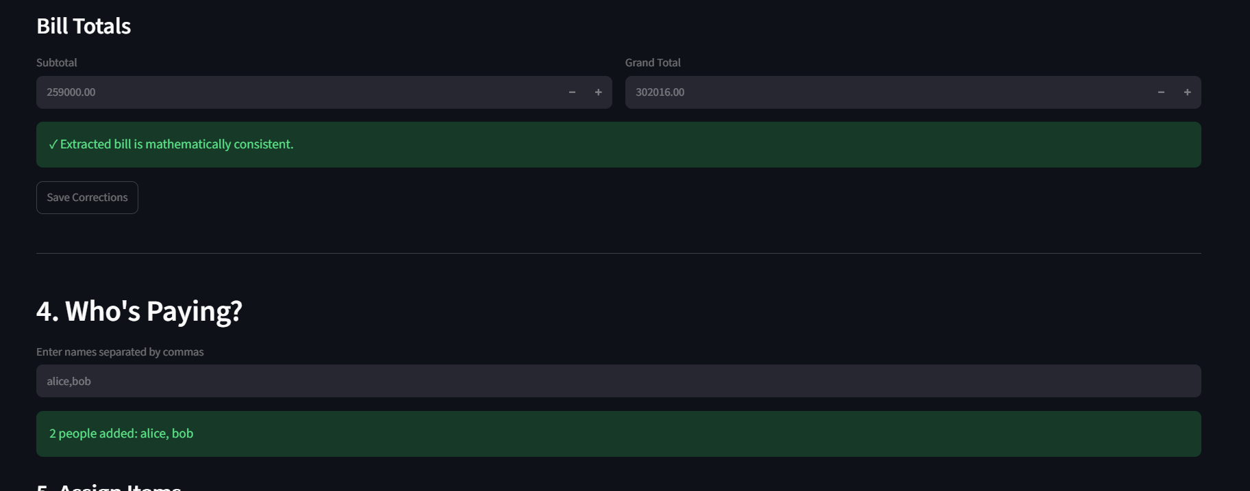
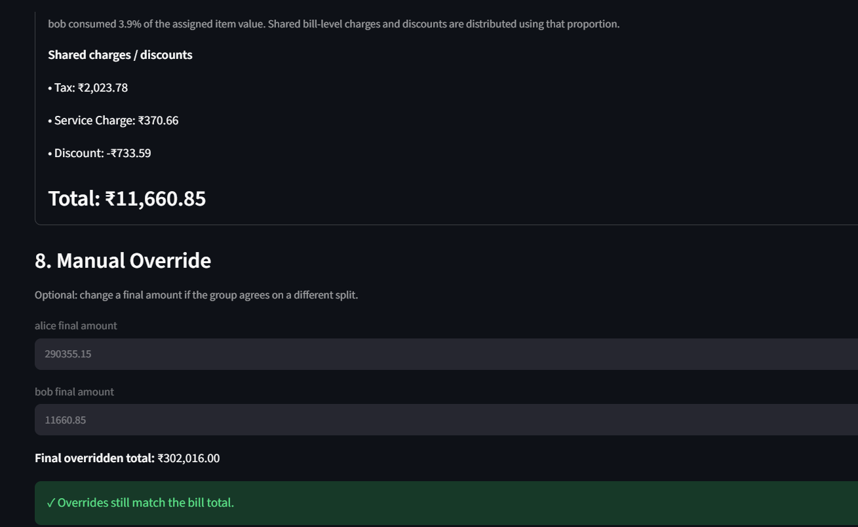
What the app does
The system is built around a human-in-the-loop receipt workflow.
Upload
receipt
Extract
JSON
Review
& correct
Add
people
Assign
items
Split +
explain
Correction is intentionally part of the UI: the model output is a draft, then the app checks the math before splitting.
The final screen gives an audit trail: items, proportional charges, final total, and optional manual override.
SplitSnap
02

Slide 3
System architecture
One learned extractor; deterministic code handles money.
Receipt
image
Fine-tuned
Donut
Bill
JSON
Manual
correction
Split
engine
Totals +
explanation
Model output
Correction layer
Split engine
items, quantities, prices
tax / service charge / discount
subtotal + grand total
editable tables
math consistency warning
invalid JSON recovery
equal shared-item split
proportional charges
Decimal rounding
SplitSnap
03

Slide 4
How the model was trained
Two-stage fine-tuning: general receipt reading first, SplitSnap schema second.
Stage 1
SROIE
Stage 2
CORD
Epoch 2
charge-focused
Final
checkpoint
Donut-base
Final dataset sizes
Preprocessing
normalized CORD into items + charges + totals
parsed messy prices like 75,000 / 25.000 / 8.500,00
discount fields normalized as negative values
filtered inconsistent receipts and >768-token targets
CORD train
764
CORD val
96
CORD test
94
SROIE train
886
SROIE val
100
Training config: 1280×960 images, CORD max length 768, FP16, AdamW, batch 1 + grad accumulation 4, Tesla T4 peak ≈ 5.41 GB.
SplitSnap
04

Slide 5
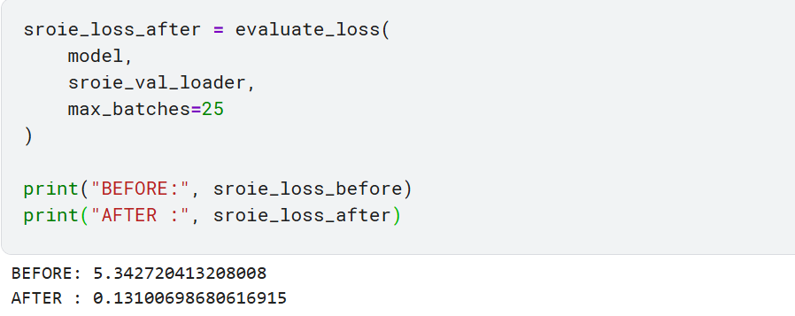
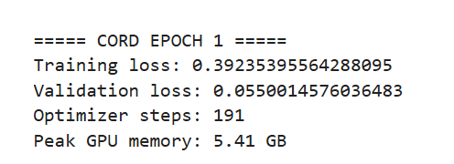
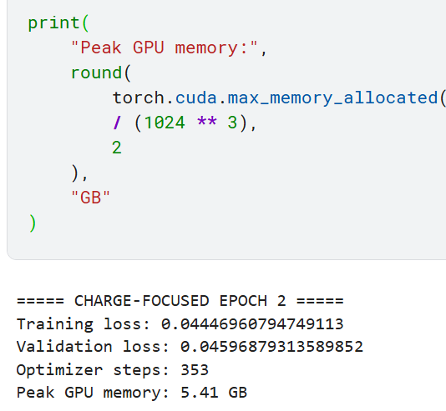
Training results
Loss dropped sharply, then validation generation showed exactly what needed improvement.
6.52
CORD before training
0.055
CORD epoch 1 val loss
0.045
charge-focused epoch 2 loss
Loss was not the final decision metric: we also generated full JSON on validation receipts and measured charge precision/recall/F1.
SplitSnap
05

Slide 6
Why charge-focused epoch 2 won
Epoch 1 learned totals, but often predicted empty charge lists.
20% → 92%
charge recall
32.65% → 91.26%
charge F1
89.58% → 98.96%
valid JSON
Design decision: oversample charge-bearing receipts for epoch 2 instead of blindly training more epochs.
SplitSnap
06

Slide 7
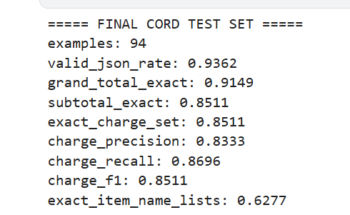
Final held-out CORD test performance
Selected epoch 2 was evaluated once on 94 untouched CORD test receipts.
We notice that totals and charges are strong but item text is weaker. That is why the UI must support correction before money is split.
85.11%
91.49%
exact charge set
grand total exact
SplitSnap
07

Slide 8
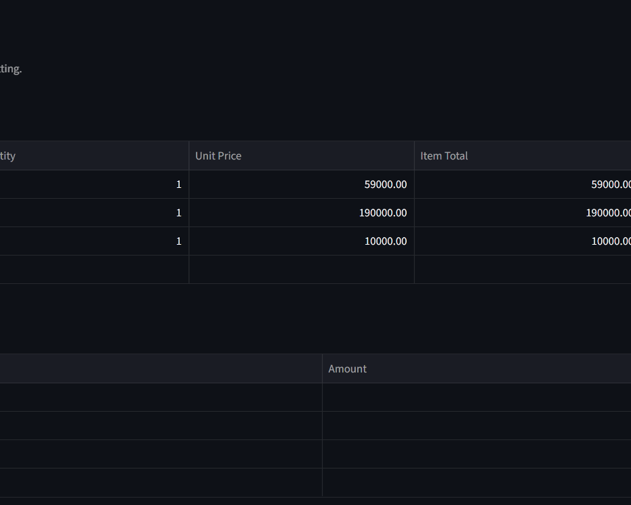
Correction UI: model output becomes an editable draft
The app keeps the workflow usable even when extraction is imperfect.
Implemented safeguards
editable item/charge/total tables
invalid JSON falls back to manual entry
missing discount / tax / fee detector
Save Corrections freezes a clean bill before splitting
Example: the UI detected a ₹19,000 missing negative adjustment; adding Discount = -19000 made the bill mathematically consistent.
SplitSnap
08

Slide 9
Fair split + explanation
After correction, splitting is deterministic and auditable.
Split logic
items assigned to one or more people
shared items split equally
tax/service/discount allocated by consumption share
Decimal rounding keeps totals reconciled
manual override is checked against bill total
The explanation shows exactly why each person pays what they pay: item shares + bill-level charges + final total.
✓ matches
₹11,660.85
example override check
bob total in demo
SplitSnap
09

Slide 10
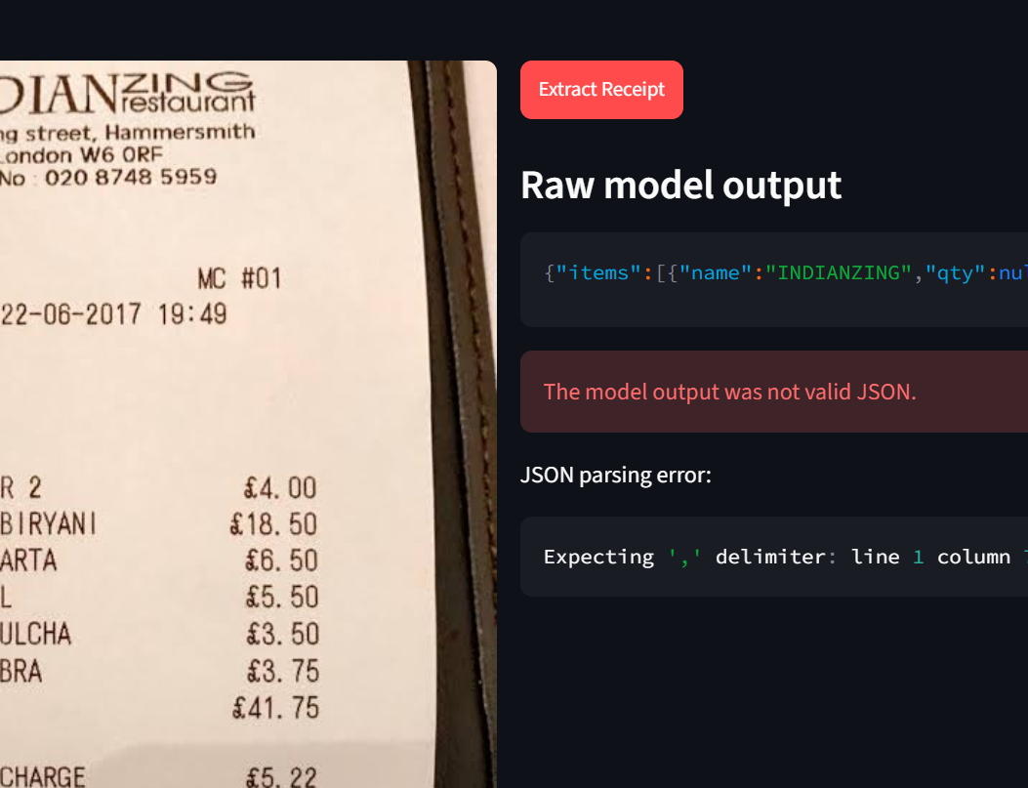
Known limits and next steps
The failure case is a reason for the correction workflow, not the opening story.
Out-of-distribution receipts can still break extraction: foreign currency, unusual layouts, headers read as items, or malformed JSON.
Current product response: do not block the user. Show raw output, allow correction, run consistency checks, then split.
Next improvements
fine-tune on Indian/local receipts
better JSON repair and confidence flags
mobile UI and photo augmentation
export/share final splits
Bottom line: ML extracts the draft; product design makes it safe to use for money.
SplitSnap
10

