Slide 1
Real-Time Sign Language Detection using DenseNet-121
21BCE5028 - Prakarsh Yadav
21BCE1129 - Ayush Kumar Lal

Slide 2
Abstract
This project aims to develop an efficient sign language detection system using CNNs, specifically the DenseNet (Densely Connected Convolutional Network) architecture.
By leveraging DenseNet-121's capability to learn complex features through its dense connectivity pattern, the model will accurately recognise and classify various hand signs from a diverse dataset.
The need for such a system arises from the growing demand for effective communication tools that bridge the gap between different communities.

Slide 3
Motivation
The motivation behind this project stems from the critical need for enhanced communication tools that facilitate interaction between the deaf and hard-of-hearing community and the broader society.
Sign language is a vital means of communication for millions, yet barriers often exist in translating these gestures into comprehensible forms for non-signers.
By developing this project, we aspire to contribute to a more inclusive society by leveraging advanced deep learning techniques to enhance communication accessibility.

Slide 4
Objectives
Implement and train a DenseNet-121 model to accurately recognise and classify a wide range of sign language gestures from images or video inputs, ensuring high accuracy and robustness in various conditions.
Ensure the model is optimised for real-time inference, enabling quick and efficient sign language interpretation without noticeable delays, thus enhancing usability in practical applications.
Conduct thorough performance evaluations using metrics such as accuracy, precision, recall, and F1 score, iteratively refining the model based on findings to enhance its reliability and effectiveness.
Develop an accessible user interface or application to showcase the sign language detection system, aiming to empower the deaf and hard-of-hearing community by providing them with a tool that facilitates communication with non-signers.

Slide 5
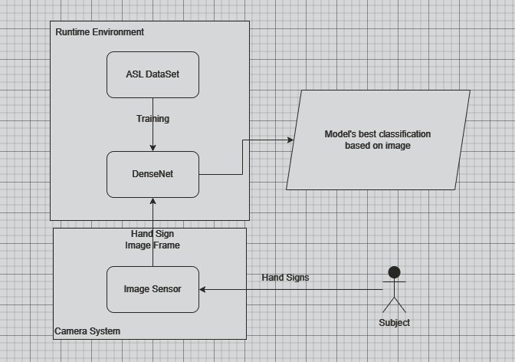
Proposed System

Slide 6
Modules
Data Collection --> | Dataset | Data Augmentation
Model Architecture --> | DenseNet-121 | Transfer Learning
Training Module --> | Loss Function | Optimizer
Evaluation Module --> | Metrics | Confusion Matrix
Deployment Module --> | Inference Pipeline | User Interface

Slide 7
Expected Outcome
Model Accuracy: Achieve a high accuracy rate (above 85% on a validation dataset) in correctly classifying hand signs.
Robustness: The model should be able to generalise well to unseen data, showing consistent performance across different lighting conditions, backgrounds, and hand orientations.
Real-Time Processing: If implemented, the system should be capable of real-time hand sign detection with minimal latency, ideally processing frames at 15-30 frames per second.
Scalability: The model should be designed to allow for easy addition of new classes (hand signs) without significant retraining from scratch.
Documentation and Usability: Develop clear documentation outlining installation, usage, and troubleshooting, making the system accessible for others to use or modify.

Slide 8
References
K Anitha, R Naveen Karthick - "Gesture based Sign Language Recognition System"
Sangeeta Kurundkar, Arya Joshi - "Real-Time Sign Language Detection"
Jeet Debnath, Praveen Joe I R - "Real-time Gesture Based Sign Language Recognition System"
Nusrat Ansari, Siddhi Awari - "GesSpy: ML Driven Real Time Sign Language Detection"

Slide 9
Monalisa Ghosh, Debjani De - "R-SLR: Real-Time Sign Language Recognition System"
Yasir Altaf, Abdul Wahid - "Deep Learning Approach for Sign Language Recognition using DenseNet201 with Transfer Learning"
Harshit Pandey, Amaan Ahmed - "CNN based Sign Language Recognition System with Multi-format Output"
Taksheel Saini, Nandini Kumari - "SignaSpectrum: AI-Driven Dynamic Sign Language Detection and Interpretation"

