Slide 1


Slide 2
VIRTUAL REALITY ZONE
LIBRARY TECHNOLOGIES
WSU

Slide 3
Today’s Topic
Use of piezoelectricity in electric cars

Slide 4
Pattern of explanation
Introduction
What is piezoelectric effect?
What is a crystal?
How piezoelectricity works?
Diagrammatic representation of a piezoelectric generated car.

Slide 5
Introduction
The battery range for many electric vehicles is limited, meaning that such methods of transportation can only be used for short trips.
In extended range vehicles manufacturers provide an internal combustion engine that uses conventional fuels to recharge batteries in motion & hence extend their range.
But in order to increase the battery efficiency and range for electric vehicles, the concept of piezoelectricity and use of thermoelectric materials can be applied.

Slide 6
What is piezoelectric effect?
Generation of electricity by applying mechanical stress is known as piezoelectricity.
Piezoelectricity was discovered in 1880 by two brothers, Pierre and Paul-Jacques Curie ,who found that when a certain type of crystals, including Quartz, Tourmaline and Rochelle salt were compressed along certain axes, a voltage was produced on the surface of the crystals. This effect is known as piezoelectric effect.

Slide 7
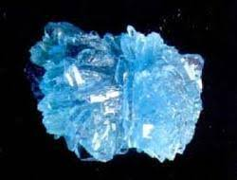
What is a crystal?
A class of material arranged in a definite geometrical pattern in three dimensions (table salt and sugar are common examples)
Quartz Crystal is silicon and oxygen arranged in a crystalline structure (SiO2).
SiO2 is also found abundantly in nature in a non-crystalline structure (“amorphous”) as sand.

Slide 8
Crystals
A method for predicting the behavior of a crystal: The unit cell
Represents silicon atom
Represents oxygen atom
Not actually correct, but this method allows
a good understanding of quartz crystals

Slide 9
Crystal
The unit cell of crystal silicon dioxide

Slide 10
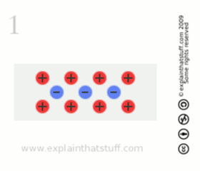
How piezoelectricity works?
Normally, the charges in a piezoelectric crystal are exactly balanced, even if they're not symmetrically arranged.
The effects of the charges exactly cancel out, leaving no net charge on the crystal faces. (More specifically, the electric dipole moments—vector lines separating opposite charges—exactly cancel one another out.)
If you squeeze the crystal , you force the charges out of balance.
Now the effects of the charges (their dipole moments) no longer cancel one another out and net positive and negative charges appear on opposite crystal faces.
By squeezing the crystal, you've produced a voltage across its opposite faces—and that's piezoelectricity!

Slide 11
Piezoelectric effect
Voltmeter
Crystal material with forces applied
Due to properties of symmetry,
charges are net + on one side &
net - on the opposite side: crystal gets
thinner and longer

Slide 12
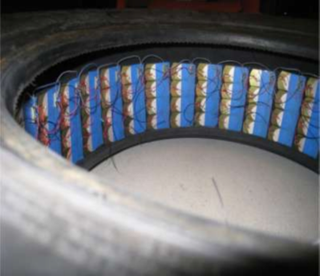
Representation of a piezoelectric generated car
Each of these piezoelectric car tires is equipped with an array of highly bendable PZT benders covering most of the inner surface .The output due to deformation of tires, which is an AC waveform has to be converted into DC signal by a rectifier before it can be cached in a capacitor . Each row of benders, running across the width of tire is taken as one generator & is rectified separately with all PZT lines connected in parallel.
At any given time only three or four rows , depending on the length of the contact patch , generate power
AN ARRANGEMENT OF PZT BENDERS IN A TIRE.

Slide 13
Representation of a piezoelectric generated car
Power is extracted from the tire-wheel system using a commutator -like assembly i.e. one that continuously maintains the electrical contact between the chassis and the wheel while allowing the latter to spin freely .Such a setup permits the extraction of tire-generated power to run on-board electronics.
The energy obtained in this method depends on two factors –tire surface area , rpm at 100 km/h. So greater the surface area more will be the output.
If a huge amount of power can be extracted so as to charge the batteries of an all-electric engine then no fossil fuel will be required to provide power reducing the pollution . Such a concept vehicle is named as P-Eco.

Slide 14
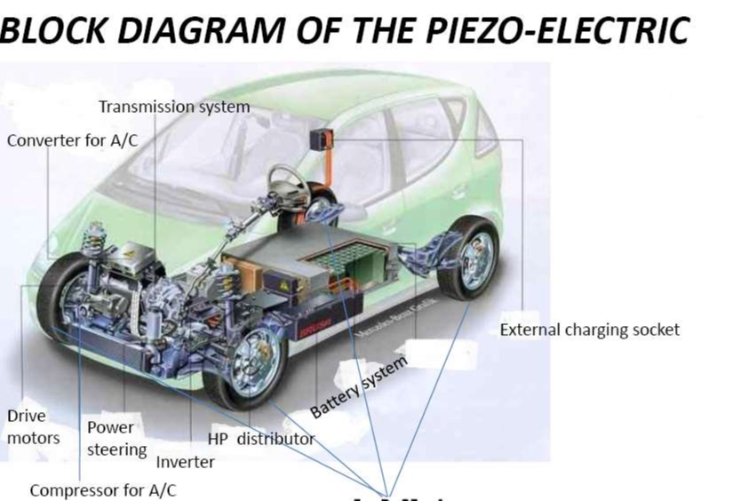
Diagrammatic representation of a piezoelectric generated car.

