Slide 1
Seminar
On
Project Loon
Guided by
Prof.P.M.Pujar
Submitted by
Nikhil Jadhav
Kiran Hanchin
Notes:
<number>
<number>
<number>

Slide 2
Contents
Project Loon
The Loon technology
The Loon Design
How Loon moves?
How Loon connects?
The Pilot Test
Engineering Challenges
Advantages
Conclusion
References

Slide 3
Project Loon
As two-thirds of the world’s population does not yet have internet access, “Google’s Project Loon” – a network of balloons travelling on the edge of space – is designed to connect people in rural and remote areas, helping fill coverage gaps, and bringing people back online after natural disasters.

Slide 4
The Loon Technology
Project Loon balloons float in the stratosphere, twice as high as airplanes and the weather.
They are carried around the Earth by winds and they can be steered by rising or descending to an altitude with winds moving in the desired direction.
People connect to the balloon network using a special Internet antenna attached to their building.
The signal bounces from balloon to balloon, then to the global Internet back on Earth

Slide 6
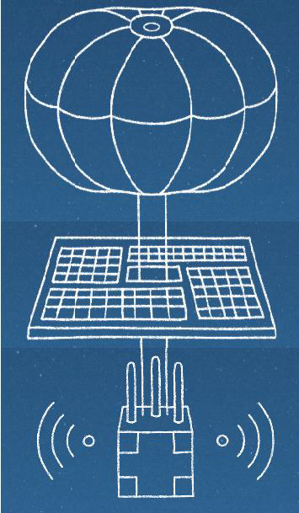
The Loon Design
There exists three main components of loon
Envelope
Solar Panel
Equipment

Slide 7
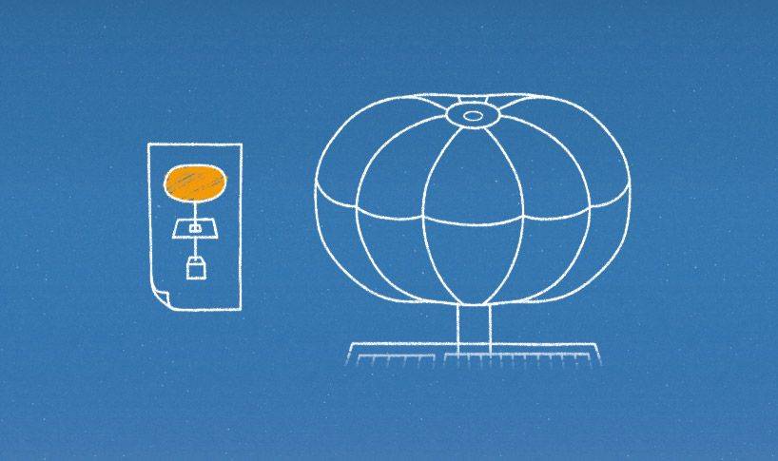
Envelope
Projects Loon’s ballon envelopes are made of sheets of ployethylene plastic and stand fifteen meters wide by twelve meters tall when fully inflated.
A parachute attached to the top of the envelope allows for a controlled descent and landing whenever a ballon is ready to be taken out of service

Slide 8
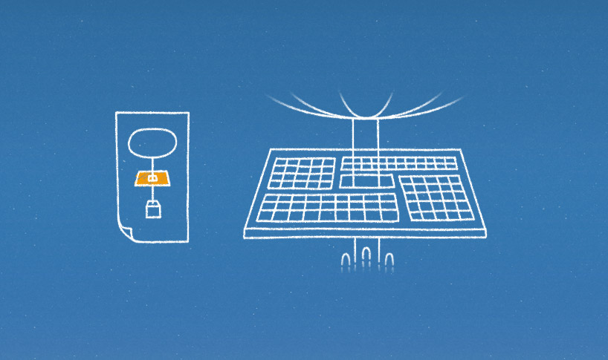
Solar Panels
Each unit’s electronics are powered by an array of solar panels that sits between the envelope and the hardware.
In full sun, these panels produce 100 Watts of power - enough to keep the unit running while also charging a battery for use at night.
By moving with the wind and charging in the sun, Project Loon is able to power itself using only renewable energy sources.

Slide 9
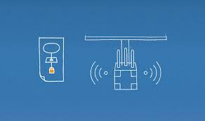
Equipment
A small box is used that contains the balloon’s electronic equipment -
Circuit boards that control the system.
Radio antennas to communicate with other
balloons and with Internet antennas on the
ground.
And batteries to store solar power so the
balloons can operate during the night .

Slide 10
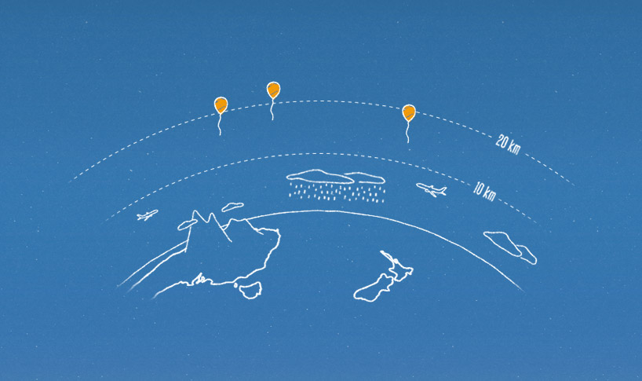
How loon moves?
Winds in the stratosphere (10 to 60 km of altitude)are steady and slow-moving between 5 and 20 mph, and each layer of wind varies in direction.
Project Loon uses
software algorithms
to determine where
its balloons need to go.

Slide 11

How loon connects?
Each balloon can provide connectivity to a ground area about 40 km in diameter at speeds comparable to 3G.
Each balloon is equipped with a GPS for tracking its location .
The balloons use antennas equipped with specialized radio frequency technology.
Project Loon currently uses ISM bands that are available for anyone to use.

Slide 12
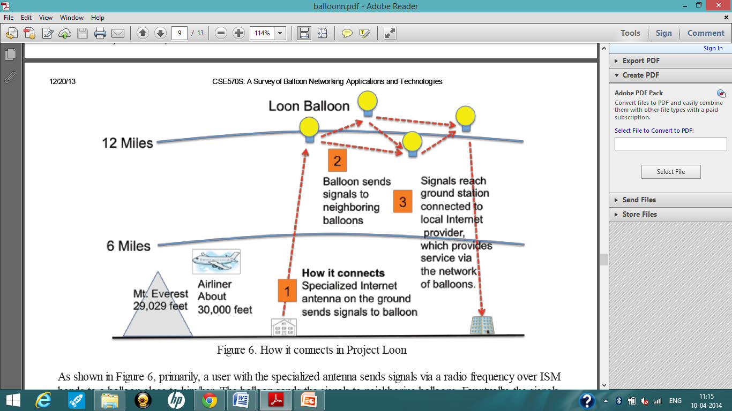
Three radio
transceivers.
Balloon-to-balloon
Communications.
Balloon-to-ground
communications.
Third for backup.

Slide 13
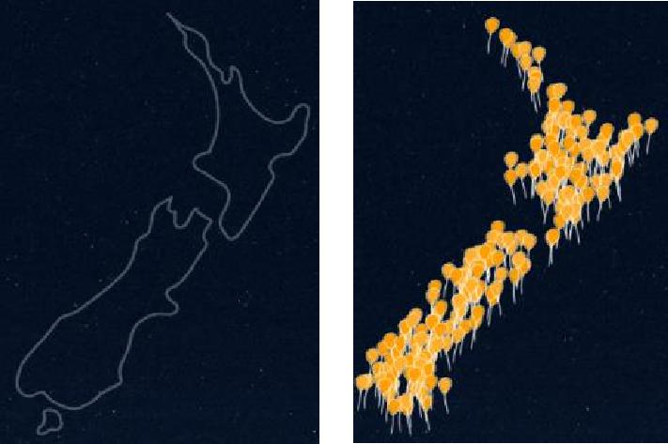
The Pilot test
The Project Loon pilot test began in June 2013 on the 40th parallel South.
30 balloons, launched from
New Zealand’s SouthIsland
around Christchurch and the
Canterbury region.
The experience of these pilot testers is now being used to refine the technology and shape the next phase of Project Loon.

Slide 14
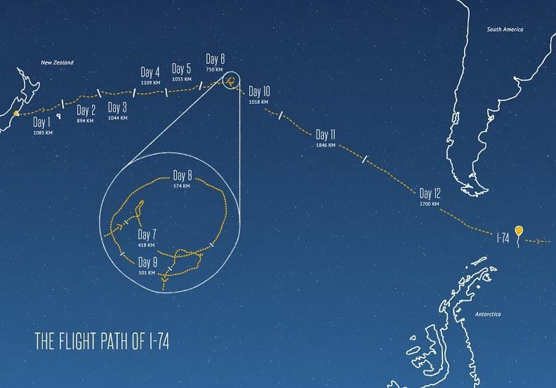
The Pilot test

Slide 15
Engineering Challenges
Moving of balloons in the stratosphere possess many challenges -
Air pressure is 1% of that at sea level
Temperatures hover around -50°C
A thinner atmosphere offers less protection
from the UV radiation and temperature swings
caused by the sun’s rays.

Slide 16
Advantages
Offer worldwide access to internet.
Provides connectivity at speeds comparable to 3G for about area of 40 km in diameter.
Wireless connection to the Web available for free to every person in the world.
It would offer a humanitarian communication
system, during emergencies in places where
communications link has broken up as in natural disasters.

Slide 17
Conclusion
Although internet has become such a handy thing for people having access to internet that they roam about with it in their pockets, but this has been possible for those countries that can afford fibre optic cables for connectivity and therefore the bitter truth remains that nearly two-thirds of the world population do not yet have internet access. The Google[X] team has therefore taken an initiative to bridge this gap and make the world actually connected to one another by introducing Google’s Project Loon.
This project has come along a long way with successful Pilot Test and also surpassing many environmental, engineering , political challenges(relating to use of airspace and radio frequencies) and now is seeking NASA

Slide 18
Reference

Slide 19
Thank you

