Slide 1
Gene Expression & Disease Relationship Analysis
End-to-end analysis of 1,000 patients using Excel, MySQL and Power BI

Slide 2
Project Overview
Objective
Explore how Gene X and Gene Y expression relate to disease status, smoking status and treatment response, and communicate the patterns through a dashboard.
Variables
Age, gender, Gene X and Gene Y expression, smoking status, disease status, treatment response. Coded fields were kept and readable label columns added.
1,000
962
Total patients
Healthy
18
20
Disease A
Disease B

Slide 3
Workflow
1
2
3
4
5
Excel
MySQL
MySQL
Excel
Power BI
Prepare
Validate
Analyze
Summarize
Visualize
Readable label columns added, original codes kept
Record count, duplicates, missing values, data types
GROUP BY, CASE, subqueries, treatment-response queries
PivotTables and PivotCharts as a second view
KPI cards, slicers and interactive charts

Slide 4
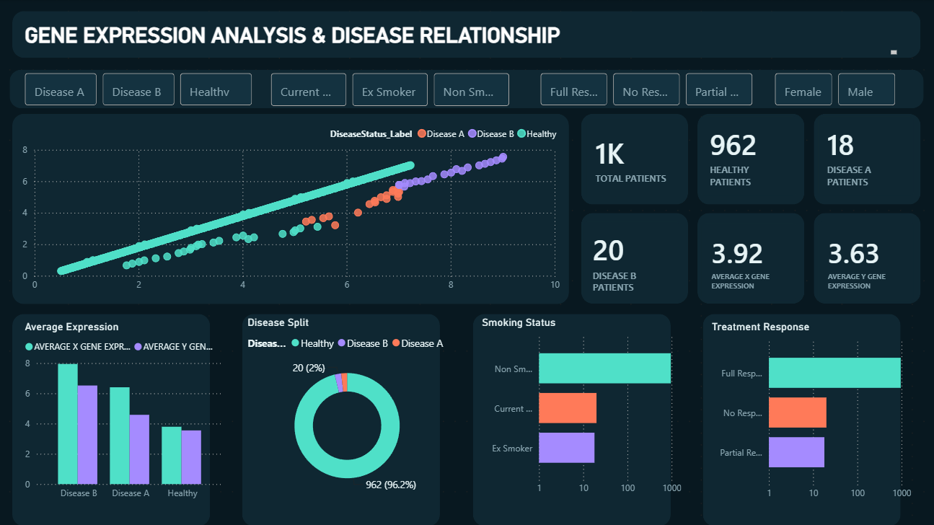
Power BI Dashboard

Slide 5
Gene Expression by Disease Group
Both genes are higher in disease groups than in Healthy.
Disease B has the highest observed average for both genes.
Disease groups are small (18 and 20 patients), so these are observed associations.

Slide 6
Smoking Status & Treatment Response
Smoking status and disease
Treatment response and expression
Non-smokers: Healthy group
Ex-smokers: Disease A
Current smokers: Disease B
Full response: lowest average expression
Partial response: intermediate
No response: highest average expression
Strong patterns observed in this dataset, not evidence of causation.

Slide 7
Key Takeaways
1
Higher expression in disease
Gene X and Gene Y averages are higher in Disease A and B than in Healthy.
2
Clear group patterns
Smoking status, disease status and treatment response line up strongly in this dataset.
3
Full workflow delivered
Excel preparation, SQL validation and analysis, and a Power BI dashboard.

