Slide 1
POWER BI PROJECT
Understanding workforce reductions
across companies, industries and countries
GLOBAL TECH
LAYOFFS
ANALYSIS
Tools: Power BI • Data analysis • Interactive visualizations
Data Analytics Dashboard
Presented by: Pramatha M C
Dataset: Global Tech Layoffs Analysis (Kaggle)

Slide 2
Project Overview
What the project explores
• Analyze global technology layoff events across time.
• Identify the companies and industries with the largest reported layoffs.
• Compare layoffs by country and company funding stage.
• Build an interactive, multi-page Power BI dashboard for exploration.
Key questions
• When were layoffs highest?
• Which companies and sectors were most affected?
• Which countries reported the most layoffs?
• How do totals differ by funding stage?
GLOBAL TECH LAYOFFS ANALYSIS | POWER BI
2

Slide 3
Dataset & Analysis Approach
From event-level records to business insights
Primary measure
Dimensions
More dimensions
Total layoffs
Company • Industry
Country • Year • Stage
• Used layoff event records with company, country, industry, date/year and funding-stage fields.
• Created measures for total layoffs, largest single layoff, average layoffs per event and distinct companies.
• Compared totals across years, companies, industries, countries and funding stages.
• Added slicers and page navigation to make the report interactive.
GLOBAL TECH LAYOFFS ANALYSIS | POWER BI
3

Slide 4
Key Dashboard Highlights
Figures shown in the final dashboard screenshots
Total layoffs
Companies affected
Countries affected
751.7K
≈ 2K
54
Industries affected
Largest single layoff
Average layoffs/event
31
≈ 22K
281.54
GLOBAL TECH LAYOFFS ANALYSIS | POWER BI
4

Slide 5
Time-Based Trends
How reported layoffs changed over the selected years
Relative annual pattern (as shown in dashboard)
• The annual chart peaks in 2023.
• The monthly trend varies across the year rather than following a steady pattern.
• Year and date filters help compare different time periods.
2020
2021
2022
2023
2024
2025
GLOBAL TECH LAYOFFS ANALYSIS | POWER BI
5

Slide 6
Company & Industry Analysis
Comparing the largest reported layoff totals
Top companies shown in the dashboard
• Intel appears as the leading company in the Top 10 chart.
• Microsoft, Amazon and Meta also appear among the leading companies.
• Hardware, Other, Consumer and Retail are among the industries with the highest totals.
• The industry-to-company matrix supports drill-down from an industry to individual companies.
Intel
Microsoft
Amazon
Meta
Tesla
GLOBAL TECH LAYOFFS ANALYSIS | POWER BI
6

Slide 7
Geographic & Funding-Stage Analysis
Where layoffs were reported and how totals vary by stage
• The United States has the largest country total in the dashboard.
• India and Germany follow among the top countries shown.
• Post-IPO is the largest funding-stage category by total layoffs in the report.
• Country and funding-stage slicers allow focused comparisons.
Top countries shown in the dashboard
United States
India
Germany
United Kingdom
Netherlands
GLOBAL TECH LAYOFFS ANALYSIS | POWER BI
7

Slide 8
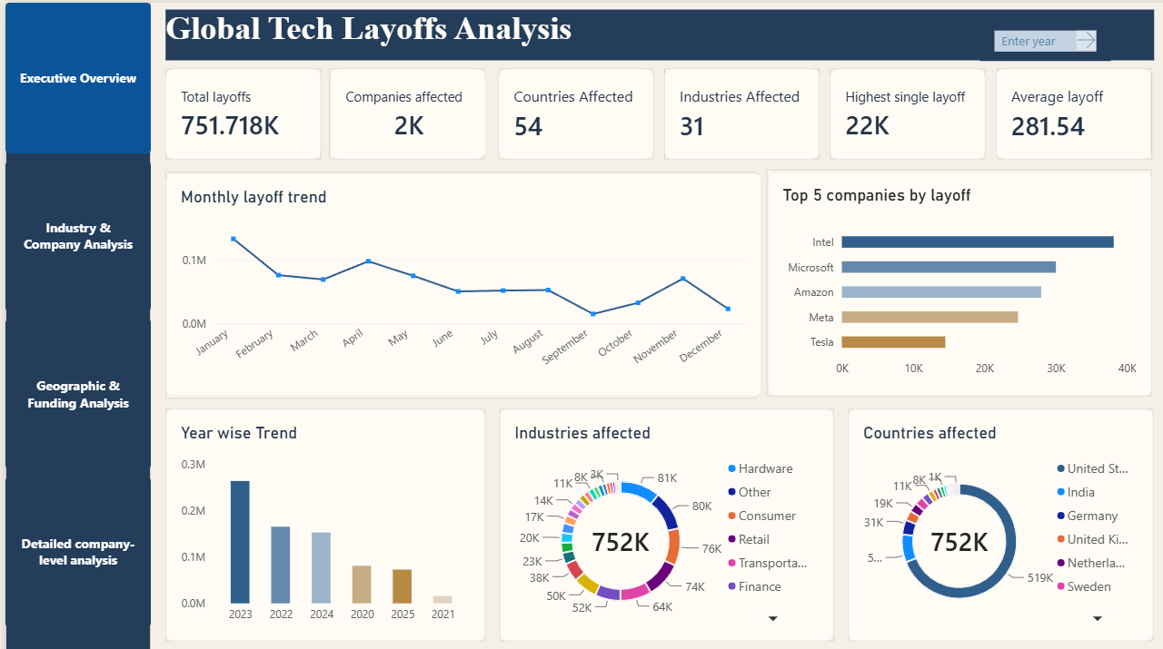
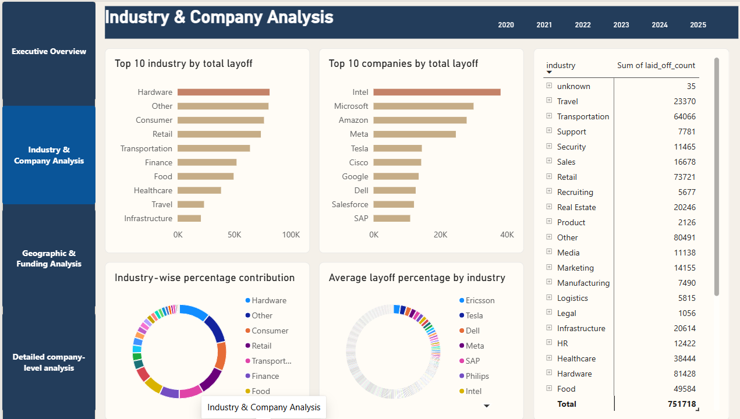
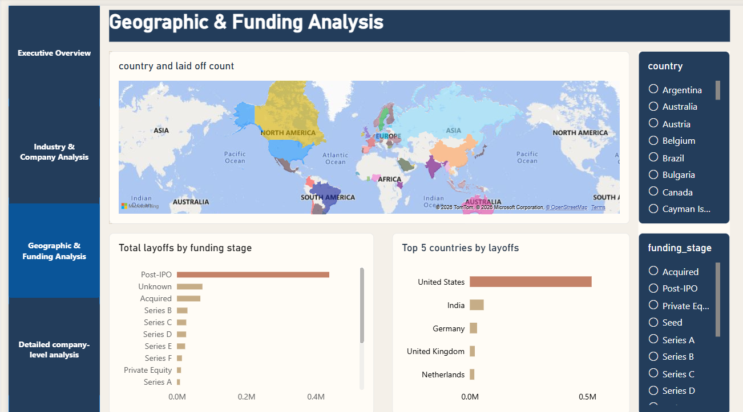
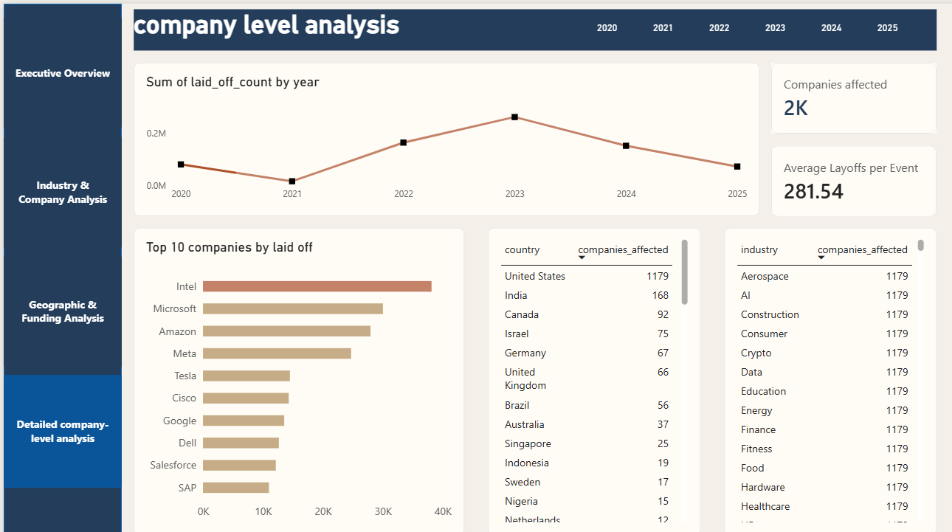
Power BI Dashboard Pages
8

Slide 9
Limitations & Interpretation
Important context when reading the dashboard
• Layoff counts describe reported events in the dataset and may not represent every company or event worldwide.
• The dataset does not currently provide a confirmed workforce layoff percentage, so average layoffs per event is used as an alternative metric.
• The funding amount field was not available in the Power BI fields, so a funds-raised-versus-layoffs scatter plot could not be supported.
• Totals can differ slightly depending on data cleaning, filters, missing values and rounding.
GLOBAL TECH LAYOFFS ANALYSIS | POWER BI
9

Slide 10
Conclusion
The dashboard brings together time, company, industry, country and funding-stage views of technology layoffs.
• 2023 is the peak year in the displayed annual trend.
• Intel leads the Top 10 company chart in the current report.
• The United States and Post-IPO stage have the largest totals in their respective comparisons.
• Interactive filters and drill-down help users explore the data from different perspectives.
THANK YOU
GLOBAL TECH LAYOFFS ANALYSIS | POWER BI
10

