Slide 1

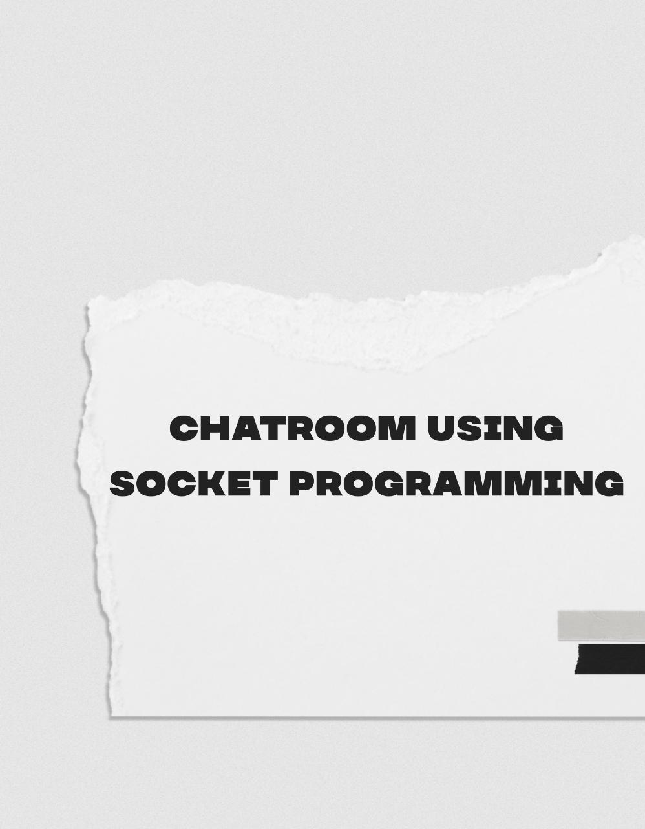

Slide 2
SUBMITTED BY
NIKHIL S.K – 1BM18IS058
PRAMILA – 1BM18IS068
SUBMITTED TO
SHUBHA RAO –
ASSISTANT PROFESSOR

Slide 3
WHAT IS SOCKET PROGRAMMING?
A socket is one endpoint of a two-way communication link between two programs running on the network. A socket is bound to a port number so that the TCP layer can identify the application that data is destined to be sent to. An endpoint is a combination of an IP address and a port number

Slide 4
Sockets and the socket API are used to send messages across a network. They provide a form of inter-process communication (IPC). The network can be a logical, local network to the computer, or one that’s physically connected to an external network, with its own connections to other networks.

Slide 5
Socket API Overview
Python’s socket module provides an network interface.
Primary socket API functions and methods in this module
are:
socket()
bind()
listen()
accept()
connect()
connect_ex()
send()
recv()
close()

Slide 6
Multithreading Concepts
Multithreading is the core concept of nearly all modern programming languages especially python because of its simplistic implementation of threads.
A thread is a sub-program within a program that can be executed independently of other section of the code. A thread executes in the same context sharing program’s runnable resources like memory.
When in a single process, we are executing multiple threads simultaneously, it is called multithreading.

Slide 7
Python Multithreading Modules for a thread implementation
To implements threads in programs, python provides two modules −
thread (for python 2.x) or _thread(for python 3.x) module
threading module
Where the thread module creates a thread as a function whereas the threading module provides an object-oriented approach to create a thread.
Syntax
_thread.start_new_thread(func, args[, kwargs])Above starts a new thread and returns its identifier.

Slide 8
TCP Sockets
We’ll create a socket object using socket.socket() and specify the socket type as socket.SOCK_STREAM. When you do that, the default protocol that’s used is the Transmission Control Protocol (TCP). This is a good default and probably what you want.
Why should you use TCP? The Transmission Control Protocol (TCP):
Is reliable: packets dropped in the network are detected and retransmitted by the sender.
Has in-order data delivery: data is read by your application in the order it was written by the sender.
In contrast, User Datagram Protocol (UDP) sockets created with socket.SOCK_DGRAM aren’t reliable, and data read by the receiver can be out-of-order from the sender’s writes.
Why is this important? Networks are a best-effort delivery system. There’s no guarantee that your data will reach its destination or that you’ll receive what’s been sent to you.
Network devices (for example, routers and switches), have finite bandwidth available and their own inherent system limitations. They have CPUs, memory, buses, and interface packet buffers, just like our clients and servers. TCP relieves you from having to worry about packet loss, data arriving out-of-order, and many other things that invariably happen when you’re communicating across a network.

Slide 9
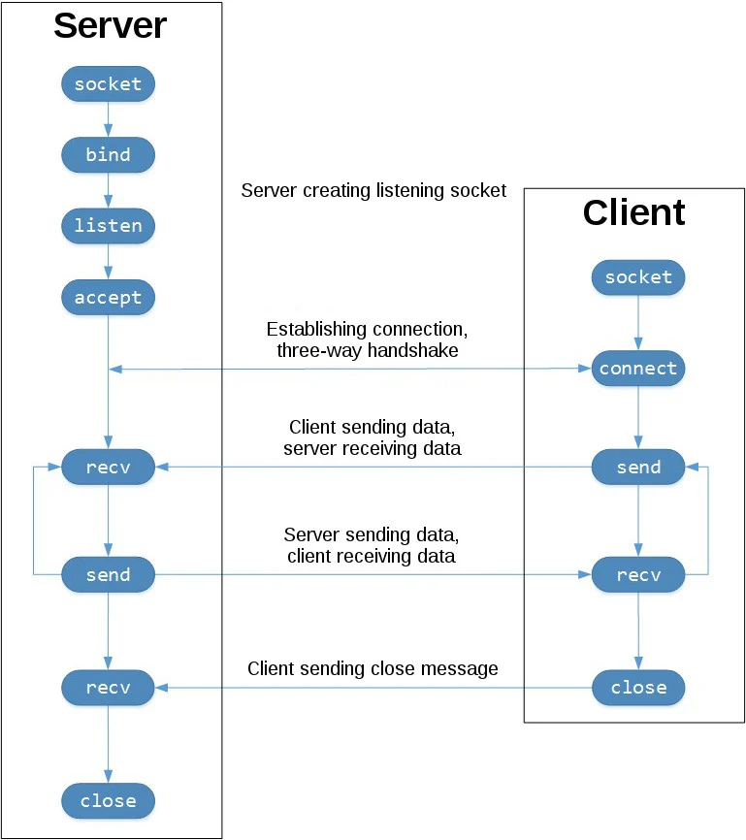
In the diagram below, displays the sequence of socket API calls and data flow for TCP:

Slide 10
A network socket is an endpoint of an interprocess communication across a computer network. The Python Standard Library has a module called socket which provides a low-level internet networking interface. This interface is common across different programming languages since it uses OS-level system calls.
To create a socket, there is a function called socket. It accepts family, type, and proto arguments (see documentation for details). To create a TCP-socket, you should use socket.AF_INET or socket.AF_INET6 for family and socket.SOCK_STREAM for type
bind(), listen() and accept() are specific for server sockets.
connect() is specific for client sockets. send() and recv() are common for both types.

Slide 11
We create a server socket, bind it to a localhost and 9999 port, and start listening for incoming connections. To accept an incoming connection we call accept() method which will block until a new client connects. When this happens, it creates a new socket and returns it together with the client's address. Then, in an infinite cycle, it reads data from the socket in batches of 1024 bytes using method recv() until it returns an empty string. After that, it sends all incoming data back using a convenient method sendall() which inside repeatedly calls send(). And after that it simply closes the client's connection. This example can serve only one incoming connection because it does not call accept() in a cycle.

Slide 12
Starting in the top left-hand column, note the API calls the server makes to setup a “listening” socket:
socket()
bind()
listen()
accept()
A listening socket does just what it sounds like. It listens for connections from clients. When a client connects, the server calls accept() to accept, or complete, the connection.
The client calls connect() to establish a connection to the server and initiate the three-way handshake. The handshake step is important since it ensures that each side of the connection is reachable in the network, in other words that the client can reach the server and vice-versa. It may be that only one host, client or server, can reach the other.
In the middle is the round-trip section, where data is exchanged between the client and server using calls to send() and recv().
Here instead of bind() and listen() it calls only connect() and immediately sends data to the server. Then it receives 1024 bytes back, closes the socket, and prints the received data.
At the bottom, the client and server close() their respective sockets.

Slide 13
CONCLUSION
In this project, we learnt three different iterations of building a socket server and client with Python:
A simple socket server and client.
How things work in API calls , we looked at an improved version that handles multiple connections simultaneously.
Progress to building an example server and client that functions like a full-fledged socket application, complete with its own custom header and content.

