Slide 1

INSTITUE : NEPAL ONLINE SCHOOL PREPARED BY : PRAMISH SHRESTHA SUBJECT : HYDROELECTRIC POWER PLANT

Slide 2

Defination :
A Hydroeletercity power plant is a facility that generates electercity by using the energy of moving water .Here is a breakdown of its components and how it works.`How Hydroelectricty power plant work ?` By hydroelecteric power comes from water at work , water in motion .it can be seen as a form of solar energy , as the sun power the hydrlogic cycle which gives the earth its water .In the hydrologic cycle , atmosphere water reaches the earth’s surface as precipation. Some of this water evapourates , but match of it either percolates into the soil or becomes surface run off. Water form rain and melting snow eventually reaches ponds , lakes,reservoirs,ocean where evaporation is constantly occurring. Moisture percolating into the soil may become water (subsurface),some which also enters water bodies through springs or underground steams.Ground water may move upward through soil during dry peroids and may retun to the atmosphere by evaporation .water vapour passes into the atomsphere by evaporation then circulates , condenses into clouds,and some returns to the earth as precipitation . Thus, the water cycle is complete . Nature ensures that water is a renewable sources .

Slide 3
Principal of hydroelectric power plant
= Hydropower relies on the endless, constantly recharging system of the water cycle to produce electricity, using a fuel—water—that is not reduced or eliminated in the process. There are many types of hydropower facilities, though they are all powered by the kinetic energy of flowing water as it moves downstream. Hydropower utilizes turbines and generators to convert that kinetic energy into electricity, which is then fed into the electrical grid to power homes, businesses, and industries.

Slide 4
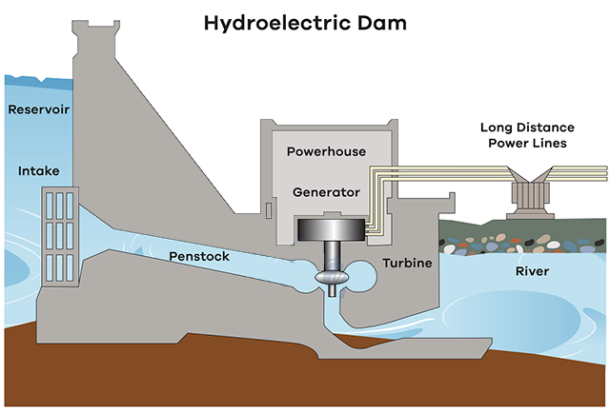
Image shows how hydroelectric power plant works :

Slide 5
ITS GENERATING POWER
In nature ,energy cannot be created or detroyed,but its form can change . In generating electricity,no new energy is created . Actually one form of energy is converted to another form .
The generate electricity, water must be in motion . This is kinetic (moving) energy .when flowing water turns blades in a turbine ,the form is changed into the mechanical (machine )energy .the turbine turns the generator rotor which then converts this mecganical energy into another energy form electricity .since water is the intial sources of energy ,we call this hydroelectric power or hydropower for short .
All facilities called hydroelectric power plants,hydropower is generated .some power plant are located on rivers , stream and canals ,but for a rellable water supply,dams are needed .dams store water for later release for such purposes as irrigation, domestic and industrial use , and power generation .

Slide 6
Equipment of hydro electrical power plant
Hydropower plants consist of electrical and mechanical components. Mechanical components include gates, turbine, gearbox, tanks, piping and hydraulic power unit; and electrical components include generator, automatic voltage regulator, transformer, and transmission line.
Radial Gates
Radial (sluice) gates are electromechanical units used in dams and canal locks to control water flow. They are used to transfer water to turbine units and are also used to discharge excess water. Typically hydraulic systems are used to open and close the gates.
‍
2. Surge Tank
Surge tanks are applied in hydroelectric power plants with long water vessels to reduce pressure forces during the acceleration of the large water masses. They are built as intermittent water reservoirs close to the turbines, either with open access to atmospheric air or a closed volume filled with pressurized air. Surge tanks are one of the methods to prevent the water hammer effect.

Slide 7
3. Penstock
Penstocks are long channels (or pipes) that carry water down from the reservoir to the turbines inside the powerhouses. They are generally made of steel. Water under high pressure flows through the penstock. The amount of water passed through the penstock is generally controlled with a sluice. Sluice is a gate that can be raised and lowered to increase or decrease the amount supplied to turbines.
4. Turbine
The most commonly used turbines are Kaplan, Francis, and Pelton. The type of hydropower turbine selected for a project is generally based on head, flow rate at the site, how deep the turbine is installed, turbine efficiency, and cost.
5. ‍Generator
A typical generator consists of a rotating part (rotor) and a stationary part (stator) that surrounds the rotating part. Hydroelectric generators convert flowing water’s mechanical energy into electricity. The rotor is attached to the main shaft and rotates at the speed of the turbine or the gearbox. In a generator, electromagnets are made by circulating direct current through field poles, which are mounted on the perimeter of the rotor. During the rotation, it causes the field poles (the electromagnets) to move past the conductors mounted in the stator. This leads electricity to flow and a voltage to develop at the generator output terminals, which is then transferred to the transformers.

Slide 8
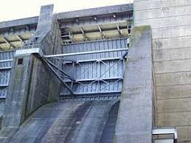
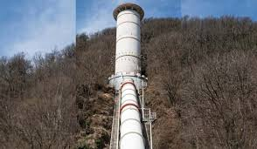
Some Pictures of Equipment :
Radial Gate :
Surge Tank :

Slide 9
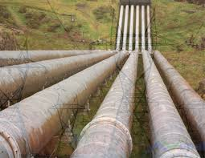
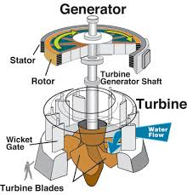
3. Penstock :
4. Generator and Turbin :

Slide 10

THANK YOU FOR YOUR ATTENTION

