Slide 1
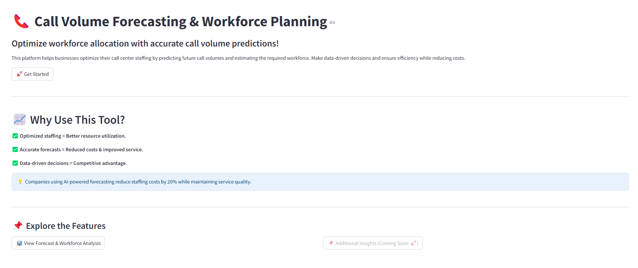
Tour of the Streamlit Dashboard : 1/4

Slide 2
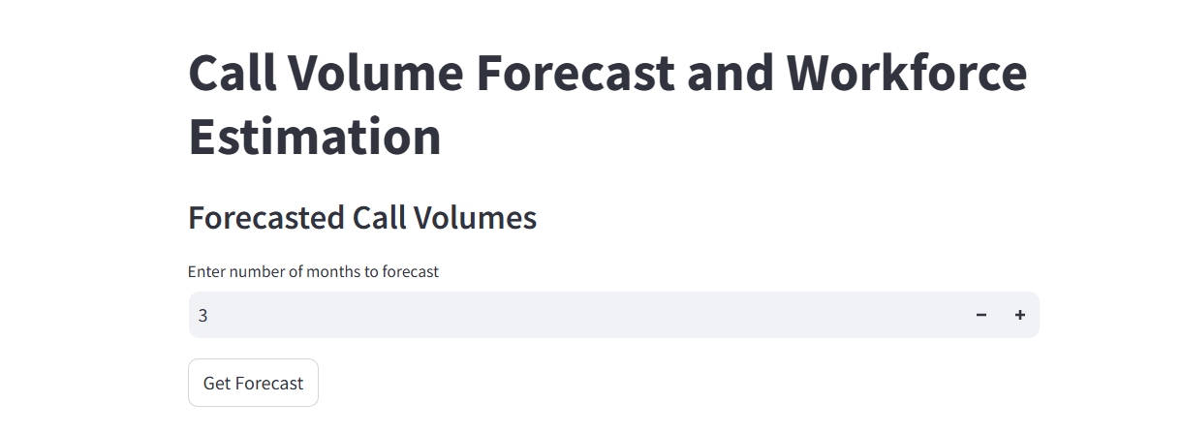
Tour of the Streamlit Dashboard : 2/4

Slide 3
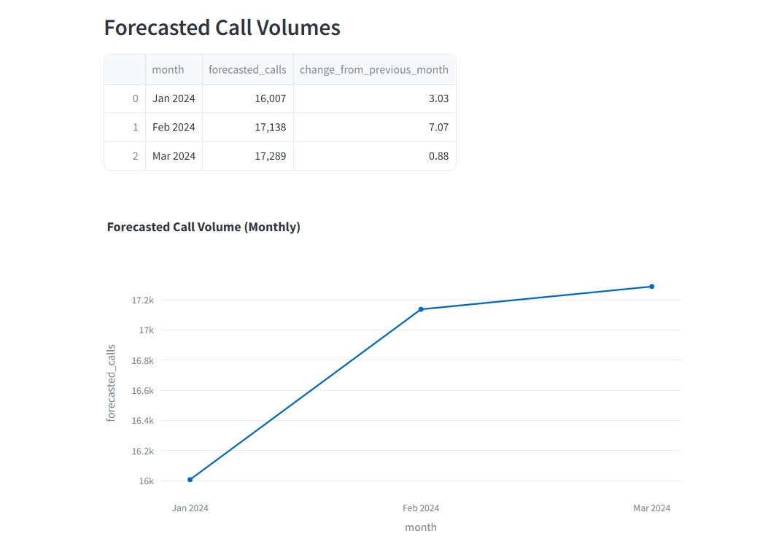
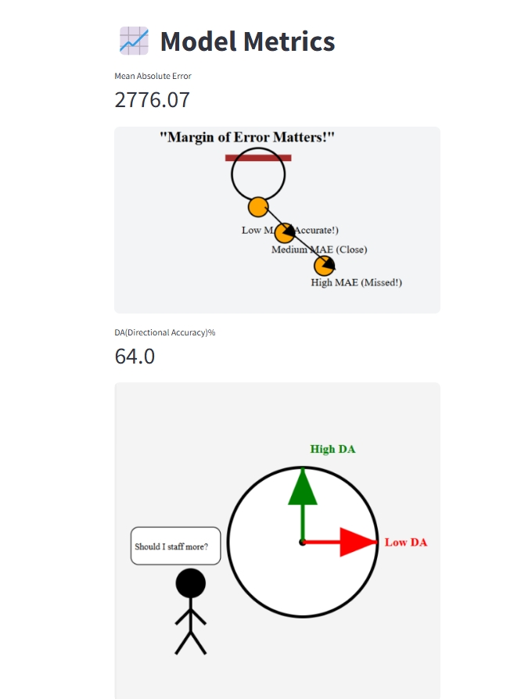
Tour of the Streamlit Dashboard : 3/4

Slide 4
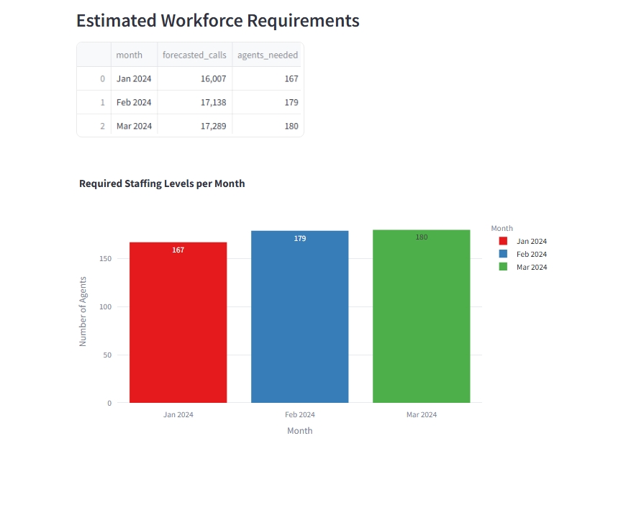
Tour of the Streamlit Dashboard : 4/4

