Slide 1
Call Volume Forecasting for Healthcare Call Centers Healthcare Operations Optimization
Pramit De
March 2025
GH: https://github.com/Pramit726/Healthcare-Call-Center-Traffic-Forecasting

Slide 2
Contents
Project Overview
Data Acquisition & Processing
Model Selection & Performance
Take-Aways
Data Overview

Slide 3
Business Objective
Goal:
To help healthcare call center managers make data-driven staffing and resource allocation decisions by forecasting monthly call volumes using time-series modeling.
Potential Interested Parties:
Call Center Operations Managers:: To optimize agent staffing schedules and reduce burnout by anticipating call surges.
Healthcare Administrators & Service Coordinators: To ensure timely patient support and reduce average wait times through better resource planning.
Outcome:
Accurately forecast monthly call volumes to improve workforce planning.Predict smartphone scores using technical specifications.
Enable real-time forecast visualization through an interactive dashboard.

Slide 4
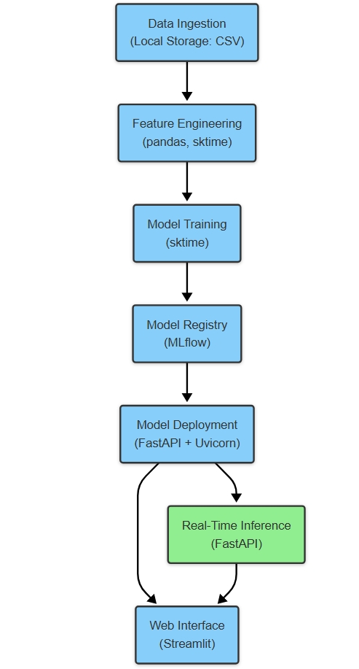
I. Project Overview
Data Source:
Utilized 132 months of historical monthly call volume data from a healthcare call center, processed using Pandas and NumPy for time-series analysis.
Outcome:
Built a robust ARIMA(1,1,4) model (MAE: 2776.07, Directional Accuracy: 63.64%) to forecast monthly call volumes and support staffing optimization.
Performed EDA to identify seasonal patterns (e.g., March and October spikes) and long-term trends affecting call traffic.
Deployed the forecasting solution using FastAPI, Streamlit, and Docker, and hosted it on Render.com with automated CI/CD via GitHub Actions.

Slide 5
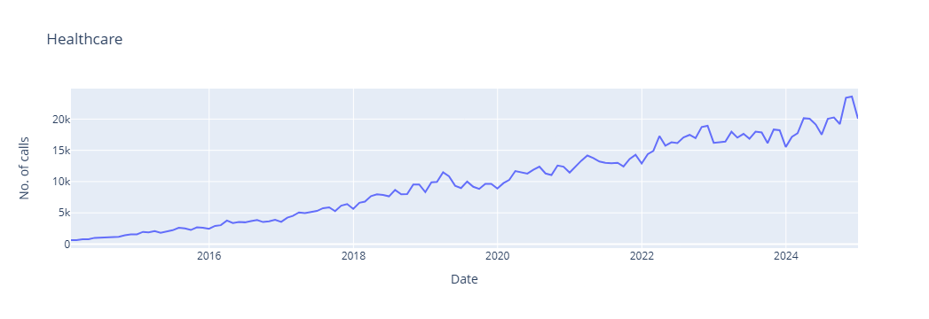
II. Data Overview
Origin:
Data was sourced from a healthcare call center’s historical monthly call logs, covering over 11 years (132 months.
Healthcare Calls Table Volume: 132 Columns: ~1
Number of calls

Slide 6
III. Data Acquisition & Processing
Data Acquisition
Collected historical monthly call volume data from a healthcare call center spanning 11 years (132 months)
Data Cleaning & Structuring
Converted date column to datetime format and set it as the index for time-series operations.
Checked and enforced uniform monthly frequency.
Process Used:
Loaded historical call volume data into a Pandas DataFrame for structured analysis.
Performed type conversions - set the date column as the index for time-series compatibility.
Conducted exploratory analysis to uncover trends, seasonality, and patterns in monthly call volumes.

Slide 7
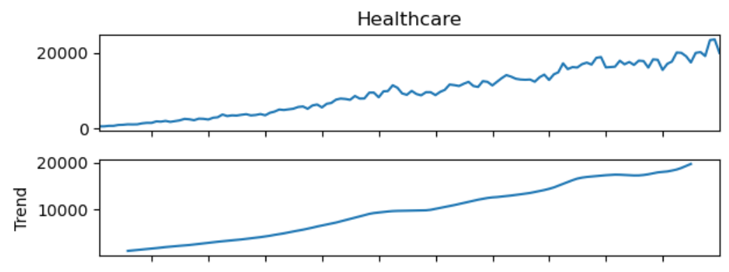
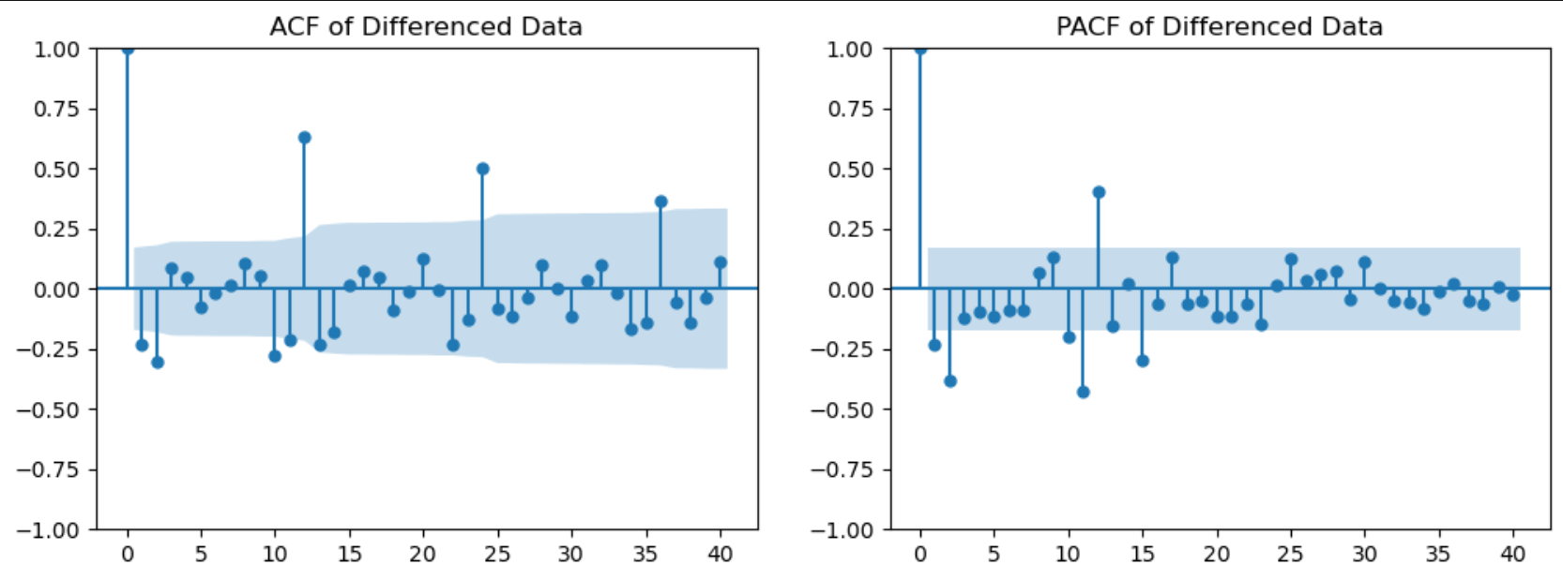
IV. Exploratory Analysis
Trend Detection:
Clear upward trend in call volume over time, indicating increased demand for healthcare support.
Seasonality Identification:
Recurring peaks observed in March and October, likely tied to healthcare cycles (e.g., seasonal illness patterns).
Stationarity Validation:
Applied first-order differencing to stabilize the mean over time.
Confirmed stationarity through ACF and PACF plots, enabling reliable model fitting.

Slide 8
V. Model Selection + Performance
We first evaluated multiple time-series models to establish performance benchmarks:
Best Baseline Model: MA(1) (ARIMA(0,1,1)) achieved the lowest Mean Absolute Error (MAE) of 2069.47 and a Directional Accuracy (DA) of 0.5455.
Other Models Considered: AR(1) and ARMA(1,1) showed higher MAE and did not improve DA significantly.
Advanced Model Selection
Final Model: ARIMA(1,1,4) was selected due to its optimal accuracy and computational efficiency.
Why ARIMA(1,1,4)?Lower AIC/BIC values indicating a better model fit.
Better MAE and DA scores compared to the baseline models.
Fine-Tuning Strategy
Moving Average (q): Explored values around q=4.
Differencing Order (d): Fixed at d=1 to ensure stationarity.
Auto-Regressive Order (p): Evaluated values of p from 1 to 5, with p=1 performing best.
Final Model Results:
ARIMA(1,1,4) achieved:
Directional Accuracy (DA): 0.6364
Mean Absolute Error (MAE): 2776.07
Model | MAE (Test) | DA (Test) | AIC | BIC
MA(1) | 2069.47 | 0.5455 | 1936.55 | 1944.91
AR(1) | 2861.39 | 0.4545 | 1947.64 | 1956.00
Combined ARMA(1,1) | 3381.94 | 0.5455 | 1953.54 | 1964.69

Slide 9
VI. Take-Aways
Biggest takeaways from the project :
Call Volume Trends:
A significant upward trend in call volumes over time was observed, indicating increasing demand for healthcare services.
Key Insight: Call volumes are steadily increasing, which emphasizes the need for scalable and flexible staffing solutions to handle future surges.
Stationarity and Model Selection:
The first-order differencing made the data stationary, enabling the use of time-series models.
Key Insight: Proper preprocessing (such as differencing) is essential for accurate model predictions. The ARIMA(1,1,4) model, chosen for its accuracy, highlights the importance of fine-tuning model parameters to capture trends effectively.
Given the results of the models and tests, my project based recommendations are:
Proactively Adjust Staffing for Trend & Seasonality:
Forecasting trends and seasonal fluctuations in call volumes should drive staffing decisions. Proactively increase staffing during peak months (e.g., March, October) to reduce wait times and improve service quality.
Optimize Workforce Scheduling:
Use the ARIMA model to predict call volumes and create flexible staffing schedules that minimize burnout while ensuring adequate coverage during forecasted high-volume periods.
Enhance Real-Time Decision-Making:
Use the real-time forecast visualizations via Streamlit for dynamic staffing adjustments based on the most recent data, helping managers respond to unexpected spikes or drops in call volumes.

Slide 10
Thanks!

