Slide 1
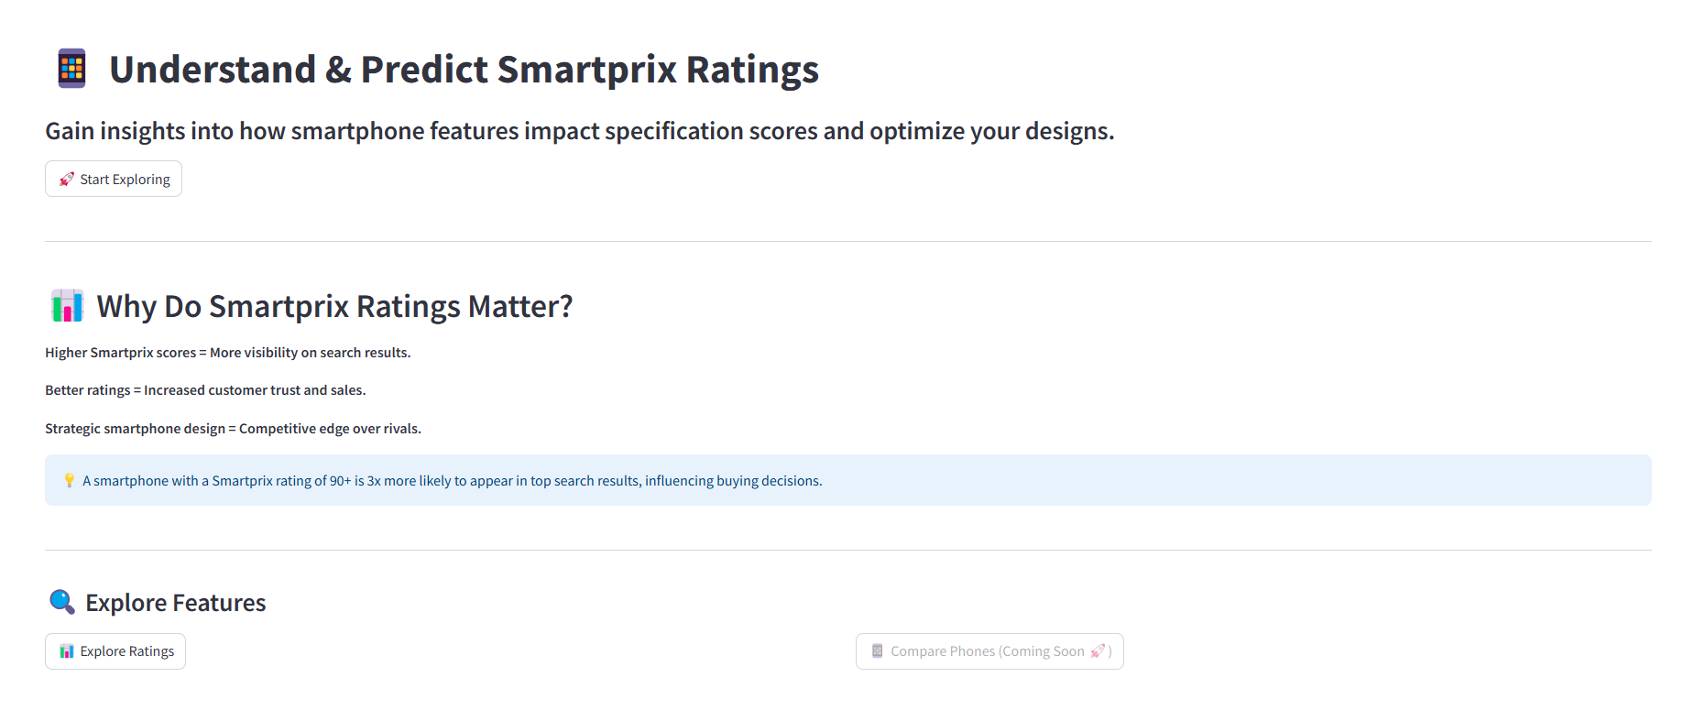
Tour of the Streamlit Dashboard : 1/6

Slide 2
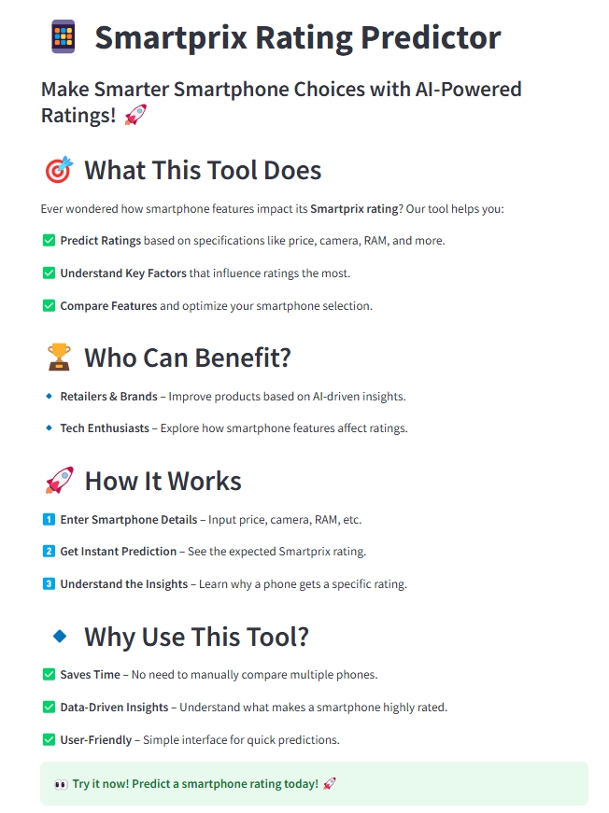
Tour of the Streamlit Dashboard : 2/6

Slide 3
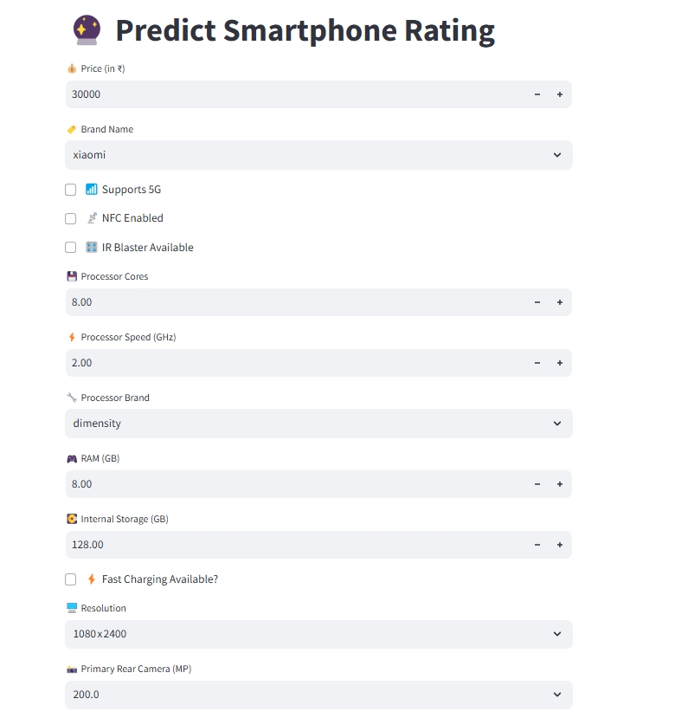
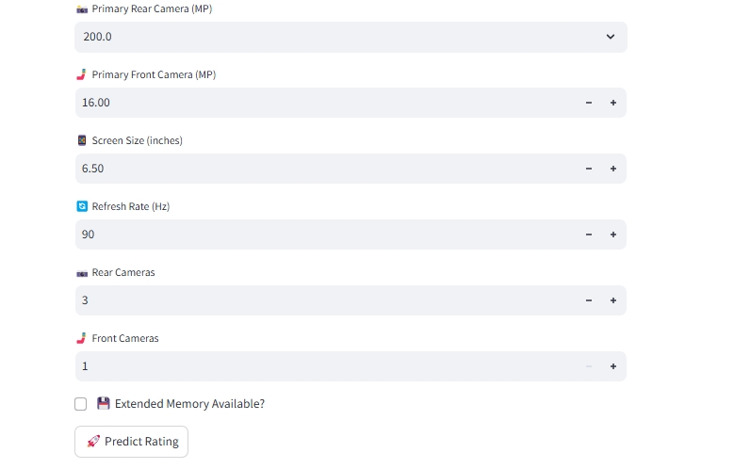
Tour of the Streamlit Dashboard : 3/6

Slide 4
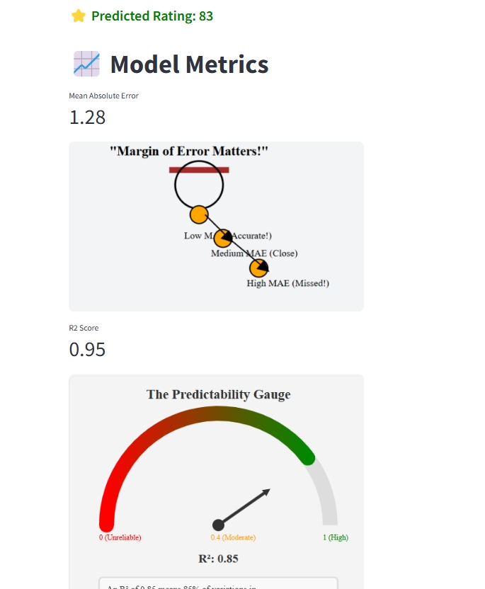
Tour of the Streamlit Dashboard : 4/6

Slide 5
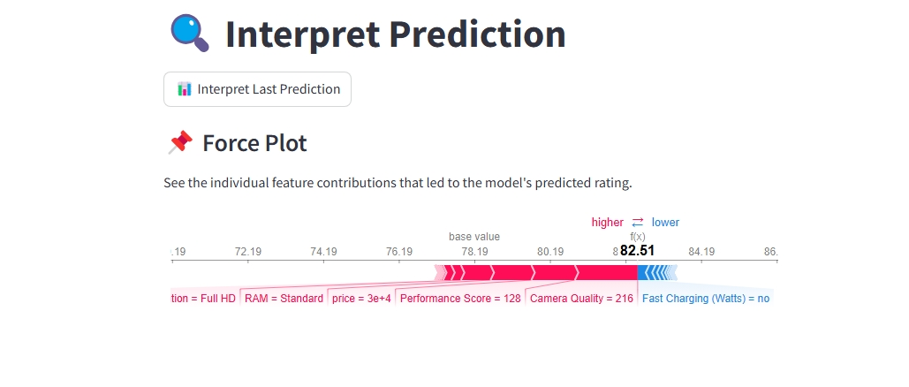
Tour of the Streamlit Dashboard : 5/6

Slide 6
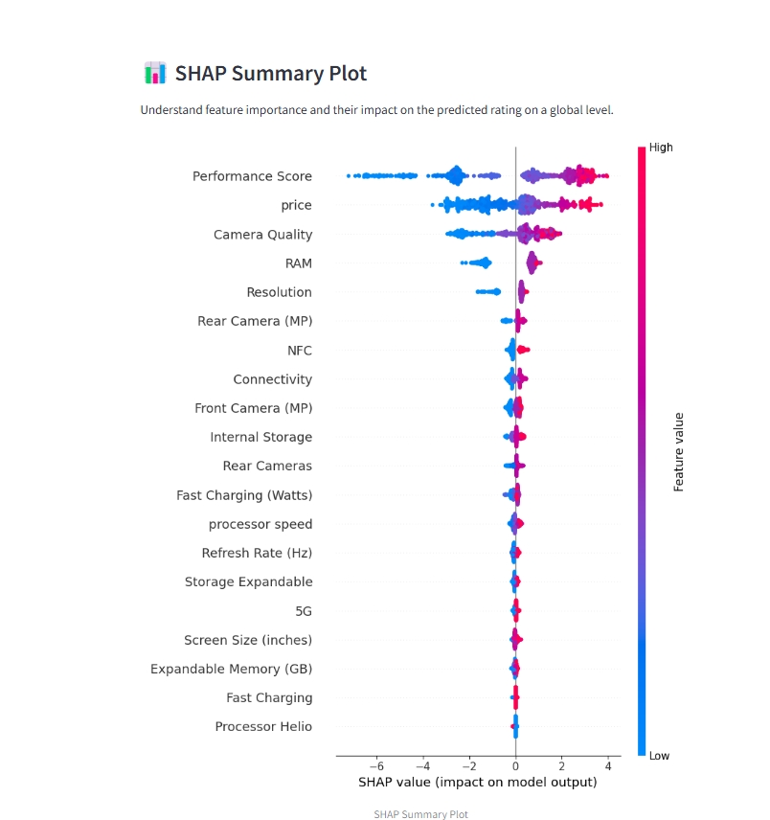
Tour of the Streamlit Dashboard : 6/6

