Slide 1
TRAFFICCLIP OPTIMIZATION EDGE A HIGH-PERFORMANCE MULTIMODAL FRAMEWORK FOR ENCRYPTED TRAFFIC CLASSIFICATION
Pramit De
March 2026
GH:

Slide 2
Contents
Project Overview
Data Acquisition & Processing
Experimental Roadmap
Take-Aways
Data Overview

Slide 3
I. Project Overview
Goal:
To develop a high-performance, privacy-preserving classification system for encrypted network traffic that
identifies applications without payload inspection by aligning visual byte-patterns, behavioral semantics, and
flow physics.
Data Source:
https://raw.githubusercontent.com/yungshenglu/USTC-TFC2016/master
Outcome:
Metric | Performance | Impact
Accuracy | 558% Improvement | Boosted Macro F1 from 0.12 to 0.79 through optimized multimodal fusion techniques.
Architecture | 3.37× Better Results | Achieved significant performance gains with only a 1.07% increase in parameter overhead.
Convergence | 1% Loss / 10 Epochs | Domain-informed prompts enabled a steady loss reduction and 7.3% higher validation Macro F1.
Efficiency | ~1.05M Params | Maintained a lightweight architecture suitable for high-speed, ISP-scale monitoring.

Slide 4
II. Data Overview
Origin:
The data is sourced from the USTC-TFC2016 dataset, a publicly available repository for encrypted traffic classification research. It contains raw network traffic (PCAP files) captured in real-world scenarios, representing both benign and malicious encrypted flows.
Data Link: USTC-TFC2016 GitHub Repository

Slide 5
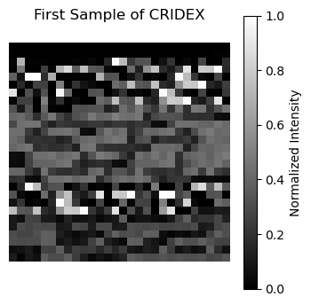
III. Data Acquisition & Processing
Data Acquisition Strategy
Target Classes: The dataset focuses on a 10-class subset consisting of five benign traffic categories—Skype, MySQL, BitTorrent, Facetime, and Weibo—and five malware families—Zeus, Tinba, Cridex, Geodo, and Miuref.
Sampling: To ensure a balanced dataset, 900 samples were extracted from each class, resulting in a total of 9,000 samples.
Processed Binary Image:
Multi-Modal Processing Pipeline
A. Visual Modality (Greyscale Images)
Flow Extraction: Packets are grouped into bidirectional 5-tuple flows.
Fixed Dimensioning: The first 784 bytes are extracted and reshaped into a 28 * 28 normalized greyscale image.
Header Anonymization: The first 54 bytes (L2/L3/L4 headers) are zeroed
to force the model to learn application-specific payloads instead of network routing metadata.
B. Statistical Modality (Flow Physics)Specific session-level metrics are calculated to
provide the StatsProjectionHead with behavioral context:Inter-Arrival Time (IAT): Captures the Mean IAT and Jitter to distinguish between bursty (Gmail) and persistent (BitTorrent) protocols.Shannon Entropy: Measures byte randomness to identify the level of encryption or obfuscation in the payload.
C. Data Structuring & StorageThe processed data is exported as a compressed NumPy (.npz) archive containing:
Visual Samples: reshaped 28 * 28 image tensors.
Physics Tensors: 3-element vectors [Mean IAT, Jitter, Entropy].
Categorical Labels: Integer-mapped IDs for supervised learning.

Slide 6
IV. Experimental Roadmap
Model Variant | Configuration | Val Acc | Val F1-Macro | Val Precision | Val Recall
Original | Without Stats | 0.6274 | 0.6221 | 0.6577 | 0.6274
Original | With Stats | 0.6163 | 0.5905 | 0.6514 | 0.6163
Optimized | Original Prompts / No Stats Head | 0.6163 | 0.631 | 0.7509 | 0.6163
Optimized | Semantic Prompts / No Stats Head | 0.7933 | 0.7857 | 0.8109 | 0.7933
Optimized | Original Prompts / Stats Head | 0.6644 | 0.6701 | 0.7878 | 0.6644
Insight: Semantic prompts alone drove the F1-score from 0.62 to 0.78, proving the power of LLM-informed feature anchoring.

Slide 7
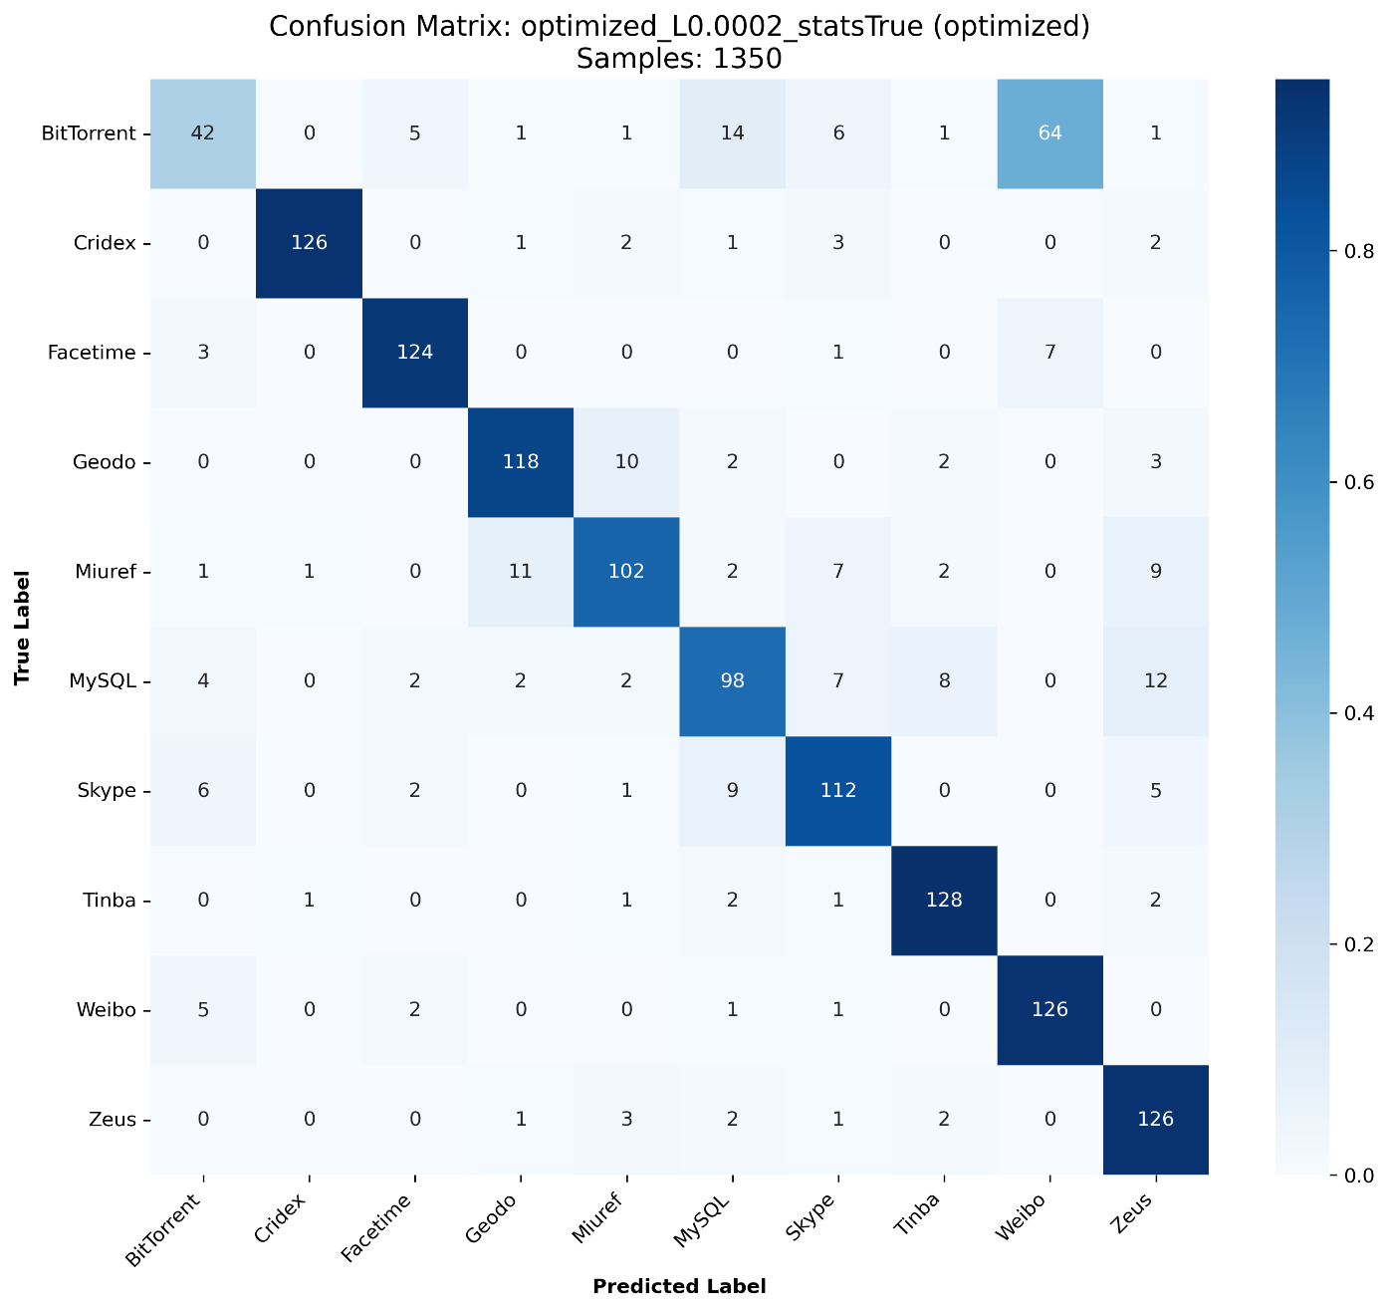
IV. Hyperparameter Optimization
Objective: To determine the optimal balance between the two modalities, an automated Bayesian hyperparameter search was conducted over 5+ trials.
Search Space
Learning Rate: 1×10⁻⁵ – 5×10⁻⁴ (log scale)
Optimizers: Adam, SGD, AdamW (Best Performer)
Contrastive Loss Weight (λ₍cl₎): 0.5 – 5.0 to balance semantic alignment
Regularization: Weight decay (1×10⁻⁴ – 0.1) to reduce overfitting
Peak Pre-Deployment Performance (10-Class Encrypted Subset)
Average Accuracy: 80.49%
Average Precision: 80.86%
Average Macro F1 Score: 79.63%

Slide 8
V. Edge Optimization & Performance
Objective: Optimize the model for real-time edge deployment while preserving classification accuracy.
Why ONNX?
Unlike INT8 quantization (which dropped F1 to <0.10 in earlier tests), ONNX preserves FP32 precision, maintaining the delicate bi-modal similarity manifold.
Graph Optimization: Achieved speedup through Operator Fusion and Constant Folding, eliminating Python runtime overhead without touching model weights.
Stability: P99 Latency reduction ensures the model is viable for Real-Time ISP-scale monitoring.
Key Achievement
Achieved 87.5% Macro F1 Score while reducing inference latency by ~14 ms per sample.
Demonstrates efficient edge deployment with zero accuracy degradation.
Metric | PyTorch (Baseline) | ONNX (Optimized) | Improvement
Macro F1 Score | 0.8754 | 0.8754 | No Accuracy Loss
Avg Latency | 47.33 ms | 34.08 ms | 1.39× Faster
P99 Latency | 50.31 ms | 37.35 ms | 25% Reduction
Throughput | 21.1 FPS | 29.3 FPS | +39% Higher

Slide 9
V. Final Takeaways & Conclusion
Key Insights
Physics + Semantics = Precision: Behavioral traffic statistics act as the strongest differentiator for encrypted traffic classification.
Deployability Matters: High accuracy alone is insufficient—efficient inference speed is critical for real-world deployment. ONNX enables practical edge deployment.
Scalability: Achieving 29.3 FPS on a standard CPU demonstrates that multimodal traffic classification can operate effectively in high-speed network environments.
Current System Performance
A robust encrypted traffic classification system achieving 87.5% Macro F1 Score.
Optimized for low-latency inference on edge CPUs.
Future Scope
Explore 1D-CNN based vision backbones to further reduce parameter size and improve efficiency.
Evaluate system robustness against zero-day malware variants and unseen encrypted traffic patterns.

Slide 10
Thanks!

