Slide 1

Department of Electronics and Telecommunication Engineering
Chittagong University of Engineering and Technology
A PRESENTATION ON Weather Monitoring and Remote Plant Watering system using ESP32 and Blynk Live Server and App
COURSE CODE: ETE-416
COURSE TITLE: IoT and Industrial Automation Sessional
PRESENTED BY:
Group-3 (ID: 1708011, 1708012, 1708013, 1708014, 1708015)

Slide 2
OUTLINE
INTRODUCTION
SIMULATION
CODE
HARDWARE IMEPLEMENTATION
RESULT
CONCLUSION
FUTURE DIRECTION

Slide 3
INTRODUCTION
1
In Today’s World of agriculture, knowing live environmental condition and take recountable actions or precautions is one of the biggest issues for farmers and agriculturist.
In this project, a remote weather monitoring and plant watering system is designed which will reduce human workload and interference in agricultural activity.

Slide 4
INTRODUCTION(CONT’D)
2
BLYNK
CLOUD
Sensor Data
Sensor Data
ESP32
Motor Control Signal
Control
Signal
Sensor Data
DC Motor
Relay Module
DHT11
Trigger
Signal
Figure 01: Working Diagram of Weather Monitoring and Remote Plant Watering System

Slide 5
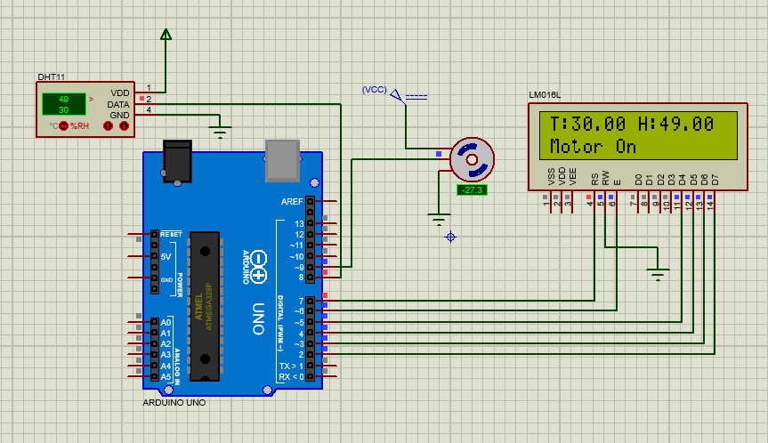
SIMULATION
3
Figure 02: Proteus Schematic Design

Slide 6
4
CODE
The code for this project is given below:
#define BLYNK_PRINT Serial
#define BLYNK_TEMPLATE_ID "TMPLQNF8LYfz"
#define BLYNK_DEVICE_NAME "Weather Monitoring and Plant Watering System"
#include <WiFi.h>
#include <WiFiClient.h>
#include <BlynkSimpleEsp32.h>
#include "DHT.h"
char auth[] = "******"; // auth token
char ssid[] = "******"; //wifi name
char pass[] = "******"; // wifi password
#define DHTPIN 2
#define DHTTYPE DHT11
DHT dht(DHTPIN, DHTTYPE);
BlynkTimer timer;
bool Relay = 0;
#define waterPump 26
void sendSensor()
{
float h = dht.readHumidity();
float t = dht.readTemperature();

Slide 7
CODE(CONT’D)
5
if (isnan(h) || isnan(t)) {
Serial.println("Failed to read from DHT sensor!");
return;
}
Blynk.virtualWrite(V1, h);
Blynk.virtualWrite(V0, t);
}
void setup()
{
Serial.begin(115200);
delay(1000);
pinMode(waterPump, OUTPUT);
digitalWrite(waterPump, HIGH);
Blynk.begin(auth, ssid, pass, "blynk.cloud", 80);
dht.begin();
timer.setInterval(1000L, sendSensor);
}

Slide 8
CODE(CONT’D)
6
void loop()
{
Blynk.run();
timer.run();
}
BLYNK_WRITE(V2) {
Relay = param.asInt();
if (Relay == 1) {
digitalWrite(waterPump, LOW);
Serial.println("Motor On");
} else {
digitalWrite(waterPump, HIGH);
Serial.println("Motor Off");
}
delay(5000);
}

Slide 9
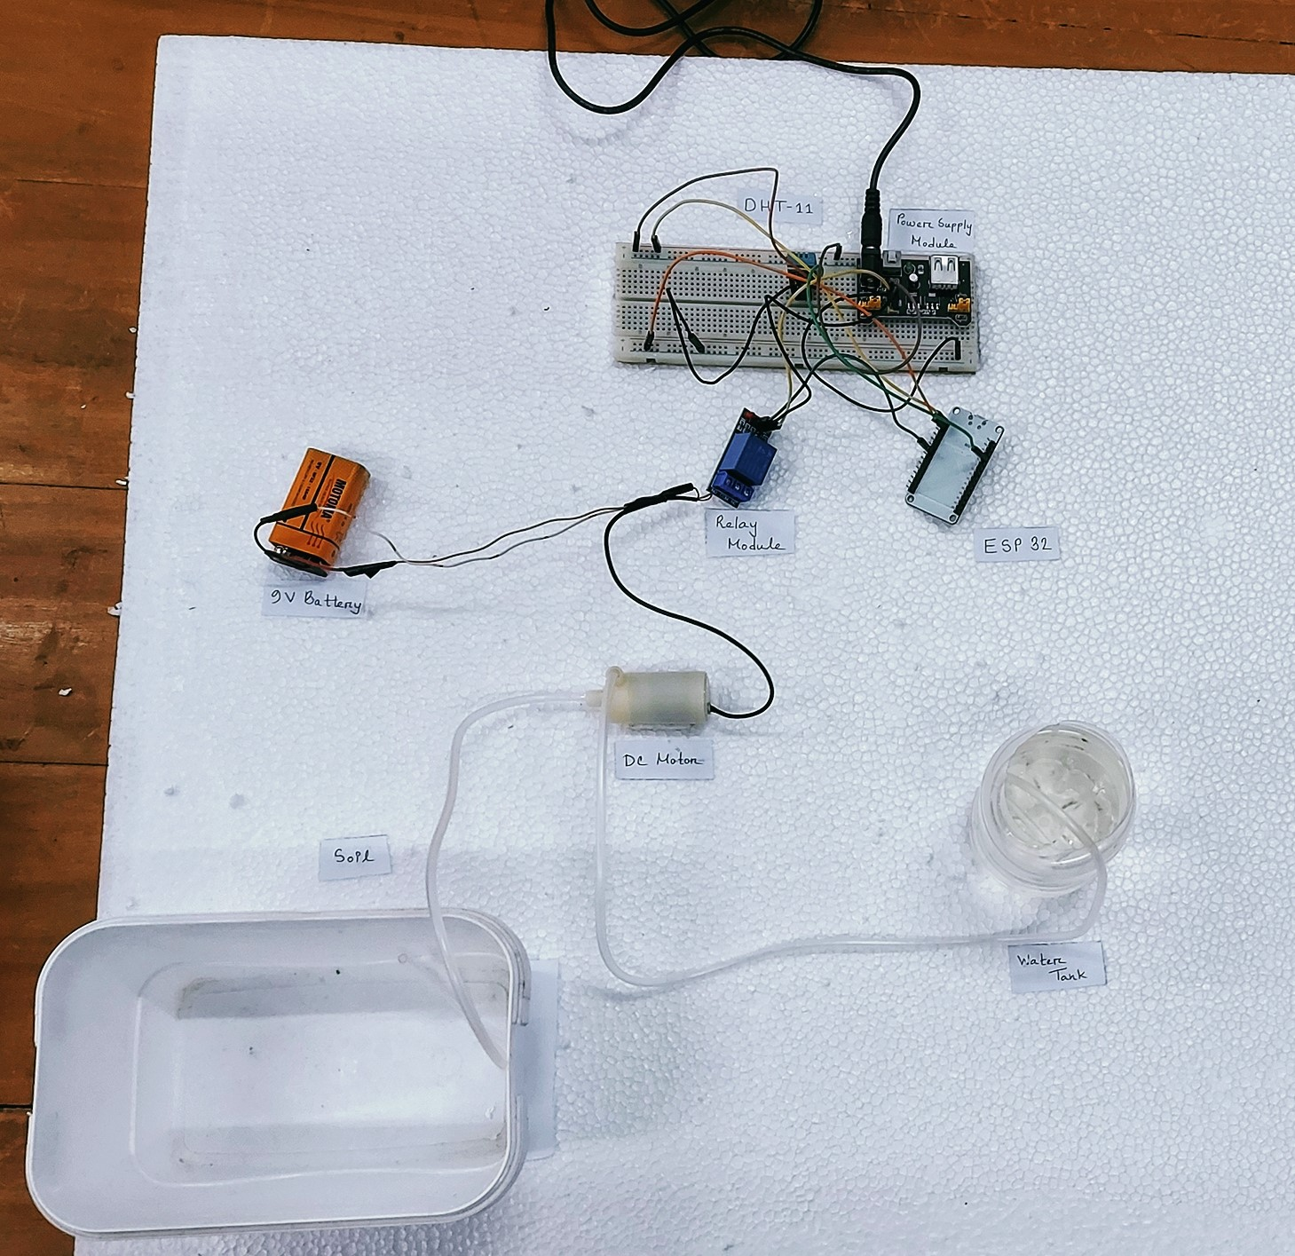
7
HARDWARE IMPLEMENTATION
Figure-03: Prototype Design of the proposed model

Slide 10
HARDWARE IMPLEMENTATION(CON’T D)
8
IoT Fundamental Stack has three layer
Application Layer
Communication Networks Layer
Things: Sensors and Actuators

Slide 11
HARDWARE IMPLEMENTATION(CON’T D)
9
Application Layer is implemented using Blynk Live server.
Communications Network layer is implemented using ESP32 microcontroller.
In Things: Sensors and Actuator layer, DHT11 was used as sensor and DC motor as actuator.

Slide 12
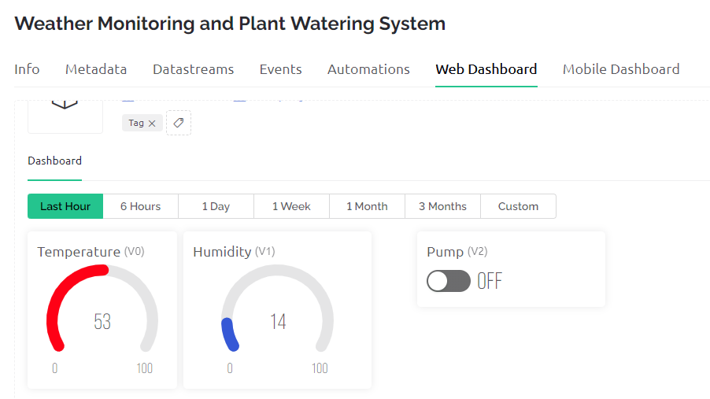
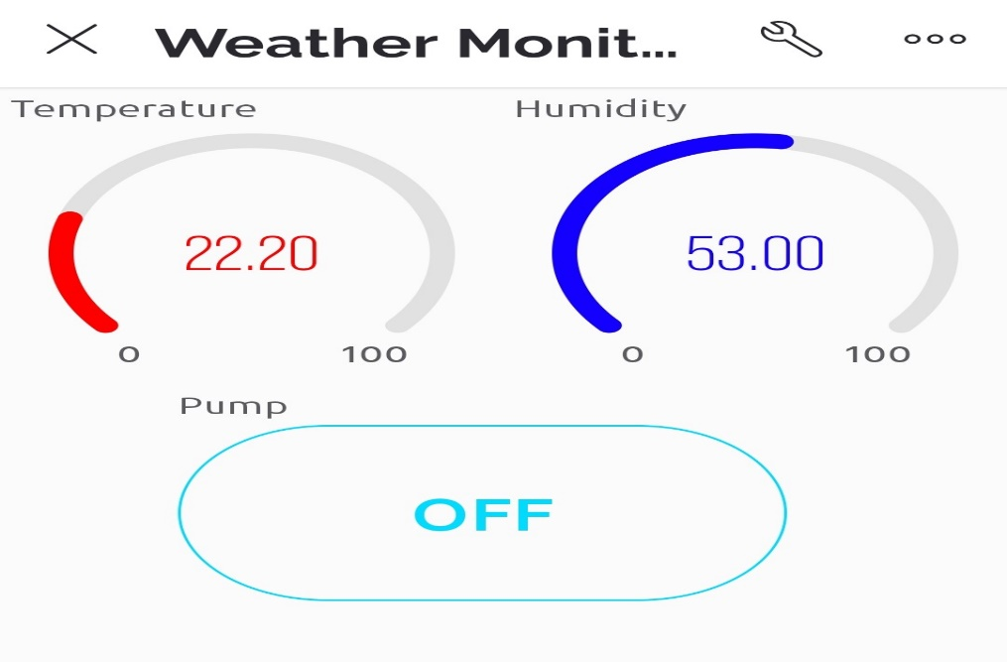
HARDWARE IMPLEMENTATION(CON’T D)
10
(a) Web Dashboard
(b) Mobile Dashboard
Figure-04: Blynk Live Server Configuration

Slide 13
RESULT
11
Table-01: Temperature Sensor Response Time Observation
Table-02: Humidity sensor Response
Time Observation
Obs. No. | Heat Source | Reading (°C) |  | Delay (s)
 |  | Before Giving Heat | After Giving Heat
01. | Candle | 22.08 | 22.15 | 7s
02. | Match | 23.60 | 23.62 | 16s
03. | Sunlight | 23.40 | 23.45 | 12s
Observation No. | Reading (%) |  | Delay(s)
 | Before GivingWater | After GivingWater
01. | 64.00 | 65.20 | 11s
02. | 70.20 | 73.65 | 7s
03. | 65.60 | 69.45 | 4s

Slide 14
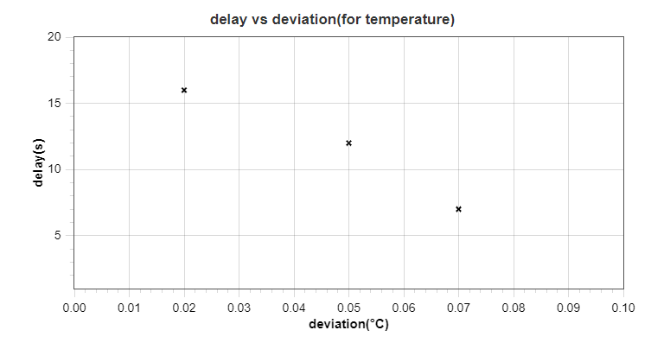
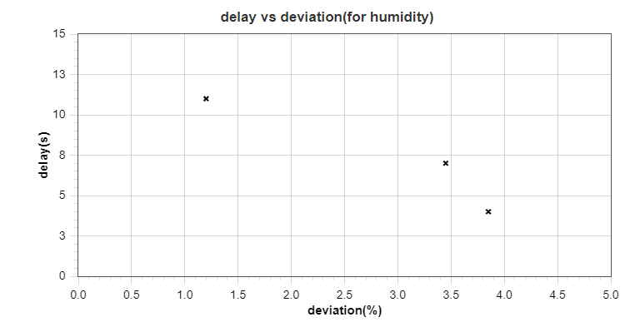
RESULT(CONT’D)
12
(a) For Temperature
(b) For Humidity
Figure-04: Relation between Response and Deviation in Measurement

Slide 15
RESULT(CONT’D)
13
Table-03: Temperature sensor
Accuracy Measurement
Table-04: Humidity sensor
Accuracy Measurement
Obs. No. | Measure by Mobile App(°C) | Measured by DHT11 (°C) | Accuracy (%)
01. | 23.59 | 24.20 | 97.41%
02. | 21.65 | 22.50 | 96.07%
03. | 22.59 | 22.85 | 98.84%
Obs. No. | Measuredby Mobile App (%) | Measured by DHT11 (%) | Accuracy (%)
01. | 53.62% | 51.43% | 95.92%
02. | 57.37 | 59.97 | 95.47%
03. | 64.60 | 65.54 | 98.54%

Slide 16
CONCLUSION
14
This project achieved the objectives to build a weather monitoring and remote plant watering system
The project has the potential to be implemented for monitoring the developing cities and industrial zones, especially for pollution monitoring

Slide 17
FUTURE DIRECTION
15
This project can be extended to automate many aspect of an agricultural system by using multiple sensor.
This sensor data can be used by experts to predict any sudden change in weather and take precautionary steps such as inventing new plants and cultivation system.

Slide 18


