Slide 1

Amazon Sales Data

Slide 2
OBJECTIVE OF CHOOSING AMAZON SALES DATASET
Predict future sales for products based on historical data.
1.Helps in inventory planning, logistics, and meeting demand.
2.ML Techniques: Time series forecasting (ARIMA) regression models.
Recommend products to users based on past behavior and similar users.
Improves user engagement, boosts cross-selling.
ML Techniques: Collaborative filtering, content-based filtering, hybrid models, matrix factorization, neural networks.
Group customers based on purchasing behavior or demographics.
1. Enables targeted marketing and personalized offers.
2. ML Techniques: Clustering (K-Means), decision trees.
Suggest optimal pricing to maximize revenue or profit.
1. Helps in dynamic pricing strategies.
2. ML Techniques: Regression, reinforcement learning.
Predict stockouts or overstock situations.
1. Reduces storage costs and lost sales.
2. ML Techniques: Classification (out-of-stock or not), forecasting.
Predict stockouts or overstock situations.
1. Reduces storage costs and lost sales.
2. ML Techniques: Classification (out-of-stock or not), forecasting.
Detect unusual or suspicious purchase behavior.
1. Prevent financial losses and secure the platform.
2. ML Techniques: isolation forest.
Predict which customers are likely to stop buying or cancel subscriptions.
1. Allows proactive retention efforts.
2. ML Techniques: Classification models (Logistic Regression).

Slide 3
# various libraries
import pandas as pd import numpy as np
import matplotlib.pyplot as plt import seaborn as sns
from sklearn.model_selection import train_test_split from sklearn.linear_model import LogisticRegression
from sklearn.metrics import classification_report, confusion_matrix
from statsmodels.tsa.holtwinters import ExponentialSmoothing
# load Dataset
df = pd.read_csv("AmazonSalesData.csv") df.head()
Region Country Item Type \
0 | Australia and Oceania |  | Tuvalu
Baby Food
1 Central | America and the Caribbean |  | Grenada
Cereal
2 | Europe |  | Russia | Office
Supplies
3 | Sub-Saharan Africa | Sao | Tome and Principe
Fruits
4 | Sub-Saharan Africa |  | Rwanda | Office
Supplies
Sales Channel Order Priority Order Date Order ID Ship Date Units
Sold \
0 Offline H 5/28/2010 669165933 6/27/2010
9925
1 Online C 8/22/2012 963881480 9/15/2012
2804
2 Offline L 5/2/2014 341417157 5/8/2014
1779
3 Online C 6/20/2014 514321792 7/5/2014
8102
4 Offline L 2/1/2013 115456712 2/6/2013
5062
Unit Price Unit Cost Total Revenue 0 255.28 159.42 2533654.00 |  |  |  | Total Cost Total Profit 1582243.50 951410.50
1 | 205.70 | 117.11 | 576782.80 | 328376.44 | 248406.36
2 | 651.21 | 524.96 | 1158502.59 | 933903.84 | 224598.75
3 | 9.33 | 6.92 | 75591.66 | 56065.84 | 19525.82
4 | 651.21 | 524.96 | 3296425.02 | 2657347.52 | 639077.50

Slide 4
df.tail()
Region
Sub-Saharan Africa
Asia
Sub-Saharan Africa
North America
Sub-Saharan Africa
Country
Mali Malaysia Sierra Leone
Mexico Mozambique
Item Type Sales Channel \
Clothes Fruits Vegetables Personal Care
Household
Online Offline Offline Offline Offline
Order Priority Order Date Order ID Ship Date Units Sold Unit
Price \
95 M 7/26/2011 512878119 9/3/2011 888
109.28
96 L 11/11/2011 810711038 12/28/2011 6267
9.33
97 C 6/1/2016 728815257 6/29/2016 1485
154.06
98 M 7/30/2015 559427106 8/8/2015 5767
81.73
99 L 2/10/2012 665095412 2/15/2012 5367
668.27
Unit Cost Total Revenue 95 35.84 97040.64 |  |  | Total Cost Total Profit 31825.92 65214.72
96 | 6.92 | 58471.11 | 43367.64 | 15103.47
97 | 90.93 | 228779.10 | 135031.05 | 93748.05
98 | 56.67 | 471336.91 | 326815.89 | 144521.02
99 | 502.54 | 3586605.09 | 2697132.18 | 889472.91
df.columns
Index(['Region', 'Country', 'Item Type', 'Sales Channel', 'Order
Priority',
'Order Date', 'Order ID', 'Ship Date', 'Units Sold', 'Unit
Price',
'Unit Cost', 'Total Revenue', 'Total Cost', 'Total Profit'],
dtype='object')
type(df)
pandas.core.frame.DataFrame
# Data Preprocessing
df['Order Date'] = pd.to_datetime(df['Order Date']) df['Ship Date'] = pd.to_datetime(df['Ship Date'])
# Missing Value
print(df.isnull().sum())

Slide 5
Region Country Item Type
Sales Channel Order Priority Order Date Order ID
Ship Date Units Sold Unit Price Unit Cost Total Revenue Total Cost Total Profit
0
0
0
0
0
0
0
0
0
0
0
0
0
0
dtype: int64
# Convert categorical order priority to binary for logistic regression
df['high_priority'] = df['Order Priority'].apply(lambda x: 1 if x in ['H', 'C'] else 0)
# Encode categorical features
df_encoded = pd.get_dummies(df, columns=['Region', 'Country', 'Item Type', 'Sales Channel'], drop_first=True)
# Logistic Regression: Predict High Priority Orders
features = ['Units Sold', 'Unit Price', 'Unit Cost', 'Total Revenue', 'Total Cost', 'Total Profit'] + \
[col for col in df_encoded.columns if col.startswith(('Region', 'Country', 'Item Type', 'Sales Channel'))]
X = df_encoded[features]
y = df_encoded['high_priority']
X_train, X_test, y_train, y_test = train_test_split(X, y, test_size=0.2, random_state=42)
model = LogisticRegression(max_iter=1000) model.fit(X_train, y_train)
LogisticRegression(max_iter=1000)
y_pred = model.predict(X_test)
# Results
print("Confusion Matrix:\n", confusion_matrix(y_test, y_pred)) print("\nClassification Report:\n", classification_report(y_test, y_pred))

Slide 6
Confusion Matrix:
[[9 1]
[3 7]]
Classification | Report:
 | precision | recall | f1-score | support
0 | 0.75 | 0.90 | 0.82 | 10
1 | 0.88 | 0.70 | 0.78 | 10
accuracy |  |  | 0.80 | 20
macro avg | 0.81 | 0.80 | 0.80 | 20
weighted avg | 0.81 | 0.80 | 0.80 | 20
# Time Series Forecasting: Forecast Total Profit
# Aggregate profit by date
daily_profit = df.groupby('Order Date')['Total Profit'].sum().asfreq('D').fillna(0)
# Train-test split (e.g., until end of 2024)
train = daily_profit[:'2024-12-31'] test = daily_profit['2025-01-01':]
# Holt-Winters Forecasting
print("Date range in data:", daily_profit.index.min(), "to", daily_profit.index.max())
Date range in data: 2010-02-02 00:00:00 to 2017-05-22 00:00:00
test = daily_profit['2025-01-01':]
# Split by index (e.g., 80% train, 20% test) split_point = int(len(daily_profit) * 0.8) train = daily_profit.iloc[:split_point] test = daily_profit.iloc[split_point:]
# Check test index
print(test.index[0], test.index[-1])
2015-12-06 00:00:00 2017-05-22 00:00:00
# Build and fit the model
model_hw = ExponentialSmoothing(train, trend='add', seasonal='add', seasonal_periods=7)
fit = model_hw.fit()
# Forecast using .predict with test index range

Slide 7
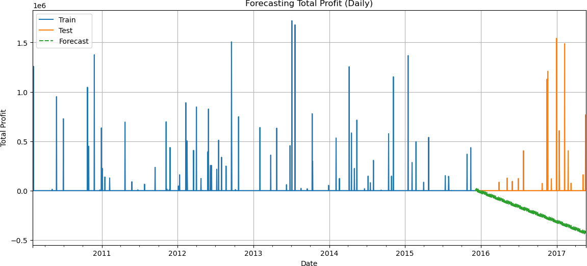
start_date = test.index[0] end_date = test.index[-1]
forecast = fit.predict(start=start_date, end=end_date)
# Plot results plt.figure(figsize=(14, 6)) train.plot(label='Train') test.plot(label='Test')
forecast.plot(label='Forecast', style='--') plt.legend()
plt.title("Forecasting Total Profit (Daily)") plt.xlabel("Date")
plt.ylabel("Total Profit") plt.grid()
plt.show()
C:\Users\MUKHERJEE\anaconda3\Lib\site-packages\statsmodels\tsa\ holtwinters\model.py:918: ConvergenceWarning: Optimization failed to converge. Check mle_retvals.
warnings.warn(
# Forecast for 30 future days
forecast = fit.forecast(steps=30)
# Create future date index
future_dates = pd.date_range(start=train.index[-1] + pd.Timedelta(days=1), periods=30, freq='D') forecast.index = future_dates
# Plot extended forecast
plt.figure(figsize=(14, 6))

Slide 8
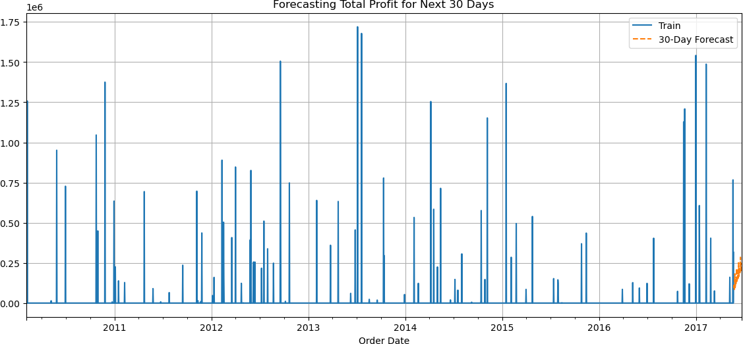
train.plot(label='Train')
forecast.plot(label='30-Day Forecast', style='--') plt.legend()
plt.title("Forecasting Total Profit for Next 30 Days") plt.grid()
plt.show()
import pandas as pd
# Load the dataset
df = pd.read_csv('amazonsalesdata.csv') # Replace with your actual file path
# Quick preview
print(df[['Total Revenue', 'Units Sold']].describe())
# Create a HighSales label based on Total Revenue being above the median
revenue_threshold = df['Total Revenue'].median()
df['HighSales'] = (df['Total Revenue'] > revenue_threshold).astype(int)
# Optional: Check label distribution
print(df['HighSales'].value_counts())
# Preview with label
print(df[['Total Revenue', 'HighSales']].head())
Total Revenue Units Sold
count 1.000000e+02 100.000000

Slide 9
 | mean | 1.373488e+06 | 5128.710000
 | std | 1.460029e+06 | 2794.484562
 | min | 4.870260e+03 | 124.000000
 | 25% | 2.687212e+05 | 2836.250000
 | 50% | 7.523144e+05 | 5382.500000
 | 75% | 2.212045e+06 | 7369.000000
 | max | 5.997055e+06 | 9925.000000
 | HighSales 1 50 0 50 Name: count, dtype: int64
Total Revenue HighSales
0 | 2533654.00 | 1
1 | 576782.80 | 0
2 | 1158502.59 | 1
3 | 75591.66 | 0
4 | 3296425.02 | 1
from sklearn.model_selection import train_test_split from sklearn.linear_model import LogisticRegression
from sklearn.metrics import classification_report, confusion_matrix
# One-hot encode categorical features
df_encoded = pd.get_dummies(df, columns=['Region', 'Country', 'Item Type', 'Sales Channel'], drop_first=True)
# Select features
features = ['Units Sold', 'Unit Price', 'Unit Cost', 'Total Profit'] +
\
[col for col in df_encoded.columns if col.startswith(('Region_', 'Country_', 'Item Type_', 'Sales Channel_'))]
X = df_encoded[features]
y = df_encoded['HighSales']
# Train-test split
X_train, X_test, y_train, y_test = train_test_split(X, y, test_size=0.2, random_state=42)
# Train logistic regression
model = LogisticRegression(max_iter=1000) model.fit(X_train, y_train)
y_pred = model.predict(X_test)
# Evaluate
print(confusion_matrix(y_test, y_pred)) print(classification_report(y_test, y_pred))

Slide 10
[[ 7 2]
[ 0 11]]
 | precision | recall | f1-score | support
0 | 1.00 | 0.78 | 0.88 | 9
1 | 0.85 | 1.00 | 0.92 | 11
accuracy |  |  | 0.90 | 20
macro avg | 0.92 | 0.89 | 0.90 | 20
weighted avg | 0.92 | 0.90 | 0.90 | 20
import pandas as pd
from sklearn.cluster import KMeans
from sklearn.preprocessing import StandardScaler from sklearn.decomposition import PCA
import matplotlib.pyplot as plt import seaborn as sns
# Select numeric columns for clustering
features = ['Units Sold', 'Unit Price', 'Unit Cost', 'Total Revenue', 'Total Cost', 'Total Profit']
X = df[features].dropna() # Drop rows with missing values
# Standardize the data
scaler = StandardScaler()
X_scaled = scaler.fit_transform(X)
# Choose number of clusters (e.g., 3)
kmeans = KMeans(n_clusters=3, random_state=42) clusters = kmeans.fit_predict(X_scaled)
# Add the cluster label to the original data
X['Cluster'] = clusters
C:\Users\MUKHERJEE\anaconda3\Lib\site-packages\sklearn\cluster\
_kmeans.py:1429: UserWarning:
KMeans is known to have a memory leak on Windows with MKL, when there
are less chunks than available threads. You can avoid it by setting
the environment variable OMP_NUM_THREADS=1.
# Reduce to 2D for visualization
pca = PCA(n_components=2)
X_pca = pca.fit_transform(X_scaled)
# Create a DataFrame for plotting
pca_df = pd.DataFrame(X_pca, columns=['PCA1', 'PCA2']) pca_df['Cluster'] = clusters

Slide 11
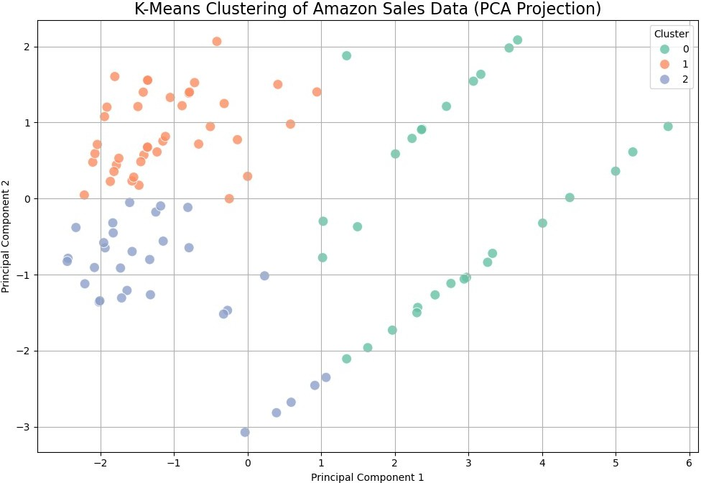
plt.figure(figsize=(10, 7))
sns.scatterplot(x='PCA1', y='PCA2', hue='Cluster', palette='Set2', data=pca_df, s=100, alpha=0.8)
plt.title('K-Means Clustering of Amazon Sales Data (PCA Projection)', fontsize=16)
plt.xlabel('Principal Component 1')
plt.ylabel('Principal Component 2') plt.legend(title='Cluster') plt.grid(True)
plt.tight_layout() plt.show()
# Elbow method to find optimal k
inertia = []
for k in range(1, 10):
km = KMeans(n_clusters=k, random_state=42) km.fit(X_scaled) inertia.append(km.inertia_)
# Plot the elbow curve plt.figure(figsize=(8, 5)) plt.plot(range(1, 10), inertia, marker='o') plt.title('Elbow Method For Optimal k')

Slide 12
plt.xlabel('Number of clusters') plt.ylabel('Inertia') plt.grid(True)
plt.show()
C:\Users\MUKHERJEE\anaconda3\Lib\site-packages\sklearn\cluster\
_kmeans.py:1429: UserWarning:
KMeans is known to have a memory leak on Windows with MKL, when there
are less chunks than available threads. You can avoid it by setting
the environment variable OMP_NUM_THREADS=1.
C:\Users\MUKHERJEE\anaconda3\Lib\site-packages\sklearn\cluster\
_kmeans.py:1429: UserWarning:
KMeans is known to have a memory leak on Windows with MKL, when there
are less chunks than available threads. You can avoid it by setting
the environment variable OMP_NUM_THREADS=1.
C:\Users\MUKHERJEE\anaconda3\Lib\site-packages\sklearn\cluster\
_kmeans.py:1429: UserWarning:
KMeans is known to have a memory leak on Windows with MKL, when there
are less chunks than available threads. You can avoid it by setting
the environment variable OMP_NUM_THREADS=1.
C:\Users\MUKHERJEE\anaconda3\Lib\site-packages\sklearn\cluster\
_kmeans.py:1429: UserWarning:
KMeans is known to have a memory leak on Windows with MKL, when there
are less chunks than available threads. You can avoid it by setting
the environment variable OMP_NUM_THREADS=1.
C:\Users\MUKHERJEE\anaconda3\Lib\site-packages\sklearn\cluster\
_kmeans.py:1429: UserWarning:
KMeans is known to have a memory leak on Windows with MKL, when there
are less chunks than available threads. You can avoid it by setting
the environment variable OMP_NUM_THREADS=1.
C:\Users\MUKHERJEE\anaconda3\Lib\site-packages\sklearn\cluster\
_kmeans.py:1429: UserWarning:
KMeans is known to have a memory leak on Windows with MKL, when there
are less chunks than available threads. You can avoid it by setting
the environment variable OMP_NUM_THREADS=1.
C:\Users\MUKHERJEE\anaconda3\Lib\site-packages\sklearn\cluster\
_kmeans.py:1429: UserWarning:
KMeans is known to have a memory leak on Windows with MKL, when there

Slide 13
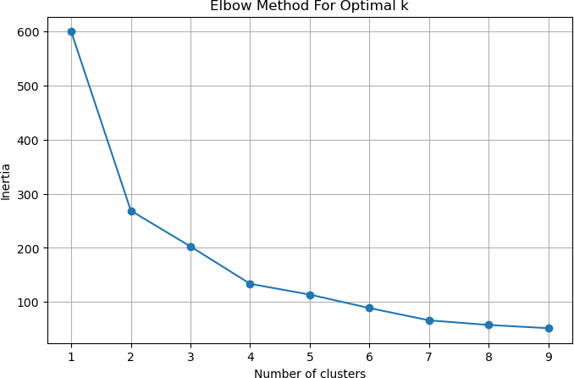
are less chunks than available threads. You can avoid it by setting the environment variable OMP_NUM_THREADS=1.
C:\Users\MUKHERJEE\anaconda3\Lib\site-packages\sklearn\cluster\
_kmeans.py:1429: UserWarning:
C:\Users\MUKHERJEE\anaconda3\Lib\site-packages\sklearn\cluster\
_kmeans.py:1429: UserWarning:
KMeans is known to have a memory leak on Windows with MKL, when there
are less chunks than available threads. You can avoid it by setting
the environment variable OMP_NUM_THREADS=1.
KMeans is known to have a memory leak on Windows with MKL, when there
are less chunks than available threads. You can avoid it by setting
the environment variable OMP_NUM_THREADS=1.
import pandas as pd
import matplotlib.pyplot as plt
from statsmodels.tsa.statespace.sarimax import SARIMAX
# Ensure dates are datetime

Slide 14
df['Order Date'] = pd.to_datetime(df['Order Date'])
# Aggregate daily total profit
daily_profit = df.groupby('Order Date')['Total Profit'].sum()
# Sort index
daily_profit = daily_profit.sort_index()
# Split into training data
train = daily_profit[:-30] # leave 30 days for testing (optional)
# Fit ARIMA model (can be tuned)
model = SARIMAX(train, order=(1, 1, 1), seasonal_order=(0, 0, 0, 0)) fit = model.fit(disp=False)
# Forecast with confidence intervals forecast_results = fit.get_forecast(steps=30) forecast = forecast_results.predicted_mean conf_int = forecast_results.conf_int()
# Create future dates index
future_dates = pd.date_range(start=train.index[-1] + pd.Timedelta(days=1), periods=30, freq='D') forecast.index = future_dates
conf_int.index = future_dates
# Plot with ribbon
plt.figure(figsize=(14, 6))
plt.plot(train.index, train, label='Train', color='blue') plt.plot(forecast.index, forecast, label='30-Day Forecast', color='orange', linestyle='--')
# Ribbon for confidence interval
plt.fill_between(forecast.index, conf_int.iloc[:, 0], conf_int.iloc[:, 1], color='orange', alpha=0.3, label='Confidence Interval')
plt.title("30-Day Forecast of Total Profit with Confidence Interval") plt.xlabel("Date")
plt.ylabel("Total Profit") plt.legend() plt.grid(True) plt.tight_layout() plt.show()
C:\Users\MUKHERJEE\anaconda3\Lib\site-packages\statsmodels\tsa\base\
tsa_model.py:473: ValueWarning: A date index has been provided, but it
has no associated frequency information and so will be ignored when
e.g. forecasting.
self._init_dates(dates, freq)
C:\Users\MUKHERJEE\anaconda3\Lib\site-packages\statsmodels\tsa\base\

Slide 15
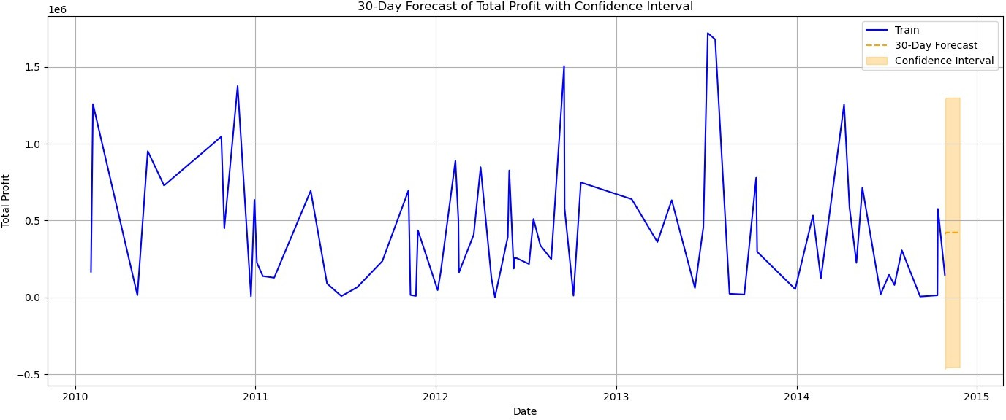
tsa_model.py:473: ValueWarning: A date index has been provided, but it has no associated frequency information and so will be ignored when
e.g. forecasting. self._init_dates(dates, freq)
C:\Users\MUKHERJEE\anaconda3\Lib\site-packages\statsmodels\tsa\ statespace\sarimax.py:978: UserWarning: Non-invertible starting MA parameters found. Using zeros as starting parameters.
warn('Non-invertible starting MA parameters found.' C:\Users\MUKHERJEE\anaconda3\Lib\site-packages\statsmodels\tsa\base\ tsa_model.py:836: ValueWarning: No supported index is available.
Prediction results will be given with an integer index beginning at
`start`.
return get_prediction_index(
C:\Users\MUKHERJEE\anaconda3\Lib\site-packages\statsmodels\tsa\base\ tsa_model.py:836: FutureWarning: No supported index is available. In the next version, calling this method in a model without a supported index will result in an exception.
return get_prediction_index(
import pandas as pd
import matplotlib.pyplot as plt
# Load your data (adjust to your file path)
# AmazonSalesData = pd.read_csv('your_file.csv')
# Plot a histogram for 'Total Profit'
plt.figure(figsize=(10, 6))
plt.hist(df['Total Profit'], bins=30, color='skyblue', edgecolor='black')
plt.title('Histogram of Total Profit') plt.xlabel('Total Profit') plt.ylabel('Frequency') plt.grid(True)

Slide 16
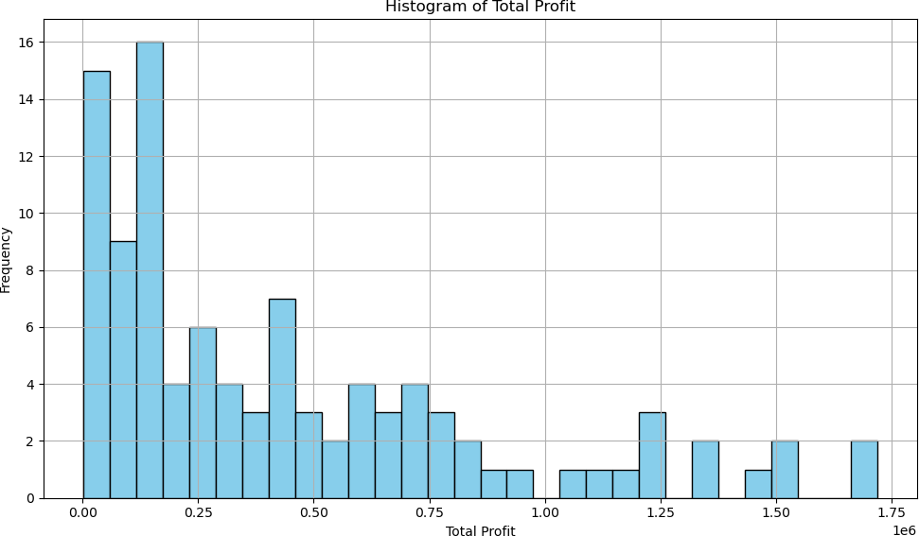
plt.tight_layout() plt.show()
plt.figure(figsize=(10, 6))
plt.hist(df['Units Sold'], bins=30, color='Yellow', edgecolor='black') plt.title('Histogram of Units Sold')
plt.xlabel('Units Sold') plt.ylabel('Frequency') plt.grid(True) plt.tight_layout() plt.show()

Slide 17
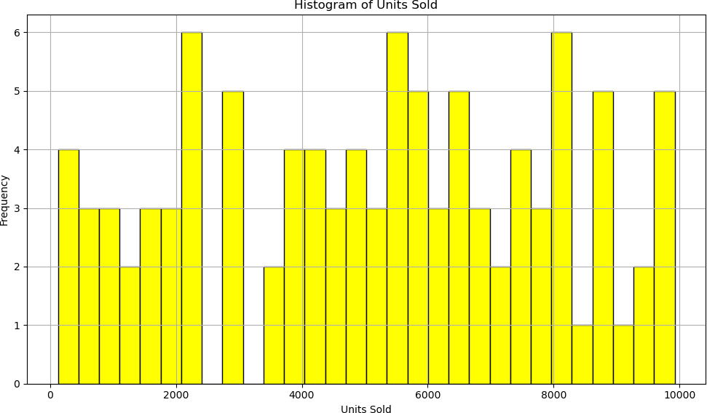
import seaborn as sns
# Plot histogram grouped by Region
plt.figure(figsize=(12, 6))
sns.histplot(data=df, x='Total Profit', hue='Region', kde=True, multiple='stack')
plt.title('Histogram of Total Profit by Region') plt.xlabel('Total Profit') plt.ylabel('Frequency')
plt.grid(True) plt.tight_layout() plt.show()

Slide 18
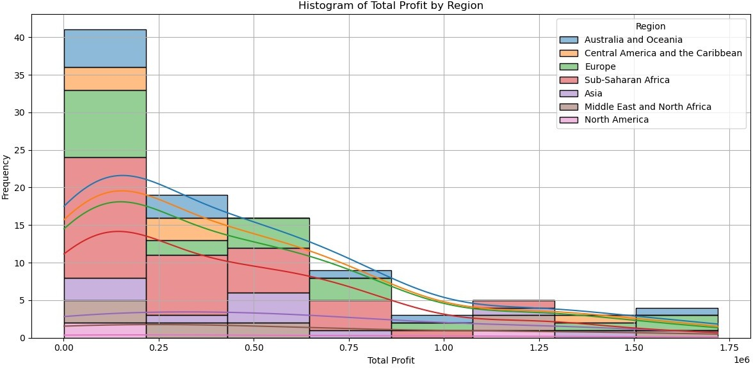
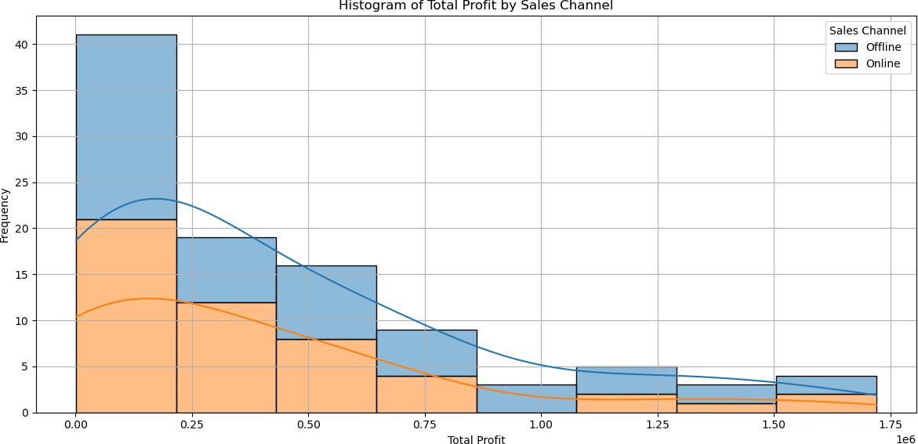
plt.figure(figsize=(12, 6))
sns.histplot(data=df, x='Total Profit', hue='Sales Channel', kde=True, multiple='stack')
plt.title('Histogram of Total Profit by Sales Channel') plt.xlabel('Total Profit')
plt.ylabel('Frequency') plt.grid(True) plt.tight_layout() plt.show()

Slide 19
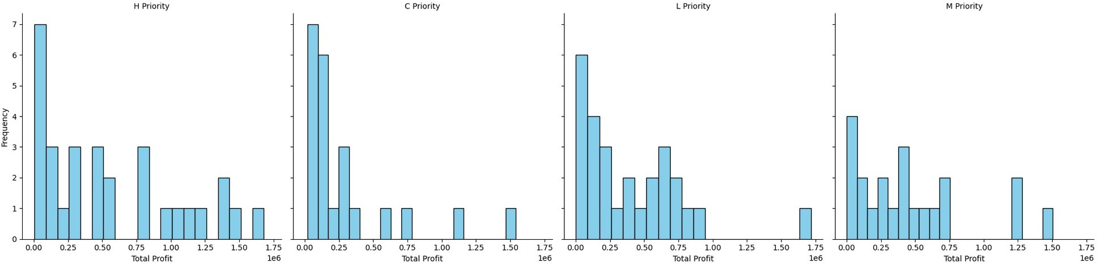
g = sns.FacetGrid(df, col='Order Priority', height=5) g.map(plt.hist, 'Total Profit', bins=20, color='skyblue', edgecolor='black')
g.set_axis_labels('Total Profit', 'Frequency') g.set_titles("{col_name} Priority") plt.tight_layout()
plt.show()
import pandas as pd
import matplotlib.pyplot as plt import seaborn as sns
# Assuming AmazonSalesData is already loaded
# Group by 'Region' and calculate the total profit for each region region_profit =df.groupby('Region')['Total Profit'].sum().sort_values(ascending=False)
# Plot a bar chart for Total Profit by Region
plt.figure(figsize=(10, 6))
region_profit.plot(kind='bar', color='skyblue', edgecolor='black') plt.title('Total Profit by Region')
plt.xlabel('Region') plt.ylabel('Total Profit') plt.xticks(rotation=45) plt.grid(True) plt.tight_layout() plt.show()

Slide 20
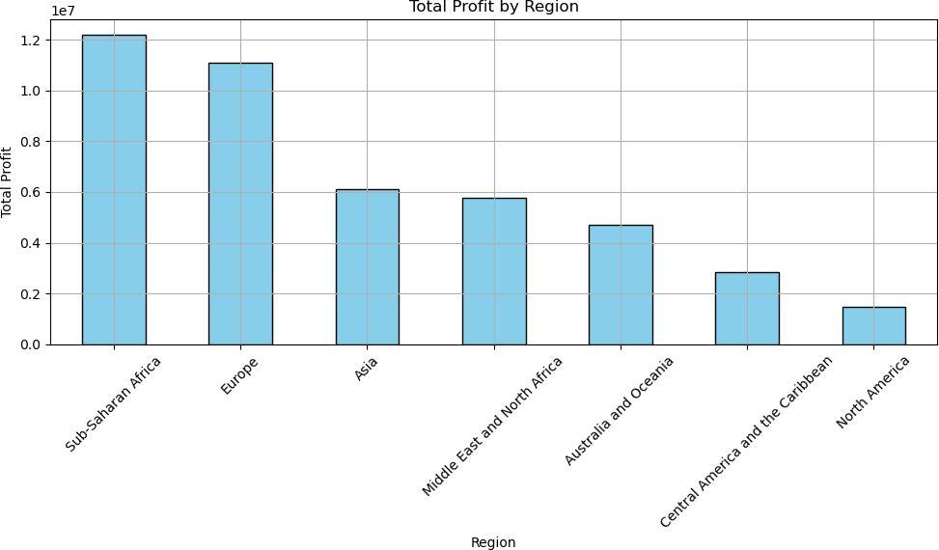
# Group by 'Sales Channel' and calculate the total units sold for each channel
sales_channel_units = df.groupby('Sales Channel')['Units Sold'].sum().sort_values(ascending=False)
# Plot a column chart for Units Sold by Sales Channel
plt.figure(figsize=(10, 6))
sales_channel_units.plot(kind='bar', color='green', edgecolor='black') plt.title('Units Sold by Sales Channel')
plt.xlabel('Sales Channel') plt.ylabel('Units Sold') plt.xticks(rotation=45) plt.grid(True) plt.tight_layout() plt.show()

Slide 21
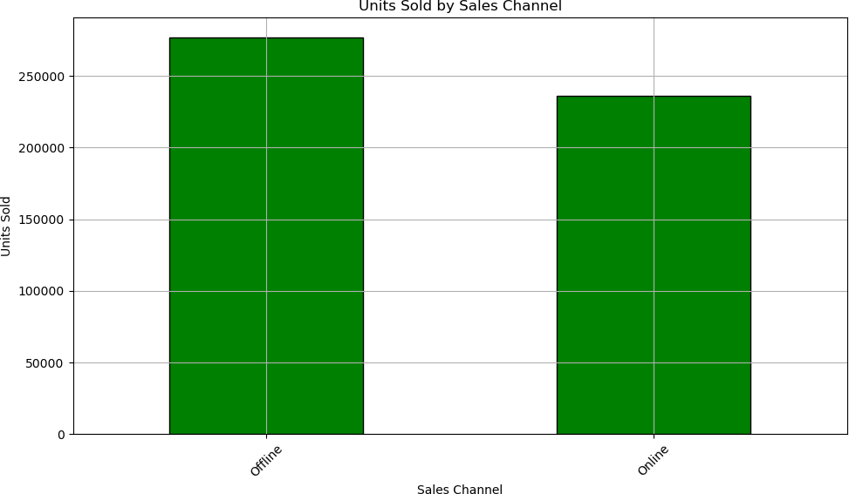
# Group by 'Item Type' and calculate the total revenue for each item type
item_type_revenue = df.groupby('Item Type')['Total Revenue'].sum().sort_values(ascending=False)
# Plot a bar chart for Total Revenue by Item Type
plt.figure(figsize=(12, 6))
item_type_revenue.plot(kind='bar', color='orange', edgecolor='black') plt.title('Total Revenue by Item Type')
plt.xlabel('Item Type') plt.ylabel('Total Revenue') plt.xticks(rotation=45) plt.grid(True) plt.tight_layout() plt.show()

Slide 22
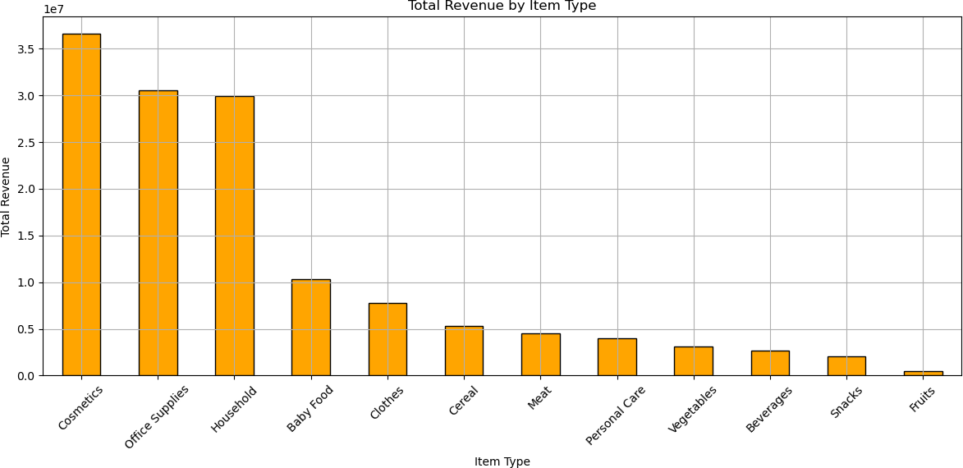
# Group by 'Order Priority' and calculate the total profit for each order priority
order_priority_profit = df.groupby('Order Priority')['Total Profit'].sum().sort_values(ascending=False)
# Plot a column chart for Total Profit by Order Priority plt.figure(figsize=(10, 6)) order_priority_profit.plot(kind='bar', color='purple', edgecolor='black')
plt.title('Total Profit by Order Priority') plt.xlabel('Order Priority') plt.ylabel('Total Profit') plt.xticks(rotation=45)
plt.grid(True) plt.tight_layout() plt.show()

Slide 23
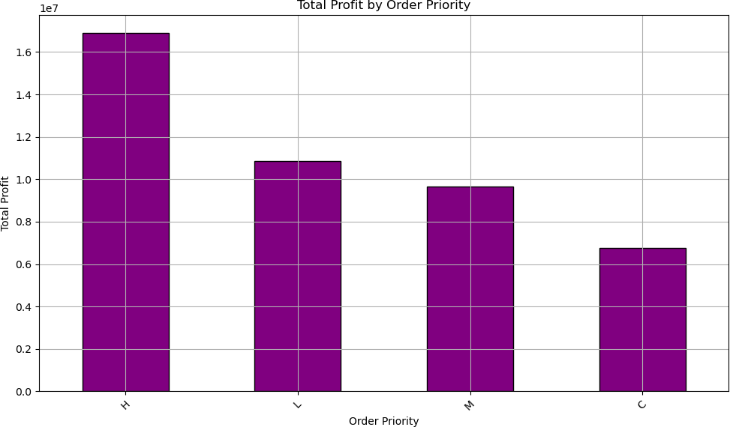
# Group by 'Country' and calculate the total cost for each country country_cost = df.groupby('Country')['Total Cost'].sum().sort_values(ascending=False)
# Plot a bar chart for Total Cost by Country
plt.figure(figsize=(12, 6))
country_cost.plot(kind='bar', color='red', edgecolor='black') plt.title('Total Cost by Country')
plt.xlabel('Country') plt.ylabel('Total Cost') plt.xticks(rotation=45) plt.grid(True) plt.tight_layout() plt.show()

Slide 24
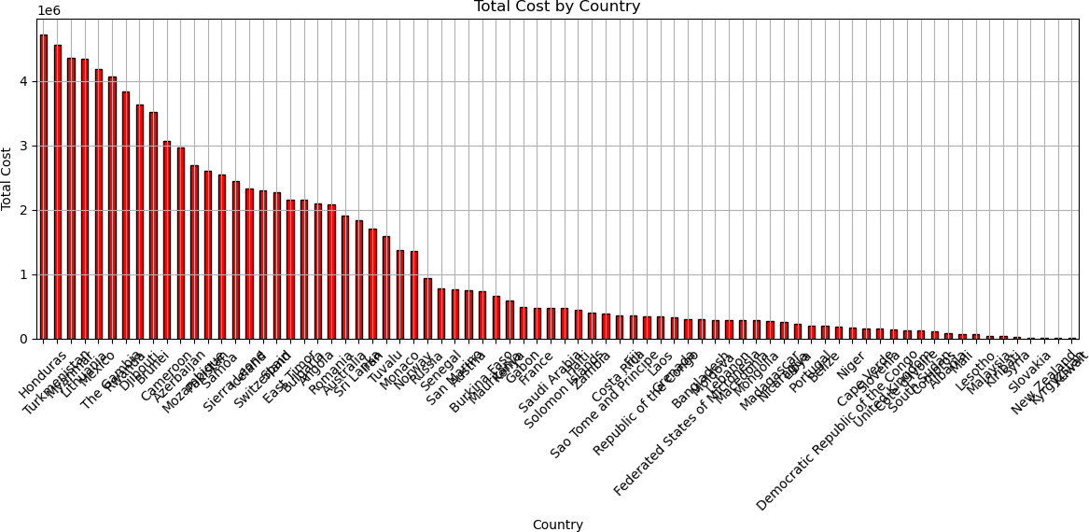
# Pivot data to get total units sold by region and sales channel sales_by_region_channel = df.pivot_table(values='Units Sold', index='Region', columns='Sales Channel', aggfunc='sum')
# Plot stacked bar chart for Sales by Region and Sales Channel sales_by_region_channel.plot(kind='bar', stacked=True, figsize=(12, 6), color=['blue', 'green', 'orange'])
plt.title('Sales by Region and Sales Channel') plt.xlabel('Region')
plt.ylabel('Units Sold') plt.xticks(rotation=45) plt.grid(True) plt.tight_layout() plt.show()

Slide 25
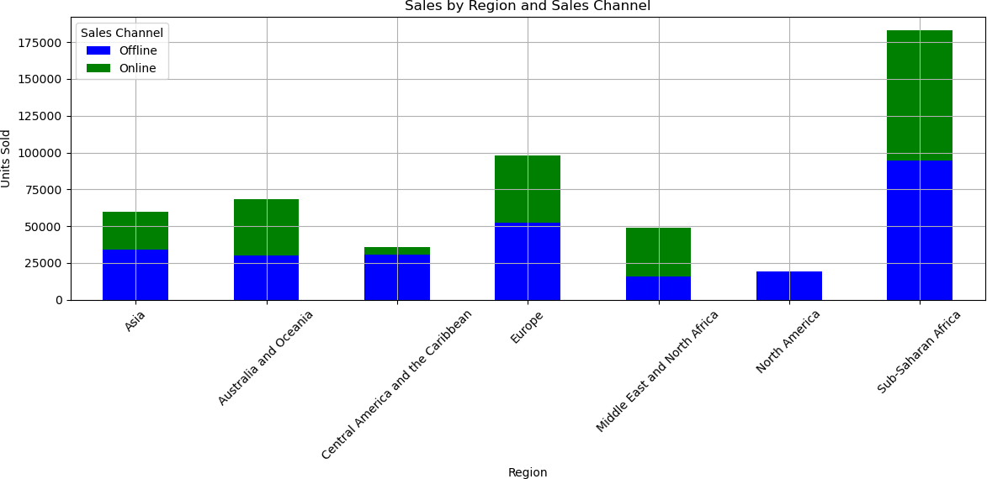
# Group by 'Country' and calculate the total profit for each country country_profit = df.groupby('Country')['Total Profit'].sum().sort_values(ascending=True)
# Plot a horizontal bar chart for Total Profit by Country
plt.figure(figsize=(10, 6))
country_profit.plot(kind='barh', color='teal', edgecolor='black') plt.title('Total Profit by Country')
plt.xlabel('Total Profit') plt.ylabel('Country') plt.grid(True) plt.tight_layout() plt.show()

Slide 26
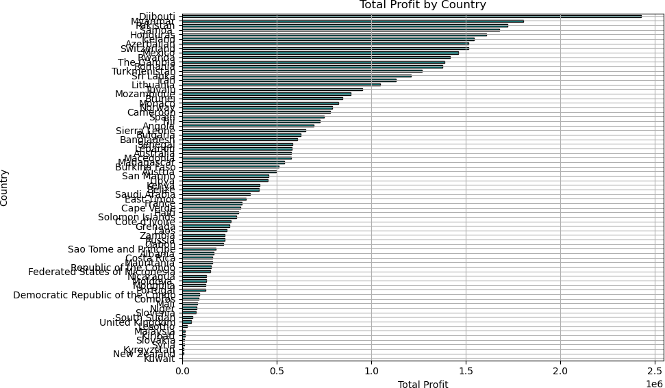
import pandas as pd
import matplotlib.pyplot as plt
# Group by 'Region' and calculate the total revenue for each region
region_revenue = df.groupby('Region')['Total Revenue'].sum()
# Create a donut chart for Total Revenue by Region
plt.figure(figsize=(8, 8))
plt.pie(region_revenue, labels=region_revenue.index, autopct='%1.1f%
%', startangle=90, wedgeprops={'width': 0.4}) plt.title('Total Revenue Distribution by Region')
plt.axis('equal') # Equal aspect ratio ensures the pie is drawn as a circle.
plt.tight_layout() plt.show()

Slide 27
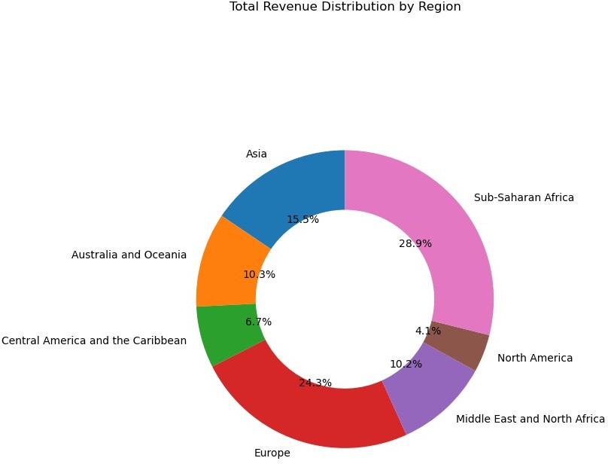
# Group by 'Sales Channel' and calculate the total units sold for each channel
sales_channel_units = df.groupby('Sales Channel')['Units Sold'].sum()
# Create a donut chart for Units Sold by Sales Channel
plt.figure(figsize=(8, 8))
plt.pie(sales_channel_units, labels=sales_channel_units.index, autopct='%1.1f%%', startangle=90, wedgeprops={'width': 0.4}) plt.title('Units Sold Distribution by Sales Channel') plt.axis('equal')
plt.tight_layout() plt.show()

Slide 28
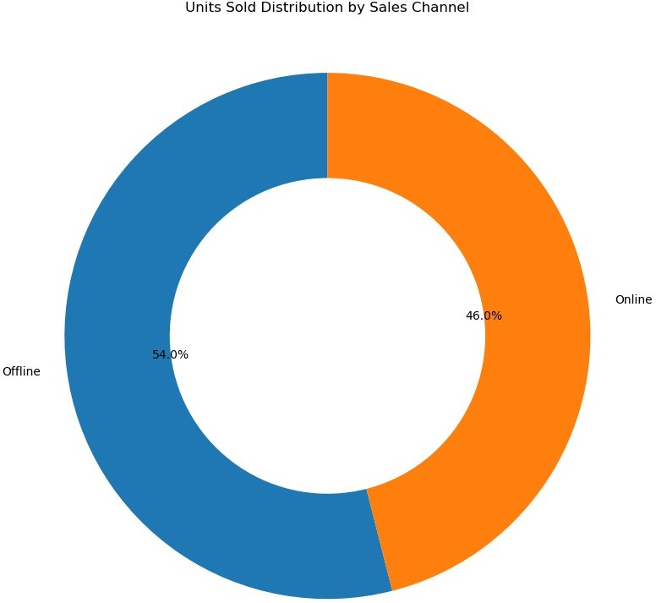
# Group by 'Item Type' and calculate the total profit for each item type
item_type_profit = df.groupby('Item Type')['Total Profit'].sum()
# Create a donut chart for Total Profit by Item Type
plt.figure(figsize=(8, 8))
plt.pie(item_type_profit, labels=item_type_profit.index, autopct='%1.1f%%', startangle=90, wedgeprops={'width': 0.4}) plt.title('Total Profit Distribution by Item Type') plt.axis('equal')
plt.tight_layout() plt.show()

Slide 29
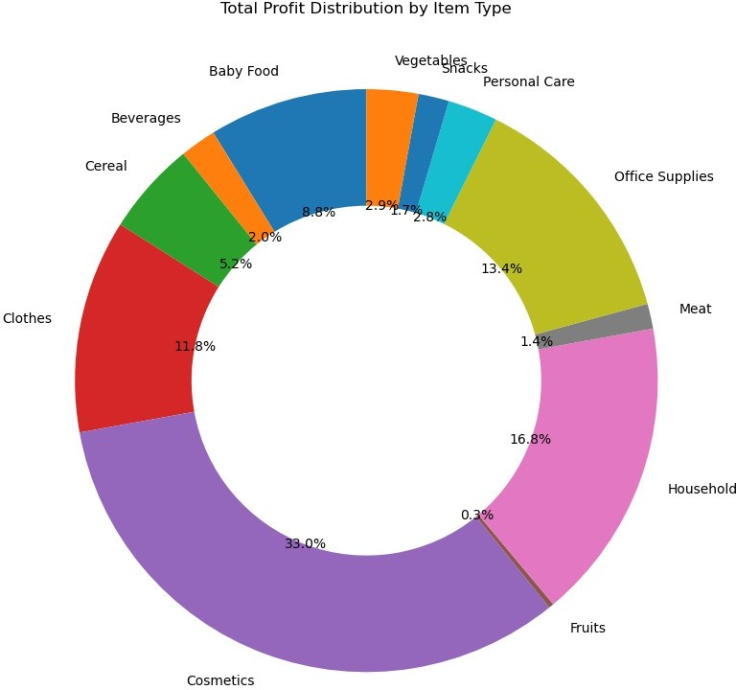
# Group by 'Country' and calculate the total cost for each country
country_cost = df.groupby('Country')['Total Cost'].sum()
# Create a pie chart for Total Cost by Country
plt.figure(figsize=(8, 8))
plt.pie(country_cost, labels=country_cost.index, autopct='%1.1f%%', startangle=90)
plt.title('Total Cost Distribution by Country') plt.axis('equal') # Ensures that pie chart is drawn as a circle. plt.tight_layout()
plt.show()

Slide 30
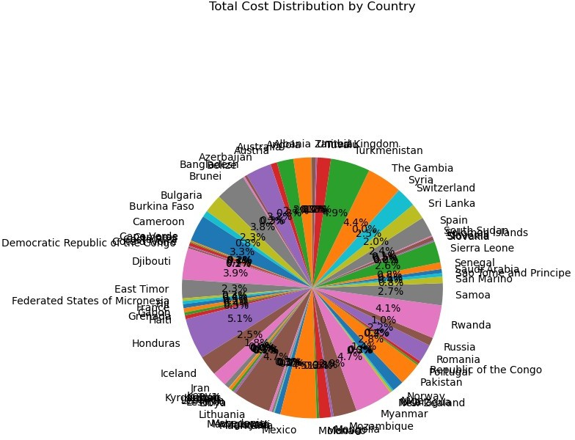
pip install plotly
Requirement already satisfied: plotly in c:\users\mukherjee\anaconda3\ lib\site-packages (5.24.1)
Requirement already satisfied: tenacity>=6.2.0 in c:\users\mukherjee\ anaconda3\lib\site-packages (from plotly) (8.2.3)
Requirement already satisfied: packaging in c:\users\mukherjee\ anaconda3\lib\site-packages (from plotly) (24.1)
Note: you may need to restart the kernel to use updated packages.
import plotly.express as px
# Group by 'Country' and calculate the total cost for each country

Slide 31
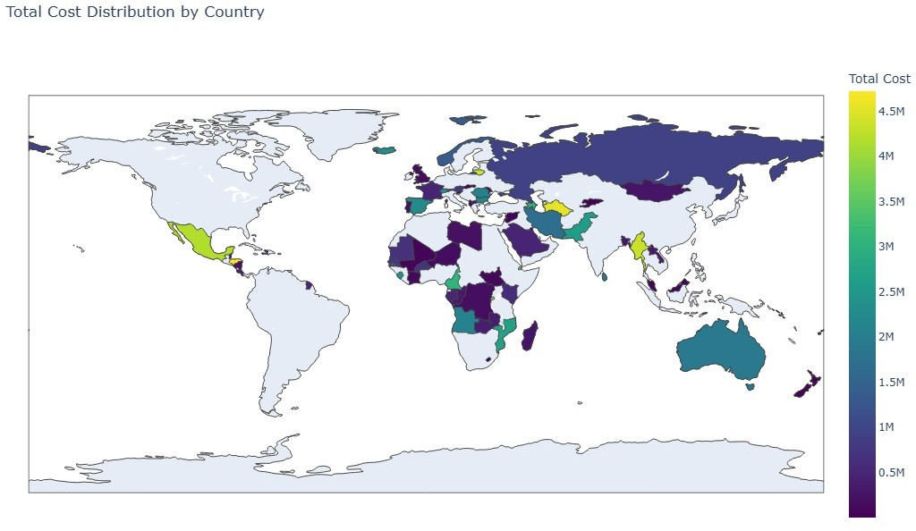
country_cost = df.groupby('Country')['Total Cost'].sum().reset_index()
# Create a choropleth map for Total Cost by Country
fig = px.choropleth(country_cost,
locations='Country', locationmode='country names', color='Total Cost', color_continuous_scale='Viridis',
title='Total Cost Distribution by Country')
# Adjusting map size for a larger visual
fig.update_layout(
width=1000, # Width of the map
height=700, # Height of the map
)
# Show the map
fig.show()
pip install matplotlib seaborn pandas
Requirement already satisfied: matplotlib in c:\users\mukherjee\ anaconda3\lib\site-packages (3.9.2)
Requirement already satisfied: seaborn in c:\users\mukherjee\ anaconda3\lib\site-packages (0.13.2)

Slide 32
Requirement already satisfied: pandas in c:\users\mukherjee\anaconda3\ lib\site-packages (2.2.2)
Requirement already satisfied: contourpy>=1.0.1 in c:\users\mukherjee\ anaconda3\lib\site-packages (from matplotlib) (1.2.0)
Requirement already satisfied: cycler>=0.10 in c:\users\mukherjee\ anaconda3\lib\site-packages (from matplotlib) (0.11.0)
Requirement already satisfied: fonttools>=4.22.0 in c:\users\ mukherjee\anaconda3\lib\site-packages (from matplotlib) (4.51.0) Requirement already satisfied: kiwisolver>=1.3.1 in c:\users\ mukherjee\anaconda3\lib\site-packages (from matplotlib) (1.4.4) Requirement already satisfied: numpy>=1.23 in c:\users\mukherjee\ anaconda3\lib\site-packages (from matplotlib) (1.26.4)
Requirement already satisfied: packaging>=20.0 in c:\users\mukherjee\ anaconda3\lib\site-packages (from matplotlib) (24.1)
Requirement already satisfied: pillow>=8 in c:\users\mukherjee\ anaconda3\lib\site-packages (from matplotlib) (10.4.0)
Requirement already satisfied: pyparsing>=2.3.1 in c:\users\mukherjee\ anaconda3\lib\site-packages (from matplotlib) (3.1.2)
Requirement already satisfied: python-dateutil>=2.7 in c:\users\ mukherjee\anaconda3\lib\site-packages (from matplotlib) (2.9.0.post0) Requirement already satisfied: pytz>=2020.1 in c:\users\mukherjee\ anaconda3\lib\site-packages (from pandas) (2024.1)
Requirement already satisfied: tzdata>=2022.7 in c:\users\mukherjee\ anaconda3\lib\site-packages (from pandas) (2023.3)
Requirement already satisfied: six>=1.5 in c:\users\mukherjee\ anaconda3\lib\site-packages (from python-dateutil>=2.7->matplotlib) (1.16.0)
Note: you may need to restart the kernel to use updated packages.
import matplotlib.pyplot as plt import seaborn as sns
import pandas as pd
plt.figure(figsize=(12, 8)) sns.scatterplot(x='Units Sold',
y='Total Revenue', hue='Item Type', style='Region', data=df, palette='Set1', s=100,
alpha=0.7)
plt.title('Total Revenue vs Units Sold by Item Type and Region', fontsize=16)
plt.xlabel('Units Sold', fontsize=14) plt.ylabel('Total Revenue', fontsize=14)

Slide 33
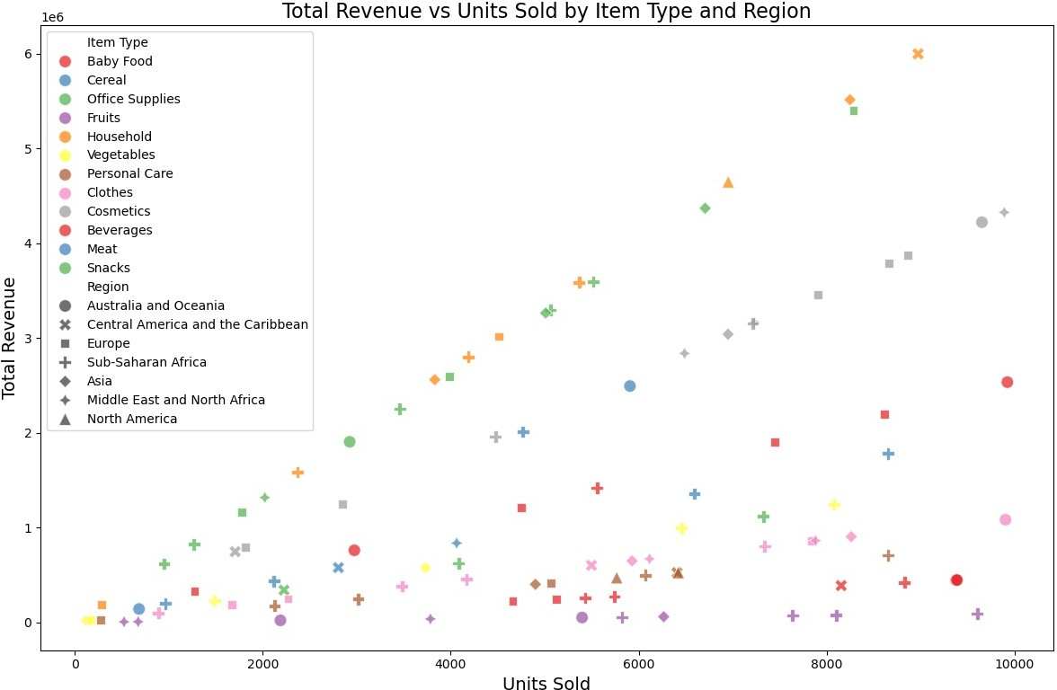
plt.tight_layout() plt.show()
plt.figure(figsize=(12, 8)) sns.scatterplot(x='Total Cost',
y='Total Profit', hue='Sales Channel', style='Order Priority', data=df, palette='twilight', s=100,
alpha=0.7)
plt.title('Total Cost vs Total Profit by Sales Channel and Order Priority', fontsize=16)
plt.xlabel('Total Cost', fontsize=14) plt.ylabel('Total Profit', fontsize=14)
plt.tight_layout() plt.show()

Slide 34
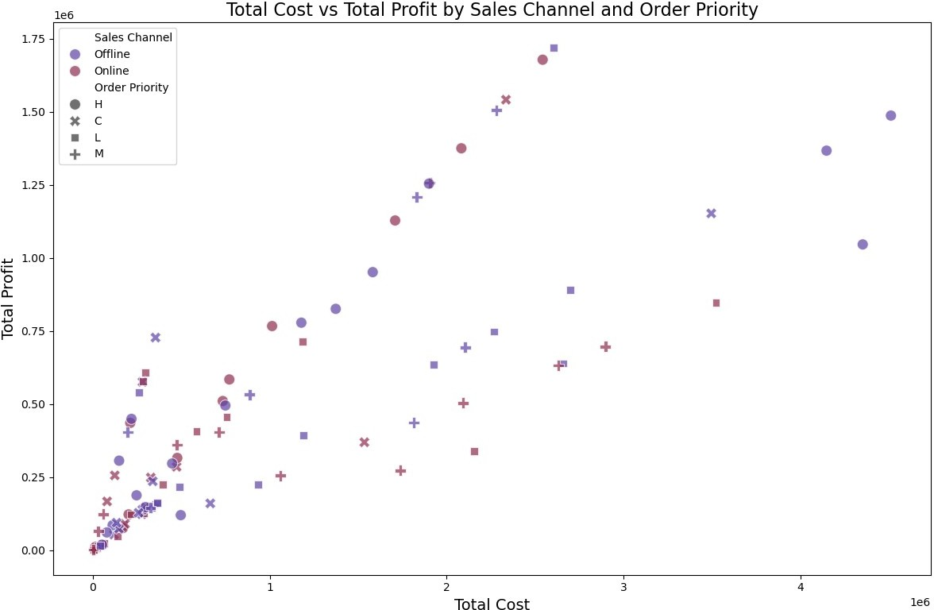
import pandas as pd import seaborn as sns
import matplotlib.pyplot as plt
# Load your data (if CSV: pd.read_csv('file.csv')) # Make sure 'Order Date' is datetime
df['Order Date'] = pd.to_datetime(df['Order Date'])
# Optional: filter or clean data
df = df.dropna(subset=['Total Profit', 'Region'])
# Violin plot
plt.figure(figsize=(12, 6)) sns.violinplot(x='Region', y='Total Profit', data=df) plt.title('Distribution of Total Profit by Region') plt.xticks(rotation=45)
plt.grid(True) plt.tight_layout() plt.show()

Slide 35
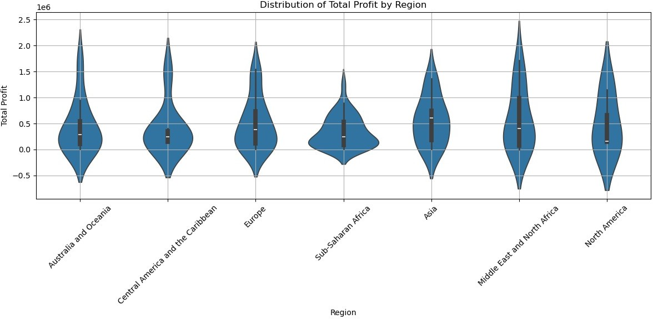

Slide 36
THANK yOU

