Slide 1
Introduction

Slide 2
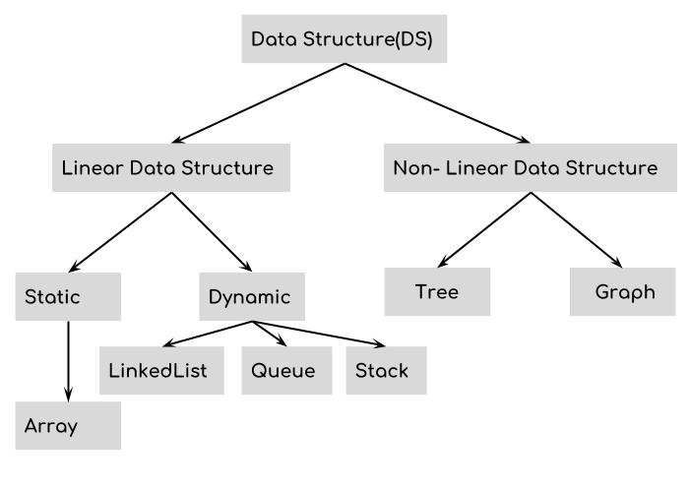
DATA STRUCTURES
A data structure is a data organization, management, and storage format that enables efficient access and modification.
ADVANCED DATA STRUCTURES AND ALGORITHMS
1

Slide 3
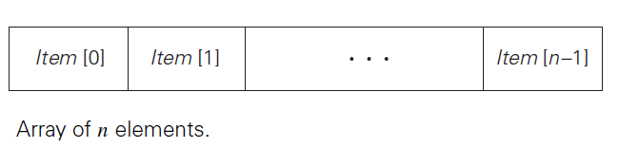
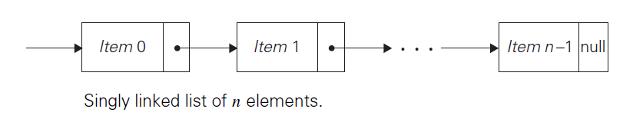
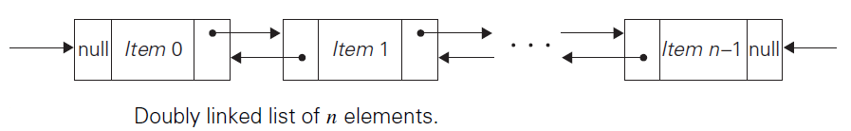
Linear Data Structures
ADVANCED DATA STRUCTURES AND ALGORITHMS
2

Slide 4
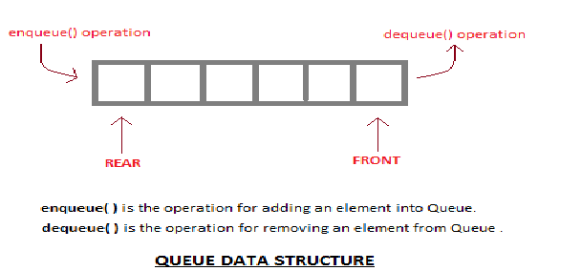
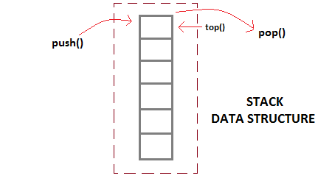
Linear Data Structures
ADVANCED DATA STRUCTURES AND ALGORITHMS
3

Slide 5
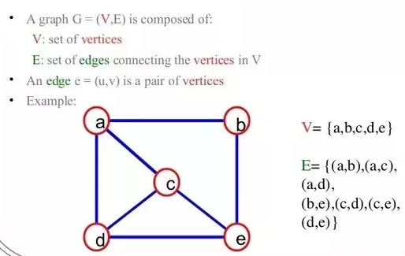
Non-Linear Data Structures
Graph
ADVANCED DATA STRUCTURES AND ALGORITHMS
4

Slide 6

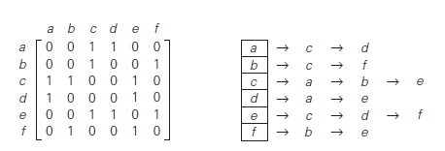
Non-Linear Data Structures
Graph Representations
ADVANCED DATA STRUCTURES AND ALGORITHMS
5

Slide 7
Non-Linear Data Structures
Weighted Graphs: A weighted graph is a graph with numbers assigned to its edges.
Paths: A path from vertex u to vertex v of a graph G can be defined as a sequence of adjacent vertices that starts with u and ends with v.
Simple path
Length of a path
Cycles
directed path
ADVANCED DATA STRUCTURES AND ALGORITHMS
6

Slide 8
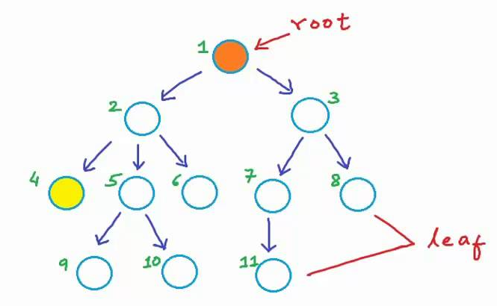
Non-Linear Data Structures
Tree - A tree is a connected acyclic graph. [Rooted Tree]
ADVANCED DATA STRUCTURES AND ALGORITHMS
7

Slide 9
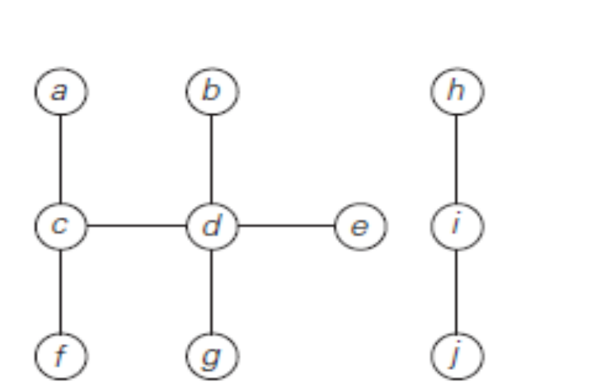
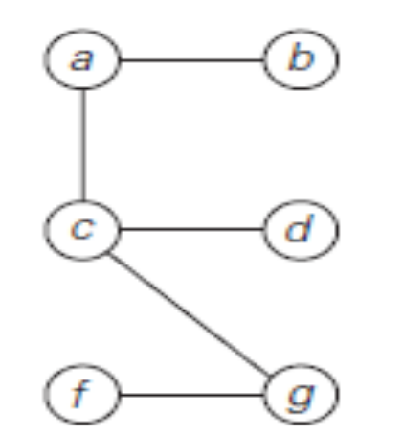
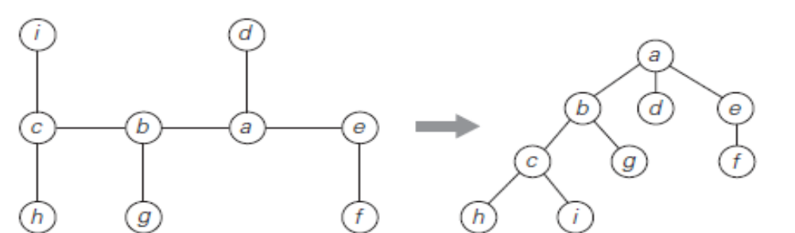
Non-Linear Data Structures
FREE TREE
FOREST
FREE TRRE ROOTED TREE
ADVANCED DATA STRUCTURES AND ALGORITHMS
8

Slide 10
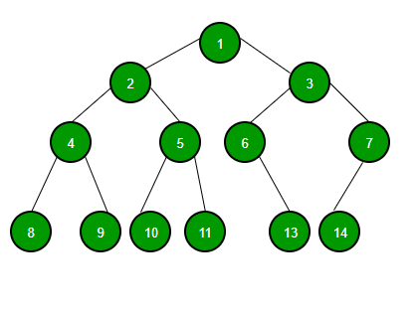
Non-Linear Data Structures
BINARY TREE
ADVANCED DATA STRUCTURES AND ALGORITHMS
9

Slide 11
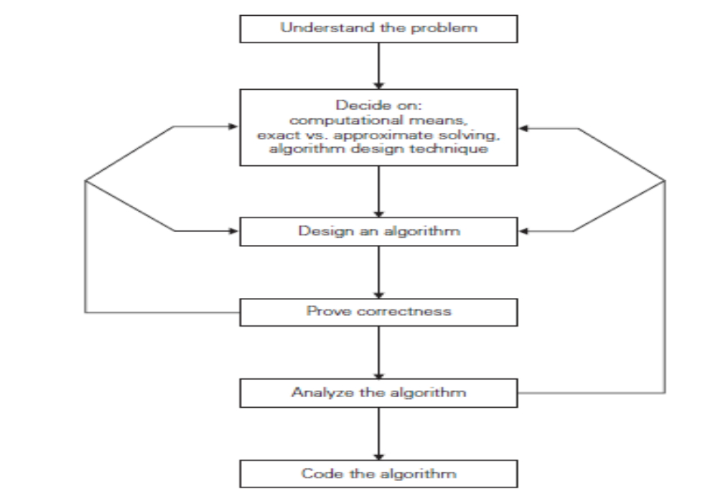
ALGORITHM DESIGN
ADVANCED DATA STRUCTURES AND ALGORITHMS
10

Slide 12
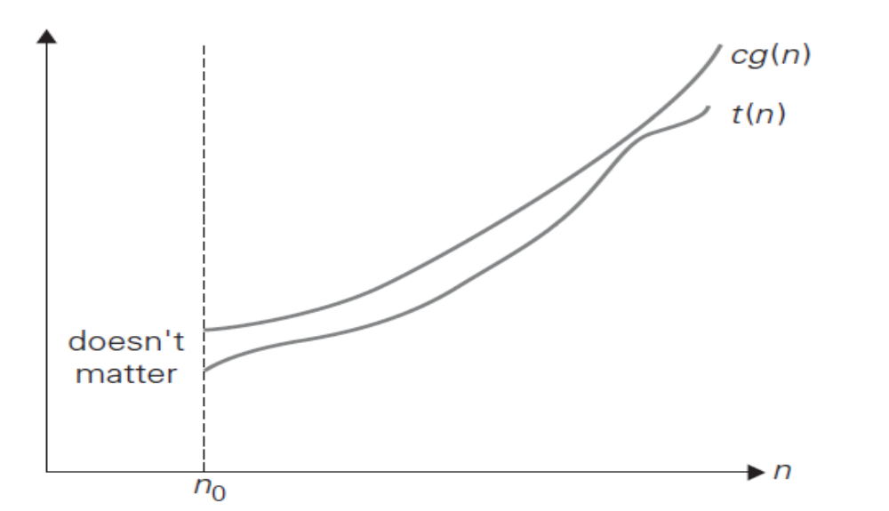
Asymptotic Notations and Basic Efficiency Classes
O-notation
DEFINITION A function t (n) is said to be in O(g(n)), denoted t (n) ∈ O(g(n)), if t (n) is bounded above by some constant multiple of g(n) for all large n, i.e., if there exist some positive constant c and some nonnegative integer n0 such that
t (n) ≤ cg(n) for all n ≥ n0.
ADVANCED DATA STRUCTURES AND ALGORITHMS
11

Slide 13
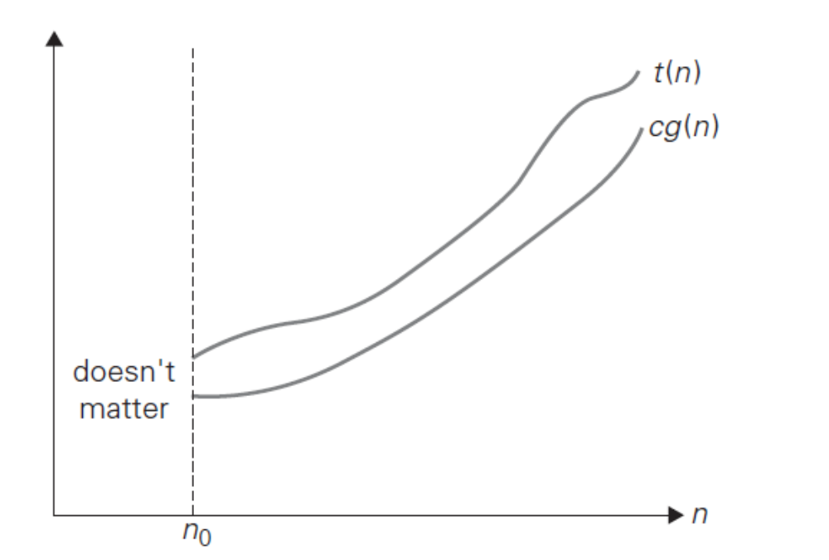
Asymptotic Notations and Basic Efficiency Classes
Ω-notation
DEFINITION A function t (n) is said to be in (g(n)), denoted t (n) ∈ (g(n)), if t (n) is bounded below by some positive constant multiple of g(n) for all large n, i.e., if there exist some positive constant c and some nonnegative integer n₀ such that
t (n) ≥ cg(n) for all n ≥ n₀.
ADVANCED DATA STRUCTURES AND ALGORITHMS
12

Slide 14
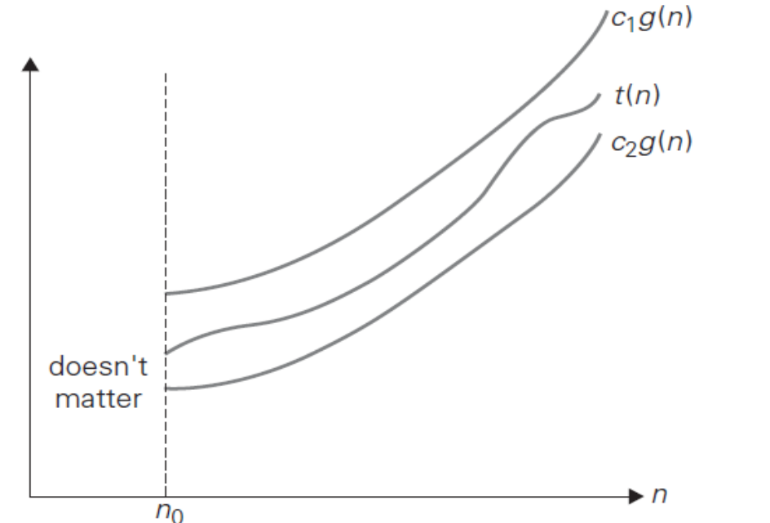
Asymptotic Notations and Basic Efficiency Classes
ϴ-notation
DEFINITION A function t (n) is said to be in (g(n)), denoted t (n) ∈ (g(n)), if t (n) is bounded both above and below by some positive constant multiples of g(n) for all large n, i.e., if there exist some positive constants c1 and c2 and some nonnegative integer n0 such that
c2g(n) ≤ t (n) ≤ c1g(n) for all n ≥ n0.
ADVANCED DATA STRUCTURES AND ALGORITHMS
13

Slide 15
CSE 5152 ADVANCED DATA STRUCTURES AND ALGORITHMS [3 1 0 4]
Amortized Analysis: Aggregate analysis, The Aggregate analysis, The accounting method, The potential method, Dynamic Tables.
B-Trees: Basic operations on B-Trees, Deleting a key from a B-Tree.
Binomial trees and Binomial heaps: Operations on Binomial heaps.
Structure of Fibonacci heaps, Mergeable heap operations, Decreasing a key and deleting a node.
The van Emde Roas Tree: Preliminary approaches, A recursive structure.
Disjoint-set operations: Linked-list representation of disjoint sets, Disjoint set forests.
Single-Source Shortest Path: The Bellman-Ford algorithm, Single-source shortest paths in directed acyclic graphs, Difference constraints and shortest paths.
ADVANCED DATA STRUCTURES AND ALGORITHMS
14

Slide 16
All-Pairs Shortest Paths: shortest Paths and matrix multiplication, Johnson’s algorithm for sparse graphs
Maximum Flow: Flow Networks, The Ford-Fulkerson method, Maximum Bipartite Matching,
Multithreaded Algorithms: The basics of dynamic multithreading, Multithreaded matrix multiplication, Multithreaded merge sort.
ADVANCED DATA STRUCTURES AND ALGORITHMS
15

Slide 17
References:
1. Cormen Thomas H., Leiserson Charles E, Rivest Ronald L. and Stein Clifford, “Introduction to Algorithms”, (3e), MIT Press, 2009.
2. Cormen Thomas H., Leiserson Charles E, Rivest Ronald L. and Stein Clifford, “Introduction to Algorithms” (2e), Prentice-Hall India, 2001.
3. Baase Sara and Gelder A.V., “Computer Algorithms -Introduction to Design and Analysis”, (3e), Pearson Education, 2000
4. Anany Levitin, “Introduction to the Design and Analysis of Algorithms,” (3e), Pearson Education, 2011
ADVANCED DATA STRUCTURES AND ALGORITHMS
16

