Slide 1
Amortized Analysis

Slide 2
Amortized Analysis
In an amortized analysis, the time required to perform a sequence of data structure operations is averaged over all the operations performed.
= T(n)/n
Goal: Show that although some individual operations may be expensive, on average the cost per operation is small.
Average in this context does not mean that we’re averaging over a distribution of inputs.
No probability is involved.
average cost in the worst case
Two problems
  stack operations, including a multipop
  binary counter using the increment operation

Slide 3
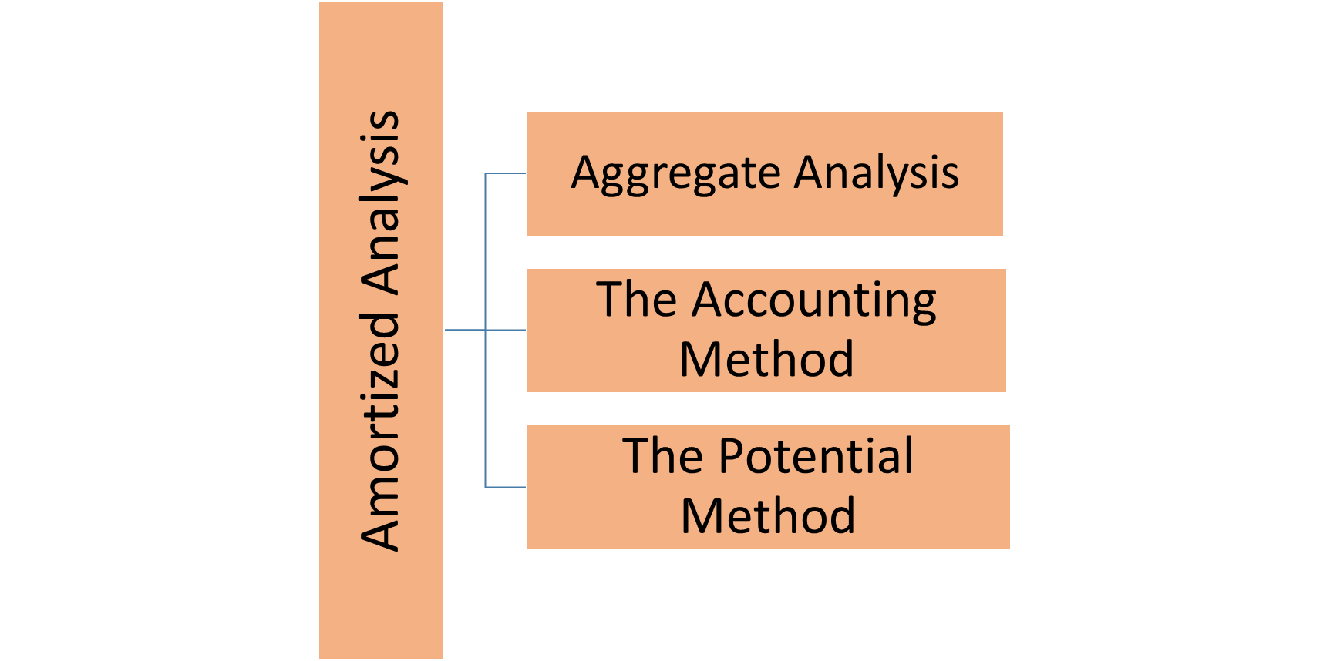
Amortized Analysis

Slide 4
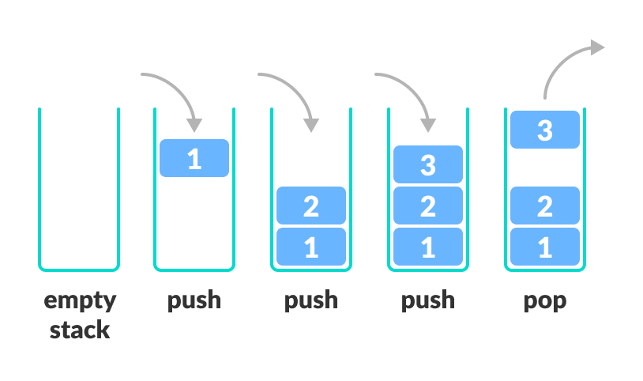
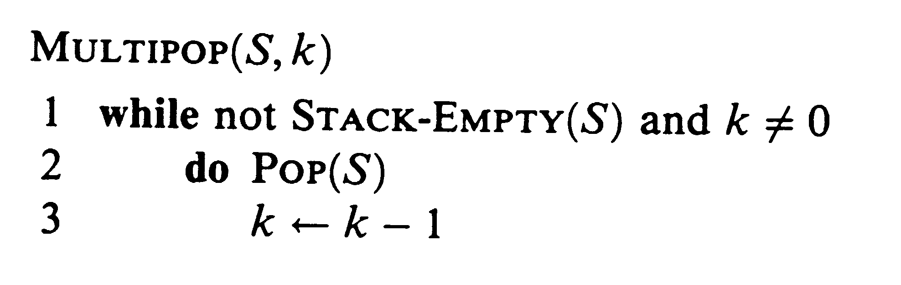
Aggregate Analysis
Stack Operations:
Goal
  find worst case time, T(n), for n operations
  the amortized cost is T(n) / n
Stack operations -Push and Pop
PUSH.S; x/: O.1/ each)O.n/ for any sequence of n operations.
POP.S/: O.1/ each)O.n/ for any sequence of n operations
  complexity is min(s,k) where s is the stack size.

Slide 5
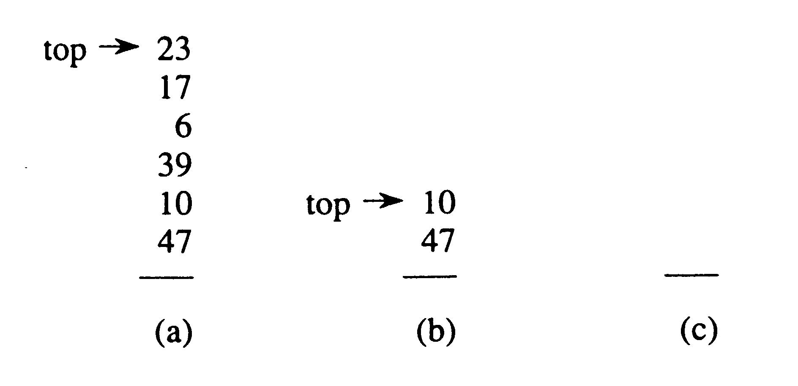
A Simple Analysis
MULTIPOP(S,7)
MULTIPOP(S,4)
Start with empty stack
  Stack can be no larger than O(n)
  So a multipop operation could have complexity O(n)
  Since there are n operations, an upper bound on complexity is O(n²)
Although this is a valid upper bound, it grossly overestimates the upper bound

Slide 6
Aggregate Analysis
Sequence of n PUSH, POP, MULTIPOP operations:
Worst-case cost of MULTIPOP is O(n)
Have n operations.
Therefore, worst-case cost of sequence is O(n²).
Observation:
Each object can be popped only once per time that it’s pushed.
Have n PUSHes→ n POPs, including those in MULTIPOP.
Therefore, total cost = O(n).
Average over the n operations → O(1) per operation on average

Slide 7
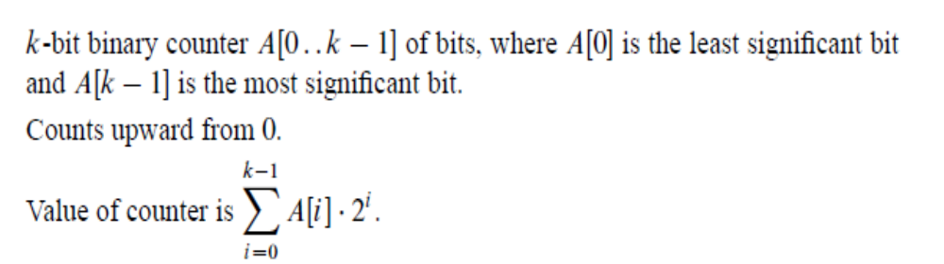
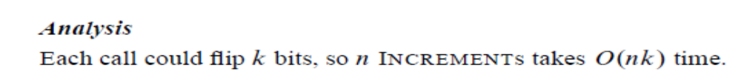
Binary counter

Slide 8
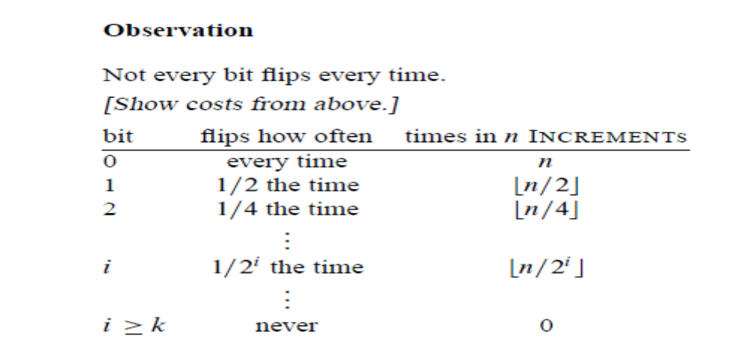
Binary counter

Slide 9
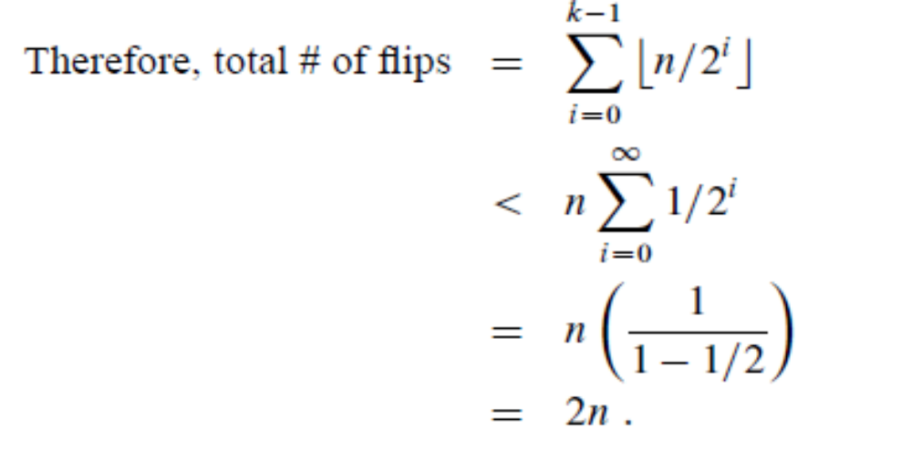
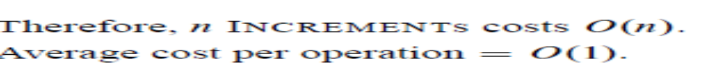
Binary counter

Slide 10
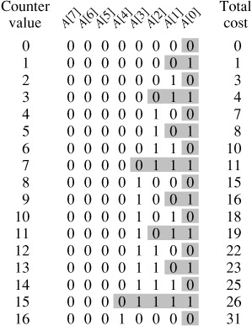
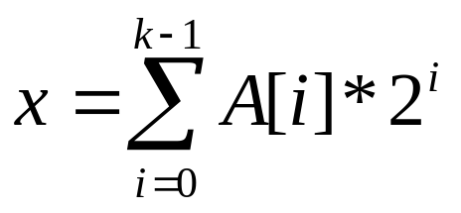
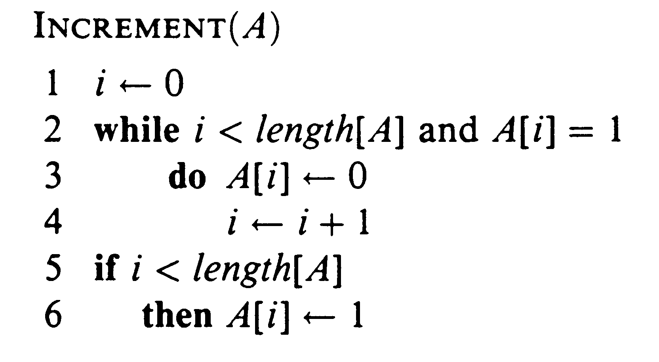
Incrementing Binary Numbers
Assume bits A[k-1] to A[0]
Incrementing starting from 0
The diagram to the right counts the number of bit flips; for the first 16 numbers the total cost is 31;

Slide 11
A Simple Analysis
We measure cost as the number of bit flips
  some operations only flip one bit
  other operations ripple through the number and flip many bits
  what is the average cost per operation?
A cursory analysis
  worst case for the increment operation is O(k)
  a sequence of n increment operations would have worst case behavior of O( n k )
Although this is an upper bound, it is not very tight

Slide 12
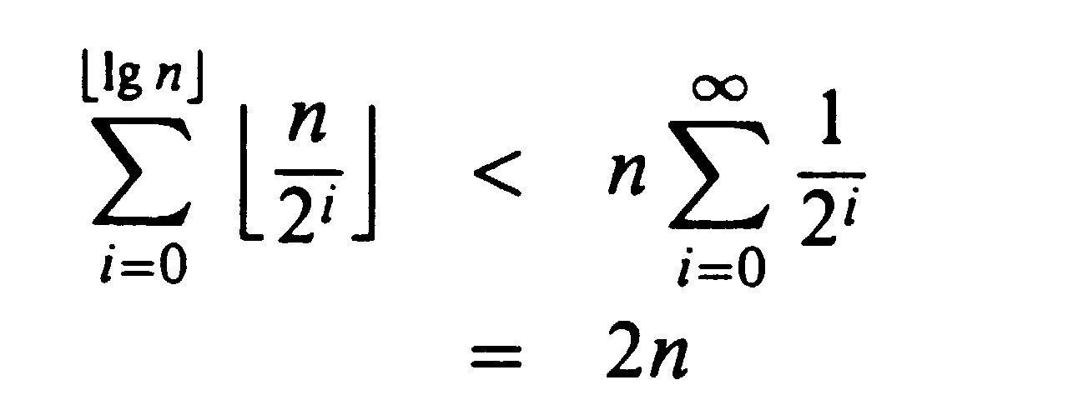
An Amortized Analysis
Not all bits are flipped each iteration
  A[0] is flipped every iteration;
  A[1] every other iteration
  A[2] every fourth, and so forth
  for i > ⎣log n⎦, the bit A[i] never flips
  summing all the bit flips we have
So it turns out the worst case is bounded by O(n)
Therefore O(n) / n is only O(1) !

