Slide 1
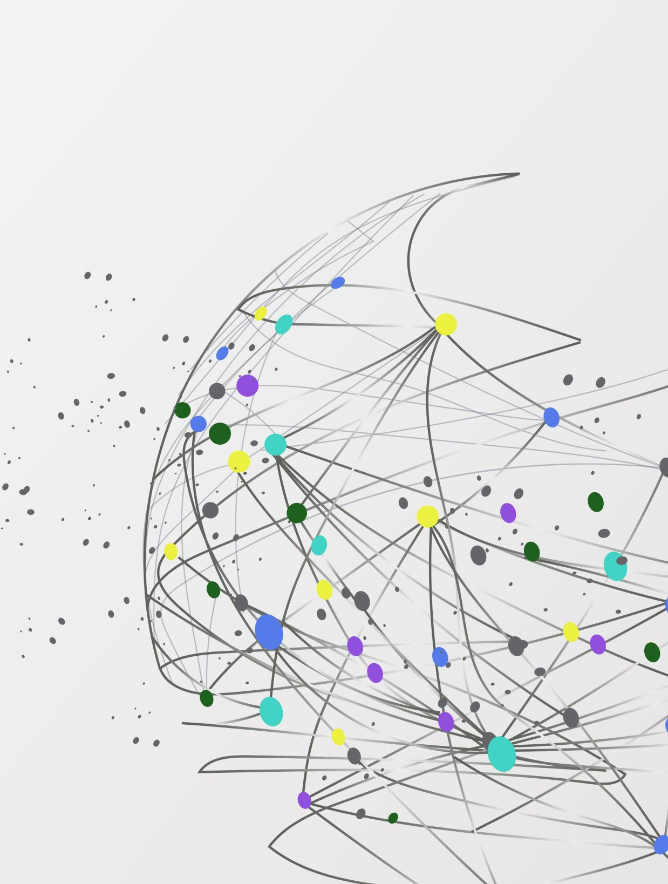
MiniPong Agent Development
Pramod K C

Slide 2
Objective
Develop an agent to play MiniPong using both a manual (non-RL) and a reinforcement learning (RL) approach
Implement a manual strategy based on relative position
Build and train an RL agent to learn optimal actions over time
Analyze and compare training and testing performance

Slide 3
Background
Environment:
Level: 1 (observed state = dz, relative distance between paddle and marker).
Size: 5 (grid size).
Game Rules:
The agent moves the paddle to keep the ball (marker) from reaching the bottom.
Receives positive reward when the ball reflects off the paddle.
Ends when the ball reaches the bottom row without bouncing off the paddle

Slide 4
Simple Non-RL Agent
Initialize environment
Create strategy based on dz
dz < 0: Move Left (ball is left of paddle)
If dz > 0: Move Right (ball is right of paddle)
If dz = 0: Stay in place
Get relative position dz from the state.
Select action based on dz using the strategy.
Take action in the environment.
Accumulate rewards from each step.

Slide 5
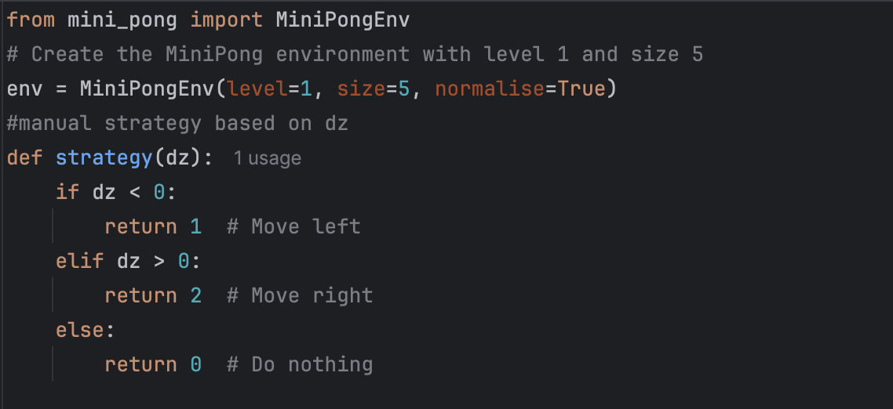
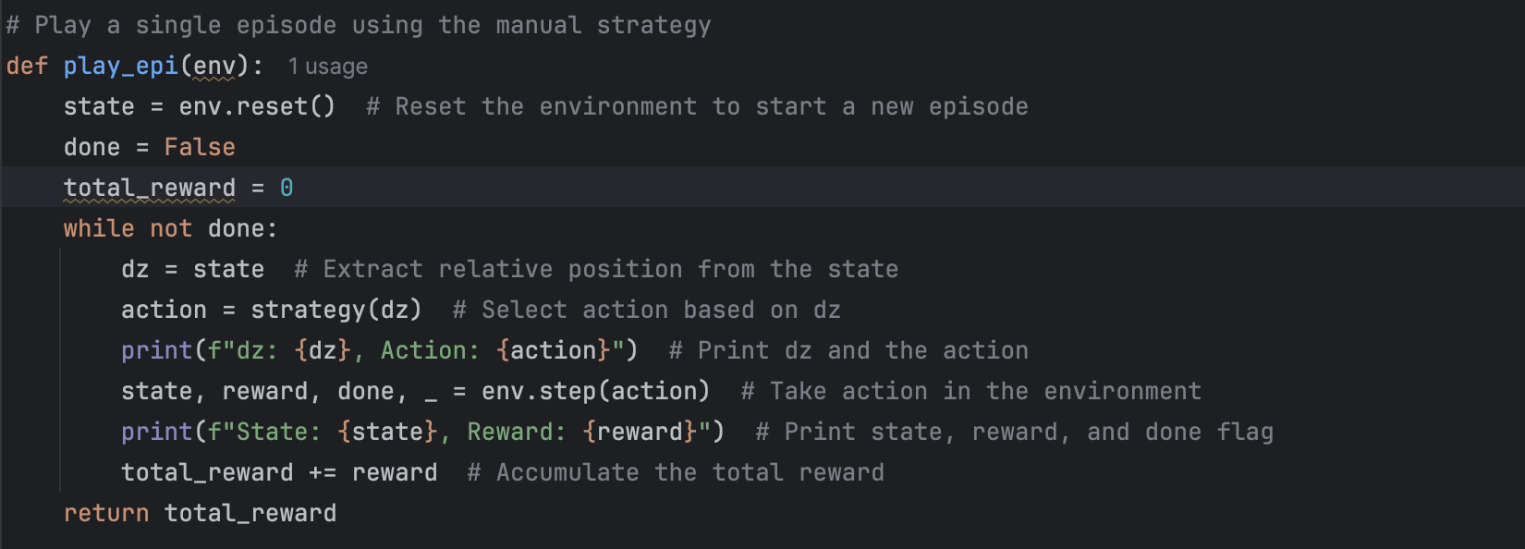
Simple Non-RL Agent

Slide 6
Reinforcement Learning (RL) Agent
an agent learns to make decisions by interacting with an environment
maximize its cumulative reward over time by choosing actions that lead to favorable outcomes
MiniPong with discrete actions (move left, right, or stay)
Tabular Q-learning with ϵ-greedy strategy for exploration

Slide 7
Q-Learning
TD learning method where the Q-values are updated using the maximum reward expected from the next state
Straightforward, easy to implement, and works well in environments with small, discrete state-action spaces
Tabular Q-learning is often faster and easier to train than a deep neural network

Slide 8
Workflow
Define Environment and Inputs
Level = 1, state dz
Action Move Left, Right, Do Nothing
Reward
Initaliaze Q-Learning Parameters
Learning Rate(alpha), Discount Factor(gamma), Exploration rate(epsilon), Epsilon Decay (epsilon decay), Number of Discrete States (bins)
bins=20, alpha=0.1, gamma=0.99, epsilon=1.0, epsilon_min=0.1, epsilon_decay=0.995
Initaliaze Q-table
stores the expected reward (Q-value) for each state-action pair.
Q-table can have dimensions [bins x number of actions]

Slide 9
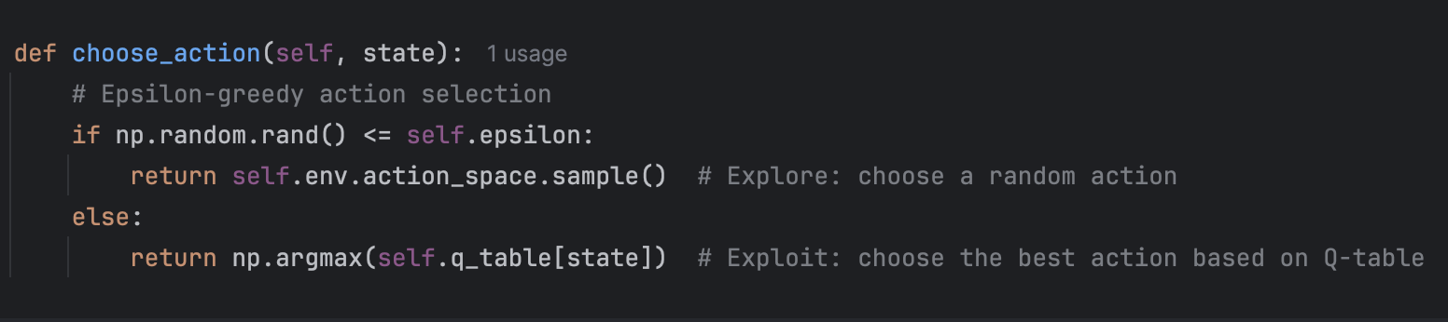
Workflow
Action Selection Policy
Use an epsilon-greedy strategy to choose actions
With probability epsilon, the agent will explore by choosing a random action.
With probability 1 - epsilon, the agent will exploit the learned Q-values by selecting the action with the highest Q-value for the current state

Slide 10
Workflow
Train the Agent
Run the agent through the MiniPong environment
Reset the environment
Use the epsilon-greedy policy to select an action based on the current state
Take Action and Observe
Update Q-value
Transition to Next State
Track Total Reward
Reduce exploration rate over time

Slide 11
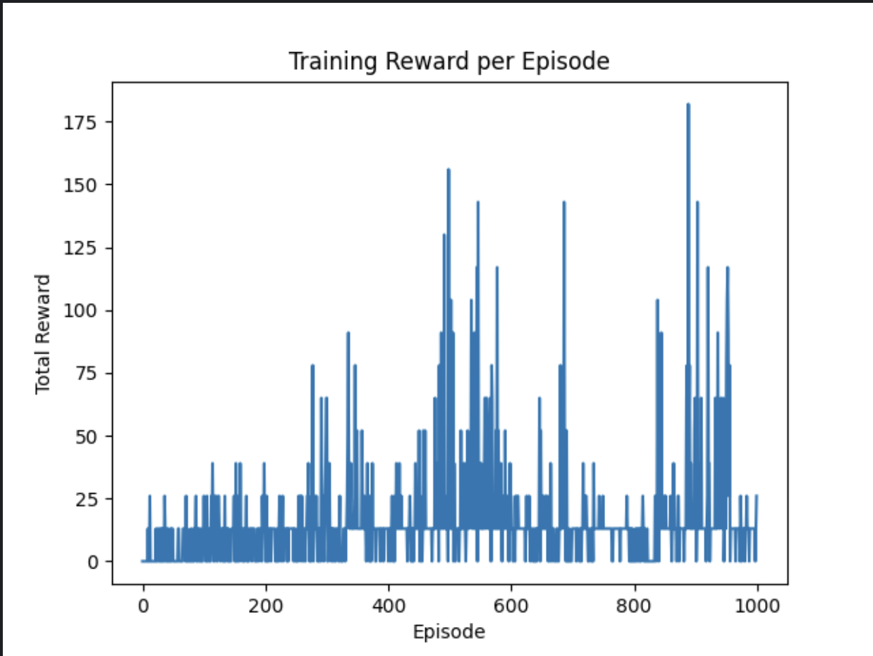
Training Agent
Training Performance
Low Initial Rewards (Episodes 0–200)
likely due to high exploration (epsilon is high at the beginning)
Increasing Rewards and Higher Variability (Episodes 200–600)
Spikes in Rewards (Episodes 600–800)
Decline in Rewards and Continued Variability (Episodes 800–1000)
epsilon has decayed to a lower value

Slide 12
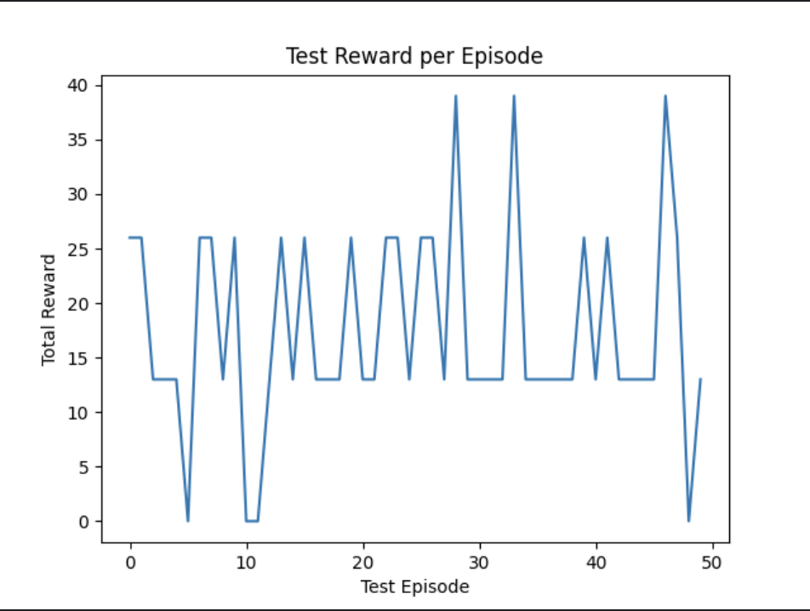
Testing Agent
Testing and Evaluation
Set epsilon=0 so the agent always selects the action with the highest Q-value
Run Test Episodes
Test Average and Standard Deviation of Test Rewards
Test-average = 21.32
Test standard deviation = 10.322

Slide 13
Challenges
Randomness in Episode Outcomes
Challenging for the agent to determine the exact positioning of the ball
Determining an appropriate decay rate for epsilon is tricky
Hyperparameter tuning

Slide 14
For level 2 Minipong
With both y and dz, the agent can potentially make more informed and timely decisions
May slow down learning initially
May help learning by enabling the agent to develop a more accurate strategy

