Slide 1

NLP for Clinical Notes: Synthetic Data Generation Using GANs
Pramod K C
Bibek Chaudhary

Slide 2
Objective
Exploring Synthetic Data Generation
Privacy Preservation
Comparative Analysis of GAN Architectures
Use Case Implementation
Statistical and Structural Fidelity
Develop Privacy Metrics

Slide 3
Background
Significance of Data in Healthcare
Challenges of Data Availability
Need for Synthetic Data
Role of GANs in Synthetic Data Generation
Focus on MIMIC-III Dataset
Objective of Privacy-Utility Tradeoff

Slide 4
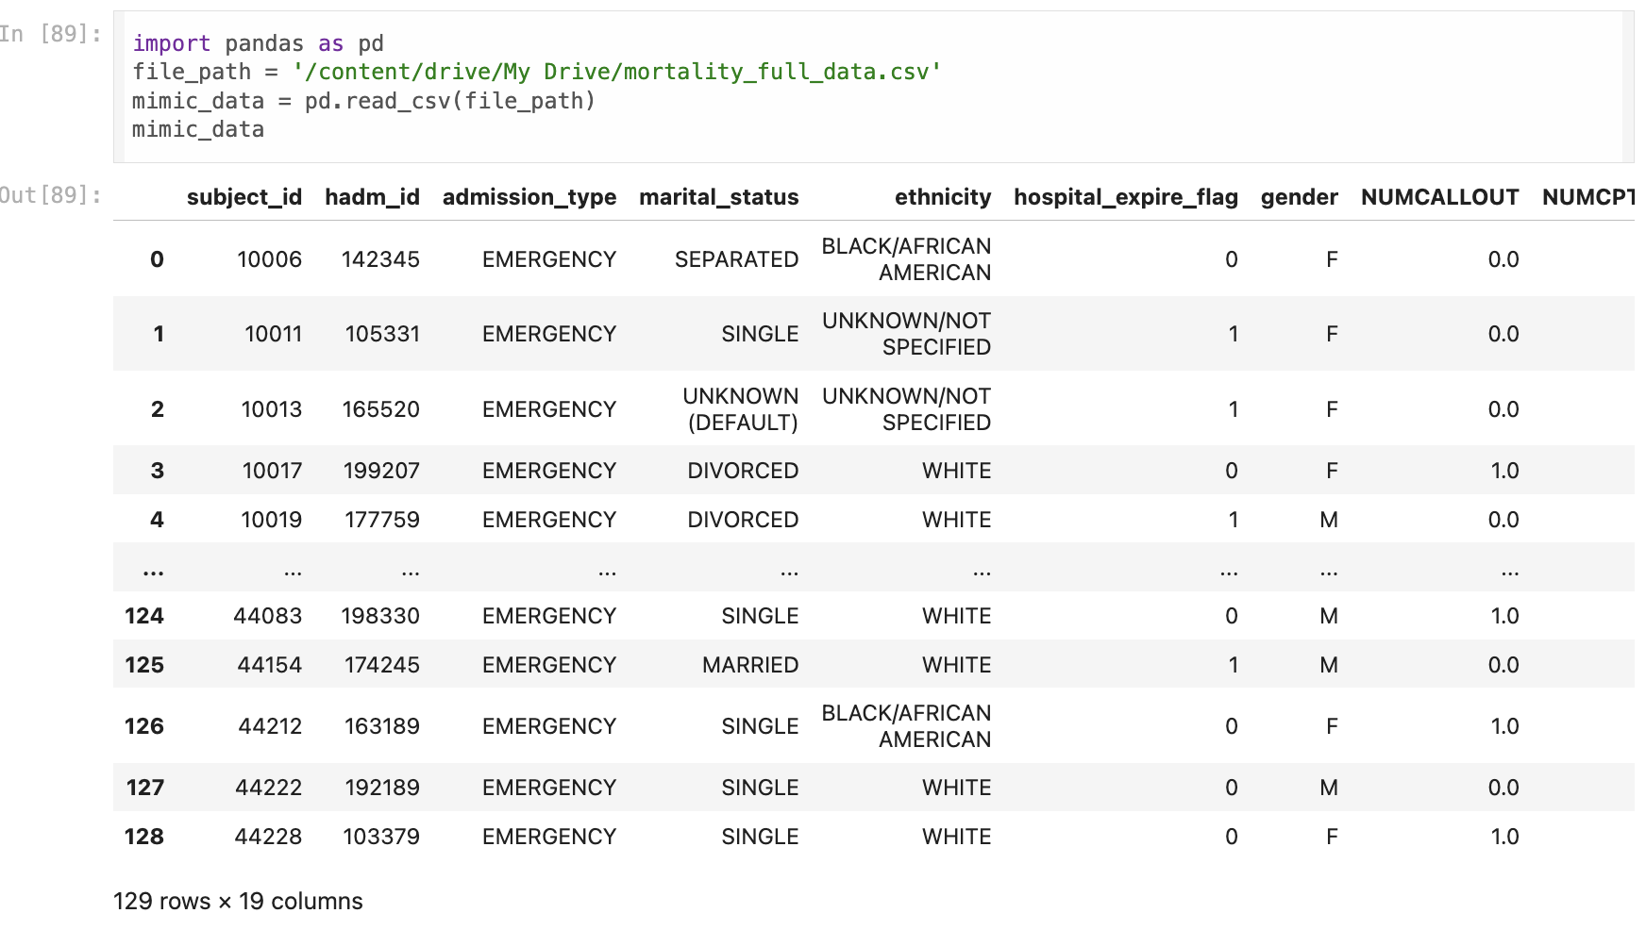
Methodology
Data Source and Preprocessing

Slide 5
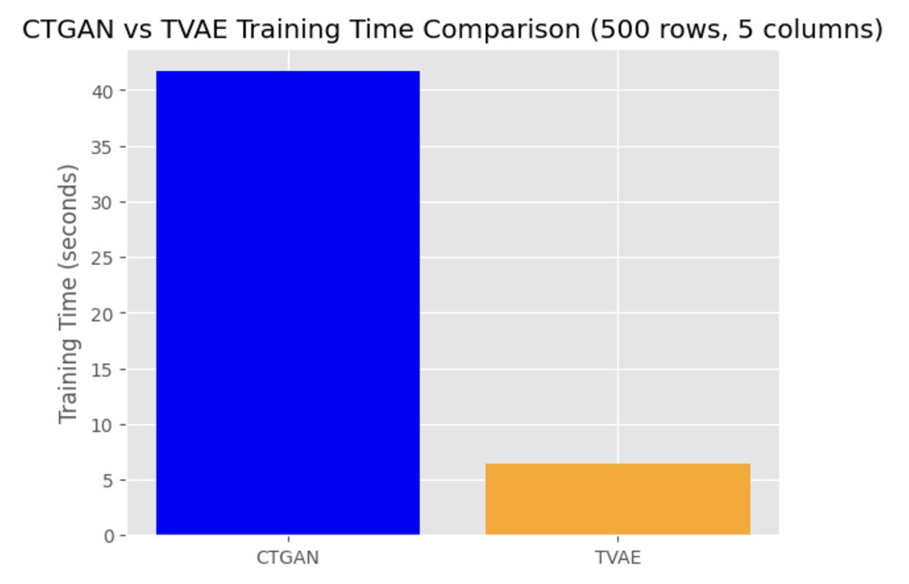
GAN Model
Synthetic Data Generation
CTGAN (Conditional Tabular GAN)
Focuses on maintaining the statistical structure of tabular data.
TVAE (Tabular Variational Autoencoder)
Combines GAN and VAE principles to ensure data diversity and privacy.

Slide 6
CTGAN
Conditional Tabular GAN specialized for generating synthetic tabular data with mixed data types (continuous and categorical).
Incorporate conditional generation and mode-specific normalization
Captures Complex Dependencies between variables.
Handles Imbalanced Data by balancing categories through conditioning.
Preserves Statistical Properties for realistic synthetic data.
Enables Data Augmentation and Privacy-Preserving Data Sharing.

Slide 7
CTGAN Evaluation
Machine learning
Logistic regression
Original data
Training Accuracy: 0.74
Testing Accuracy: 0.69
Synthetic data
Training Accuracy: 0.68
Testing Accuracy: 0.58
Neural network
Original data
TrainingAccuracy:0.74
TestingAccuracy:0.58
Synthetic data
Training Accuracy: 0.74
Testing Accuracy: 0.31

Slide 8
TVAE-GAN
Tabular Variational AutoEncoder (TVAE) designed for generating synthetic tabular data with mixed data types (continuous and categorical).
Incorporate Variational AutoEncoder Framework and handle Categorical Variables:
Captures Complex Data Distributions
Efficient Training with stable convergence due to the VAE framework.
Generates Realistic Synthetic Data preserving the statistical properties of the original dataset.
Scalable and Flexible for various tabular data applications, including data augmentation and privacy preservation.

Slide 9
TVAE-GAN Evaluation
Machine learning
Logistic regression
Original data
Training Accuracy: 0.74
Testing Accuracy: 0.69
Synthetic data
Training Accuracy: 0.83
Testing Accuracy: 0.46
Neural network
Original data
TrainingAccuracy:0.74
TestingAccuracy:0.58
Synthetic data
Training Accuracy: 0.96
Testing Accuracy: 0.62

Slide 10
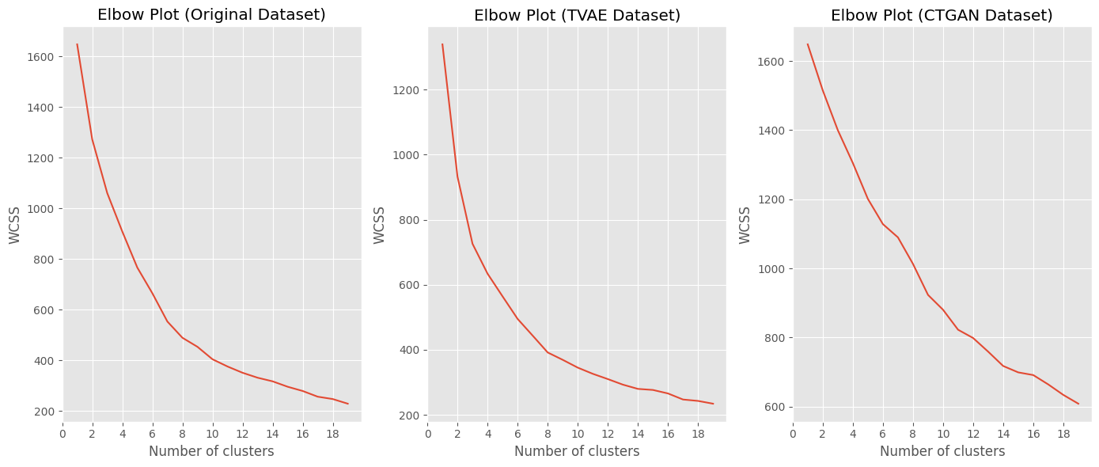
Scalability Tests
K Means Clustering
Structural Comparison
By comparing the cluster patterns (centroids and distributions) of the original and synthetic datasets, we can determine how well the synthetic data captures the underlying structure of the original data.
Elbow Method Analysis
The Elbow Plot shows the Within-Cluster Sum of Squares (WCSS) versus the number of clusters.

Slide 11
Scalability Tests
Kolmogorov-Smirnov (KS) Test
non-parametric statistical test that compares two distributions to assess whether they are significantly different
Distributional Comparison
effective for comparing the distributions of continuous features between the original and synthetic datasets
Feature-Level Analysis
Each feature in the dataset can be tested independently
Interpretation
A high p-value (e.g., > 0.05) suggests no significant difference
A low p-value (e.g., < 0.05) indicates significant differences

Slide 12
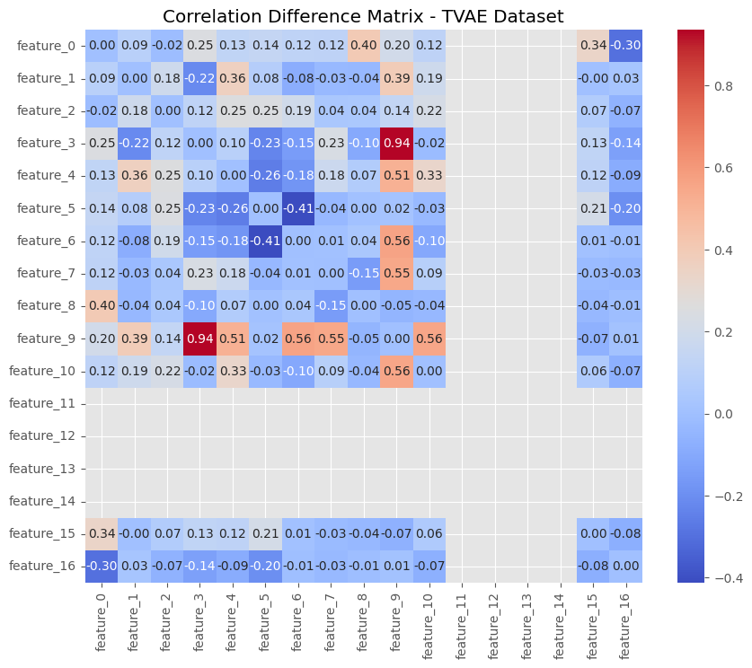
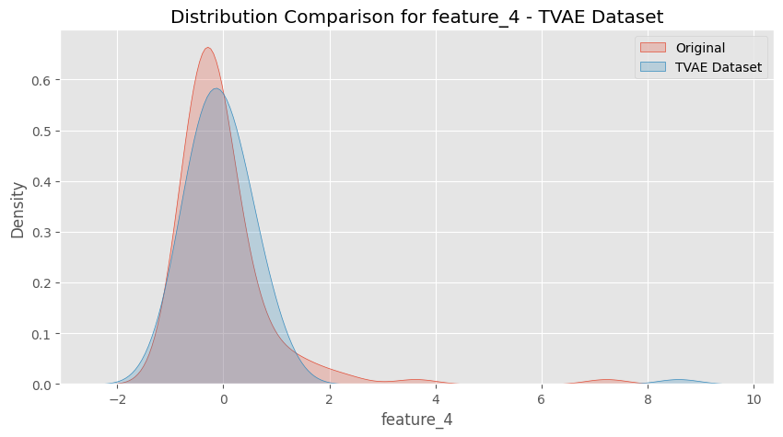
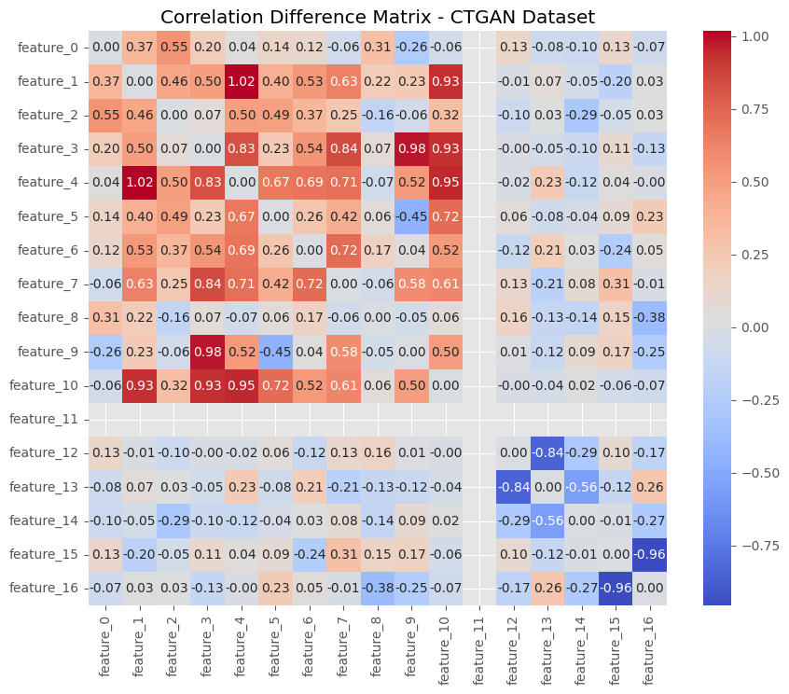
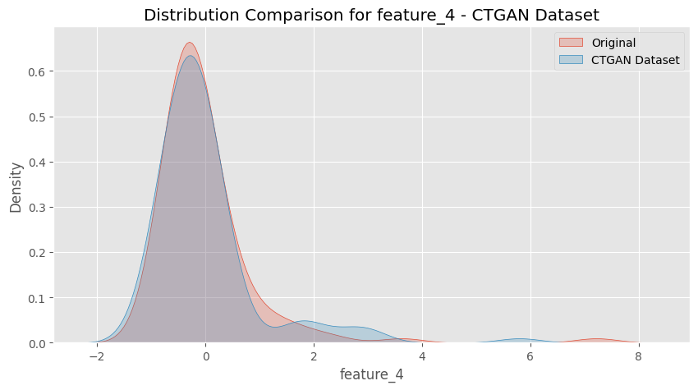
Statistical Analysis
Pairwise Correlation Comparison
Distribution Plots

Slide 13
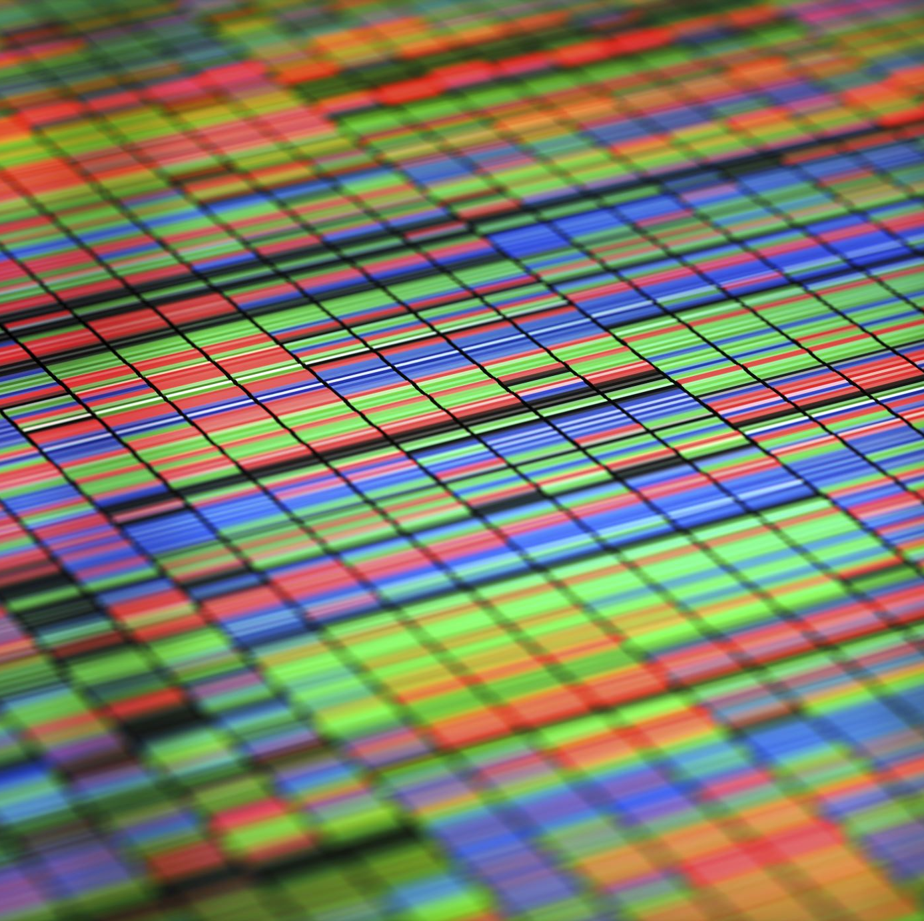
Similarity Test
Autoencoders
Captures Complex Patterns
High-Level Features
Dimensionality Reduction
Reconstruction Ability
Applicable to Complex Data

Slide 14
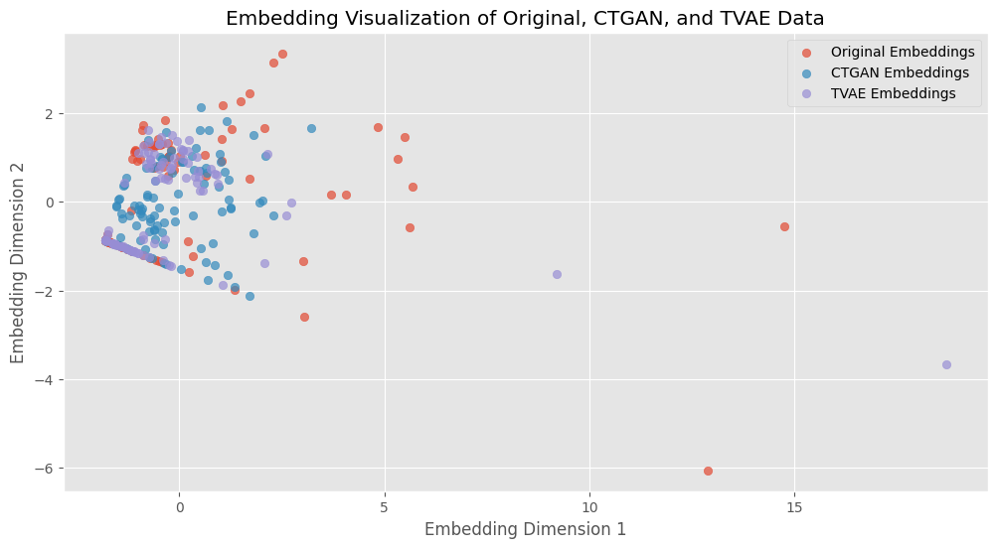
Why Autoencoder??
Latent Space Representation
Maps both original and synthetic datasets to a common reduced-dimensional space
Cosine Similarity Metric
A higher cosine similarity score indicates stronger structural resemblance
Holistic Comparison
Unlike feature-by-feature comparisons, it evaluates the overall structure of the data, including inter-feature dependencies
Visualization
Reduces embeddings to 2D (e.g., using PCA) for graphical comparison, making structural similarities and differences visually interpretable

Slide 15
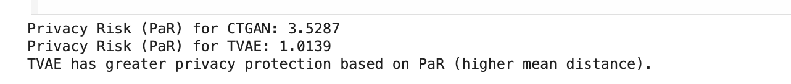
Privacy Risk Metrics
Quantitative measures used to evaluate the potential risk of exposing sensitive or personally identifiable information (PII) in a dataset
K-Nearest Neighbor Distance
Evaluates how closely synthetic data points resemble original data points by calculating distances between them in a feature space
Provides an intuitive and interpretable metric where smaller distances indicate higher privacy risks, and larger distances suggest better privacy preservation.
Findings
TVAE generated synthetic data with larger average distances from original data, indicating better privacy preservation.

Slide 16
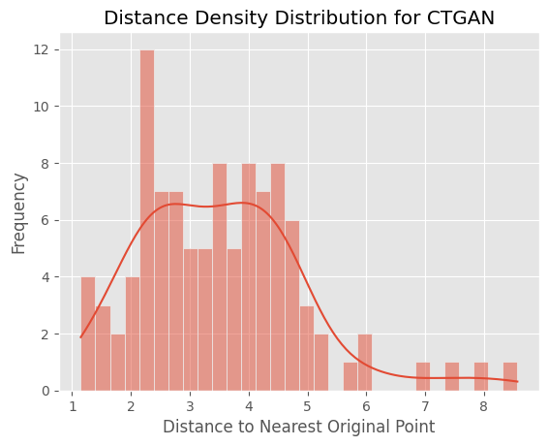
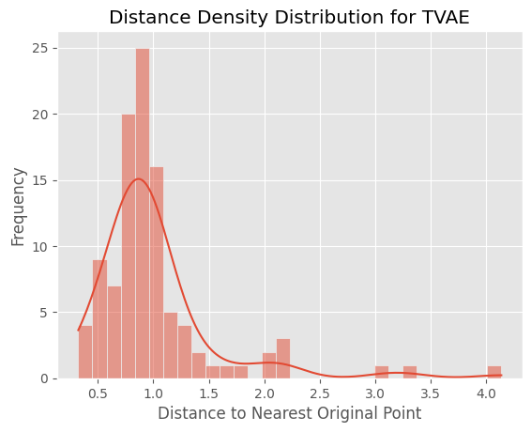
Contd…
Distance Density
Method used to evaluate privacy risks by analyzing the distribution of distances between synthetic and original data points
Goes beyond simple nearest-neighbor distances by considering the overall density of distances in a dataset, providing deeper insights into how closely synthetic data resembles original data
Density Estimation
Use statistical tools (e.g., Kernel Density Estimation or histograms) to create a probability density function of these distances

Slide 17
Conclusion
CTGAN works best for applications requiring high statistical fidelity, such as predictive modeling and statistical analysis
TVAE offers better privacy security with larger Privacy at Risk values, which makes it more acceptable for applications

