Slide 1

Face Mask Detection For Covid Precorrection
c

Slide 2

TEAM DETAILS
Kamala Navya sri
17D41A0598
Gummadiraju Pooja
17D41A0577
Goda Shivashankar
17D41A0570
G Manasa
17D41A0562
Guide
Mrs. B Varija

Slide 3

Contents
Introduction
Existing system
Proposed system
Image processing
OpenCV
Deep Learning
Data Visualization
Training the model
Algorithms and implementation
Evaluation
Conclusion

Slide 4
Introduction
According to WHO report,coronavirus disease has globally infected over 20 million people causing over 0.7 deaths.Symptoms reported are like shortnes of breath andserious illness.
Some common coronaviruses that infect human and animals around world are 229E,HKUI,SARS-CoV and MERS-CoV.It spreads from among persons who are close in contact.
To curb COVID-19, wearing a clinical mask is very necessary.The public should be aware of whether to put on the mask for control of COVID-19.Vulnerability of risk is less by utilization of masks during the "pre-symtotic " period.
Therefore,face mask detection has become a crucial task in present global society.
Face mask detection involves in detecting the location of the face and determining whether it has a mask on it or not.
Technologies used are ML packages such as OpenCV AND Scikit-Learn.

Slide 5
Existing system
COVID-19 pandemic has rapidly affected our day-to-day life allover the world.
Wearing a protective face mask has become a new normal.
In the future, many public service providers will ask the customers to wear masks correctly to make use of of their services.
Therefore, face mask detection has become a crucial task to help global society.
This paper presents a simplified approach to achieve this purpose using some basic Machine Learning packages like OpenCV and Scikit-Learn.

Slide 6
Proposed system
The proposed method detects the face from the image correctly and then identifies if it has a mask on it or not.
As a surveillance task performer, it can also detect a face along with a mask in motion.
The method attains accuracy up to 95.77% and 94.58% respectively on two different datasets.
In face detection method, a face is detected from an image that has several attributes in it.
According to, research into face detection requires expression recognition, face tracking, and pose estimation.
Given a solitary image, the challenge is to identify the face from the picture.
Face detection is a difficult errand because the faces change in size, shape, colour, etc and they are not immutable.

Slide 7
Image processing
In the smart city, all public places are monitored by cameras.
The cameras are used to capture images from public places;
Then these images are feed into a system that identifies if any person without face mask appears in the image.
If any person without a face mask is detected.
The images captured by the CCTV cameras required preprocessing before going to the next step.
In the preprocessing step, the image is transformed into a grayscale image because the RGB color image contains so much redundant information that is not necessary for face mask detection. RGB color image stored 24 bit for each pixel of the image. On the other hand, the grayscale image stored 8 bit for each pixel and it contained sufficient information for classification.
Then, we reshaped the images into (64×64) shape to maintain uniformity of the input images to the architecture. Then, the images are normalized and after normalization, the value of a pixel resides in the range from 0 to 1. Normalization helped the learning algorithm to learn faster and captured necessary features from the images.

Slide 8
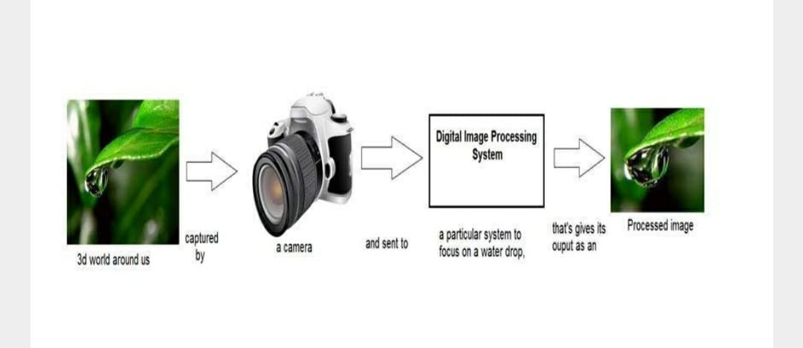
Image processing

Slide 9
OpenCV
OpenCV (Open Source Computer Vision Library), an open-source computer vision and ML software library, is utilized to differentiate and recognize faces, recognize objects, group movements in recordings, trace progressive modules, follow eye gesture, track camera actions, expel red eyes from pictures taken utilizing flash, find comparative pictures from an image database, perceive landscape and set up markers to overlay it with increased reality and so forth.
The proposed method makes use of these features of OpenCV in resizing and color conversion of data images.

Slide 10
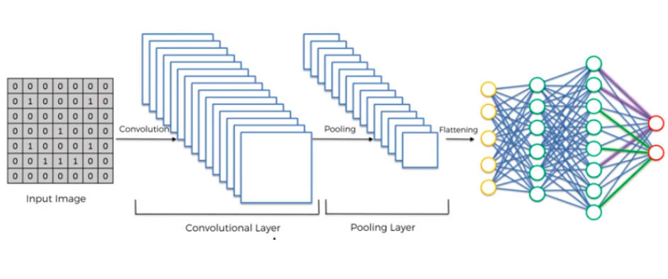
OpenCV

Slide 11
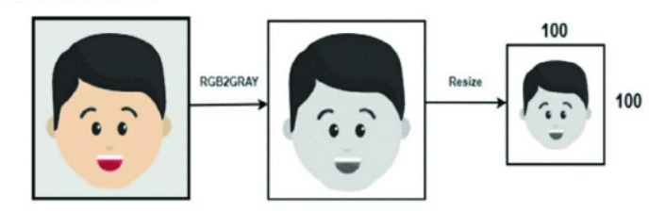
Data Visualization
Data visualization is the process of transforming abstract data to meaningful representations using knowledge communication and insight discovery through encodings. It is helpful to study a particular pattern in the dataset.
The total number of images in the dataset is visualized in both categories – ‘with mask’ and ‘without mask’.

Slide 12
Deep Learning
The deep learning architecture learns various important nonlinear features from the given samples.
Then, this learned architecture is used to predict previously unseen samples.
To train our deep learning architecture, we collected images from different sources.
The architecture of the learning technique highly depends on CNN. All the aspects of deep learning architecture are described below.
Two datasets have been used for experimenting the current method.
Dataset consists of images with people wearing face masks and the images with people who do not wear face masks.

Slide 13
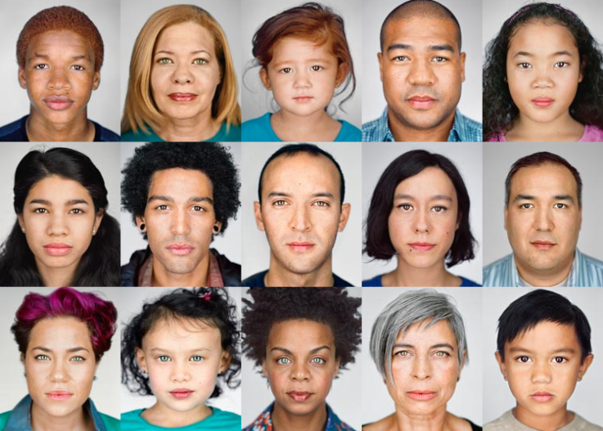
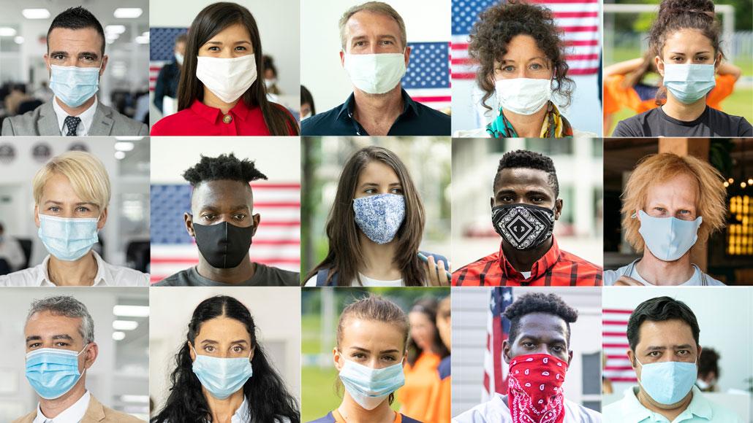
NO MASK
MASK

Slide 14
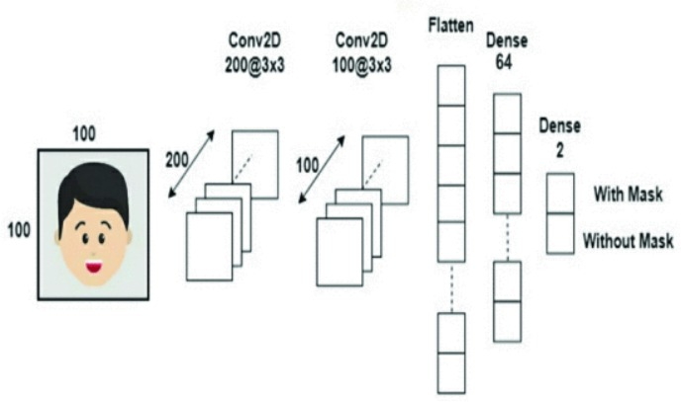
Training the Model
A) Building the model using CNN architecture
CNN has become ascendant in miscellaneous computer vision tasks. The current method makes use of Sequential CNN.
The Convolution layer learns from 200 filters. As the model should be aware of the shape of the input expected, the first layer in the model needs to be provided with information about input shape. Following layers can perform instinctive shape reckoning. In this case, input_shape is specified as data.shape[1:] which returns the dimensions of the data array from index 1. Default padding is “valid” where the spatial dimensions are sanctioned to truncate and the input volume is non-zero padded. The activation parameter to the Conv2D class.. It represents an approximately linear function that possesses all the assets of linear models that can easily be optimized with gradient-descent methods. Considering the performance and generalization in deep learning, it is better compared to other activation functions.

Slide 15
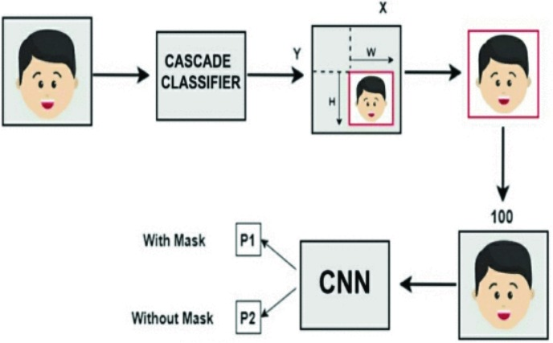
Training the Model
B) Splitting the data and training the CNN model:
After setting the blueprint to analyze the data, the model needs to be trained using a specific dataset and then to be tested against a different dataset. A proper model and optimized train_test_split help to produce accurate results while making a prediction. The test_size is set to 0.1 i.e. 90% data of the dataset undergoes training and the rest 10% goes for testing purposes. The validation loss is monitored using ModelCheckpoint. Next, the images in the training set and the test set are fitted to the Sequential model. Here, 20% of the training data is used as validation data. The model is trained for 20 epochs (iterations) which maintains a trade-off between accuracy and chances of overfitting.

Slide 16
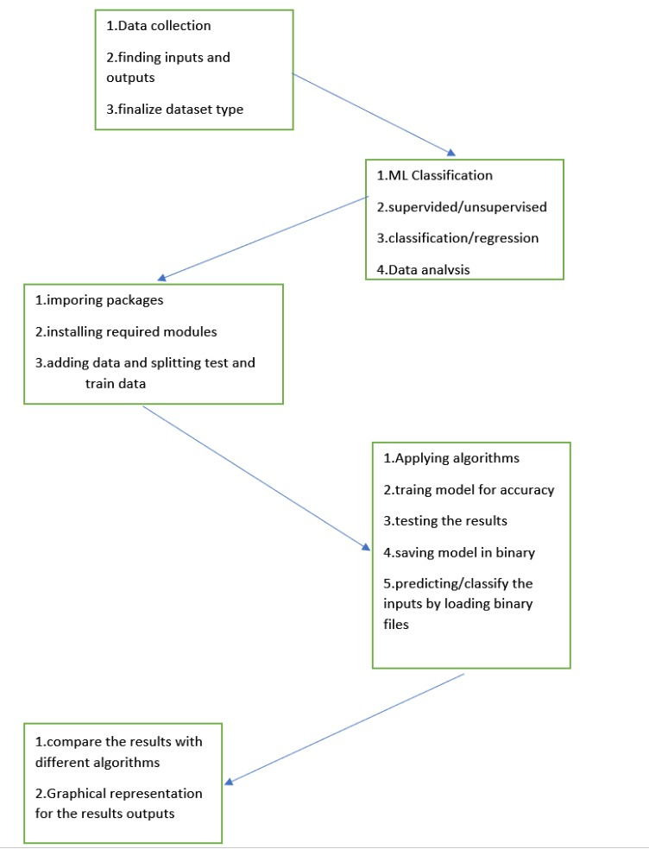
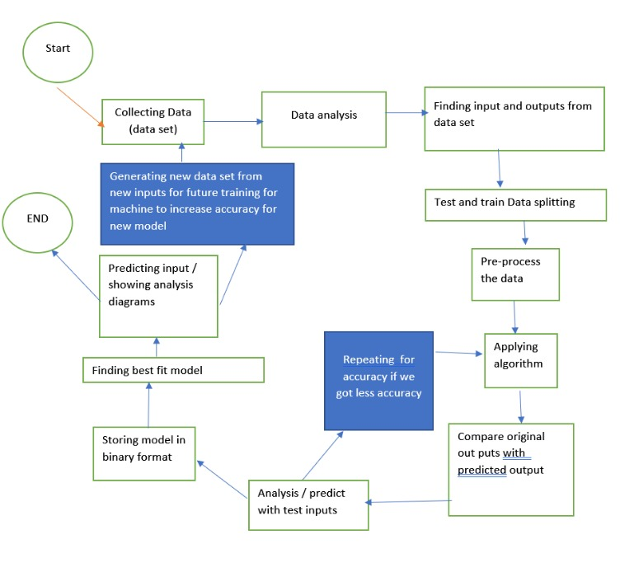
Algorithms and Implementation

Slide 17
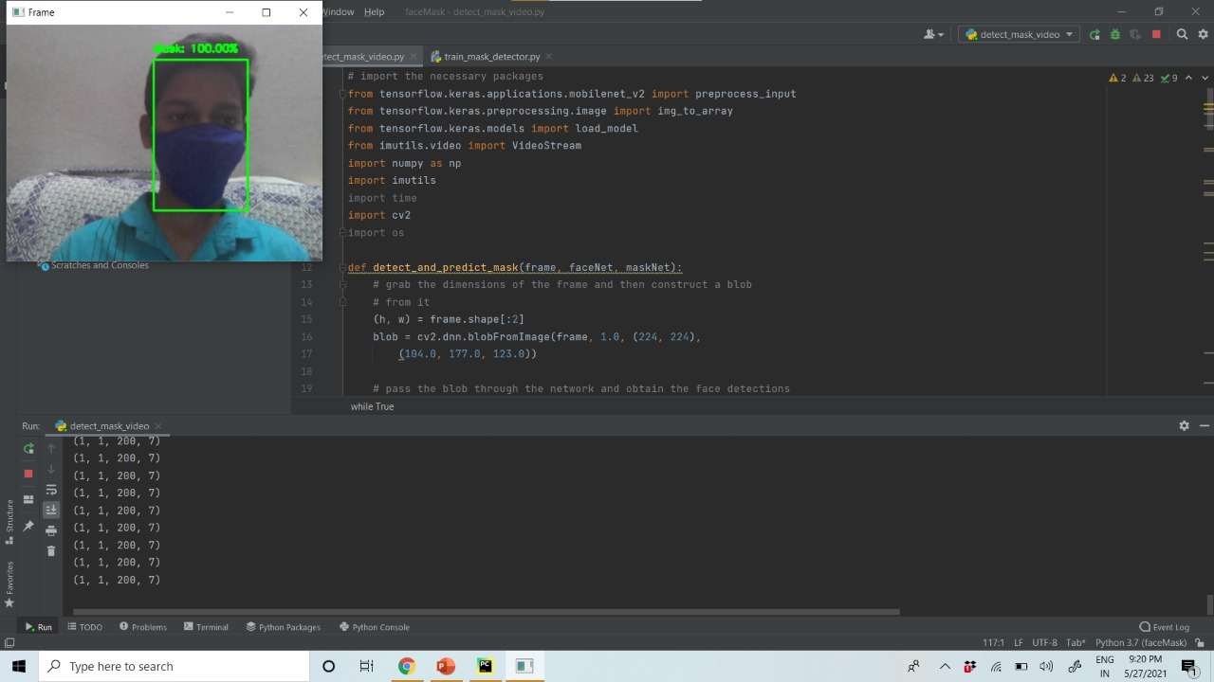

Slide 18
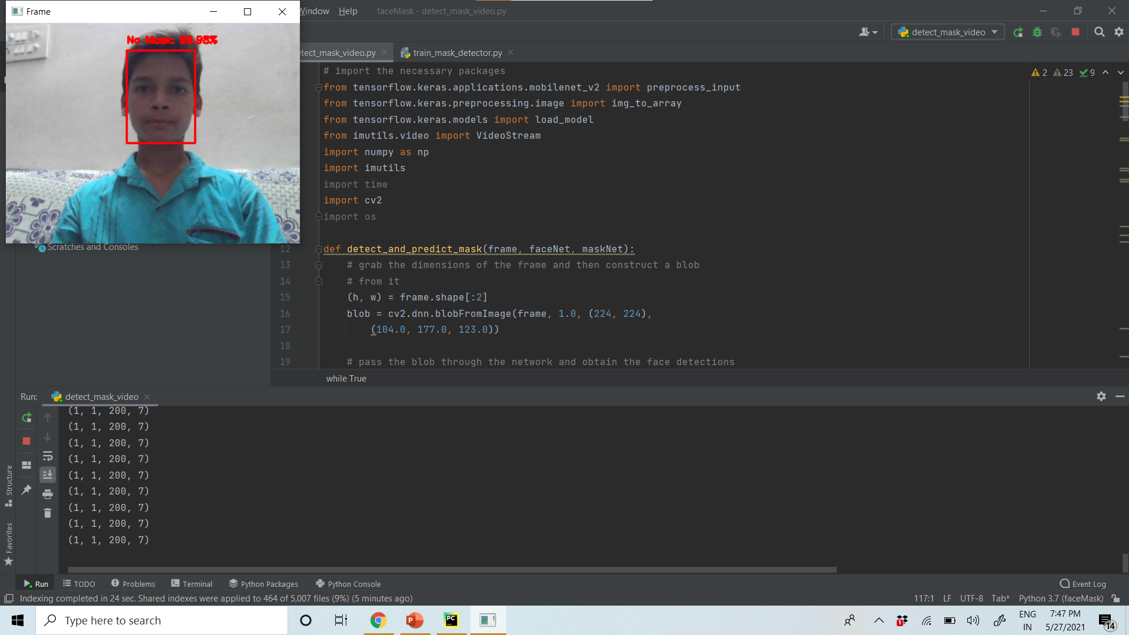

Slide 19
Evaluation
ACCURACY
Accuracy is a metric for how much of the predictions the model makes are true. The higher the accuracy is, the better. However, it is not the only important metric when you estimate the performance. We get 97.5 % accuracy by using face mask detection.
PRECISION
The precision metric marks how often the model is correct when identifying positive results. For example, how often the model diagnoses cancer to patients who really have cancer.
REDUCED LOSS
Loss is a metric that is used to determine bad predictions predicted by the model.The loss rate is zero when we use the proposed system.

Slide 20
Conclusion
We have studied the problem of face mask detection relevant in the scope of monitoring applications for the covid19 pandemic we introduced a novel data set for studying face masks detection problems and conducted experimental study that gives the performance of existing face detectors with masked face detection and also the usefulness of existing face mask detection models for monitoring applications in the existing pandemic . Our results showed that all tested detection models are working properly when trying to detect masked faces compared to the performance observed with faces without mask.

Slide 21
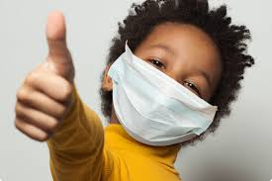

THANK YOU

