Slide 1

Ant Colony Optimization
Dr. M. K. Tiwari
Dept. of Ind. Engg and Mngmt.
IIT Kharagpur

Slide 2
Ant Colony Optimization
Overview
  Introduction
  Defining Characteristics
  Generic Steps
  Diversity in Ant Colony Optimization
  Application of ACO in FMS loading

Slide 3
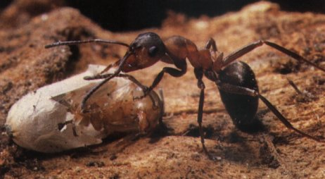
Inspiration
Ants are practically blind but they still manage to find their way to the food. How do they do it?
These observations inspired a new type of algorithm called ant algorithms (or ant systems).
Result of research on computational intelligence approaches to combinatorial optimization.
The algorithm is modeled after the natural behavior of ants.

Slide 4


Natural behavior of ant
Nest
Food
Ant search for their food

Slide 5

Natural behavior of ant
Nest
Food
Obstacle
An obstacle has blocked the path of ants

Slide 6

Natural behavior of ant
Nest
Food
Obstacle
What to do? Every ant flips a coin and choose a path

Slide 7
Natural behavior of ant
Nest
Food
Obstacle
Finally, after some time shorter path reinforced

Slide 8

Natural Ants
Almost Blind.
Incapable of achieving complex task alone.
Rely on the phenomena of swarm intelligence for survival.
Capable of establishing shortest-route paths from their colony to feeding sources and back.
Use stigmergic communication via pheromone trails.

Slide 9
Natural Ants
Follow existing pheromone trails with high probability.
What emerges is a form of autocatalytic behavior: the more ants follow a trail, the more attractive that trail becomes for being followed.
The probability of a path choice increases with the number of times the same path was chosen before.

Slide 10
What is
Stigmergy?

Slide 11
Stigmergic
A term coined by French biologist Pierre-Paul Grasse, is interaction through the environment.
Two individuals interact indirectly when one of them modifies the environment and the other responds to the new environment at a later time. This is stigmergy.

Slide 12

Stigmergy
PHEROMONES
Ants uses stigmergy.
But how?

Slide 13
Pheromones
These are chemical substances dropped by us in our path.
What
is
Pheromone?

Slide 14
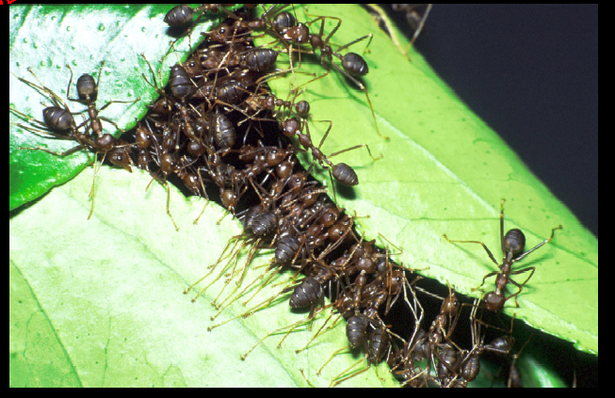
Ant Colony Optimization

Slide 15

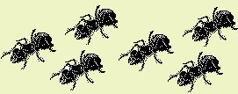
History of Ant Algorithms
Goss et al. 1989, Deneuborg et al. 1990, experiments with Argentine ants
Dorigo et al. 1991, applications to shortest path problems
Now: established method for various optimization problems

Slide 16
Basic Requirements
Since the ant algorithms are based on shortest path finding methodology utilized by the ants in search for their food, thus their implementation requires:
  The problem to be solved must either be in graphical format or could be expressed in graphical form.
  Must be finite (i.e. must have a start and end).

Slide 17
Ant Algorithms
Ant systems are a population based approach. In this respect it is similar to genetic algorithms.
Each ant is a simple agent with the following characteristics:
  It probabilistically chooses the node to visit with certain probability.
  Uses a tabu list to avoid revisit to the node.
  After the completion of tour it lays pheromone trail on each visited edge.

Slide 18


Flowchart of Ant algorithms
Initialize
Ants
Evaluate
Solutions
Update
Pheromone
Find Solutions
Probabilistically find
New solutions based
On pheromone values
Is
Termination
Criteria met?
Yes
No
STOP
Update
Pheromone
Evaluate
Solutions

Slide 19
Initialization
Initialize
Ants
Initially ants are randomly placed on the nodes.
Each edge is initialized with small amount of pheromones.
Each edge’s Visibility, a heuristic value equal to the inverse of distance between the edge, is initialized.

Slide 20
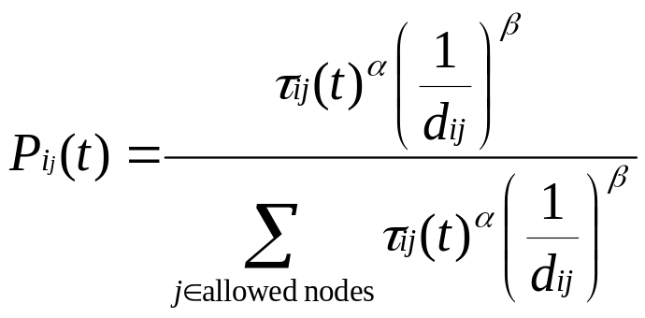
Find Solutions
Find Solutions
Each ant probabilistically select the next node to visit with certain probability given by:
Cycle Number
Quantity of pheromone
on edge i-j.
Distance between edge i-j
α,β constants
Identified
Using Tabu List
Probability of transition from node i to j

Slide 21
Tabu List
It is used by the ant to avoid revisit to any node.
It stores the node to be visited by the ant.
It updates continuously and decreases with each subsequent step taken by the ants.

Slide 22
Pheromone Update
Initialize
Ants
Evaluate
Solutions
Update
Pheromone
Find Solutions
Probabilistically find
New solutions based
On pheromone values
Is
Termination
Criteria met?
Yes
No
STOP
Update
Pheromone
Evaluate
Solutions

Slide 23
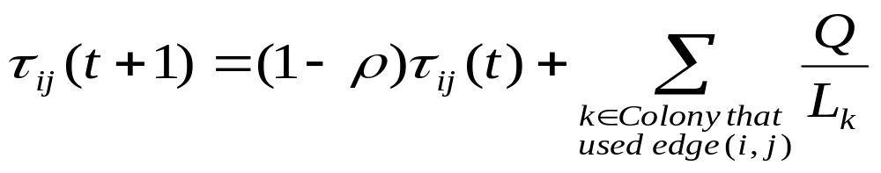
Pheromone Update
Update
Pheromone
After each ant complete their tour, pheromone count on each edge is updated using:
Pheromone laid by each ant that uses edge (i,j)
Evaporation rate
Quantity of pheromone
on edge i-j during cycle t+1.
Total distance traveled
by ant k during its tour

Slide 24
Termination
The termination criteria commonly used are:
  Designated Maximum number of cycles.
  Specified CPU time limit.
  Maximum number of cycles between two improvements of the global best solution.

Slide 25

Control Parameters
Number of ants
Pheromone Weight α
Visibility Weight β
Pheromone persistence
Number of cycles

Slide 26
Ant Algorithms - Applications
Travelling Salesman Problem (TSP)
Facility Layout Problem - which can be shown to be a Quadratic Assignment Problem (QAP)
Vehicle Routing
Stock Cutting (at Nottingham)

Slide 27
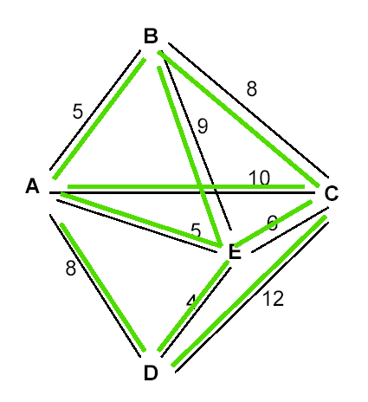
Ant Colony Application to Traveling Salesman Problem – An Example Illustration

Slide 28

Ant Colony Algorithms and TSP
Ant Colony Optimization was initially designed for Traveling Salesman Problem.
At the start of the algorithm one ant is placed in each city.
Assuming that the TSP is being represented as a fully connected graph, each edge has an intensity of trail on it. This represents the pheromone trail laid by the ants.

Slide 29
Ant Colony Algorithms and TSP
The distance to the next town, is known as the visibility, n_{ij}, and is defined as 1/d_{ij}, where, d_{ij}, is the distance between cities i and j.
When an ant decides which town to move to next, it does so with a probability that is based on the visibility for that city and the amount of trail intensity on the connecting edge.

Slide 30
Ant Colony Algorithms and TSP
At each cycle pheromone evaporation takes place.
The evaporation rate,1- p, is a value between 0 and 1.
In order to stop ants visiting the same city in the same tour a data structure, Tabu, is maintained.

Slide 31
Hand Calculations
A sample problem

Slide 32
TSP
There are n cities
A salesman starts from city A
He has to visit all the city
He can visit any city only once
He has to return back to city A
He has to do that in minimum cost of travel

Slide 33
A more realistic TSP
A salesman has to visit the cities:
  Kolkata
  Mumbai
  Delhi
  Chennai
He starts from Kolkata and returns back

Slide 34
Objective
The cost of the tour has to be minimized
It is assumed that the cost of the tour is directly related to the length of the tour
For example, a tour of 100kms costs 1000rs and this relation is linear

Slide 35
Approximate Distances (in km)
 | Kolkata | Delhi | Chennai | Mumbai
Kolkata | 0 | 1461 | 1676 | 1987
Delhi | 1461 | 0 | 2095 | 1407
Chennai | 1676 | 2095 | 0 | 1329
Mumbai | 1987 | 1407 | 1329 | 0

Slide 36
Possible solutions
Kolkata–Delhi–Chennai–Mumbai-Kolkata
Kolkata-Chennai-Delhi-Mumbai-Kolkata
Kolkata-Mumbai-Chennai-Delhi-Kolkata
And so on…
Which is the most optimal??
Answer: Find by using ACO

Slide 37
Steps
Define an objective function:
Let for a route x,
  Cost of travel = C(x)
  Length of travel = L(x)
  C(x) = K(L(x))
  K is a conversion factor let us say 0.2
Therefore objective function:
  F(x)=C(x)=0.2L(x)
Minimize the objective function

Slide 38
Steps
Initialize parameters
  Number of ants = 100
  Alpha=1
  Beta=1
  Evaporation Coefficient = 0.0 (for simplicity)
  Initial pheromone = 100
Pheromone deposit function:
  Y = 10000/F(x)

Slide 39
Solution: Kolkata – (incomplete)
 | Distance (d) | Pheromone (p) | p/d | Probability
Delhi | 1461 | 100 | =100/1461 = 0.0684 | =0.0684/0.1784 =0.3834
Mumbai | 1676 | 100 | 0.05967 | 0.3345
Chennai | 1987 | 100 | 0.05033 | 0.2821
Other |  |  | =sum of above =0.1784 | =sum of above = 1.0000

Slide 40
Solution: Kolkata – (Incomplete)
Salesman is at Kolkata (start)
Probability of visiting the next city:
  Delhi: 38.34%
  Mumbai: 33.45%
  Chennai: 28.21%
Select the city based on the probability using a roulette wheel
Let us say that the city selected is Mumbai
So, solution: Kolkata-Mumbai- (incomplete)
Repeat the following steps till solution is complete

Slide 41
Kolkata-Mumbai- (incomplete)
 | Distance (d) | Pheromone (p) | p/d | Probability
Delhi | 1407 | 100 | 0.0717 | 0.488
Chennai | 1329 | 100 | 0.0752 | 0.512
 |  |  | 0.1469 | 1.000

Slide 42
Kolkata-Mumbai- (incomplete)
Salesman is at Mumbai
Probability of visiting the next city:
  Delhi: 48.8%
  Chennai: 52.1%
Select the city based on the probability using a roulette wheel
Let us say that the city selected is Chennai
So, solution: Kolkata-Mumbai-Chennai- (incomplete)
There is only one city left
So, soluton: Kol-Mum-Che-Del- (incomplete)
He has to return back to Kol as all cities are visited once
Hence final solution:
  Kolkata-Mumbai-Chennai-Delhi-Kolkata

Slide 43
Evaluate the solution
X=Kolkata-Mumbai-Chennai-Delhi-Kolkata
Total trip length:
  1987+1329+2095+1461
  L(X) = 6872 kms
Therefore,
  F(X)=C(X)=0.2L(X)
  =0.2 x 6872 = 1374.4
Pheromone Update:
  10000/1374.4 = 7.276

Slide 44
Updated Pheromone Values
Updated pheromone values on the routes:
  Kolkata to Mumbai – 100 + 7.276 = 107.276
  Mumbai to Chennai – 107.276
  Chennai to Delhi – 107.276
  Delhi to Kolkata – 107.276
The pheromone count on other routes remain unchanged (It is assumed that there is no evaporation)

Slide 45
Iterations
The whole process discussed above constitutes the iteration:
  Construction of solution
  Evaluating the solution
  Updating the pheromone
This iteration is repeated again and again, until all ants have been used
For example say, the second ant constructs the solution:
  Kolkata-Chennai-Mumbai-Delhi-Kolkata

Slide 46
Evaluate the solution (Ant no. 2)
X=Kolkata-Chennai-Mumbai-Delhi-Kolkata
Total trip length:
  1676+1329+1407+1461
  L(X) = 5873 kms
Therefore,
  F(X)=C(X)=0.2L(X)
  =0.2 x 5873 = 1174.6
Pheromone Update:
  10000/1174.6 = 8.513

Slide 47
Update Pheromones (Ant No. 2)
Updated pheromone values on the routes:
  Kolkata to Chennai – 100 + 8.513 = 108.513
  Chennai to Mumbai – 107.276 + 8.513 = 115.789
  Mumbai to Delhi – 100 + 8.513 = 108.513
  Delhi to Kolkata – 107.276 + 8.513 = 115.789
The pheromone count on other routes remain unchanged (It is assumed that there is no evaporation)

Slide 48
Extrapolating
It is observed that as the number of ants increases, the probability of choosing the following solutions increases and the solution then alternates between the following:
  Kolkata-Chennai-Mumbai-Delhi-Kolkata
  Kolkata-Delhi-Mumbai-Chennai-Kolkata
It is to be noted that these two paths infact represent the same
Hence the solution can be any of these
Let us choose the first path

Slide 49
Result
X=Kolkata-Chennai-Mumbai-Delhi-Kolkata
Total trip length:
  1987+1329+2095+1461
  L(X) = 6872 kms
Therefore,
  F(X)=C(X)=0.2L(X)
  =0.2 x 6872 = 1374.4
Hence, the path with the least cost is obtained using Ant Colony Optimization
The salesman expresses his gratitude to you for solving the problem and saving him a lot of money ☺

Slide 50
Example 2

Slide 51
Minimizing Total Tardiness on a Single Machine
Machine scheduling is a central task in operations and production planning.
The main focus is on the efficient allocation of the resources to activities over time.
In this problem jobs are scheduled on a single machine such that the total tardiness is minimized.

Slide 52

The problem can be describe as follows:
There is one single machine which is used to process n jobs.
Scheduling a set of n jobs that are to be processed on a single machine minimizing total tardiness is known as Single Machine Total Tardiness Problem (SMTTP).
The machine can only handle one job at a time and every job j (j=1…….n) is available for processing at time zero and requires a positive processing time

Slide 53



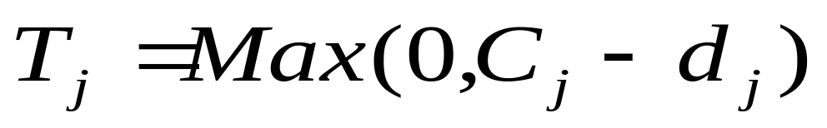
Further problem relevant data associated with each job j is job’s due date .
The job’s completion time and the job’s tardiness where
are a result of sequencing of the jobs.
The objective of SMTTP is to find the feasible processing sequence (out of all feasible permutations of n jobs) that includes all jobs exactly once and that minimizes the total tardiness.

Slide 54
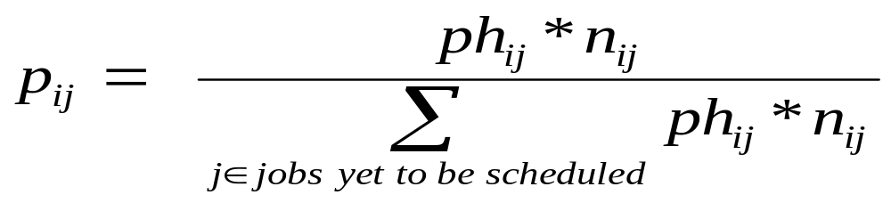
Ant Colony Optimization for SMTTP
For this problem Machine acts as Ants and jobs correspond to the path followed ants(machine).
Visibility n_{ij} is equal to 100/d_{j} ,where d_{j} is due date of job j(yet to be scheduled).
The probability p_{ij} can be defined as:

Slide 55
where ph_{ij} is pheromone quantity laid on path i to j and n_{ij} is the visibility.
for selecting the job, based on its probability value, Roulette wheel selection will be used .

Slide 56
Hand Calculations
A sample problem

Slide 57
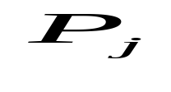
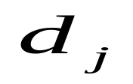
A sample problem
Job
1 | 6 | 18
2 | 2 | 6
3 | 3 | 9
4 | 4 | 11
5 | 5 | 8

Slide 58
Steps
Initialize parameters
  Number of ants = 100
  Alpha=1
  Beta=1
  Evaporation Coefficient = 0.0 (for simplicity)
  Initial pheromone = 100
Pheromone deposit function:
  Y = 100/T(x)
    Where T(x) is total tardiness.

Slide 59
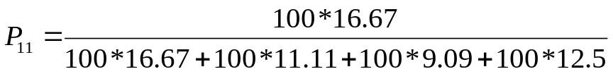
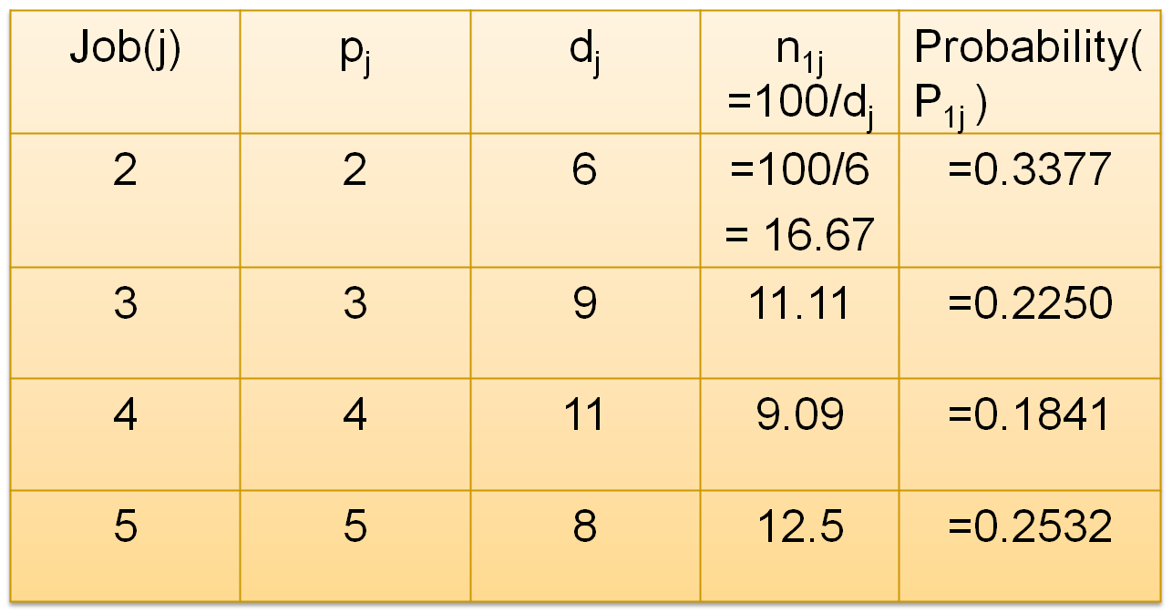
Solution: 1 – (incomplete)

Slide 60
Solution: 1 – (Incomplete)
Machine is at 1 (start)
Probability of Scheduling the next job:
  2 => 33.77%
  3 => 22.5%
  4 => 18.41%
  5 => 25.32%
Select the job based on the probability using a roulette wheel
For roulette wheel selection generate a random number n between 0 and 1.

Slide 61
Random Number (n) | Selection
0 < n <= 0.3377 | Select job 2
0.3377 < n <= 0.3377+0.2250 | Select job 3
0.5627 < n <= 0.5627+0.1841 | Select job 4
0.7468 < n <= 0.7468+0.2532 | Select job 5
Random number comes out to be 0.9532, so job 5 is selected.
So solution is 1-5-(incomplete).
Repeat the same procedure until solution is complete.

Slide 62
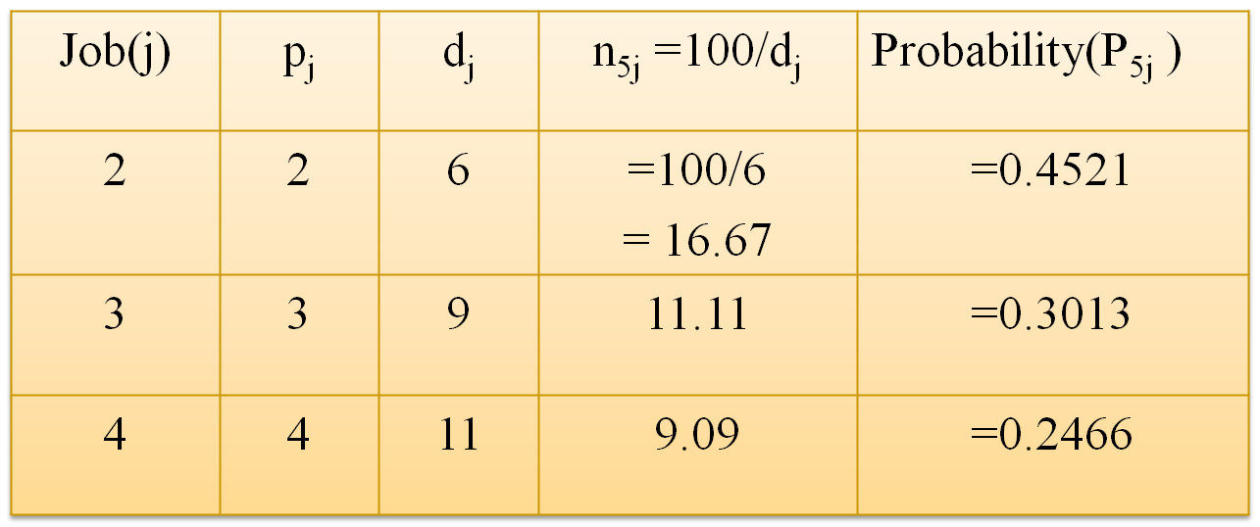
Solution: 1 – 5 (incomplete)

Slide 63
Solution: 1 – 5 (Incomplete)
Machine is at 5
Probability of Scheduling the next job:
  2 => 45.21%
  3 => 30.13%
  4 => 24.66%
Select the job based on the probability using a roulette wheel
Let us say that the job selected is 2.
So, solution: 1-5-2 (incomplete)
Repeat the following steps till solution is complete

Slide 64
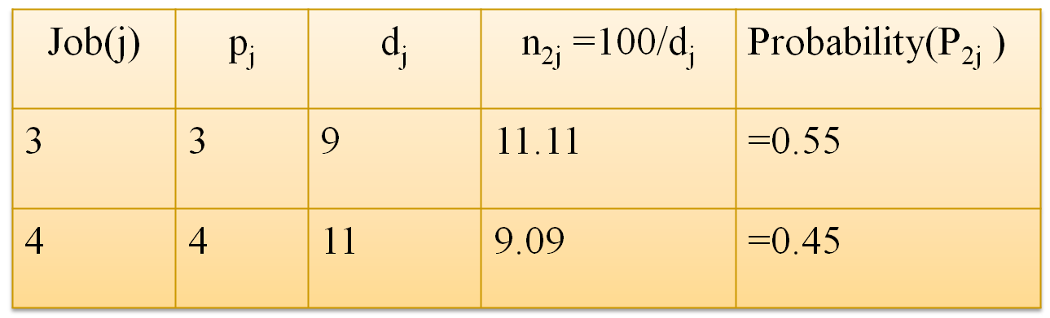
Solution: 1 – 5 – 2 (incomplete)

Slide 65
1-5-2 (incomplete)
Machine is at 2
Probability of scheduling the next job:
  3 => 55.0%
  4 => 45.0%
Select the job based on the probability using a roulette wheel
Let us say that the job selected is 3
So, solution: 1-5-2-3- (incomplete)
There is only one job left
Hence final solution:
  1-5-2-3-4

Slide 66
Total Tardiness based on Initial Schedule
The initial schedule comes out to be:
X= 1–5–2–3–4
Total Tardiness is calculated as:
Job(j) | P_{j} | C_{j} | d_{j} | L_{j} = C_{j} - d_{j} | T_{j}
1 | 6 | 6 | 18 | -12 | 0
5 | 5 | 11 | 8 | 3 | 3
2 | 2 | 13 | 6 | 7 | 7
3 | 3 | 16 | 9 | 7 | 7
4 | 4 | 20 | 11 | 9 | 9
Total |  |  |  |  | T(x) = 26

Slide 67
Updating Pheromone Values
X=1-5-2-3-4
Total Tardiness:
  T(X) = 26 units
Pheromone Update = 100/26 = 3.846
Update Pheromone values on the routes:
From 1 to 5 => ph₁₅ = 100+3.846 = 103.846
From 5 to 2 => ph₅₂ = 100+3.846 = 103.846
From 2 to 3 => ph₂₃ = 100+3.846 = 103.846
From 3 to 4 => ph₃₄ = 100+3.846 = 103.846
The pheromone count on other routes remain unchanged (It is assumed that there is no evaporation)

Slide 68
Iterations
Now, let Ant-2 starts with job-2.
So, solution 2-(incomplete)
Job(j) | p_{j} | d_{j} | n_{2j} =100/d_{j} | Probability(P_{1j} )
1 | 6 | 18 | =100/18 = 5.56 | =0.3165
3 | 3 | 9 | =11.11 | =0.2347
4 | 4 | 11 | =9.09 | =0.1848
5 | 5 | 8 | =12.5 | =0.2640

Slide 69
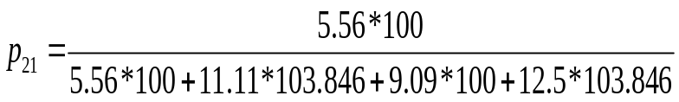
Iterations
Now, let Ant-2 starts with job-2.
So, solution 2-(incomplete)
Job(j) | p_{j} | d_{j} | n_{2j} =100/d_{j} | Probability(P_{2j} )
1 | 6 | 18 | =100/18 = 5.56 | =0.1419
3 | 3 | 9 | =11.11 | =0.2946
4 | 4 | 11 | =9.09 | =0.2321
5 | 5 | 8 | =12.5 | =0.3314

Slide 70
By using Roulette wheel selection, the next job selected for scheduling be 3. So solution 2-3-(incomplete).
Similarly following the full procedure schedule by Ant-2 is found as follows:
2-3-5-4-1
Find the total tardiness of the above schedule and update the pheromone values on the selected routes.
Repeat the full procedure for 100 Ants.

Slide 71
Extrapolating
It is observed that as the number of ants increases, the probability of choosing the following solution increases:
2-5-3-4-1
So the final optimal solution is 2-5-3-4-1. The total tardiness for the above solution comes out to be 6.

Slide 72
Variants
Ant Colony Optimization

Slide 73
ACO and Tabu Search (Variant-1)
Initialization: set the algorithm parameters.
Generation of new nest (exploration): use the tabu-search method to generate a new nest.
Exploitation
  Intensification search: For each ant , if it has less than hunting sites in its memory, then create a new site in the neighbourhood and exploit this new site; else If the previous site exploitation is successful, then exploit the same site again; else exploit a probabilistically selected site (among its sites in memory).
  Information sharing: probabilistically replace a site in the memory of the ant by the best one searched so far in this cycle.
  Nest movement: if the condition for nest movements is satisfied, go to (4); otherwise, go to (3.1).
Termination test: If the test is passed, stop; otherwise, empty the memories of all ants and then go to (2).
Ho, Yang, Ni and Machado., A modified ant colony optimization algorithm modeled using tabu search methods,
IEEE Transactions On Magnetics, Vol 42, No. 4, April 2006.

Slide 74
ACO Variant for Vectors (Variant-2)
Input ACO parameters;
Initialize trail;
While Termination criteria not true do
  For each axis ‘v’ do
    For each ant ‘a’ do
      Find probability for component;
      Choose axis value;
      Local trial update;
    End
  End
  Find cost (RMS error) for all ants;
  Global trial update;
End
Print best found result
Saurabh Samdani, Nune Rakesh, M. A. Reddy and K. S. Reddy
''Ant Colony Optimization- Artificial Neural Network Technique for Back calculation of Pavement Layer Moduli''
22nd Australian Road Research Board Conference, 29 Oct - 2 Nov 2006, Canberra Australia. .

Slide 75
Other Variants
Several other variants of Ant Colony Optimization have been proposed in literature such as:
  MIN-MAX Ant System
  Rank Based Ant System
  Best-Worst Ant Variant
The above mentioned variants and several others can be obtained from journals such as IEEE Transactions on evolutionary computing etc.

Slide 76
Collaborative Ant Colony Optimization

Slide 77
ACO Recap
Applied to traveling sales man type problems
Starting node is selected randomly
Path is probabilistically selected
  According to the amount of pheromone present on the possible paths from the starting node
Ant reaches the next node and selects the next path
Process continues until the ant reaches the destination node

Slide 78
ACO Recap
Completed tour of the ant is analyzed for minimization of distance traveled
‘Trail’ adjusted to favor better solution
  Better solutions receive more trail than weaker solution
  Higher probability of ant selecting path that is part of a better-performing tour
Cycle repeated until the convergence is reached
  Most ants choose the same path on every cycle

Slide 79
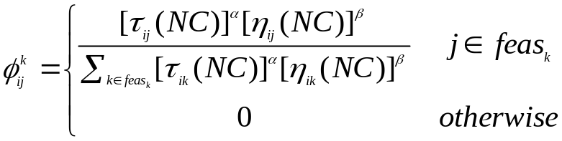
ACO Recap
Probability of k^{th} ant in cycle number CN, located at i^{th} node to choose j^{th} node as the next node
Where,
  η_{ij} (NC) → Visibility of edge i-j during NC cycle
  τ_{ij} →Pheromone count on edge i-j
  α →Weight of pheromone in path selection
  β →Weight of given edge in path selection
  feas_{k} Set of modes that are feasible for ant k

Slide 80
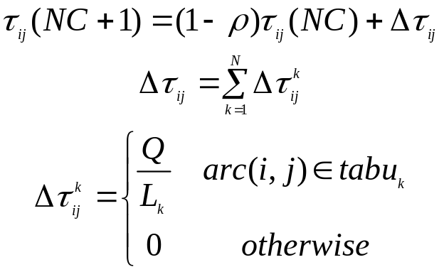
ACO Recap
Pheromone value updated on path traversed
Where
  tabu_{k} → Tabu list for k-th ant
  Q → Amount of pheromone added if a path is selected
  L_{k} →ACO Delta trail divisor value; here set equal to objective function
  ρ →Pheromone persistence
  N→ Number of ants

Slide 81
Collaborative Ant Colony Optimization Algorithm (CACO)
Collaborative Ant Colony Optimization Algorithm (CACO) has its root in the basic ACO
Applied when problem structure is complex
Implements a parallel as well as feedback-based search strategy

Slide 82
CACO Example
Accounts for the dual objectives of line balancing and model sequencing in a Stochastic Mixed Model U-shaped Disassembly Line
Optimality of an individual sequence does not ensure the optimality of the overall process which on the other hand depends on the optimal combination of both the sequences
CACO thrives for the global optimum obtained by the collaboration of their solutions

Slide 83
Collaborative Ant Colony Optimization
Two colonies of ants are utilized in parallel in order to independently identify the individual solution sequences.
The trail values are augmented only for those edges that belong to feasible combinations.
A minimum value of trail on each edge is fixed to avoid the entrapment into local optimum.
During the start of each cycle the ants are randomly initialized and positioned on feasible nodes.

Slide 84
CACO Algorithm
Utilizes a bilateral colony, each comprising of N ants
  One colony guided to determine the potential task sequences
  Another colony designed to identify prospective model sequences
On the tour for the first colony of ants each task is considered as a node
For the second colony of ants nodes represent a model belonging to the set

Slide 85
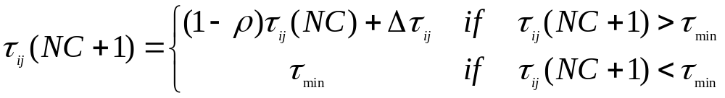
CACO Algorithm
Initially N ants are randomly placed on the feasible nodes
Pheromone matrix is initialized with certain minimum quantity of pheromone (τ_{min}) on each path
Each ant is allowed to visit all the feasible nodes not already present in the solution (using tabu list)
Feasible steps are assigned a proportionate probability similar to that of ACO

Slide 86
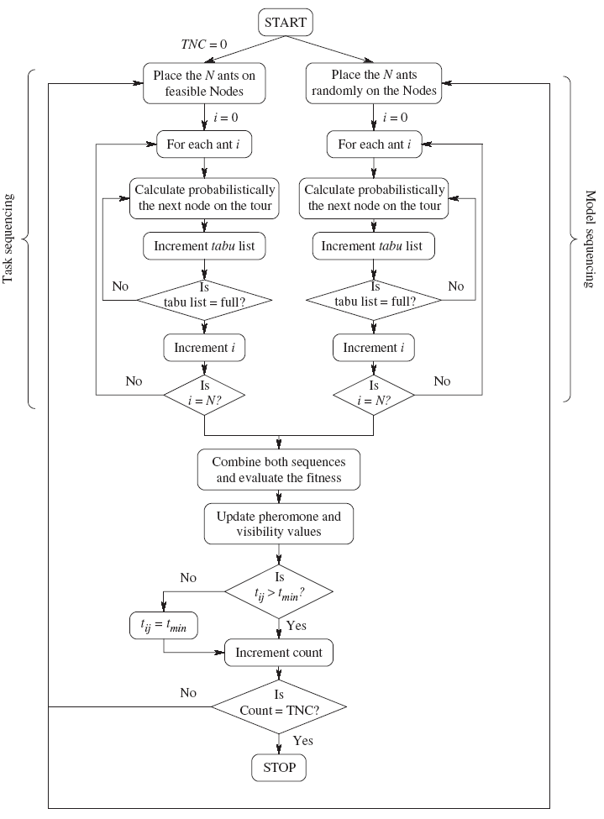
Flowchart of the CACO algorithm

Slide 87
CASE STUDY 1
The Stochastic Mixed Model U-shaped Disassembly Line Balancing/Sequencing problem

Slide 88
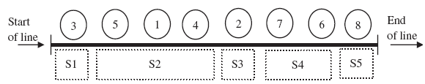
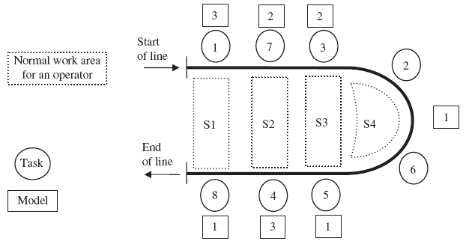
U-shaped layouts compared to straight-line layouts
Straight Line Layout
U-shaped Layout

Slide 89
Major advantages offered by U-shaped layouts
Setup times are almost negligible for U-shaped layouts.
It permits tasks from different parts of the line to be grouped into the same station.
It results in a lesser number of workstations and thereby huge savings in cost.
Increased efficiency of operators.
Increased flexibility of operation due to forward as well as backward assignment of tasks.

Slide 90
Arriving models
A set of similar products are called models.
A_{m} (m=1, 2, 3, . . . ,m) average arrival rate for a model m
Repetition of Minimum Part Set (MPS)
  MPS=(a₁, a₂, . . . , a_{m}) where a_{m}=A_{m}/G
  Meets the total disassembly requirement during a planning period
Tasks
  T → set of all tasks
  T_{m} → tasks specific to model m

Slide 91
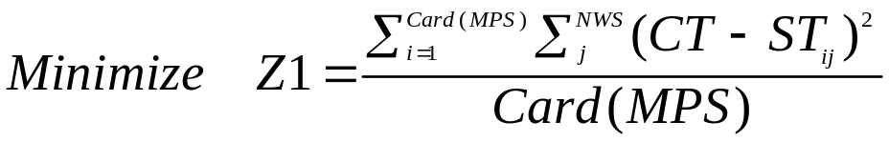
Objective functions
Efficient utilization of resources
  Total idle time and thereby the number of workstations need to be minimized
Where,
  CT → Cycle time
  ST_{ij} → Station time when models i are being processed on j-th station

Slide 92
Constraints
Precedence constraints
Cycle time constraints

Slide 93
CACO Based Approach
Accounts for the dual objectives of line balancing and model sequencing in a Stochastic Mixed Model U-shaped Disassembly Line
Utilizes a bilateral colony, each comprising of N ants
  One colony guided to determine the potential task sequences
  Another colony designed to identify prospective model sequences
On the tour for the first colony of ants each task is considered as a node
For the second colony of ants nodes represent a model belonging to the set

Slide 94
CACO Based Approach
Probability of selection of a node is calculated at the beginning of each cycle
These probabilities are used to randomly select each ant’s succeeding steps
After the completion of tour by each ant the sequences obtained for both the colonies are combined and evaluated
Best found solution is stored as the global best

Slide 95
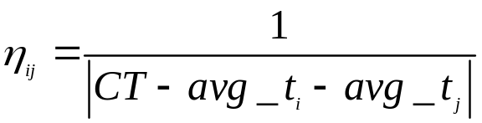
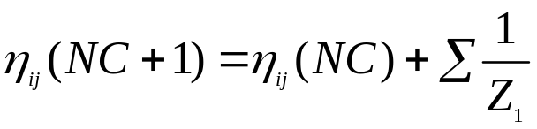
CACO Based Approach
The visibility η_{ij} for the two colonies is computed using different procedures
  The value for task sequencing is kept constant
  The value for model sequencing is dynamically calculated for each cycle
After the cycle is completed tabu list is emptied and the ants are reinitialized to begin their tour.
Iteration continued until the maximum number of cycles

Slide 96
ACO Based Approach
The optimum balancing schedule is obtained first
  Ant algorithm is initially utilized for identifying the task sequence which minimizes the deviation of station workloads.
Then the model sequencing is performed
  The solution obtained is utilized as input for solving the model sequencing problem with the primary objective of minimizing the total idle time over the MPS production schedule.

Slide 97
Design of Experiment
In the absence of benchmark instances, the test bed has been generated utilizing the essential problem factors.
Seven factors were chosen and varied at two different levels using the standard L8 orthogonal array
  The motive behind varying the factors at two different levels (low and high) is to gain an insight of the effect of these parameters on our objective

Slide 98
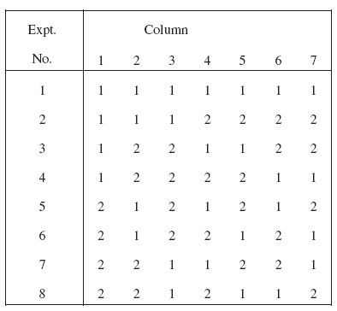
An L8 orthogonal array

Slide 99
Factors for L8 orthogonal array
Number of tasks (40 and 80 tasks)
Number of models (3 and 5)
Tasks for each model (p=0.7 and 0.9)
  The probability that a task, from the complete set of tasks, is included into the disassembly sequence of a model
Precedence relationship (p’=0.4 and 0.9)
  For model m, precedence relationships are generated from the expression

Slide 100
Factors for L8 orthogonal array
Task completion times (0.75 tt_{k}, 1.25 tt_{k})
  Reference time tt_{k} has been generated randomly from the uniform interval (5, 20).
Cycle time
  Second smallest cycle time is 1.5 times the largest task completion time
  Largest cycle time is twice the small cycle time
Minimum Part Set (MPS) (Similar and dissimilar availability)
  Cardinality of MPS fixed to 15.
  In case of similar availability the MPS consists of equal quantities of all the models
  In the case of dissimilar availability the individual model counts for the MPS are generated from a uniform distribution on the interval [3, 10]

Slide 101
Parameter settings
τ_{min} = 10
Total number of ants = cardinality of MPS.
Q=1000
ρ = 0.5
α = 2
β = 0.5

Slide 102
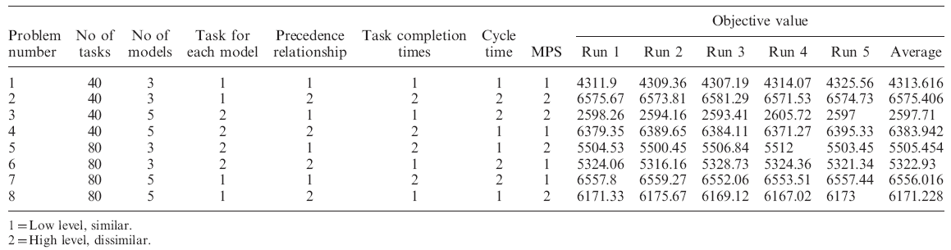
Results of CACO and experimental design

Slide 103
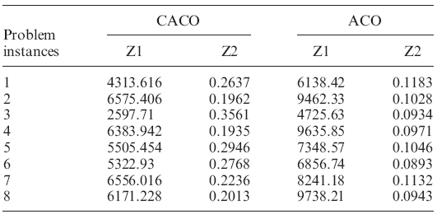
Comparison of results obtained by CACO and ACO

Slide 104
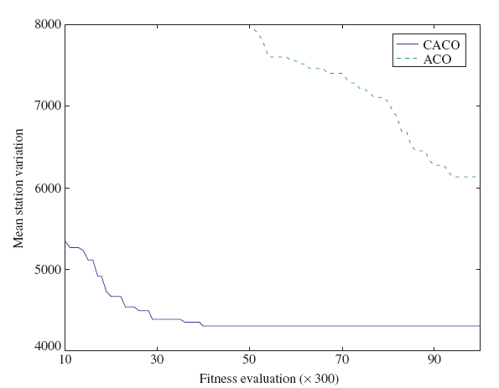
Convergence trends of CACO and ACO

Slide 105
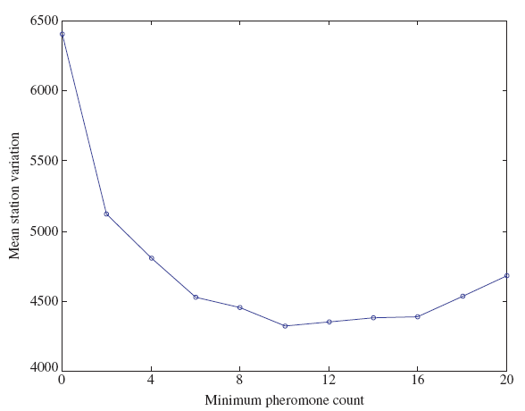
Deviation of station variation with τmin

Slide 106
Conclusion
The CACO algorithm obtained consistently better results than the ACO algorithm thereby validating its superiority over traditional ACO on the underlying problem.
DOE techniques have been utilized to statistically study the obtained results as well as validate the algorithm’s performance

Slide 107
Algorithm of Self Guided Ants(ASGA)
It utilizes a speed versus accuracy trade-off in collective decision making demonstrated by Temnothorx Albipennis ants.
In this algorithm we mathematically model and simulate the house hunting behavior of these ants
We map it with the selection of the edges joining two nodes by utilizing a new state transition rule.
An interesting phenomenon occurring in colonies of such ants corresponds to their quick decision making in harsh environmental conditions than benign ones.

Slide 108
Algorithm of Self Guided Ants(ASGA)
It was observed that their quick decision making generally lead to error primarily due to omission error rather than due to judgment error as ants would have discovered all alternative nests before making a choice for initiating an emigration
This error in accuracy is mostly due to strict time constraints imposed during the need for urgent decision making in harsh environmental conditions.

Slide 109
Algorithm of Self Guided Ants(ASGA)
By incorporating similar idea in foraging behavior of ants, convergence trends of the proposed ant algorithm can be controlled making an apposite tradeoff in solution quality.
The choices of an appropriate nest is a highly structures process involving following stages: exploration, decision making and migration and these stages are characterized by multi faceted options, high stakes and involvement of numerous individuals.
For the crisis management and rapid achievement of consensus over optimal location of nest from amongst a large set of probabilities the ants utilize the concept of “QUORUM THRESHOLD”(discussed later) while choosing whether to give emphasis to speed or to move for accuracy.

Slide 110
Algorithm of Self Guided Ants(ASGA)
These self-guided ants while making a transition to the next node, the ants take into consideration only the pheromone concentration.
Consideration for distance between the two nodes is omitted from the criteria of the probabilistic selection of the nodes.
This heuristic information has been implicitly merged with pheromone concentration by utilizing some appropriate dynamic pheromone evaporation rule during the tour construction.
The Algorithm of Self Guided Ants (ASGA) is first discussed in terms of a traveling salesman problem (TSP) and thereafter its application on the FDOM problem is detailed.

Slide 111


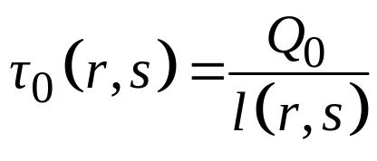
The initialization criteria
Path between any two nodes is an arc with an integrated collection of infinite discrete points.
The initial pheromone count at each arc is assumed to be equal.
The pheromone concentration on the path between the two nodes is calculated by computing the ratio of the net pheromone content on the arcs and the length of that arc.
If denotes the length of the path between the nodes r and s then the initial pheromone concentration between the same two paths is modeled by the following equation,

Slide 112
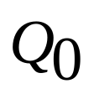
The initialization criteria
is a fixed pheromone content assumed to be distributed uniformly over each arc.
Computationally, it is a model dependent parameter.
For initialization, ants are randomly positioned on the feasible nodes.
In order to simulate real ant’s motion in forward direction only, a data structure called tabu-list is associated with each ant for maintaining the feasibility constraint.

Slide 113
The self guided state transition rule
In ASGA, the artificial ants utilize a concept similar to QUORUM THRESHOLD as shown by the T. Albipennis ants.
A quorum index is defined whose values determine whether to use probabilistic model to select the next nodes in the path or to simply follow the pheromone trail intensity.
If there is an urgent need for speedy convergence (harsh environment), the quorum threshold is low, otherwise it is high (benign environment).

Slide 114
The self guided state transition rule
Therefore, before making a move, the ant decides its behavior for running – tandem running or social carrying.
The scout first assesses the quorum size (or the quorum index), which is compared with the context sensitive threshold quorum ‘B’.
If the threshold is low, tandem running is preferred, whereas social running is used in the other case.
The probabilistic model simulates the tandem running where as the mechanism to follow pheromone trail intensity is used for social carrying.

Slide 115
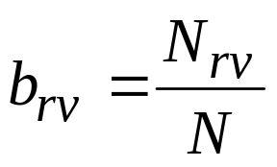
The self guided state transition rule
The quorum index for an ant positioned at node r is defined as,
N_{rv} is the number of ants that have passed through the nodes (r, v) in the last iteration;
N is the total number of ants in the colony.
The quorum index is calculated for each path connecting the current node r and the feasible node v.

Slide 116
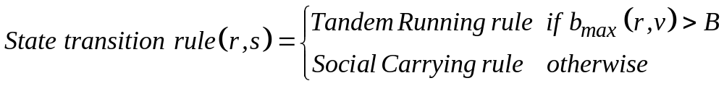
The self guided state transition rule
The state transition rule for the path between the nodes r and s is dynamically chosen by the ant according to,
When an ant arrives at any node r, the decision regarding choosing the next node is based upon the maximum quorum index and the value of quorum threshold B.
If the value of maximum quorum index is larger than the quorum threshold, tandem running is invoked, otherwise social running is used.

Slide 117
Tandem running rule
In tandem running rule, the speed accuracy tradeoff is maintained where the transition probabilities governing the movement of ants derives information only from the quorum index and the quorum threshold value.
Such a modification maintains fast convergence of the algorithm in addition to keeping the explorative structure in cases of local convergence.

Slide 118

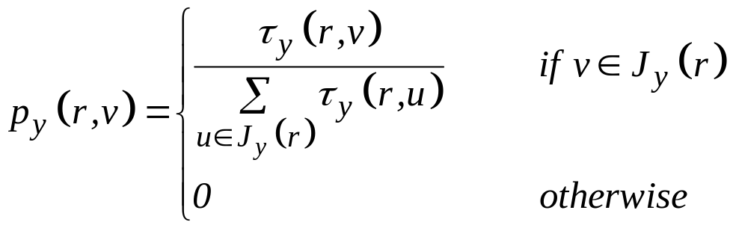
Social carrying rule
This rule is followed if no b exists for which the criteria for quorum threshold ( ) is satisfied. In this case, the transition probability is mathematically modeled as ,
Thus, in any iteration y, an ant positioned on node r chooses to move to a feasible node v (i.e., a node lying in the list of feasible nodes), according to above equation

Slide 119
The pheromone update rules
Two pheromone update rules are utilized to update the pheromone concentration lying between the paths of the nodes.
Dynamic pheromone evaporation and update rule
Global pheromone update rule

Slide 120
Dynamic pheromone evaporation and update rule
The study of real ant phenomenon states that the ants reside for lesser time on the shorter paths than on the longer paths.
The evaporation on the shorter paths occurs for a lesser time which indirectly leads to higher pheromone concentration over these paths than on the longer ones.

Slide 121
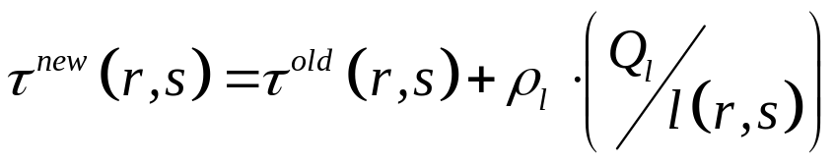
Dynamic pheromone evaporation and update rule
To simulate this phenomenon, cumulative pheromone added to each path is governed by the following equation,
Q_{l} is the model dependent positive quantity.
This rule implicitly merges the greedy heuristic information with the pheromone information by logically relating it with the actual evaporation phenomenon that occurs in movement of real ants.

Slide 122
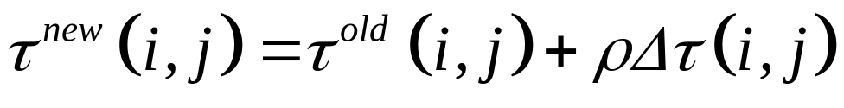


Global pheromone update rule
At the tour completion by all the ants, the N ants which correspond to the best N tours till the current iteration are rewarded according to the global update rule.
The purpose of this rule is to search in the vicinity of the best N tours found so far.
In above equation the term represents the new pheromone concentration.
It is obtained by incrementing the original pheromone value by .

Slide 123

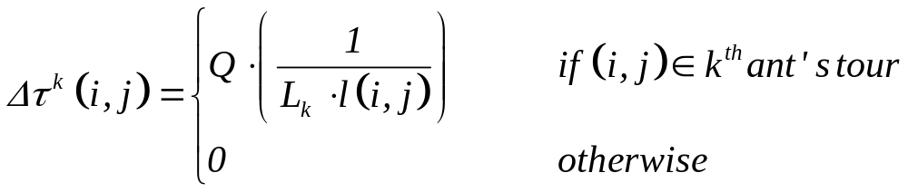
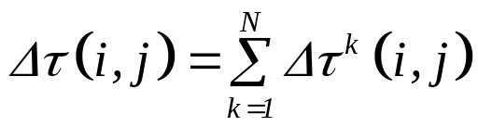
Global pheromone update rule
The factor represents the accumulated increment by each of the N ants which are ranked best till the current iteration.
Accumulated increment is depicted in the following equation.
,
Parameter Q is the positive model dependent constant.
L_{k} is the tour length by the global best ant. is a dynamic quantity that is added to all the paths after the tour completion.

Slide 124
Global pheromone update rule
The equations have been designed such that obtains a non zero value only for paths that are traversed by the global best ant.
After global pheromone update, all the ants are reinitialized and their tabu-lists are emptied.
Algorithm is iterated in this fashion till certain terminating criterion (Maximum number of iterations or functional evaluations) is met.

Slide 125

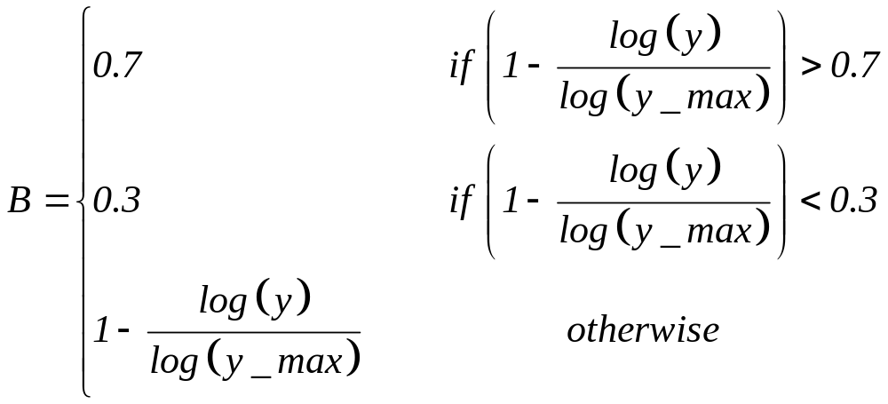
Parameter Settings for ASGA
Numerous experiments were performed to determine the optimum parameter setting.
The value of is set equal to 30,
Q_{l} is set equal to 10 and Q to 50.
Values of quorum threshold B are given hereunder

Slide 126
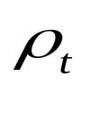

Parameter Settings for ASGA
The dynamic evaporation rate governing parameter is equal to 0.05 and the parameter is set equal to 0.5.
Maximum number of fitness evaluations is set to 5000 for small problems and 10000 for large problems. It is taken as the terminating criterion.

Slide 127
The Fuzzified Disassembly Optimization Model
For the maximization of profits in Fuzzified Disassembly Optimization Model problem, we applied the proposed ASGA to obtain the near optimal results.
For this purpose, following modifications are made: number of cities and the number of ants are both set equal to n_{t.}
The length of the tour is modified as L_{k}=50+(5000/Z_{p} ) for all the problem instances.

Slide 128
The Fuzzified Disassembly Optimization Model
The path length between two cities is defined by the sequence dependent setup cost matrix such that, l(r,v)=W(r,v).
The precedence constraint is maintained with the help of a tabu-list.
The tabu-list consists of only those cities which satisfy the feasibility criteria.
Many designed experiments use multi-level matrices called orthogonal arrays for determining the combinations of factor levels to use for each experimental run and for analyzing the data thereafter .

Slide 129
The Fuzzified Disassembly Optimization Model
The problem discussed involves seven factors which were identified to have major impact on the results.
These factors were varied at two different levels (low and high) and their effect on the objective function value has been studied.
The test bed is generated with due considerations to the Taguchi’s orthogonal arrays and thereby the resulting 8 experiments serve as the balanced combination of the levels of the factors selected.

Slide 130







The Fuzzified Disassembly Optimization Model
The factors considered for this study are,
Number of parts ( ):
Number of subassemblies ( ):
Number of joints ( ):
Setup Costs ( ):
Joint breaking costs ( ):
Recovery value ( ):
Disposal costs ( ):

Slide 131
The Encoding Schema
Integer coding is done for the string representations such that each joint and subassembly is assigned the value of a unique positive integer.
The string representation is interpreted as:
The joints and subassemblies are broken according to the sequence of their appearance in the solution string.
Depth of disassembly is ascertained by using the analogy behind the special number ‘0’ which states that only those subassemblies and joints that lie before ‘0’ in the solution string are allowed to be broken down for further disassembly.

Slide 132
The Encoding Schema
As an example, consider the following 9-tuple string representation, < 2 3 1 4 8 0 7 6 5 >
Integers from 1 to 8 represents joints/subassemblies to be broken
‘0’ identifies the depth of disassembly.
The final sequence of joints to be broken are those that lie ahead of ‘0’, i.e., <2 3 1 4 8>.
Based upon the joints broken, the associated subassemblies and parts recovered can be determined.
If there were six joints and two subassemblies in this example product configuration, then ‘7’ represents the subassembly ‘1’, and ‘8’ represents the subassembly ‘2’.

Slide 133
A Simulated Example
FA
Network representation of the electric drill.
Triangles represent subassemblies
Circles represent the parts
Bars represent the joints.
1
2
3
1
1
2
3
4
5
6
7
8
9
4
5
2
6
7
8
10
11
9
10
11

Slide 134
A Simulated Example
The simulated problem is related to the optimal disassembly sequencing of a hand-held electric drill.
The representation has the potential of exhibiting not only the parts but also the joints and fasteners holding them.
The cost matrices have been formed based on the analysis of material constituent and their alignment within the product.

Slide 135
A Simulated Example
The network representation shows 11 parts, 11 joints and 2 subassemblies.
According to the encoding schema, subassembly 1 has been referred as joint 12 and subassembly 2 as joint 13.
From the figure, it is observed that the parts 4 to 11 reside within the subassembly 1 (joint 12) whereas the parts 9 to 11 belong to the trigger and stator subassembly (subassembly 2 or joint 13).

Slide 136
A Simulated Example
Result obtained for optimal disassembly of hand held electric drill by ASGA
Joint breaking sequence 3_1_2_12_5_9_7_8_6_4
Parts recovered P₁, P₂, P₃, P₄, P₅, P₆, P₇, P₈
Subassemblies recovered S₂
Total Profit 54.01 units

Slide 137
Discussion of Results
The algorithm took about 1500 fitness evaluations before stagnating to the objective function value of 54.01 units.
The sequence in which the joints should be broken for minimum sequence dependent setup costs has also been given.
The trigger and stator subassembly (subassembly 2) is recovered as such because profits obtained from subassembly 2 as a whole outweigh the net profits that can be obtained on breaking the subassembly 2 (joint 13) and the joints 10 and 11 underneath it in order to recover parts 9, 10 and 11.

Slide 138
Thank You
Queries?

Slide 139
Thank You
Queries?

