Slide 1
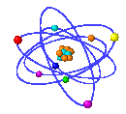
Particle Swarm Optimization
An Overview
Prof. M K Tiwari
Department of Industrial Engineering & Management
IIT-Kharagpur, India.

Slide 2
Introduction
Nature is full of complex systems studied from different angles with different objectives.
Complex Systems
To simulate the complex behavior of system through mathematical modeling.
Formulate a problem solving strategy for hard computational problems that arise in the course of the mathematical modeling of the complex systems for the sake of improving and incorporating innovation in it.
E.g. Global Optimization techniques
To understand the working mechanism of Complex Systems
E.g. To know the factor contributing to the ups and downs in share prices
To identify the factors affecting a machine.

Slide 3
General Optimization Strategies
Computer Scientists and Mathematicians have formulated various algorithms based on Natural Evolution to solve their problem.
One wants to be able to Predict, Reconstruct and Deploy a Complex System.
Optimization Strategies are employed
  To solve hard computational problem
  To help characterize the behavior of Complex Systems.

Slide 4
General Optimization Strategies
Most Common because of computational effectiveness and time efficiency
Optimization Algorithms
Stochastic algorithms
E.g. Evolutionary Computation
Enumerative schemes
(implicit methods)
Each possible solution is evaluated
Our Focus
Deterministic algorithms
E.g. Using calculus etc.,

Slide 5
Evolutionary Computation
Focus:
To build a mapping between a Real problem and a Natural phenomenon.
Natural phenomena being mapped will be, in general, a goal oriented phenomena followed by natural life forms or processes.
In the mapping,
    Synthetic entities ⬄ Natural life-forms
    Parameters ⬄ Properties.
    Solutions to Real problem ⬄ States or goals of Natural Phenomenon
Natural
Phenomenon
Real problem
Mapping

Slide 6

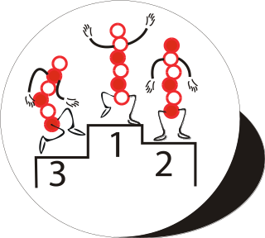

Common Characteristics of Evolutionary Computation
Population:
  Population of Individuals or of candidate solutions
  is maintained which is characterized by set of objectives, states, behavior, behavior rules etc.
Evolution of Population
  The composition of the population changes by the process analogous to birth and death of the individuals called generation.
    Birth ➔ Enhancement of Desired features
    Death ➔ Elimination of Undesired features
  The population at any instance may also be referred to as a generation.
  The more the desired features, the better the fitness of an individual
Objectives
Stepwise ⬄ Selection of superior individual at each step in evolution.
Ultimate ⬄ Overall best individual selection at the end

Slide 7
Generic Concept
Procedure
Initialize population (randomly)
Individuals (candidate solution)
Evaluation (fitness function) for all individuals
While (termination criterion not satisfied)
Select (superior individuals from parent population)
Evolution of Population (Method Varies among different algorithms)
Evaluate of fitness of Newly generated population
Selection of Superior individuals
Creation of Next generation population
End
May be fixed number of generations or some value of best fitness attained.

Slide 8
Particle Swarm Optimization (PSO)

Slide 9
Particle Swarm
Goal:
To explain the natural evolutionary process involved in a Stochastic Optimization Technique called Particle Swarm Optimization (PSO) to solve computationally hard Optimization problems .

Slide 10

Particle Swarm Optimization
(PSO)
PSO is a robust stochastic optimization technique based on the movement and intelligence of swarms.
It was developed in 1995 by James Kennedy and Russ Eberhart.
It has been applied successfully to a wide variety of search and optimization problems

Slide 11
Inspiration
PSO has been built by abstracting the working mechanism of natural phenomenon.
Specifically, it was inspired from the swarms in nature such as swarms of birds, fish, etc.

Slide 12

PSO Formulation
In PSO, a swarm of n particles (individuals) communicate either directly or indirectly with one another using search directions (gradients).
The algorithm adopted uses a set of particles flying over a search space to locate a global optimum.
During an iteration of PSO, each particle updates its position according to its previous experience and the experience of its neighbors.

Slide 13
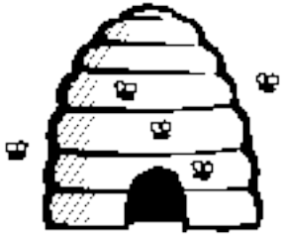
Fundamental details of PSO
A particle (individual) is composed of:
  Three vectors:
    The x-vector records the current position (location) of the particle in the search space,
    The p-vector (pbest) records the location of the best solution found so far by the particle, and
    The v-vector contains a gradient (direction) for which particle will travel in if undisturbed

Slide 14

PSO: Generic Algorithm Schema
Start
Initialize swarm with random position (x₀)
and velocity vectors (v₀)
For Each Particle
Evaluate Fitness
Next Particle
If
fitness(x_{t})> fitness (gbest)
gbest=x_{t}
Update Position
x_{t+1}= x_{t+1} + v_{t+1}
If
fitness(x_{t})> fitness (pbest)
pbest=x_{t}
Update velocity
gbest= Global Best Position
pbest= Self Best Position
If
Terminate
false
c₁ and c₂= Acceleration Coefficients
W = Inertial Weight
true
gbest = output
End

Slide 15

Algorithm Implementation
The basic concept of PSO lies in accelerating each particle toward the best position found by it so far (pbest) and the global best position (gbest) obtained so far by any particle, with a random weighted acceleration at each time step.
This is done by simply adding the v-vector to the x-vector to get another x-vector (X_{i} = X_{i} + V_{i}).
Once the particle computes the new X_{i} it then evaluates its new location. If x-fitness is better than p-fitness, then pbest = X_{i} and p-fitness = x-fitness.

Slide 16
Psychosocial compromise
Particle’s best position so far
Particle’s Current position
i-proximity
Global best position attained
pbest
x
gbest
g-proximity
v
gbest = Global Best Position
c₁ and c₂ = Acceleration Coefficients
pbest= Self Best Position
W = Inertial Weight
Notes:
This may be the most important slide of this presentation, for it summarizes the core of the method.
Let’s take a bit time to comment it.
You are a particle. Sorry, I don’t mean you are quite stupid, but it is just to explain how it works.
(By the way, Jim Kennedy has designed a nice game in which you compete with such stupid particles. I have it here, and if we have time, you will see it is almost impossible to beat it.)
You can compute how good is your position (that is to say you can compute the objective function at the place you are). You remember the best position you ever found (and the objective function value). You can ask your neighbours for this information they also have memorized, and choose the best one.
Now, you have three tendancies,
- audacious, following your own way (just using your own velocity)
- conservative, going back more or less towards your best previous position
- sheeplike, going more or less towards your best neighbour
What PSO formalizes is how to combine these tendancies in order to be globally efficient.

Slide 17
Initial parameters
Swarm size
Position of particles.
Velocity of particles.
Maximum number of iterations.

Slide 18

Control Parameters
Swarm size
Inertial Weight W
Acceleration Coefficients c₁ and c₂
Number of iterations

Slide 19
Inertia Weight W
A large inertia weight (w) facilitates a global search while a small inertia weight facilitates a local search.
Larger W
Greater Global Search Ability
Smaller W
Greater Local Search Ability

Slide 20
Acceleration Coefficients
Determines the inclination of search.
C₁ larger
than C₂
Greater Local Search Ability
C₂ larger
than C₁
Greater Global Search Ability

Slide 21
A Numerical Example
Let our Control parameters be
W =0.70 ; C1 =0.20 ; C2 =0.60 ; n=5 → 5 Swarm Particles.
E=4 iterations (just for simplicity)
Let the Random numbers used for updating Velocity of particles be
r1 =[ 0.4657,0.8956,0.3877,0.4902,0.5039] ( each one corresponding each particle)
r2 =[0.5319,0.8185,0.8331,0.7677,0.1708]
Note: For our simplicity ,we fix these random numbers through out our
calculations, in fact they need not be fixed.

Slide 22
Numerical Example Continued…
Initialization of Swarm Particles:
We initialize fitness of all the particles as Zeros
Current Position of all the 5 particles as
CP(0) =10 * [r1 -0.5]
CP(0) = 10 *{[ 0.4657,0.8956,0.3877,0.4902,0.5039] -0.5}
So, CP(0) =[-0.3425,3.9558,-1.1228,-0.0981,0.0385]
Note :here 10 is multiplied randomly to initialize at least some of the particles as greater than 1 and 0.5 is subtracted from random numbers just to avoid biasness in generating only positive swarm particles initially. Now both negative and positive numbers are generated

Slide 23
Numerical Example Continued…
Initialization of Velocity :
V(0) = r2-0.5 , r2 we already defined initially.
V(0) ={[0.5319,0.8185,0.8331,0.7677,0.1708]-0.5}
we get
V(0) =[0.0319,0.3185,0.3331,0.2677,-0.3292]

Slide 24
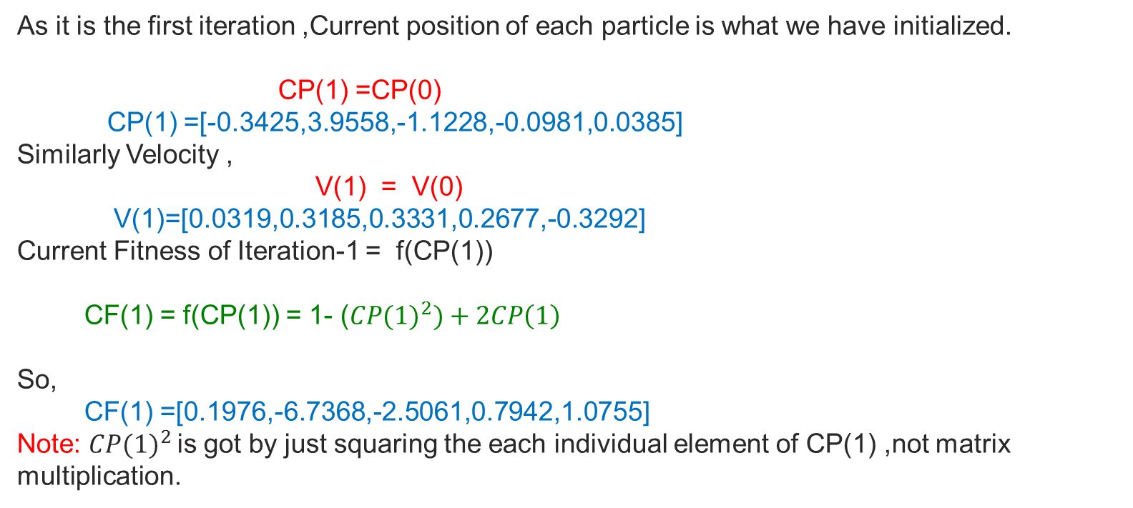
Numerical Example Continued…

Slide 25
Numerical Example Continued…
Note that Local Best position of each particle up to first iteration is just its current position only.
So LBP(1) =CP(1)
LBP(1) =[-0.3425,3.9558,-1.1228,-0.0981,0.0385]
Local Best Fitness of each particle up to iteration 1 =Current Fitness of Iteration -1,
LBF(1) = CF(1)
so LBF(1) =[0.1976,-6.7368,-2.5061,0.7942,1.0755]
Global Best Fitness of iter1 =Max(LBF(1)),
GBF(1) = 1.075 → for 5th particle
Global Best Position of iter1 = 0.0385 →corresponding current position of 5th particle in CP(1).

Slide 26
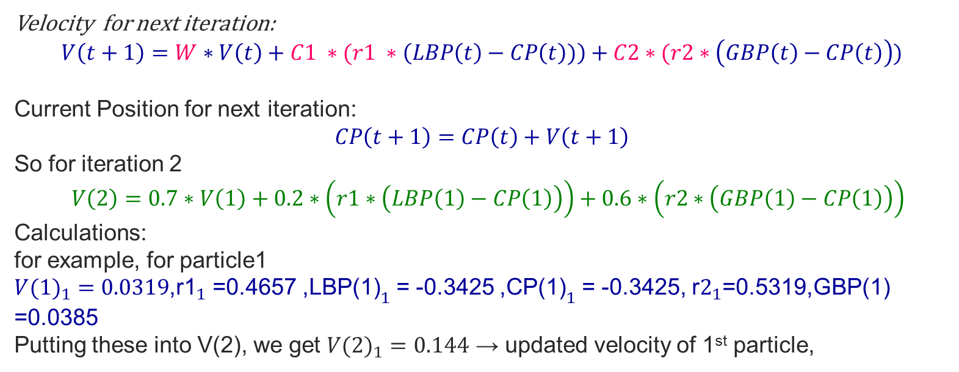
Numerical Example Continued…

Slide 27
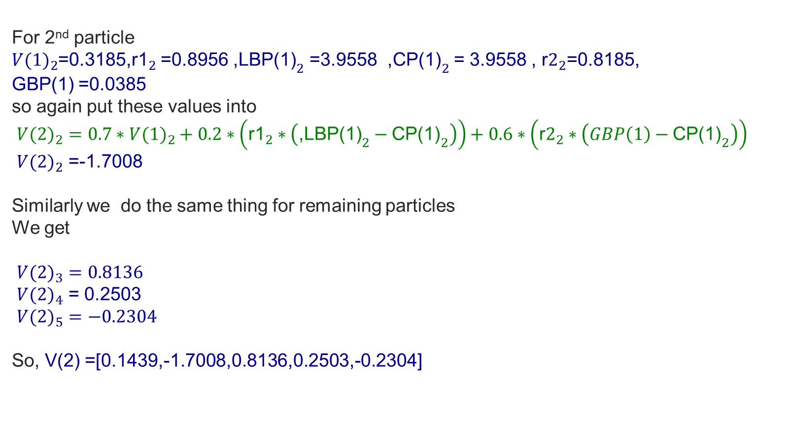
Numerical Example Continued…

Slide 28
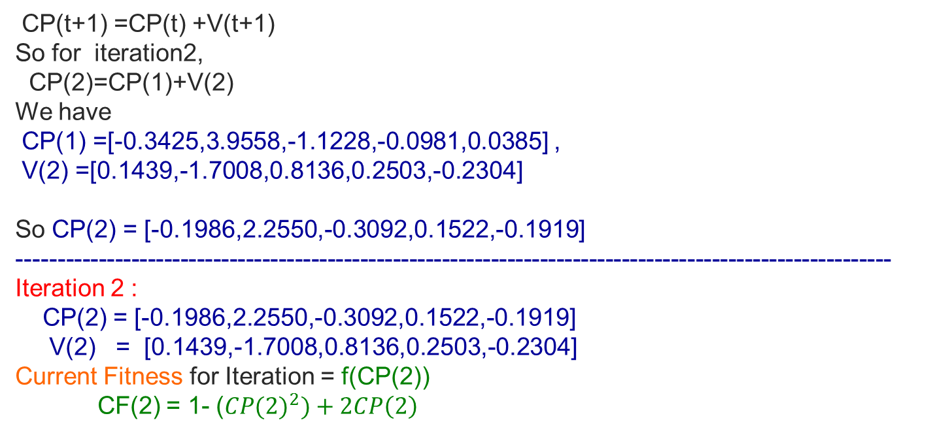
Numerical Example Continued…

Slide 29
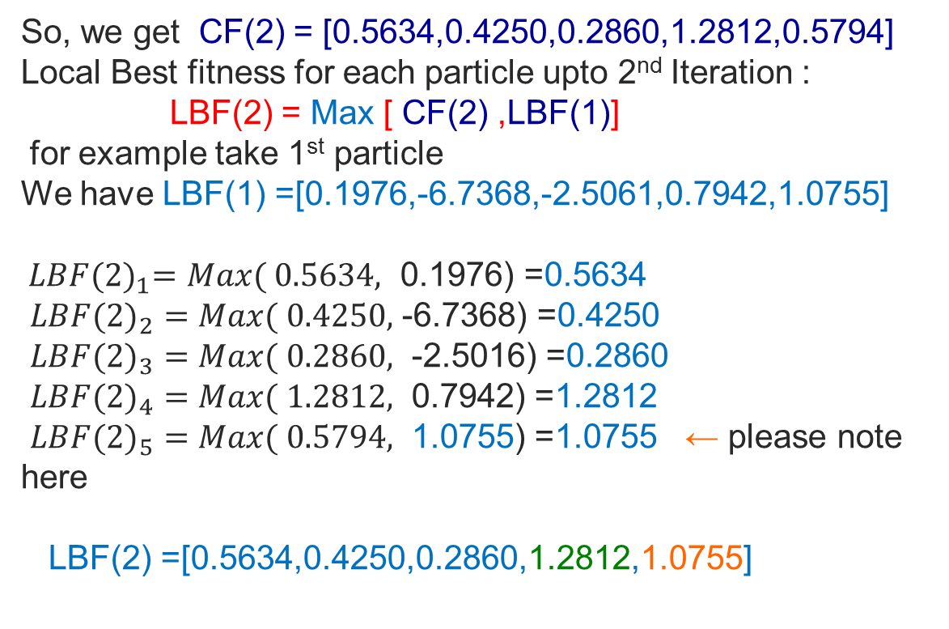
Numerical Example Continued…

Slide 30
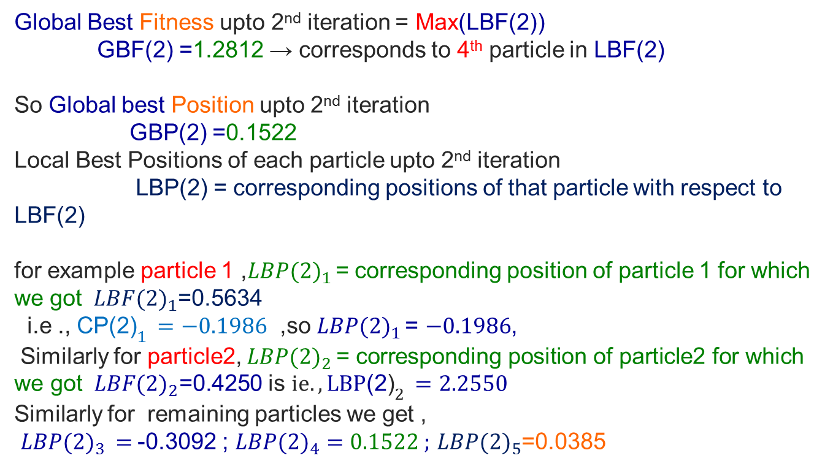
Numerical Example Continued…

Slide 31
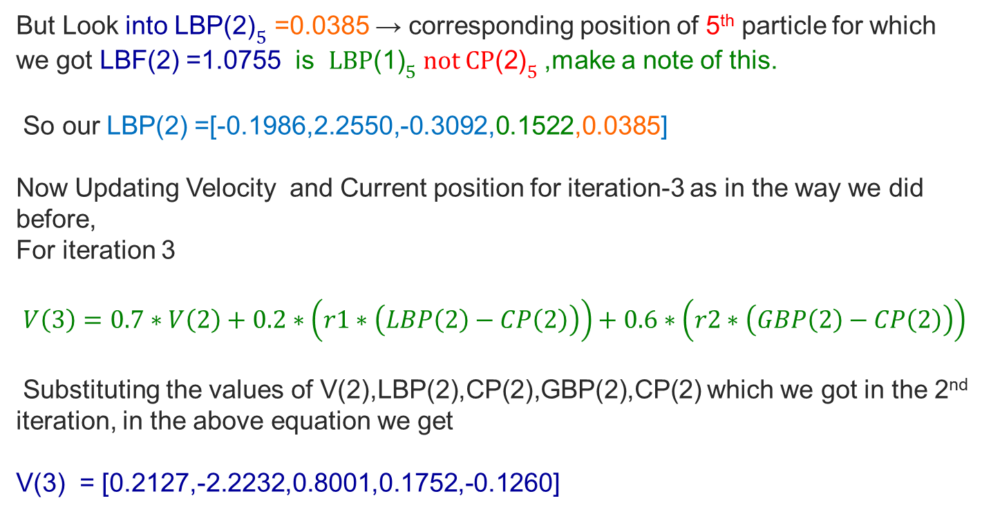
Numerical Example Continued…

Slide 32
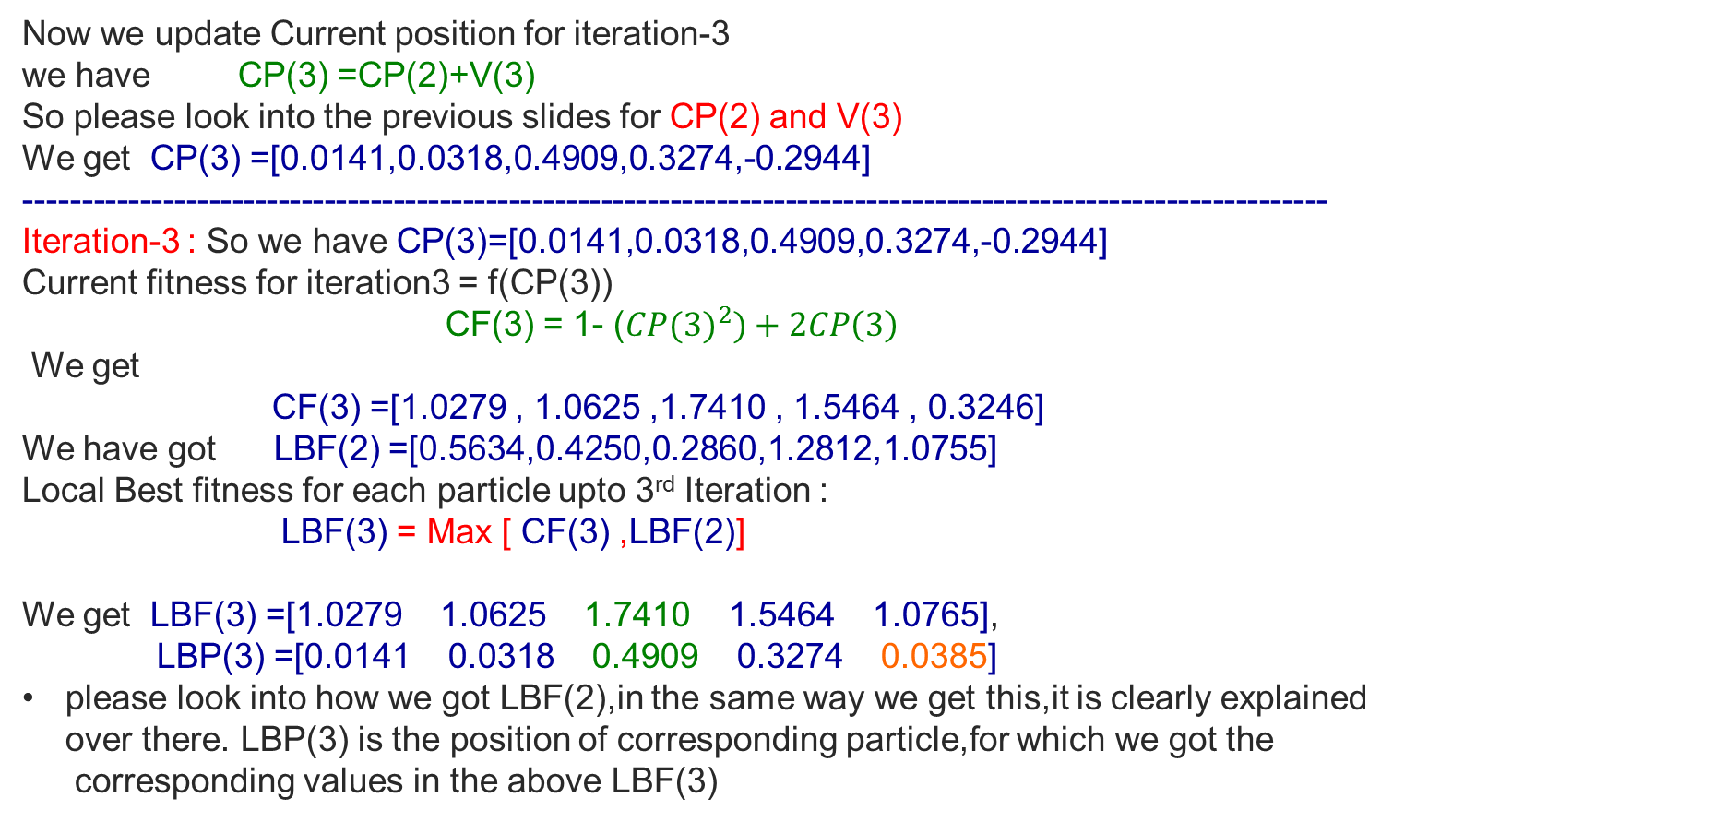
Numerical Example Continued…

Slide 33
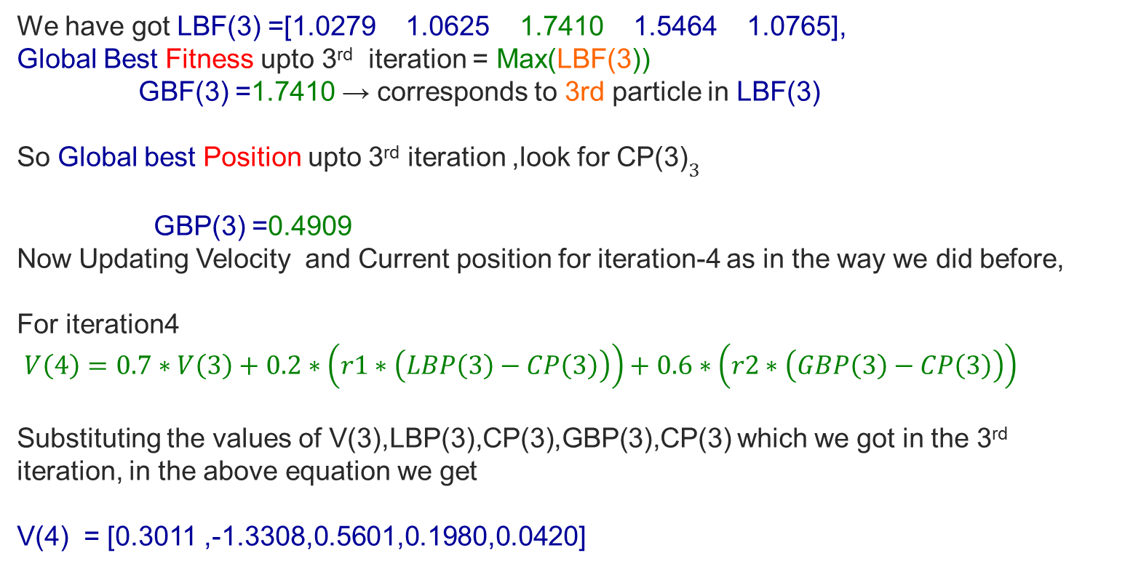
Numerical Example Continued…

Slide 34
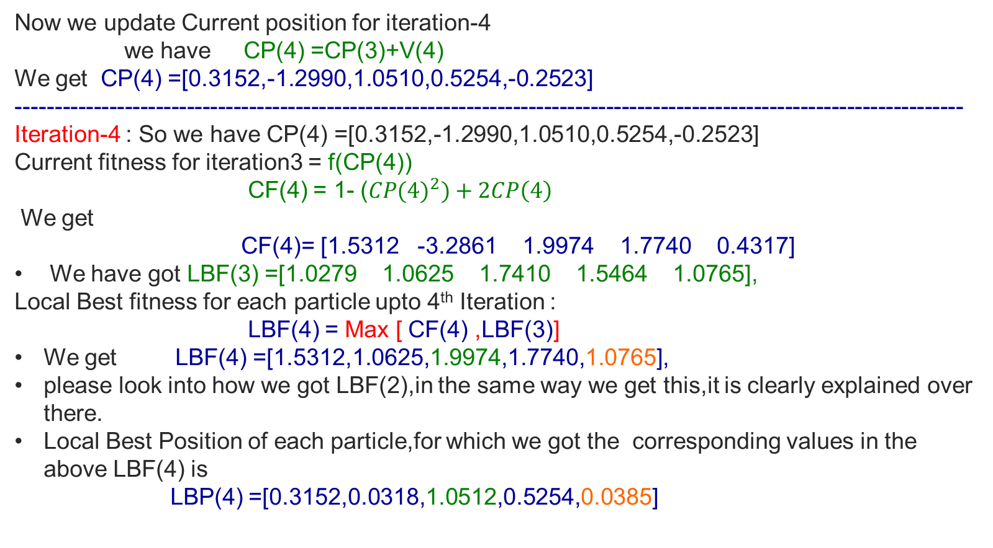
Numerical Example Continued…

Slide 35
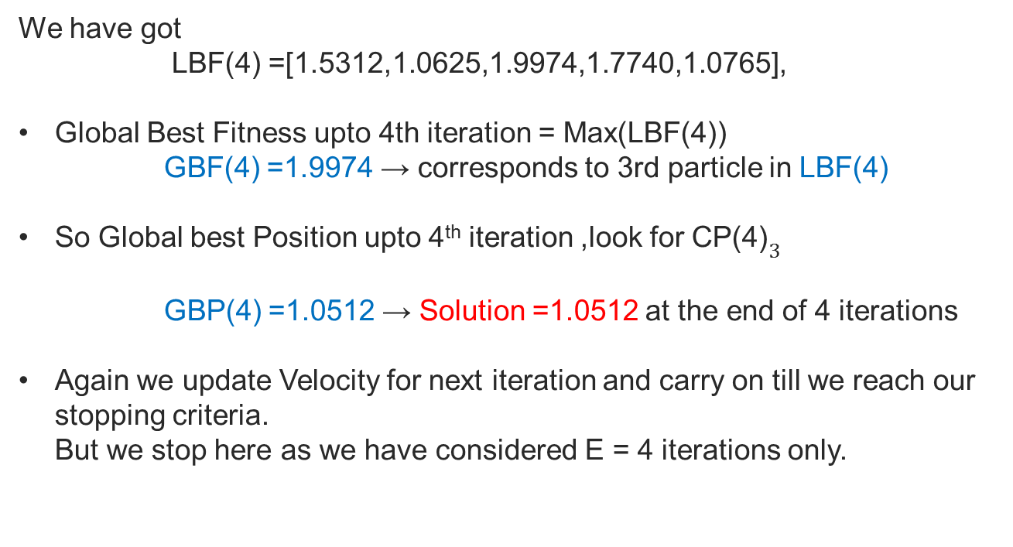
Numerical Example Continued…

Slide 36
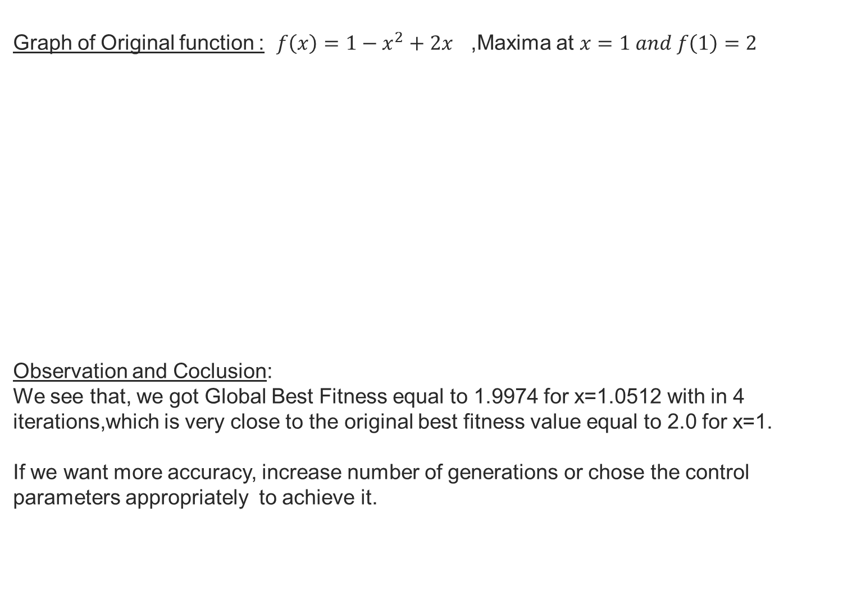
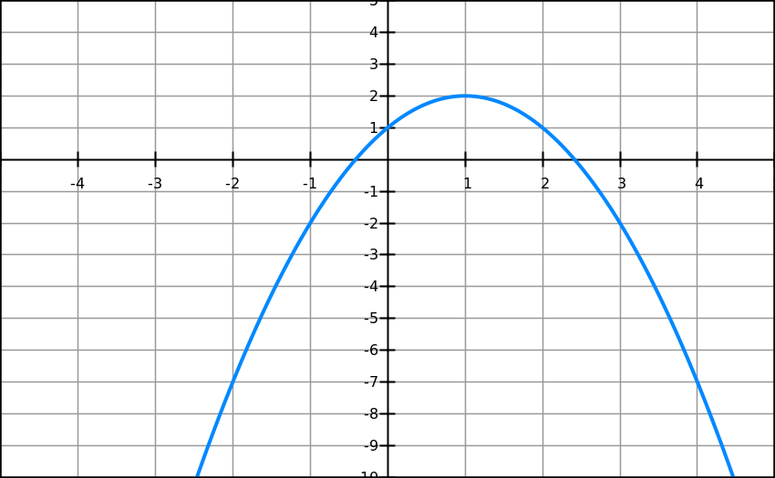
Numerical Example Continued…

Slide 37
Comparison with Genetic Algorithm (GA)
Unlike GA, in PSO there is no selection operator.
PSO does not implement survival of the fittest strategy and all individuals are kept as members of the population throughout the course.

Slide 38
PSO implementation on TSP

Slide 39
Encoding Schema
Generally PSO is applied over problems involving real variables.
However, through the use of proper encoding schema it can be applied to solve hard combinatorial optimization problems like Traveling Salesman Problem, Knapsack Problem, Node Coloring, Sequencing and Scheduling.

Slide 40
Encoding Schema
For TSP, each particle’s position is coded in the form of a one dimensional string whose dimensions equals the number of cities that are to be visited.
The particles are randomly initialized with rank vectors.
5 | 9 | 2 | 4 | 6 | 3
String representation for TSP with 6 cities
rank

Slide 41
Decoding
Best rank
Encoded
String
5 | 9 | 2 | 4 | 6 | 3
Decoded
String
 |  | 1
priority is assigned to the third
city

Slide 42
Decoding
Best rank
among the remaining
Best rank
among the remaining
Best rank
among the remaining
Best rank
among the remaining
Encoded
String
5 | 9 | 2 | 4 | 6 | 3
Representing that it has been decoded
Representing that it has been decoded
Representing that it has been decoded
Representing that it has been decoded
Representing that it has been decoded
Decoded
String
 |  | 1
4
6
3
5
2
Corresponding next priority is assigned to the 1st
city
Repeated till all cities are assigned
Corresponding next priority is assigned to the 5th
city
Repeated till all cities are assigned
Repeated till all cities are assigned
Corresponding next priority is assigned to the 6th
city
2nd city has the least priority
Corresponding next priority is assigned to the 4rth
city
Repeated till all cities are assigned

Slide 43
Decoding
Encoded
String
5 | 9 | 2 | 4 | 6 | 3
After Decoding
Finally
Decoded
String
4 | 6 | 1 | 3 | 5 | 2

Slide 44
Solution Strategy by Particle Swarm Algorithm
Randomly initialize the particle’s position (ranks) and velocity.
Decode the particles and evaluate objective function value.
Store the initial position in particle’s memory.
Repeat the process till required no. of iterations are complete
If the position of particle at present is better than the position
stored in its memory, update memory.
Update the global best if a better position than the previous best
is obtained
Modify velocity using cognitive and social components and
update position.
Decode the particles’ positions and evaluate objective function
values.
The particle with best position is the output.

Slide 45
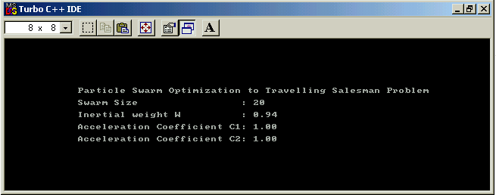
Results of PSO on TSP with 10 Nodes

Slide 46
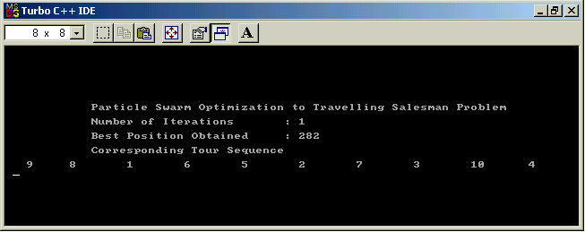
Results of PSO on TSP with 10 Nodes

Slide 47
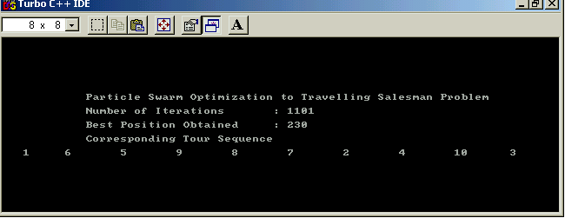
Results of PSO on TSP with 10 Nodes

Slide 48
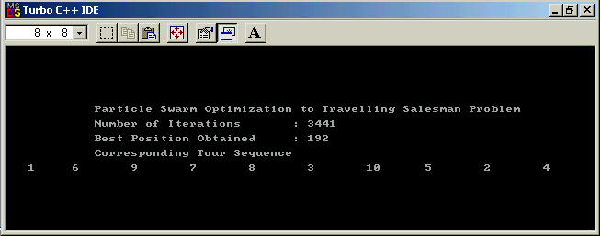
Results of PSO on TSP with 10 Nodes
PSO took relatively large time to evolve the optimal solution

Slide 49
Remarks about “Particle Swarm”
Fast convergence thus time requirement is less.
Global as well as Local search component.
Dependence on parameter tuning is less.
More effective on problems involving real values.
Chances of early convergence due to high convergence speed.

Slide 50
Various Combinatorial Problems vis-à-vis Traveling Sales Problem

Slide 51
Job Shop Scheduling

Slide 52
Job Shop Scheduling
J × M JSSP: J jobs with M machines.
Each job has M operations, each operation requires a particular machine to run.
Precedence Constraint; each job has exact ordering of operations to follow.
Non-preemptible.

Slide 53
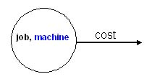
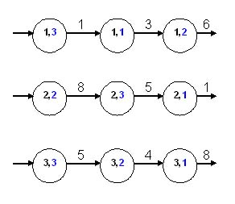
JSSP Instance
Job | Machine (Processing Time)
1 | 3(1) | 1(3) | 2(6)
2 | 2(8) | 3(5) | 1(4)
3 | 3(5) | 2(4) | 1(8)

Slide 54
Objectives
Makespan
  Time from when first operation starts to last operation finishes.
Flow times
  Time when a job is ready to when the job finishes.
With deadlines
  Lateness
  Tardiness
  Unit penalty
If each job has varying importance, utilities can also be weighted.

Slide 55
Similar Problems
Open-shop scheduling
  No precedence constraint.
Flow-shop scheduling
  Identical precedence constraint on all jobs.

Slide 56
Implementation of Evolutionary Algorithm
Procedure
Initialize population (randomly)
Individuals (candidate solution)
Evaluation (fitness function) for all individuals
While (termination criterion not satisfied)
Select (superior individuals from parent population)
Evolution of Population (Varies with Algorithms)
Evaluate Newly generated population
Selection Superior individuals
Creation Next generation population
End

Slide 57

JSSP- Evolutionary Algorithm
Initialization:
  The solution string is represented in the form of Job sequence matrix
  Similar to permutation string used in TSP, but separated to each machine.

Slide 58
JSSP- Evolutionary Algorithm
The subsequent steps will similar to that of the implementation of various Evolutionary Algorithms on TSP.
The implementation steps of Evolutionary algorithms will help us to solve the underlying Job shop scheduling problem.

Slide 59
Resource Constrained Project Scheduling Problem

Slide 60
Resource Constrained Project Scheduling Problems (RCPSP)
A RCPSP can be viewed as a kind of the ordering problem subject to some constraints once the ordering of the activities are known
The solution string may be represented as
[i₁ i₂ .... i_{j.} .... i₅ i₆]
Where, i_{k} represents the activity in the j^{th} position
For RCPSP having 5 activities, the solution string can be:
[3 5 4 2 1]
Similar to the Traveling Salesman Problem

Slide 61
Interactive Particle Swarm for Multiobjective Optimization

Slide 62
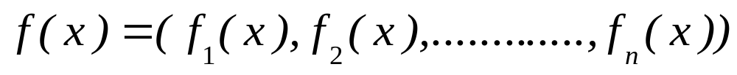
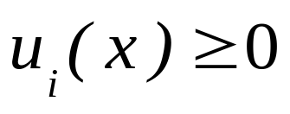
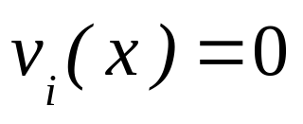
MULTIOBJECTIVE OPTIMIZATION
Multiobjective optimization refers to the simultaneous minimization of several objectives, subjected to a number of constraints, i.e.
Min/Max
subjected to constraints,

Slide 63
Continued.........
In the absence of preference information, a set of solutions is obtained called Non-dominated or Pareto Optimal Set of solutions.
Mathematically,
if,

Slide 64
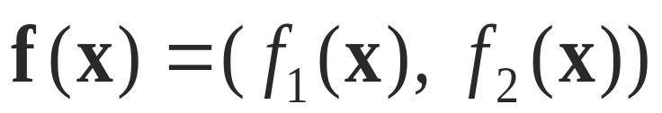


Pareto Dominance
Minimize
A
B dominates A
A is dominated by B
(B is better than A)
Minimize
B
Minimize

Slide 65
Pareto Dominance (continued......)
Minimize
A
B and C are non-dominated
with each other.
B
Minimize
C
Minimize

Slide 66
Pareto Optimal Front
A Pareto Optimal Front is obtained by mapping the non-dominated solutions in the objective function space.
Pareto Optimal
Front
Minimize
Minimize

Slide 67
Evolutionary Algorithms(EA) and Multiobjective Optimization(MOO)
Computational complexity involved in handling of multiple objectives, has lead to increased application of evolutionary algorithms in the field of MOO.
A number of search strategies like Genetic Algorithm (GA), Simulated Annealing (SA), Tabu Search (TS), Particle swarm (PSO), Ant Colony Optimization (ACO) etc. have been applied to handle multiple objectives simultaneously.

Slide 68
Multiobjective Techniques
Most of the multiobjective techniques like Non dominated Sorting Genetic Algorithm (NSGA), Pareto Archived Evolutionary Strategy (PAES), Strength Pareto Evolutionary Algorithm (SPEA), are aimed at obtaining the Pareto Front of the problem.
However, these approaches are marked by their inability to provide compromise solution, best suited to the needs of the situation.

Slide 69
Decision Making in MOO
Decision making is incorporated in the search process, in order to obtain the compromise solution as:
Priori articulation of preferences.
Posteriori articulation of preferences
Progressive articulation of preferences.

Slide 70
MOO-REQUIREMENTS
To find well-distributed Pareto-optimal solutions as close to the optimal front as possible.
To facilitate the process of decision making.
To obtain the compromise solution in consonance with DM’s preference.
To decrease the cognitive load on DM.
To reduce the time required in decision making to a minimum.

Slide 71
Proposed Metaheuristic for solution to MOO problems: IPSO
Particle Swarm Optimization (PSO) has been utilized.
Non-dominated solutions are stored in an external memory.
Adaptive grid procedure to present a representative Pareto front to the DM.
Self adaptive mutation operator to impart high exploratory capability to the particles at various stages of the search.
Strategic inclusion of decision making to guide the search partially towards preferable regions.

Slide 72
PSO in Multiobjective Optimization
In the past, several times PSO has been successfully applied to handle multiple objectives.
PSO is ideally suited for multiobjective optimization due to its high exploratory capacity and fast convergence.

Slide 73
Initialize Position of particles
Initialize Velocity of particles
Evaluate Objectives
Locate the
Particles
Store into
Repository
Yes
Is Particle
Nondominated
No
Update Particle’s Memory
Update Velocity
Update Position
Par[i] =Par[i] +V[i]
Maintain Particles in search space
Store into
Repository
Yes
Repository
Empty?
Yes
Is Particle
Nondominated
No
No
Decision Making
Update Particle’s Memory
Pruning of Non dominated set by adaptive grid
Mutation
Operator
Is termination
Criteria met?
No
Yes
STOP

Slide 74
External Repository
It is used to store non-dominated particles found along the search process.
If a solution present in the repository is dominated by any other particle it is removed from it.

Slide 75
Adaptive Grid
The large size of the trade-off front makes it impossible to determine the complete front.
The adaptive grid procedure is used to maintain diversity in the Pareto Front and prune the it to generate a representative front for presenting to the decision maker. .
In the adaptive grid procedure, the search space explored, so far is divided into grids whose number is pre-specified depending on the problem concerned.

Slide 76
Adaptive Grid (continued..)
When a particle enters into the repository it is assigned to a particular grid depending on its objective function value.
When the repository is filled, any solution wishing to enter is first checked for its position.
If it lies in a lesser crowded grid, it is given access to the repository and a corresponding particles from the grid with maximum members is deleted.
The particle deleted is the one having least utility.

Slide 77
Adaptive Grid Procedure
Non-dominated solution

Slide 78
Utility Function
Utility function is calculated based on the preference information received from the decision maker.
It is a tool to reduce the cognitive load on the decision maker.
It also reduces the time involved in decision making.
Feedback received from the utility function is used to drive the search towards preferable regions.

Slide 79
Formulation of Utility Function
A set of solutions lying on different regions of the efficient frontier is sent to DM in order to obtain preference information based on comparisons performed by him/her.
Consider DM prefers x over y
A linear program is formulated as
Max ∆
subjected to constraints,

Slide 80
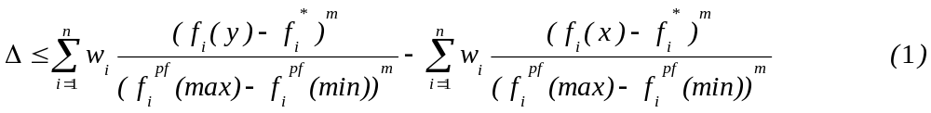


Formulation (Continued)..................
Where,
p = number of objectives
= weights on the objectives
= ideal point of ith objective

Slide 81
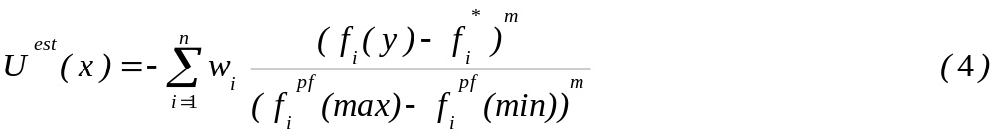
Formulation (Continued)..................
The aforementioned LP has been solved using genetic algorithm.
After obtaining the weights utility function is formulated as:
Sorting operation at the later part of the process ensures no preference is lost.

Slide 82
Adaptive Mutation Operator
High convergence speed offered by the PSO justifies the use of a mutation operator that delays convergence and increases exploration.
The mutation operator proposed is adaptive as it depends on the number of particles in the repository to determine the probability of mutation. i.e.

Slide 83
Mutation (Continued)..................
It imparts high exploratory capability to the particles at the beginning of search, and enables them to explore the vast search space thereby reducing the chances of convergence at the local Pareto Front.
During the search process, it attains peaks and troughs depending on the requirements.
The motive behind such a variation of probability is to test the global behavior of the Pareto front obtained by the process and motivate the particles to search for new solutions compatible with the DM.

Slide 84
Particle’s Memory Updation
The memory of a particle serves as the basis of its cognitive search component.
The proposed IPSO had ingeniously used the potential of this component to guide the search effort towards preferred regions of the Pareto Front.
It has been achieved by storing those non-dominated particles in the memory who have higher values of utility.

Slide 85
Results and Discussion
For a better appraisal of the algorithm performance this section has been divided into two sub-parts:
Analysis of the Pareto Front.
  Extent of Convergence – Convergence Metric.
  Spread of Solutions - Diversity metric.
Quality of the compromise solution.
  Scaled deviation percentage of the obtained solution from the optimal solution.
  Number of comparisons made by DM.

Slide 86
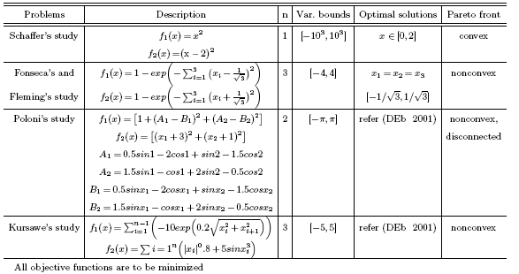
Test Problems (without constraints)

Slide 87
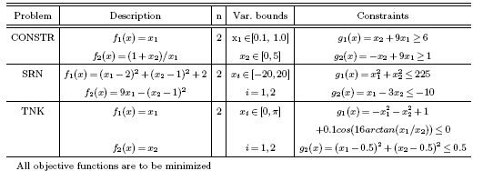
Test Problems (With Constraints)

Slide 88
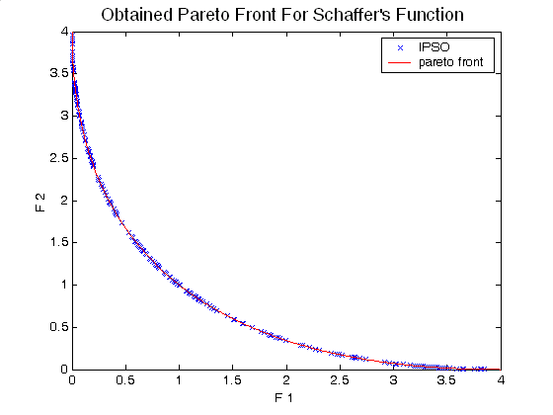
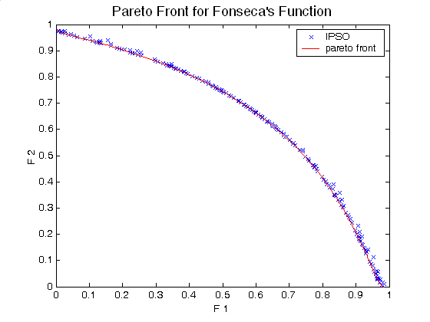
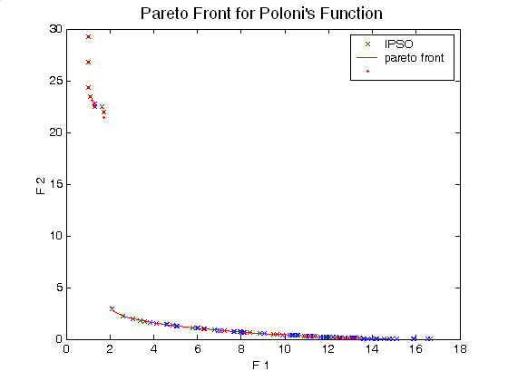
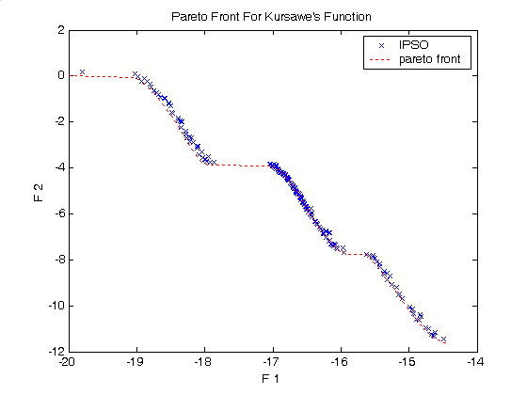
Obtained Pareto Fronts

Slide 89
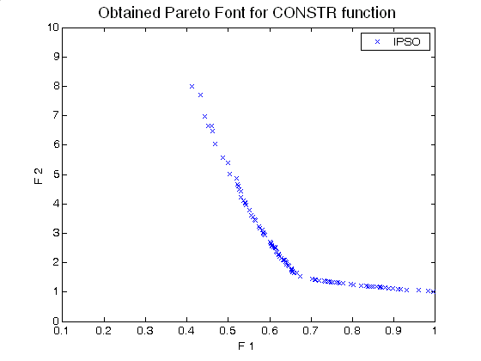
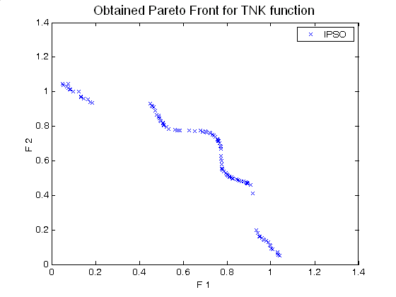
Obtained Pareto Fronts
The results clearly revealed that the approach succeeded in obtaining a diverse and optimal Pareto Front.
For all the test problems the average value of deviation from preferred solutions is less than 1% and the maximum number of comparisons by the DM lies below eight.

Slide 90
Conclusions and Insights
Proposed IPSO intends to find a compromise solution along with a set of Pareto optimal solutions having higher utility.
Simulation results indicate that it is capable of exploring the feasible space in very less time and require very few interactions in order to assist the decision maker to locate the satisfactory solution.
Other established strategies, though competitive, were not able to dominate IPSO in general.
One of the major advantage lying with the approach is its adaptivity to the practical situations with a known preference and a set of preferences depending upon the decision maker.
The future research is directed to explore the applications and performance of IPSO for the practical industry applications

Slide 91
Now, Please Ask Your Doubts

Slide 92
Thanks

