Slide 1

TECHNOLOGY EXHIBITION EDITION
ROLES
2
INVENIA AI
APPLICATION STAGES
5
The intelligent recruitment and assessment operating system
AI INTERVIEW TURNS
3
From job design and CV intelligence to secure assessment, voice interview, evidence-grounded scoring, and recruiter decision support.
DEPLOYMENT
LIVE
Commercial product showcase
frontend-production-fad4.up.railway.app
INVENIA AI | Intelligent Recruitment and Assessment
01

Slide 2
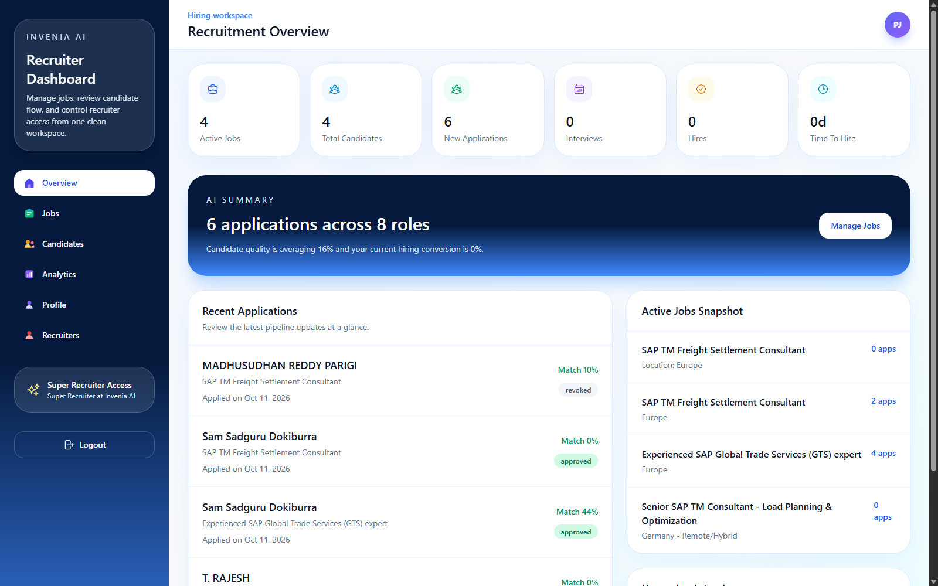
PRODUCT INTRODUCTION
A single decision layer for modern hiring
Invenia AI connects the candidate journey, recruiter workflow, assessments, media, and analytics in one governed platform.
2
5
ROLE-SPECIFIC PORTALS
APPLICATION STAGES
69
LIVE
BACKEND API ROUTES
RAILWAY DEPLOYMENT
AI
Product thesis
Replace fragmented hiring tools with one evidence-driven workflow where every score is traceable to candidate evidence, enabled rounds, and recruiter-approved decisions.
INVENIA AI | Intelligent Recruitment and Assessment
02

Slide 3
PROBLEM STATEMENT
Hiring is fragmented, slow, and difficult to trust
Enterprises often combine disconnected ATS, assessment, interview, file, and reporting tools - creating delays and weak decision traceability.
P1
Manual screening overload
P2
Generic scores
P3
Disconnected rounds
Recruiters compare CVs against complex job requirements by hand, creating inconsistent shortlists.
Keyword-only scores do not explain evidence, job context, or why one candidate outranks another.
Aptitude, technical, coding, and interviews live in separate products and data silos.
P4
Interview integrity
P5
Poor recruiter visibility
P6
Candidate uncertainty
Remote interviews require identity checks, camera evidence, transcripts, and auditable behavior signals.
Decision makers need job-wise comparisons, recordings, reports, and exports in one place.
Applicants need clear status, stage gates, notifications, and transparent next steps.
INVENIA AI | Intelligent Recruitment and Assessment
03

Slide 4
PRODUCT OBJECTIVES
Designed around measurable hiring outcomes
The implementation prioritizes decision quality, candidate clarity, assessment integrity, and operational speed.
01
Unify
02
Automate
03
Explain
One platform from authentication to final hiring analysis
Structured job and profile extraction plus role-specific question generation
Evidence-grounded Job ATS with transparent mathematical components
04
Control
05
Secure
06
Compare
Recruiter approval gates, optional rounds, immutable decisions, account controls
Fullscreen monitoring, camera, mic test, snapshots, recording, and warnings
Job-wise candidate ranking, detailed reports, filters, and exports
SUCCESS = higher-quality evidence + faster screening + controlled assessments + explainable decisions
INVENIA AI | Intelligent Recruitment and Assessment
04

Slide 5
EXPERIENCE ARCHITECTURE
Two portals. One synchronized hiring record.
Candidates control their career journey while recruiters control screening, stage access, analysis, and final decisions.
C
Candidate portal
R
Recruiter portal
SHARED INTELLIGENCE CORE
• Profile and CV autofill
• Profile ATS and job-specific ATS
• Job search, save, apply, revoke
• Approval-gated assessment access
• Secure voice interview and status tracking
Identity + roles
• Smart job creation and stage rules
• Job-wise candidate comparison
• Approve, reject, activate, deactivate, delete
• Interview media, transcript, and reports
• Analytics, rankings, and spreadsheet exports
Jobs + applications
Workflow + scores
Media + reports
Analytics + exports
INVENIA AI | Intelligent Recruitment and Assessment
05

Slide 6
END-TO-END WORKFLOW
From job intent to recruiter-ready evidence
Every transition is persisted, role-gated, and visible to the appropriate participant.
1
Create job
2
Apply + scan
3
Recruiter gate
Autofill or manual details; configure optional and compulsory rounds
CV is compared against the exact job and sent for screening
Job-wise ranking supports an approve or reject decision
4
Assess
5
Interview
6
Decide
Only enabled aptitude, technical, and coding stages appear
Camera, mic test, fullscreen, three voice questions, recording
Final score, evidence, media, report, comparison, and export
Recruiter configuration controls the path. Candidate eligibility controls access. Persisted evidence controls the decision.
INVENIA AI | Intelligent Recruitment and Assessment
06

Slide 7
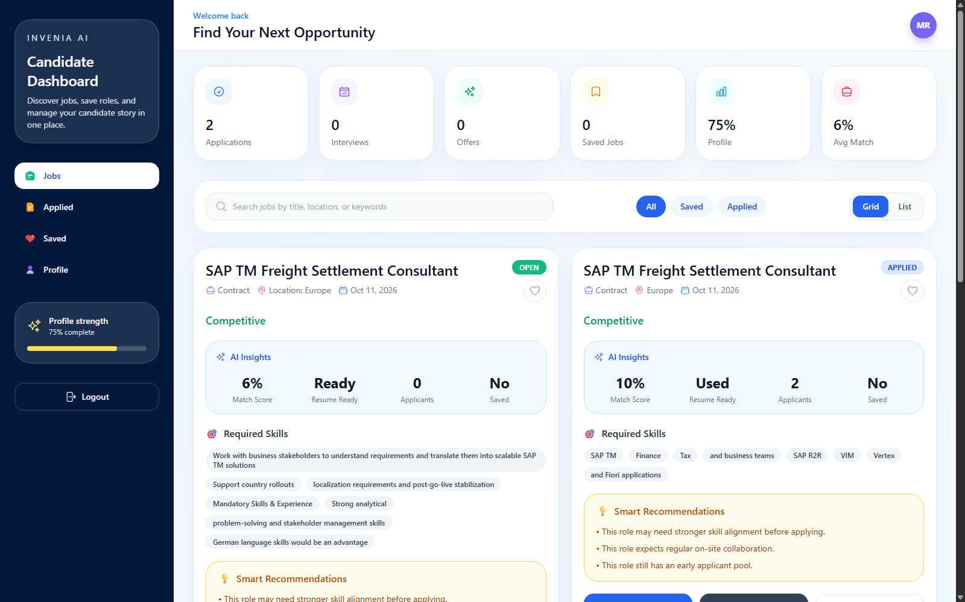
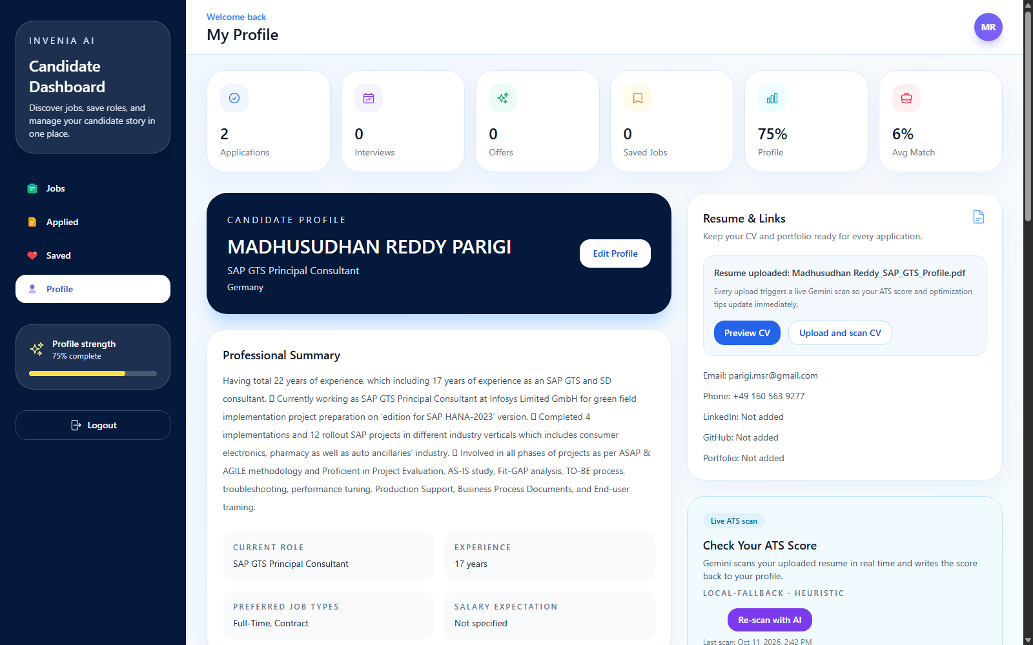
CANDIDATE EXPERIENCE
Clarity before, during, and after every application
The portal combines opportunity discovery, profile intelligence, CV access, status tracking, and assessment readiness.
DISCOVER
UNDERSTAND
TRACK
CONTROL
Grid/list jobs, search, save, view, apply
Profile strength, CV preview, ATS insights
Applied status, stage lock, next-round access
Revoke once, avoid duplicates, receive notifications
INVENIA AI | Intelligent Recruitment and Assessment
07

Slide 8
RECRUITER COMMAND CENTER
One view from workload to hiring intelligence
Overview KPIs surface active jobs, total candidates, applications, interviews, hires, and time-to-hire alongside live pipeline data.
01
Pipeline visibility
Recent applications and job demand in one dashboard
02
Job operations
Create, edit, archive, export, and switch grid/list views
03
Candidate governance
Approve/reject decisions and account lifecycle controls
04
Decision intelligence
Job ATS, final score, reports, recordings, comparisons
INVENIA AI | Intelligent Recruitment and Assessment
08

Slide 9
FEATURE PORTFOLIO
Commercial capability across the full hiring lifecycle
Implemented functions are organized as reusable product modules rather than isolated demos.
ACCESS
PROFILE
JOBS
WORKFLOW
• Candidate sign-up/login
• Recruiter login
• JWT role gates
• Account controls
• CV upload/preview
• Profile autofill
• ATS readiness
• Skills/preferences
• Smart autofill
• Grid/list views
• Currency/period
• Views/applicants
• Approval gate
• Optional stages
• Duplicate prevention
• Application revoke
ASSESSMENT
INTERVIEW
ANALYTICS
OPERATIONS
• 5 aptitude MCQs
• 5 technical MCQs
• 2 coding prompts
• Role-context generation
• Face presence
• 10s mic test
• 3 voice questions
• Recording + snapshot
• Job-wise ranking
• Detailed analysis
• Performance reports
• Top-N filters
• Excel/CSV export
• CV one-click preview
• Media download
• Railway hosting
Modular by design: capabilities can evolve independently without breaking the core application journey.
INVENIA AI | Intelligent Recruitment and Assessment
09

Slide 10
INTELLIGENCE ORCHESTRATION
AI proposes. Deterministic systems validate and score.
Invenia AI separates semantic reasoning from numeric calculation to reduce arbitrary scoring and improve auditability.
INPUT SIGNALS
INVENIA INTELLIGENCE LAYER
GOVERNED OUTPUTS
Job description
1
EXTRACT
Structured profile and job fields
Evidence-grounded Job ATS
CV and profile
2
CLASSIFY
Matched, partial, or missing evidence
Versioned final score
Assessment answers
3
GENERATE
MCQs, coding prompts, interview turns
Question sets
Interview transcript
4
ANALYZE
Interview performance and hiring risks
Interview report
Proctoring events
5
VALIDATE
Evidence quotes, schemas, confidence
Recruiter recommendation
INVENIA AI | Intelligent Recruitment and Assessment
10

Slide 11
SYSTEM ARCHITECTURE
Cloud-hosted, API-driven, and modular
Separated frontend and backend services connect to managed data, persistent media, and external intelligence services.
DB
PostgreSQL
C
Candidate
APPLICATION API
Users, jobs, workflows, reports
Profile, jobs, applications, assessments, interview
FRONTEND
FastAPI
React 19 + Vite 8
JWT + role gates
Workflow engine
Scoring + analytics
Uploads + media APIs
FS
Persistent volume
Tailwind CSS
Axios + Router
Nginx container
R
Recruiter
CVs, snapshots, recordings
Jobs, pipeline, decisions, media, analytics
AI
Model APIs
Extraction, evidence, questions, analysis
RAILWAY - CONTAINERIZED PRODUCTION HOSTING
VO
Voice service
Interview question speech
INVENIA AI | Intelligent Recruitment and Assessment
11

Slide 12
TECHNOLOGY BIFURCATION
A modern full-stack implementation
Each layer uses focused frameworks and services chosen for delivery speed, maintainability, and cloud portability.
UI
API
DB
AI
OPS
CLIENT
SERVER
DATA
INTELLIGENCE
PLATFORM
React 19.2
Python 3.11
SQLAlchemy 2
Gemini 2.5 Flash
Docker
Vite 8
FastAPI 0.135
PostgreSQL 18
Structured JSON
Railway
React Router 7
Pydantic 2
SQLite local mode
Evidence validation
Nginx
Tailwind CSS 3
Uvicorn
Persistent volumes
Deterministic scoring
CORS controls
Heroicons
Requests
JSON workflow state
ElevenLabs TTS
Health checks
Axios
Multipart uploads
Binary media fields
Browser speech APIs
Environment secrets
INVENIA AI | Intelligent Recruitment and Assessment
12

Slide 13
DATA ARCHITECTURE
One application record becomes the audit spine
Structured entities and stored workflow state keep candidate evidence, decisions, scores, and media connected job-by-job.
USERS
PROFILES
JOBS
APPLICATIONS
INTERVIEWS
Identity, role, status
Candidate + recruiter details
Details + assessment config
Status + workflow + scores
Schedule + report + media
APPLICATION WORKFLOW STATE
Screening
Assessments
Interview
Media
Scoring
Audit
Approval / rejection
Questions + answers
Turns + transcript
Recording + snapshot
ATS + final formula
Events + timestamps
Result: recruiters can open one candidate/job record and inspect the CV, workflow, scoring calculation, interview answers, media, and decision status.
INVENIA AI | Intelligent Recruitment and Assessment
13

Slide 14
SECURE ASSESSMENT AND INTERVIEW
A controlled browser workflow with persistent evidence
Security controls improve integrity and traceability while preserving a clear, guided candidate experience.
01
Device readiness
02
Face presence
03
Verification
Camera and microphone permission
One-face monitoring where supported
Snapshot plus 10-second mic sample
04
Secure session
05
Voice loop
06
Evidence save
Fullscreen and visibility warnings
Question speech and live transcript
Video, audio, photo, transcript, report
Integrity policy
Leaving fullscreen or closing the secure terminal triggers warnings and can submit or lock the current attempt. Proctoring events are stored with the workflow.
INVENIA AI | Intelligent Recruitment and Assessment
14

Slide 15
EXPLAINABLE SCORING I
Job ATS: evidence against one exact role
The language model classifies evidence; the backend applies a deterministic, versioned formula. Grammar and visual formatting do not affect this score.
Job ATS = 0.50R + 0.20S + 0.20E + 0.10D
Requirement evidence weighting
R = requirement evidence S = skill/tool coverage E = relevant experience D = responsibility readiness
MANDATORY
1.35x
Must / required / essential
Requirement evidence
50%
Matched=1.00 | Partial=0.45 | Missing=0.00
STANDARD
1.00x
Normal role requirement
Skill and tool coverage
20%
Role-specific terms found in CV/profile evidence
PREFERRED
0.70x
Nice-to-have / desirable
Experience alignment
20%
40% tenure sufficiency + 60% domain/title fit
No artificial floor
Responsibility readiness
10%
An unrelated CV can score near 0 instead of being forced to 35%. Each report also includes exact evidence, gaps, confidence, and formula components.
Evidence for expected execution responsibilities
INVENIA AI | Intelligent Recruitment and Assessment
15

Slide 16
EXPLAINABLE SCORING II
Final Score: job fit plus enabled assessment evidence
Disabled or skipped rounds are excluded. Remaining weights are normalized, and incomplete workflows remain explicitly provisional.
Final = weighted average(Job ATS, Aptitude, Technical, Coding, Interview)
Worked example
Job ATS
80% x 30%
(80x0.30) + (100x0.10) + (80x0.15) + (70x0.20) + (90x0.25)
24.0 pts
Aptitude
100% x 10%
10.0 pts
82.5
Technical MCQ
80% x 15%
12.0 pts
FINAL SCORE
Coding
70% x 20%
14.0 pts
If Technical and Coding are disabled, their weights are removed and Job ATS + Aptitude + Interview weights are normalized to 100%.
Interview
90% x 25%
22.5 pts
INVENIA AI | Intelligent Recruitment and Assessment
16

Slide 17
DECISION USEFULNESS
Each score answers a different recruiter question
Keeping profile quality, job fit, stage performance, and confidence separate prevents misleading comparisons.
PROFILE ATS
MATCH SCORE
JOB ATS
Is the CV/profile sufficiently complete and readable?
Do declared skills overlap with posted requirements?
What evidence proves fit for this exact role?
GENERAL READINESS
FAST PREVIEW
SCREENING PRIORITY
STAGE SCORES
FINAL SCORE
CONFIDENCE
How did the candidate perform in each enabled round?
What is the normalized outcome across available evidence?
How strong and well-structured is the underlying evidence?
CAPABILITY EVIDENCE
OVERALL COMPARISON
MANUAL REVIEW SIGNAL
Scores support decisions; evidence and recruiter judgment remain the final authority.
INVENIA AI | Intelligent Recruitment and Assessment
17

Slide 18
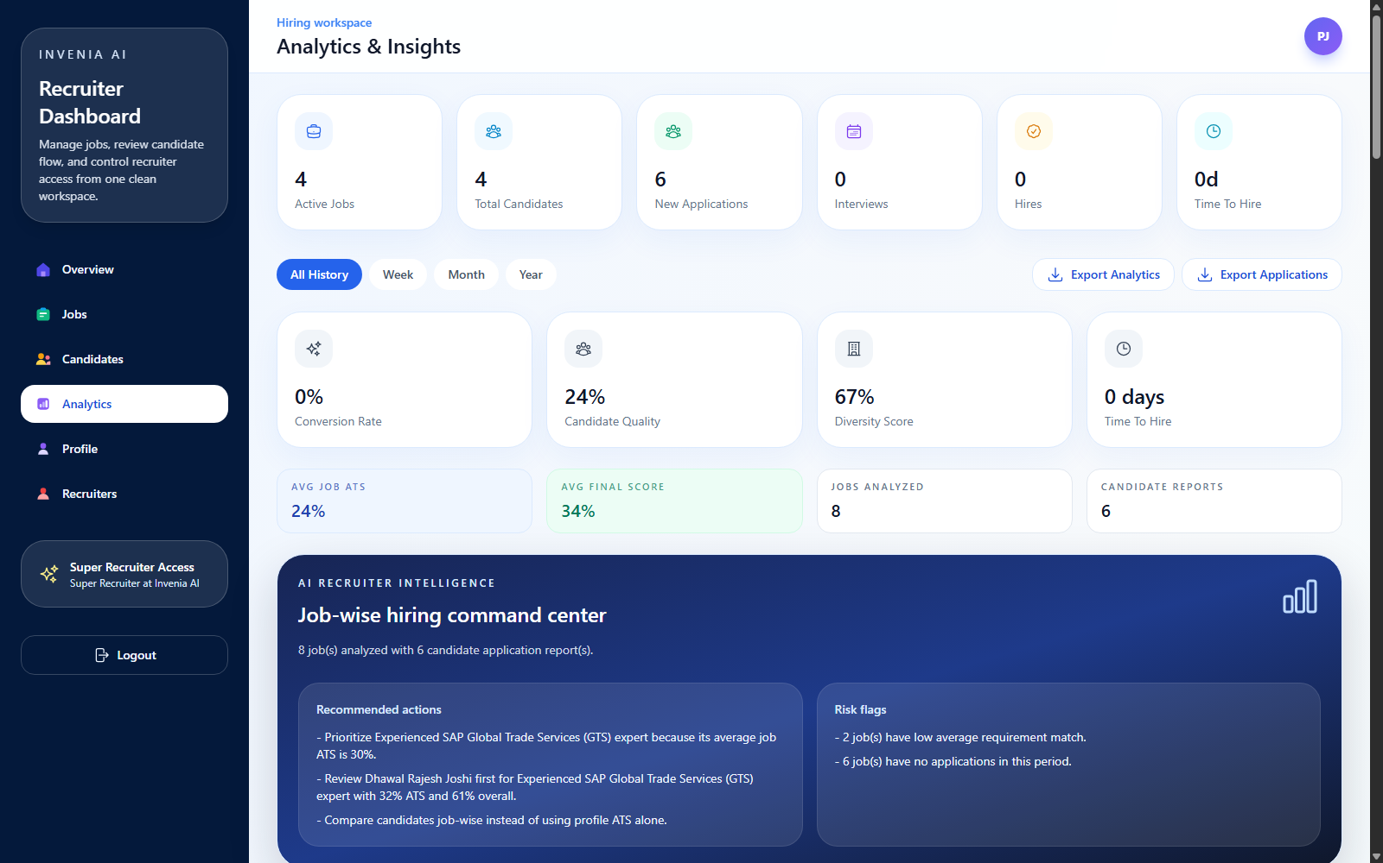
RECRUITER INTELLIGENCE
Job-wise comparison instead of profile-only ranking
Recruiters can move from portfolio KPIs to job-level demand, candidate evidence, performance, risk, recordings, and approval actions.
RANK
Top 5 / 10 / 20 candidates by job
COMPARE
ATS, stages, final score, evidence
INSPECT
CV, interview turns, transcript, media
ACT
Approve, reject, schedule, export
THE RECRUITER SEES THE WHY, NOT ONLY THE RANK
INVENIA AI | Intelligent Recruitment and Assessment
18

Slide 19
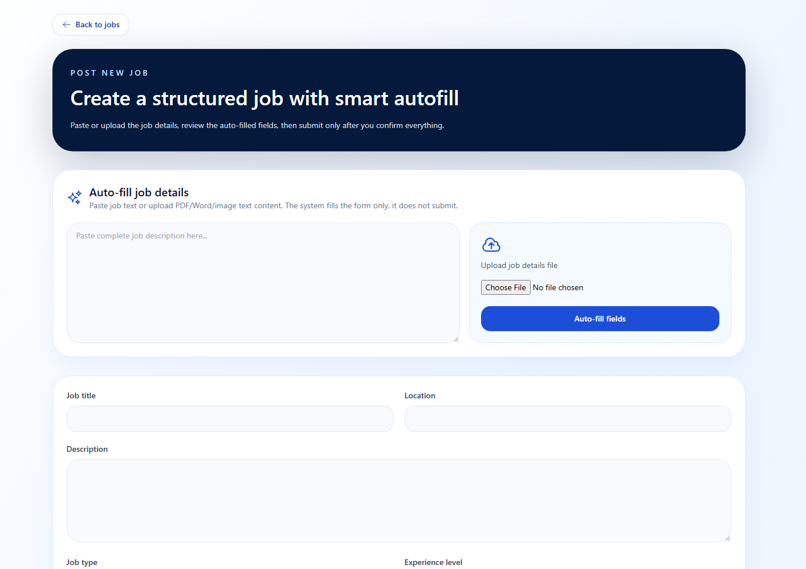
SMART AUTOMATION
Convert unstructured hiring inputs into reviewable workflows
Automation accelerates setup while preserving human confirmation before publishing or making decisions.
JOB AUTOFILL
Paste text or upload PDF, Word, or image. Structured JSON fills title, type, experience, salary, requirements, responsibilities, and benefits.
PROFILE AUTOFILL
CV extraction fills candidate details, experience, skills, summary, links, and preferences with uncertainty warnings.
QUESTION GENERATION
Role-context aptitude, technical, coding, and interview questions vary between sessions.
HUMAN REVIEW
Autofill never publishes automatically. Recruiters review values and warnings before submission.
LOW-TEMPERATURE STRUCTURED OUTPUT + SCHEMA VALIDATION + EVIDENCE CHECKS
INVENIA AI | Intelligent Recruitment and Assessment
19

Slide 20
IMPLEMENTATION FEASIBILITY
Built with deployable technology and practical controls
The current system proves technical and operational feasibility; enterprise hardening can be added incrementally without replacing the core architecture.
TECHNICAL
PROVEN
OPERATIONAL
USABLE
Mature web frameworks, REST APIs, browser media primitives, structured model outputs, and managed PostgreSQL.
Role-specific interfaces, guided stage gates, review-before-publish, immutable decisions, and exports.
ECONOMIC
LEAN
SCALABILITY
READY
Open-source application stack with usage-based external intelligence and container hosting.
Separated services, stateless API patterns, pooled DB connectivity, and persistent storage volumes.
CURRENT PRODUCTION
Frontend + backend on Railway | PostgreSQL service | persistent CV/interview media volume | health checks | environment-managed secrets
INVENIA AI | Intelligent Recruitment and Assessment
20

Slide 21
SECURITY AND GOVERNANCE
Defense-in-depth across identity, workflow, and media
The implementation combines preventive controls, evidence capture, and role-separated operations.
1
2
3
4
5
IDENTITY
WORKFLOW
ASSESSMENT
EVIDENCE
PLATFORM
• Password hashing
• JWT bearer tokens
• Active-account checks
• Role-specific route guards
• Recruiter approval gate
• No duplicate application
• Irreversible approve/reject
• Disabled stages omitted
• Fullscreen events
• Visibility warnings
• Camera and mic readiness
• Face-presence signal
• Snapshot
• Video + audio recording
• Transcript + question turns
• Timestamped report
• CORS allowlist/regex
• Environment secrets
• Upload size controls
• Persistent storage
Enterprise next step: SSO/SAML + RBAC policies + encrypted object storage + retention controls + audit export
INVENIA AI | Intelligent Recruitment and Assessment
21

Slide 22
COMPETITIVE POSITIONING
Why Invenia AI is differentiated
The USP is not one AI feature; it is the connected, explainable decision workflow across screening, assessment, interview, and analytics.
CAPABILITY
TRADITIONAL ATS
TEST PLATFORM
VIDEO TOOL
INVENIA AI
Job-context CV evidence
Limited
No
No
Strong
Configurable stage workflow
Partial
Partial
No
End-to-end
Secure voice interview
No
No
Video only
Integrated
Deterministic score formula
Opaque
Test only
No
Explainable
Interview media + transcript
External
External
Yes
Connected
Job-wise comparison + export
Basic
Partial
No
Unified
01
Evidence-grounded
02
Workflow-aware
03
Media-complete
Scores show matched, partial, missing, and quoted evidence
Only recruiter-enabled stages influence candidate flow and final score
CV, snapshot, recording, transcript, report, and exports stay connected
INVENIA AI | Intelligent Recruitment and Assessment
22

Slide 23
FUTURE SCOPE
Roadmap from commercial MVP to enterprise talent platform
The architecture supports incremental hardening, deeper automation, and enterprise integrations.
NOW
NEXT
SCALE
INTELLIGENCE
Commercial MVP
Enterprise readiness
Hiring ecosystem
Advanced decision science
• Dual portals
• Grounded ATS
• Assessments
• Recorded interview
• Analytics + export
• SSO/SAML
• Fine-grained RBAC
• Object storage/CDN
• Audit retention
• Automated backups
• HRIS/ATS connectors
• Calendar + email
• Webhook/API marketplace
• Multilingual interviews
• Mobile candidate app
• Validated benchmark sets
• Bias/fairness audits
• Skills ontology
• Talent rediscovery
• Predictive workforce insights
01
02
03
04
INVENIA AI | Intelligent Recruitment and Assessment
23

Slide 24
INVENIA AI
EXHIBITION DEMO
1
Role-based login
Hire with evidence. Assess with integrity. Decide with confidence.
2
Smart job creation
A live, full-stack recruitment platform for the next generation of enterprise hiring.
3
Candidate job ATS
4
Approval-gated rounds
5
Recruiter analytics
OPEN LIVE PRODUCT
Thank you
Questions and product walkthrough
INVENIA AI | Intelligent Recruitment and Assessment
24

