Slide 1

IT-632 Software Engineering Group ID: 14 Project Title: Stock
Market
Team Members
Student ID | Name
202312048 | Kartik Chaudhary
202312053 | Ankita kumari
202312038 | Dinesh Jumani
202312121 | Anjali Singh

Slide 2
Index
1. Introduction | 3
1.1 System Details | 3
1.1.1 Existing System | 3
1.1.2 Proposed System | 4
1.2 Scope of System | 4
1.3 Objectives | 5
2. Proposed System Requirement Gathering | 5
2.1 Stakeholder of System | 5
2.2 Consolidated List of Requirements | 5
3. System Management and Planning | 6
3.1 Feasibility Study | 6
3.1.1 Technical Study | 6
3.1.2 Economical Study | 6
3.1.3 Operational Study | 7
3.2 Hard Ware - Soft Ware Requirement | 7
3.3 Process Model | 9
4. System Analysis And Design | 11
4.1 E R Diagram | 11
4.2 Data Flow Digrams | 12
4.3 UML (Unified Modelling Language) | 22
4.3.1 Use Case Diagram | 22
4.3.2 Sequence Diagram | 25
4.3.3 Activity Diagram | 28
4.3.4 Class Diagram | 31
4.4 Data Dictionary | 32
4.5 User Interface | 37
5. Input / Output Design | 46
6. Testing | 63
7. Summary | 70

Slide 3
CHAPTER-1
INTRODUCTION
Our stock market app provides a user-friendly platform for trading stocks and managing investments, catering to the preferences of digital-savvy investors. With real-time market data and personalized portfolio management features, users can make informed decisions and stay ahead in the financial markets. Our app prioritizes security and reliability, ensuring a seamless and trustworthy trading experience for all users.
Proposed System
❖ The system will feature a user-friendly interface for easy navigation and accessibility.
❖ Users will have access to live stock prices and market updates to make informed decisions
❖ Each user will get a personalized dashboard to track their portfolio and receive relevant alerts.
❖ Seamless integration with financial data providers will enable efficient execution of trades within the app.
❖ The system will be scalable to accommodate future growth and enhancements.
❖ Regular updates and improvements will be made based on user feedback and market trends.

Slide 4
Scope of System
> The app will allow users to execute buy and sell orders for stocks, bonds, and other financial instruments directly through the platform.
> Users will be able to track and manage their investment portfolios, including viewing portfolio performance, holdings, and transaction history.
> The app will provide users with access to real-time stock prices, market indices, and news updates to stay informed about market trends.
> Each user will have a personalized dashboard where they can customize their watchlists, alerts, and preferences based on their investment strategies.
> Robust security measures will be implemented to protect users' sensitive information and transactions, ensuring a secure trading environment.
> The app may offer educational resources, tutorials, and investment insights to help users enhance their financial literacy and make informed investment decisions.
> The app will be accessible across multiple platforms, including web browsers, mobile devices, and desktop applications, enabling users to manage their investments anytime, anywhere.
> Seamless integration with brokerage firms and financial data providers will enable efficient execution of trades and access to comprehensive market data within the app.
> Dedicated customer support channels will be available to assist users with any inquiries, technical issues, or account-related concerns they may encounter while using the app.

Slide 5
^ Modules:
• Customers
o Customers can easily buy or sell stocks from anywhere at anytime.
• Visitors
o Visitors can get information about stocks available.
Objectives
> The primary objective is to provide users with a convenient platform to buy and sell stocks, simplifying the trading process.
> To educate users about investment strategies and market trends, fostering better decision-making and risk management.
> Enable users to manage their investment portfolios efficiently by providing tools for tracking performance, diversification, and risk assessment.
> Implement robust security measures to safeguard user information and transactions, ensuring a safe and secure trading environment.
> Empower users to take control of their financial futures by providing them with the resources and tools needed to succeed in the stock market.

Slide 6
CHAPTER-2
Proposed System Requirement Gathering
Stake-Holders of System
The end users of the system are,
1. Customer
> Customer is the user of the system which uses the functionalities and services provided by the system.
> Customer can easily buy or sell stock from anywhere at anytime.
2. Visitor
> Visitor is also the user of the system that visits the system without getting registered into the system.
> Visitor can get information about appliances available.

Slide 7
CHAPTER-3
SYSTEM MANAGEMENT AND PLANNING
Feasibility study Technical study
> Stock Market app is a application. The main technologies and tools which are going to be used in this are as follows :-
o FLUTTER o FIREBASE
> Each of these technologies are freely available and the skills required are manageable. It provides a high level of reliability and availability.
> By considering all these points we can say that our system is technically feasible and maintaining it is also quite easy.

Slide 8
Economical study
> Determine initial development and ongoing operational costs.
> Analyze potential revenue streams and user adoption rates.
> Calculate ROI by comparing projected revenue to investment costs.
> Identify the point where revenue equals costs to determine profitability.
> Evaluate potential risks and their impact on financial performance.
> Assess how changes in key variables affect project outcomes.
> Ensure long-term viability through recurring revenue and cost management.

Slide 9
Operational study
> Identify necessary personnel, technology, and infrastructure.
> Define project milestones and timelines for development.
> Determine methodology and tools for effective project management.
> Assign roles and responsibilities to team members.
> Establish channels for efficient communication and collaboration.
> 6. **Quality Assurance**: Implement testing procedures to ensure app quality.
> Plan rollout strategy and user training.
> Define procedures for ongoing maintenance and support.
> Design app for future growth and adaptability.
> Identify and mitigate potential risks to project success.
Hardware/Software Requirements

Slide 10
> Client side Requirements
O Hardware Requirements
Processor | Minimum Core i3 or Higher
RAM | Minimum 2 GB or Higher
Hard Disk | Minimum 300 MB or Higher
o Software Requirements
OS | Minimum Windows 7 or Higher
Browser | Mozilla v5.0.2 or Chrome v73.0.3683.86

Slide 11
> Server side requirements
o Hardware requirements
Processor | Minimum Core i3 or Higher
RAM | Minimum 2 GB or Higher
Hard Disk | Minimum 500 MB or Higher
o Software Requirements :-
OS | Minimum Windows 7 or Higher
Server | FIREBASE
Database | FIREBASE

Slide 12
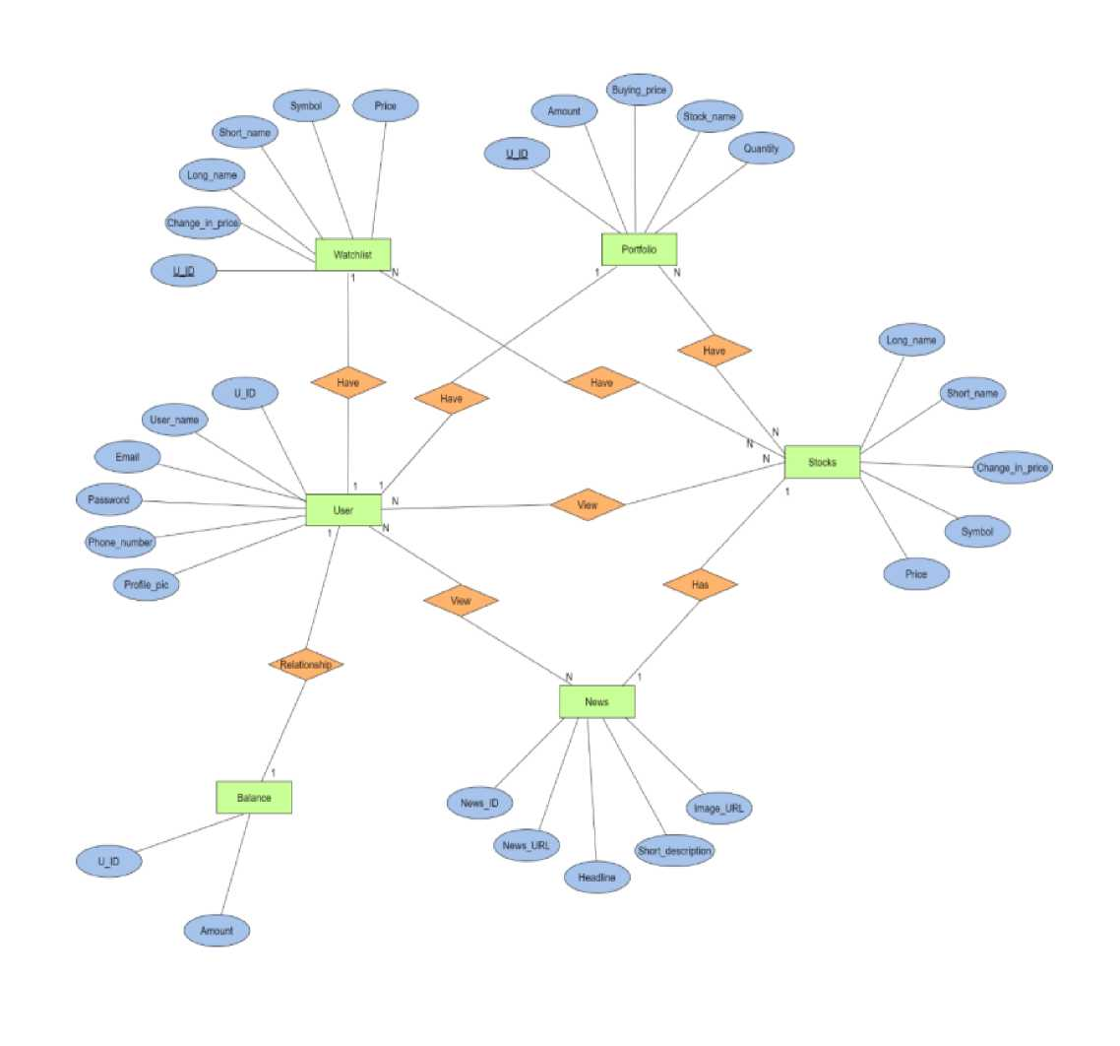
SYSTEM ANALYSIS AND DESIGN
^ Entity Relationship Diagram

Slide 13
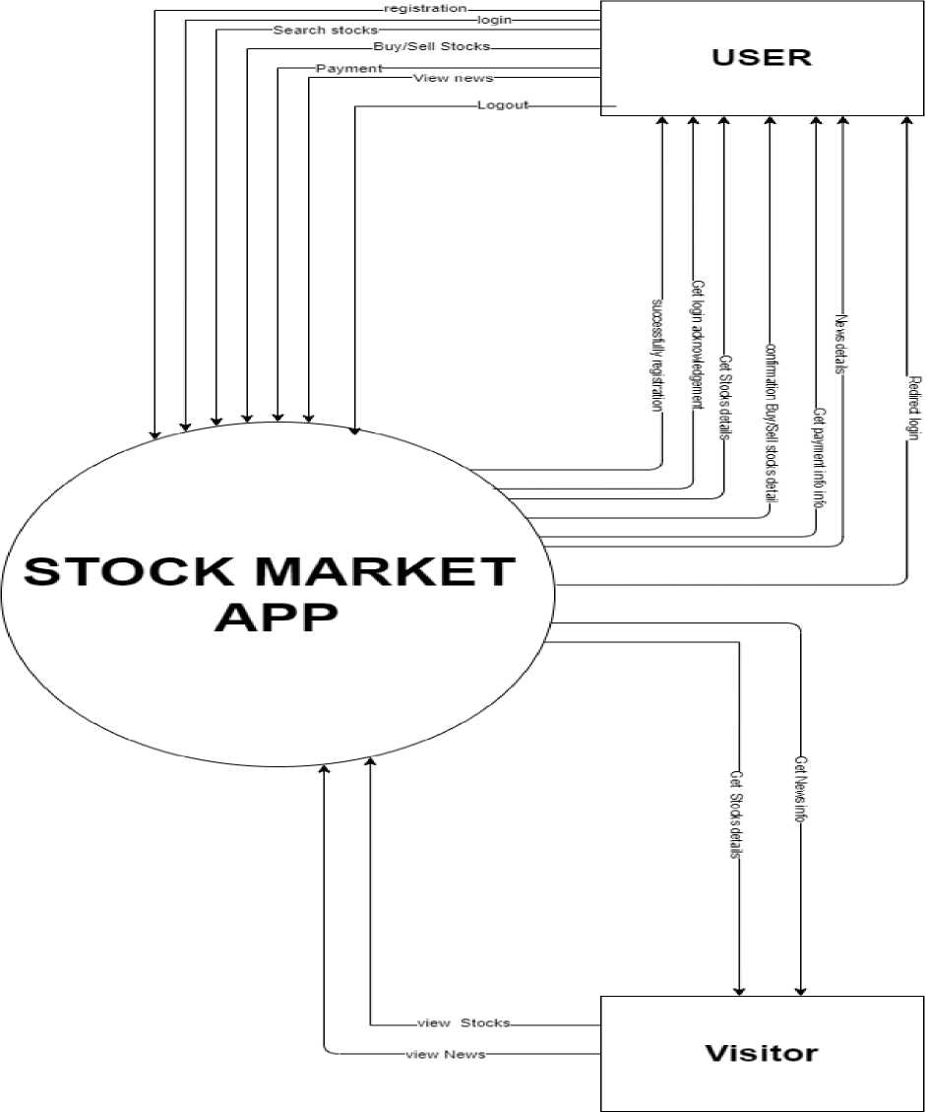
^ Data Flow Diagrams
o Context-level

Slide 14
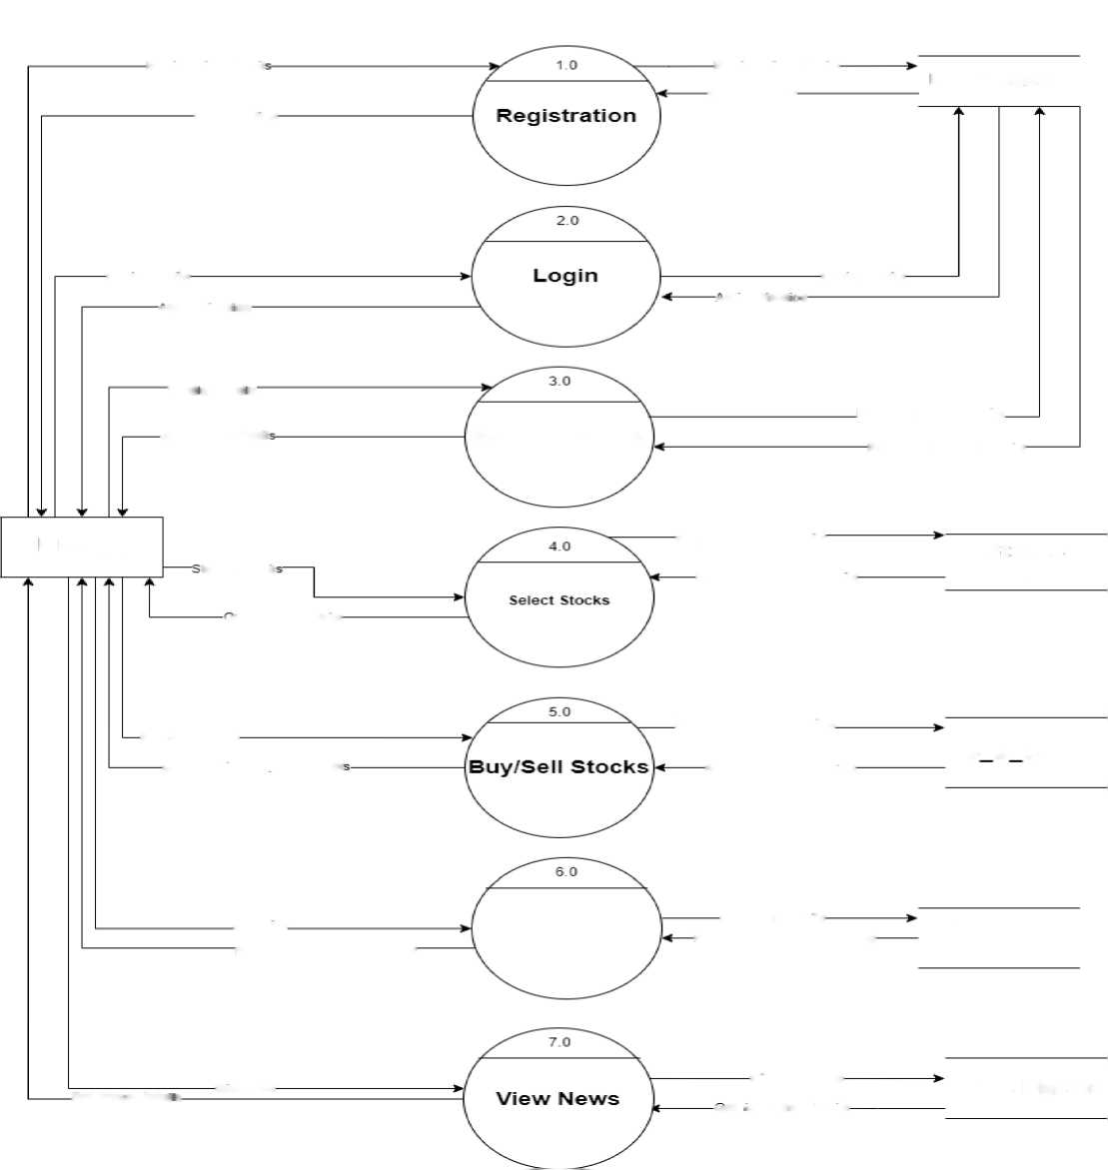
o Level - 1
• User
Registration detail
Registration details
User master
Confirmation
■Confirmation-
Login details
-uthenticat on
-.utrent; cat : r
Login details
Profie detai s
Request profile details.
Get profile detail
Manage profile
Response profile details
USER
tocks detail
Request Stocks details
Stocks
Response Stocks details
master
.jet Stocks details
Buyj'sell Stocks
Request Stocks booking
B S Stock
Confirmation Buv/Sell stock
Response confirmation
Pay bills
Payment
Payment details
Payment
Payment acknowledgement
Payment acknowledgement
master
Get Nev.’S deta i s
Give Nes
Give feedback
News Master
jet *eedback details

Slide 15
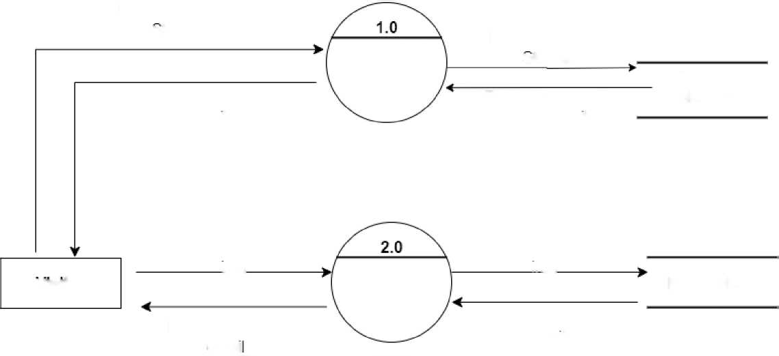
• Visitor
Request Search
stocks
Request Search
Search
Stocks
stocks
Stocks
Response search
Response search
Master
Stocks details
Stocks details
Request News
Request News
visitor
info
View News
info
News Master
Response News
Response News
detai
detail

Slide 16
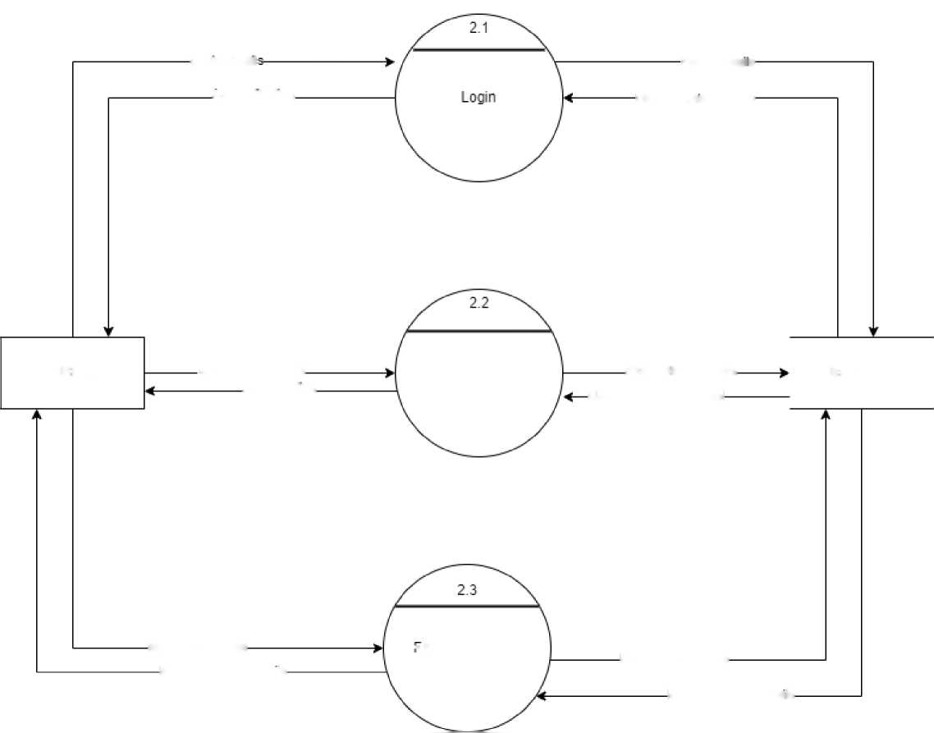
o Level - 2
o USER
Login detail
Fetch detai s
a.uthenticalion
LJ sername.- p a ssword
USER
Glld/new password
Reset password
Fetch old password
User master
Confirmation
Updated new password
Genrat password
-ergot password
Updated password
New password details
New password details

Slide 17
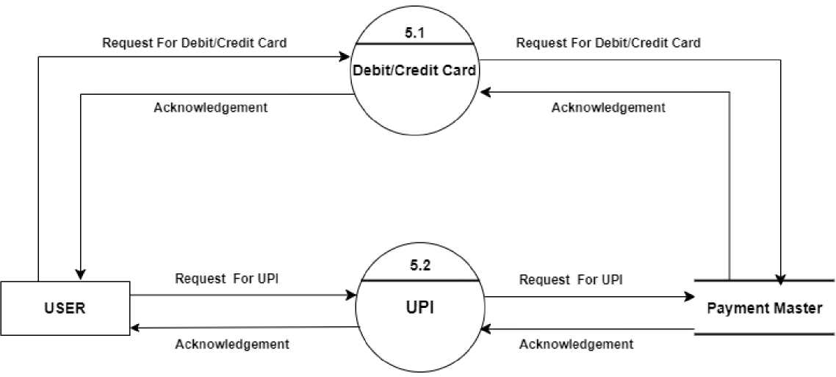

Slide 18
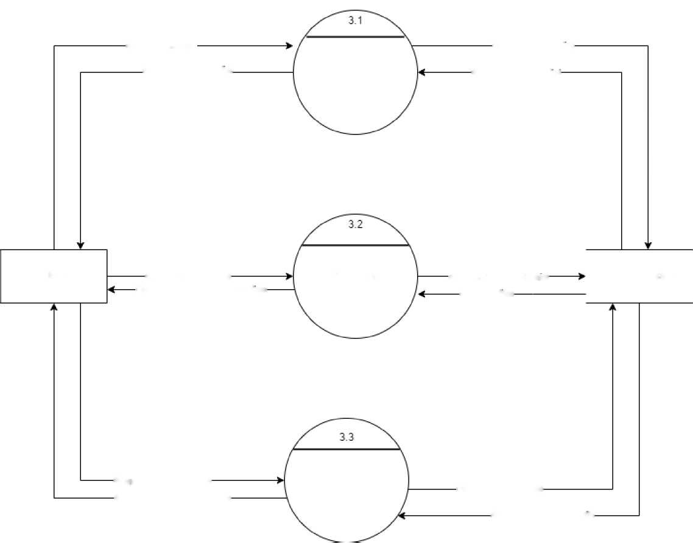
Request Stocks
Request Stocks list
Response Slocks lisl
View Stocks
Response Slocks list
User
Request add Srocks
Add watch list
Add new Stocks details
Stocks Master
Response Stocks confirmation
Confirm atior
Request search slocks
Search Stocks
req searched stocks
Response searched stocks
Response stocks details

Slide 19
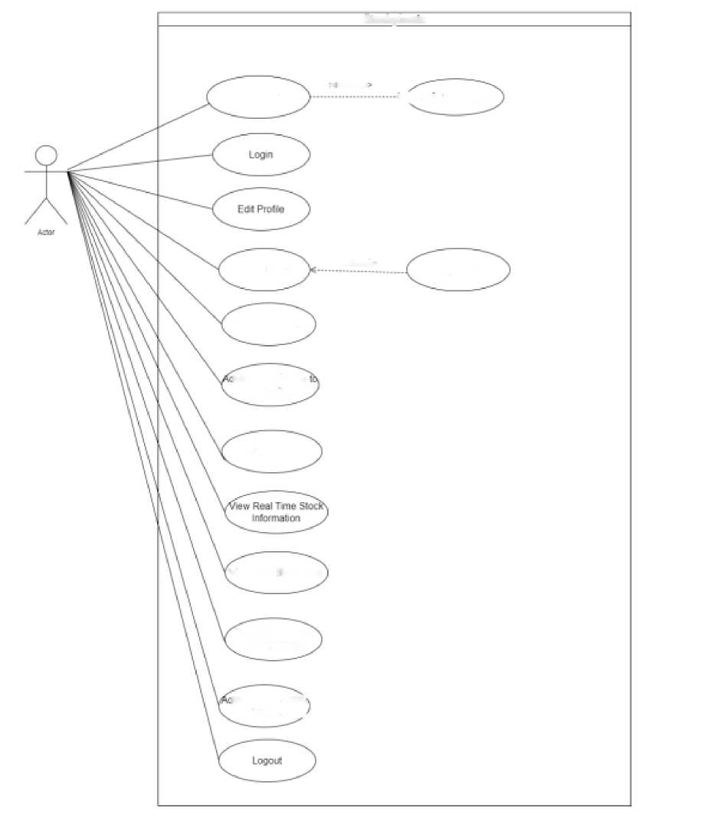
UML (Unified Modelling Language)
Use Case Diagrams
• User
Stockphona
Registei
«■■■• ncudc-
p< Verify Password
Buyvseil stocks
■:-:eonends>>
Pay™™
View DgghOwnd
Id'renme Stocks walchiist
View graph
VBW Real Tme News
Track inweslrnenl Rgrfofrnance
Id'Remwe Waitel Balance ,

Slide 20
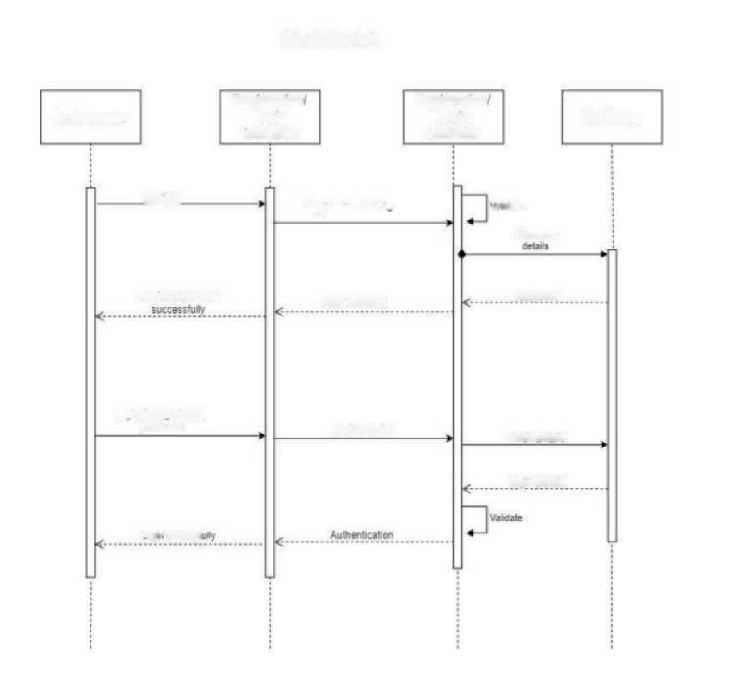
Sequence Diagrams
• Login
Stock Market
System use'
Registration
Login
interface
Registration
Login
controller
Database
Bustst
Registration Detas*
• scale
Store use«
Registration done
send message
Response
Loan inrouan »d and
BMMNN
Login Details
Fetcn Details
Login DetaMs
l gg - HMMl

Slide 21
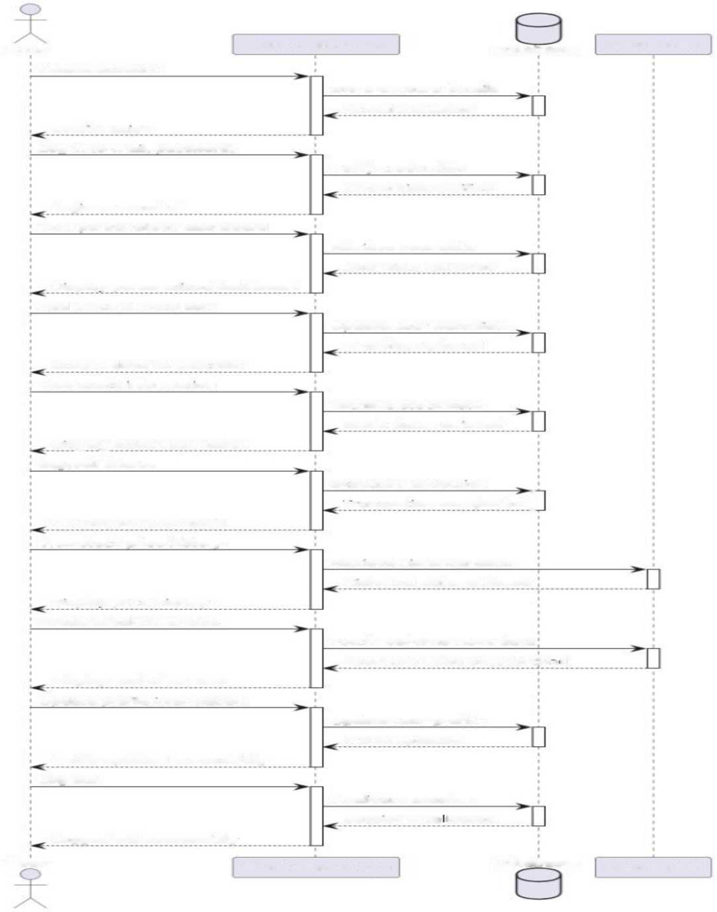
User
Stock: Market App
Database
External API
Create account
Store account (details
Confirmation
Account created
Log in ( e - mail, password)
Verify credentials
Login successful
Credentials verified
View personalized dashboard
Retrieve user data
[Display personalized dashboard
User data retrieved
Add stock to watchlist
Update user watchlist
Stock added to watchlist
Watchlist updated
View stock information
Retrieve stock data
Display stock information
Stock data retrieved
Buy/sell shares
Execute transaction
T ransact 10
n completed [
Transaction successful
View stock price history
Retrieve historical data
Display price history
Historical data retrieved
Receive real-time news
Fetch real-time news data
Display real-time news
Real-time news data fete
l'l-r J
Update profile information
Update user profile
Profile updated successfully
Profile updated
Log out
Invalidate session
Logged out successfully
Session inva idated
User
Stock Market App
[Database
External API

Slide 22
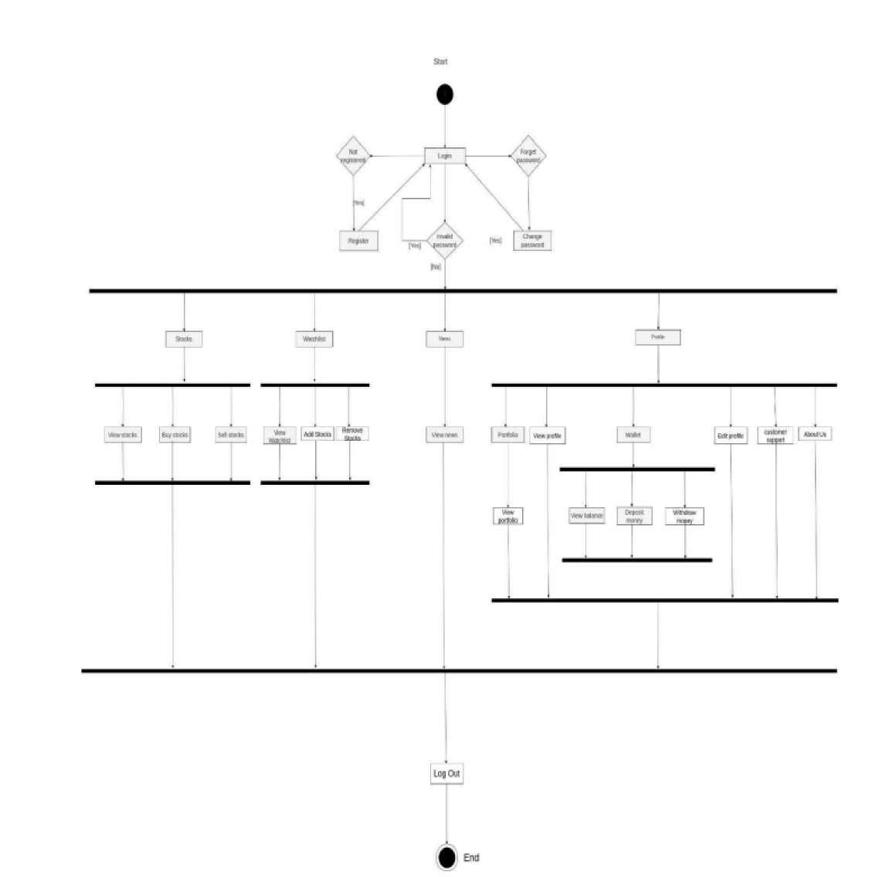
Activity Diagrams
• USER

Slide 23
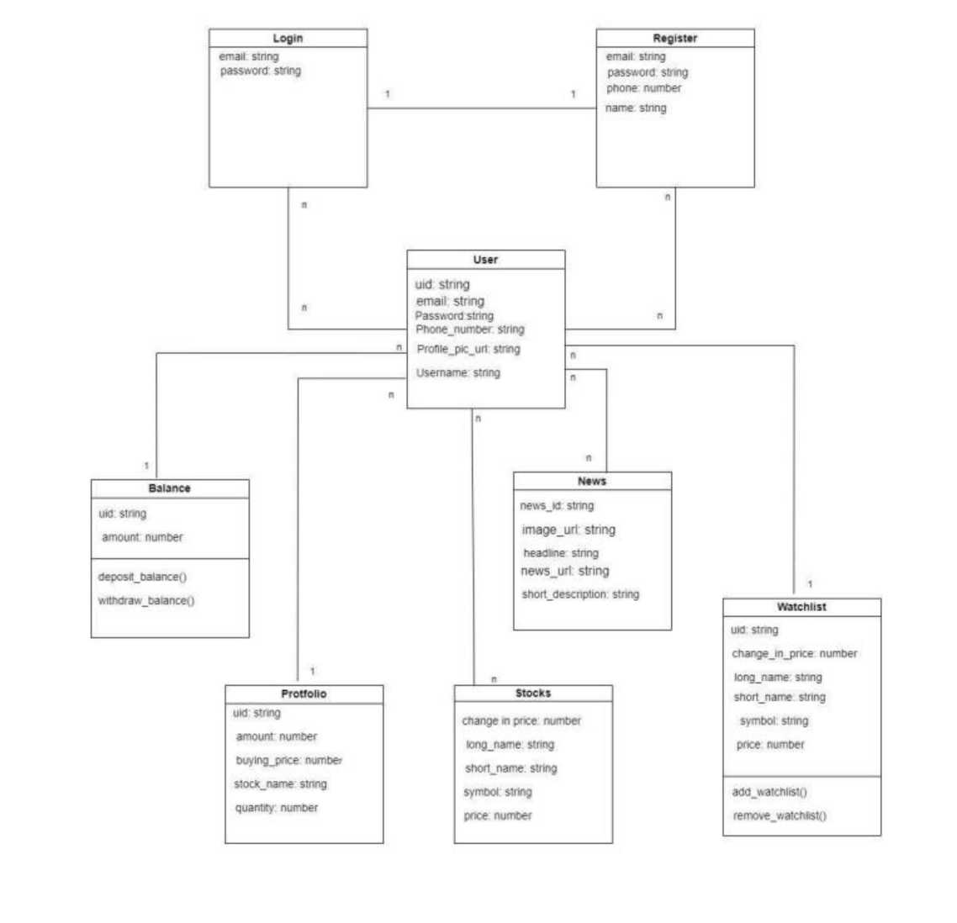
Class Diagram

Slide 24
DATA DICTIONARY
Total Tables:
1 User Table
2 Watchlist Table
3 Stocks Table
4 Transaction Table
5 Payment Table
6 News Table
7 Portfolio Table

Slide 25
Table Number: 1 Table Name: UserTable Primary key:user_id Description: stores details of users
Sr. No. | Column Name | Data ^{T}yp e | Size | Constraints | Description
1 | user_id | Int | 5 | Primary key/Auto Increment | System User Id
2 | Username | String | 30 | Not Null | Name of User
3 | user_email | Varchar | 20 | Not Null | User’s Email
4 | User_password | Varchar | 20 | Not Null | User’s Password
5 | user_image | File | 200 | Not Null | User’s Profile image
6 | user_address | Varchar | 50 | Not Null | Address of user
7 | User mobile | Int | 10 | Not Null | Contact no of user

Slide 26
Table Number: 2
Table Name: STOCKS
Table Primary key: stock_id
Description: stores details of stocks
Sr. No. | Column Name | Data ^{T}yp e | Size | Constraints | Description
1 | stocks_id | Int | 5 | Primary key/Auto Increment | System news Id
2 | symbol | Varchar | 30 | Not Null | symbol of stocks
3 | company name | Varchar | 80 | Not Null | company Description
4 | Price | Intr | 80 | Not Null | Price of stocks
5 | Quantity | int | 200 | Not Null | Quantity of stocks

Slide 27
Table Number: 3 Table Name: Transaction
Primary key: Transaction_id Description: stores details of transactions
Sr. No. | Column Name | Data ^{T}yp e | Size | Constraints | Description
1 | transation_id | Int | 5 | Primary key | transaction id
2 | User_id | Varchar | 30 | FK | user identification
3 | Stocks_id | Int | 4 | Fk | stocks id
4 | T ransaction_type | Int | 10 | Not Null | Transaction type
5 | timestamp | varchar | 10 | Not Null | transaction time
6 | transaction_price | int | 10 | Not Null | transaction price
7 | Quantity | int | 10 | Not Null | transaction stocks

Slide 28
Table Number: 4 Table Name: Watchlist Table Primary key: wactlist_id Description: stores details of watchlist
Sr. No. | Column Name | Data ^{T}yp e | Size | Constraints | Description
1 | watchlist_id | Int | 5 | Primary key/ Auto Increment | watchlist
2 | user_id | Int | 5 | Foreign key | System user Id
3 | watchlist_name | Float | 10 | Not Null | watchlist stock name
4 | Stock_id | int | 20 | FK | Stocks id
Table Number: 5

Slide 29
Table Name: Payment Table Primary key: payment_id
Description: stores details of Payments by Users
Sr. No. | Column Name | Data ^{T}yp e | Size | Constraints | Description
1 | payment_id | Int | 5 | Primary key/Auto Increment | System Payment Id
2 | transaction_id | Int | 5 | Foreign key | transaction id
3 | transaction_amo unt | Int | 10 | Not Null | Total Amount of Order
4 | invoice no | Varchar | 20 | Not Null | Invoice no. for order
5 | payment_mode | Varchar | 30 | Not Null | Mode of Payment
6 | date | Date | 10 | Not Null | Date of Payment
7 | payment_status | Boolean | 10 | Not Null | Status of payment

Slide 30
Table Number: 6 Table Name: Portfolio Table Primary key: protfolio_id Description: Portfolio Details
Sr. No. | Column Name | Data ^{T}yp e | Size | Constraints | Description
1 | protfolio_id | Int | 5 | Primary key | portfolio id
2 | user_id | int | 30 | FK | user id
3 | Return | int | 20 | Not Null | return amount
4 | invesment amt | INT | 20 | Not Null | investment amount

Slide 31
Table Number: 7 Table Name: news Table Primary key: news_id Description: news Details
Sr. No. | Column Name | Data ^{T}yp e | Size | Constraints | Description
1 | news_id | Int | 5 | Primary key | news id
2 | title | varchar | 30 | Not Null | news title
3 | content | varchar | 20 | Not Null | news content
4 | publish_date | Date | 20 | Not Null | news date

Slide 32
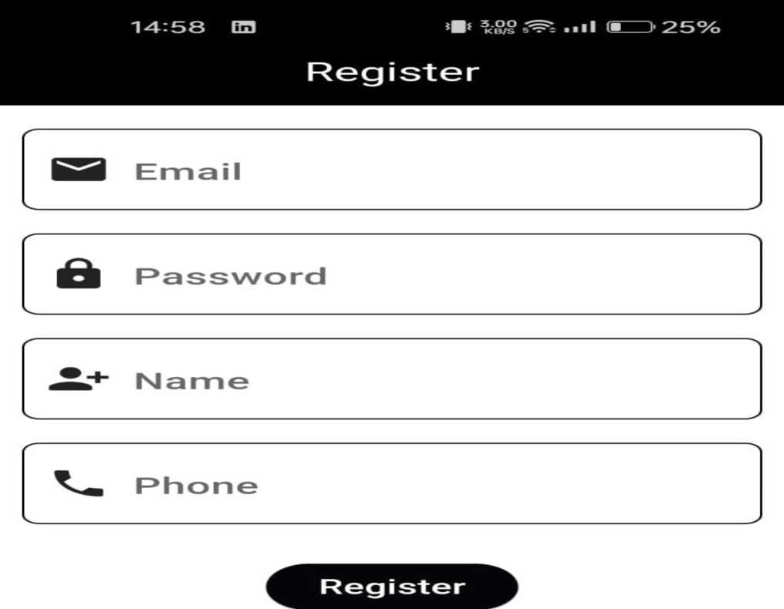
Already Registered! Login Here

Slide 33



14:57 an | 5^ .III ®H | 3 25%
 | News
5 Upcoming Compact SUVs In 2024-25 In India -Tata To Kia -GaadiWaadi.com
April 21 . 2024
EPFO February payroll data: 1 5.48 lakh net members added, over 50% of new members in 1 8-25 years age group - Moneycontrol
April 21, 2024
Custom Royal Enfield Shotgun 350 Is A Meteor 350 Converted To Bobber - GaadiWaadi.com
April 21 , 2024
Post Office Superhit
Inx/P¹
Watchlist
Stocks
News
Profile

Slide 34
14:57 EJ
It 4.00 ..I
* KB/S SI* I III I
CD 25%
Stocks
o | NVIDIA Corporation NVIDIA Corporation | 762.00 -1 0.00%
o | Super Micro Computer, Super Micro Computer, Inc. | 713.65 -23.1 4%
 | Waste Management, Waste Management, Inc. | 207.07 + 0.98%
o | Tesla, Inc. Tesla, Inc. | 147.05 -1 .92%
o | TENCENT Tencent Holdings Limited | 320.40 + 5.46%
o | DBS DBS Group Holdings Ltd | 34.07 +2.93%
o | Riot Platforms, Inc. Riot Platforms, Inc. | 9.13 + 1 0.13%
<*> ii; s Watchlist Stocks News |  | A Profile

Slide 35
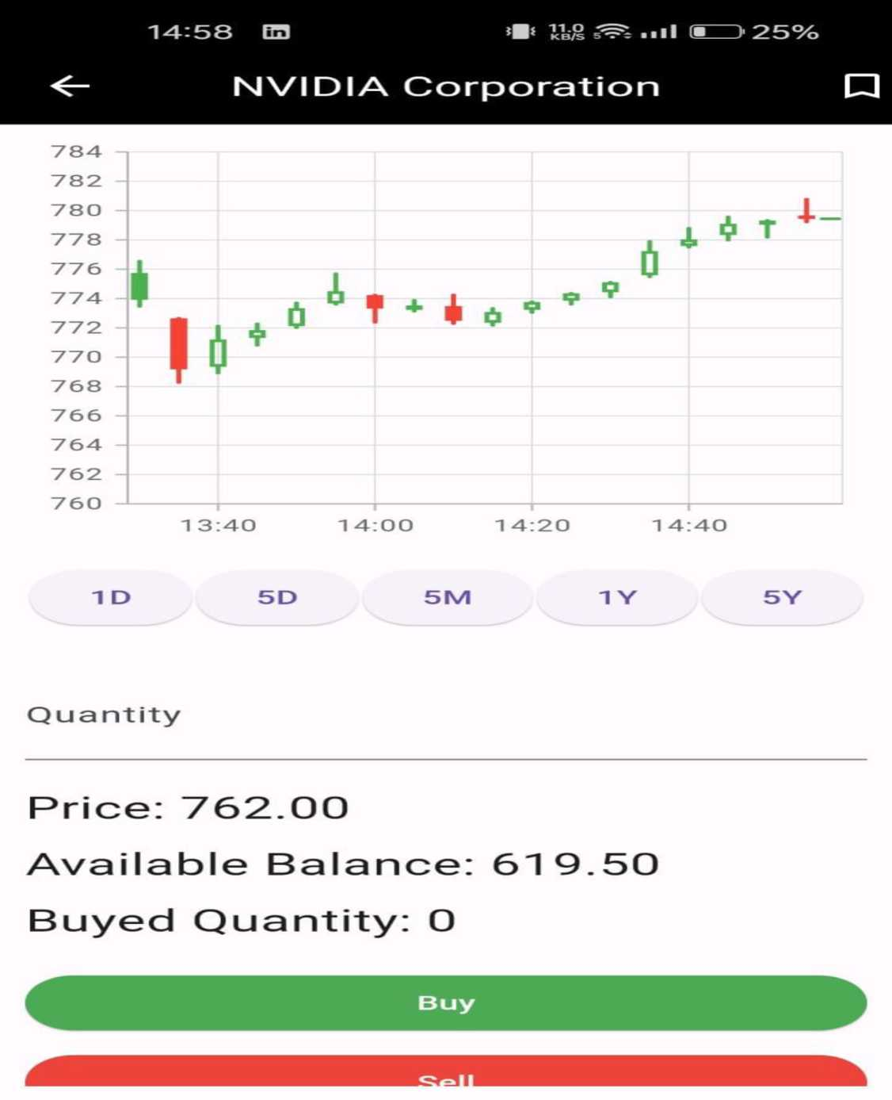

Slide 36
14:58 B3 | ..il (S~Z> 25%
<- | Support
^ ADDRESS
DA-11CT, DA-IIOT Road, Gandhinagar 382 007, Gujarat (India)
V. CONTACT NO
Central Office:
92500 07070
WhatsApp:
+91 85001 85001
Main Branch(Avaliable 24x7):
0251 898770
EMAIL ID
Customercare@gmail.conn
market07@gmail.com

Slide 37

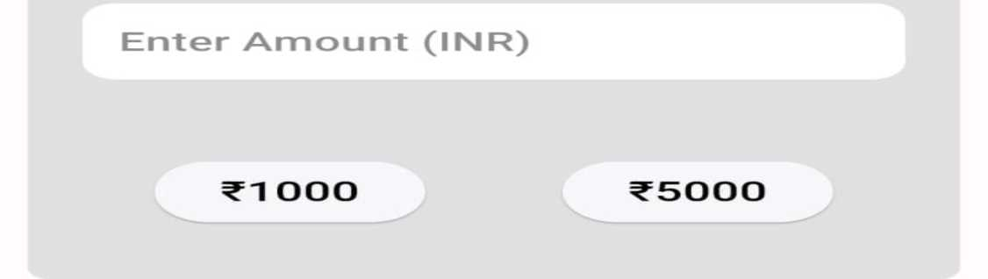
14:58 03 | *■* > ■ 11 (M | 3 25%
<- | Wallet
WITHDRAW
DEPOSIT

Slide 38



20^09
4.00 -5
KB/S 5
7%
Watohlist
GE Aerospace
General Electric Company
1 59.40
+ 6.1 3%
JetBlue Airways
JetBlue Airways Corporation
6.30
-1 6.09%
Lockheed Martin
Lockheed Martin Corporation
461 .80
+ o.i o%
Watohlist
Stocks
News
Rrof i le

Slide 39

15:03 B3
6.00
.Ml CC
l* 24%
KB/S 5
Watchlist
Add Stocks in Watchlist!
<s> | iis
Watchl ist | Stocks | News | Prof i le

Slide 40
14:58 03 | .*ii (nz | D¹ 25%
 | About Us
About Platform
Know more about application
Rrivaoy Policy
How we colect, use, and protect your data
Terms of Use
The terms governing use of Platform
Risk Disclosure
Outlining the risks associated with services/products available on Rl atf orm
Listing/Delisting Policy
Explain the framework of listing/ delisting a token on this Platform
Refund/Cancellation Policy
Explains the circumstances.

Slide 41
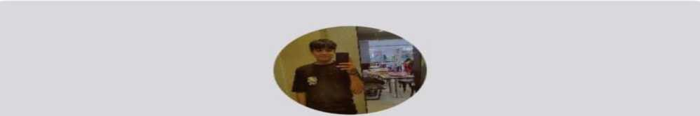
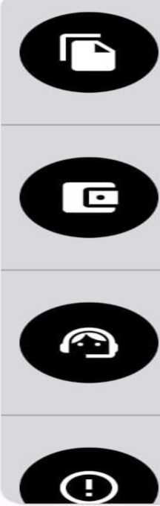
14:5V B3 | *■* g | 3 25%
 | Profile
Dinesh >*
Portfolio
View your Portfolio
Wallet
Add Money
Customer Support 24x7
FAQ s, Contact Us
About Us
LOG OUT
Watch I i st
Stocks
News
Profile

Slide 42

14:57 B3 ..ii m > 25%
<- Edit Profile
Change
Username
D inesh
 | __7
--'N
Email
devanisuman@gmail .com
s-\
Contact
8238484230
v_y
s- | X
Old Password
'—
New Password | ‘X
 | __7
Save Changes

Slide 43
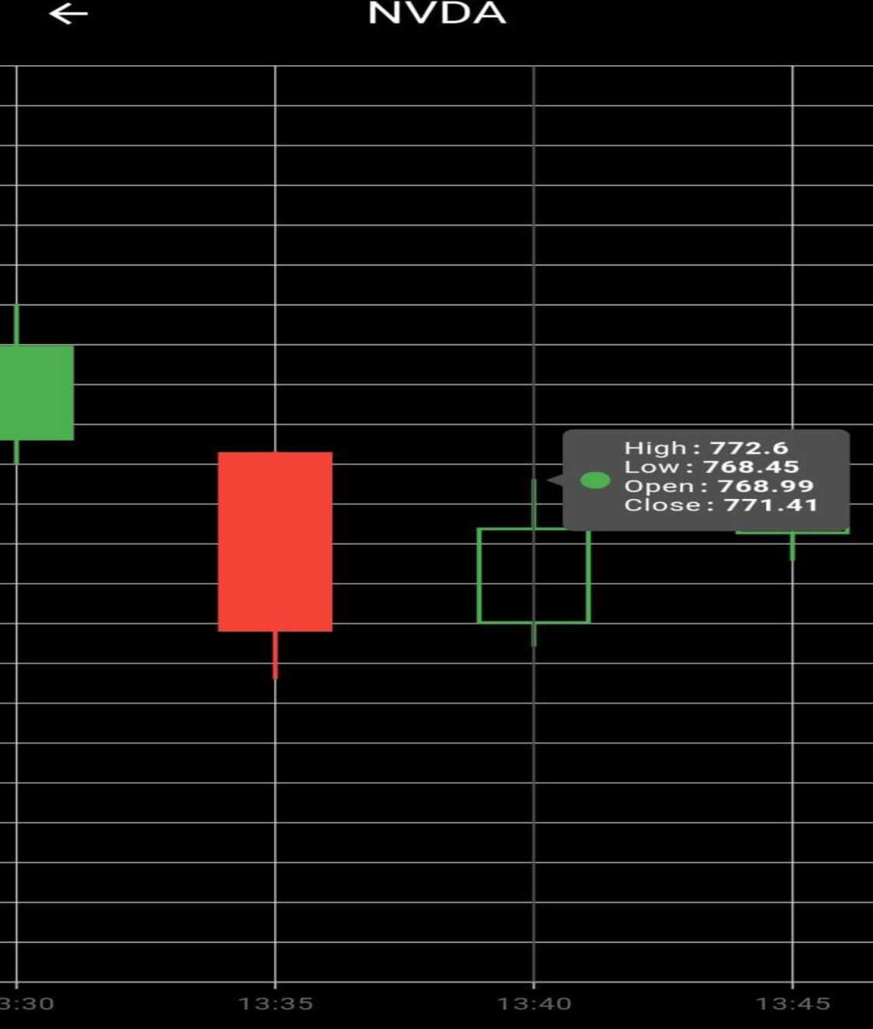
14:58 03
*■* * ..il (E
I’ 25%

Slide 44

14:58 B3 | KB/g ^ .III (HI | 3 25%
 | Login
a Password
Log in
New to Application? Register Here
Forgot password

Slide 45
20-09 O ^{d,}9"
^ ..iI 0 )■ 7%
Portfolio
ImmunityBio, Ino.
Quantity: 108 541.62
LTP: 5.01
Lockheed Martin Oorporation
Quantity: 5 2302.40
LTP: 460.48
Pepsico, Ino.
Quantity: 10 1707.65
LTP: 1 70.76

Slide 46
CHAPTER-7
SUMMARY
Assumptions
1) The customer should have the basic knowledge of how the online systems works.
2) Proper Internet setup is required to run the system smoothly.
3) Users must have knowledge of English Language, as interface will be provided in English.
4) Users should be having a valid Gmail id.
Limitations
1) The system will run only with the help of Internet connection.
2) If the user is not able to understand English language then user will not be able to use the system.
3) End to end security is not provided in the system currently.
4) Currently, the scope of System is bounded to the Gujarat state only.
Future Scope
1) New Services other than the existing services will be added to the system into the future.
2) Scope of the System will be expanded to the other states as well.
3) We will implement net banking in our system.
4) We will implement our system in android or IOS. (Mobile application)
Conclusion
We have taken enough care to make the project user friendly and more interactive but there maybe some defects or errors. We can sum up the entire system in simple words that the System is stable enough to provide the services and ease to the users.

