Slide 1
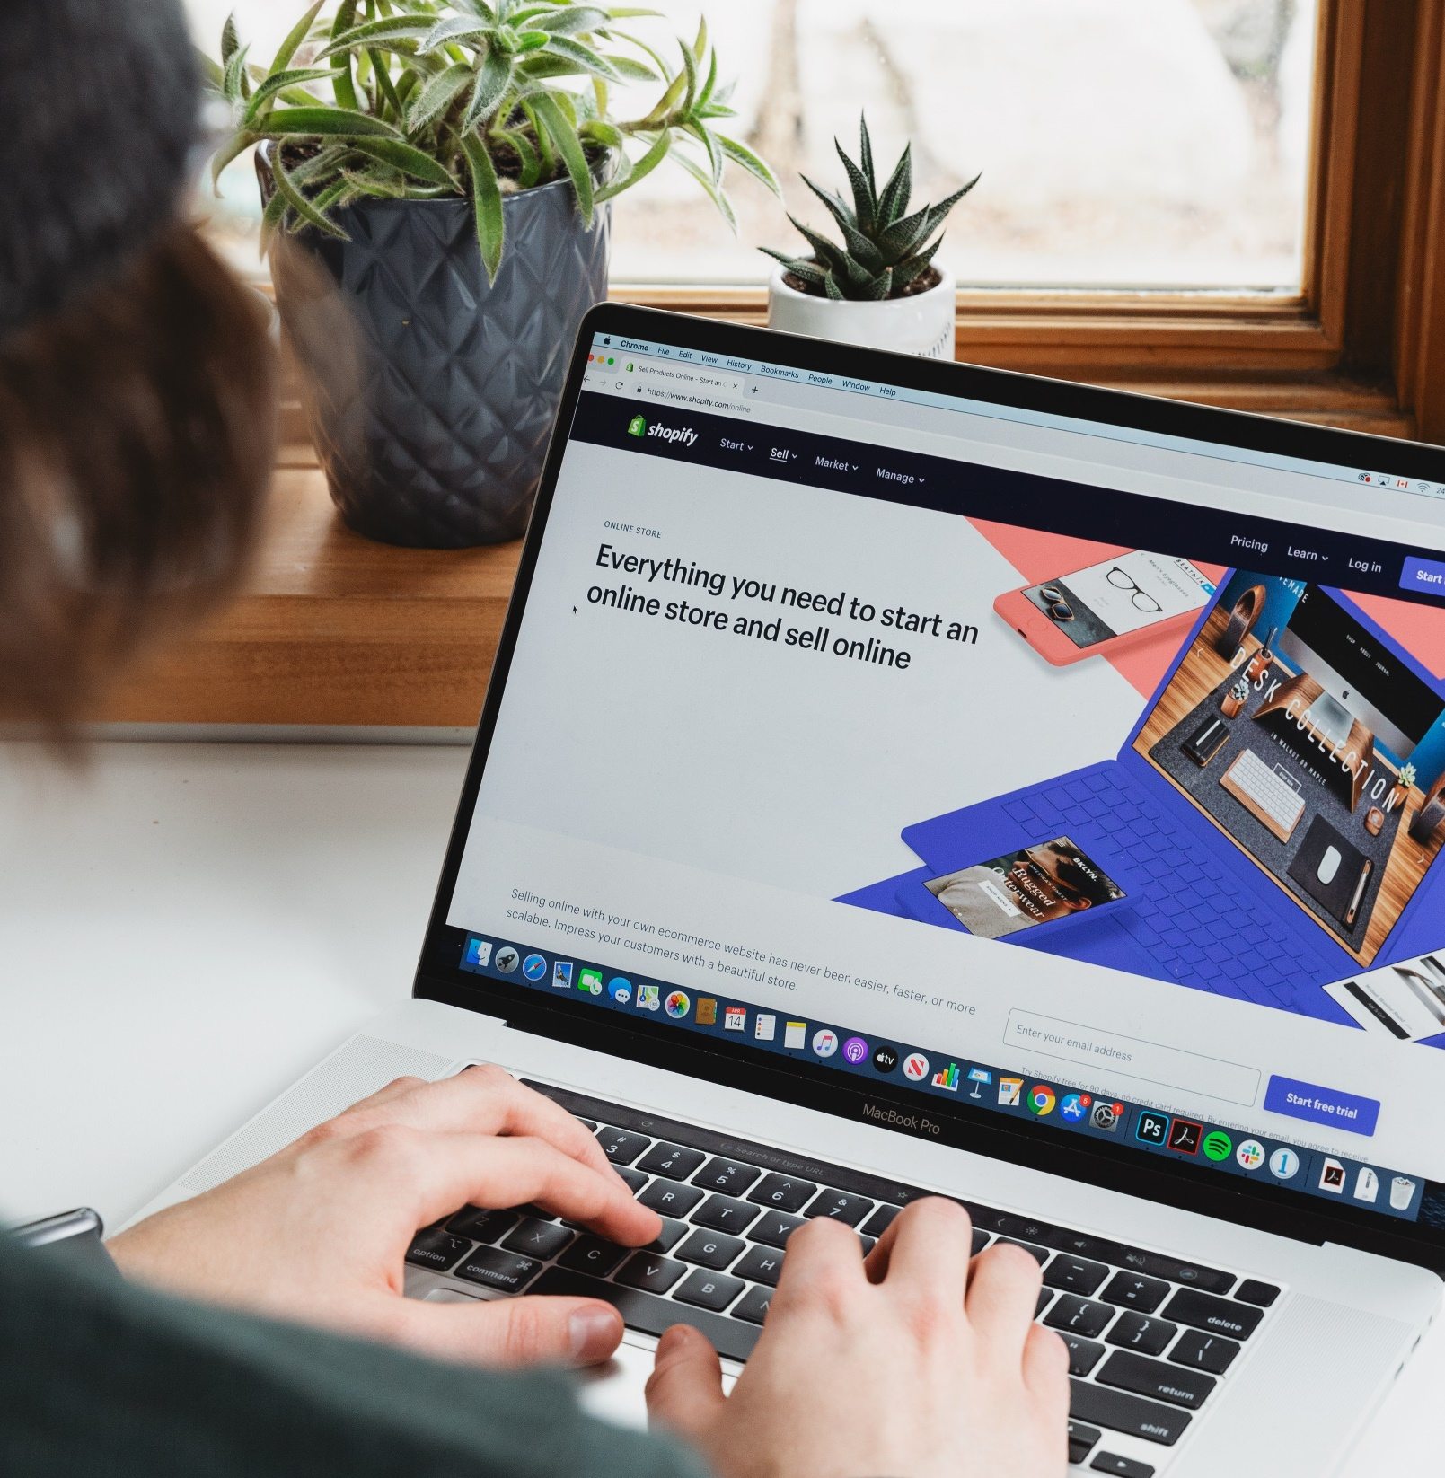

Marketplace
Presented By:
Pramod Chhetri

Slide 2
Contents
INTRODUCTION
BACKGROUND STUDY
STATEMENT OF PROBLEMS
OBJECTIVES
METHODOLOGY
FEASIBILITY STUDY
REQUIREMENT SPECIFICATION
DESIGN
IMPLEMENTATION
RISKS
TIME PLAN
CONCLUSION

Slide 3
Introduction
A marketplace is an online platform that connects buyers and sellers, facilitating the exchange of goods, services, or information in a virtual environment.
In a marketplace, various vendors and local business offer their products or services, while customers can compare options and make purchases conveniently through the platform.
User can buy products and list their own products to sell.

Slide 4
Background Study
Online marketplaces in Nepal are very less advertised.
It is still a new born industry.
Customer behavior and preferences is still negative.
Marketing and awareness is needed.
Website design and user experience should be improved.
Notes:
Online marketplaces: Online book stores are part of the broader e-commerce industry, and studying online marketplaces such as Amazon, eBay, and Alibaba can provide insight into best practices, industry trends, and consumer behavior.
Book industry trends: Understanding the book industry is important for an online book store to succeed. This includes studying the trends in book publishing, distribution, and consumption, as well as the impact of digital technology on the industry.
Customer behavior and preferences: Online book stores must understand their customers' behavior and preferences to provide a personalized and efficient shopping experience. This involves studying consumer behavior, demographic trends, and preferences for different genres and formats.
Online marketing: Online book stores need to effectively market their products to attract customers. This involves studying online marketing techniques such as search engine optimization (SEO), social media marketing, email marketing, and paid advertising.
Website design and user experience: The success of an online book store depends largely on its website design and user experience. Background studies in website design, user

Slide 5
Statement Of Problem
Competition
Supply chain management
Shipping and logistics
Digital piracy
Technical issues
Notes:
Competition: Online book stores face intense competition from other online retailers as well as physical bookstores. This can make it challenging to attract and retain customers, especially if the competition offers lower prices or a wider selection of books.
Supply chain management: Online book stores must manage the supply chain effectively to ensure that books are in stock and available for shipping to customers. This can be challenging, especially for smaller book stores that may have limited resources.
Shipping and logistics: Shipping and logistics can be a significant challenge for online book stores, especially if they have a large customer base spread across a wide geographic area. Shipping costs can also eat into profit margins, making it challenging to offer competitive prices.
Digital piracy: Online book stores may face issues with digital piracy, where customers may illegally download or share e-books. This can negatively impact sales and revenue for the online book store.
Technical issues: Online book stores must maintain a reliable and user-friendly website that can handle high levels of traffic. Technical issues such as website crashes or slow loading

Slide 6
Objectives
To offer a personalized shopping experience
To provide a wide range of products
To ensure a user-friendly website
To provide reliable payment and shipping options
To provide excellent customer service
To grow the customer base

Slide 7
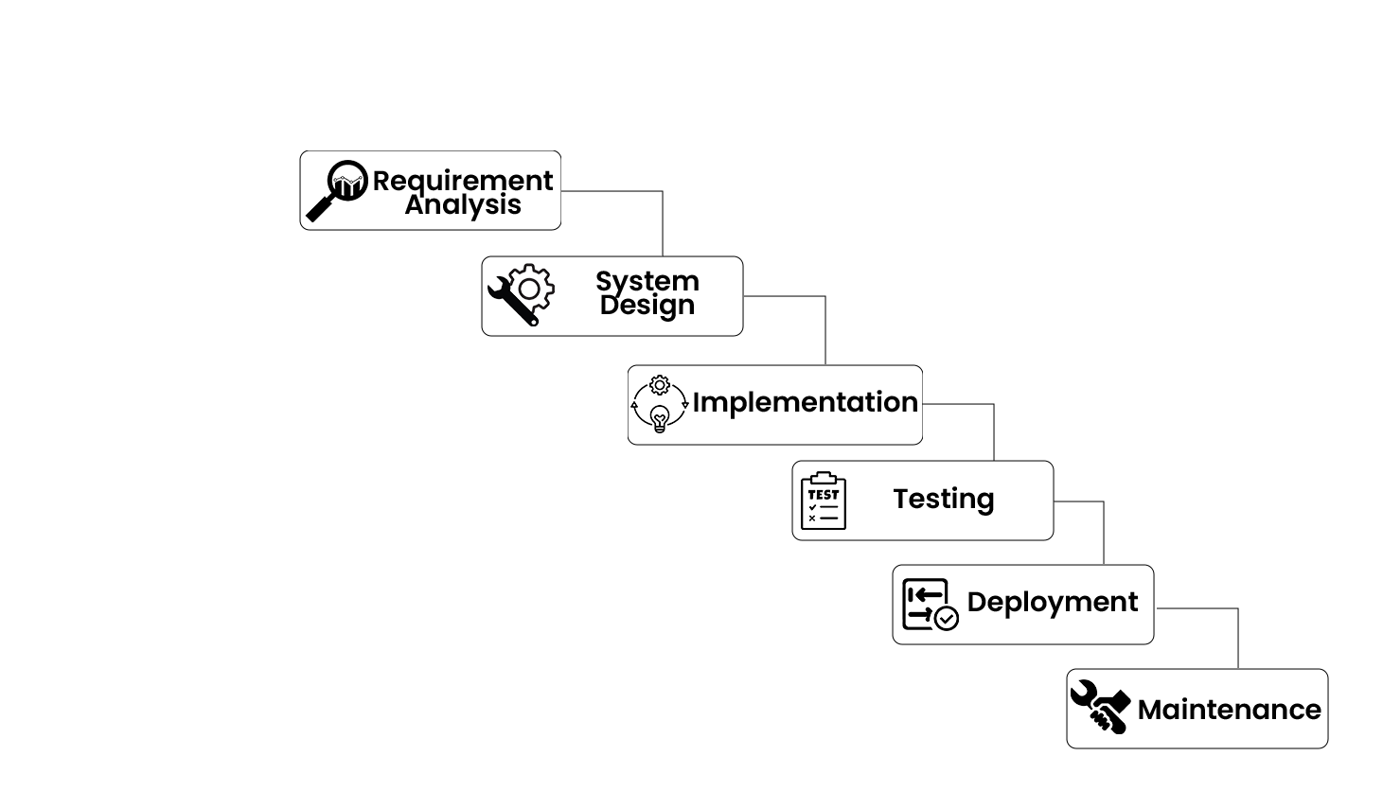
Methodology
Incremental Model

Slide 8
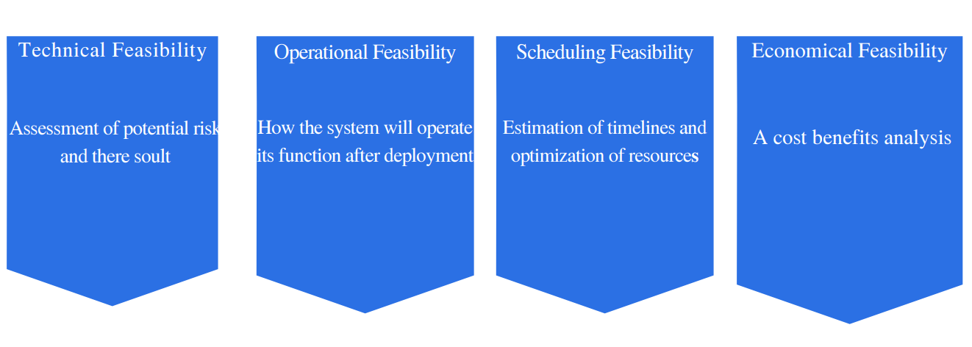
Feasibility Study
Notes:
Technical Feasibility
This is technically feasible as it can be developed easily with the help of available technology like HTML, CSS, PHP, Bootstrap etc. Development team are technical skill and capabilities. The technology we use is stable and established.
Operational Feasibility
This is operationally feasible because system interface is standard, user friendly and provides extensive help. Hence, no special training is required.
Economic Feasibility
This is economically feasible because organization does not need to spend much money for the development of this system. The only thing is to be done is making an environment for the development.
Schedule Feasibility
A work schedule includes the days of the week and times of the day a particular employee is scheduled to work at a job. The traditional full-time work week in the project involves 4–6-hour days

Slide 9
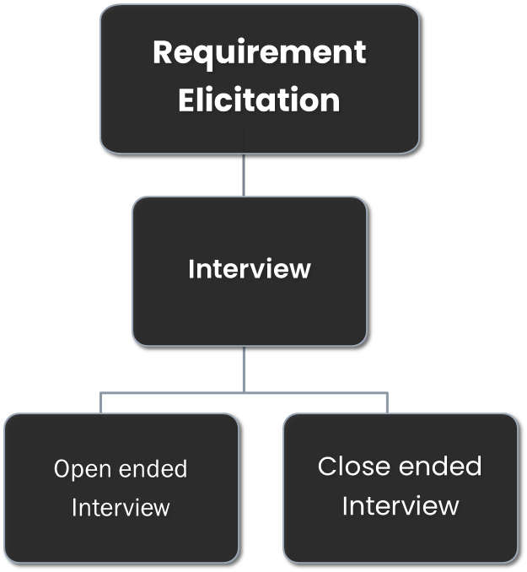
REQUIREMENT ENGINEERING

Slide 10
REQUIREMENT ENGINEERING
Requirement Analysis and Validation
Review with supervisor for requirement analysis and validation

Slide 11
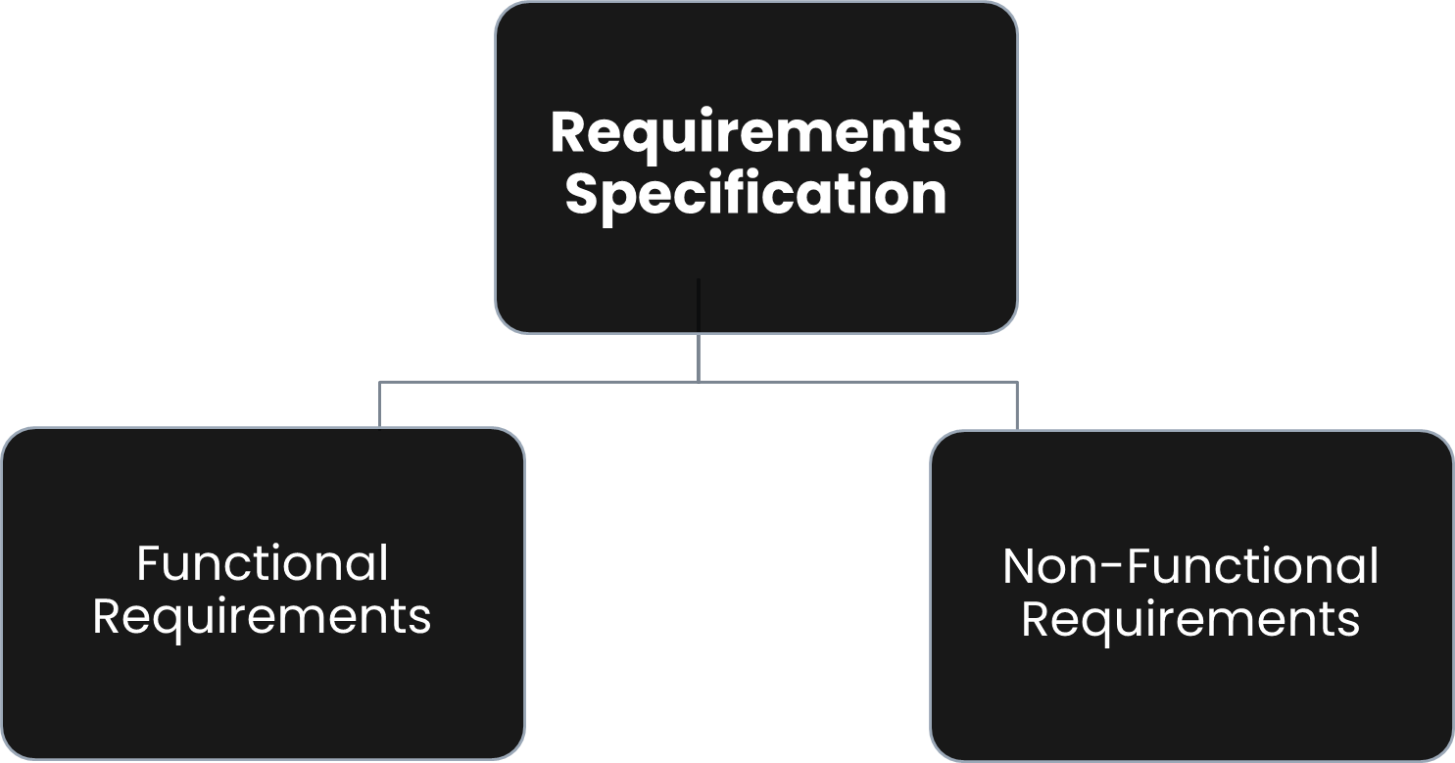
REQUIREMENT ENGINEERING

Slide 12
Requirement Specification
Functional Requirements
User Module | Admin Module
• Login/Signup • Homepage • View item • Add to cart • Select quantity • Checkout • View profile • Billing • logout | • Login/Signup • Update profile • Manage category • Manage order • Manage product • Assign permissions • Manage role • logout

Slide 13
Non-Functional Requirements
Security
Performance
Error handling
Availability
User friendly

Slide 14
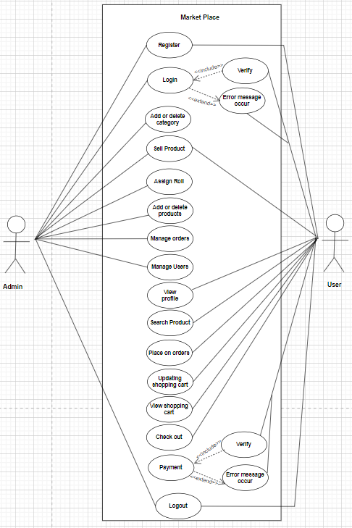
DESIGN
Context Modeling
Use-Case Diagram

Slide 15
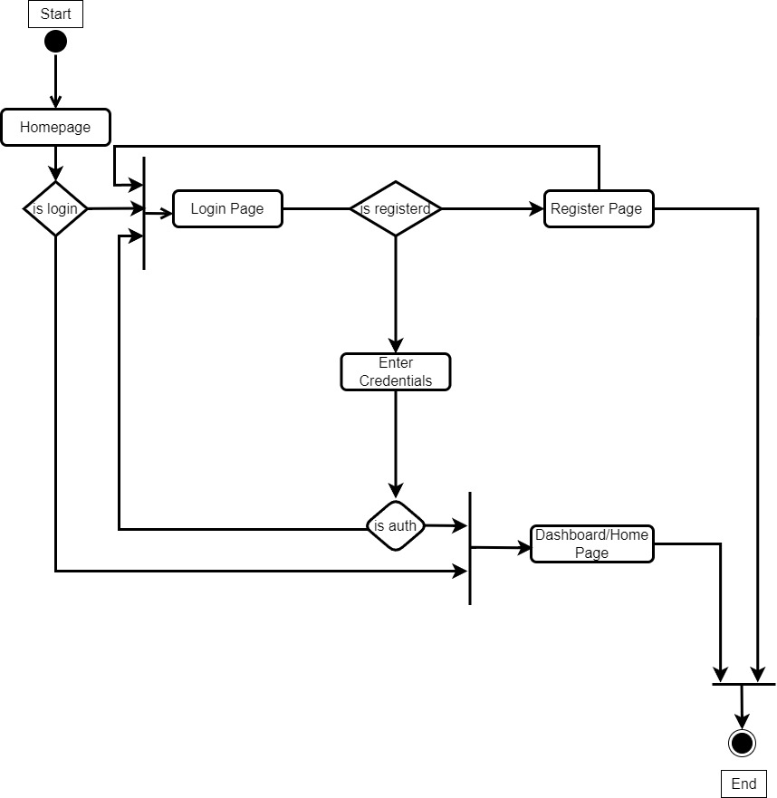
DESIGN
Process Modeling
LoginActivity Diagram

Slide 16
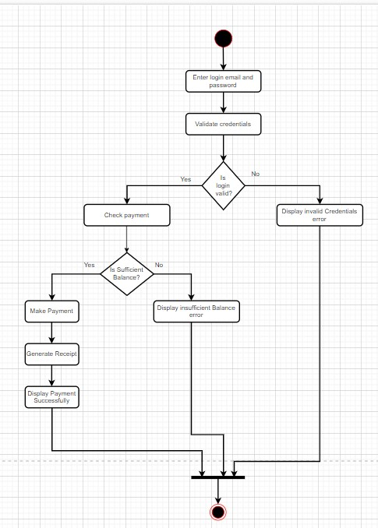
Payment Activity Diagram

Slide 17
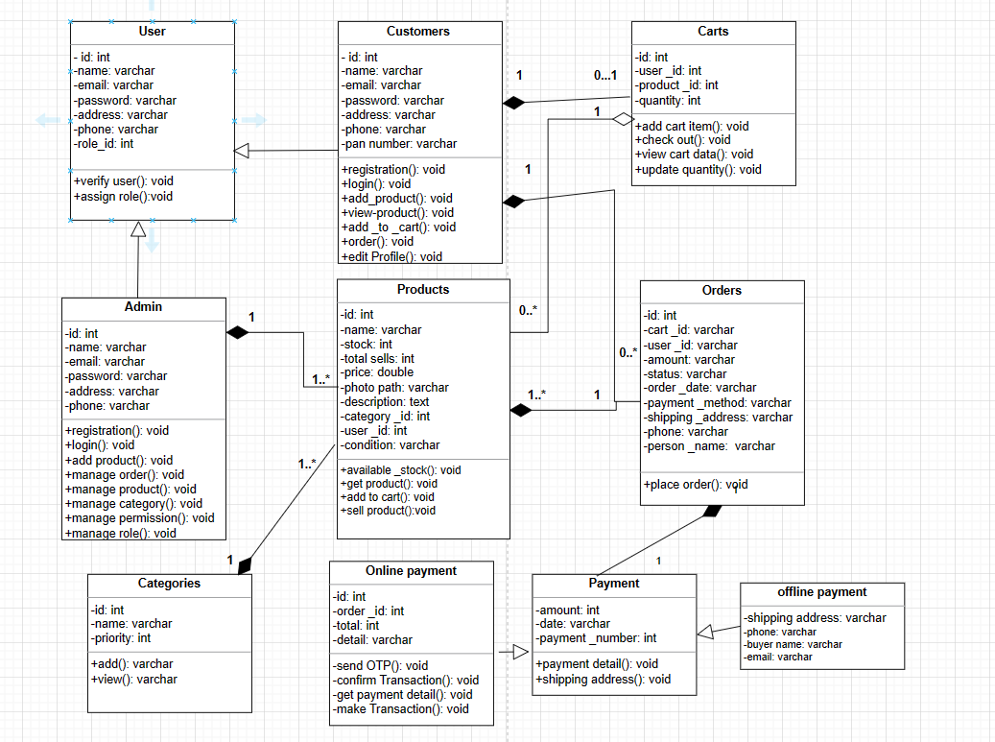
DESIGN
Structural Modeling
Class Diagram

Slide 18
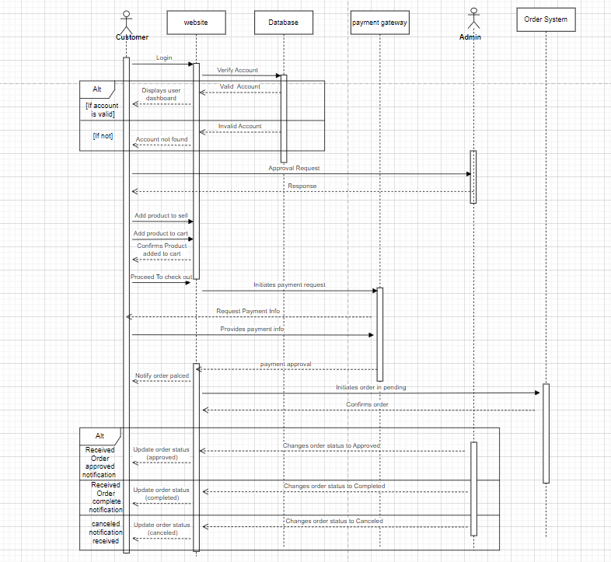
DESIGN
Dynamic Modeling
Sequence Diagram

Slide 19
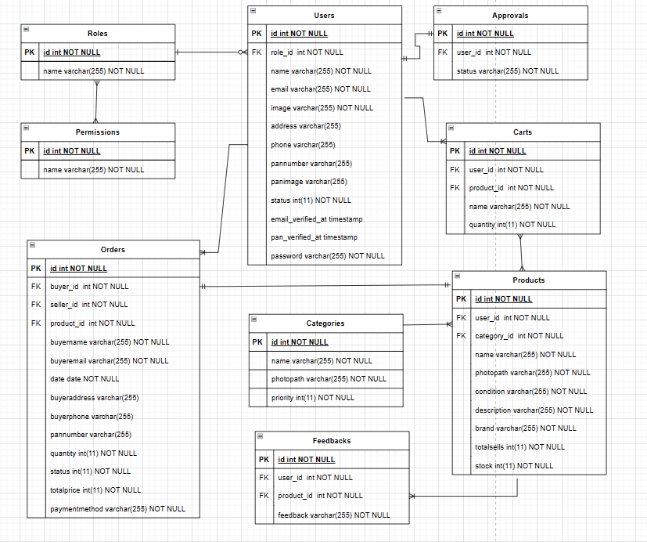
DESIGN
Database Design
ER Diagram

Slide 20
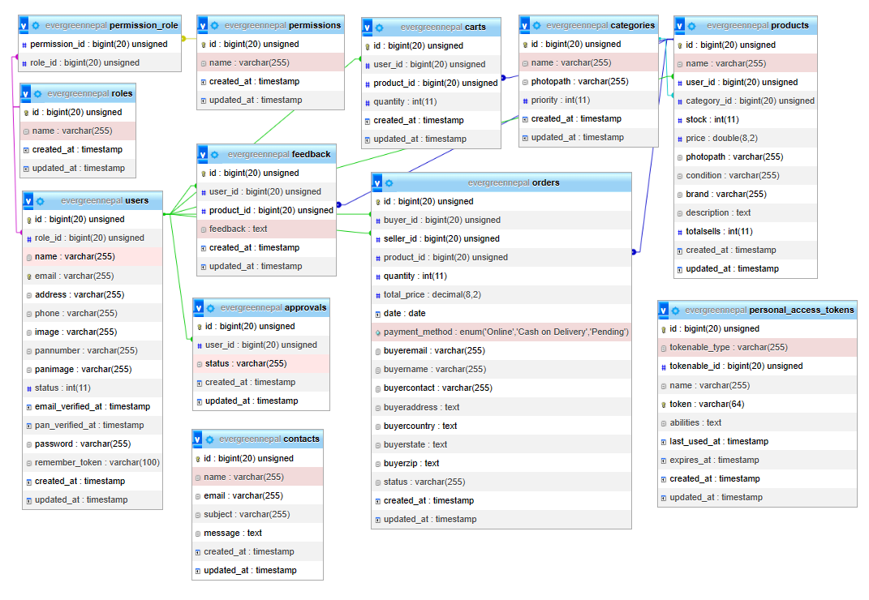
DESIGN
Database Design
Schema Diagram

Slide 21
ALGORITHM
Step 1 - Fetching Products from the Database:
$topproducts = Product::all();
Step 2 - Bubble Sort for Sorting::
$n = count($topproducts);
for ($i = 0; $i < $n - 1; $i++) {
for ($j = 0; $j < $n - $i - 1; $j++) {
if ($topproducts[$j]->totalsells < $topproducts[$j + 1]->totalsells)
temp = $topproducts[$j];
$topproducts[$j] = $topproducts[$j + 1];
$topproducts[$j + 1] = $temp;
Step 3 - Pagination Implementation:
$perPage = 6;
$currentPage = request()->input('page', 1);
Step 4 - Slicing and Creating a Paginator:
$topproducts = collect($topproducts)->slice(($currentPage - 1) *$perPage, $perPage)->all();
$topproducts = new \Illuminate\Pagination\LengthAwarePaginator($topproducts, count($topproducts), $perPage, $currentPage);

Slide 22
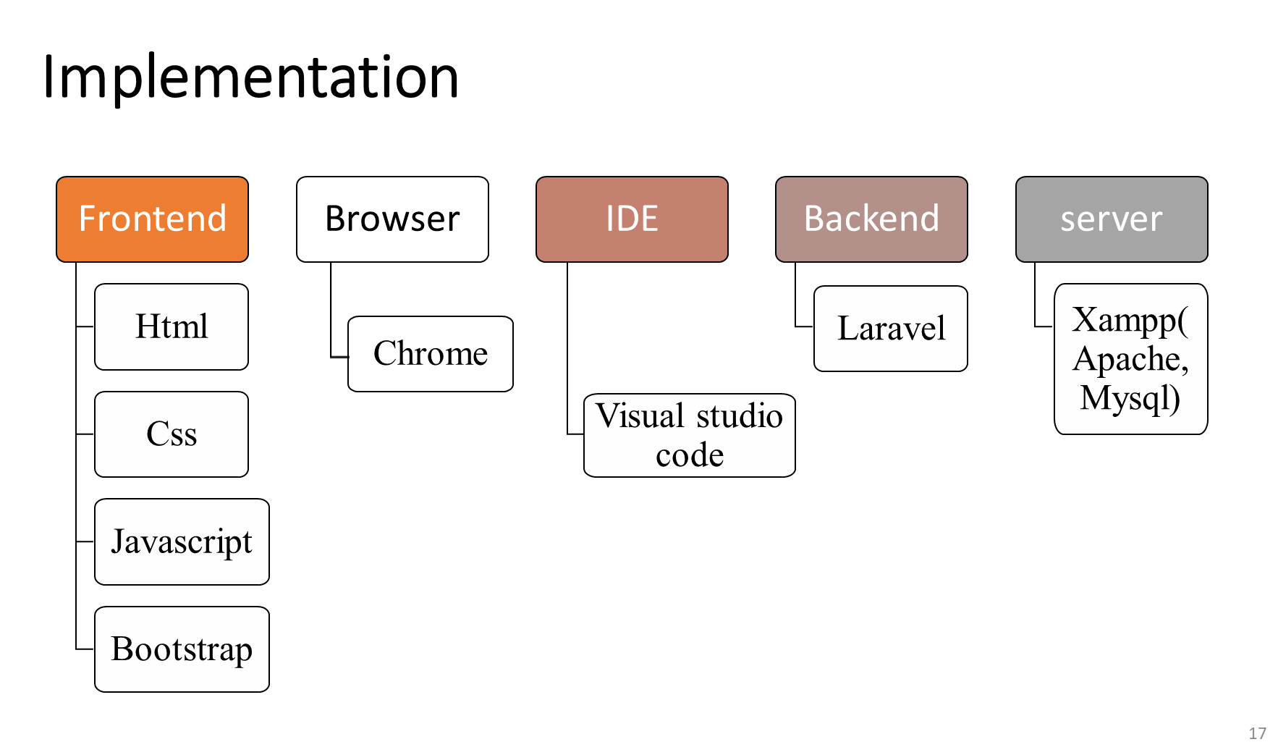
Implementation

Slide 23
Testing
Unit Testing
By ourself
Acceptance Testing
Reviewing it with supervisor

Slide 24
Risk
Malware
Thift and Loss
Notes:
. Malware Malware is intrusive software that is designed to damage and destroy computers and computer systems. Examples of common malware includes viruses, worms, Trojan viruses, spyware, adware, and ransomware. ii. Theft and loss 7 Unauthorized users without permissions who have access to sensitive data can cause harm to as a result of theft.

Slide 25
Future Recommendations
Integrate multiple load balancers to distribute loads of the system.
Create the master and slave database structure to reduce the overload of the database queries.
Automation
Add multiple suppliers
Product return

Slide 26
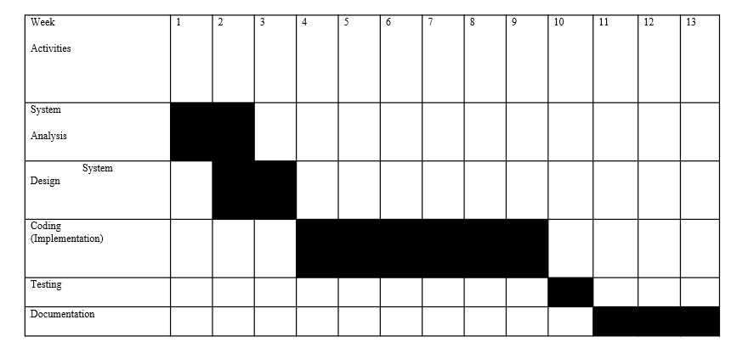
Time Plan

Slide 27
References
[1] "Daraz Nepal - Online Shopping in Nepal," Daraz Nepal, 2022. [Online]. Available: https://www.daraz.com.np/. [Accessed: 06- Jun- 2022].
[2] "SastoDeal - Online Shopping in Nepal," SastoDeal, 2022. [Online]. Available: https://www.sastodeal.com/. [Accessed: 06- Jun- 2022].
[3] "HamroBazar - Sell & Buy Online in Nepal," HamroBazar, 2022. [Online]. Available: https://hamrobazar.com/. [Accessed: 06- Jun- 2022].
[4] "Mero Shopping - Online Shopping in Nepal," Mero Shopping, 2022. [Online]. Available: https://www.meroshopping.com/. [Accessed: 06- Jun- 2022].
[5] "OkDam - Online Shopping in Nepal," OkDam, 2022. [Online]. Available: https://www.okdam.com/. [Accessed: 06- Jun- 2022].
[6] "NepBay - Online Shopping in Nepal," NepBay, 2022. [Online]. Available: https://nepbay.com/. [Accessed: 06- Jun- 2022].

