Slide 1
Laravel

Slide 2
Introduction
Environmental Setup
Configuration
Routing
Controllers

Slide 3
Introduction
MVC framework
It consists of bundles, migrations and artisan CLIs.
Open Source Framework
It consists of rich set of features which will boost the speed of Web Development.
The website built in Laravel is also secure

Slide 4
Environmental SetUp
https://getcomposer.org/download/
Creation of new project:
composer create-project laravel/laravel sampleProject
php artisan serve

Slide 5
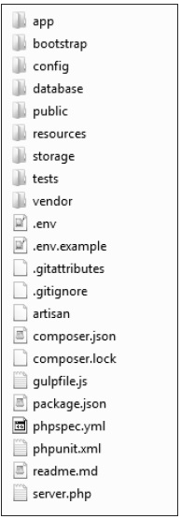
Application Structure

Slide 6
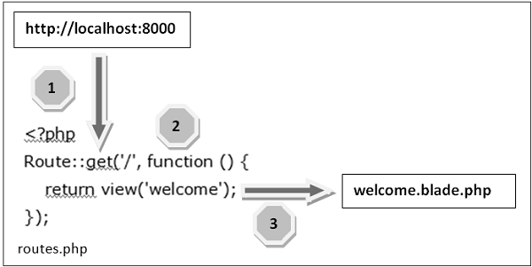
Routing

