Slide 1
OmniScript

Slide 2
OmniScript is an omnichannel customer engagement and a business tool built on the Salesforce platform. OmniScript allows you to craft dynamic customer interactions without code and deploy to multiple channels and devices. Administrators can define a script once and then deploy the script within a Salesforce application or on a web page.
You can create OmniScripts to guide users through sales and service processes with fast, personalized responses, and seamless integration to enterprise applications and data.

Slide 3
LWC OmniScripts
LWC OmniScripts enable you to enhance an existing OmniScript element or add custom functionality to the OmniScript by using custom Lightning web components. For information on Vlocity's Lightning web components

Slide 4
LWC OmniScript Designer Highlights
Notable features of the LWC OmniScript Designer include:
Building your scripts on a wide and adjustable Canvas, and instantly view changes made to element properties.
Repositioning, cloning, and adjusting the width of step elements along a 12-column horizontal grid.
Accessing inactive elements and navigating between elements in high-level and detailed views from the Navigation Panel.
Configuring elements from the Properties Panel.
Searching for and dragging elements onto the Canvas from the Build Panel,
Configuring script-wide settings from the Setup Panel.
Viewing contextual In-Product Help to discover and learn about elements and properties without leaving your script.
Previewing, testing, and debugging your script in Preview.

Slide 5
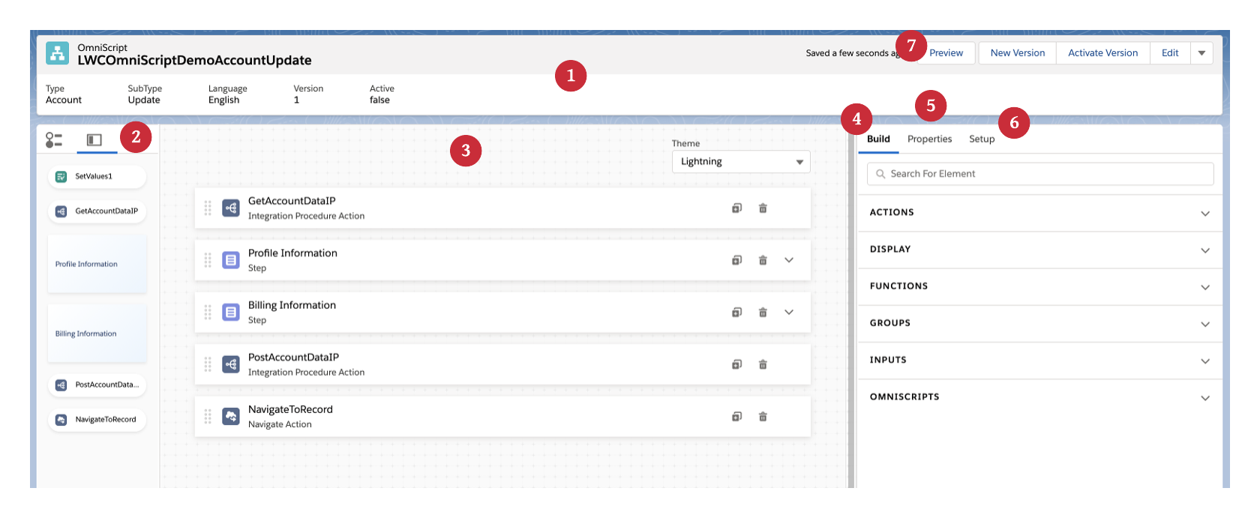
LWC OmniScript Designer Overview

Slide 6
LWC OmniScript Designer Overview
Header (1)
In the Header, view metadata and perform actions related to your script.
View high-level metadata about your OmniScript such as Type, SubType, Version, Language, and Activation status.
In the actions navigation, toggle between design and preview mode, create a new version, activate or deactivate the current version, edit basic settings, download your OmniScript, and get launch instructions.
Navigation Panel (2)
Access and navigate between active and inactive actions, steps, and step elements from the Navigation Panel.
The Slide View tab provides a high-level view of the structure of large and complex scripts. Click on a slide to open the Properties Panel for a step or action.
The Tree View tab provides a detailed view of the script's structure. Click on a branch to open the Properties Panel for a step, element, or action.

Slide 7
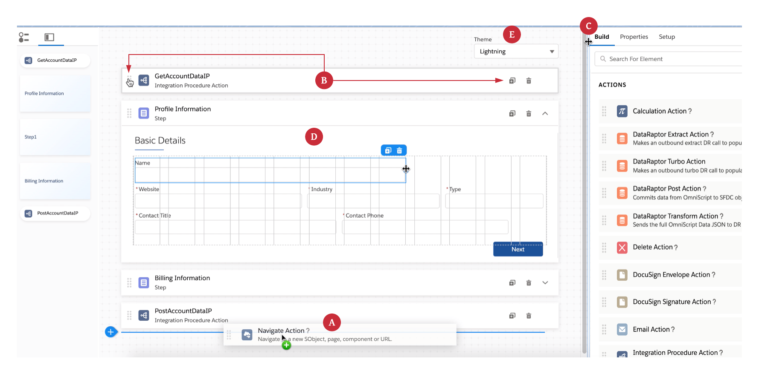
LWC OmniScript Designer Overview
Canvas (3)
(A) Build your scripts by dragging elements from the Build Panel onto the Canvas.
(B) Rearrange, clone, and delete elements as needed.
(C) Adjust the width of the Canvas from either side.
(D) Expand Steps to preview and configure elements. Adjust the width of elements on a 12-column grid, and drag elements next to each other to automatically take up the remaining width of the grid.
(E) See how your scripts look with a Newport or Lightning theme without switching to Preview.

Slide 8
LWC OmniScript Designer Overview
Build Panel (4)
Drag action, display, function, group, and input elements, and entire OmniScripts from the Build Panel onto the Canvas to build your scripts.
Properties Panel (5)
In the Properties Panel, configure properties for action, display, function, group, input, and embeddable OmniScript elements in the UI, or edit properties as JSON.
Setup Panel (6)
Configure optional script-wide settings in the Setup Panel.
Configure basic settings, Step Chart Options, Save Options, Knowledge Options, Error Messages, Messaging Framework, and Lightning Design System Tokens in the UI, or edit properties as JSON.

Slide 9
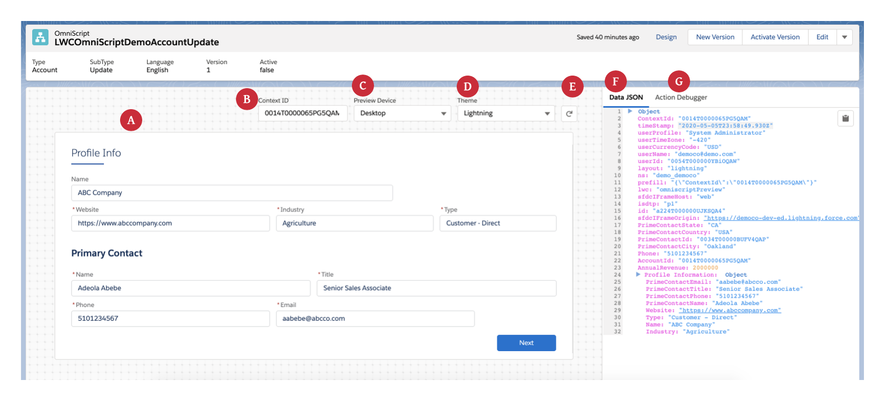
Preview
(A) Preview your script in real-time with real data.
(B) Enter a record Id into the Context Id field and click refresh to preview your form with test data.
(C) Preview how an OmniScript appears on different devices, such as mobile, desktop, and tablet, with the Preview Device feature.
(D) With the Theme dropdown, see how your OmniScript looks with a Lightning or Newport theme. If a custom Newport stylesheet is in the org, it overrides the out-of-the-box Newport stylesheet.
(E) Reload the Canvas to reset data, and update the Data JSON and Action Debugger.
(F) The Data JSON provides an easy-to-read JSON format, which updates when you enter values in data fields on the Canvas. Also, copy the entire JSON with just one click.
Debug
(G) The Action Debugger enables you to debug action requests and response data. Search for actions, copy specific nodes in one click, and clear the console logs.

Slide 10
Create an LWC OmniScript to Build in the LWC OmniScript Designer
To create an LWC OmniScript in the LWC OmniScript Designer:
From the Vlocity OmniScript Designer tab, click New.
Enter a Name for your OmniScript.
Enter a Type, SubType , and Language to create the unique identity of your OmniScript.
Select LWC Enabled OmniScript.
(Optional) Enter a Description of your OmniScript which displays along with the Name on the Vlocity OmniScript Designer home page.
Click Save.
Click Open in LWC OmniScript Designer.

Slide 11
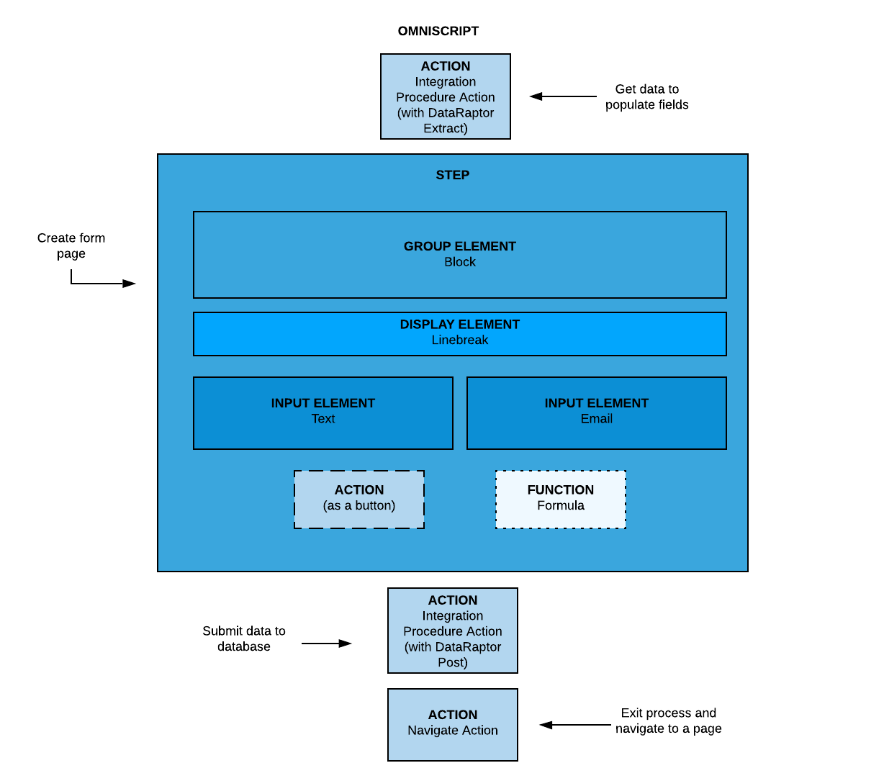
Creating the Script Structure
To create the logic that executes when the script runs, create a hierarchical structure of Actions and Steps. Actions outside steps perform actions for the entire script, such as getting, posting, evaluating, and transforming data. Steps typically include Block, Input, and Display elements, but can also include Actions as buttons and Functions specific to the step.
Each page of an OmniScript is called a Step and can contain Group elements, such as Blocks, Input elements, such as Checkboxes, Actions, such as Email Actions, and Functions, such as Formulas.

Slide 12
Build an LWC OmniScript with Elements in the LWC OmniScript Designer
Before you begin
Before building your script, complete these tasks:
Create an LWC OmniScript.
Setup your LWC OmniScript with optional settings.
Building an LWC OmniScript
To build an LWC OmniScript:
From the Vlocity OmniScript Designer tab, click the down arrow for a version of an LWC Omniscript, and click Open in LWC OmniScript Designer.
Click Build to open the Build Panel.
To get data to populate the script's data fields, click Actions, and drag the DataRaptor Extract Action onto the Canvas.
Enter a name in the Name field.
From the DataRaptor Extract Action dropdown, select a DataRaptor that retrieves data from one or more related Salesforce objects.
(Optional) To configure other DataRaptor Extract Action properties, see DataRaptor Extract Action Properties.
Note - To execute more than one server call to fetch data use an Integration Procedure or an Action Block.
(Optional) To enable canceling out of an OmniScript and navigating to a different Salesforce experience, add a Cancel action, see Enable and Configure Cancel Functionality in an LWC OmniScript.
To create a page for your form:
Click Groups, and drag Step on to the Canvas.
To populate your form with data fields and other elements, click the down arrow on the step, and drag elements from the Build Panel into the step.
Note - Actions placed inside a step render as buttons.
To post changes made to data fields:
Enter a name in the Name field.
From the DataRaptor Post Action dropdown, select a DataRaptor that posts data back to Salesforce.
(Optional) To configure other DataRaptor Post Action properties, see DataRaptor Post Action Properties.
Note - To execute more than one server call to fetch data use an Integration Procedure or an Action Block.
To end the OmniScript and return the user either to where the script was launched or a custom URL:
Click Actions, and drag a Navigate Action on to the Canvas.
To configure the Navigate Action, click the help icon (?) next to the Navigate Action Properties title in the Properties Panel, or see Navigate Action.

Slide 13
Configure Elements in the LWC OmniScript Designer
Configure elements for your LWC OmniScript in the Properties Panel of the designer when an element is selected, such as the name, label, and instructions for a step element.
Before you begin
Before configuring elements, complete these tasks:
Create an LWC OmniScript.
Setup your LWC OmniScript with optional settings.
Add elements to your OmniScript.
Configuring Elements
To configure elements:
From the Vlocity OmniScript Designer tab, click the down arrow for a version of an LWC Omniscript, and click Open in LWC OmniScript Designer.
Click an element on the Canvas or the Navigation Panel to open the Properties Panel.
Enter values for any required fields marked with an asterisk (*), such as the Name field of a Text input element.
(Optional) To view an inactive element
(Optional) Enter values for optional fields, such as the Placeholder and Label fields of a Text input element.
(Optional) To learn more about a specific property, hover over the tooltip icon (i) next to the name of the property.
(Optional) For detailed documentation about your selected element, select the help icon (?) next to the name of the property.
To activate the element, click Active.

Slide 14
Previewing an LWC OmniScript
To preview an LWC OmniScript in the LWC OmniScript Designer:
In your org, click the App Launcher, click Vlocity OmniScript Designer, click a version of an LWC enabled OmniScript to open the OmniScript Designer, and click Open in LWC OmniScript Designer.
Click Preview.
For additional preview options, select these properties:
Context ID: If your OmniScript does not have a Set Values Action that defines a ContextId, to preview the form with test data, enter a record ID.
Important - Using Set Values Action to set the context ID only works in preview.
Note - Confirm that a Context Id is defined in your data source. For example, if you have a DataRaptor Extract Action that gets account records, you must have an Input Parameter whose Data Source is ContextId, and whose Filter Value is the DataRaptor Extract's output name, such as AccountId.
Preview Device: To preview how your OmniScript appears on different devices, select Mobile, Tablet, or Desktop.
Theme: Preview your OmniScript with a Lightning or Newport theme.
To reset data fields in your OmniScript after making changes, click the reload icon.
(Optional) Hide the Data JSON and Action Debugger by clicking X. Display the Data JSON and Action again by clicking the debug panel button that appears when the panel closes.

Slide 15
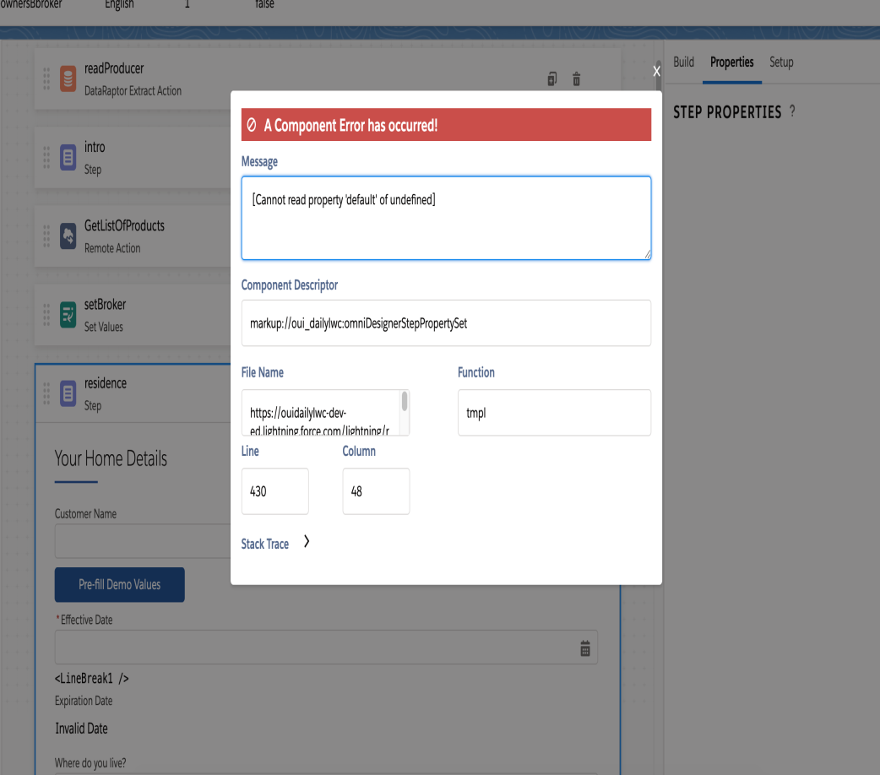
Upgrade an LWC OmniScript's Property Set
When using an existing OmniScript in the LWC OmniScript Designer, create a new version of the OmniScript to update the OmniScript's property set. Without a new version, errors could appear in the designer.
Creating a New Version
To resolve or prevent this error:
From the Vlocity OmniScript Designer tab, click the down arrow for a version of an LWC Omniscript, and click Open in LWC OmniScript Designer.
Click New Version to trigger a class that adds any missing JSON properties.
Repeat the process for any older or imported OmniScripts.

Slide 16
Launch Vlocity Cards within an LWC OmniScript
To add a Vlocity Card to an LWC OmniScript:
Ensure your Vlocity Card is LWC enabled and includes OmniScript support. For more information on including OmniScript support,
In an LWC enabled OmniScript, drag the Custom LWC element into a Step. For information on creating an LWC OmniScript,
In the Custom LWC's Lightning Web Component Name property, enter the name of the Vlocity Card Component.
Save and Activate the Script.
Preview the OmniScript.
Note
LWC OmniScripts using custom Lightning web components must be active to preview the OmniScript.

Slide 17
OmniScript Best Practices
Business Process and Logic best practices include:
Use one owner for each OmniScript.
Identify reusable elements by building a skeleton of the entire OmniScript.
Document the purpose of an element in the element's Internal Notes property.
Maintain DataRaptors and Apex classes by avoiding element name changes. If the element name must be updated, apply the name changes to the DataRaptor or Apex class.
Avoid assigning a ContextId within the OmniScript. OmniScript's ContextId is a reserved key that is assigned by the URL.
When processes are repeatable across multiple OmniScripts, create a reusable OmniScript, and add it to the appropriate parent OmniScripts. For more information

Slide 18
OmniScript Best Practices
UX design principles include:
Reduce the number of fields the user must input information into by prefilling the fields using contextual data. For more information, see Prefilling OmniScript Elements using DataRaptor.
Avoid confusing the user by breaking processes up into shorter steps that contain a minimal amount of elements.
Guide the user by creating contextual help text and logically ordering input fields.

Slide 19
OmniScript Best Practices
Performance Factors
Client-side best practices include:
Reduce Conditional Views, Merge Fields, Formulas where possible.
Speed up the application of responses by trimming the Response JSON.
Remove spaces from element names to improve the OmniScript's load time.
Reduce the number of elements in the script. A single OmniScript should not exceed 200 elements.
Run logic on the server where possible, including conditional logic in Integration Procedures and formulas in DataRaptors.
Test performance by enabling time tracking. If time tracking is not used in production, disable the feature before deploying to production.

Slide 20
OmniScript Best Practices
Performance Factors
Server-side best practices include:
Cut down the payload size of a request by trimming the JSON request. For more information, see Manipulating JSON with the Send/Response Transformations Properties.
Reduce server roundtrips by using Integration Procedures whenever multiple actions run between steps. Run Integration Procedures asynchronously by enabling the fire and forget property.
Remove unnecessary data by trimming the DataRaptor extract output.

Slide 21
Access OmniScript Data JSON with Merge Fields
Additional Syntax
This table provides additional syntax examples for nested JSON.
JSON Node | Merge Field Syntax Example
"ContactInfo": { "FirstName": "John" } | Use a colon symbol : to access a nested JSON node. %ContactInfo:FirstName%
"ParentObject": { "NumberMap": [ 1, 2, 3 ] } | Use a colon symbol : to access nested JSON nodes and a pipe symbol | and the index of the array that value. %ParentObject:NumberMap|3%
"ContactInfoStep": { "ContactInfoBlock": [ { "FirstName": "John" }, { "FirstName": "Adam" }, { "FirstName": "Steve" } ] } | When a formula exists within a repeatable block, use |n to access the node in which the formula exists. Depending upon which node the formula exists in, it will return the correlating value. For more information, see Evaluating Elements in Repeatable Blocks. %ContactInfoStep:ContactInfoBlock|n:FirstName%

Slide 22
Add Options for Selects, Multi-Selects, and Radio Buttons
To add options for Select, Multi-Select, and Radio Buttons, go to the Option Source section of the element and click +Add new option. If no values are defined for a Select element, an Undefined Value is returned.
Each option has a Value/Label pair. The Value is the language-independent data that gets passed in and out of the OmniScript remotely, either through DataRaptor or Remote/Rest actions. It is also referenced when setting up Conditional View.
The Label is displayed on the form. The Value and Label can be identical or different
For Multi-Select elements, if the user selects multiple options, a semicolon-delimited list of data is returned.
Note
If the values change frequently, enable the "Fetch Picklist Values at Script Load" to ensure that the OmniScript elements contain the most up-to-date set of values. Salesforce sources include picklists and custom classes.

Slide 23
Setting Date and Time Ranges
Date Range
To create a selectable Date range for the Date or Date/Time element, configure the following properties:
minDate: Sets the earliest selectable date in the range.
maxDate: Sets the latest selectable date in the range.
The minDate and maxDate fields accept both dynamic and static values
Time Range
Note
LWC OmniScripts using Time do not allow the DateTime format to be included in the minTime or maxTime fields.
To create a selectable Time range for the Time element, configure the following properties:
minTime: Sets the earliest selectable time in the range.
maxTime: Sets the latest selectable time in the range.
The minTime and maxTime fields accept static values that must include four digits formatted as HH:mm in the 12-hour clock or 24-hour clock syntax.

