Slide 1

Context Rules
Use the context rules framework to build rules that change what products, promotions, and prices appear for customers.

Slide 2
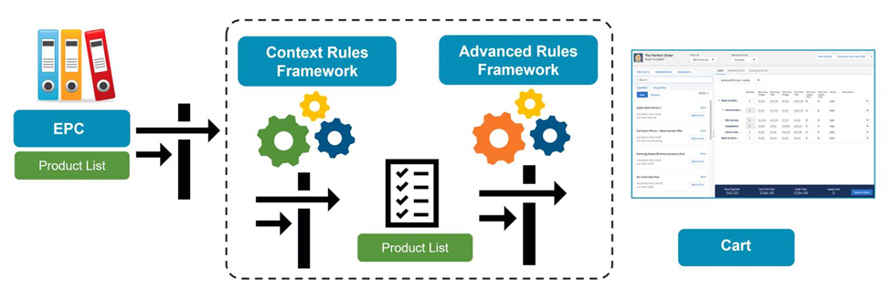
Dual Frameworks, Working Together
Context Rules qualify products, promotions, price lists, price list entries and pricing adjustments in the Cart. This framework can also be used for Salesforce Industries API Caching, which is used for digital commerce.
Advanced Rules is Salesforce Industries' original rules framework, and it is used primarily to create rules for product compatibility or configuration

Slide 3
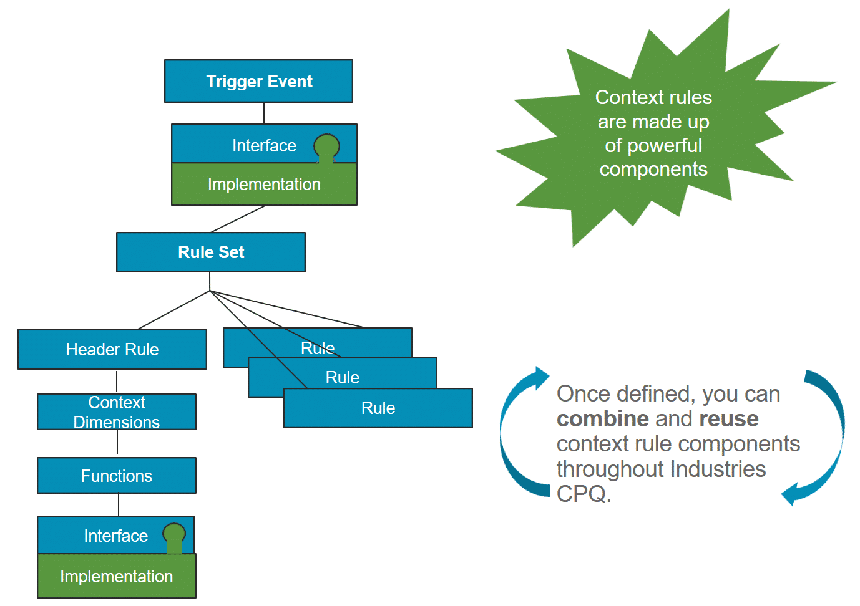
The Context Rules Framework (General Flow)
The Context Rules Framework allows you to build context rules to apply qualification and penalty rules.

Slide 4
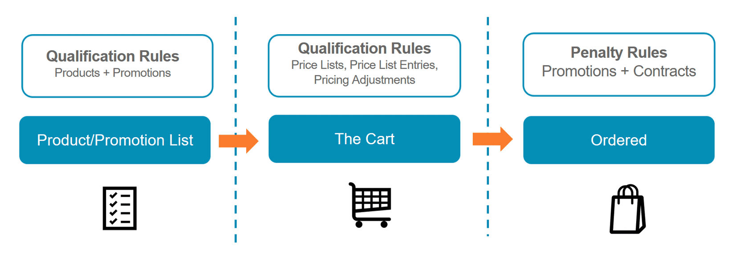
Context Rule Types
In the Vlocity Product Console, you can create the following types of context rules:
Qualification: This rule type determines eligible products and promotions for a customer before you add them to the Cart, and determine eligible price lists, price list entries, and pricing adjustments for products in the Cart.
Penalty: This rule type determines penalties for a customer who cancels contracts or promotions they've already ordered.

Slide 5
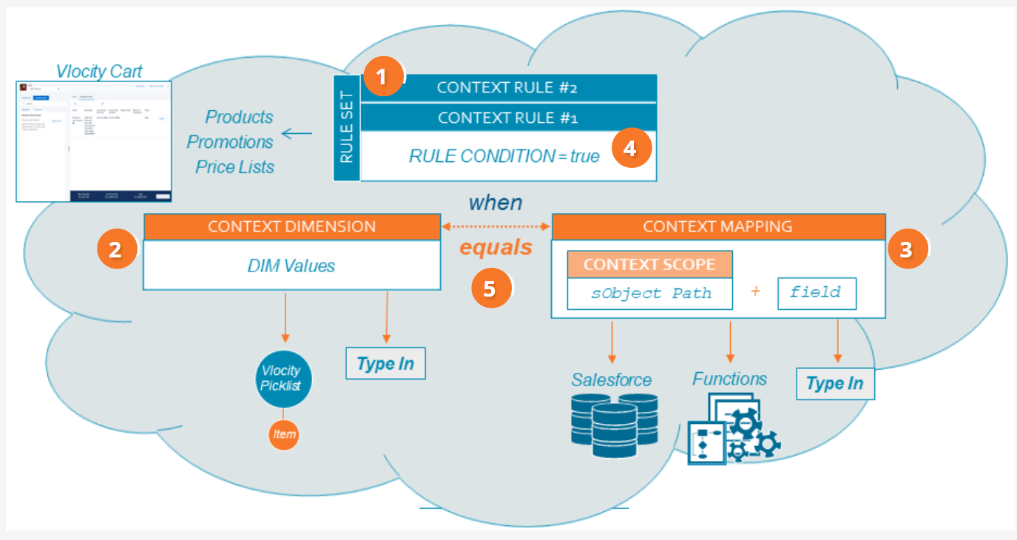
Workflow of Context Rules
Rule set – a rule set contains one or more context rules. You can apply rule set to product promotion and price list
Context dimension – the context dimension includes possible values, either from Vlocity Picklist or Type In.
Context mappings – the context mapping includes context scope to pull data from salesforce, a function, or type in
When the context dimension and context mapping match – the rule condition evaluates to true, and the context rules engine runs the context rules in the rule set. Each context rule, Context Rule #1 and Context Rule #2, evaluates a condition
Resulting Logical Expression – the different places work together to form the following logical expression: Rule Condition = true WHEN {{Context Dimension}} == {{Context Mapping{Context Scope.Source Expression}}

