Slide 1
Design and Veriflcation of 32-Bit RISC-V Processor Core Using Verilog HDL

Slide 2
ABSTRACT
This project focuses on the design and veriflcation of a 32-bit RISC-V Processor Core using Verilog HDL.
RISC-V is an open-source instruction set architecture widely used in modern processor design. The
proposed processor executes basic arithmetic, logical, load/store, and branch instructions. The processor consists of main modules such as Program Counter, Instruction Memory, Register File, ALU, Control Unit, and Data Memory. Functional veriflcation is performed using simulation tools to validate instruction execution and processor performance. This project helps in understanding processor architecture, RTL design, and VLSI veriflcation flow.

Slide 3
EXISTING SYSTEM
The existing system is based on the implementation of a 32-bit RISC-V Architecture processor core using Verilog HDL.
It performs arithmetic, logical, memory access, and branching operations using fundamental processor modules such as ALU, Register File, Control Unit, Program Counter, Instruction Memory, and Data Memory.
The processor executes instructions sequentially, where instructions are fetched, decoded, executed, and written back to registers through difterent stages of operation.
However, the system sufters from limitations such as lower execution speed due to non-pipelined architecture, higher processing delay, and limited optimization techniques for power and performance improvement.

Slide 4
Proposed system
The proposed system focuses on the design and veriflcation of a 32-bit RISC-V processor core using Verilog HDL.
RISC-V is an open-source Instruction Set Architecture (ISA) that provides a simple, modular, and flexible processor design.
The processor is developed using RTL design methodology and verifled through simulation techniques.
The proposed processor supports RV32I base integer instruction set architecture.

Slide 5
RISC-V Processor
A RISC-V processor is a processor based on the Reduced Instruction Set Computer (RISC) architecture. It uses a simple and efficient set of instructions, making it easier to design, verify, and implement in hardware.
Key Features
32-bit architecture: Processes 32-bit data in one operation.
32 general-purpose registers (x0–x31).
Open-source ISA (Instruction Set Architecture).
Simple instruction formats and fixed 32-bit instruction length.
High performance with reduced hardware complexity.

Slide 6
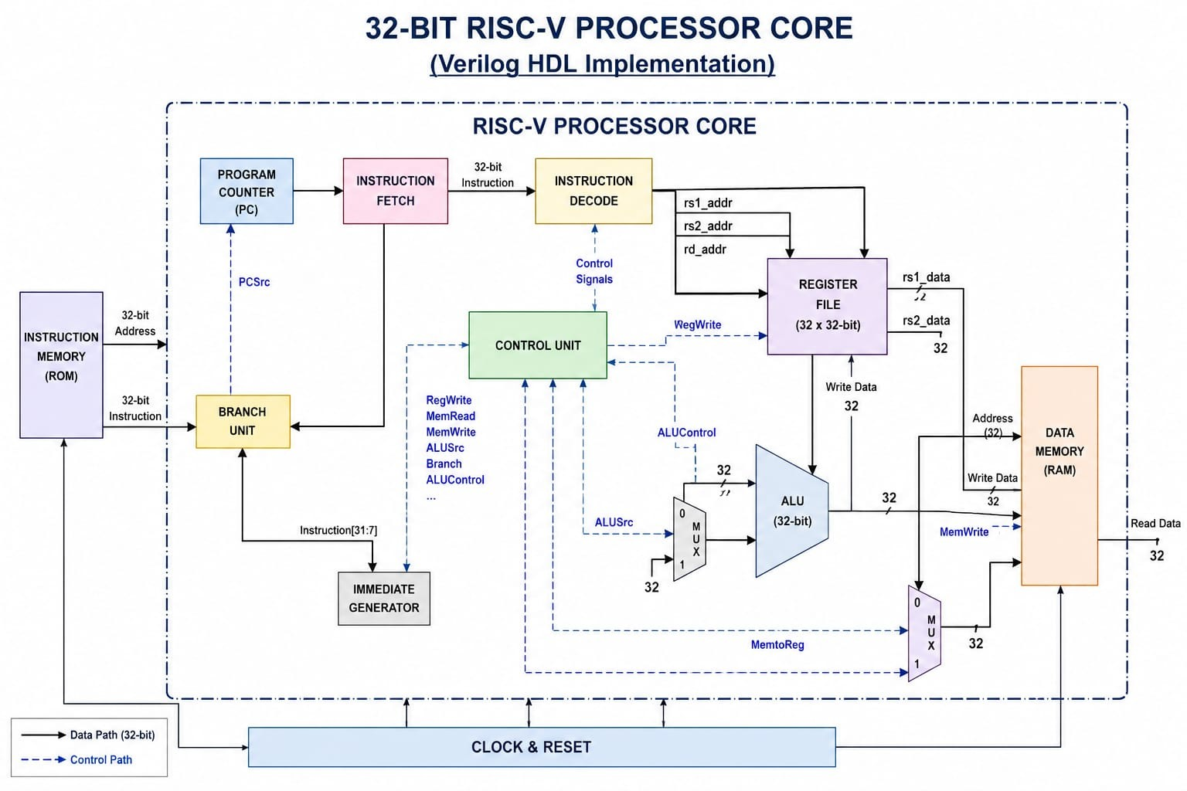
Block diagram

Slide 7
Tools used
Xilinx ISE
ModelSim
GTKWave
FPGA Development Board
Language used
Verilog HDL

Slide 8
Applications
Embedded Systems
Internet of Things (IoT) Devices
FPGA-Based Development Platforms
Industrial Automation Systems
Robotics and Control Systems
Consumer Electronics
Real-Time Processing Applications
Educational and Research Projects

Slide 9
DRAWBACKS
More hardware complexity
Higher power consumption
Longer execution time
Difficult implementation

Slide 10
CONCLUSION
The 32-bit RISC-V Architecture Processor Core was successfully designed and verifled using Verilog HDL. The processor performs fundamental operations such as arithmetic, logical, memory access, and branching instructions eThciently. The design was implemented using modular architecture including ALU, Register File, Control Unit, Instruction Memory, and Data Memory.
Simulation and veriflcation were carried out using HDL simulation tools to validate the correct functionality of the processor core. The project demonstrates the advantages of RISC-V architecture such as simplicity, flexibility, and open-source implementation. This design can further be enhanced by adding pipelining, cache memory, and advanced optimization techniques for improved performance and eThciency.

Slide 11
Thank you

