Slide 1
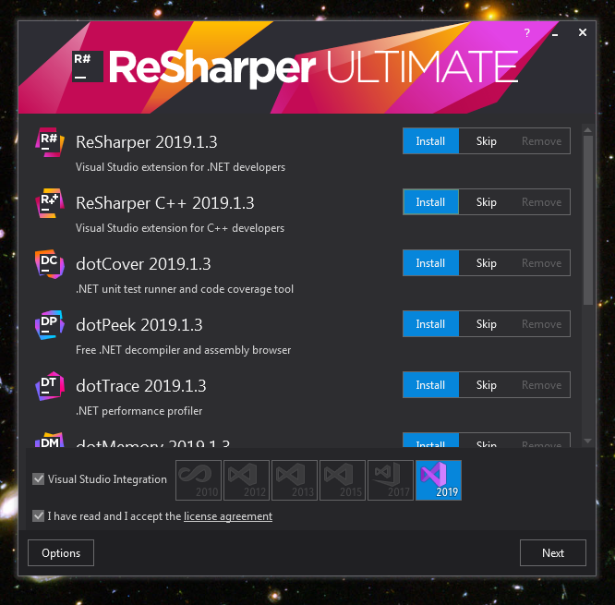
Open the Installer file
And choose the products to be installed

Slide 2
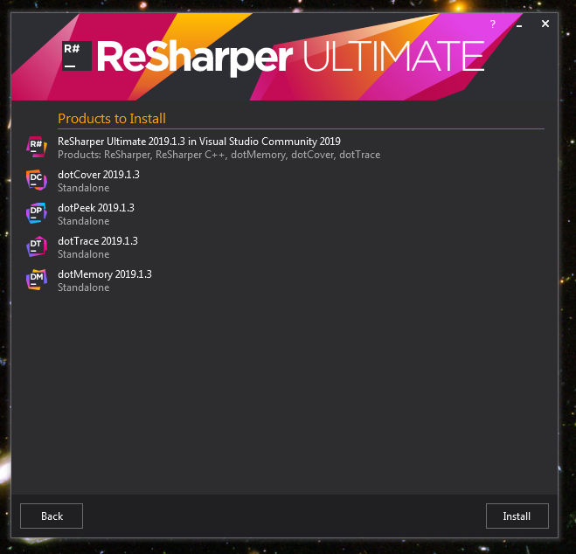
Products to be installed are shown

Slide 3
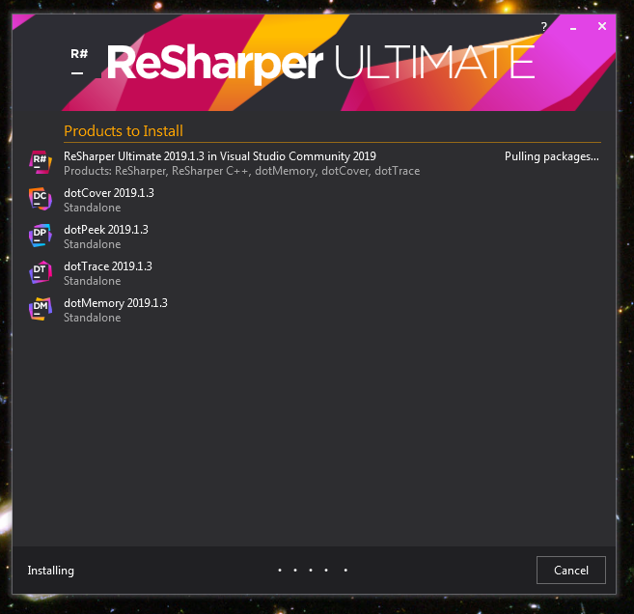
Installing in progress

