Slide 1
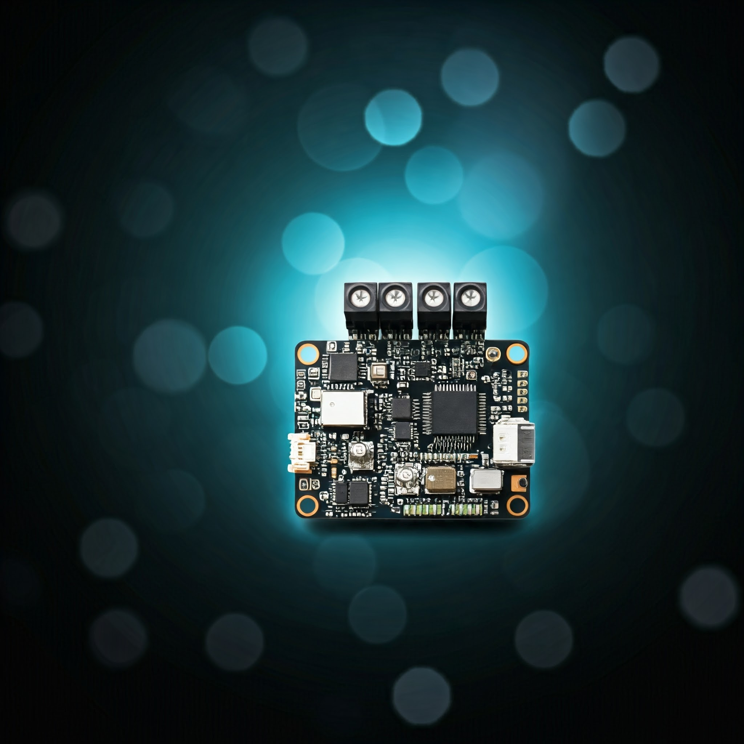
COMPUTER SCIENCE MINI-PROJECT-1 PROJECT-TITLE: INTRODUCTION TO EMBEDDED SYSTEMS
THE POWER OF TINY TECHNOLOGY
PRESENTED BY: PRAMODH NARAIN
CHANNEL: PRAMODH CODE CRAFTER
DATE: 19-11-2024

Slide 2

INTRODUCTION
What are Embedded Systems?
A combination of hardware and software designed for a dedicated function within a larger system.
Examples: LED Blinkers, medical devices, smart home appliances.
Importance of Embedded Systems in modern technology:
Enables automation, optimization, and real-time solutions across various fields.

Slide 3

KEY FEATURES OF EMBEDDED SYSTEMS
Dedicated Functionality:
Focused on a specific task.
Real-Time Operations:
Ensures timely execution of tasks.
Resource-Efficiency:
Operates within limited memory and processing power.

Slide 4
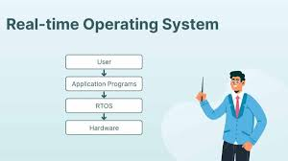
KEY TERMS IN EMBEDDED SYSTEMS
Microcontroller: The processing unit (e.g., Arduino, STM32).
Firmware: Software that controls hardware (stored in non-volatile memory).
Real-Time Operating Systems (RTOS): Manages resources for real-time tasks.

Slide 5
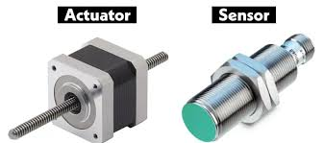
KEY TERMS IN EMBEDDED SYSTEMS
Sensors and Actuators:
Sensors: Detect environmental changes (e.g., temperature, light)
Actuators: Respond with actions (e.g., moving a motor).
Interrupts: Signals that interrupt normal execution for urgent tasks.

Slide 6
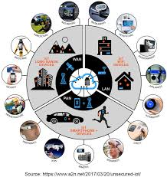
REAL-WORLD APPLICATIONS OF EMBEDDED SYSTEMS
Healthcare: Insulin pumps, ECG machines.
Automotive: Cruise control, airbag deployment systems.
Internet of Things (IoT): Smart home systems, industrial automation.
Aerospace: Flight control systems, drones.

Slide 7
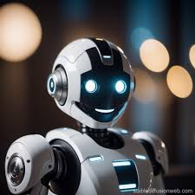
FUTURE OF EMBEDDED SYSTEMS
Emerging Trends:
AI Integration: Smarter edge services with on-chip AI.
Robotics: Advanced robots in manufacturing and healthcare.
Sustainability: Energy-efficient designs for renewable systems.

Slide 8



FUTURE OF EMBEDDED SYSTEMS
Challenges to Address:
Power Optimization
Scalability
Security concerns

Slide 9

CONCLUSION
Embedded Systems: A Powerful Force
Recap: Embedded systems are the backbone of modern tech.
Key Takeaway: Understand the fundamentals of embedded systems.
Call to Action: Explore complex embedded applications and innovate.

Slide 10
