Slide 1
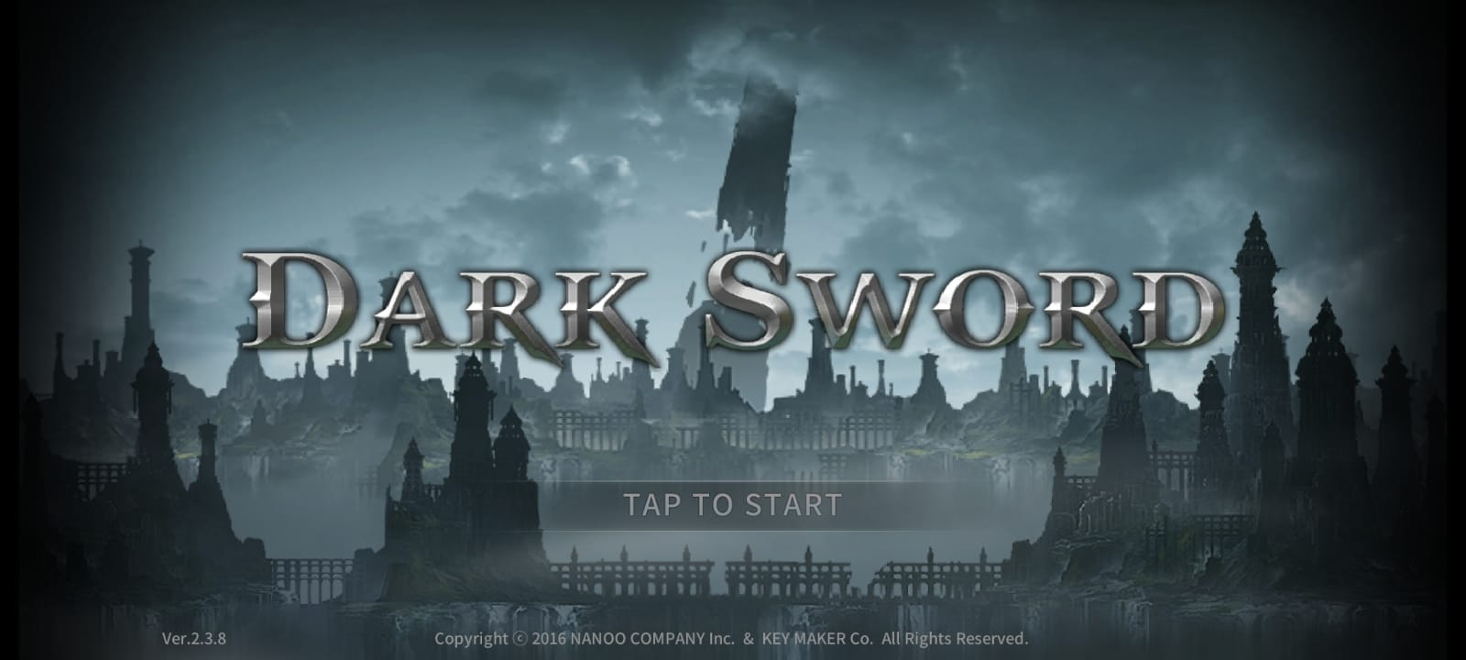
DARK SWORD GAMING MEGA SERIES PROJECT
CHAPTER-2: AN Insight into the game [prologue]
PRESENTED BY: PRAMODH NARAIN
CHANNEL: PRAMODH CODE CRAFTER
DATE: 22-11-2024

Slide 2

INTRODUCTION
Enticement: Immerse yourself in a captivating mobile game… Dark Sword!
Core Gameplay: A thrilling ARPG (Action Role-Playing Game) where you master combat as a lone warrior.
Key Features:
Challenging Gameplay
Stunning Visuals
Immersive Sound Design
Strategic Depth
h

Slide 3
MASTERING COMBAT
Intuitive Controls: Easy to learn, engaging for all skill levels
Skillfull Warrior: Master swordplay and special abilities.
Strategic Thinking: Adapt, dodge, block and counterattack.
Evolving Enemies: Bosses and foes challenge you to improve.
h

Slide 4
BEYOND THE BLADE
A World to Explore: Uncover hidden secrets and powerful artifacts.
Rich Environments: Dungeons, mysteries, and captivating stories.
Non-Player Characters: Interact with a diverse cast.

Slide 5
UNLEASHING YOUR POWER
Core Gameplay Mechanics:
Basic Attacks: The foundation of your combat arsenal.
Special Abilities: Unleash devastating attacks to defeat enemies.
Dodging and Blocking: Essential defensive manoeuvres.
Combo System: Execute chains of attacks for increased damage.
Energy Management: Balance your resource usage wisely.

Slide 6
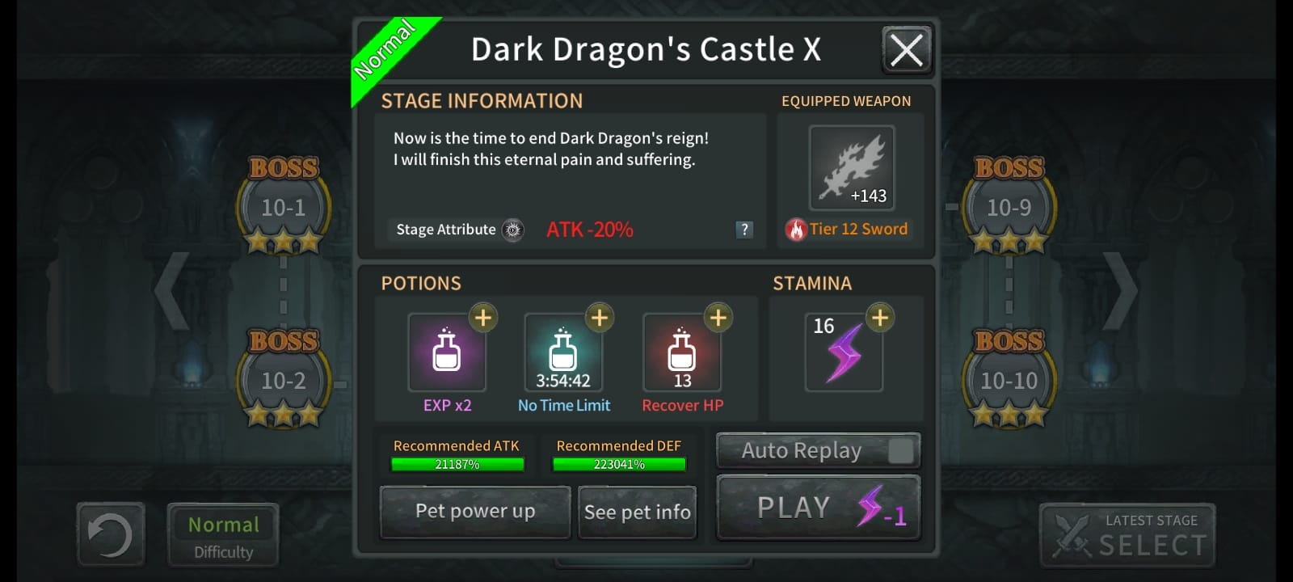
FACING THE CHALLENGE (Difficulty Levels)
Test Your Limits:
Normal: A gentle introduction to the game

Slide 7
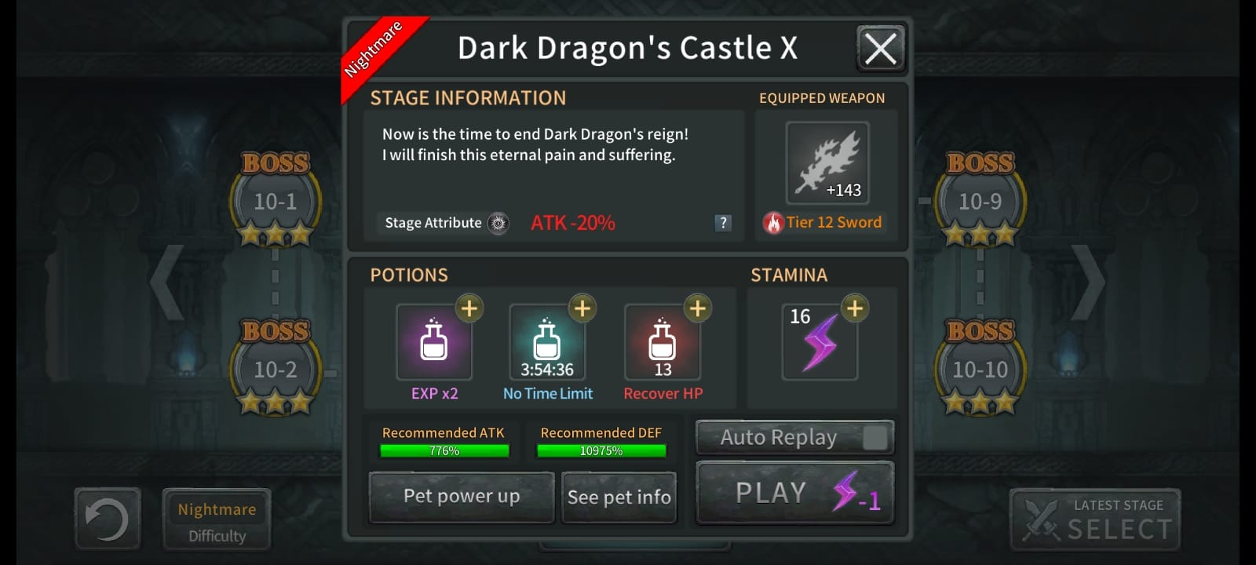
FACING THE CHALLENGE (Difficulty Levels)
Test Your Limits:
Nightmare: Increased difficulty, requiring strategic thinking.

Slide 8
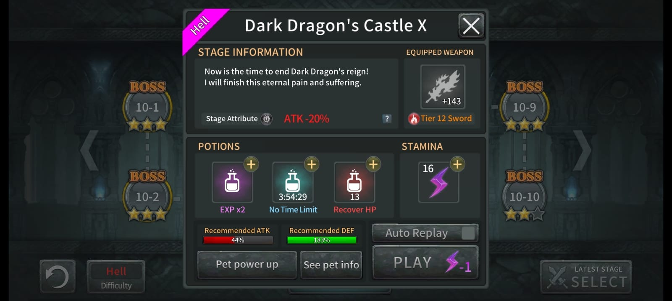
FACING THE CHALLENGE (Difficulty Levels)
Test Your Limits:
Hell: A brutal challenge for skilled players.

Slide 9
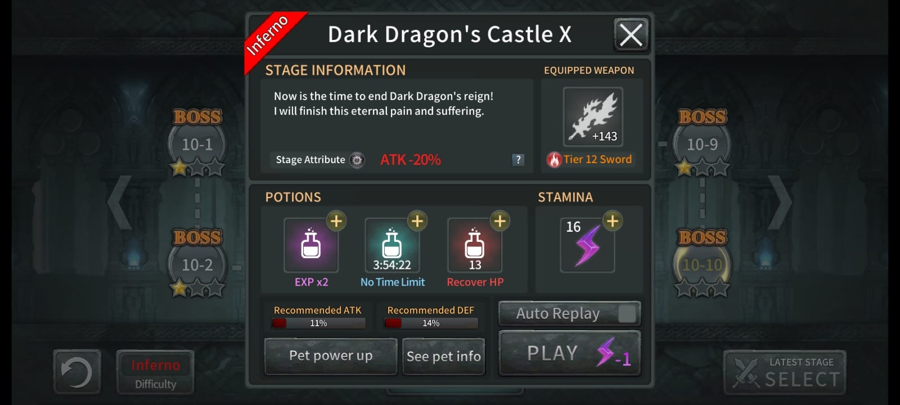
FACING THE CHALLENGE (Difficulty Levels)
Test Your Limits:
Inferno: Only for most skilled players

Slide 10
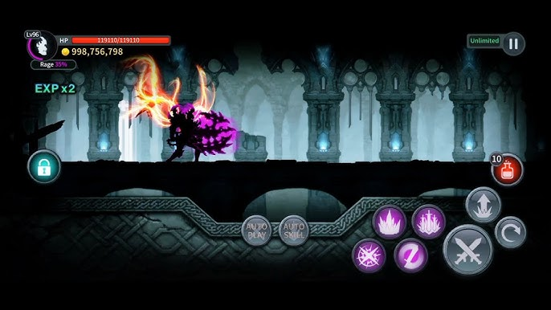
FACING THE CHALLENGE (Difficulty Levels)
Test Your Limits:
Dark: The ultimate test of your abilities with the merciless difficulty.

Slide 11
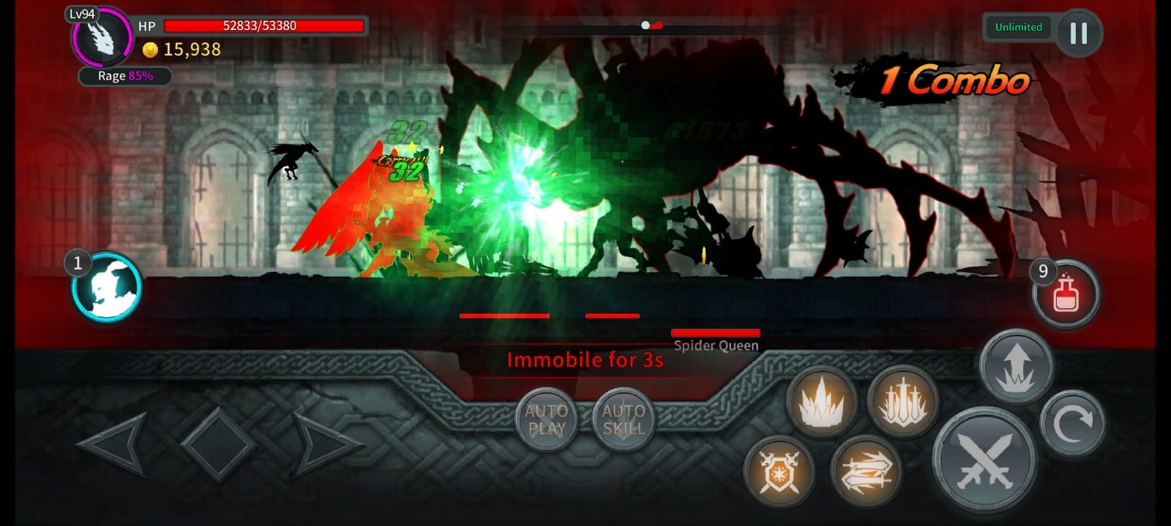
A GALLERY OF BOSSES
Following are the bosses encountered by the player as a warrior during the gameplay:
Spider: A giant arachnid with venomous attacks and web-spinning abilities.

Slide 12
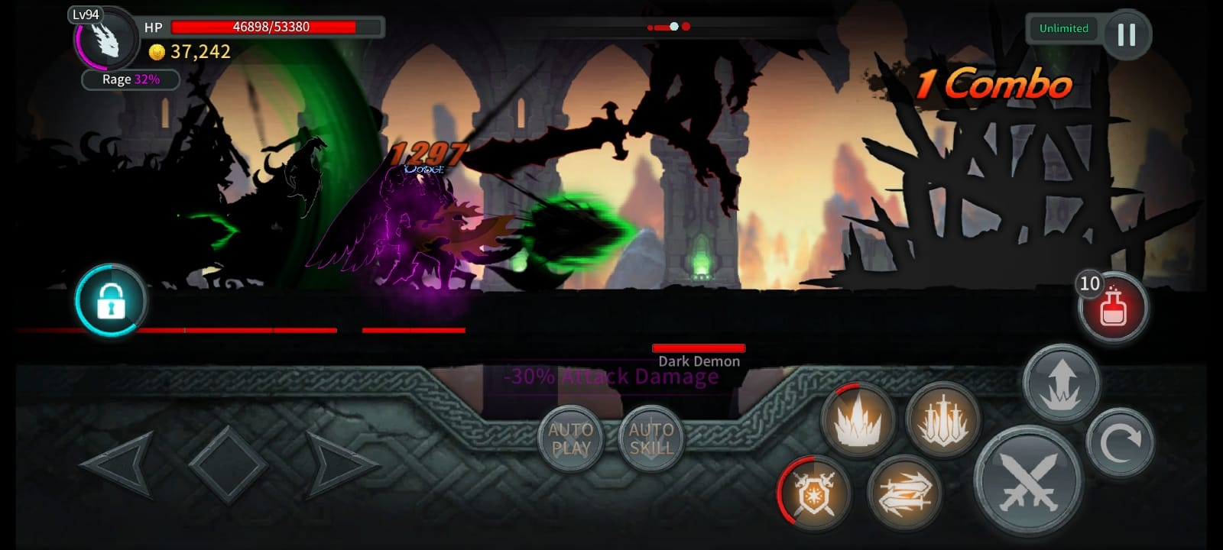
A GALLERY OF BOSSES
Following are the bosses encountered by the player as a warrior during the gameplay:
Dark Demon: A demonic entity that summons dark energy and wields powerful melee attacks.

Slide 13
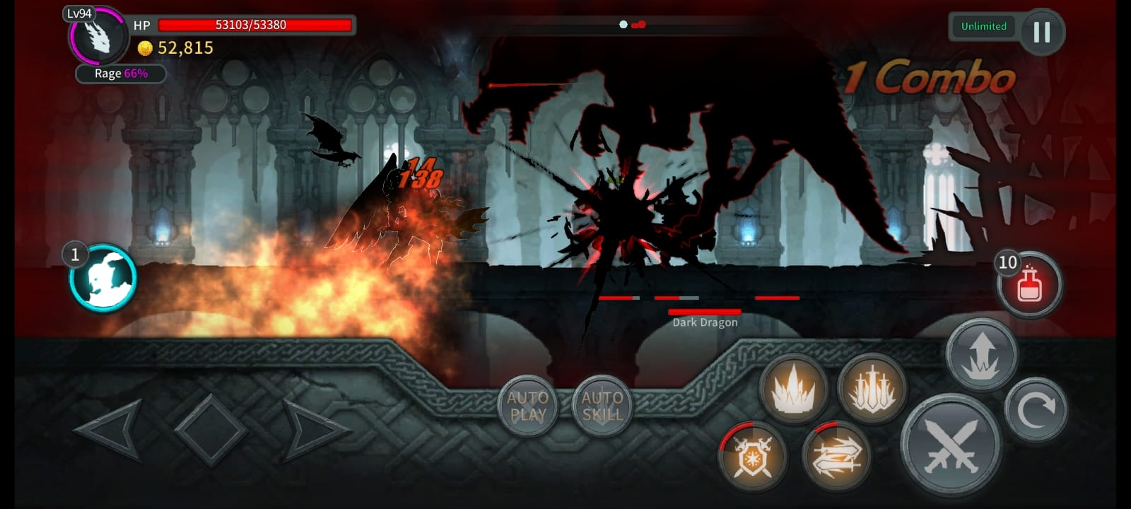
A GALLERY OF BOSSES
Following are the bosses encountered by the player as a warrior during the gameplay:
Dark Dragon: A fearsome dragon that can fly and unleash devastating fire breath.

Slide 14
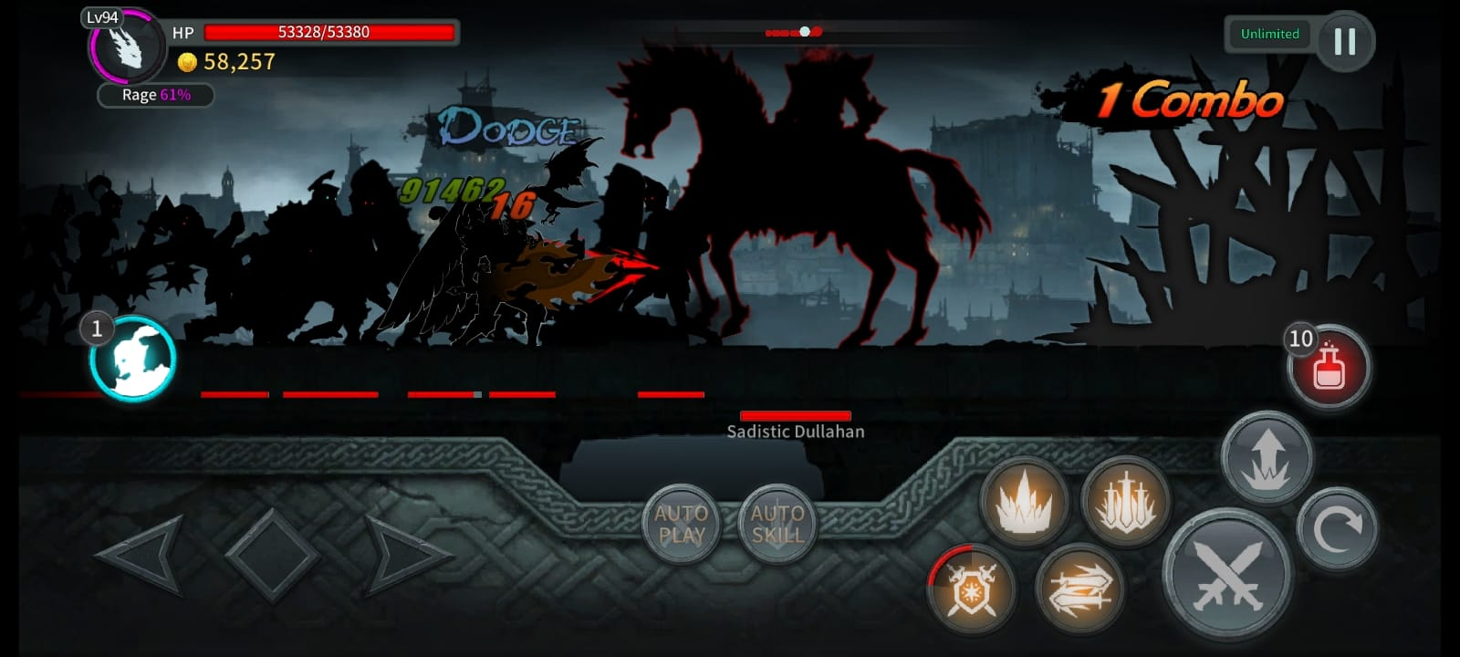
A GALLERY OF BOSSES
Following are the bosses encountered by the player as a warrior during the gameplay:
Sadistic Dullahan: A headless horseman with a flaming sword and teleportation abilities.

Slide 15
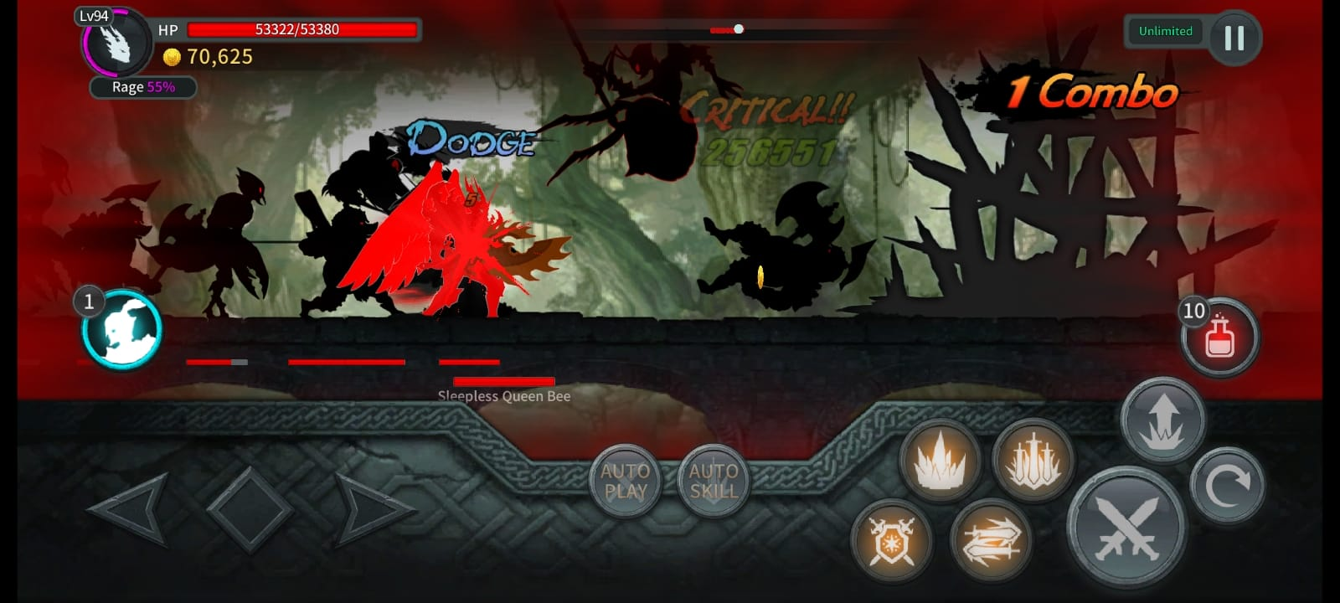
A GALLERY OF BOSSES
Following are the bosses encountered by the player as a warrior during the gameplay:
Queen Honey Bee: A giant bee that controls a swarn of smaller bees

Slide 16
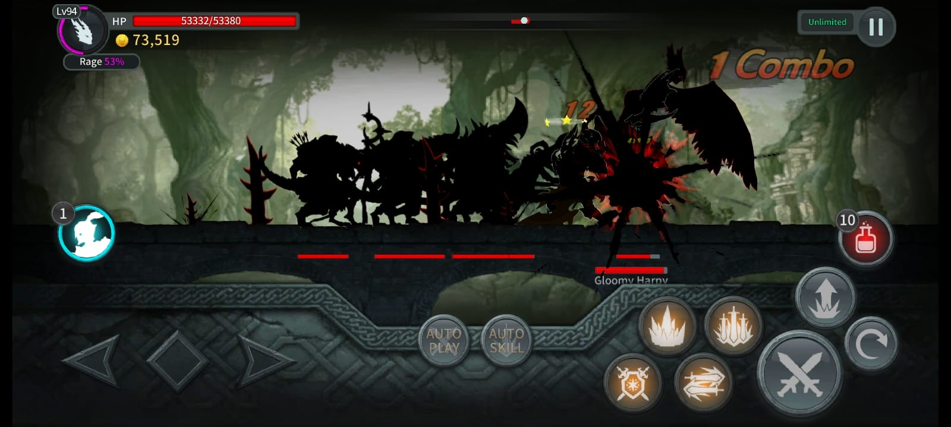
A GALLERY OF BOSSES
Following are the bosses encountered by the player as a warrior during the gameplay:
Gloomy Harpy: A bird-like creature that can fly and spit venomous light in order to reduce the life of the warrior or the player

Slide 17
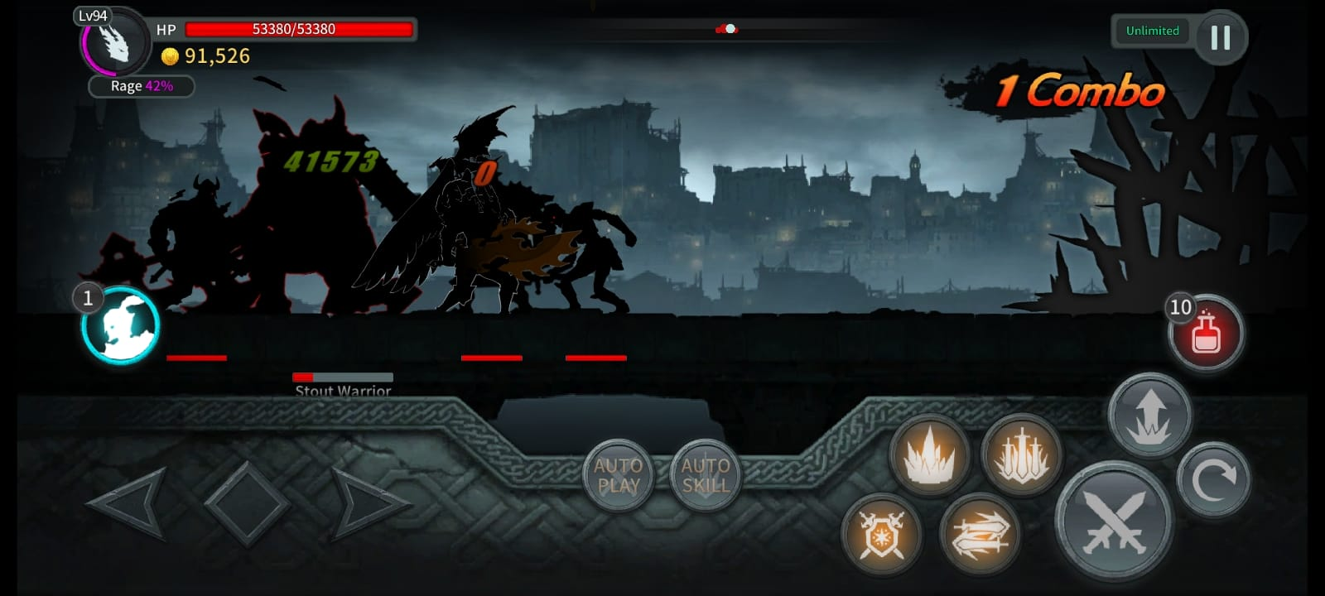
A GALLERY OF BOSSES
Following are the bosses encountered by the player as a warrior during the gameplay:
Stout Warrior: A heavily armoured warrior with a powerful shield and sword.

Slide 18
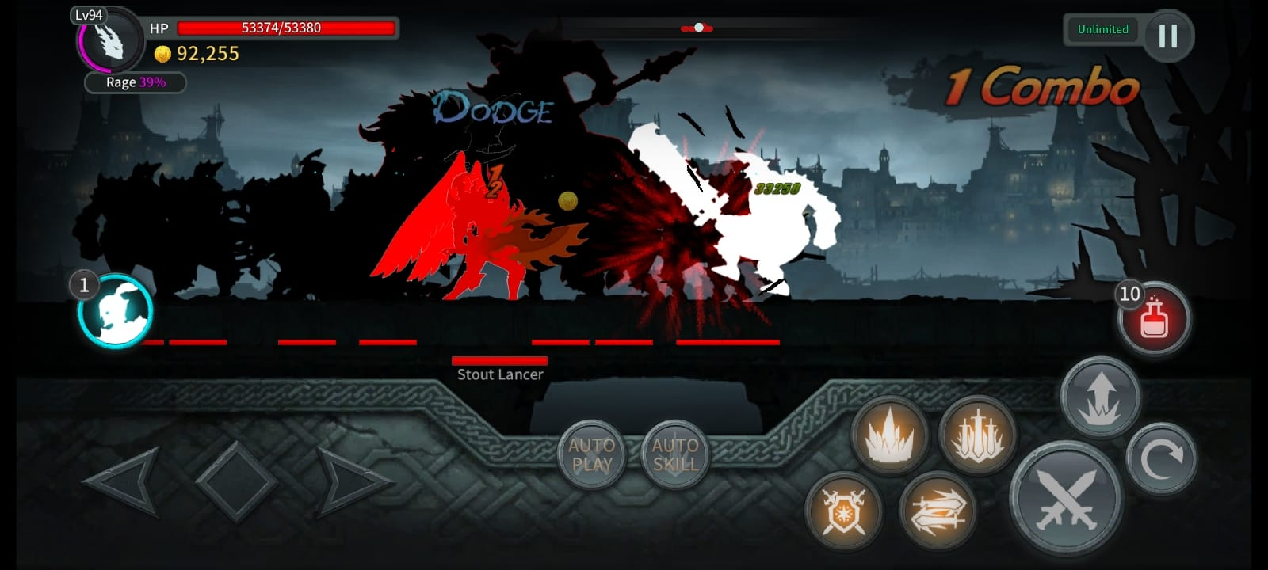
A GALLERY OF BOSSES
Following are the bosses encountered by the player as a warrior during the gameplay:
Stout Lancer: A knight armed with a long lance and heavy armour.

Slide 19
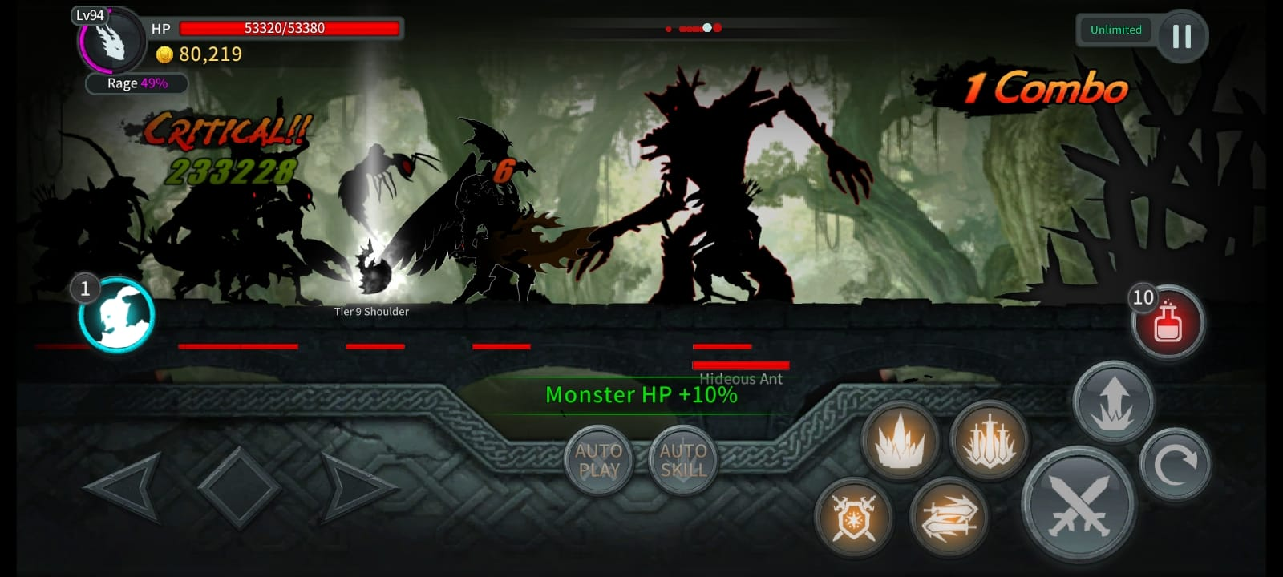
A GALLERY OF BOSSES
Following are the bosses encountered by the player as a warrior during the gameplay:
Hideous Ant: A giant ant with powerful mandibles and very sharp nails that cut through the warrior’s body and defeat them.

Slide 20
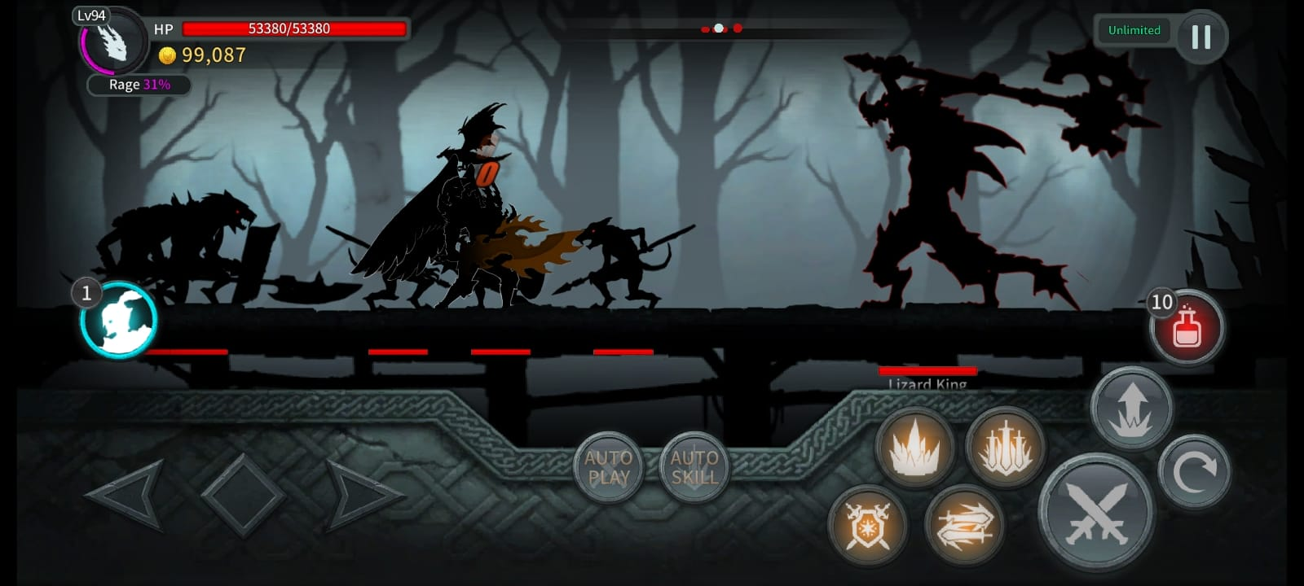
A GALLERY OF BOSSES
Following are the bosses encountered by the player as a warrior during the gameplay:
Lizard King: A reptilian creature with sharp claws and a poisonous tail.

Slide 21
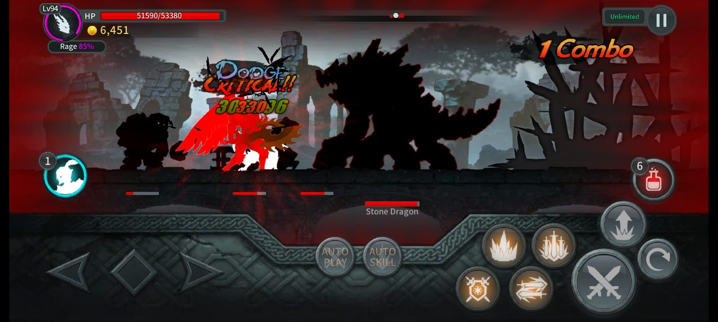
A GALLERY OF BOSSES
Following are the bosses encountered by the player as a warrior during the gameplay:
Stone Dragon: This colossal creature is a fearsome opponent with devastating attacks.

Slide 22
MASTERING THE BLASÉ (SWORD SKILLS)
Following are the sword skills which we will come across in the stunning game of Dark Sword !!!
Sword Quake: A powerful ground-shaking attack.
Crystal Shock: Pierce through enemy defences with this high-damage strike.
Lightning Strike: A lightning-fast attack that stuns enemies.
Crown of Pain: Inject harmful weed plant’s thorns into enemies.
Soul Breaker: Unleash a barrage of souls to attack enemies.
Infinity Shield: A protective barrier that can withstand damage to any extreme!!!
Dark Hole: Release toxic gas to drain enemy health.
Bloody Kiss : Summon a swarm of bats to attack enemies.

Slide 23
WHO PLAYS DARK SWORD ? (TARGET AUDIENCE)
A GAME FOR ALL !!! ;)
Core Demographic: Young adults and teenagers who enjoy action-packed games.
Gaming Preferences: Fast-paced combat, challenging levels, and strategic gameplay.

Slide 24

SHARPEN YOUR MIND (BENEFITS OF PLAYING)
MORE THAN JUST A GAME !!!
Cognitive Benefits: Improve problem-solving, decision-making, and spatial awareness.
Strategic Thinking: Develop critical thinking skills to overcome challenges.
Stress Relief: Immerse yourself in a captivating world and unwind.
Social Interaction: Connect with other players and build friendships.

Slide 25

SHARPER THAN EVER (CONTINUED BENEFITS)
MORE THAN JUST A GAME !!!
Logical Thinking: Analyze situations and make informed decisions.
Reasoning Ability: Deduce solutions to complex puzzles.
By playing Dark Sword you’ll not only have fun but also develop valuable skills.

Slide 26

A JOURNEY OF DARKNESS AND REWARDS (CONCLUSION)
Immerse yourself in a captivating world filled with danger and excitement.
Face challenging bosses and master powerful sword skills.
Develop your strategic thinking and problem-solving abilities
Call to Action: Download Dark Sword today and start your journey!

Slide 27

Thank you viewers!!!
Thank you!!! For your attention.
We appreciate your time and interest in our presentation
Please feel free to leave your questions in the comments section of this video.
We will be happy to answer any questions you may have
Thank you so much again for your attention
We hope you found our presentation informative and engaging.

Slide 28


