Slide 1
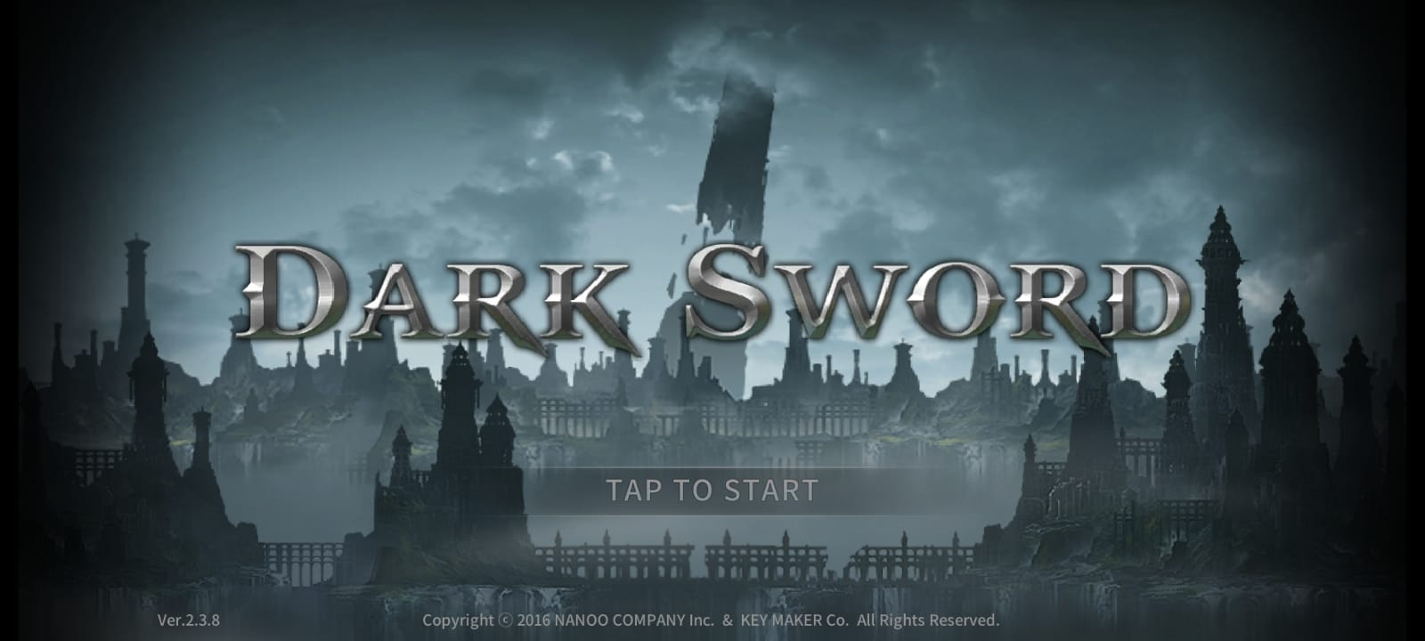
DARK SWORD GAMING MEGA SERIES PROJECT
CHAPTER-1: AN INTRO TO DARK SWORD
PRESENTED BY: PRAMODH NARAIN
CHANNEL: PRAMODH CODE CRAFTER
DATE: 18-11-2024

Slide 2
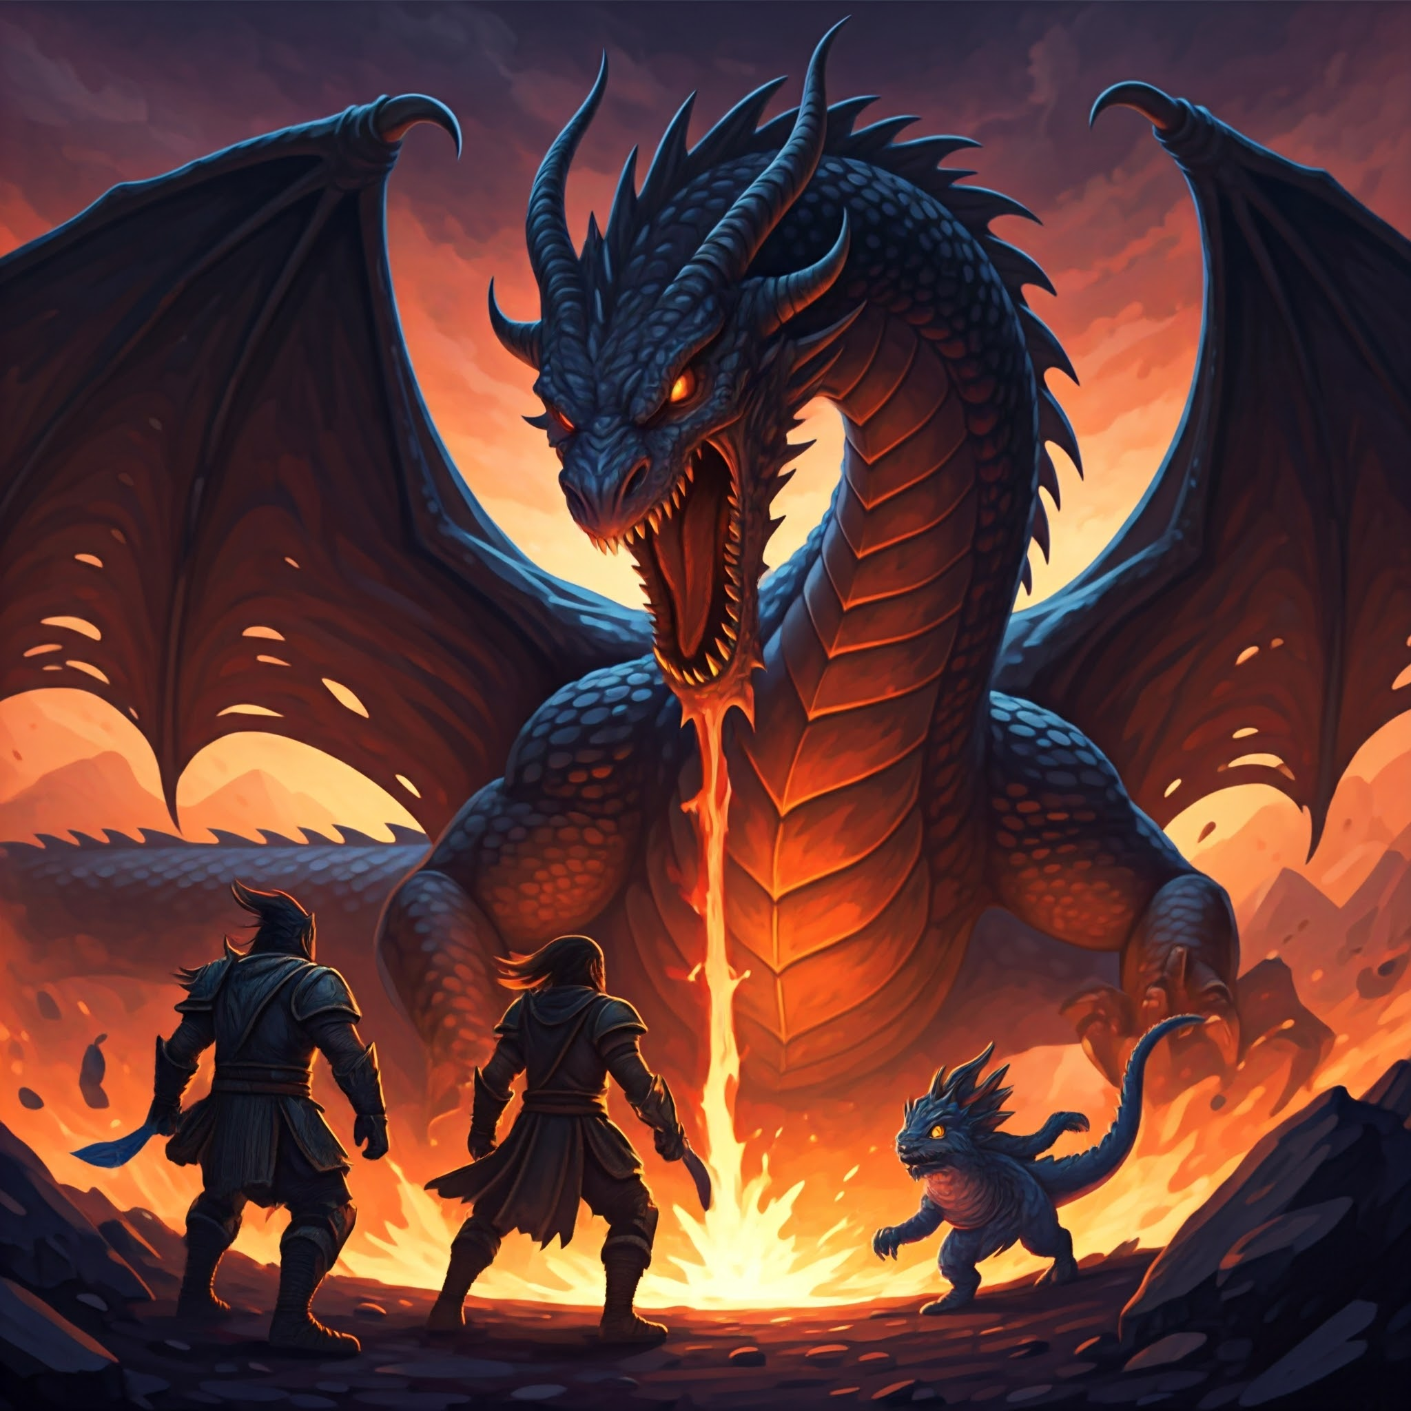
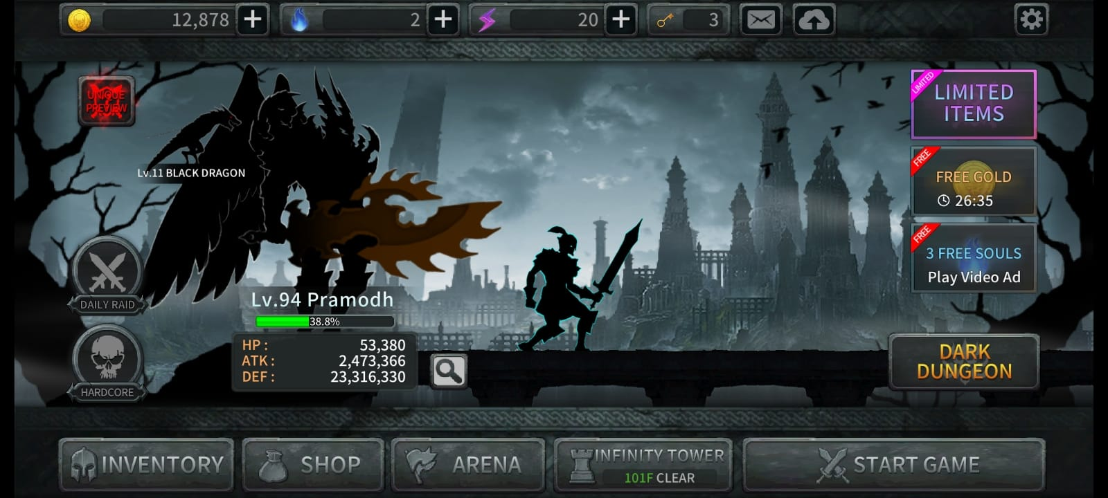
INTRODUCTION
Dark Sword: A New Era of RPGs (Role Playing Games):
Immerse yourself in a world of darkness and light.
Embark on an epic journey filled with challenges and rewards.
Experience thrilling combat, deep character customization, and a captivating storyline.

Slide 3
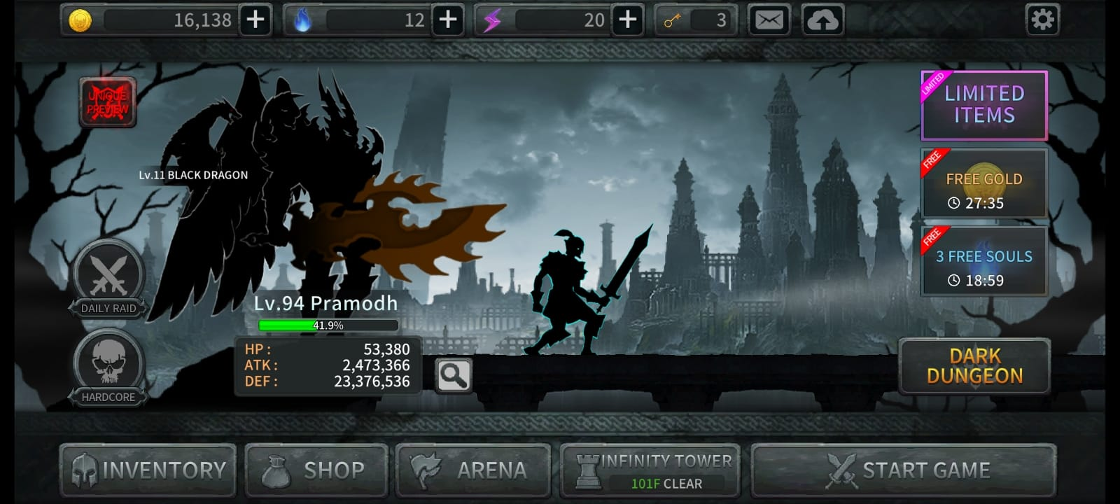
CORE GAMEPLAY
Character Progression:
Level up your hero, unlock powerful abilities, and customize your playstyle.
Gold and Souls:
Acquire and manage resources to enhance your character and equipment.
Inventory:
Strategically equip weapons, armour, and items to overcome challenges.

Slide 4
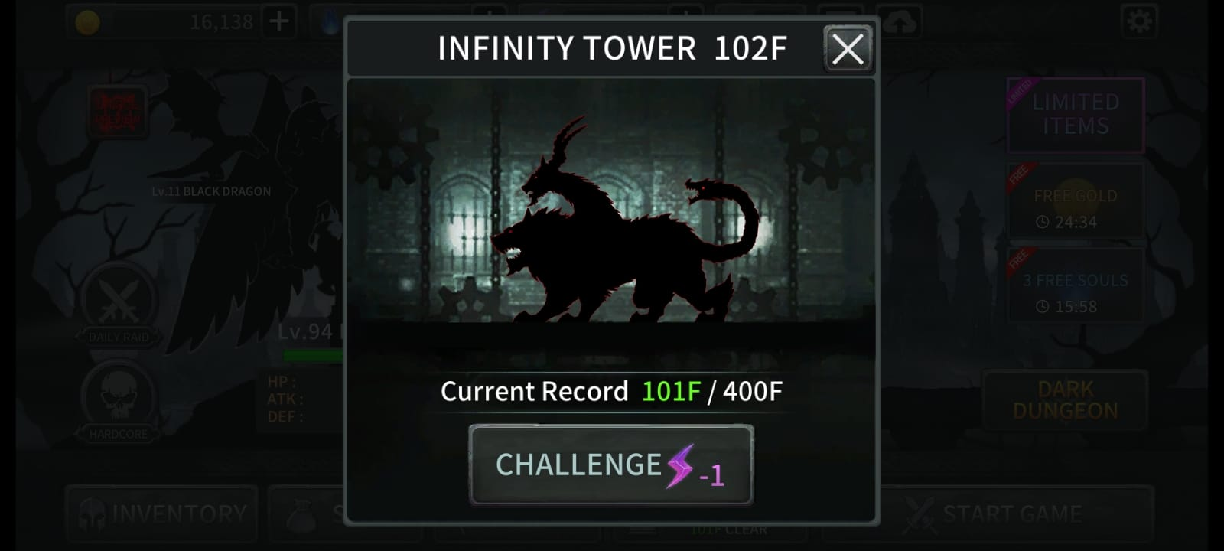
GAME MODES AND CHALLENGE
Infinity Tower:
Climb the infinity tower, facing increasingly difficult foes.

Slide 5
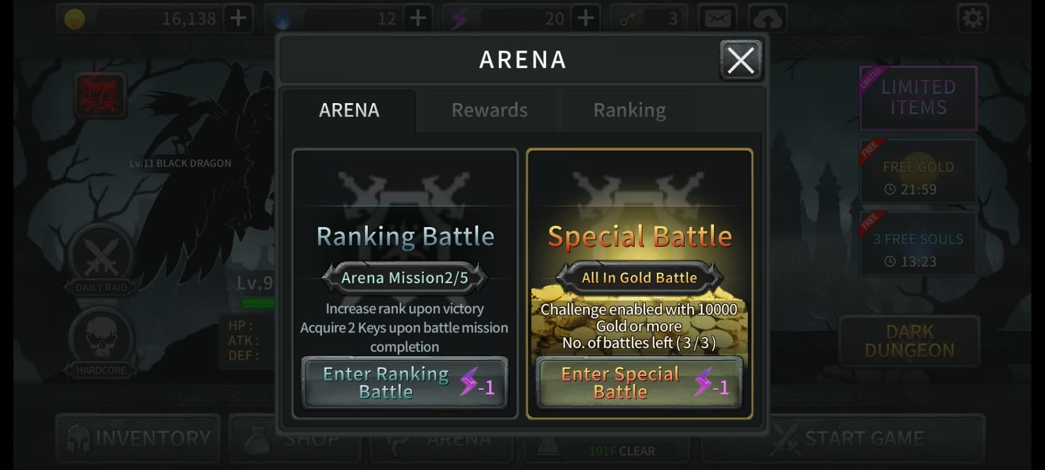
GAME MODES AND CHALLENGE
Arena:
Test your skills against other players in intense PvP battles.

Slide 6
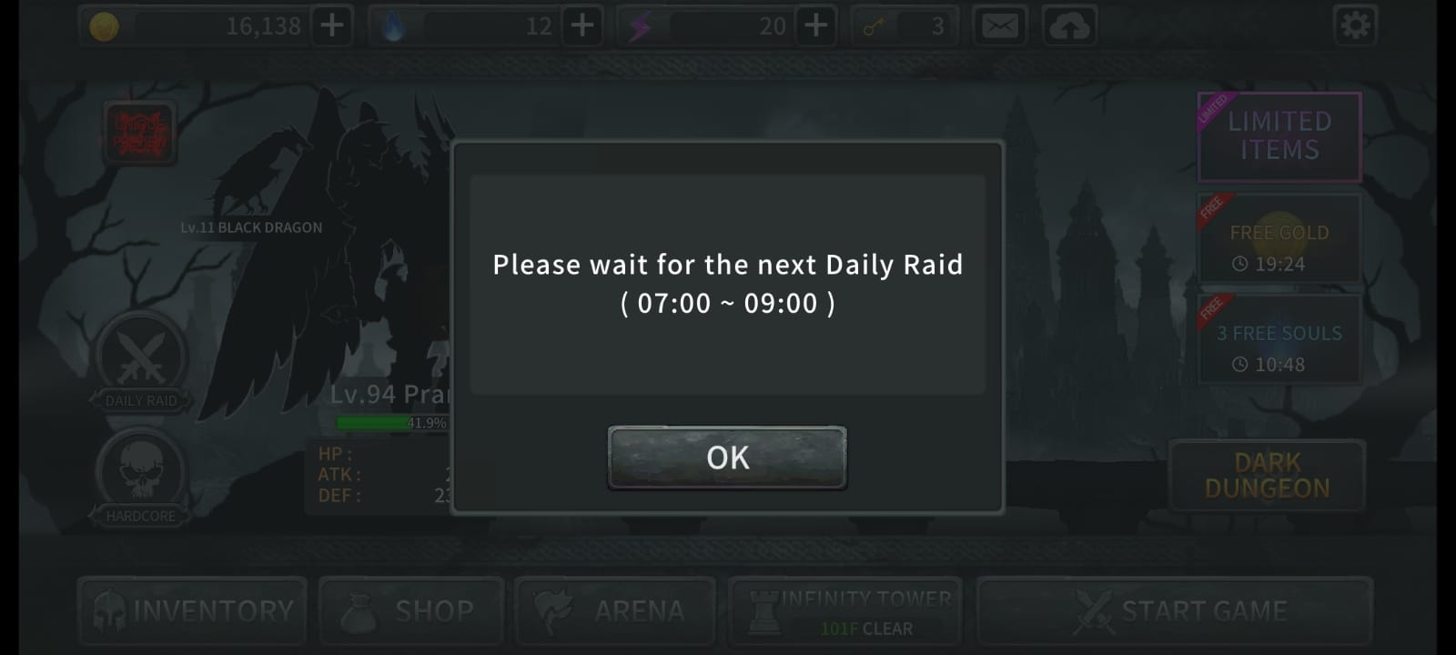
GAME MODES AND CHALLENGE
Daily Raid:
Team up with friends to defeat powerful bosses and earn rare loot.

Slide 7
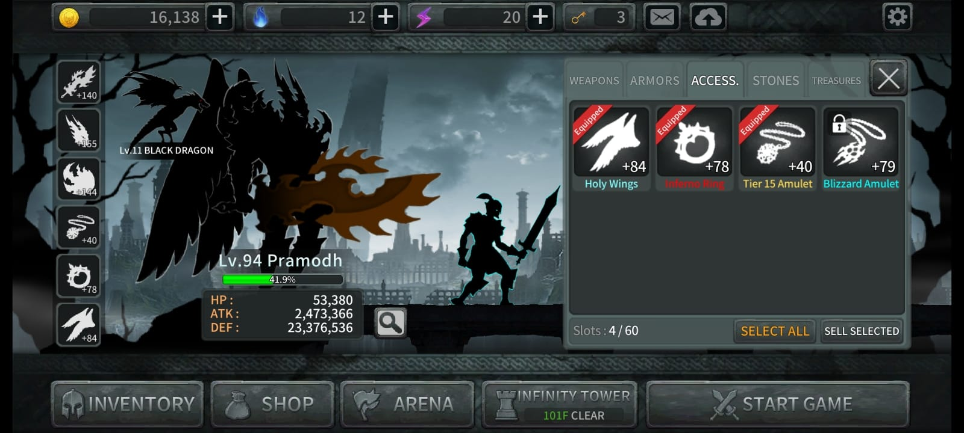
GAMEPLAY MECHANICS
Combat System:
Master the art of swordplay and magic to defeat enemies
Skill Tree:
Customize your character’s abilities to suit your playstyle.
Loot System:
Discover powerful weapons, armour, and artifacts.
Boss Battles:
Confront fearsome creatures and overcome their unique challenges.

Slide 8
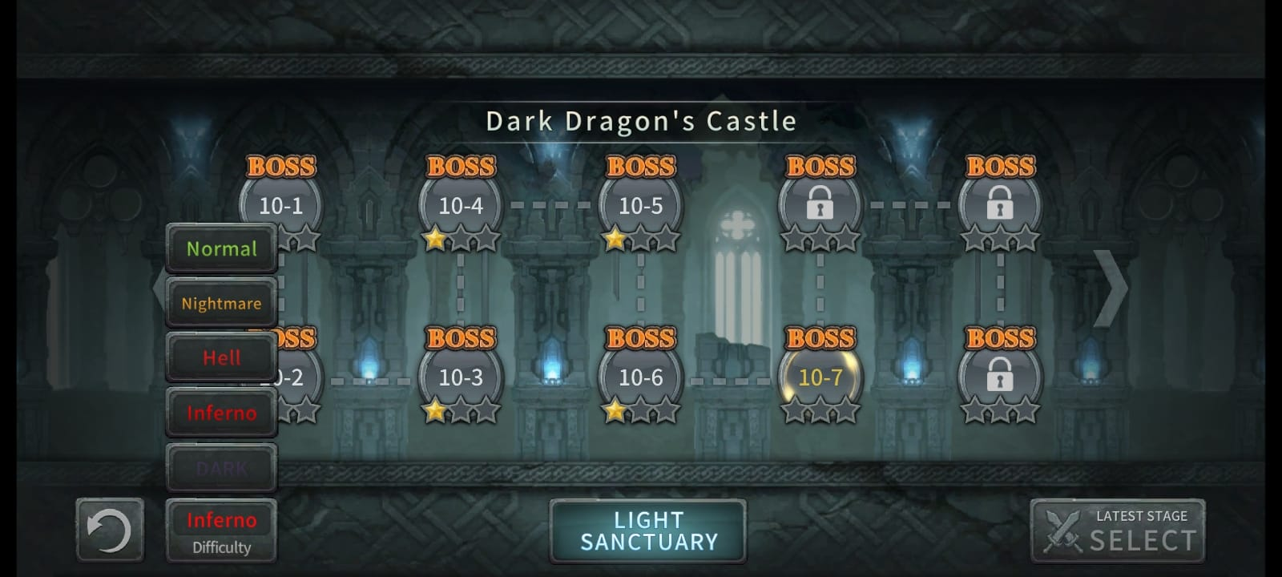
GAMEPLAY MECHANICS
Difficulty Levels:
Normal:
A balanced experience for new
players.
Nightmare:
Increased challenge with
tougher enemies and more
complex mechanics.
Hell:
Brutal difficulty with relentless
enemies and deadly traps.
Inferno:
Extremely difficult, requiring
precise timing and strategic
thinking.
Dark:
The ultimate test of skill, with
punishing difficulty and
unforgiving consequences.

Slide 9
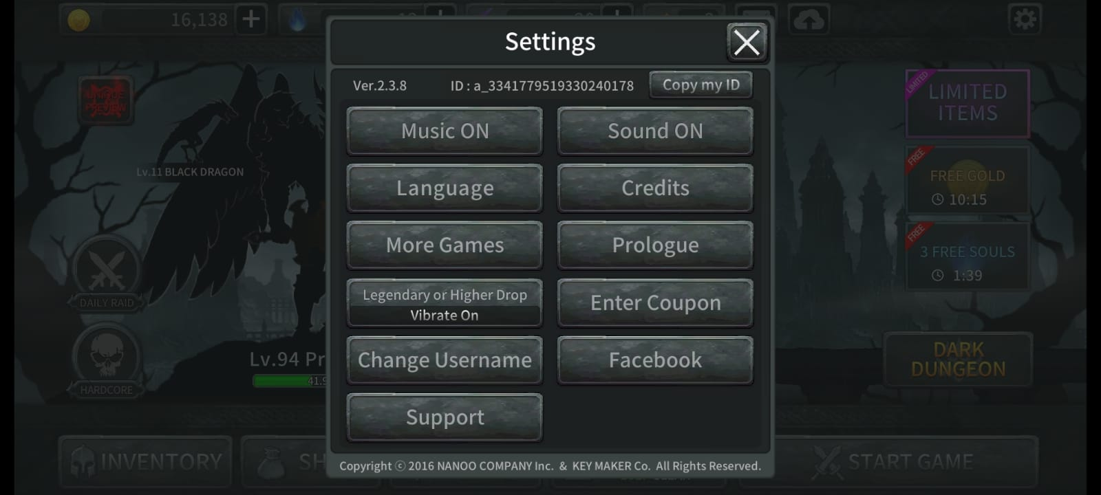
TECHNICAL IMPLEMENTATION
Game Engine:
Unity
Programming Language:
C#
Art and Design:
High-quality visuals and immersive atmosphere.
Sound and Design:
Immersive audio experience with dynamic sound effects and music.

Slide 10
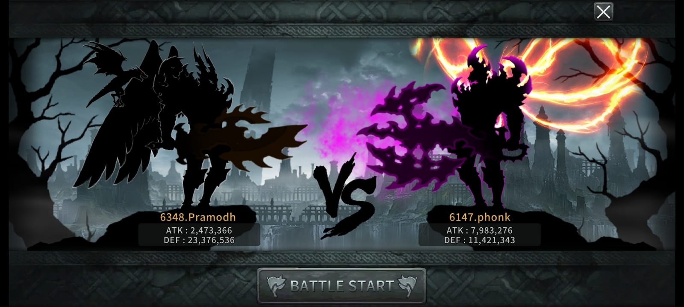
CHALLENGES AND SOLUTIONS
Performance Optimization:
Strategies to ensure smooth gameplay on various devices.
Multiplayer Synchronization:
Finding the right balance between challenge and accessibility.
Balancing Difficulty:
Finding the right balance between challenge and accessibility.
Teamwork and Collaboration:
Effective teamwork and communication within the development.

Slide 11
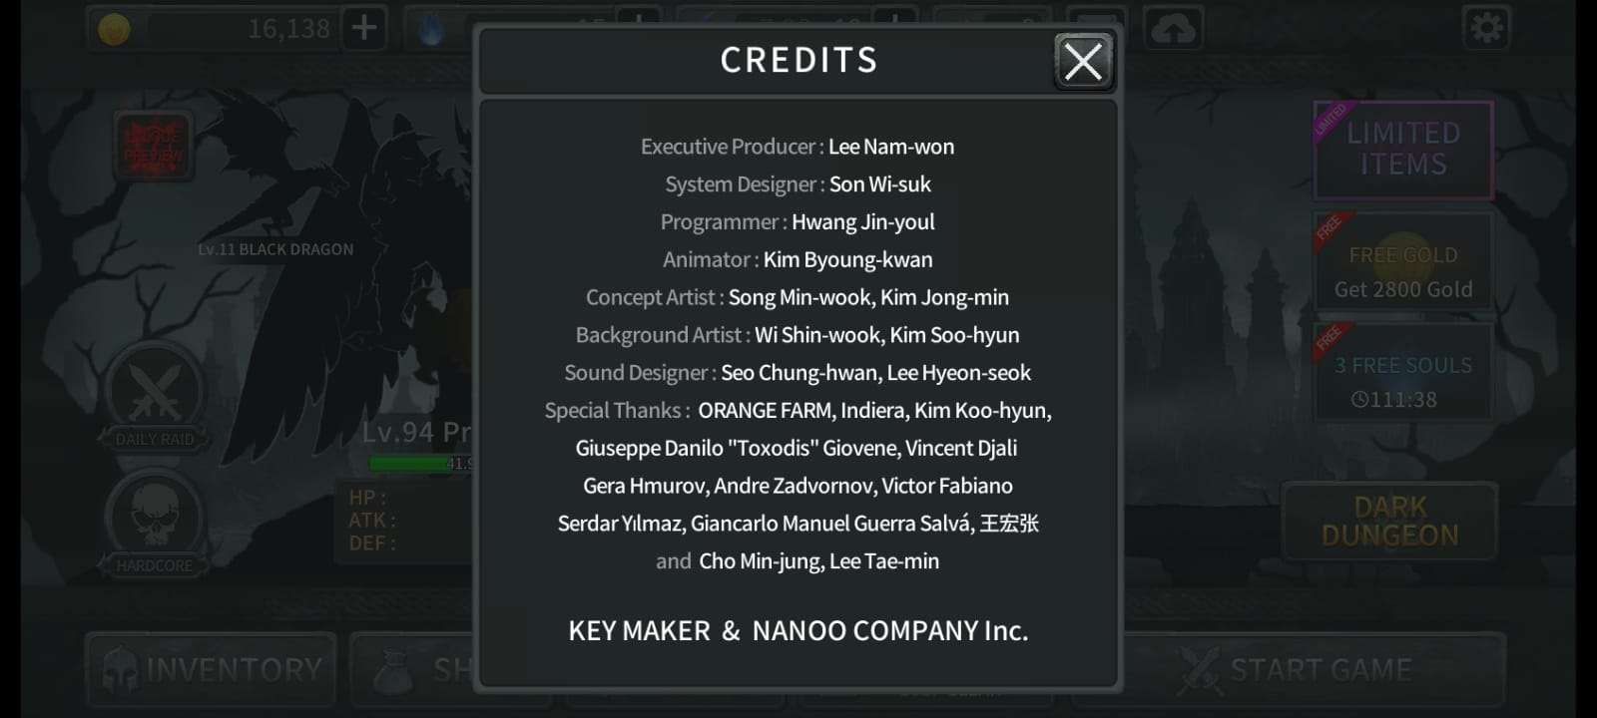
FUTURE PLANS
Expansion and DLC [Downloadable content]:
Introducing new content and features.
Community Engagement:
Building a strong and active community.
Continuous Improvement:
Listening to player feedback and iterating on the game.

Slide 12
CONCLUSION
Recap of Key Points:
Summarizing the main features of Dark Sword Game.
Thank you Audience!!!
I sincerely express my gratitude towards the audience for staying with me till the end of this Dark Sword Game project series.
Thanks a lot to all of my viewers and subscribers!!!
Call to Action:
I would encourage my dearest viewers to try thos superb game, provide feedback and also join the community.

Slide 13
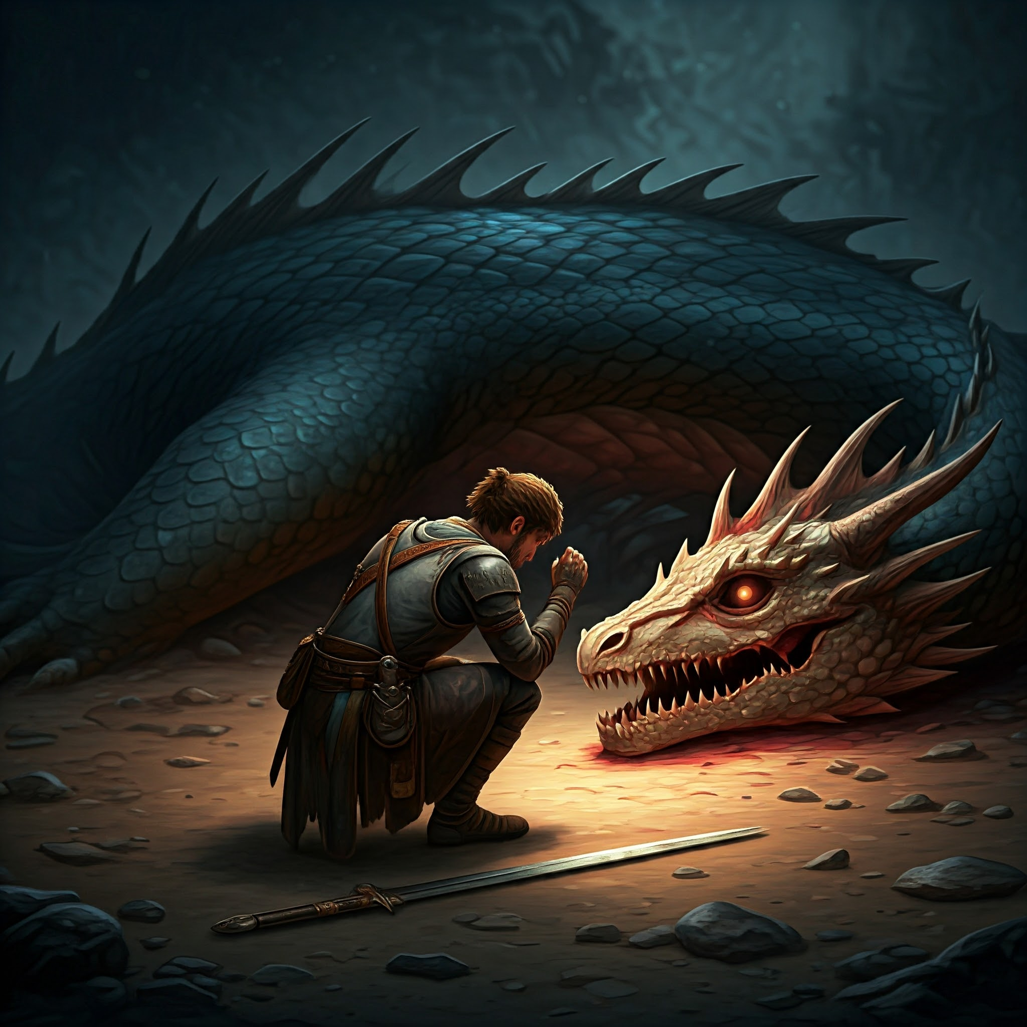
THANK YOU ALL
FOR WATCHING THE PROJECT
THE END WITH ME!!!

