Slide 1
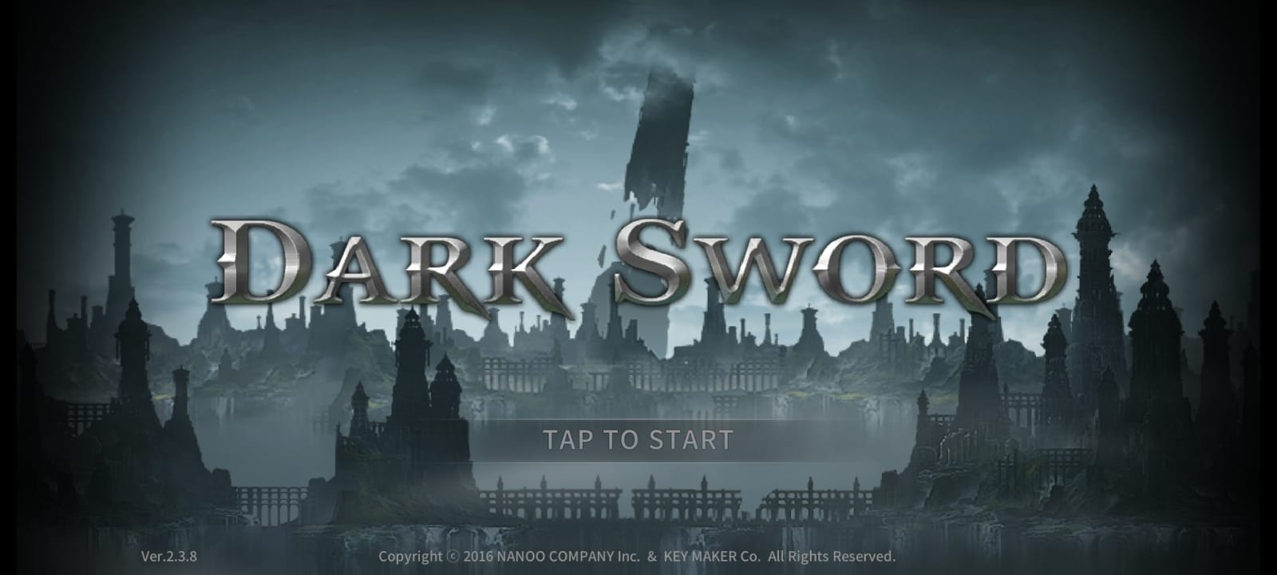
DARK SWORD GAMING MEGA SERIES PROJECT
CHAPTER-3: A QUICK GLIMPSE INTO THE RUINS OF
DARK DUNGEON
PRESENTED BY: PRAMODH NARAIN
CHANNEL: PRAMODH CODE CRAFTER
DATE: 30-11-2024

Slide 2
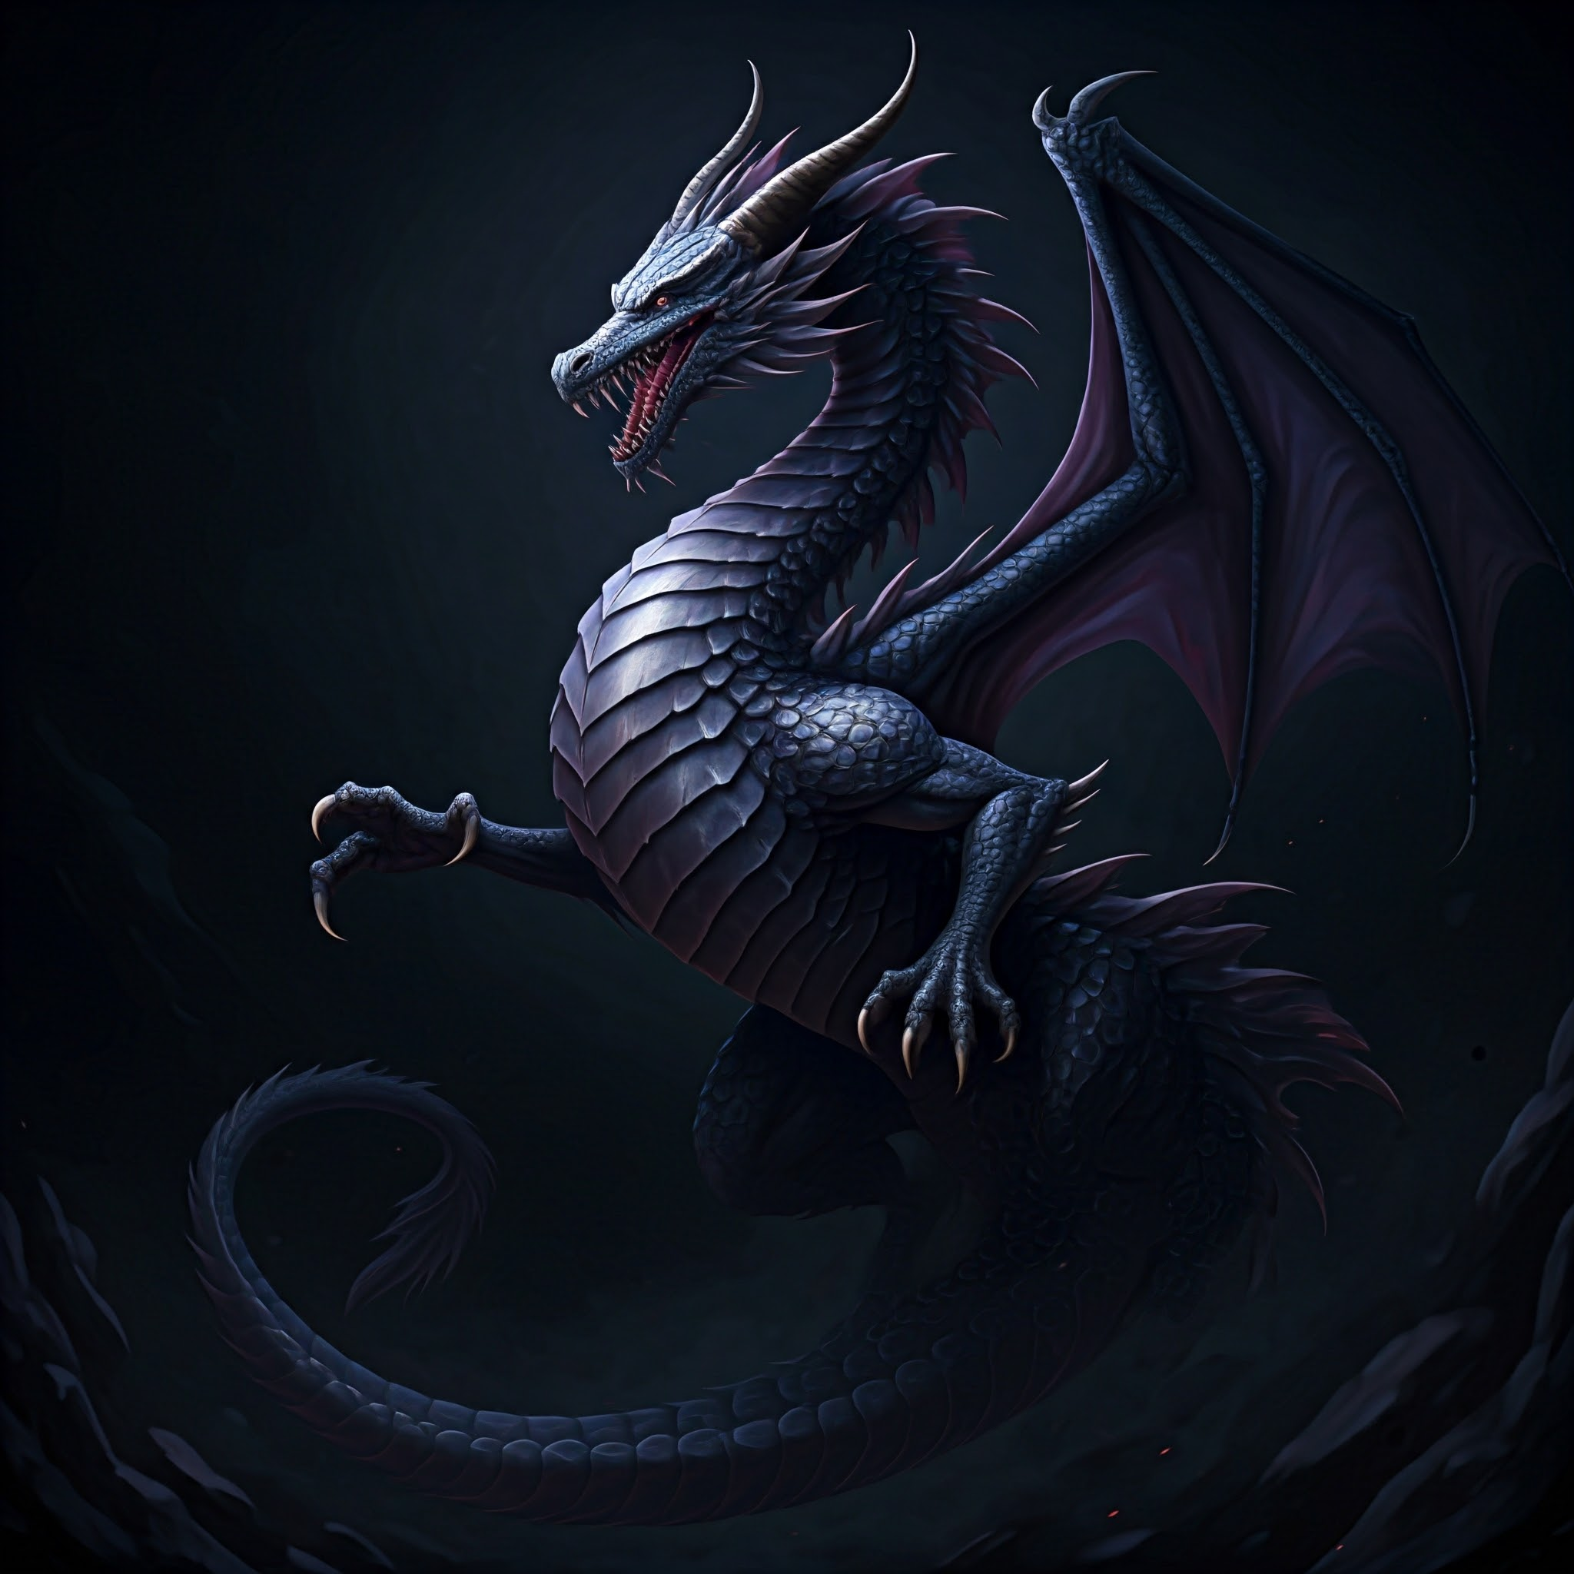
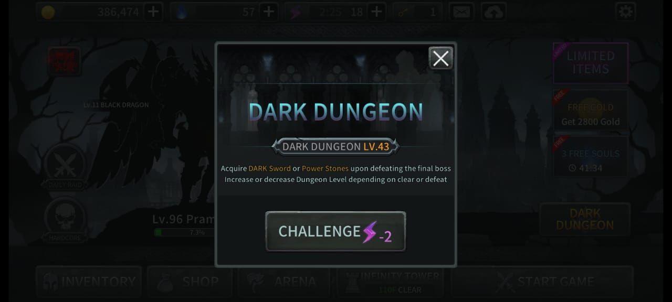
INTRODUCTION

Slide 3
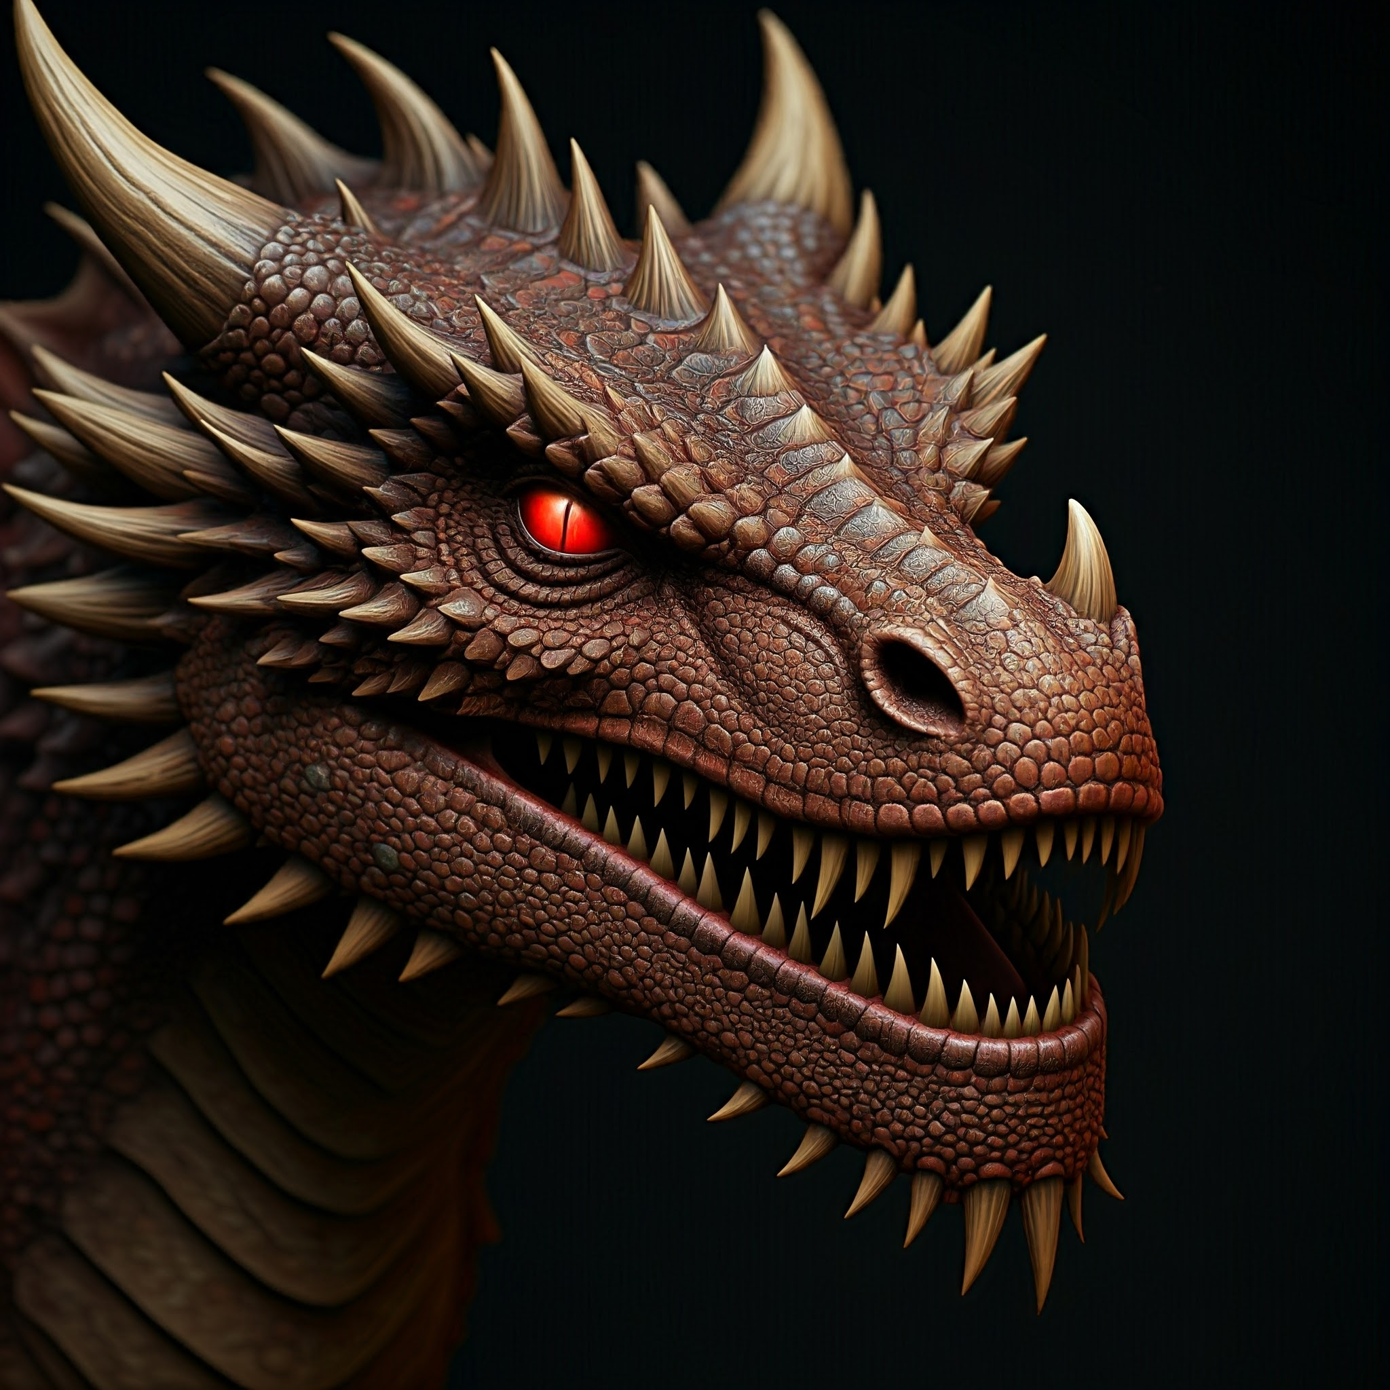
INTRODUCTION
  A mysterious and unexplored ruin
  Filled with ancient secrets and untold dangers
  A place of shadows and whispers
  Home to creatures of darkness and despair
  A challenge for the brave and the bold
  JOIN US ON A JOURNEY INTO THE HEART OF DARKNESS
  h

Slide 4
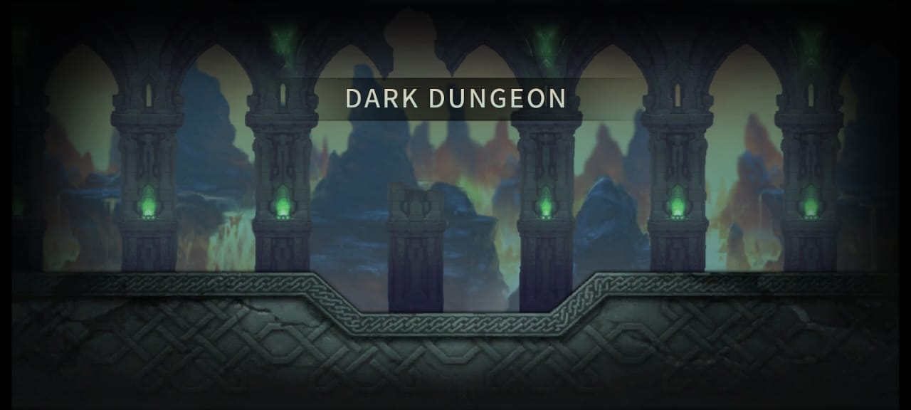
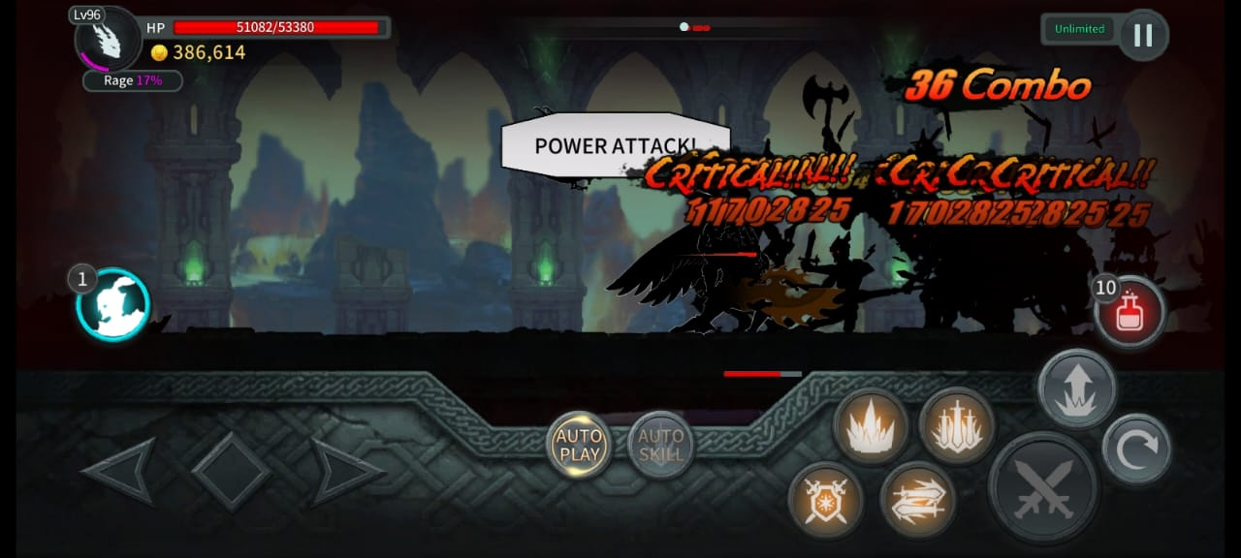
THE DARK DUNGEON: A GLIMPSE INTO THE ABYSS
  Why “Dark Dungeon”?
  Named for its perpetual darkness and ominous aura
  A place where light fears to tread
  A labyrinth of shadows, concealing ancient secrets
  h

Slide 5
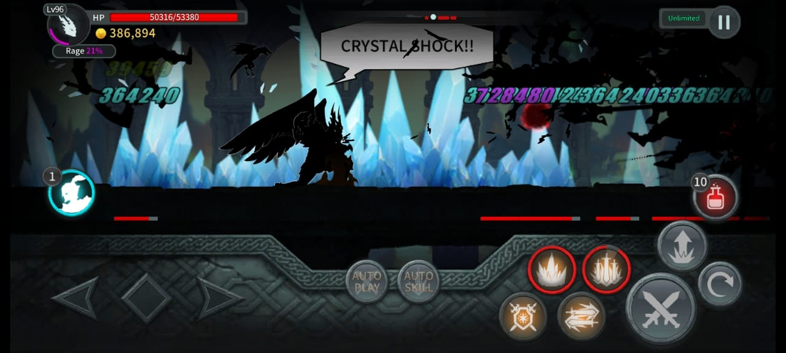
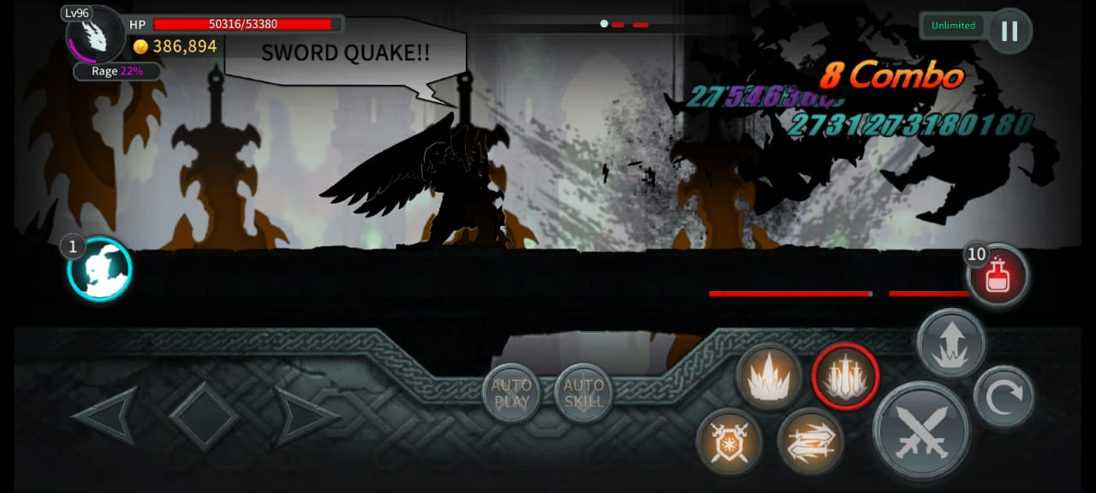
THE DARK DUNGEON: A GLIMPSE INTO THE ABYSS
  A Ruin of “Unholy Power”:
  A once-grand structure, now corrupted by evil.
  Filled with decaying remnants of a forgotten civilization
  A breeding ground for grotesque creatures and twisted begins

Slide 6
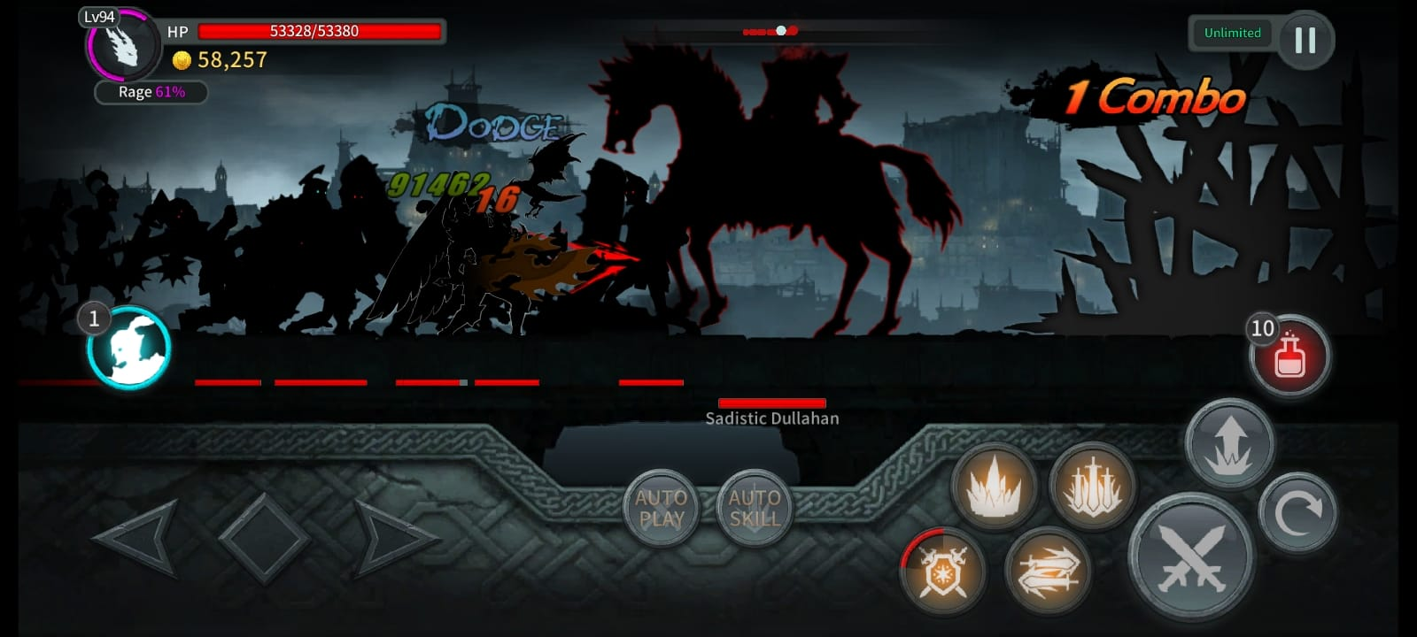
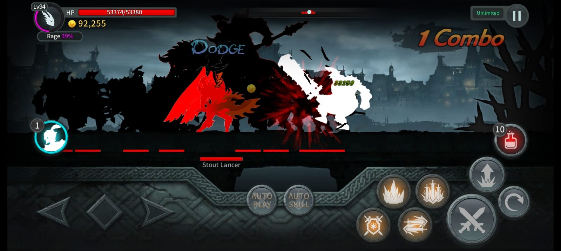
THE DARK DUNGEON: A GLIMPSE INTO THE ABYSS
  The Monsters within:
  Guardians of the Dark Dungeon, twisted by darkness
  Creatures born from nightmares, hungry for souls
  A deadly gauntlet for any who dare to enter

Slide 7
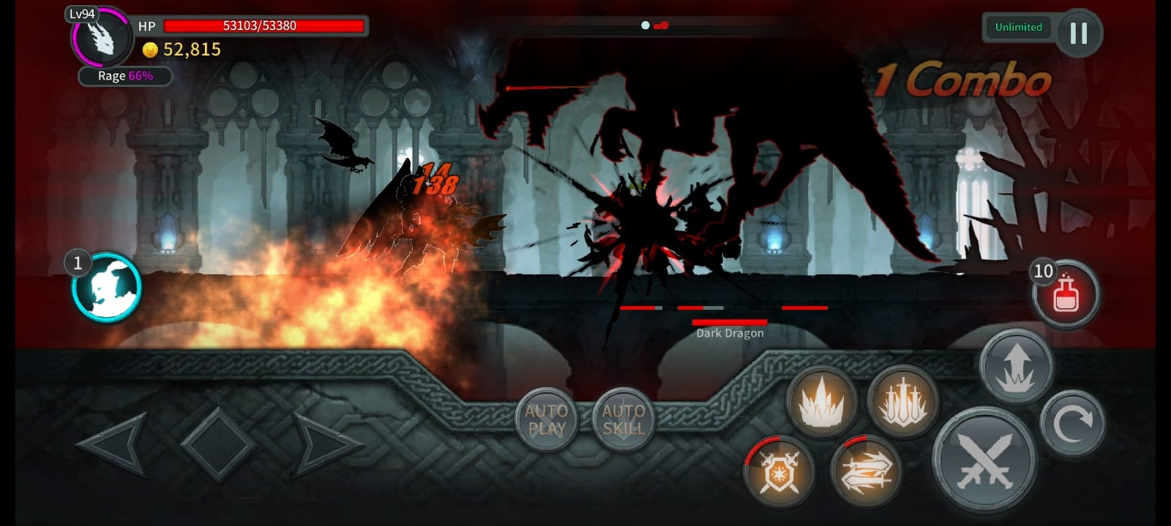
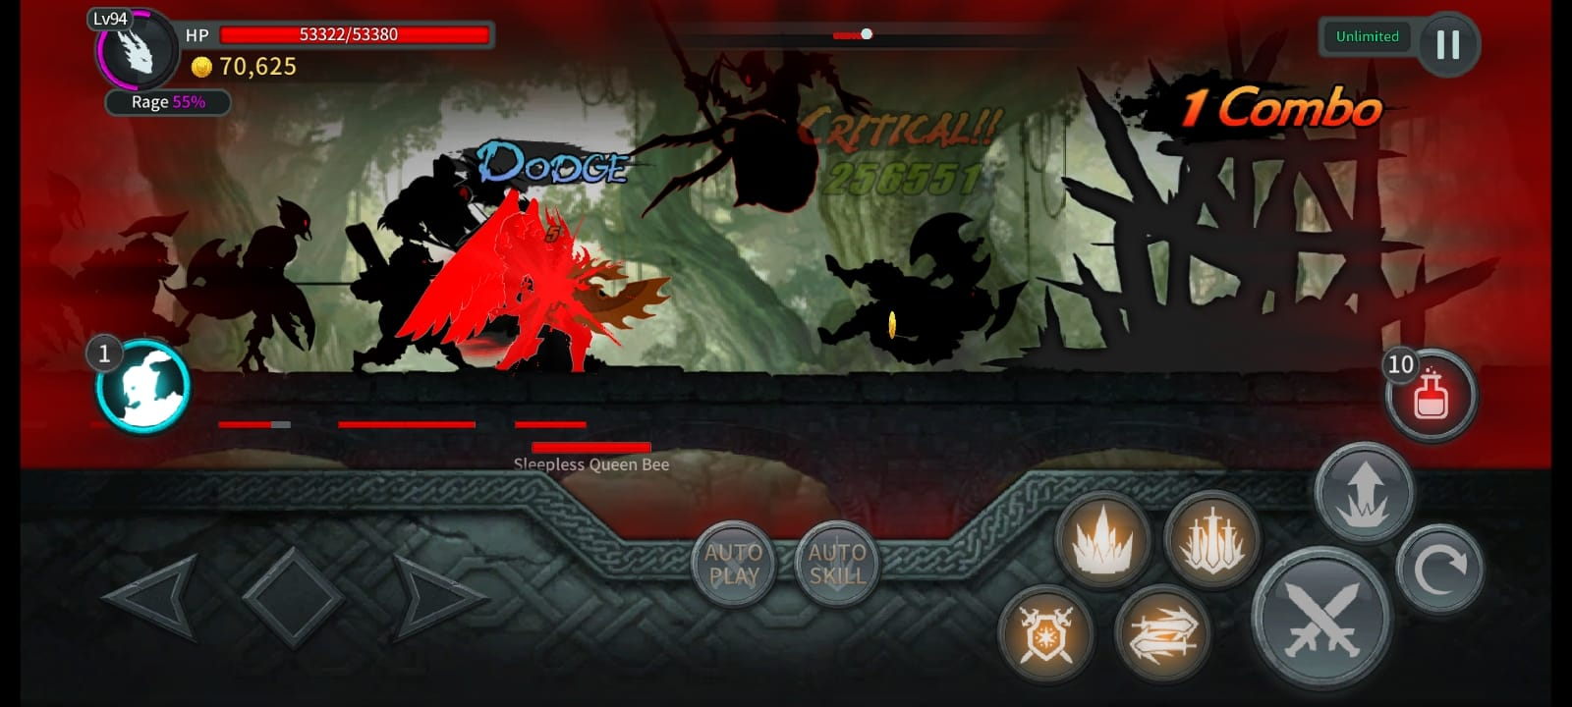
THE DARK DUNGEON: A GLIMPSE INTO THE ABYSS
  Descend into the Depths of Darkness:
  The Dark Dungeon is a perilous labyrinth, divided int 10 treacherous levels. Each level presents its own unique challenges:

Slide 8
THE DARK DUNGEON: A GLIMPSE INTO THE ABYSS
  Levels 1-2: Filled with lesser demons and traps.
  Levels 3, 6, 9 and 10: Guarded by powerful bosses
  THE FINAL CHALLENGEl
  The Dark Lord, the ultimate evil, awaits at the heart of the Dungeon.
  Defeat the Dark Lord to claim victory and restore balance.

Slide 9
THE REWARDS OF THE DARK DUNGEON
DARE TO CONQUER, DARE TO WIN
  Level Up: Significant level increase based on challenge completion
  Legendary Equipment: Acquire powerful artifacts like Power Stones to enhance abilities
  The Ultimate Weapon: Obtain the legendary Dark Sword, a weapon of immense power
  Enhanced Abilties: Increase your DEF (Defence) and ATK (Attack) to overcome formidable foes.

Slide 10
THE CALL TO ADVENTURE
  Are You Ready to Face the Darkness?
  The Dark Dungeon awaits your courage. Are you ready to:
    Confront terrifying creatures?
    Claim legendary treasures?
    Embark on your own epic quest?
  The fate of the realm depends on your bravery

Slide 11
CONCLUSION
THE DARK DUNGEON AWAITS
  The Dark Dungeon, a place of shadows and secrets, offers a thrilling challenge for the brave.
  Perilous Depths: Descend into a labyrinth of darkness filled with deadly traps and monstrous creatures.
  Epic Battles: Confront powerful bosses and claim legendary loot.
  Ultimate Challenge: Defeat the Dark Lord and restore balance to the realm.
  ARE YOU READY TO FACE THE DARK DUNGEON ?

Slide 12

THANK YOU FOR WATCHING
MY PROJECT TILL THE END
MORE PROJECTS
COMING SOON
GOOD BYE

