Slide 1



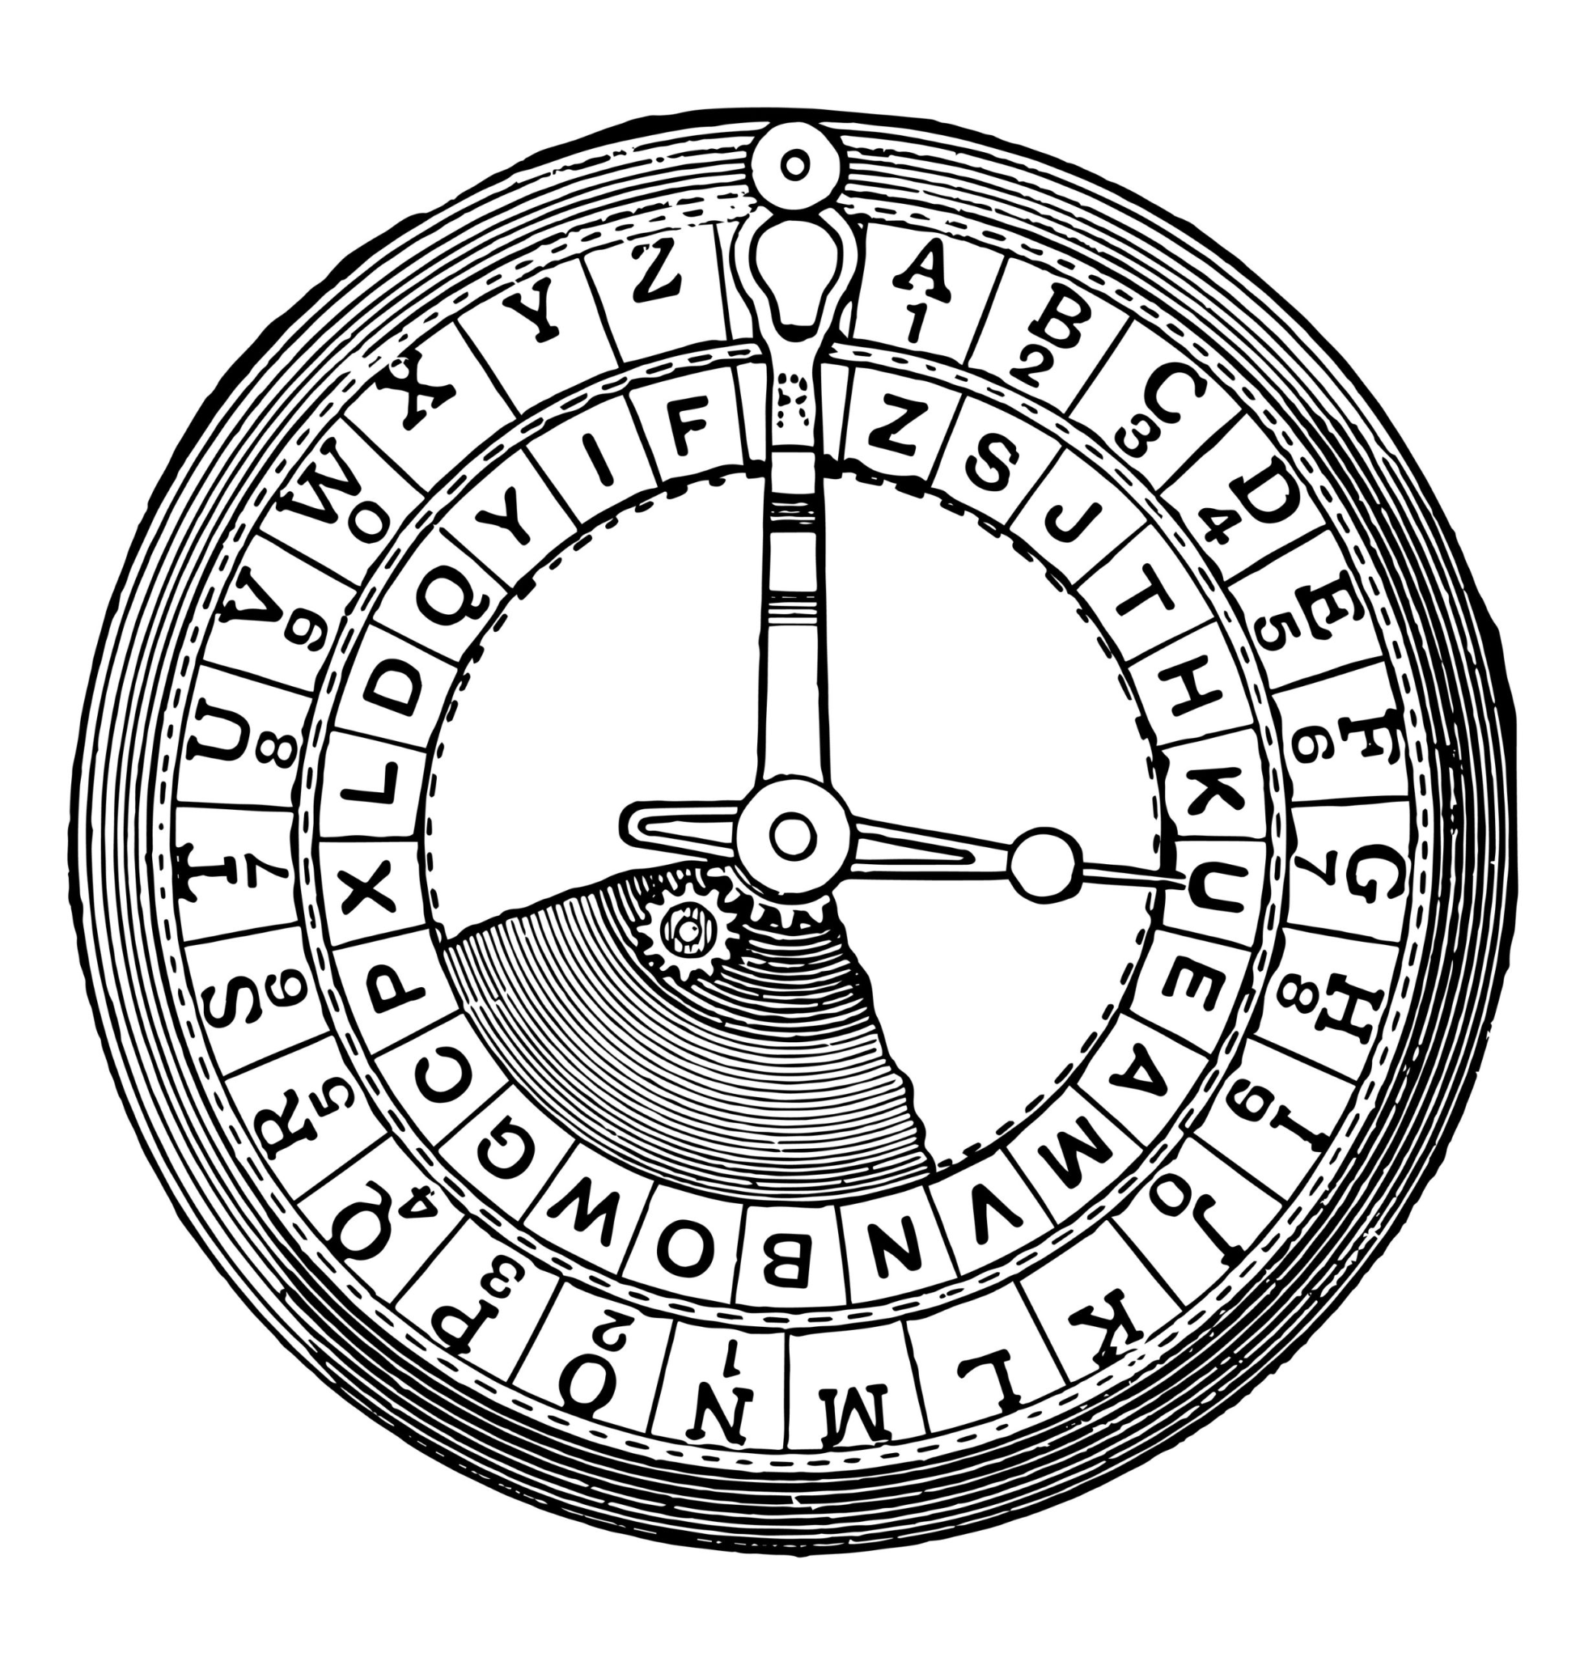
Computer-Science: Mini Project
Project-Title: Caesar-Cipher
Objective of this Project: To develop a Python-Based Interactive Caesar Cipher for text encryption/decryption.

Slide 2
Introduction
In today’s world, cryptography is vital for securing information. One of the earliest encryption is the Caesar Cipher, also known as Caesar’s code. It disguises messages by shifting each letter in the text by a fixed number of positions in the alphabet. Despite being named after Julius Caesar, who used it for confidentiality, the cipher is easily deciphered and not secure in modern communication

Slide 3
Problem Statement: Develop a Python-based program utilizing the Caesar-Cipher algorithm to enable users to encrypt and decrypt messages.
1. User Interaction:Create an interactive interface prompting users for message input, encryption or decryption selection, and shift amount.
2. Cipher Implementation: Implement the Caesar Cipher algorithm using Python, utilizing ASCII values and string manipulation for letter shifting.
3. Conditional Encoding: Based on user input, shift the letters in the message to encrypt or decrypt text accordingly.
4. Handling Special Characters: Ensure the program retains non-alphabetic characters (numbers, symbols) unchanged during encryption/decryption.

Slide 4
5. Interactive Loop: Allows users to perform multiple encryption actions until they opt to exit.
6. Modular design: Utilize functions to enhance code readability and maintainability, encapsulating the encryption/decryption logic.
7. Output Display: Present the resulting encoded or decoded text to the user in an understandable format.
8. Range Consideration: Implement a mechanism to ensure shifts remain within the alphabet’s range (0-25) to prevent errors.

Slide 5
Algorithm:
Following is the algorithm for the Caesar Cipher project:
1.Start:
-Initialize the program
-Define the Caesar Cipher function (‘caesar’).
-Set the variable ‘should_continue’ to ‘True’ for loop control.

Slide 6
2. Caesar Cipher Function:
Define the ‘caesar’ function taking parameters: ‘start_text’, ‘shift_amount’, and ‘cipher_direction’.
-Create an empty string ‘end_text’ to store the resulting text.
-Define a string of special characters.
-Iterate through each character in the ‘start_text’.
-If the character is an alphabet:
-Determine the starting point based on case (lower or upper)
- Calculate the shifted character using the Caesar Cipher formula
- Print the resulting text indicating the direction (encoded or decoded).

Slide 7
3. Loop:
-Run a ‘while’ loop based on the ‘should_continue’ variable.
-Display the logo and a welcome message.
-Prompt the user for the desired action: encode or decode.
-Take user input for the message and shift amount.
-Ensure the shift amount stays within the range (0-25).
-Adjust the shift amount for decoding if necessary.
-Call the ‘caesar’ function with the provided inputs.
-Ask the user if they want to continue. If ‘no’, set ‘should_continue’ to ‘False’.
-Display ‘Goodbye!’ when the loop ends.

Slide 8
4. End:
-Terminate the program.
This algorithm outlines the steps involved in implementing the Caesar Cipher project using Python, including user interaction, cipher logic, loop control, and termination.

