Slide 1
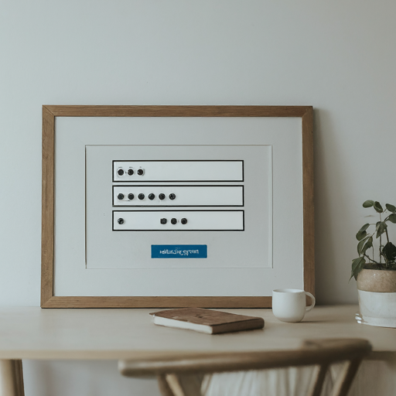

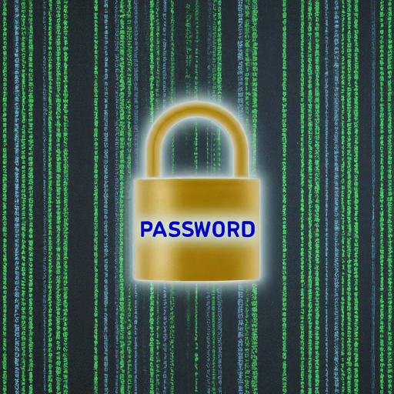
Python-Mini-Project:
Password Generator
Enhancing Security with Python

Slide 2

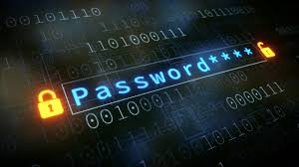
INTRODUCTION
The importance of strong and secure passwords in the digital age.
Overview of the Password Generator Project.
Objective: To create a customizable and secure password generator using Python.

Slide 3
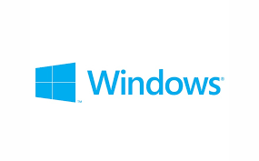
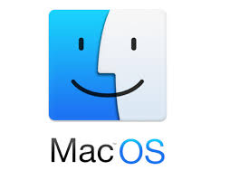

System Requirements
Operating System: Windows, macOS, or Linux.
Python Version: Python 3.6 or higher.
Memory: At least 512 MB of RAM.
Storage: At least 10 MB of free disk space

Slide 4
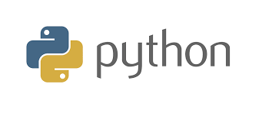
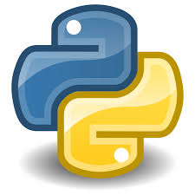
Coding Tools
Python: The primary programming language
Random Module:
Used for generating random selections and shuffling.

Slide 5
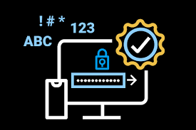
Major Features
User Input: Prompting for number of letters, symbols, and numbers.
Password Generation: Random selection from predefined lists.
Shuffling and Output: Ensuring randomness and displaying the final password.

Slide 6

Real-Time Applications
Online Account Security: Ensuring unique and strong passwords for online accounts.
Data Protection: Protecting sensitive and personal information.
Corporate Security: Enhancing security protocols within organizations.
Personal Use: Creating secure passwords for personal use such as banking, social media and email

Slide 7
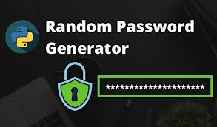
How it Works
The user specifies the number of letters, symbols, and numbers for the password.
The program generates a random selection of characters based on user input.
The selected characters are shuffled to ensure randomness.
The final password is displayed to the user.

Slide 8
Project Benefits
Security: Generates complex and hard-to-guess passwords.
Customization: Allows users to tailor passwords to their needs.
Simplicity: Easy to use with straightforward user prompts.
Randomness: Ensures passwords are unique every time.

Slide 9
Conclusion
Summary of Success: Success Achieved 📈 : The project effectively generates secure, random passwords that can be tailored to user preferences.
Importance of Customization:
🔧 Customization Matters: The ability to customize passwords (choosing the number of letters, symbols, and numbers) ensures they meet specific security needs.
Call to Action:
🚀 Get Started: Try building your own password generator to understand the fundamentals of password security and Python Programming.

