Slide 1


Group:A3
Kishan Raj KC
Lok Khanal
Ishan Raj Regmi

Slide 2
contents
Introduction
Openfire Installation
Running Openfire
Spark
Live Demo
References

Slide 3
Introduction
Openfire is an instant messaging server that implements the XMPP(jabber) protocol. It features high performance, a robust administration console, and a full plug-in system.
The server is 100% java
Openfire is a professional open source project, led by jive Software.

Slide 4

Openfire Installation

Slide 5
Openfire is 100% java so java installation on the ubuntu server is mandatory.
Unfortunately , Openfire does not work with the OpenJDK Java Runtime Environment. So Sun JRE should be installed

Slide 6
Commands used for installing java sun JRE
java –version
sudo apt-get install sun-java6-bin
sudo apt-get install sun-java6-jre
sudo apt-get install sun-java6-jre sun-java6-plugin
gksu /usr/bin/software-properties-gtk
sudo update-java-alternatives –l
sudo add-apt-repositoriy "deb http://archive.canonical.com/lucid partner”

Slide 7
2nd Step Openfire installation
kisson@ubuntu:~$elinks http://www.igniterealtime.org/downloads/index.jsp
kisson@ubuntu:~$tar xzvf openfire_3_6_4.tar.gz
kisson@ubuntu:~$sudo cp -R openfire /etc/init.d
kisson@ubuntu:~$sudo mv openfire /opt
kisson@ubuntu:~$sudo reboot
kisson@ubuntu:~$/opt/openfire/bin/openfire start
kisson@ubuntu:~$nohup nohup ls >ls.log 2>&1 &

Slide 8
Web-based installation
After the installation of openfire package is complete, you must point your browser to (in my case) http://192.168.10.73:9090/ to finish the installation.
The first screen is for language set up.

Slide 9
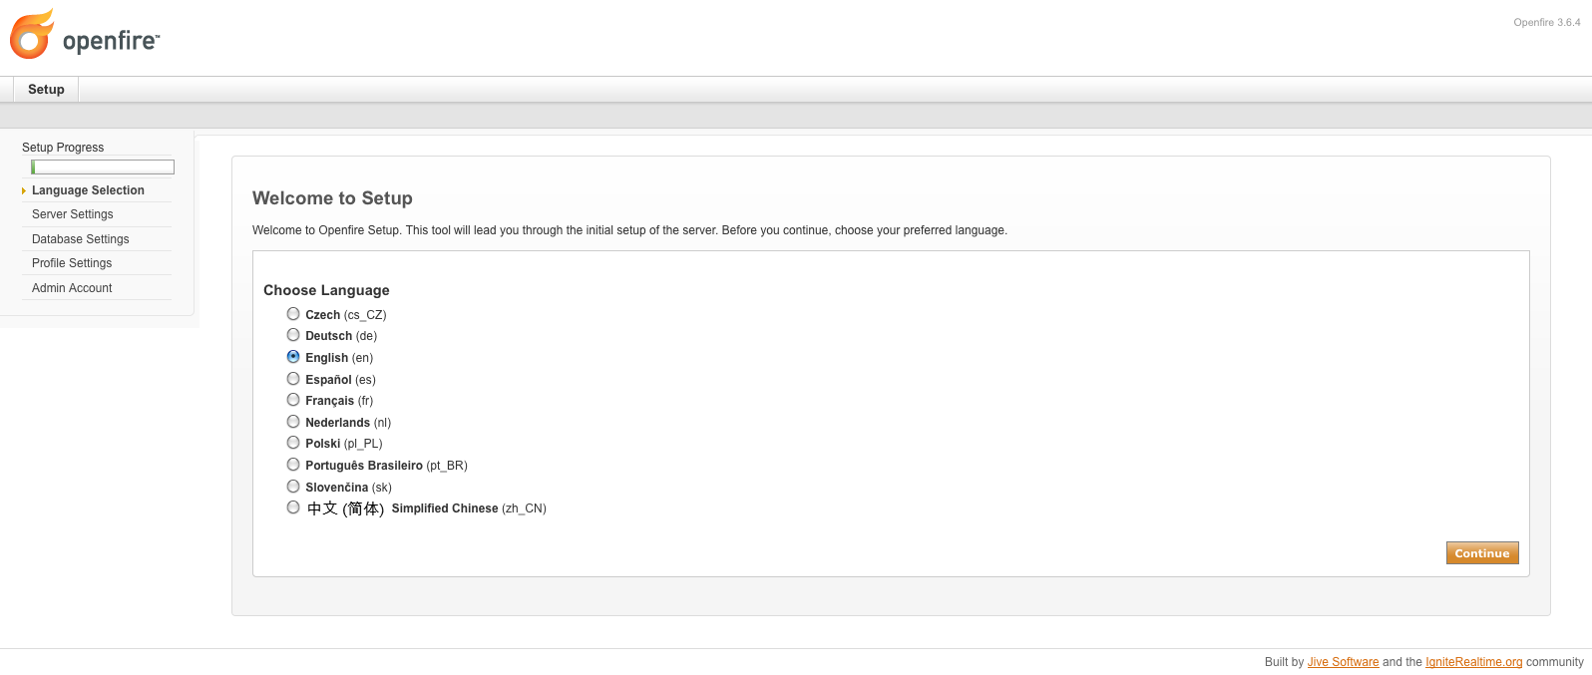

Slide 10
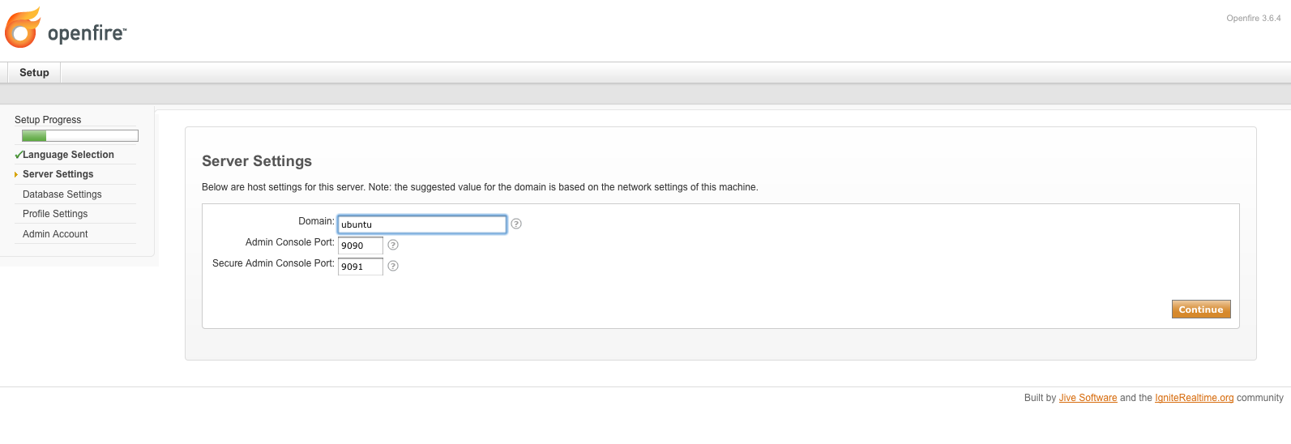

Slide 11
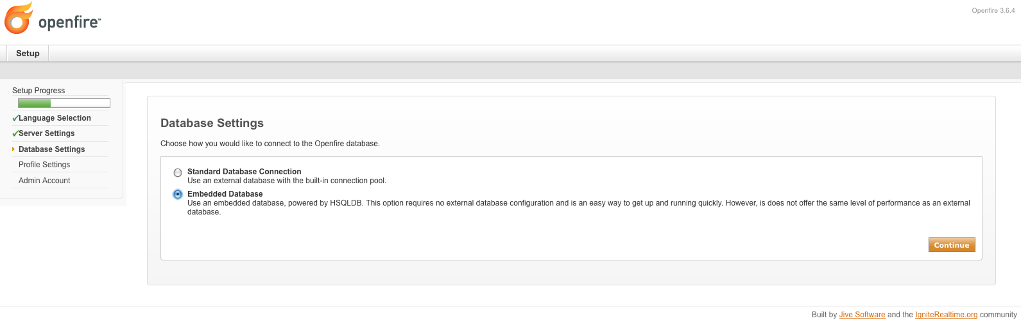

Slide 12
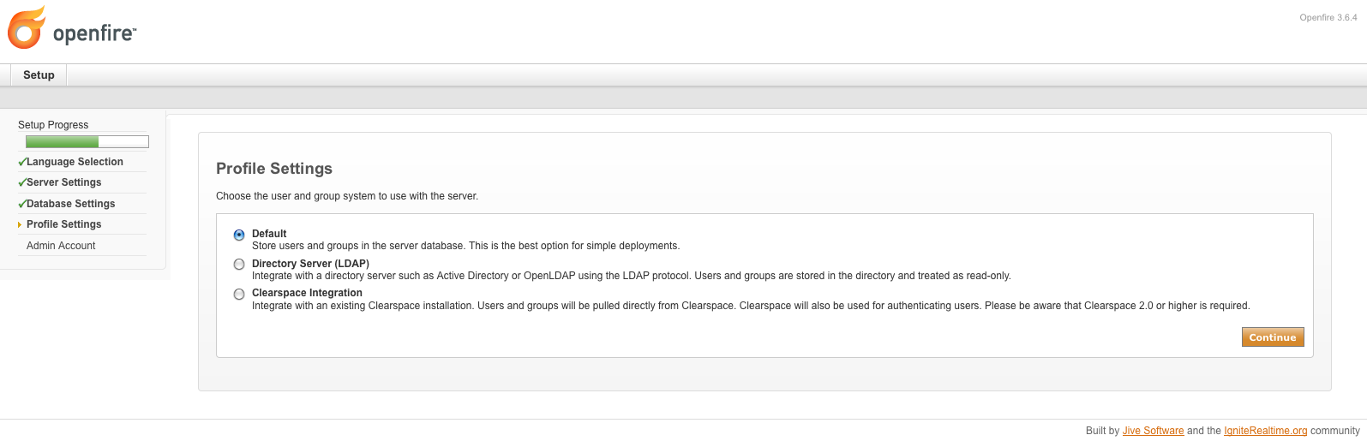

Slide 13
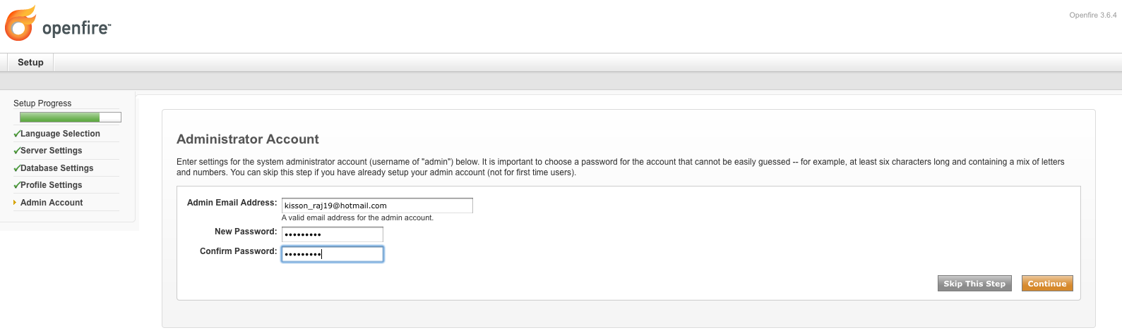

Slide 14
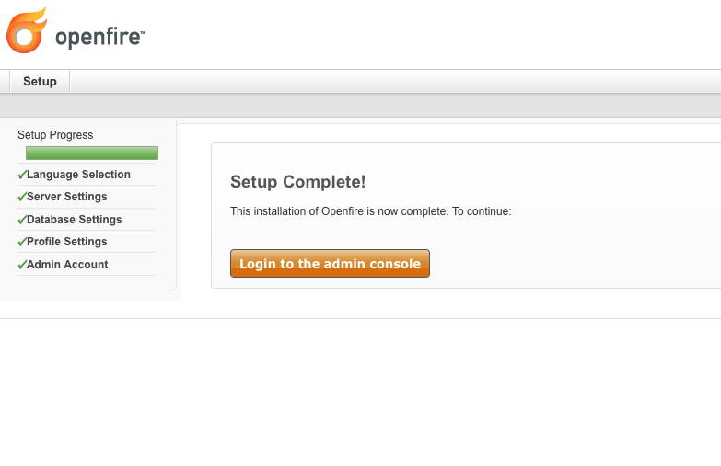

Slide 15
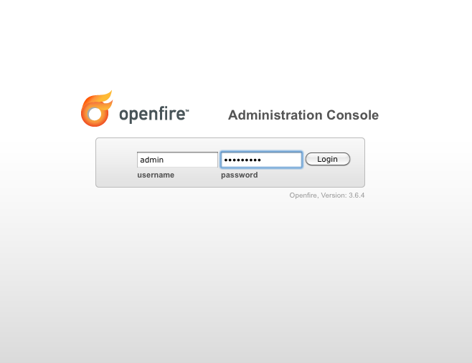

Slide 16
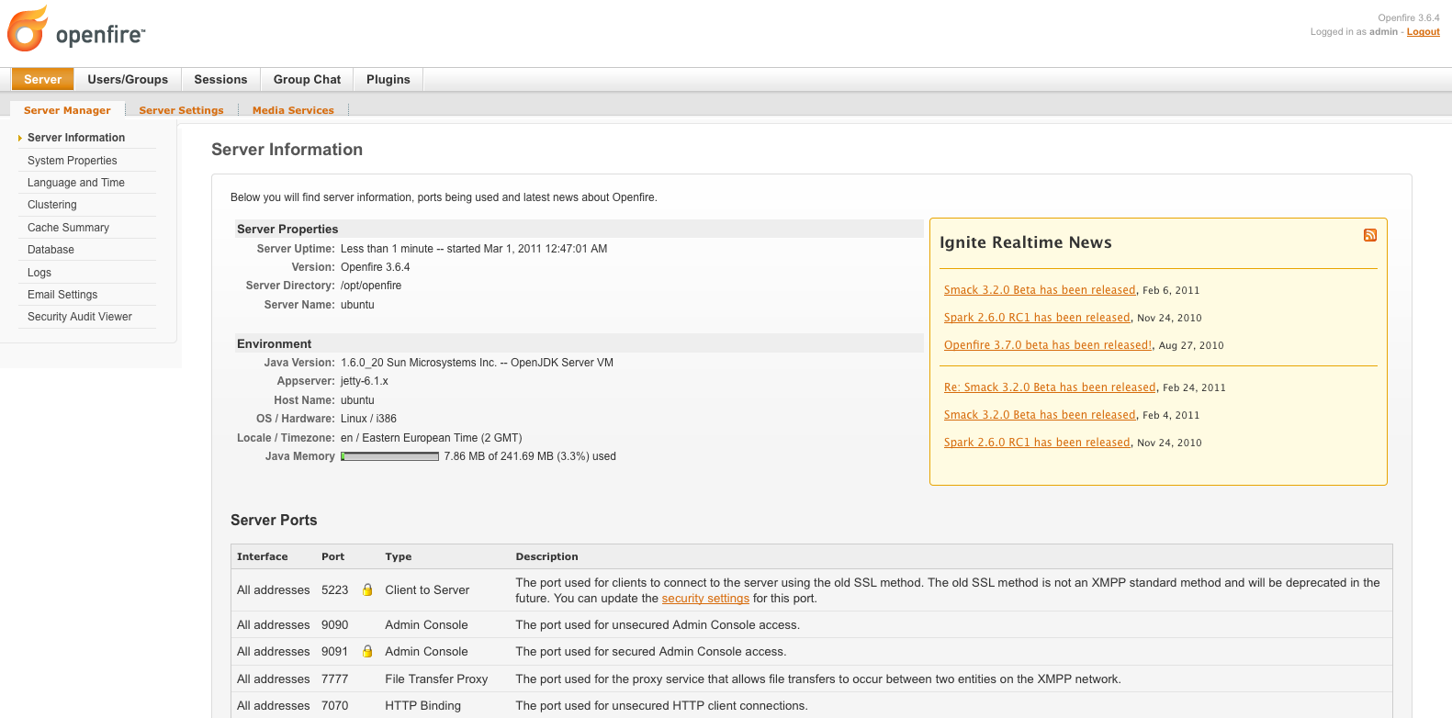

Slide 17
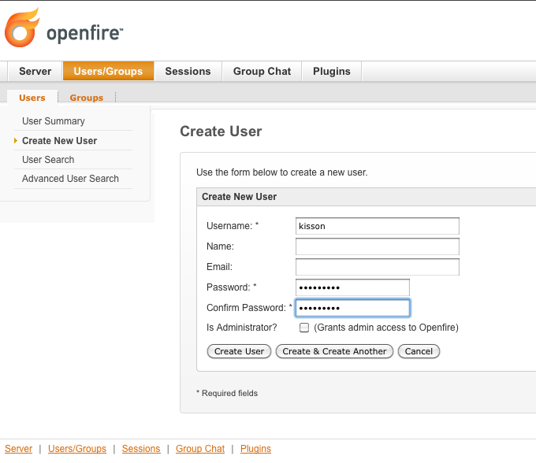

Slide 18
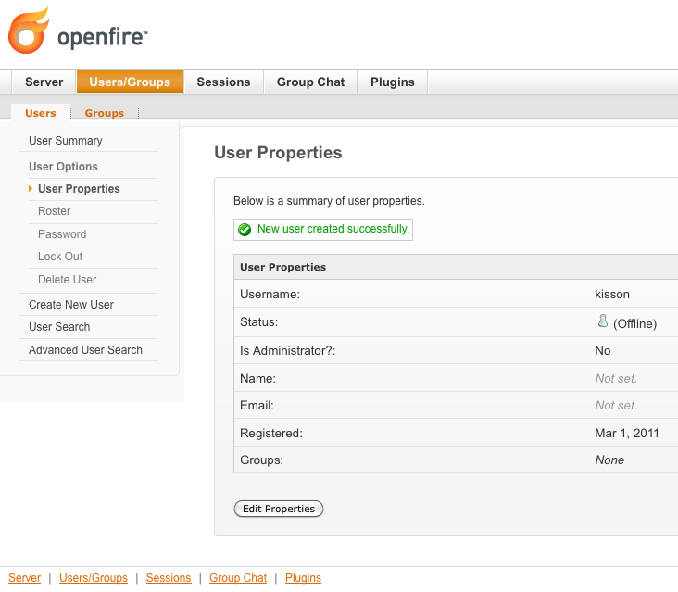

Slide 19

SPARK

Slide 20
Spark is an Open Source, cross-platform IM client optimized for businesses and organizations.
It features built-in support for group chat, telephony integration, and strong security.
It also offers a great end-user experience with features like in-line spell checking, group chat room bookmarks, and tabbed conversations.

Slide 21
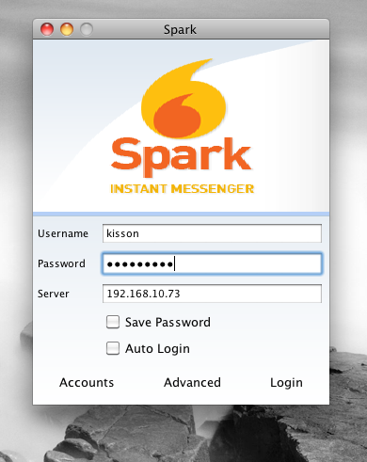

Slide 22
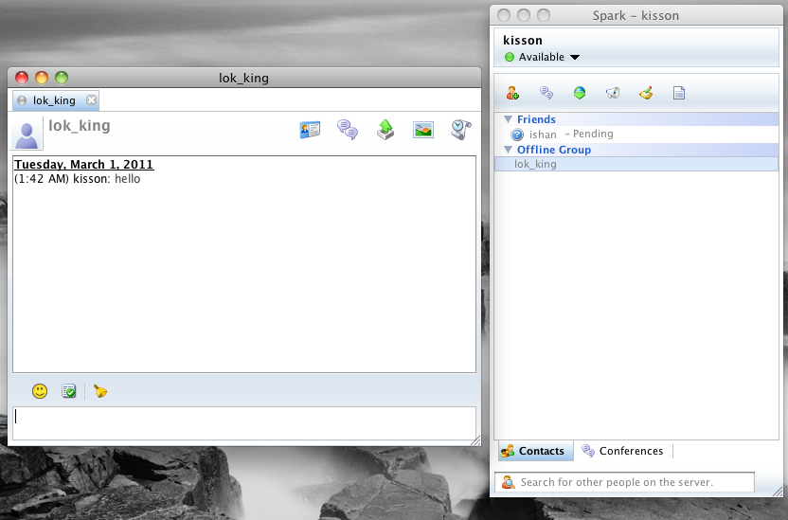

Slide 23

Thank You…For your time.

Slide 24
References
http://www.igniterealtime.org/support/index.jsp
https://help.ubuntu.com/
http://www.linux.com/
http://www.google.com

