Slide 1

JOB MARKET INSIGHTS
Team Member
M. Pramodha Varshini
K. Praveen

Slide 2
About us
M. Pramodha Varshini [ B.Tech ]
K. Praveen [B.Tech]

Slide 3
Agenda
Objective of the Project
Data Collection
Raw Data
Data Cleaning
Data Visualization
Uni-Variate Analysis
Bi-Variate Analysis
Conclusion

Slide 4
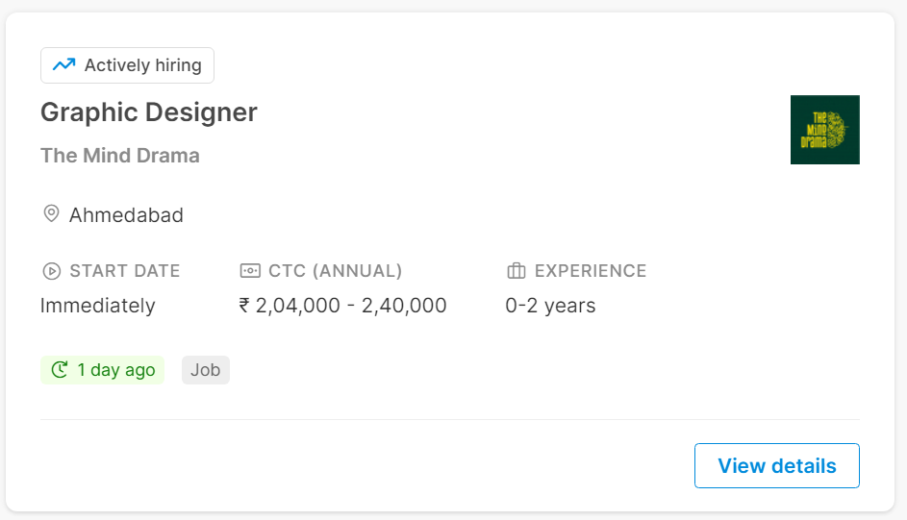
Objective: Our aim is to perform analysis on available jobs.
URL : https://internshala.com/jobs/

Slide 5
Data Collection
For real time analysis data is scrapped from https://internshala.com website
Looking for a job applying website to see differ jobs
Save it to the
.csv file
Scrap the data using Beautiful Soup library
Download URL data
Extract the features

Slide 6
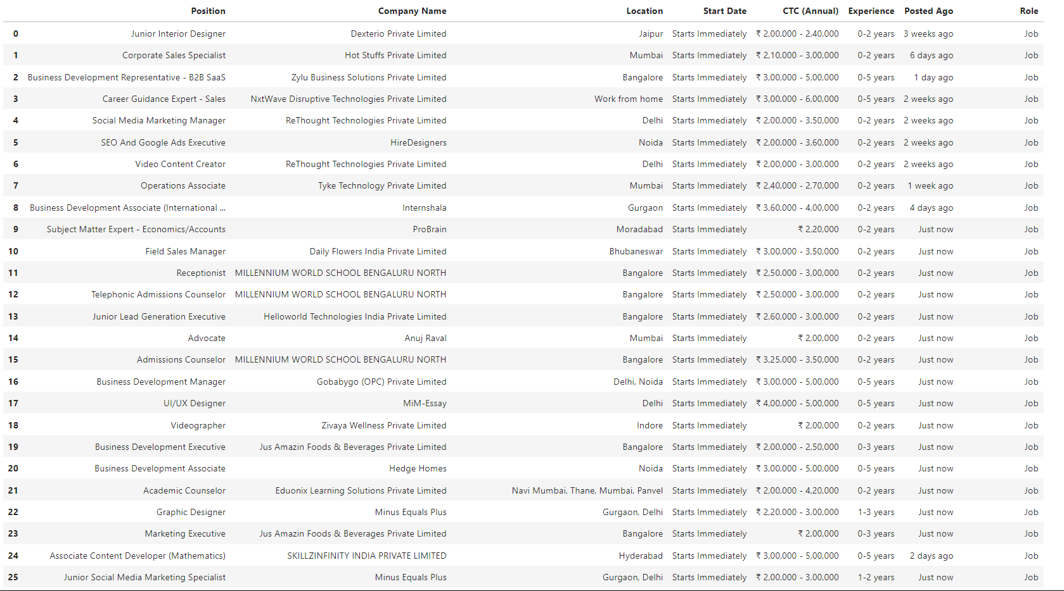
Raw Data

Slide 7
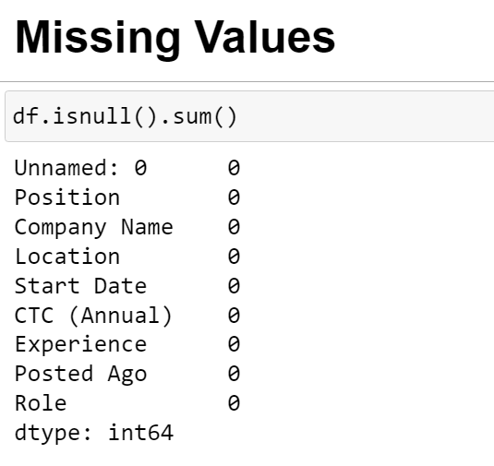
Data Cleaning
Inside the columns the special characters , White spaces are removed from each row
After cleaning data and applying some important codes , Numerical and Categorical data is ready for Visualization

Slide 8
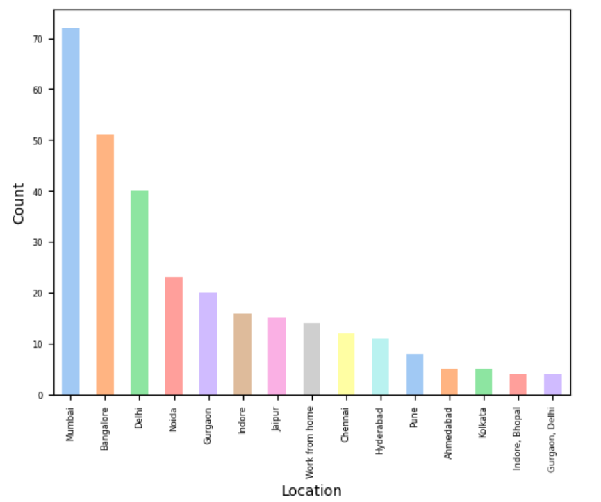
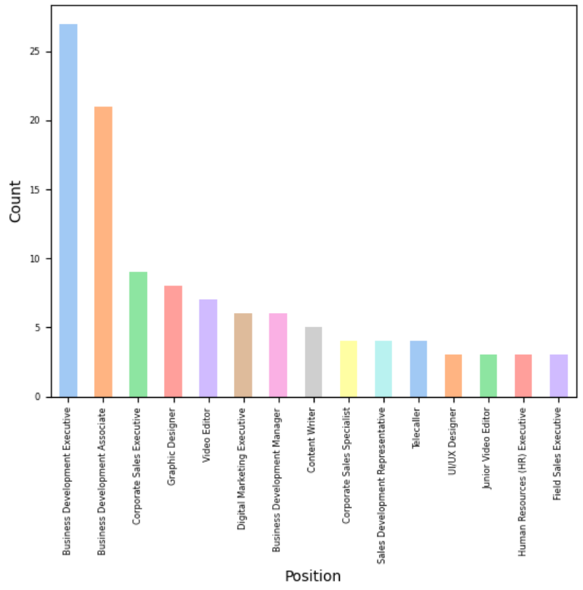
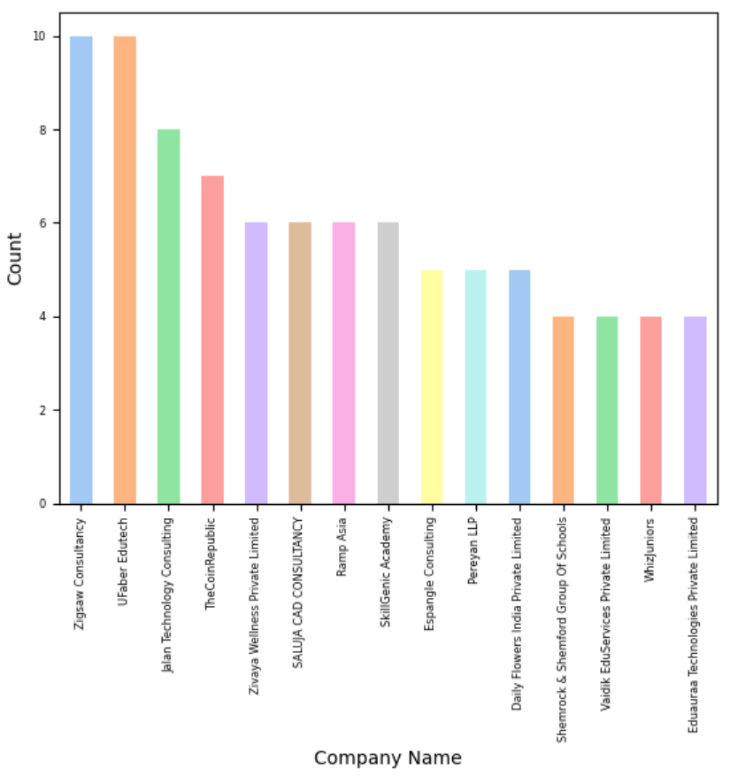
Data Visualization
Uni-Variate Analysis
1. Top 15 cities with highest availability of jobs representing using bars
2. Top 15 Positions that had huge demand now-a-days
3. Top 15 Companies that were posting many jobs now-a-days

Slide 9
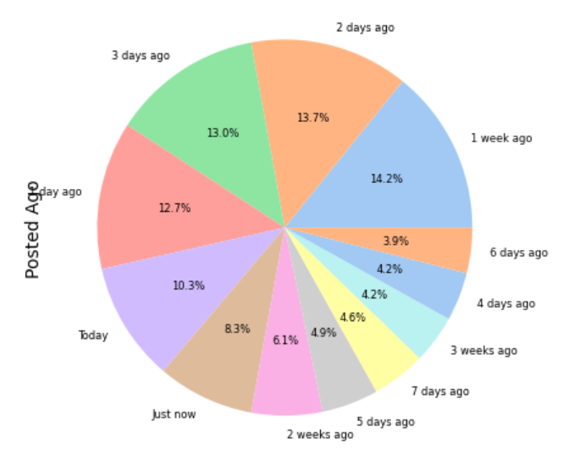
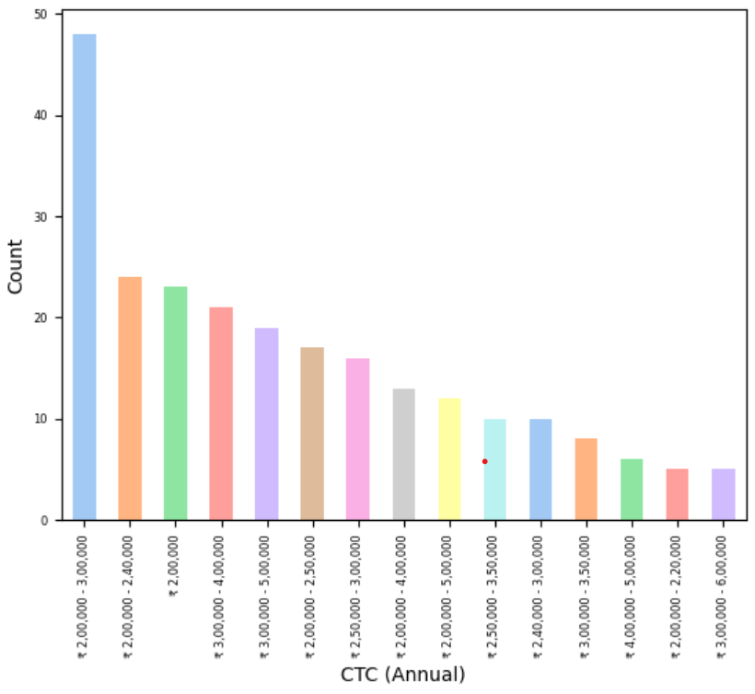
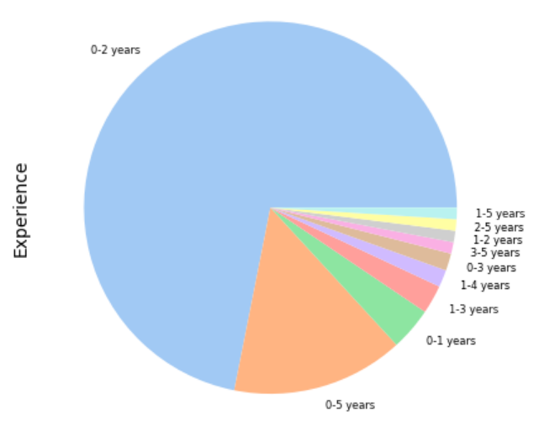
Data Visualization
Uni-Variate Analysis
4. Top 15 offered CTC (Annual) by different companies
5. Common experience that were chosen more likely by companies
6. Top 15 latest posted jobs representing using pie chart

Slide 10
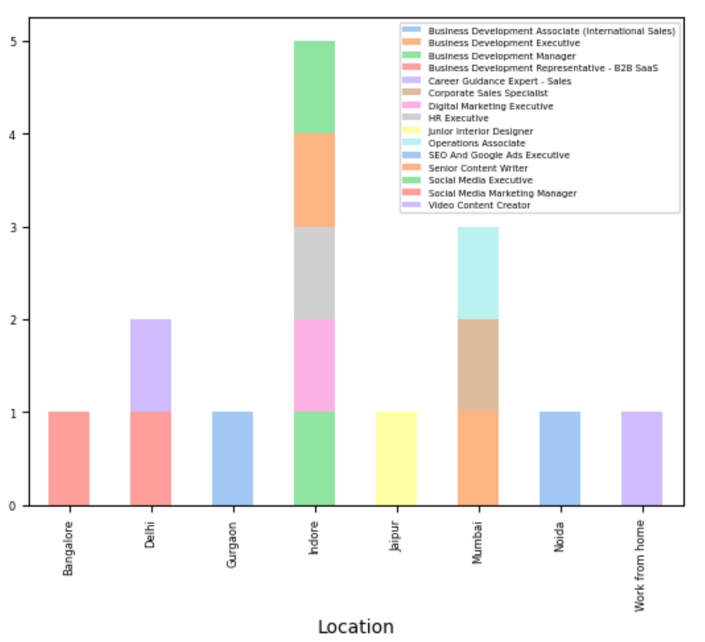
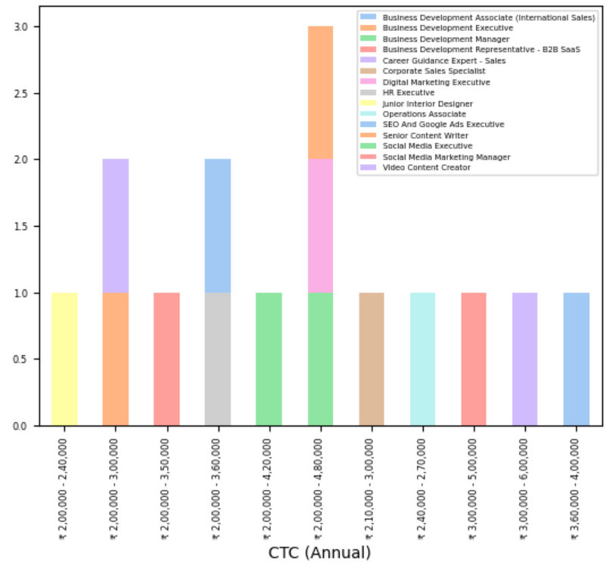
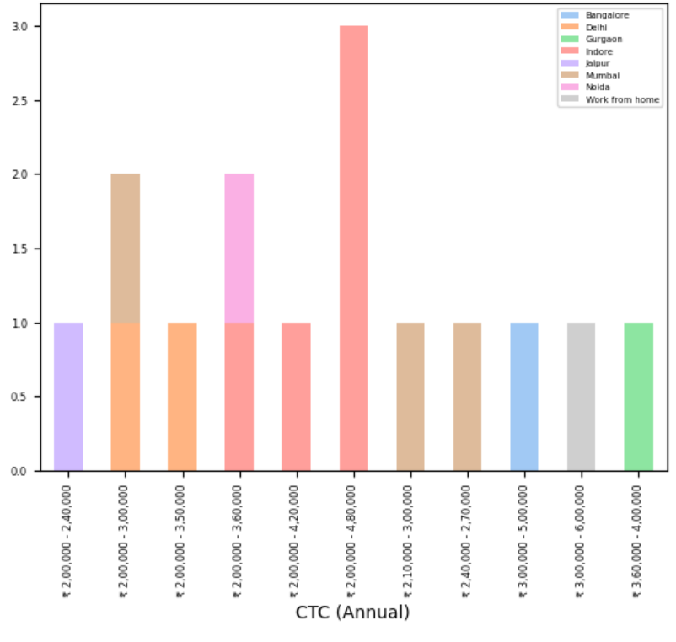
Bi-Variate Analysis
Preferred Combinations
Position and Location
Position and CTC (Annual)
CTC (Annual) and Location
Position and Company Name (PASSION)
CTC (Annual) and Experience (EXPERIENCED)
Location and Posted Ago (FRESHERS)

Slide 11
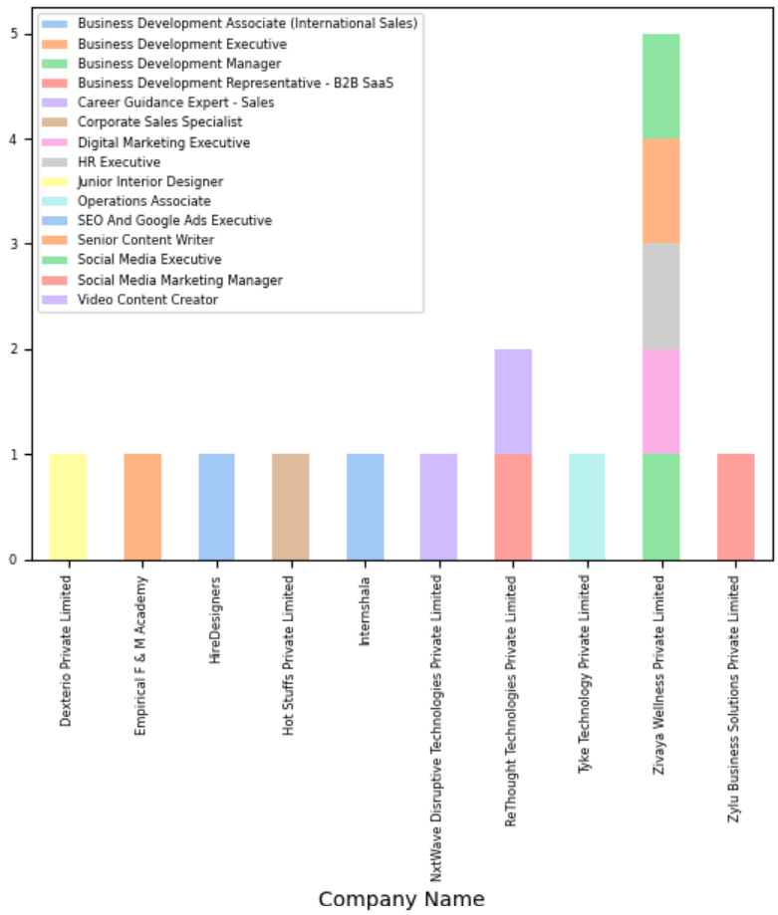
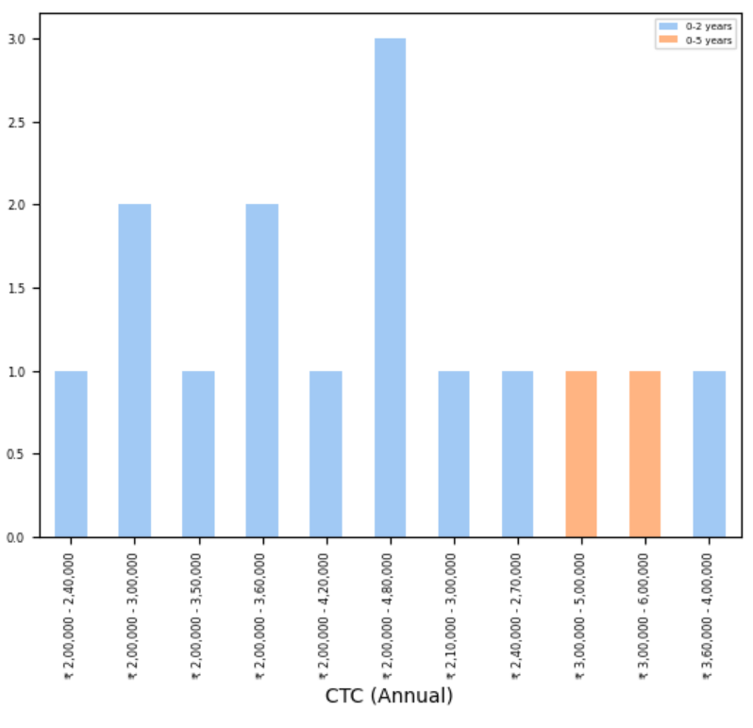
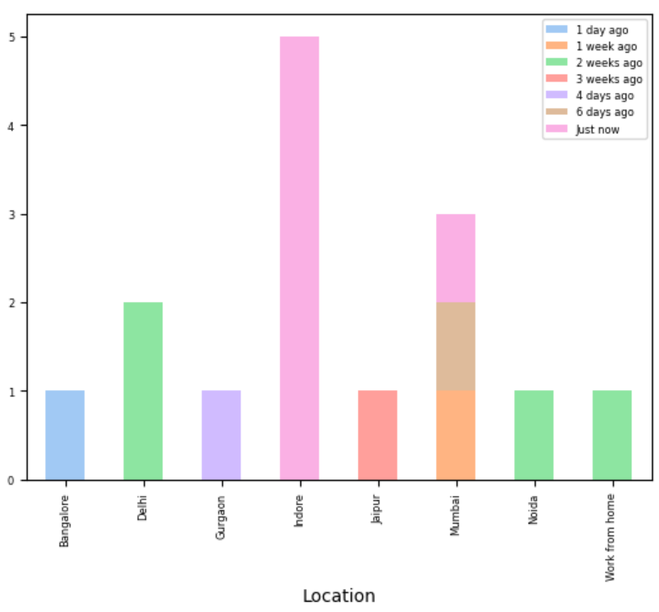
Bi-Variate Analysis
Preferred Combinations
Position and Location
Position and CTC (Annual)
CTC (Annual) and Location
Position and Company Name (PASSION)
CTC (Annual) and Experience (EXPERIENCED)
Location and Posted Ago (FRESHERS)

Slide 12
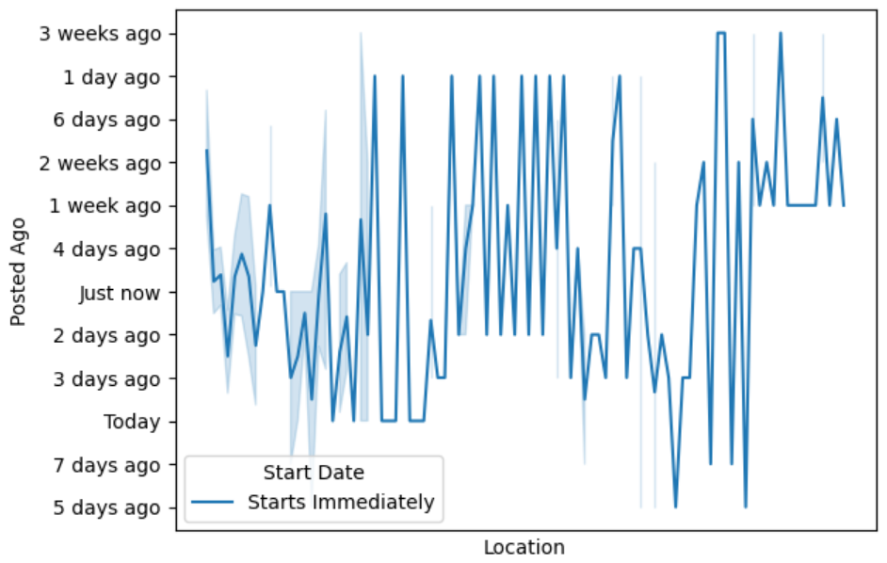
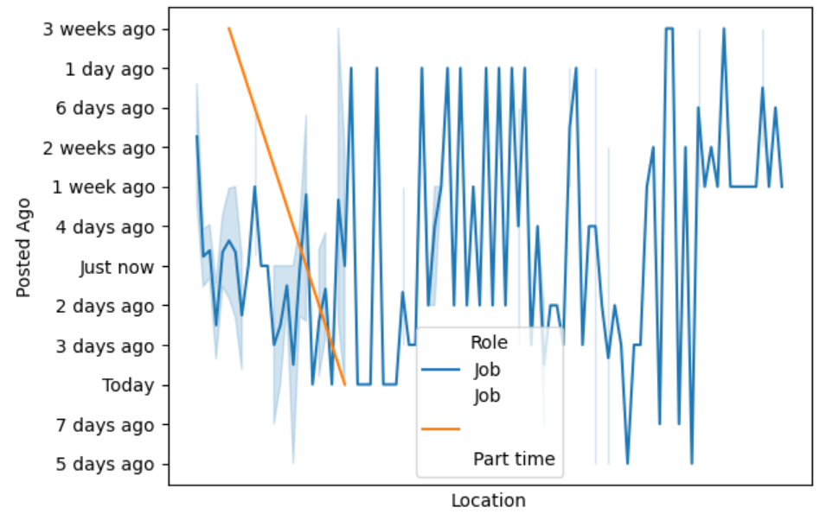
Multi-Variate Analysis Combination of 3 categorical columns are represented using lines

Slide 13
RESULTS
Indore, Mumbai and Delhi had more openings for different positions.
Business Development Executive, Business Development Manager and Digital Marketing Executive had higher CTC (Annual).
People get highly paid CTC (Annual) at Indore and second comparatively Noida and Delhi.
Business Development Executive had openings in Zivaya Wellness Private Limited and Empinical F&M Academy.
Most of the companies are hiring people having experience in range of 0-2 years and offering them with 2,00,000 to 4,80,000 CTC (Annual).
There were 'Just now' postings available in Indore abundantly but there were 1 week ago, 6 days ago and Just now postings available in Mumbai.
FINAL ASSUMPTION :
Finally, As a Graduated Student having 0-2 years of experience with expectation of 2,00,000 - 4,80,000 CTC (Annual) applying for a position of Business Development Executive at Zivaya Wellness Private Limited in Indore (City in Madhya Pradesh), which had a lot of openings released by just now.

Slide 14
CONCLUSION
In conclusion, each of these eight attributes plays a vital role in a fresher's job search. Fresher’s should carefully consider their preferences, expectations, and goals when exploring job opportunities, using the insights gained from analysing these attributes to make informed decisions about their career paths. Additionally, staying updated with recent job postings and conducting thorough research on companies can significantly enhance the job search experience for fresher’s.

Slide 15


THANK YOU

