Slide 1

ISHOPSMART - Analysing the Best iPhones on Flipkart
Team Member(s)
M. Pramodha Varshini
K. Praveen

Slide 2
About us
M. Pramodha Varshini [ B.Tech ]
K. Praveen [B.Tech]

Slide 3
Agenda
Objective of the Project
Data Collection
Raw Data
Data Cleaning
Data Visualization
Uni-Variate Analysis
Bi-Variate Analysis
Conclusion

Slide 4
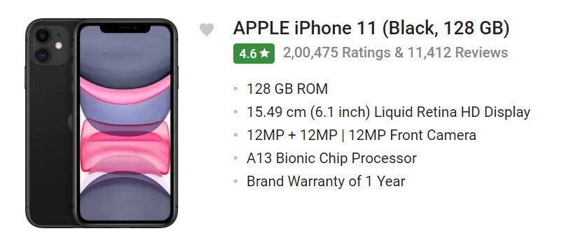
Objective: The objective of this project is to analyse iPhone listings on Flipkart, leveraging data scraped from the platform.
URL : https://www.flipkart.com/search?sid=tyy%2C4io&otracker=CLP_Filters&p%5B%5D=facets.brand%255B%255D%3DAPPLE

Slide 5
Data Collection
For real time analysis data is scrapped from https://www.flipkart.com/ website
Select an E-commerce Website
Utilize Beautiful Soup
Download URL Data
Feature Extraction
Save as CSV
1. Select an E-commerce Website : Choose a suitable e-commerce website, such as Flipkart, to explore and collect data on different iPhone models.
2. Utilize Beautiful Soup : Implement web scraping techniques using the Beautiful Soup library to extract information from the selected website's HTML structure.
3. Download URL Data : Retrieve the relevant data from the identified URLs that contain information about iPhone models, ratings, specifications, and pricing.
4. Feature Extraction : Extract the desired features such as model name, rating, ROM, display size, chip processor, number of ratings, number of reviews, and price from the downloaded data.
5. Save as CSV : Organize the extracted data into a structured format and save it to a .csv file for further analysis and reference.

Slide 6
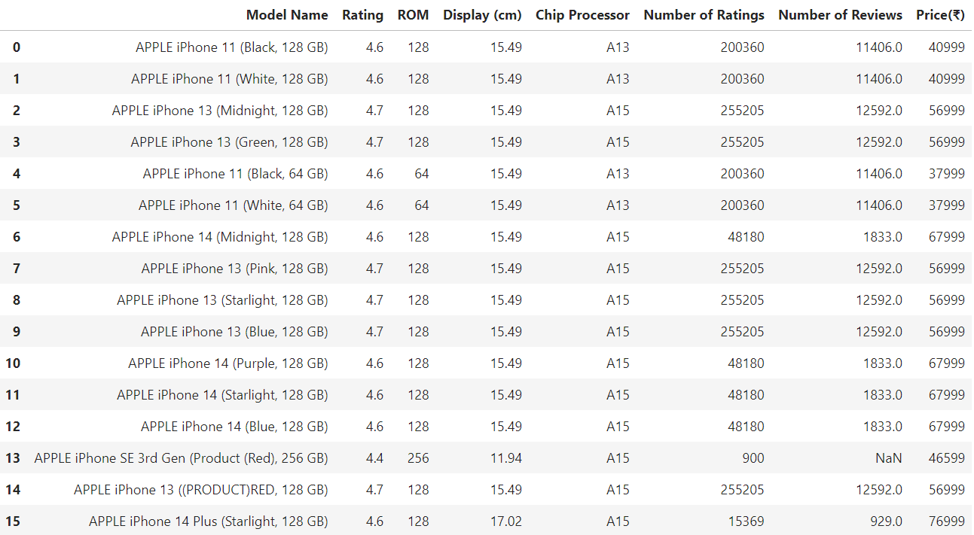
Raw Data

Slide 7
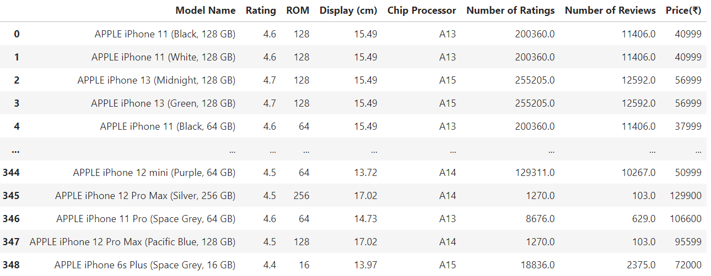
Data Cleaning
1. Remove Duplicates: Eliminate duplicate records from the dataset.
2. Fill Null Values: Address missing data by filling null values in the "Chip Processor," "Number of Ratings," and "Number of Reviews" columns.
3. Check for Invalid Values: Identify and address any invalid or inconsistent data entries.
4. Remove Outliers: Use the IQR (Interquartile Range) method to identify and remove outliers in the "Display (cm)" column.

Slide 8
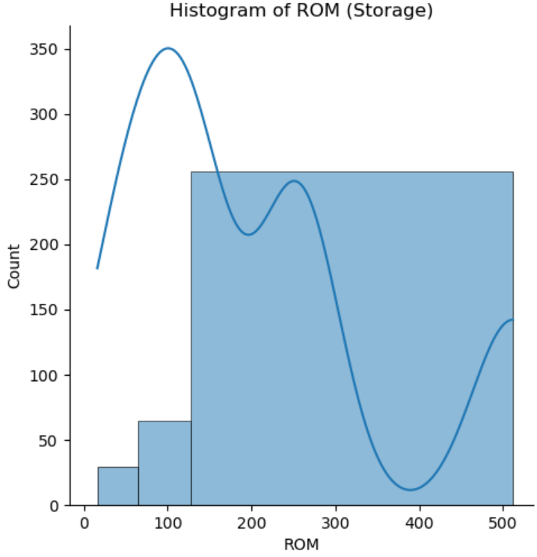
Data Visualization
Uni-Variate Analysis
1. ROM: The univariate analysis of ROM revealed the distribution and central tendencies of storage capacities among the iPhone models, highlighting variations in storage options.

Slide 9
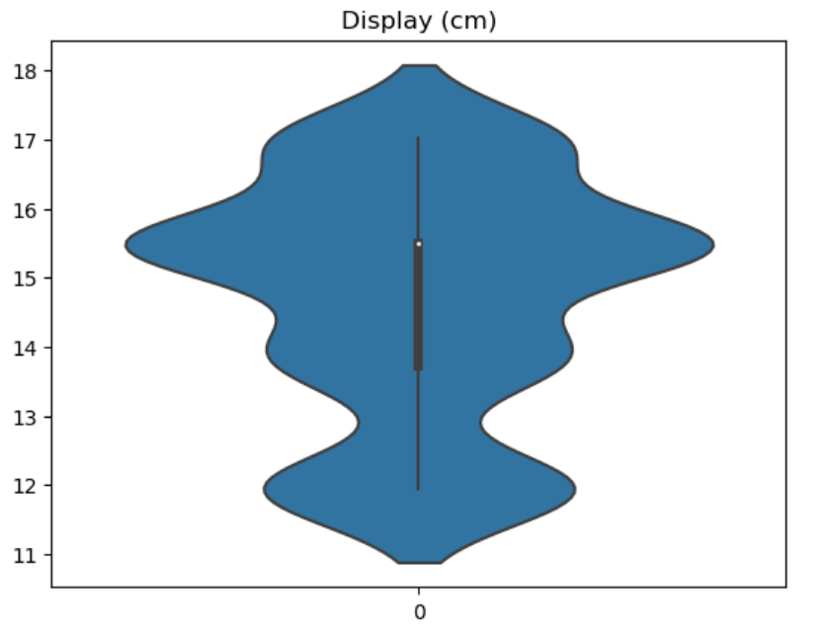
Data Visualization
Uni-Variate Analysis
2. Display (cm): Univariate analysis of the "Display (cm)" variable provided insights into the distribution of display sizes, indicating the range and common screen dimensions in the iPhone models.

Slide 10
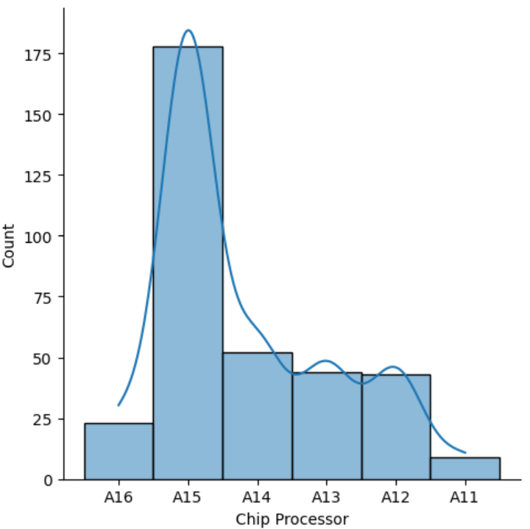
Data Visualization
Uni-Variate Analysis
3. Chip Processor: In the univariate analysis of the "Chip Processor," we examined the distribution of different processor types used in iPhones, shedding light on the prevalence of specific chips in the dataset.

Slide 11
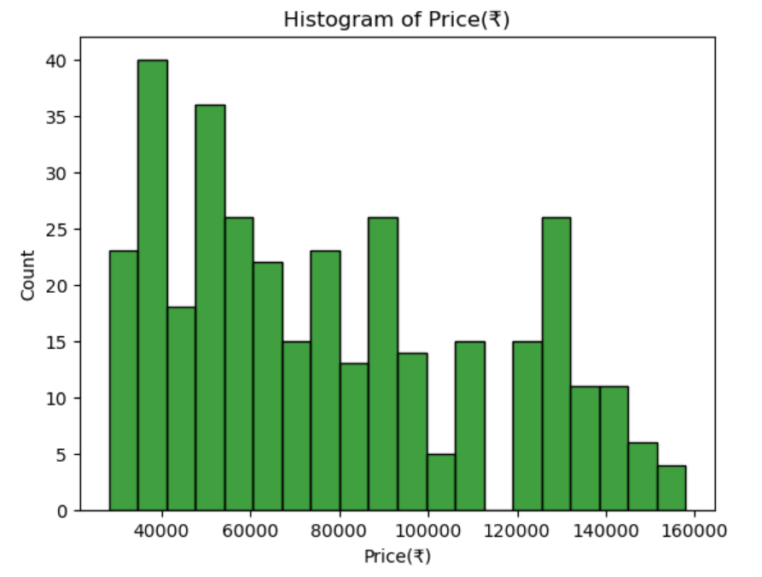
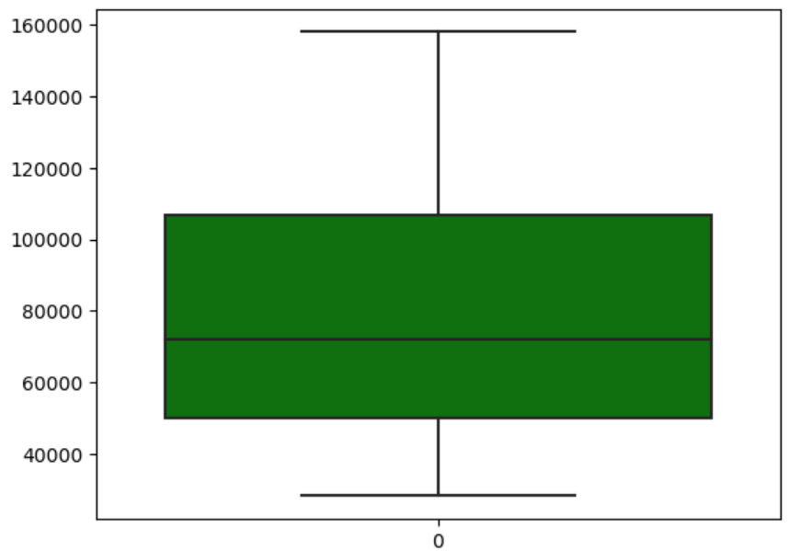
Data Visualization
Uni-Variate Analysis
4. Price: Univariate analysis of the "Price" variable allowed us to explore the price distribution, central tendencies, and potential outliers among the iPhone models, aiding in understanding pricing patterns.

Slide 12
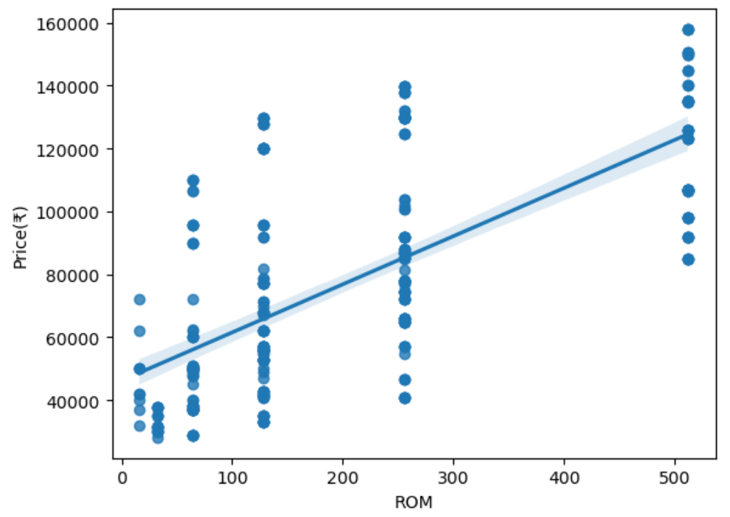
Data Visualization
Bi-Variate Analysis (Numerical vs Numerical)
A bivariate analysis between ROM and Price revealed a positive correlation, indicating that as the ROM (storage capacity) of iPhones increased, so did their prices, suggesting that higher storage options typically come at a premium cost.

Slide 13
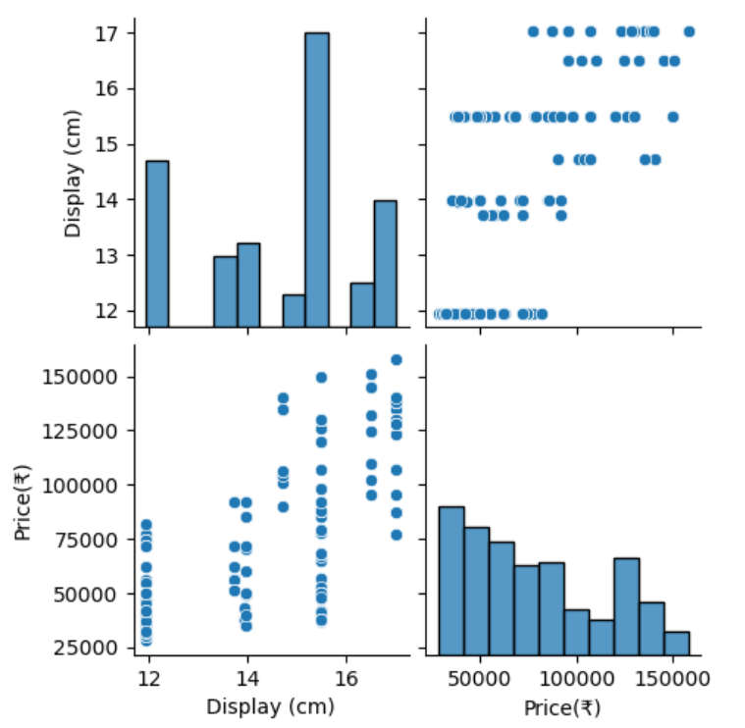
Data Visualization
Bi-Variate Analysis (Numerical vs Numerical)
The bivariate analysis between "Display (cm)" and "Price" revealed a moderate positive correlation, indicating that, on average, iPhones with larger displays tended to have higher prices; however, this relationship also exhibited some variability, with occasional exceptions where smaller displays had higher prices, suggesting other factors may influence pricing decisions.

Slide 14
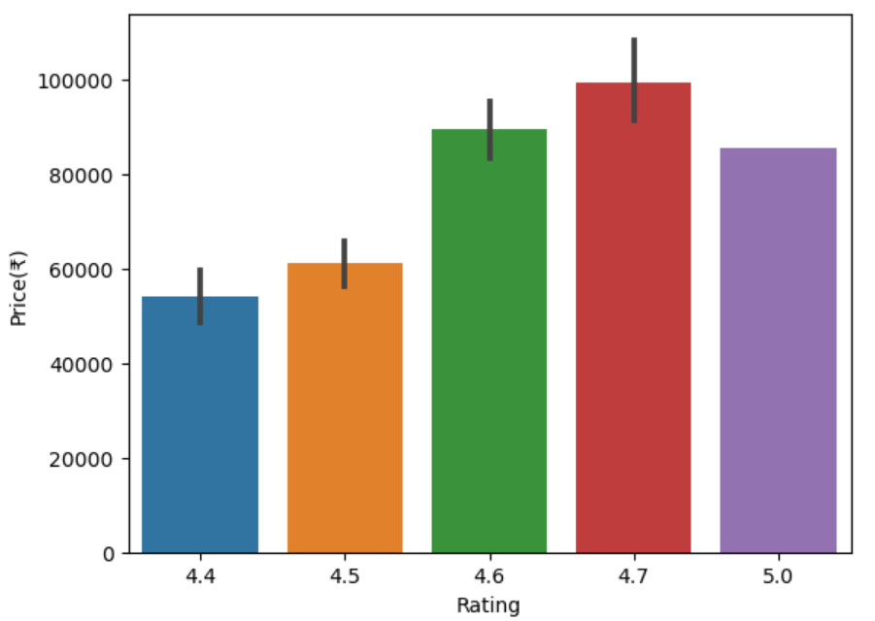
Data Visualization
Bi-Variate Analysis (Numerical vs Numerical)
The bivariate analysis between "Rating" and "Price" revealed a nuanced relationship, indicating that higher-priced iPhones tended to have slightly higher average ratings, suggesting a potential correlation between price and customer satisfaction, but with some exceptions.

Slide 15
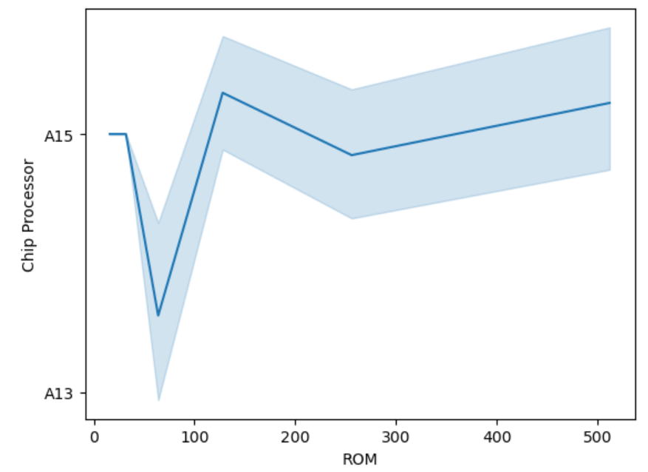
Data Visualization
Bi-Variate Analysis (Categorical vs Numerical)
The bivariate analysis between ROM and Chip Processor revealed potential associations between storage capacity (ROM) and the type of chip processor used in iPhones, indicating that certain chip processors are more commonly paired with specific ROM capacities.

Slide 16
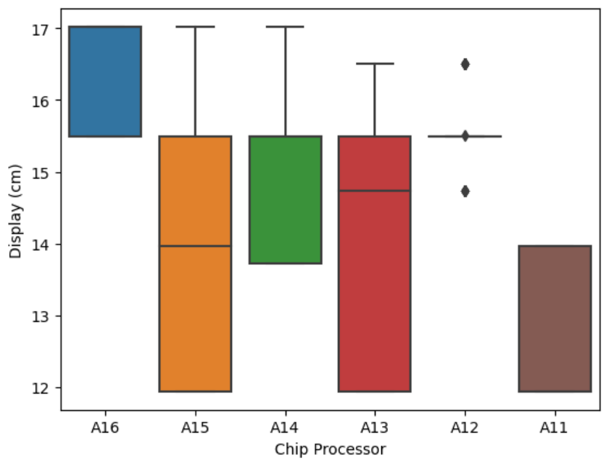
Data Visualization
Bi-Variate Analysis (Categorical vs Numerical)
In the bivariate analysis between "Display (cm)" and "Chip Processor," we investigated the relationship between the size of iPhone displays and the types of chip processors used, revealing potential correlations between these two key hardware features.

Slide 17
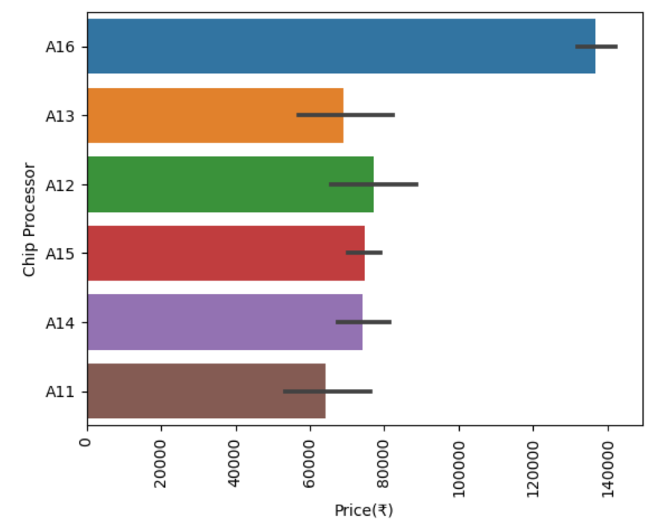
Data Visualization
Bi-Variate Analysis (Categorical vs Numerical)
The bivariate analysis between Price and Chip Processor revealed that there is a discernible relationship between the two variables, with higher-priced iPhones typically equipped with more advanced and powerful chip processors, demonstrating a positive correlation between price and processor capabilities.

Slide 18
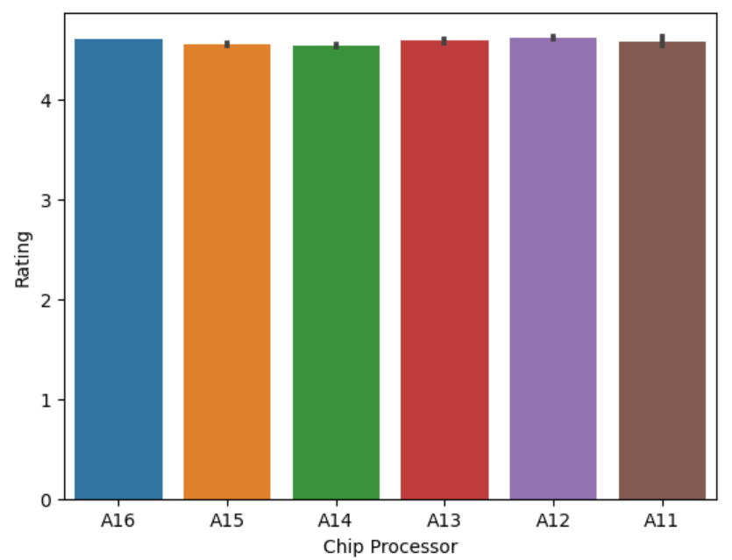
Data Visualization
Bi-Variate Analysis (Categorical vs Numerical)
The bivariate analysis between "Rating" and "Chip Processor" revealed that specific chip processor types were associated with variations in user ratings, with some processors consistently yielding higher ratings than others, indicating a potential relationship between processor choice and customer satisfaction.

Slide 19
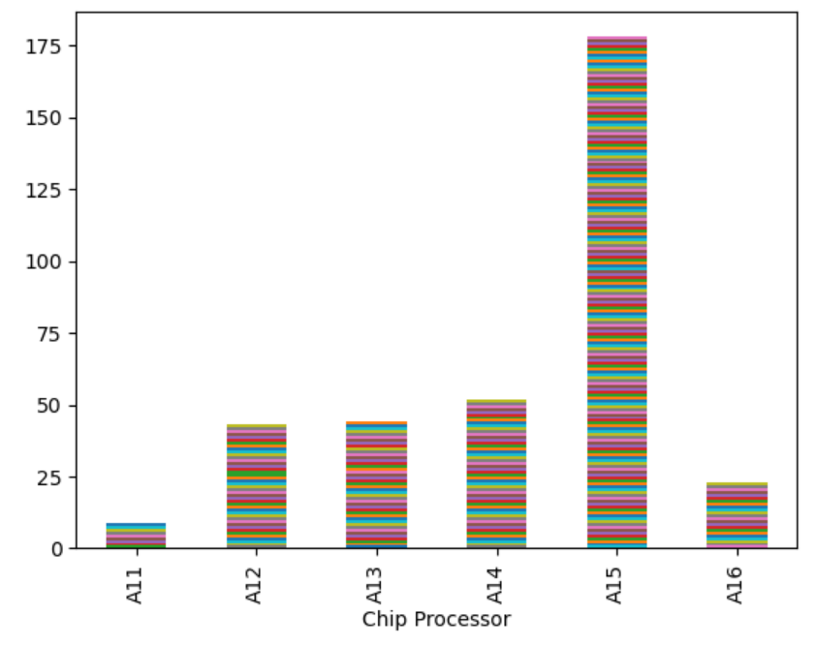
Data Visualization
Bi-Variate Analysis (Categorical vs Categorical )
The bivariate analysis between "Model Name" and "Chip Processor" revealed the associations between specific iPhone models and the chip processors they are equipped with, helping identify patterns of chip usage across different iPhone variants.

Slide 20
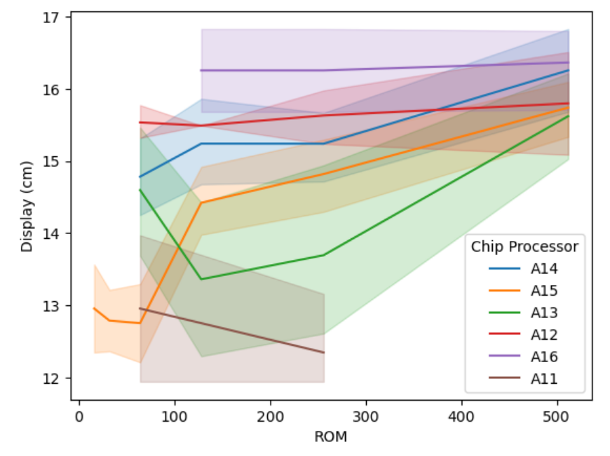
Data Visualization
Multi-Variate Analysis
The multivariate analysis among ROM, Display (cm), and Chip Processor unveiled intricate relationships and patterns within iPhone models. It allowed us to explore how storage capacity (ROM), screen size (Display (cm)), and processor type (Chip Processor) interacted, enabling us to identify trends in feature combinations that appealed to consumers and impacted pricing and ratings.

Slide 21
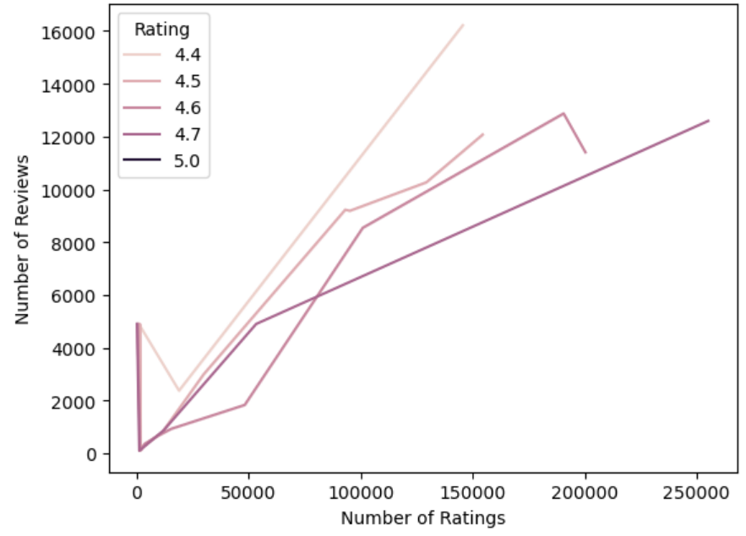
Data Visualization
Multi-Variate Analysis
In the multivariate analysis among "Number of Ratings," "Number of Reviews," and "Rating," we explored the relationships and correlations between these variables to understand how customer feedback (ratings and reviews) and engagement (number of ratings and reviews) collectively contribute to the overall rating distribution, providing valuable insights into customer satisfaction and engagement trends.

Slide 22
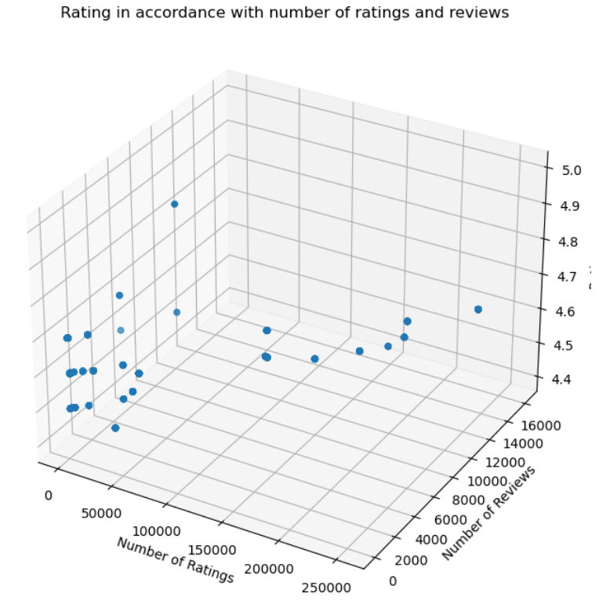
Data Visualization
Multi-Variate Analysis
In the multivariate analysis among "Number of Ratings," "Number of Reviews," and "Rating," we explored the relationships and correlations between these variables to understand how customer feedback (ratings and reviews) and engagement (number of ratings and reviews) collectively contribute to the overall rating distribution, providing valuable insights into customer satisfaction and engagement trends.

Slide 23
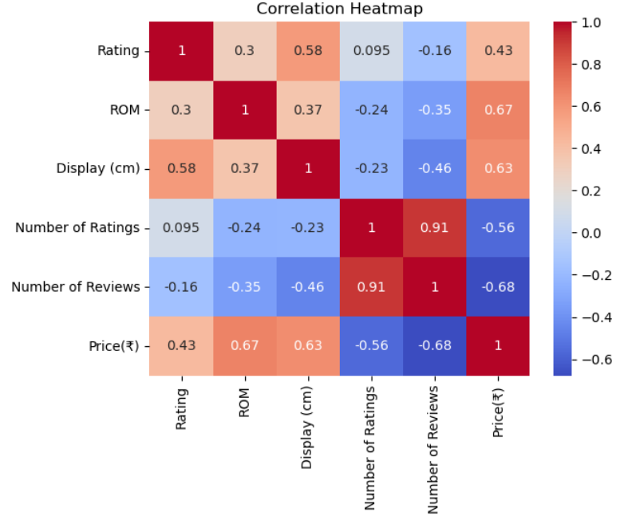
Data Visualization
CORRELATION HEATMAP
The multivariate analysis, represented by the correlation heatmap among all eight columns, revealed valuable insights into the relationships and dependencies among the iPhone model features, highlighting potential correlations between variables such as Model Name, Rating, ROM, Display (cm), Chip Processor, customer ratings, customer reviews and Price assisting in the identification of significant factors influencing consumer choices.

Slide 24
RESULTS
1. Optimal Chip Processor - A15: The A15 processor exhibits extensive availability across various phone models, making it a compelling choice.
2. Recommended ROM - 256GB: Despite having two more options in the 128GB category, the preference leans towards 256GB of ROM (Storage). This choice anticipates the evolving technology landscape, necessitating ample space for software installations and updates.
3. Immersive Display - 15.49 cm: The market offers a plethora of smartphone models with a 15.49 cm display size. This variety provides consumers with a wide range of choices to explore.
4. Top Ratings - 4.5 and Above: Our selection criteria prioritize iPhones that meet all the aforementioned conditions while also boasting a minimum rating of 4.5 or higher.
5. Budget-Friendly Pricing - Starting at ₹65,999/-: Remarkably, you can discover iPhones that meet all the specified criteria, and they start at a competitive price point of ₹65,999/-. This ensures an attractive blend of performance and affordability.
FINAL ASSUMPTION :
These refined observations guide us towards making an informed choice when selecting the ideal iPhone model that aligns with our preferences and requirements.

Slide 25
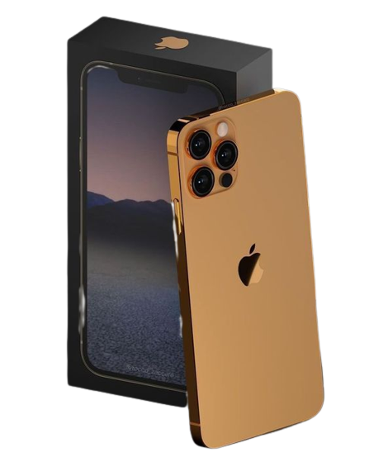
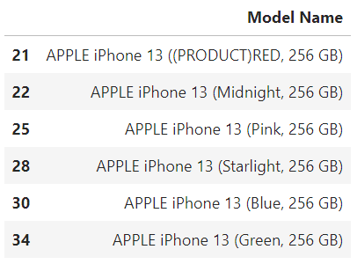
RESULT MODEL :

Slide 26
CONCLUSION
In conclusion, the iPhone 13 excels in all the key features you've scraped from Flipkart. It boasts high ratings, ample storage options, a versatile display, a powerful processor, a substantial user base, and a price point that reflects its premium quality. Therefore, based on this analysis, the iPhone 13 is indeed the best choice for those looking for a top-tier smartphone on Flipkart. However, it's essential to consider your personal preferences and budget before making a final decision.

Slide 27


THANK YOU

