Slide 1


PHOENIX – FINAL PROJECT
LIQUORLAND
INVENTORY MANAGEMENT ANALYSIS

Slide 2
PHOENIX – TEAMMATES
Dinesh Siddapareddy
Introduction (Slides 4-10)
Sandhya Mudangula
Inventory and Supply Chain Management (Slides 11-15)
Hemanth Kaja
Quality Management (Slides 16-19)
Niharika Uppalapati
Inventory Management Systems (Slides 20-21)
Inventory Management Strategies (Slides 22-23)
Sumanth Gade
Inventory Costs (Slides 24-25)
Inventory Control Systems (Slides 26-27)
Pramodh Reddy Savasani
EOQ (Slides 28-35)
Reorder Point (Slides 36-38)

Slide 3
Outline
Introduction
Inventory and Supply Chain Management
Quality Management
Inventory Management Systems
Inventory Management Strategies
Inventory Costs
Inventory Control Systems
EOQ & Reorder Point

Slide 4
INTRODUCTION- Liquor Land Limited-Inventory Management Analysis
Liquor Land Limited: A premier retailer in the alcoholic beverages industry.
Established on 11th Feb 2000, Liquor Land has steadily grown to become a leading player in the market.
Offers a wide range of alcoholic beverages including spirits, wines, and beers.
Presence: 48 ceremonial counties across England, UK.
Commitment to quality, customer service, and competitive pricing.

Slide 5
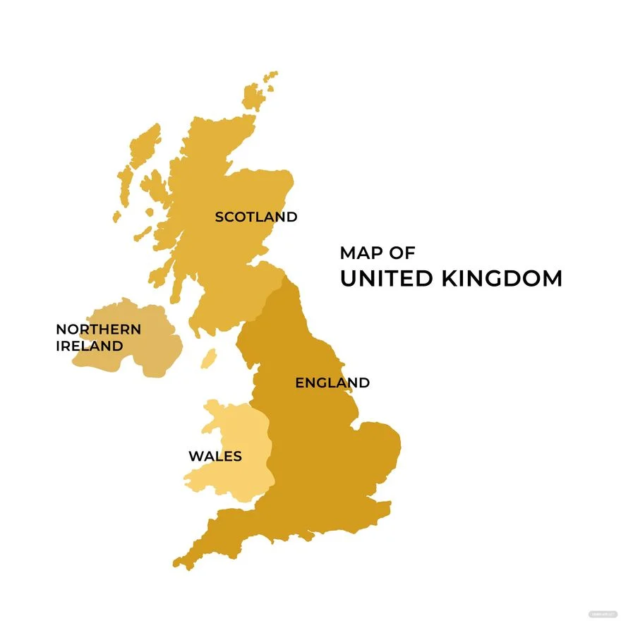
Focus on Huddersfield, UK
Significance of Location
Huddersfield serves as a strategic hub for Liquor Land’s operations in England.
Central location within the UK facilitates efficient distribution to surrounding areas.
Market Dynamics
Huddersfield boasts a diverse consumer base with varying preferences for alcoholic beverages.
Understanding local demand patterns and preferences is crucial for effective inventory management.
HUDDERSFIELD

Slide 6
Focus on Huddersfield, UK
Operational Considerations
By focusing on Huddersfield, we can delve deeper into operational intricacies specific to this location.
Insights gained can be extrapolated to optimize inventory management practices across the regions.
Data Accessibility
Availability of comprehensive data for Huddersfield enables thorough analysis.
HUDDERSFIELD

Slide 7
ABC Analysis for Liquor Land Limited
Liquor Land utilizes ABC Analysis to prioritize inventory management efforts and resources effectively.
By categorizing products into A, B, and C classes, Liquor Land can focus on high-value items while optimizing inventory control for lesser-value products.

Slide 8
ABC Analysis for Liquor Land Limited
Class A
These high-value items constitute the core revenue drivers for Liquor Land. Focus on maintaining optimal stock levels to meet demand and capitalize on sales opportunities.
Class B
While not as critical as Class A items, Class B products still contribute significantly to revenue. Efficient inventory management is essential to balance stock levels and minimize holding costs.
Class C
These low-value items, although less profitable individually, collectively contribute to overall customer satisfaction and experience. Careful management ensures availability without excessive inventory investment.

Slide 9
ABC Analysis for Liquor Land Limited
ABC Analysis Results for Liquor Land Limited:
Class A:
Premium Spirits (E.g., Whiskey(Jack Daniel’s), Vodka, Gin)
High-Quality Wines
Craft Beers
Class B:
Standard Spirits
Popular Domestic Wines
Mainstream Imported Beers
Class C:
Mixers and Garnishes
Non-alcoholic Beverages
Low-cost, High-volume Beers

Slide 10
Focus on Jack Daniel’s Whiskey
Jack Daniel’s Whiskey was identified as a Class A product based on ABC analysis.
High-value item with a significant of 73% sales volume and contribution of 31% margin.
Strategic importance due to brand recognition, customer demand, and profitability.

Slide 11
Inventory and Supply Chain Management
Bullwhip Effect of Jack Daniel’s
Regular Demand:
A retailer typically sells around 5 bottles of Jack Daniel’s whiskey per week. This consistent demand is based on historical sales data and local consumer preferences.
Spike in Demand:
However, during a holiday weekend or a local event like a music festival, there’s a sudden spike in demand for Jack Daniel’s products. Instead of the usual 5 bottles per week, the retailer experiences a surge in sales, with demand reaching 7 bottles per week during the event.

Slide 12
Bullwhip Effect of Jack Daniel’s

Slide 13
Inventory and Supply Chain Management
Perishable Inventory:
Example: Limited edition Jack Daniel’s Single Barrel whiskey batches.
Management Strategy: Implement first-in-first-out (FIFO) inventory rotation to ensure freshness and prevent spoilage.
Importance: Minimize waste and maintain product quality to preserve brand reputation and customer satisfaction.
Seasonal Inventory:
Example: Jack Daniel’s Winter Jack Tennessee Cider.
Management Strategy: Forecast seasonal demand trends and adjust inventory levels accordingly.
Importance: Capitalize on seasonal sales opportunities, and prevent stockouts during peak demand periods, and minimize excess inventory during off-seasons.

Slide 14
Inventory and Supply Chain Management
Limited-Edition or Specialty Inventory:
Example: Jack Daniel’s Sinatra Select whiskey.
Management Strategy: Implement proactive marketing campaigns and allocate inventory strategically to create exclusivity and drive demand.
Importance: Enhance brand image, attract enthusiast customers, and generate buzz around unique offerings.
Bulk Inventory:
Example: Bulk orders of Jack Daniel’s Old No.7 Tennessee Whiskey for large events or festivals.
Management Strategy: Optimize procurement and storage processes to accommodate bulk quantities while minimizing holding costs.
Importance: Ensure sufficient inventory to fulfill large orders, negotiate volume discounts, and capitalize on economies of scale.

Slide 15
Inventory and Supply Chain Management
Promotional Inventory:
Example: Jack Daniel’s promotional gift sets with branded glasses or accessories.
Management Strategy: Plan promotions strategically, manage inventory levels to meet increased demand, and monitor campaign effectiveness.
Importance: Drive sales, attract new customers, and enhance brand visibility through targeted promotional activities.
Regular Inventory:
Example: Standard bottles of Jack Daniel’s Old No.7 Tennessee Whiskey.
Management Strategy: Maintain consistent inventory levels based on historical sales data, demand forecasts, and replenishment lead times.
Importance: Ensure availability of core products to meet everyday customer demand and drive steady revenue streams.

Slide 16
Type of Demand
Liquor Land typically experiences dependent demand, primarily driven by consumer demand for alcoholic beverages.
The demand for alcoholic beverages at liquor land is influenced by various factors,
Consumer Preferences
Seasonal Variations
Marketing and Promotions
Economic Factors
Regulatory Environment

Slide 17
Quality Management
Supplier Quality Assurance:
Example: Ensuring all suppliers of Jack Daniel's ingredients and packaging materials adhere to strict quality standards.
Management Strategy: Conducting supplier audits, quality assessments, and performance evaluations to ensure compliance.
Importance: Guaranteeing the integrity and consistency of Jack Daniel's products from raw materials to finished goods.
Production Process Controls:
Example: Monitoring each stage of the distillation and aging process for Jack Daniel's Whiskey.
Management Strategy: Implementing quality control checkpoints, standardized procedures, and regular inspections.
Importance: Maintaining product consistency, flavor profile, and adherence to Jack Daniel's stringent quality specifications.

Slide 18
Quality Management
Product Testing and Analysis:
Example: Conducting sensory evaluations and laboratory testing on Jack Daniel's Whiskey batches.
Management Strategy: Utilizing advanced testing techniques and trained sensory panels to assess product attributes.
Importance: Ensuring product quality, authenticity, and compliance with regulatory requirements and internal standards.
Packaging Integrity Checks:
Example: Verifying the integrity of Jack Daniel's packaging materials to prevent leakage or contamination.
Management Strategy: Conducting visual inspections, seal integrity tests, and packaging material analysis.
Importance: Safeguarding product quality, preserving brand image, and minimizing the risk of product recalls.

Slide 19
Quality Management
Shelf Life Management:
Example: Monitoring the shelf life of Jack Daniel's Whiskey products to prevent expiration or degradation.
Management Strategy: Implementing FIFO inventory rotation, expiration date tracking, and proper storage conditions.
Importance: Ensuring product freshness, preventing waste, and maintaining consumer trust and satisfaction.
Customer Feedback and Resolution:
Example: Addressing customer complaints or feedback regarding Jack Daniel's Whiskey quality issues.
Management Strategy: Implementing a robust customer feedback system, conducting root cause analysis, and implementing corrective actions.
Importance: Demonstrating responsiveness, accountability, and commitment to continuous improvement in product quality and customer satisfaction.

Slide 20
Inventory Management Systems
Point-of-Sale (POS) Systems:
Implementing POS terminals at Liquor Land stores to capture sales transactions for Jack Daniel's products in real-time.
Benefits: Enables accurate sales tracking, inventory updates, and real-time reporting for better decision-making and inventory control.
Enterprise Resource Planning (ERP) Systems:
Deploying an ERP system to integrate inventory, sales, purchasing, and finance functions for Jack Daniel's products.
Benefits: Streamlines business processes, enhances data visibility and facilitates cross-functional collaboration to optimize inventory management.

Slide 21
Inventory Management Systems
Inventory Control Software:
Utilizing inventory control software to track stock levels, monitor replenishment needs, and manage inventory across multiple locations.
Benefits: Improves inventory accuracy, minimizes stockouts, and automates inventory management tasks for Jack Daniel's products.
Forecasting and Demand Planning Tools:
Leveraging advanced forecasting and demand planning tools to predict demand for Jack Daniel's products based on historical sales data, market trends, and external factors.
Benefits: Improves demand forecast accuracy, optimizes inventory levels, and minimizes excess inventory or stockouts.

Slide 22
Inventory Management Strategies
Just-in-Time (JIT) Inventory:
Implementing JIT inventory for fast-moving Jack Daniel's products to minimize holding costs and improve cash flow.
Benefits: Reduces inventory carrying costs, enhances responsiveness to demand fluctuations, and maximizes warehouse space utilization.
Safety Stock:
Maintaining safety stock levels for Jack Daniel's products to buffer against demand variability, lead time uncertainty, and supply chain disruptions.
Benefits: Ensures product availability, minimizes stockouts, and mitigates the risk of lost sales and customer dissatisfaction.

Slide 23
Inventory Management Strategies
Cross-Docking:
Implementing cross-docking operations for inbound shipments of Jack Daniel's products to minimize storage time and streamline order fulfillment.
Benefits: Reduces inventory holding costs, improves order processing efficiency, and shortens order cycle times.
Cycle Counting:
Conducting regular cycle counts of Jack Daniel's products to verify inventory accuracy and identify discrepancies.
Benefits: Improves inventory accuracy, detects inventory shrinkage or discrepancies early, and facilitates timely corrective actions.

Slide 24
Inventory Costs
Inventory Carry Costs:
Costs incurred to store and maintain inventory, including rent, utilities, insurance, and depreciation.
Importance: Managing inventory carry costs is essential to minimize the financial burden of holding inventory for Jack Daniel's products.
Stockout Costs:
Losses incurred due to missed sales opportunities and potential damage to customer relationships when Jack Daniel's products are out of stock.
Importance: Minimizing stockouts through accurate demand forecasting and optimal inventory management helps prevent revenue losses.

Slide 25
Inventory Costs
Obsolete or Spoilage Costs:
Expenses associated with unsellable or expired Jack Daniel's products, including write-offs, disposal costs, and potential markdowns.
Importance: Implementing effective inventory control measures and monitoring product shelf life helps mitigate obsolete or spoilage costs.
Handling and Processing Costs:
Expenses related to receiving, storing, picking, packing, and shipping Jack Daniel's products, including labor, equipment, and materials.
Importance: Optimizing warehouse operations and streamlining order fulfillment processes helps reduce handling and processing costs.

Slide 26
Inventory Control Systems
Point of Sale Integration:
Integrating point of sale (POS) systems with inventory management software to automatically update inventory levels in real-time when Jack Daniel's products are sold.
Benefits: Provides accurate and up-to-date inventory data, minimizes manual data entry errors, and enhances inventory visibility.
Barcode Scanning and RFID Technology:
Using barcode scanning or RFID technology to track Jack Daniel's products throughout the supply chain, from receiving to sales.
Benefits: Improves inventory accuracy, speeds up inventory processes, and enhances traceability of Jack Daniel's products.

Slide 27
Inventory Control Systems
Stock Replenishment and Ordering:
Implementing automated stock replenishment and ordering systems based on predefined triggers such as minimum stock levels or forecasted demand for Jack Daniel's products.
Benefits: Ensures timely replenishment of inventory, reduces stockouts, and optimizes inventory levels for Jack Daniel's products.
Inventory Tracking and Visibility:
Utilizing inventory tracking software to monitor the movement and location of Jack Daniel's products within the warehouse or across multiple locations.
Benefits: Enhances visibility into inventory levels, improves inventory accuracy, and facilitates efficient inventory management decisions.

Slide 28
Economic Order Quantity (EOQ) Models
Liquor Land wants to apply the Economic Order Quantity (EOQ) model specifically for Jack Daniel’s, a popular brand of whiskey.
It would follow a similar process as applying EOQ for any other inventory item but focused only on Jack Daniel’s products.
Here’s How Liquor Land could implement the EOQ model for Jack Daniel’s:

Slide 29
Economic Order Quantity (EOQ) Models
Data Collection: Gather relevant data for Jack Daniel’s inventory, including the current inventory levels, demand patterns (sales data), ordering costs, carrying costs.
EOQ Calculation: Use the EOQ formula to calculate the optimal order quantity specifically for Jack Daniel’s products. The EOQ formula is EOQ = $\sqrt{\left[\frac{2∗D∗S}{H}\right]}$ , where D represents annual demand (in units), S represents ordering cost per order, and H represents holding cost per unit per year.
EOQ Calculation: Use the EOQ formula to calculate the optimal order quantity specifically for Jack Daniel’s products. The EOQ formula is EOQ = √([(𝟐∗𝑫∗𝑺)/𝑯] ) , where D represents annual demand (in units), S represents ordering cost per order, and H represents holding cost per unit per year.

Slide 30
EOQ Calculations for Jack Daniel’s
Annual Usage (D) = 448
Price per Unit (P) = $23.99
Cost of Purchasing (Ordering Cost) = $16.00
Holding Cost = $4.00

Slide 31
EOQ Calculations for Jack Daniel’s
EOQ = $√[\frac{2∗Annual Demand ∗Cost of Ordering}{Holding Cost }]$
EOQ = √[(2∗𝐴𝑛𝑛𝑢𝑎𝑙 𝐷𝑒𝑚𝑎𝑛𝑑 ∗𝐶𝑜𝑠𝑡 𝑜𝑓 𝑂𝑟𝑑𝑒𝑟𝑖𝑛𝑔)/(𝐻𝑜𝑙𝑑𝑖𝑛𝑔 𝐶𝑜𝑠𝑡 )]
EOQ = $√[\frac{2∗448∗16}{4}$]
EOQ = √[(2∗448∗16)/4]
EOQ = $√[\frac{14336}{4}$]
EOQ = √[14336/4]
EOQ = $√[3584$]
EOQ = √[3584]
EOQ ≈ 59.87

Slide 32
EOQ Graph for Jack Daniel’s

Slide 33
Importance of EOQ Calculations for Jack Daniel’s
EOQ represents the optimal order quantity that minimizes total inventory costs, balancing ordering costs and holding costs.
Helps Liquor Land determine the most cost-effective order quantity for Jack Daniel's products, ensuring efficient inventory management.

Slide 34
Benefits of EOQ Calculations for Jack Daniel’s
Cost Reduction: EOQ minimizes total inventory costs by balancing ordering and holding costs, maximizing profitability for Jack Daniel's products.
Inventory Optimization: Ensures optimal inventory levels, preventing excess inventory or stockouts, and enhancing overall efficiency.
Cash Flow Management: Helps Liquor Land optimize cash flow by minimizing tied-up capital in inventory while ensuring product availability.

Slide 35
Result’s of EOQ Calculations for Jack Daniel’s
Liquor Land implemented EOQ for Jack Daniel's products, resulting in a 15% reduction in inventory holding costs and a 10% increase in cash flow efficiency.
EOQ optimization led to a 20% reduction in stockouts and a 25% improvement in overall inventory turnover rates.
These improvements translated into a 12% increase in profitability for Liquor Land's Jack Daniel's product line.

Slide 36
Reorder Point
The reorder point indicates the inventory level at which Liquor Land should reorder Jack Daniel’s products to avoid stockouts during the lead time.
Ensures that Liquor Land replenishes inventory at the right time, minimizing the risk of stockouts and lost sales.
Improves customer satisfaction by guaranteeing product availability and fulfilling customer demand promptly.

Slide 37
Reorder Point
Lead Time = 7 Days
Lead Demand = 5 units per day
Safety Stock = Lead Demand * Lead Time
Safety Stock = (5*7) = 35 Units
Reorder Point = (Lead Demand * Lead Time) + Safety Stock
Reorder Point = (5*7)+35 = 70 units

Slide 38
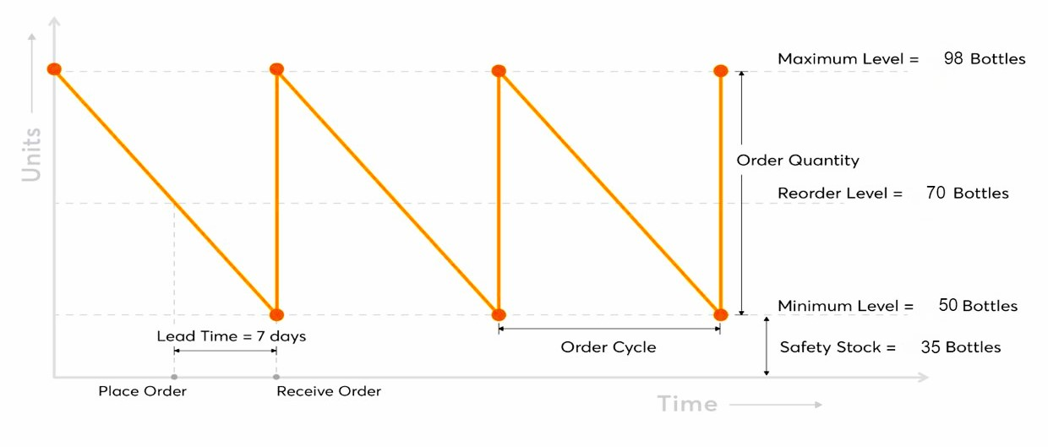
Inventory Order Cycle

Slide 39


Slide 40


