Slide 1

IILM
UNIVERSITY
GREATER NOIDA
INTERNSHIP REPORT PRESENTATION
SIEMENS DATA SCIENCE MASTER VIRTUAL INTERNSHIP
AICTE – EduSkills • 8-Week Virtual Internship Program
Student Name
PRAMOD KUMAR
Enrollment Number
2410030367
Program & Semester
B.Tech CSE • 5th Semester
Organization Name
Siemens
Institute
IILM University, Greater Noida
College Email: pramod.kumar.cs28@iilm.edu
IILM University • Internship Report Presentation
1

Slide 2
Presentation Overview
Internship Report
01 Internship Introduction
02 Organization & Domain
Programme, duration and purpose
Siemens Data Science Master
03 Objectives & Scope
04 Internship Structure
Skills and professional outcomes
Week-wise learning modules
05 Learning & Activities
06 Project / Technical Exposure
Assessments, assignments and practical exposure
Data science workflow covered in the report
07 Outcomes & Conclusion
Skills gained and future scope
08 Certificates & Proof
Completion certificate and offer-letter evidence
IILM University • Internship Report Presentation
2

Slide 3
1. Internship Introduction
Report Section 4.1
About the Internship
Duration
Format
The internship was undertaken through the 8-Week AICTE–EduSkills Virtual Internship Program in the Siemens Data Science Master domain. The programme combines structured learning with practical exposure, weekly assessments, project documentation/assignments and a final assessment.
April 2026 – June 2026
Virtual / Online
Domain
Credential
Data Science Master
Virtual Internship Certificate
Evaluation
Weekly assessments • Project submissions • Final Assessment Test
IILM University • Internship Report Presentation
3

Slide 4
2. Organization & Internship Domain
Report Section 4.2
Key Areas Covered
Siemens Data Science Master
The internship domain focuses on industry-relevant data science and AI/ML capabilities. The offer letter identifies the domain as “Siemens Data Science Master” and describes a structured, week-wise learning plan.
• AI and machine learning applications & use cases
• Data engineering and data transformation
• Machine learning foundations and advanced techniques
• Data preparation and automation
• Model deployment and monitoring
• RapidMiner AI Hub platform administration
IILM University • Internship Report Presentation
4

Slide 5
3. Objectives & Scope
Report Sections 4.3–4.5
Objectives
Scope
• Develop industry-relevant data science skills. • Understand practical AI/ML workflows. • Learn data access, transformation and preparation. • Build foundational and advanced ML knowledge. • Understand deployment, monitoring and platform administration. • Improve employability through structured assessments and practical exposure.
• End-to-end learning across data science stages. • Exposure to both technical and application-oriented modules. • Weekly assessments for progress tracking. • Project documentation and assignments. • Final assessment for overall programme evaluation. • Development of a foundation for future data analytics / ML projects.
IILM University • Internship Report Presentation
5

Slide 6
4. Week-wise Internship Structure
Offer Letter
Week 1 | Applications & Use Cases Professional
Week 2 | Data Engineering Professional
Identify business problems suitable for AI/ML.
Access, load, transform and calculate data.
Week 3 | Machine Learning Professional
Week 4 | Data Preparation Master
Build foundational machine learning skills.
Advanced data handling and automation.
Week 5 | Machine Learning Master
Week 6 | Applications & Use Cases Master
Learn advanced machine learning techniques.
Deploy and monitor ML models.
Week 7 | Platform Administration Master
Week 8 | Platform Administration Master
Configure and manage RapidMiner AI Hub.
Enterprise-level platform operations.
IILM University • Internship Report Presentation
6

Slide 7
5. Internship Activities & Evaluation
Structured Learning
Completed the week-wise modules provided in the internship programme.
Weekly Assessments
Progress and understanding were tracked through weekly assessments.
Project Documentation
Certain modules required project documentation and assignments.
Final Assessment
The final week included a Final Assessment Test.
Overall Evaluation
Final grade considered weekly assessments, project submissions and final test.
IILM University • Internship Report Presentation
7

Slide 8
6. Technical Skills & Tools Covered
Report
Data Handling
Machine Learning
Data access, loading, transformation, calculation and preparation.
Foundational and advanced ML concepts and techniques.
Model Lifecycle
AI/ML Applications
Deployment and monitoring of machine learning models.
Mapping business problems to suitable AI/ML use cases.
Platform Skills
Professional Skills
RapidMiner AI Hub configuration and administration.
Assessment discipline, documentation, practical exposure and employability.
IILM University • Internship Report Presentation
8

Slide 9
7. Technical Exposure Documented in the Report
Project Description
Project Work
The report documents practical data-science work as part of the internship experience. The project section applies the learned workflow to a machine-learning problem.
Data Preparation
Machine Learning
Outcome
Data inspection Cleaning Encoding Scaling Train-test split
Regression models Model training Evaluation metrics Model comparison
Model evaluation Performance interpretation Best-model selection Technical documentation
This slide is included only as a part of the internship report; the presentation is focused on the overall internship.
IILM University • Internship Report Presentation
9

Slide 10
8. Learning Outcomes
Outcome 1
Outcome 2
Understanding of an end-to-end data science workflow.
Improved knowledge of data engineering and data preparation.
Outcome 3
Outcome 4
Foundational and advanced machine learning exposure.
Understanding of model deployment and monitoring concepts.
Outcome 5
Outcome 6
Exposure to RapidMiner AI Hub administration.
Experience with structured assessments and technical documentation.
Outcome 7
Greater confidence in applying data science concepts to practical problems.
IILM University • Internship Report Presentation
10

Slide 11
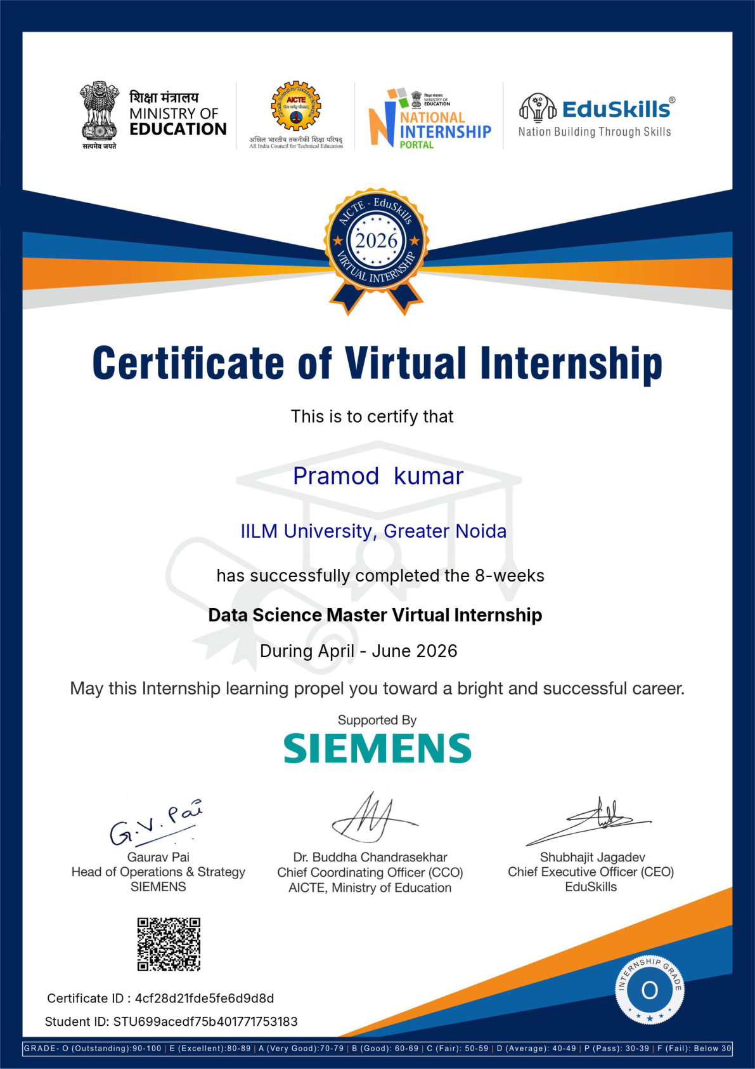
9. Internship Completion Certificate
Evidence
Student: Pramod Kumar • Enrollment No. 2410030367
IILM University • Internship Report Presentation
11

Slide 12
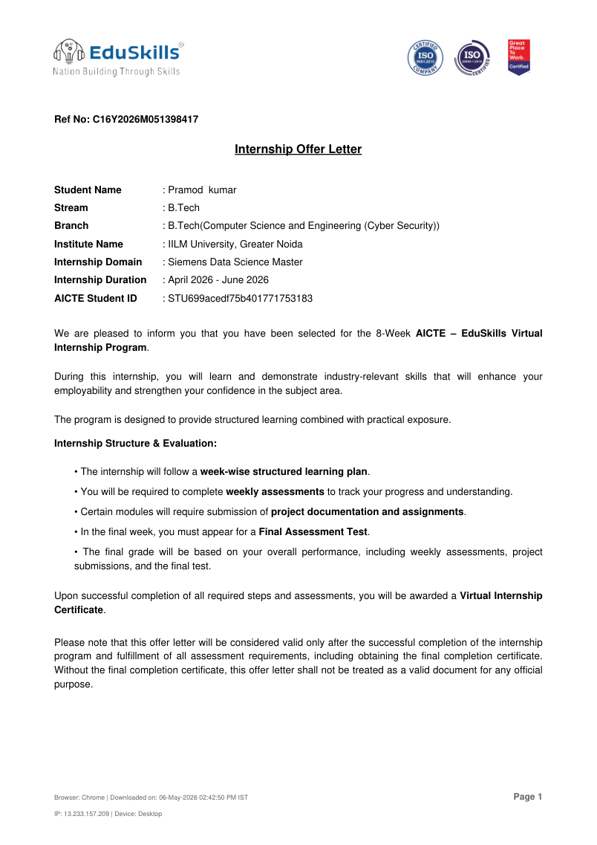
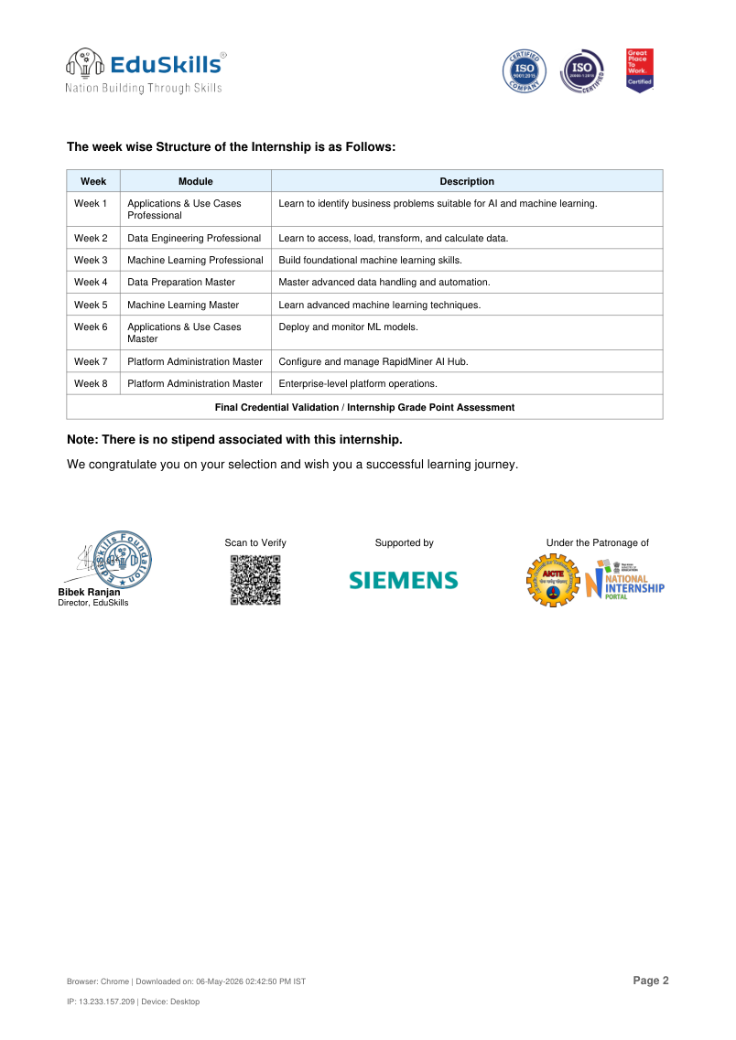
10. Internship Offer Letter
Evidence
Offer letter confirms Siemens Data Science Master • April–June 2026 • 8-week AICTE–EduSkills programme
IILM University • Internship Report Presentation
12

Slide 13
11. Professional Reflection
What I Gained
How It Supports My Career
• Better understanding of data science as an end-to-end process. • Exposure to real-world AI/ML use cases. • Stronger understanding of data preparation and machine learning. • Awareness of model deployment and monitoring. • Improved ability to learn through structured assessments and documentation.
The internship provides a foundation for future roles and projects in data analytics, data science and machine learning. The combination of technical modules, assessments and practical exposure helps connect academic learning with industry-oriented skills.
IILM University • Internship Report Presentation
13

Slide 14
12. Conclusion & Future Scope
Conclusion
Future Scope
The Siemens Data Science Master Virtual Internship provided a structured 8-week learning journey covering AI/ML applications, data engineering, machine learning, data preparation, deployment and platform administration. The programme strengthened technical understanding through assessments and practical documentation.
• Continue advanced machine learning practice • Build more end-to-end data science projects • Explore model deployment and MLOps • Strengthen data engineering and cloud skills • Work with larger and real-world datasets • Pursue industry-oriented certifications and internships
IILM University • Internship Report Presentation
14

Slide 15
IILM
UNIVERSITY
GREATER NOIDA
THANK YOU
Questions & Discussion
Pramod Kumar • Enrollment No. 2410030367
B.Tech CSE • 5th Semester
pramod.kumar.cs28@iilm.edu
IILM University, Greater Noida
IILM University • Internship Report Presentation
15

