Slide 1
Predicting Which Recommended Content Users Click
DS-SEA-07
Pramod Varma

Slide 2
What is the challenge?
Can we predict which recommended content each user will click?
What are the significant features that drive the likely hood of user clicking the recommended content indicating association?
Improving Outbrain’s recommendation algorithm will mean more users uncover stories that satisfy their individual tastes.
Notes:
Problem Definition
: Given some
webpage and ad information, determine
which ad is more likely to be clicked on
the given webpage
Input
: Sparse information related to each
webpage, the ads on the webpage
•
Output
: Which ad is clicked of a set of
ads that user is reading

Slide 3
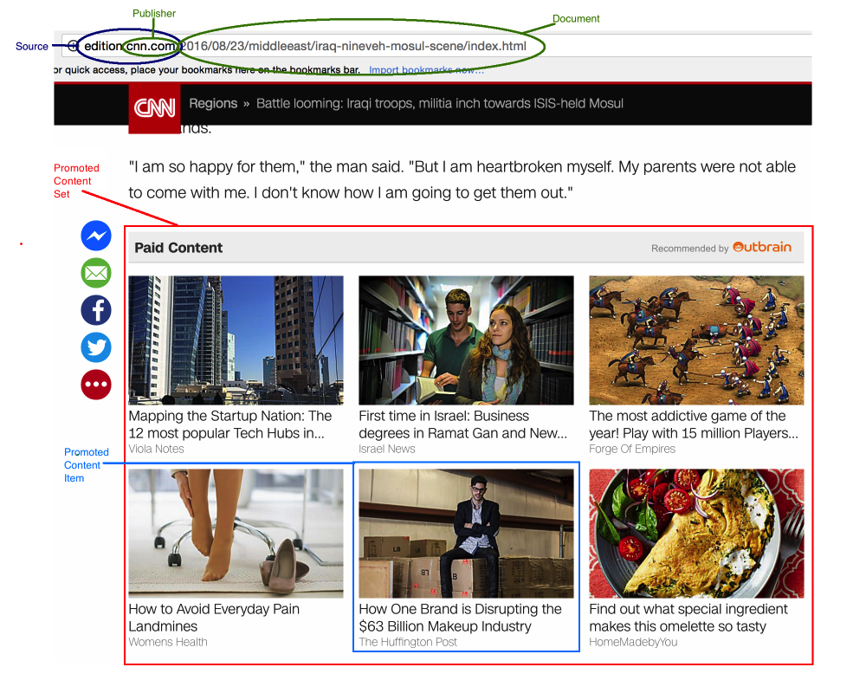
DATA – Sample Page?

Slide 4
What data would be used ?
Outbrain's two weeks of data from 14-Jun-2016 and 28-jun-2016 provided on kaggle.
This is a very large relational set where one of the log file is ( 2B rows and 100GB uncompressed).
2 Billion page views and 16,900,000 clicks of 700 Million unique users, across 560 sites.
Link to acquire the data: https://www.kaggle.com/c/outbrain-click-prediction/data.
Notes:
If the large amount of data is unmanageable the data size may be reduced 1/10th so the project could be completed in the given timeframe.

Slide 5
Data – BiG or Small ?
Collected Data from multiple CSV files
Database Size - ~9.7GB
Did not even load the entire PAGE_VIEW log!!
table | table_size | related_objects_size | total_table_size | live_rows
----------------------+------------+----------------------+------------------+-----------
promoted_content | 32 MB | 32 kB | 32 MB | 559583
documents_meta | 164 MB | 64 kB | 164 MB | 2999334
documents_categories | 273 MB | 88 kB | 273 MB | 5481471
documents_entities | 446 MB | 136 kB | 446 MB | 5537633
page_views_sample | 726 MB | 200 kB | 726 MB | 10000008
documents_topics | 564 MB | 160 kB | 564 MB | 11325980
events | 1822 MB | 480 kB | 1822 MB | 23121858
clicks_test | 1361 MB | 360 kB | 1361 MB | 32225335
clicks_train | 4336 MB | 1112 kB | 4337 MB | 87141751
TOTAL | 9724 MB | 2632 kB | 9726 MB | 178392953
Notes:
If the large amount of data is unmanageable the data size may be reduced 1/10th so the project could be completed in the given timeframe.

Slide 6
Data - Cleaning and Munging
Current Status
Analysis is in progress using following notebook
DSClickPrediction/notebooks/OutbrainDataAnalysis.ipynb
Created a relational database locally for each data set
Next Step
Create a de-normalized fact table to get all the features
Convert categorical variables into dummy variables
Lots of missing values – Need to decide how to handle them
Create Feature and Response vector

Slide 7
Project - Next Steps
Model Selection
Model training
Model Prediction
Model Evaluation

Slide 8
Questions ?

Slide 10
APPENDIX – II ; Graphical Representation of the data
Raw Data
Document_id
Ad_id
Document
AD
Topic
Category
Source
Advertiser
Campaign
Notes:
Features
Topic id: Topic of webpage
Category id: Category of
webpage
Source id: source that webpage is from
Advertiser id: Advertiser of ad
Campaign id: Campaign of ad

